Slide 1


SQL for Humanities
Lucia Michielin
Edinburgh University
L.Michielin@sms.ed.ac.uk

Slide 2
Plan of the Workshop
1. Databases using SQL
2. Basic Queries
3. SQL Aggregation
4. Joins and Aliases

Slide 3

1. Databases using SQL
Questions
What is a relational database and why should I use it?
What is SQL?
Objectives
Understand the benefits of using a relational database
Set up a small database from csv files using SQLite
Understand SQLite data types

Slide 4

1. Databases using SQL
Our Dataset
Real Dataset extract from the Text Creation Partnership
It is a time-series for the texts collected and encoded by the Text Creation Partnership
The files we are going to work with are:
authors.csv
titles.csv
dates.csv

Slide 5
1. Databases using SQL
Challenge 1
Querying the Data
What would I need to answer these questions?
Which files have the data I need?
What operations would I need to perform if I were doing these analyses by hand?
How has the length and dates of Martin Luther title attributions changed over time?
What is the average number of each titles, per year?
What information can I learn about Martin Luther species in the 1500s, over time?

Slide 6
1. Databases using SQL
Workflow
Do you really want to do it manually?
Doing it manually does also imply that whatever change you will have to do to the spreadsheet you will have to repeat the whole path again
Select subsets of the data (rows and columns)
Group subsets of data
Do math and other calculations
Combine data across spreadsheets
Automatization of the Data mining!!!!

Slide 7

1. Databases using SQL
What a Relational Database is?
A relational database stores data in relations made up of records with fields. The relations are usually represented as tables; each record is usually shown as a row, and the fields as columns. In most cases, each record will have a unique identifier, called a key, which is stored as one of its fields (foreign key). Records may also contain keys that refer to records in other tables, which enables us to combine information from two or more sources.
Keeping it simple: a series of linked tables

Slide 8

Why use relational databases?
1. Databases using SQL
Lern how to ask
It keeps your data separate from your analysis.
This means there’s no risk of accidentally changing data when you analyse it.
If we get new data we can just rerun the query.
It’s fast, even for large amounts of data.
It improves quality control of data entry (type constraints and use of forms in MS Access, Filemaker, Oracle Application Express etc.)
The concepts of relational database querying are core to understanding how to do similar things using programming languages such as R or Python.

Slide 9
1. Databases using SQL
Database Management Systems
MySQL
PostgreSQL
MS Access
MS SQL Server
Oracle Database
Which one should I use?
Depend on what you need to do.
Few things to take into account:
Size of the Dataset
Single/multiple user
User friendly
Costs
Need to link it to other system (e.g. GIS)
SQLite

Slide 10


1. Databases using SQL
Let’s start having a look
Open DB browser for SQLite
Relational databases store data in tables with fields (columns) and records (rows)
Data in tables has types, and all values in a field have the same type (list of data types)
Queries let us look up data or make calculations based on columns

Slide 11

1. Databases using SQL
Database Design
Every row-column combination contains a single atomic value, i.e., not containing parts we might want to work with separately.
One field per type of information
No redundant information
Split into separate tables with one table per class of information
Needs an identifier in common between tables – shared column - to reconnect

Slide 12
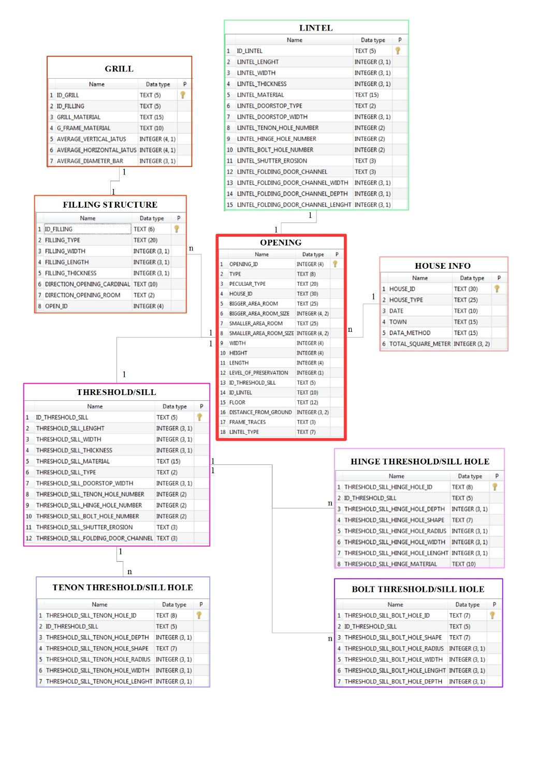

Keying is the key
1. Databases using SQL
Primary key
Secondary/Foreing key

Slide 13

1. Databases using SQL
What is the relationship of your data?
1 to 1: Book and catalogue number
1 to n: one author can have published more than one book
n to n: different authors have published their books in different places
Let’s start building our DataBase

Slide 14
1. Databases using SQL
Data type | Description
CHARACTER(n) | Character string. Fixed-length n
VARCHAR(n) or CHARACTER VARYING(n) | Character string. Variable length. Maximum length n
BINARY(n) | Binary string. Fixed-length n
BOOLEAN | Stores TRUE or FALSE values
VARBINARY(n) or BINARY VARYING(n) | Binary string. Variable length. Maximum length n
INTEGER(p) | Integer numerical (no decimal).
SMALLINT | Integer numerical (no decimal).
INTEGER | Integer numerical (no decimal).
BIGINT | Integer numerical (no decimal).
DECIMAL(p,s) | Exact numerical, precision p, scale s.
NUMERIC(p,s) | Exact numerical, precision p, scale s. (Same as DECIMAL)
FLOAT | Approximate numerical
DOUBLE PRECISION | Approximate numerical
DATE | Stores year, month, and day values
TIME | Stores hour, minute, and second values
TIMESTAMP | Stores year, month, day, hour, minute, and second values
INTERVAL | Composed of a number of integer fields, representing a period of time, depending on the type of interval
ARRAY | A set-length and ordered collection of elements
MULTISET | A variable-length and unordered collection of elements
XML | Stores XML data

Slide 15
1. Databases using SQL
Data type | Access | SQLServer | Oracle | MySQL | PostgreSQL
boolean | Yes/No | Bit | Byte | N/A | Boolean
integer | Number (integer) | Int | Number | Int / Integer | Int / Integer
float | Number (single) | Float / Real | Number | Float | Numeric
currency | Currency | Money | N/A | N/A | Money
string (fixed) | N/A | Char | Char | Char | Char
string (variable) | Text (<256) / Memo (65k+) | Varchar | Varchar2 | Varchar | Varchar
binary object OLE Object Memo Binary (fixed up to 8K) | Varbinary (<8K) | Image (<2GB) Long | Raw Blob | Text Binary | Varbinary

Slide 16

2. Basic Queries
Questions
How do I write a basic query in SQL?
Objectives
Write and build queries.
Filter data given various criteria.
Sort the results of a query.

Slide 17

2. Basic Queries
SQL queries repository
SELECT (what do we want to see)
FROM (in which table this info are stored)
WHERE (condition)

Slide 18


2. Basic Queries
Limiting Result
What if we want to see just the first 5, 10 etc rows
Unique values
Single recurrences of one value or a combination of values
LIMIT
Calculated values
What if we want to play with the INTEGER columns.
E.g. I stored my information in gr but I want to see them in kg
SELECT DISTINCT

Slide 19
2. Basic Queries
Challenge
Write a query that returns the year, EEBO and page length
Solution:
SELECT date, EEBO, pages
FROM catalogue;

Slide 20
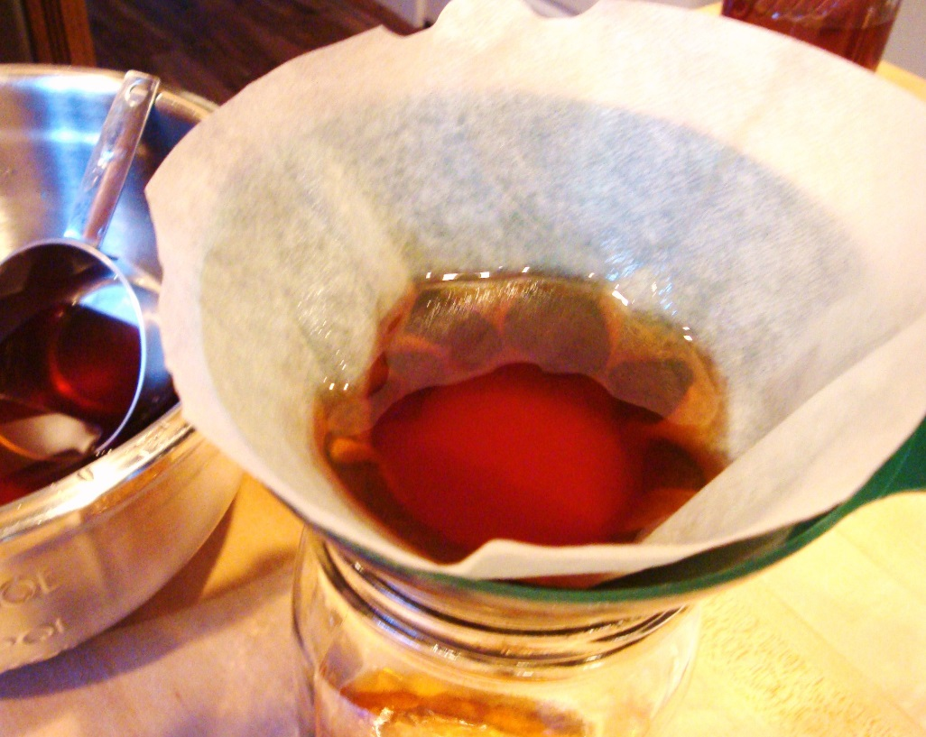
2. Basic Queries
Filtering
What if you want to see just the data meeting a certain criteria
E.g. Only the titles that have a free status, which has a species code of DM
WHERE
Combine more than one condition with AND and OR

Slide 21
2. Basic Queries
Challenge 2
Produce a table listing the data for all titles in the catalogue with a page length more than 75, telling us the date, eebo id code, and page.
Solution:
SELECT date, EEBO, pages
FROM catalogue
WHERE pages >= '75';

Slide 22

2. Basic Queries
Building more complex queries
Now, lets combine the above queries to get data for 2 authors from the year 1580 on.
Start simple
When the queries become more complex, it can be useful to add comments. In SQL, comments are started by --, and end at the end of the line. For example, a commented version of the above query can be written as :
Link together
-- Get post 1580 data on authors
-- These are in the catalogue table, and we are interested in all columns
SELECT *
FROM surveys
-- Sampling year is in the column `Date`, and we want to include after 1580
WHERE (year >= 1580)
-- Author names
AND (author IN ('Aylett, Robert, 1583-1655?', 'Bacon, Francis, 1561-1626.'));

Slide 23
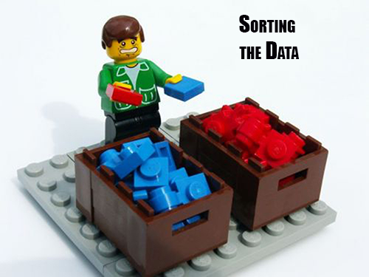
2. Basic Queries
Sorting
We can also sort the results of our queries
How do we want our data to be displayed
ASC
DESC
ORDER BY

Slide 24
2. Basic Queries
Challenge 3
Write a query that returns year, eebo id, and page from the catalogue table, sorted with the largest page lengths at the top.
Solution:
SELECT date, EEBO, pages
FROM catalogue
ORDER BY pages DESC;

Slide 25
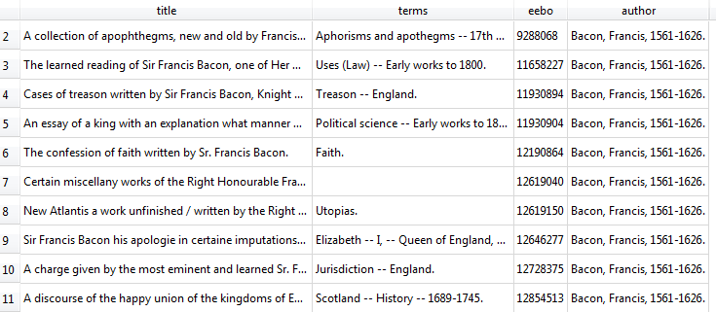
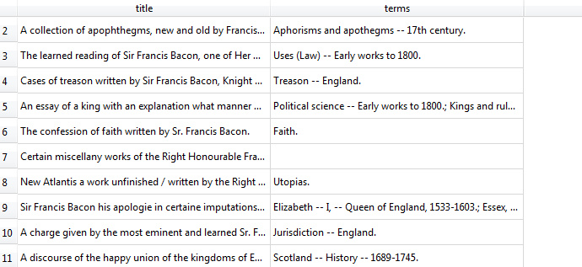
2. Basic Queries
Order of execution
Another note for ordering. We don’t actually have to display a column to sort by it.
Eg. If we want to show title and terms of Francis Bacon ordered by EEBO we don’t need to show either the EEBO or the Author
We can do this because sorting occurs earlier in the computational pipeline than field selection.
The computer is basically doing this:
Filtering rows according to WHERE
Sorting results according to ORDER BY
Displaying requested columns or expressions.

Slide 26
2. Basic Queries
Challenge 4
Let’s try to combine what we’ve learned so far in a single query. Using the catalogue table write a query to display the title, terms field and the page length (rounded to two decimal places), for titles published in 1650, ordered alphabetically by the author.
Write the query as a single line, then put each clause on its own line, and see how more legible the query becomes!
Solution:
SELECT title, terms, ROUND(pages, 2)
FROM catalogue
WHERE date = '1650'
ORDER BY author ASC;

Slide 27

3. SQL Aggregation
Questions
How can I summarize my data by aggregating, filtering, or ordering query results?
Objectives
Apply aggregation to group records in SQL.
Filter and order results of a query based on aggregate functions.
Save a query to make a new table.
Apply filters to find missing values in SQL.

Slide 28

3. SQL Aggregation
COUNT and GROUP BY
Aggregation allows us to combine results by grouping records based on value and calculating combined values in groups
Calculate and sum all the possible combination of values
Eg. What if we want to know how many pages there are in total?
MIN | returns the smallest value in a given column
MAX | returns the largest value in a given column
SUM | returns the sum of the numeric values in a given column
AVG | returns the average value of a given column
COUNT | returns the total number of values in a given column
COUNT(*) | returns the number of rows in a table

Slide 29
3. SQL Aggregation
Challenge 1
Write a query that returns: total page length, average page length, and the min and max page lengths for all titles encoded over the duration of the project. Can you modify it so that it outputs these values only for books published before 1601?
Solution:
SELECT SUM(pages), MIN(pages), MAX(pages), AVG(pages)
FROM catalogue
WHERE date <= '1600';

Slide 30

3. SQL Aggregation
GROUP BY
The GROUP BY statement is often used with aggregate functions (COUNT, MAX, MIN, SUM, AVG) to group the result-set by one or more columns.
Challenge 2
Write queries that return:
How many groups of terms were created in each year
in total
per author
Average number of each term groupings in each year.
Solution:
SELECT COUNT(terms), date, author
FROM catalogue
GROUP BY date
ORDER BY author;
SELECT AVG (co), date, author
FROM (SELECT date, author, COUNT (terms) AS co
FROM catalogue
GROUP BY date
ORDER BY author) catalogue
GROUP BY date
ORDER BY author;

Slide 31

3. SQL Aggregation
HAVING Keyword
Filter the results based on aggregate functions.
E.g. we can adapt the last request we wrote to only return information about page length with a count higher than 100
Use AS to simplify
The HAVING keyword works exactly like the WHERE keyword, but uses aggregate functions instead of database fields.
If you use AS in your query to rename a column, HAVING can use this information to make the query more readable. For example, in the above query, we can call the COUNT(pages)by another name, like page.

Slide 32
3. SQL Aggregation
Challenge 3
Write a query that returns from the Authors table, the EEBO ids in each authors, only for the authors with more than 5 works
Solution:
SELECT EEBO, Author
FROM Authors
GROUP BY author
HAVING (SELECT COUNT (title)
FROM catalogue
GROUP BY author)> 5;

Slide 33


3. SQL Aggregation
Ordering Aggregated Results
Saving Queries for Future Use
Sometimes you need to repeat the same operation. SQL comes with a very powerful mechanism to do this: views. Views are a form of query that is saved in the database, and can be used to look at, filter, and even update information.
One way to think of views is as a table, that can read, aggregate, and filter information from several places before showing it to you.
The results can also being ordered both on a field value or on an aggregation result
CREATE VIEW viewname AS

Slide 34
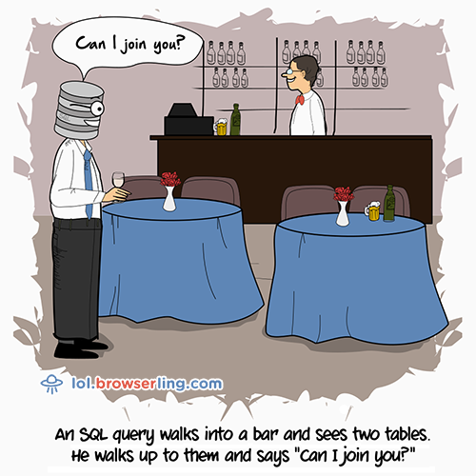
4. Joins and Aliases
Questions
How do I bring data together from separate tables?
How can I make sure column names from my queries make sense and aren’t too long?
Objectives
Employ joins to combine data from two tables.
Apply functions to manipulate individual values.
Employ aliases to assign new names to items in a query.

Slide 35

4. Joins and Aliases
Joins
To combine data from two tables we use the SQL JOIN command, which comes after the FROM command.
The JOIN command on its own will result in a cross product, where each row in first table is paired with each row in the second table. Usually this is not what is desired when combining two tables with data that is related in some way.
For that, we need to tell the computer which columns provide the link between the two tables using the word ON. What we want is to join the data with the same species codes.
The two table to be joined need to share a field (normally primary and foreign key respectively)

Slide 36
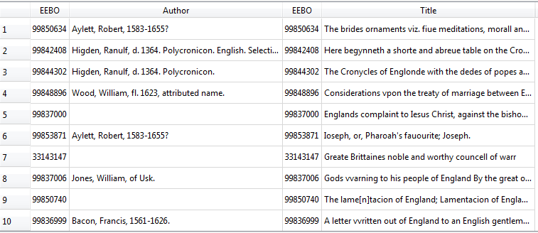
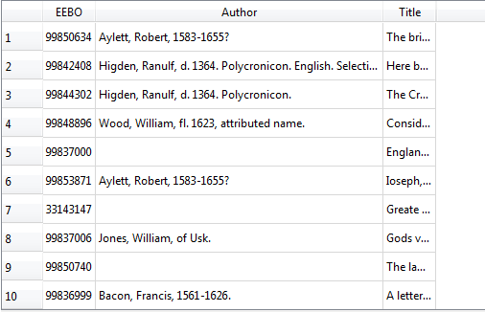
4. Joins and Aliases
Join on (where) VS Join using
We often won’t want all of the fields from both tables, so anywhere we would have used a field name in a non-join query, we can use table.columname.

Slide 37
4. Joins and Aliases
Challenge 1
Write a query that returns the authors, terms and page length of every EEBO ID captured in the catalogue
Solution
SELECT authors.author, catalogue.terms, catalogue.pages
FROM catalogue
JOIN authors
USING (EEBO);

Slide 38

4. Joins and Aliases

Slide 39

4. Joins and Aliases
Challenge 2
Re-write the original query to keep all the entries present in the Catalogue table
Count the number of records in the catalogue table that have a NULL value in the EEBO column
Solution
SELECT authors.author, catalogue.terms, catalogue.pages
FROM catalogue
LEFT JOIN authors
ON catalogue.eebo = authors.eebo
SELECT authors.author, catalogue.terms, catalogue.pages
FROM catalogue
LEFT JOIN authors
ON catalogue.eebo = authors.eebo
WHERE catalogue.eebo IS NULL

Slide 40

4. Joins and Aliases
Combining joins with sorting and aggregation
Joins can be combined with sorting, filtering, and aggregation. So, if we wanted average pages present in the catalogue for every author
SELECT authors.author, AVG(catalogue.pages)
FROM catalogue
JOIN authors
ON authors.eebo = catalogue.eebo
GROUP BY catalogue.pages;

Slide 41
4. Joins and Aliases
Challenge 3
Write a query that returns the number of authors of the titles published in each year in descending order
Write a query that finds the average pages of each year of publication
Solution
SELECT COUNT(authors.author), catalogue.title, catalogue.date
FROM catalogue
JOIN authors
ON authors.eebo = catalogue.eebo
GROUP BY catalogue.date
ORDER BY catalogue.date DESC;
SELECT authors.author, AVG(catalogue.pages), catalogue.date
FROM catalogue
JOIN authors
ON authors.eebo = catalogue.eebo
GROUP BY catalogue.date;

Slide 42
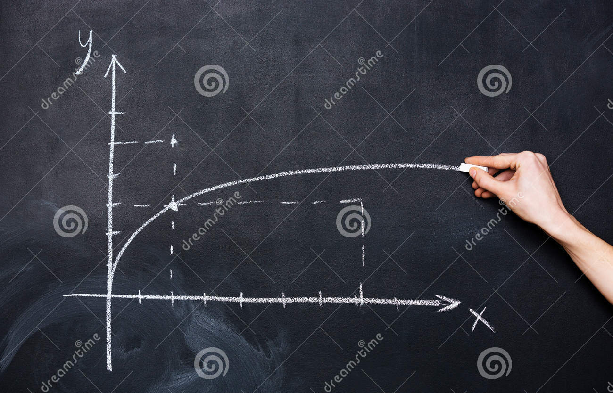
4. Joins and Aliases
Functions
SQL includes numerous functions for manipulating data. You’ve already seen some of these being used for aggregation (SUM and COUNT) but there are functions that operate on individual values as well. Probably the most important of these are IFNULL and NULLIF. IFNULL allows us to specify a value to use in place of NULL.
We can represent unknown ids with “U” instead of NULL:
SELECT eebo, vid, IFNULL(vid, 'U')
FROM catalogue;

Slide 43
4. Joins and Aliases
Challenge 4
Write a query that returns 30 instead of NULL for values in the pages column.
Write a query that calculates the average page length of each title, assuming that unknown lengths are 30 (as above).
Solution
SELECT pages, IFNULL(pages, 30)
FROM catalogue;
SELECT title, AVG(IFNULL(pages, 30))
FROM catalogue
GROUP BY title
ORDER BY pages;
Really useful when you have a join can you guess why?

Slide 44
4. Joins and Aliases
Nullif
Is the opposite of ifnull and restore to NULL the wanted array of data.
This is useful for “nulling out” specific values.
We can “null out” vid:
SELECT eebo, vid, NULLIF(vid, 7) FROM catalogue;

Slide 45
4. Joins and Aliases
Function | Description
ABS(n) | Returns the absolute (positive) value of the numeric expression n
LENGTH(s) | Returns the length of the string expression s
LOWER(s) | Returns the string expression s converted to lowercase
NULLIF(x, y) | Returns NULL if x is equal to y, otherwise returns x
ROUND(n) or ROUND(n, x) | Returns the numeric expression n rounded to x digits after the decimal point (0 by default)
TRIM(s) | Returns the string expression s without leading and trailing whitespace characters
UPPER(s) | Returns the string expression s converted to uppercase

Slide 46
4. Joins and Aliases
Specific of SQLite
Function | Description
IFNULL(x, y) | Returns x if it is non-NULL, otherwise returns y
RANDOM() | Returns a random integer between -9223372036854775808 and +9223372036854775807.
REPLACE(s, f, r) | Returns the string expression s in which every occurrence of f has been replaced with r
SUBSTR(s, x, y) or SUBSTR(s, x) | Returns the portion of the string expression s starting at the character position x (leftmost position is 1), y characters long (or to the end of s if yis omitted)

Slide 47
4. Joins and Aliases
Challenge 5
Write a query that returns author names, sorted from longest titles name down to shortest.
Solution
SELECT author, LENGTH(author)
FROM catalogue
ORDER BY LENGTH(author);

Slide 48

4. Joins and Aliases
Aliases
As queries get more complex names can get long and unwieldy (as we saw before). To help make things clearer we can use aliases to assign new names to things in the query.
AS
Table names
Column names

Slide 49
4. Joins and Aliases
Last Challenge
Have a look at the following questions; these questions are written in plain English. Can you translate them to SQL queries and give a suitable answer?
How many entries from each year are there per year?
How many years have similar amounts of books published?
Solution
SELECT date AS year, count(*) FROM catalogue GROUP BY year ORDER BY year DESC;
SELECT date AS year, count(*) AS volumes FROM catalogue GROUP BY year ORDER BY volumes DESC;

Slide 50
