Slide 1
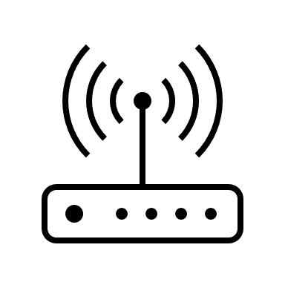




Overview of device setup and operation

Slide 2
Usage
Attach sensors to board and skater
Place laptop in secure location away from skater and board
Turn on sensors and start laptop
Start the model to analyze the data received from sensor A and sensor B in real time
Model will predict the best times for the skater to pump on the transition, based on similar data it has been trained on from a similar transition type (half pipe, pump track etc.)
Skater listens to the audio cues
Explore a future version that can learn a new transition in real time or learn to teach on an unseen transition

Slide 3
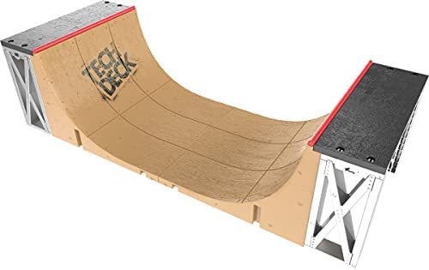
Initial setup
Skater
Phone sensor
Cell phone hotspot for shared wi-fi
Laptop running ML model
Half Pipe
Board
Phone sensor

Slide 4
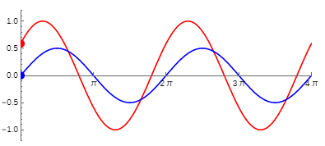



Data sources and expected results
accel
time
I would expect to see the output of both sensors looking something like this for successful pumping. N.B I have no idea if the phase shift is remotely correct yet !
Red is sensor A Blue is sensor B
The board sensor data does look like a sine wave as it is ‘fixed’ to the transition. I have seen this from my real world data.
The skater accelerates faster than gravity at the right time to add impulse on the transition
Sensor A
Sensor B

