Slide 1

Iain workman, john mason, Matthew galbraith, Mitchell Corbett, ryan la forge

Slide 2
Motivation
Design software to assist the Producer of a small-scale film production company.
There are many things to keep track of throughout the production of a movie. Our system aims to make the producer’s book-keeping duties as automated as possible allowing him or her to focus on the film itself and not the details of its realization.

Slide 3
Introduction 1/2
Our system has several parts which will work in unison to make life as easy as possible for our client, the producer.
Entry form for volunteers to fill out and edit indicating their availability through a web applet.
Entry form for the producer to enter in equipment and its availability.
Database storing all of the volunteer and equipment information
A scheduling application that will generate emails allowing the cast and crew to view their schedule once it is completed.

Slide 4
Introduction 2/2
Our system will
Track volunteer cast, crew members, and equipment.
Schedule filming around the time constraints of the available volunteers and equipment.
Keep time records of all the cast/crew members and use records for the equipment.
Track scenes which are required for the movie, both completed and yet to be shot.
Allow the producer to manage conflicts created by cast, crew, or equipment.
Allow the producer to easily create a schedule, or even automatically generate an appropriate schedule.

Slide 5
PrOgress
Main window for user access.
Creation of basic volunteer form UML diagrams and Java classes for volunteers and equipment.
Basic database to store information generated by volunteer and equipment classes.

Slide 6
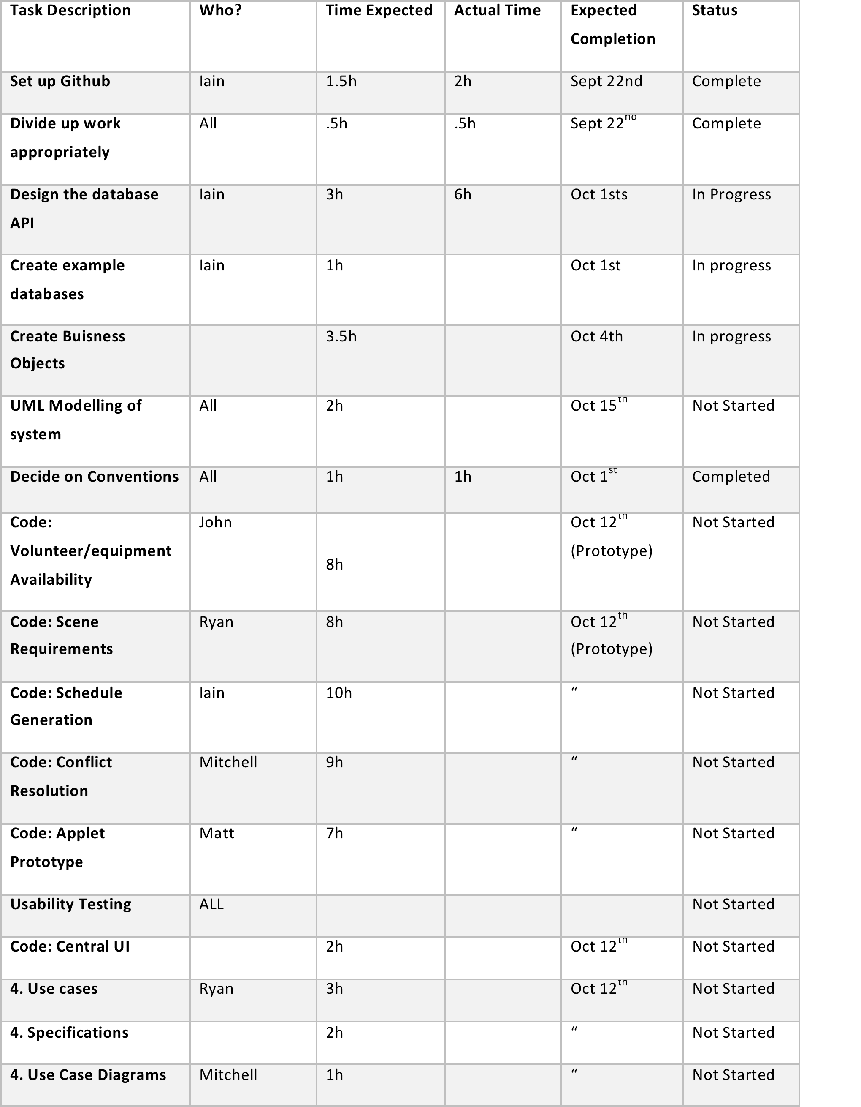
Work allocation

Slide 7
Work allocation cont’d
Volunteer management Assigned to: John Mason Duties: manage the addition and updating of volunteers and equipment.
Script/Scene management Assigned to: Ryan La Forge Duties: Manage scripts, scenes, and the interactions between scenes and volunteers/equipment
Timetable Management Assigned to: Iain Workman Duties: Manages the interactions between the user and the schedule.
Conflict Resolution Management Assigned to: Mitchell Corbett Duties: Automatic schedule generation and conflict management.
Volunteer information Web Applet Assigned to: Mathew Galbraith Duties: Manage the interactions between the main system and the volunteers/crew members.

Slide 8
planning
Weekly meetings to evaluate and discuss progress.
Weekly goals to ensure linear progress.
Paired programming:
To ensure clear understandable code.
To practice working in small teams.
Ensures a broader understanding of the project for each individual.

Slide 9
issues
Code: Java
IDE: Netbeans
Source code managenment: Github
Requested and received private repository due to student status!

Slide 10
conclusion
We at Achievatron Unlimited believe that this software we are creating can have real use in the private filming sector.
We chose a small target market because we want to learn to develop specific software for a unique set of needs
If it appears we have not been ambitious enough remember, promise a little but give a lot. This presentation has outlined *only* what we feel we can reasonably and comfortably create given the time restrictions for this class. It has not included some of our more high reaching goals.

