Slide 1
Project Proposal
DS 5200 | Supervised Machine Learning
American Sign Language Alphabets Recognition/Classification
Team: Ajay Karthick Senthil Kumar & Firdose Shaik
Presented on: 11/14/2022

Slide 2
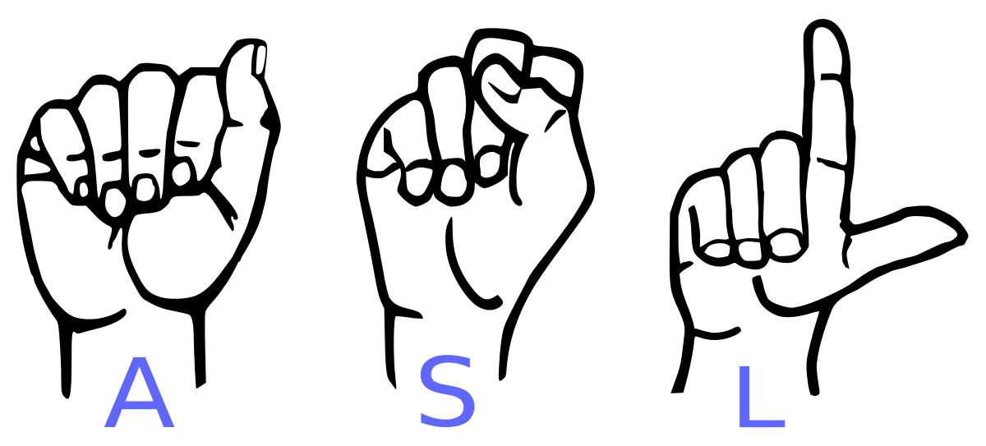
About
We propose to develop a deep learning model to classify images of the American Sign Language Alphabets. American Sign Language (ASL) is a commonly used visual language by the people who are hard of hearing in the United States. It uses hand gestures to convey thoughts instead of the spoken words. ASL has 26 signs for the alphabets of the English language.
The hearing-impaired person can communicate to only limited number of people using ASL since very few people understand ASL. Hence developing a Machine Learning Model to recognize ASL alphabets will pave a way to create an effective communication channel
It is interesting because it tries to address a real-world problem and an attempt to resolve it via machine learning algorithms.

Slide 3

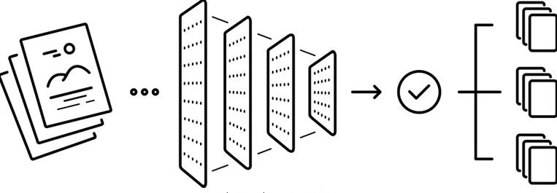
Dataset
Source : https://www.kaggle.com/datasets/grassknoted/asl-alphabet
Training Dataset : 87000 images
29 classes - 26 alphabets (A-Z), Space, Delete and Nothing.
Approach
We plan to make use of the Deep Learning algorithm of Convolutional Neural Network (CNN) for the task of classification of the ASL Alphabets.
Image data pre-processing
Build Deep CNN
Compile and train the model
Finetune the model
Evaluate the model
Use the model to recognize the real-time input
(ASL alphabet)

Slide 4
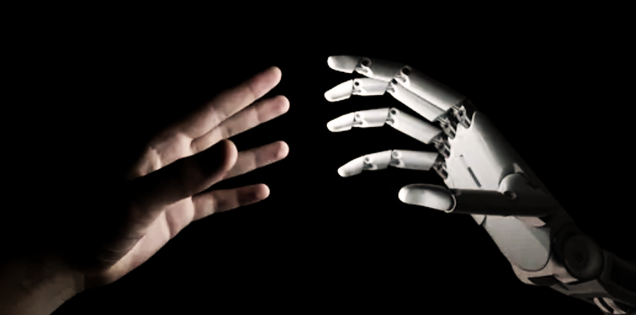
Key components and expected outcomes
Data Preprocessing phase may include steps like resizing all images data to uniform size, normalization and image augmentation. We intend to build the CNN with deep convolutional layers, max pooling layers, ReLU activation, SoftMax activation for classification.
We are planning to develop a web application that will capture the real-time ASL alphabet hand gestures shown by the end user, feed it to the trained model, and the model will classify and gives the corresponding English Alphabet.
While most of the competing approach uses Transfer Learning where it uses pre-trained models to achieve this task, we intend to build the entire CNN model from scratch and train it with the sufficiently large training data
If time permits, we are also looking to work on generating the entire word/sentence formed by the ASL alphabets hand gestures shown by the user in addition to classify the alphabets.

