Slide 1
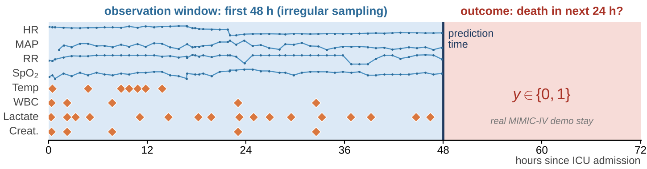
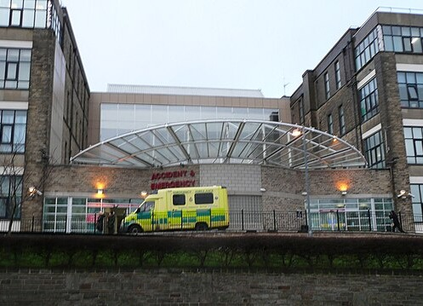
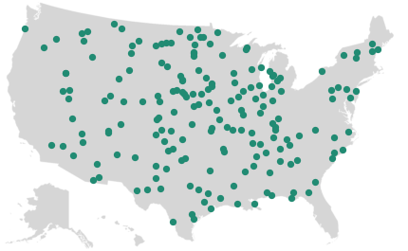
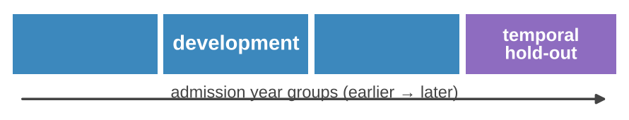
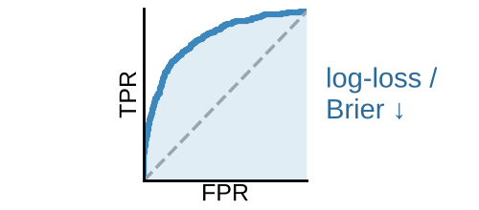
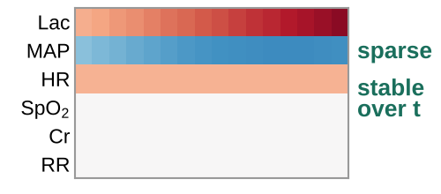

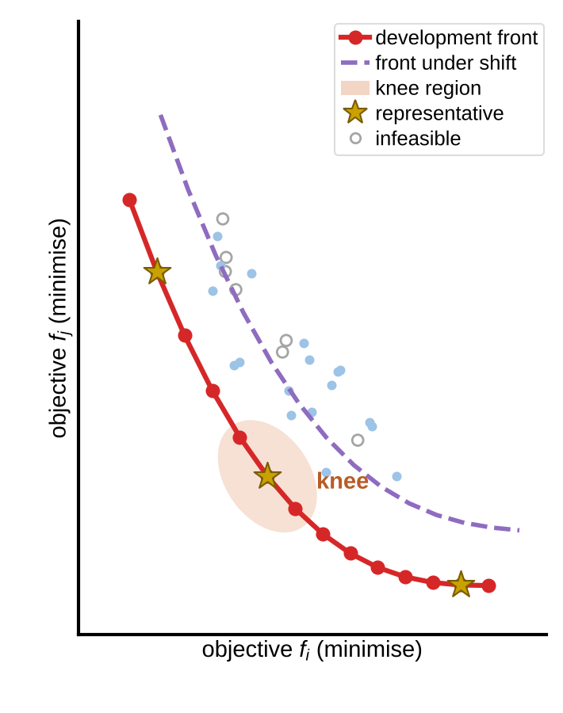

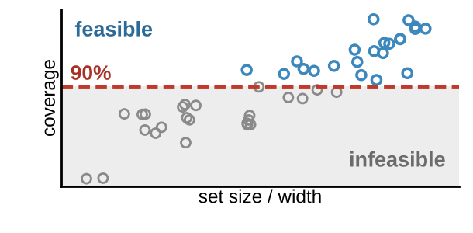
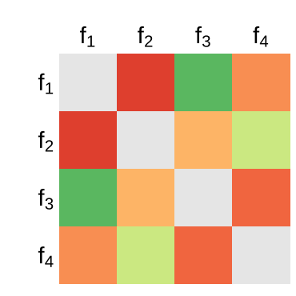
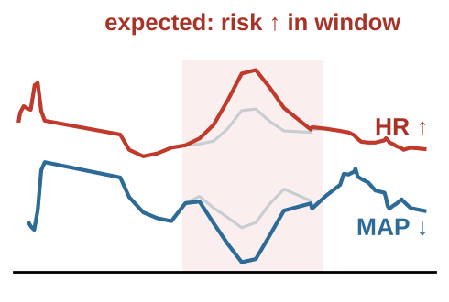
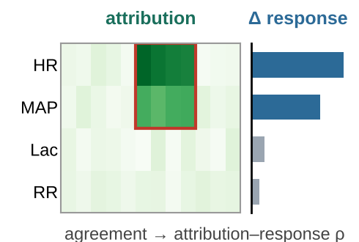
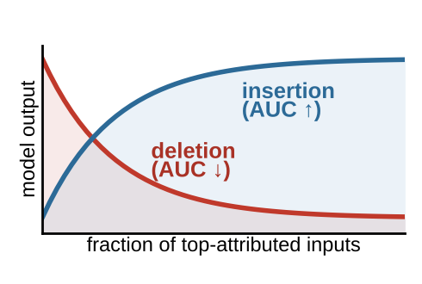

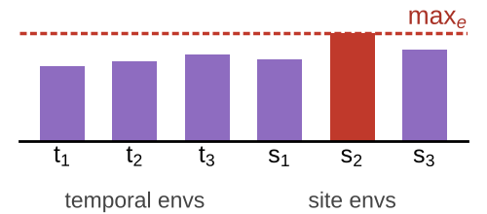



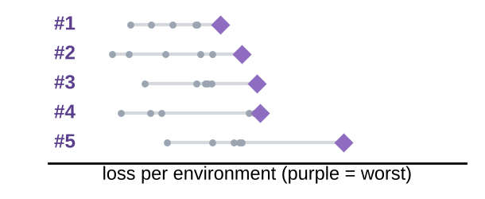


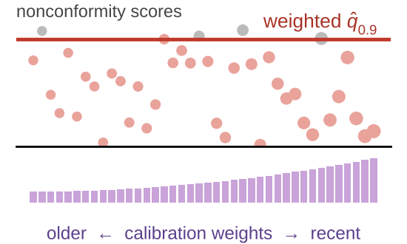



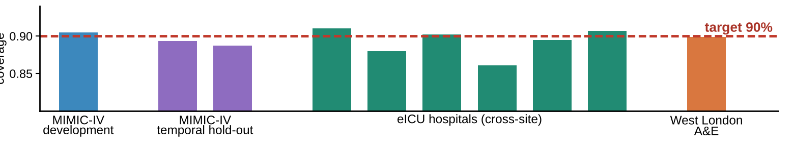
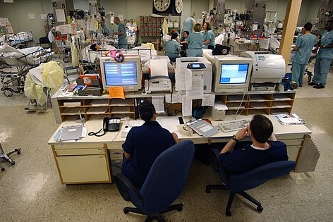

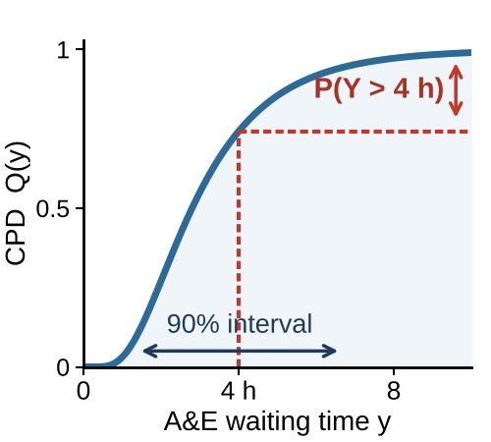

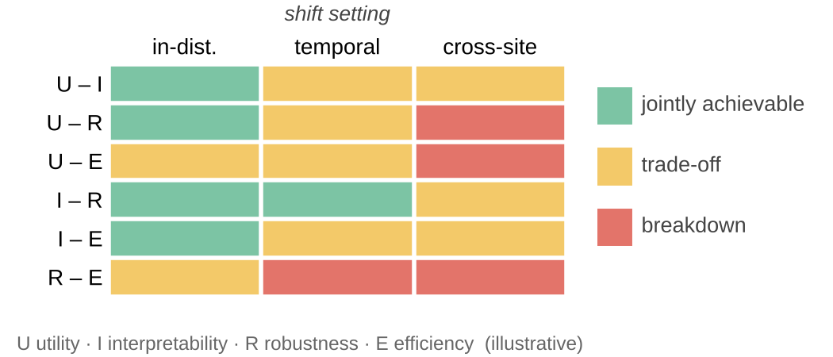

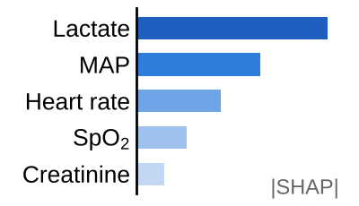
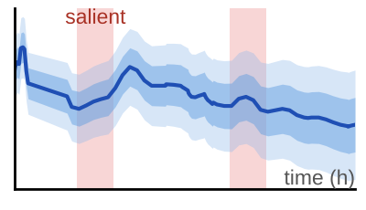






Shared clinical
time-series testbed
Primary task (binary)
24-h ICU mortality from the first 48 h of irregularly sampled physiological and laboratory observations
Complementary task (regression)
A&E waiting-time prediction
real-world attendances, West London hospital [15]
continuous outcomes → CPDs
MIMIC-IV [13]
ICU · development + temporal hold-out
eICU [14]
multi-centre US ICUs · independent cross-hospital validation
runs throughout M1–24
retrospective · de-identified · no prospective collection
data properties: irregular sampling, temporal dependence, shift
MIMIC-IV development data (training & calibration)
temporal hold-out · eICU · West London A&E
WP1 Objective and
Constraint Definition
WP2 Many-Objective Method Development
WP3 Technical Verification and
External Validation
M1–6
M3–14
M8–22
Quantitative objectives (minimised)
Candidate population θ
Evaluate F(θ) per environment
Constraint- & shift-aware selection
Pareto-frontier characterisation
① Explanation faithfulness
F(θ) = (f₁, f₂, f₃, f₄) s.t. coverage ≥ 90%
+ predefined temporal & site environments E
(illustrative; 2 of 4 objectives shown)
Selected Pareto
solutions θ*
ablation + controlled perturbation
(temporal & site shifts, e ∈ E)
Coverage-constrained selection
objective correlation
Physiology-based perturbation
Attribution vs. observed response
Deletion / insertion fidelity
f₁ predictive loss
f₁ predictive loss
f₂ sparsity & temporal stability
Model hyper-parameters
f₂ sparsity & temporal stability
f₃ worst-group loss
Environment-aware robustness ranking
joint gain
Interpretability settings
trade-off
f₃ worst-group loss under shift
f₄ set size / interval width
★ representative → WP3, WP4
Faithfulness
feedback
② Performance & coverage under shift
f₄ set size / interval width
MIMIC-IV
development
MIMIC-IV
temporal hold-out
eICU
cross-hospital
West London A&E
continuous task
Coverage: validity constraint
Faithfulness-informed refinement (from WP3)
marginal ≥ 90%
time-series & non-exchangeable calibration
re-evaluated under temporal & site shift
Other model settings
c: coverage (by subgroup & site)
Benchmark vs established methods
feasibility · front quality under shift
Iterate: variation (crossover, mutation) → new population
calibrated on development data · compared with shift-robust conformal baselines
representative Pareto candidates (selected solutions)
Pareto-frontier structure
faithfulness · performance · coverage
WP4 Clinical and Uncertainty Evaluation
WP5 Evidence Integration and Guidance
M14–22
M20–24
Goal: do jointly optimised, uncertainty-aware outputs support appropriate clinical reliance?
Clinical evaluation
evidence
Goal: where are trustworthy-AI properties jointly achievable, and how does shift change this?
Three output conditions
Outcomes
CPDs
Clinical evidence (WP4)
Optimisation evidence (WP2)
Verification evidence (WP3)
continuous tasks
A
Point prediction
B
+ Post-hoc explanation
C
Pareto model + conformal
Reliance accuracy
0.28
0.28
0.28 [0.12–0.46]
Confidence calibration
Joint-achievability map
Open release
ICU clinicians
balanced, de-identified cases
Interpretability
Incompatibility is a first-class outcome
where & why the frontier breaks down
Methodological guidance
risk score only
Algorithms
Time to decision
→ different decision rules
Evaluation protocols
+ qualitative comments
Open-access publications
Notes:
图1（v2）流程与过程量说明
共享临床时间序列测试平台（M1–24 全程）：主任务 = 用入 ICU 前 48 h 不规则采样的生理/实验室观测预测随后 24 h 死亡（二分类）；补充任务 = 西伦敦医院 A&E 等待时间预测（回归）；连续结局用于 CPD。数据：MIMIC-IV（开发 + 时间外推验证）、eICU（独立跨医院验证）、West London A&E（连续任务）。仅使用回顾性、去标识化数据。
测试平台 → WP1：数据特性（不规则采样、纵向依赖、分布漂移）；→ WP2：MIMIC-IV 开发数据（训练与校准）；→ WP3：时间外推集、eICU、A&E。
WP1（M1–6）→ WP2：目标向量 F(θ) = (f1 预测损失, f2 特征贡献的稀疏性与时间稳定性, f3 预定义时间/站点漂移下的最差组损失, f4 预测集大小/区间宽度)，约束：边际覆盖率 ≥ 90%（时间序列/非可交换校准，按亚组与站点复核），以及预定义的漂移环境 E。
WP2（M3–14）：候选种群 θ → 在每个环境 e∈E 上评估 F(θ) 与覆盖率 c → 覆盖约束选择 + 环境感知鲁棒排序（+ WP3 忠实度反馈）→ 交叉/变异生成新种群并迭代；输出 Pareto 前沿刻画（联合改进区、膝点区、漂移下前沿变化）、代表性候选解，并与现有多目标方法对比。
WP2 → WP3：选定的 Pareto 解 θ*；WP3 → WP2：解释忠实度结果，用于改进 f2 可解释性代理与候选选择。
WP3（M8–22）：① 忠实度——消融 + 基于简单生理模型的受控扰动（预先设定期望方向与时间位置），用归因–响应相关和删除/插入保真度量化；② 性能与覆盖——MIMIC-IV 开发/时间外推、eICU 跨医院、A&E 连续任务。
WP2 → WP4：代表性 Pareto 候选解。WP4（M14–22）：ICU 医生在三种条件下审阅平衡的去标识化病例（A 点预测；B 点预测 + 事后解释；C 联合优化输出 + 保形不确定性），结局 = 依赖决策准确性、置信度校准、感知可解释性、决策时间及定性意见；连续任务探索 CPD 支持不同决策规则。
WP2/WP3/WP4 → WP5（M20–24）：优化、验证、临床证据整合为“可联合实现性”图谱（联合可实现 / 权衡 / 失效，随时间与站点漂移变化）；不相容被视为一等结果；输出方法学指导、算法、评估规范与开放获取论文。
图中前沿、相关矩阵、覆盖率柱、可实现性图谱等为示意（illustrative），非结果。
图片与数据来源：
- ICU 中央监护站照片：US Navy photo by PH1 Shane T. McCoy，Wikimedia Commons，公有领域。
- A&E 入口照片：“Entrance to the Accident and Emergency Department, Bradford Infirmary”，Humphrey Bolton，geograph.org.uk / Wikimedia Commons，CC BY-SA 2.0。
- 美国地图底图：“Blank US Map (states only).svg”，Heitordp，Wikimedia Commons，CC0；站点按 eICU Demo 医院所属区域示意摆放。
- 生命体征曲线/不规则采样示意：MIMIC-IV Clinical Database Demo v2.2、eICU-CRD Demo v2.0.1（PhysioNet，开放获取）中的真实数据。
- 图标：Font Awesome（react-icons）。

