Slide 1
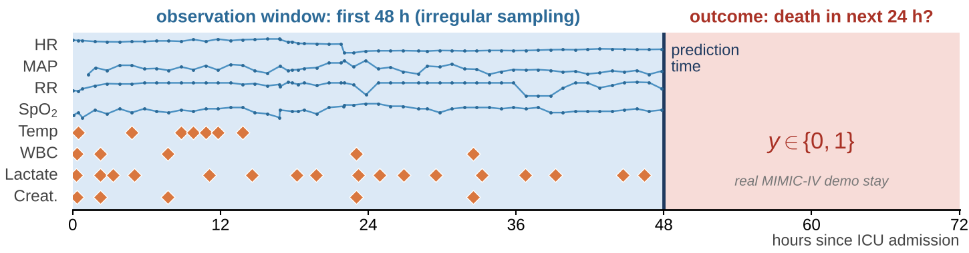
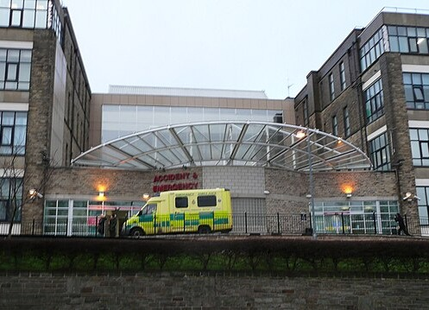
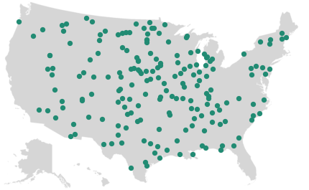
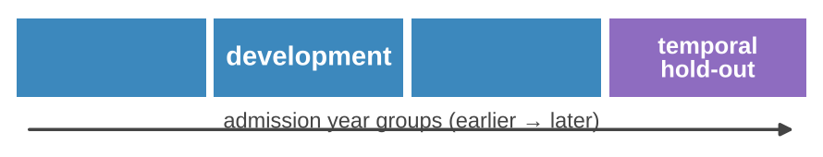
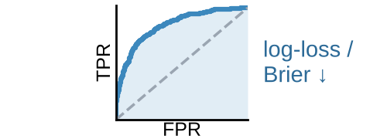
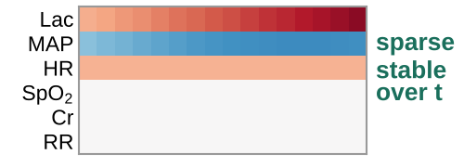

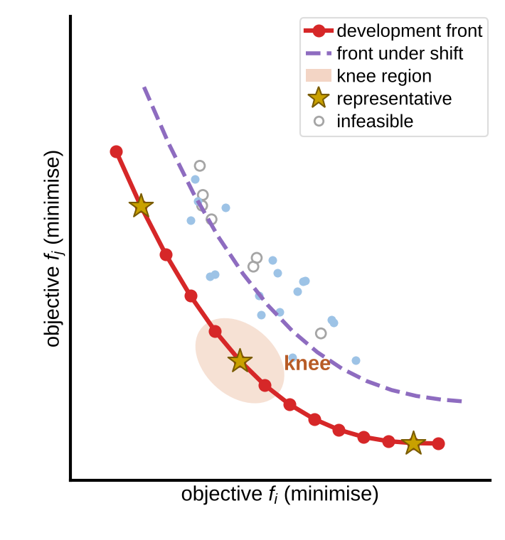

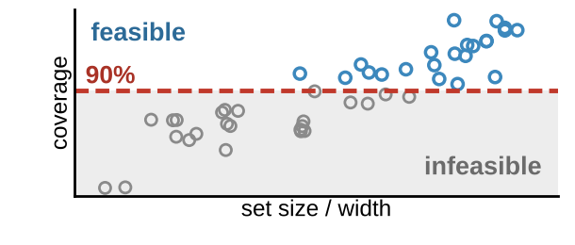
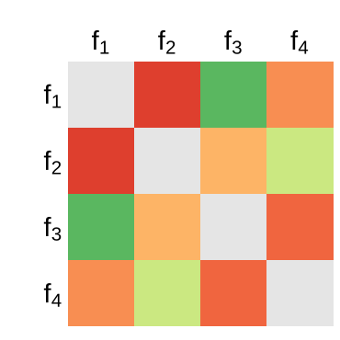
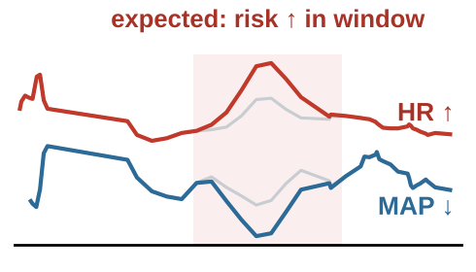
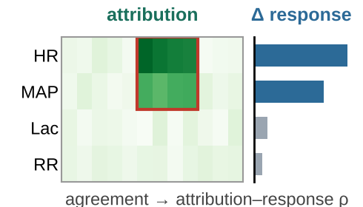
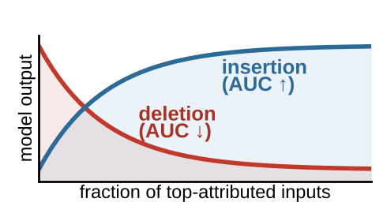
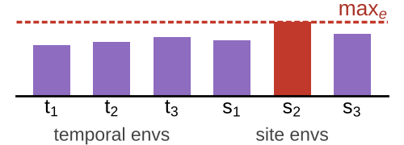




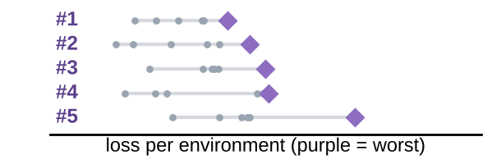


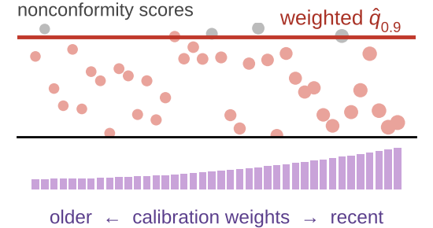



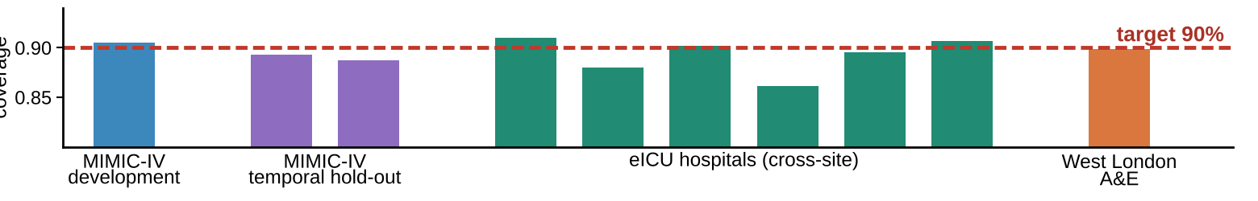
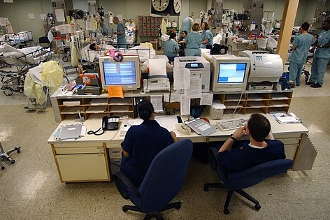

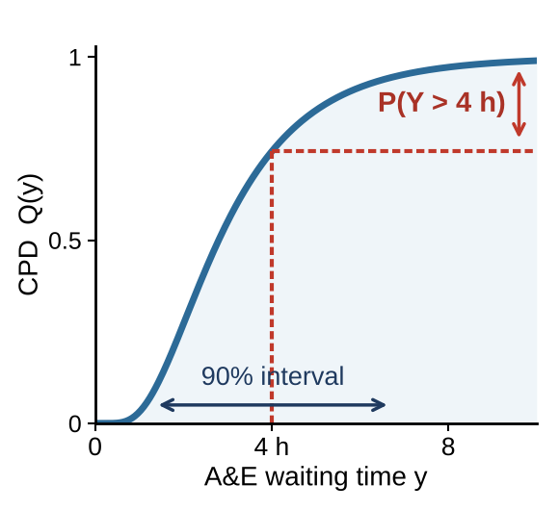


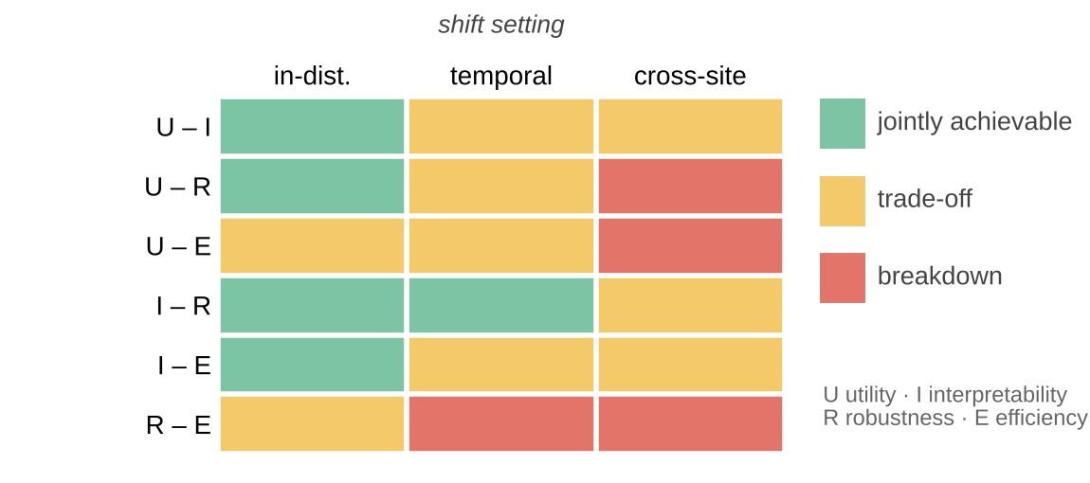


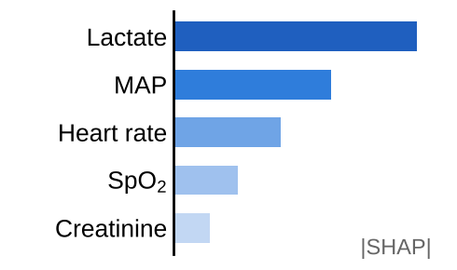
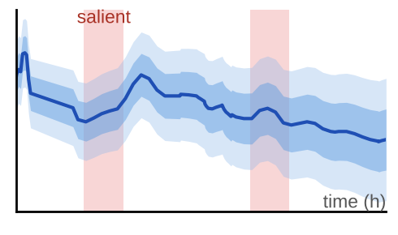





Shared clinical
time-series testbed
Primary task (binary)
24-h ICU mortality from the first 48 h of irregularly sampled physiological and laboratory observations
Complementary task (regression)
A&E waiting-time prediction
real-world attendances, West London hospital [15]
continuous outcomes → CPDs
MIMIC-IV [13]
ICU · development + temporal hold-out
eICU [14]
multi-centre US ICUs · independent cross-hospital validation
runs throughout M1–24
retrospective · de-identified · no prospective collection
data properties: irregular sampling, temporal dependence, shift
MIMIC-IV development data (training & calibration)
temporal hold-out · eICU · West London A&E
WP1 Objective and
Constraint Definition
WP2 Many-Objective Method Development
WP3 Technical Verification and
External Validation
M1–6
M3–14
M8–22
Quantitative objectives (minimised)
Candidate population θ
Evaluate F(θ) per environment
Constraint- & shift-aware selection
Pareto-frontier characterisation
Selected Pareto
solutions θ*
① Explanation faithfulness
F(θ) = (f₁, f₂, f₃, f₄) s.t. coverage ≥ 90%
+ predefined temporal & site environments E
(illustrative; 2 of 4 objectives shown)
ablation + controlled perturbation
(temporal & site shifts, e ∈ E)
Coverage-constrained selection
objective correlation
Physiology-based perturbation
Attribution vs. observed response
Deletion / insertion fidelity
Model hyper-parameters
f₁ predictive loss
f₁ predictive loss
f₂ sparsity & temporal stability
f₂ sparsity & temporal stability
Interpretability settings
f₃ worst-group loss
Environment-aware robustness ranking
joint gain
f₃ worst-group loss under shift
f₄ set size / interval width
trade-off
Faithfulness
feedback
② Performance & coverage under shift
f₄ set size / interval width
★ representative → WP3, WP4
MIMIC-IV
development
MIMIC-IV
temporal hold-out
eICU
cross-hospital
West London A&E
continuous task
Coverage: validity constraint
Other model settings
c: coverage (by subgroup & site)
Faithfulness-informed refinement (from WP3)
Benchmark vs established methods
feasibility · front quality under shift
marginal ≥ 90%
time-series & non-exchangeable calibration
re-evaluated under temporal & site shift
Iterate: variation (crossover, mutation) → new population
calibrated on development data · compared with shift-robust conformal baselines
representative Pareto candidates (selected solutions)
Pareto-frontier structure
faithfulness · performance · coverage
WP4 Clinical and Uncertainty Evaluation
WP5 Evidence Integration and Guidance
M14–22
M20–24
Structured ICU clinician review
Outcomes
CPDs for continuous tasks
Clinical evaluation
evidence
Clinical evidence (WP4)
Optimisation evidence (WP2)
Verification evidence (WP3)
balanced set of de-identified cases · three output conditions
Accuracy of reliance decisions
reliance accuracy · confidence calibration · interpretability · time to decision
frontier structure · joint-gain & knee regions · effect of shift
faithfulness · performance & coverage under temporal / site shift
A
Point prediction alone
B
Point prediction + post-hoc explanation
C
Jointly optimised output + conformal uncertainty
Confidence calibration
Risk 0.28
Risk 0.28
Risk 0.28 [0.12–0.46]
Perceived interpretability
Integration: where are trustworthy-AI properties jointly achievable?
Open release & dissemination
0
1
0
1
0
1
Methodological guidance
single score: no explanation, no uncertainty
Time to decision
probabilistic outputs support different decision rules, e.g. P(wait > 4 h) or a 90% interval
Incompatibility is a first-class outcome
characterise where and why the frontier breaks down (rigorous negative result)
Released algorithms
Qualitative comments
Evaluation protocols (temporal & site shift)
post-hoc feature importance
intrinsic temporal explanation
Open-access publications
Notes:
图1（v2）流程与过程量说明
共享临床时间序列测试平台（M1–24 全程）：主任务 = 用入 ICU 前 48 h 不规则采样的生理/实验室观测预测随后 24 h 死亡（二分类）；补充任务 = 西伦敦医院 A&E 等待时间预测（回归）；连续结局用于 CPD。数据：MIMIC-IV（开发 + 时间外推验证）、eICU（独立跨医院验证）、West London A&E（连续任务）。仅使用回顾性、去标识化数据。
测试平台 → WP1：数据特性（不规则采样、纵向依赖、分布漂移）；→ WP2：MIMIC-IV 开发数据（训练与校准）；→ WP3：时间外推集、eICU、A&E。
WP1（M1–6）→ WP2：目标向量 F(θ) = (f1 预测损失, f2 特征贡献的稀疏性与时间稳定性, f3 预定义时间/站点漂移下的最差组损失, f4 预测集大小/区间宽度)，约束：边际覆盖率 ≥ 90%（时间序列/非可交换校准，按亚组与站点复核），以及预定义的漂移环境 E。
WP2（M3–14）：候选种群 θ → 在每个环境 e∈E 上评估 F(θ) 与覆盖率 c → 覆盖约束选择 + 环境感知鲁棒排序（+ WP3 忠实度反馈）→ 交叉/变异生成新种群并迭代；输出 Pareto 前沿刻画（联合改进区、膝点区、漂移下前沿变化）、代表性候选解，并与现有多目标方法对比。
WP2 → WP3：选定的 Pareto 解 θ*；WP3 → WP2：解释忠实度结果，用于改进 f2 可解释性代理与候选选择。
WP3（M8–22）：① 忠实度——消融 + 基于简单生理模型的受控扰动（预先设定期望方向与时间位置），用归因–响应相关和删除/插入保真度量化；② 性能与覆盖——MIMIC-IV 开发/时间外推、eICU 跨医院、A&E 连续任务。
WP2 → WP4：代表性 Pareto 候选解。WP4（M14–22）：ICU 医生在三种条件下审阅平衡的去标识化病例（A 点预测；B 点预测 + 事后解释；C 联合优化输出 + 保形不确定性），结局 = 依赖决策准确性、置信度校准、感知可解释性、决策时间及定性意见；连续任务探索 CPD 支持不同决策规则。
WP2/WP3/WP4 → WP5（M20–24）：优化、验证、临床证据整合为“可联合实现性”图谱（联合可实现 / 权衡 / 失效，随时间与站点漂移变化）；不相容被视为一等结果；输出方法学指导、算法、评估规范与开放获取论文。
图中前沿、相关矩阵、覆盖率柱、可实现性图谱等为示意（illustrative），非结果。
图片与数据来源：
- ICU 中央监护站照片：US Navy photo by PH1 Shane T. McCoy，Wikimedia Commons，公有领域。
- A&E 入口照片：“Entrance to the Accident and Emergency Department, Bradford Infirmary”，Humphrey Bolton，geograph.org.uk / Wikimedia Commons，CC BY-SA 2.0。
- 美国地图底图：“Blank US Map (states only).svg”，Heitordp，Wikimedia Commons，CC0；站点按 eICU Demo 医院所属区域示意摆放。
- 生命体征曲线/不规则采样示意：MIMIC-IV Clinical Database Demo v2.2、eICU-CRD Demo v2.0.1（PhysioNet，开放获取）中的真实数据。
- 图标：Font Awesome（react-icons）。

