Slide 1
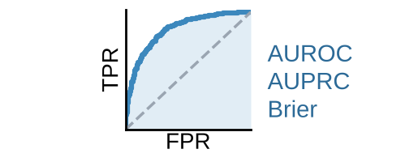
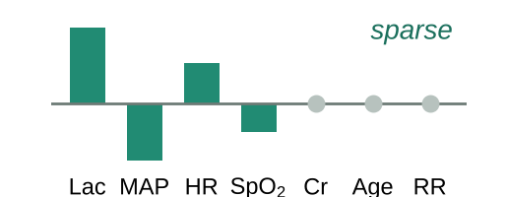
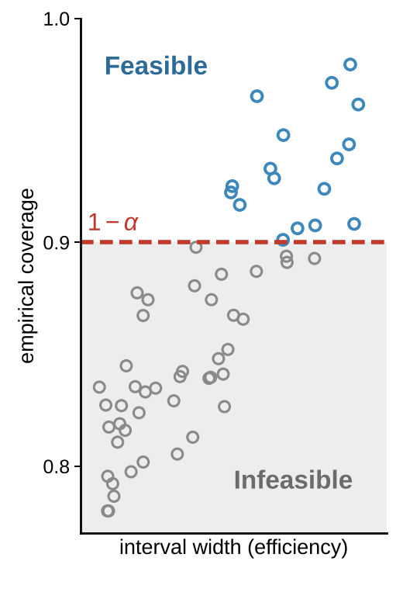



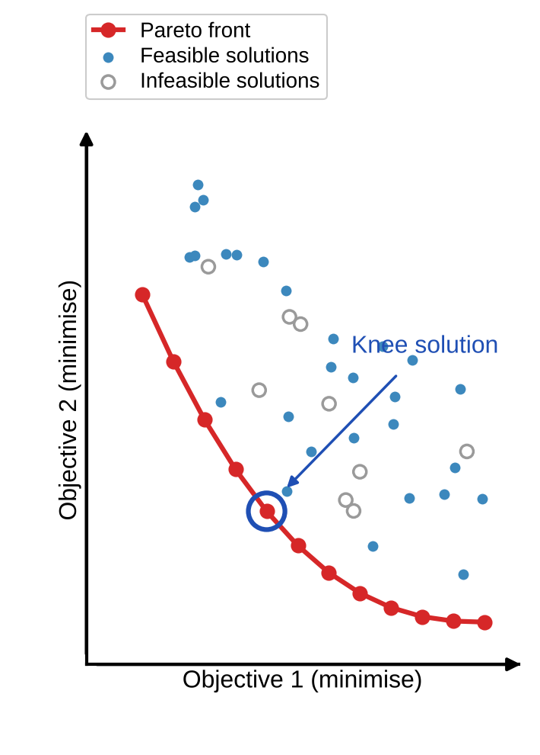
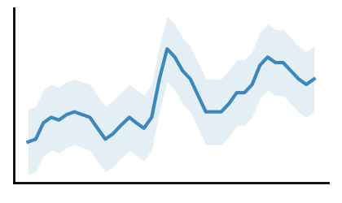
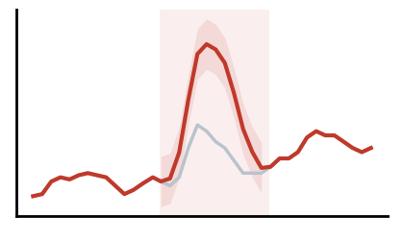
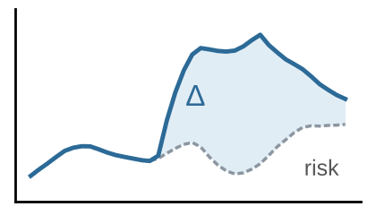
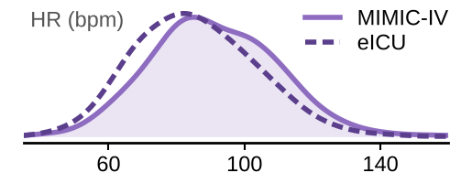
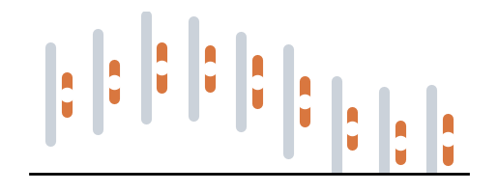






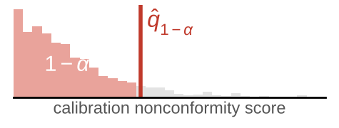

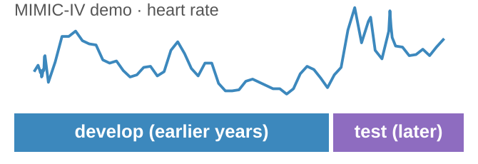
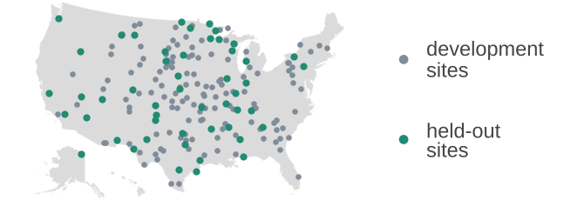
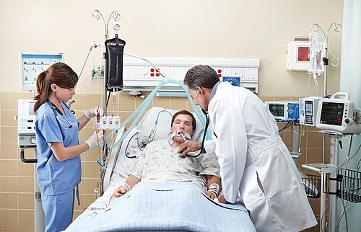
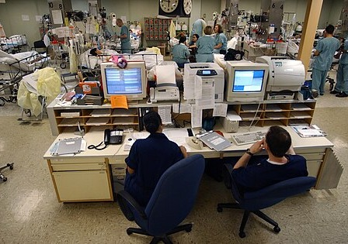

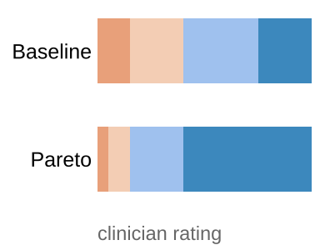
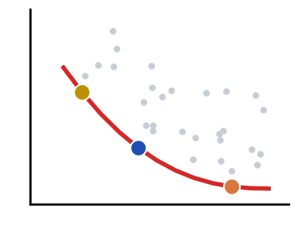
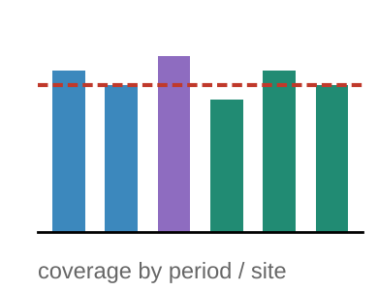



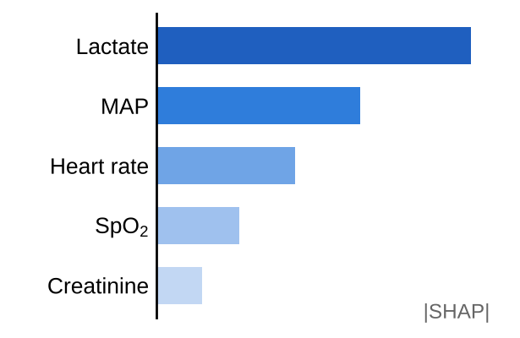
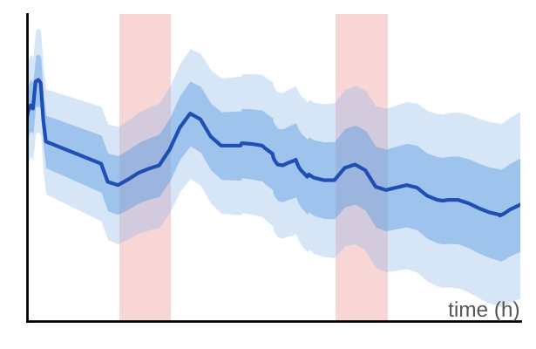
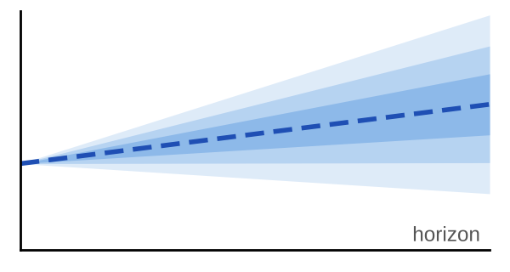
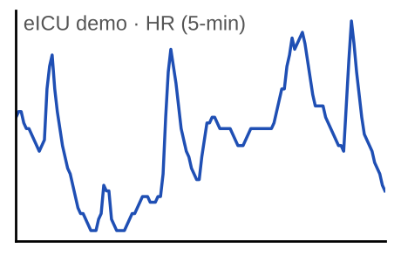




Objective and Constraint Definition (WP1)
Constraint- and Shift-Aware Many-Objective Method Development (WP2)
Interpretability and Robustness Verification (WP3)
Joint optimisation objectives
Candidate solutions
Four-objective evaluation
Coverage-aware constraint handling
Evolutionary search
Illustrative Pareto front
Interpretability verification
(decision variables)
(under temporal and
site shift)
(shift-aware)
(2 objectives shown)
Original input
Controlled perturbation
Changed model response
Predictive performance
Selection
(physiology-informed)
Predictive performance
Intrinsic interpretability
Model hyperparameters
(non-dominated, constraint-aware)
Intrinsic interpretability
Variation
Ablation tests and controlled perturbations
Robustness under temporal and site shift
Conformal efficiency
Interpretability settings
Robustness
(crossover, mutation)
Performance and coverage under distribution shift
Conformal coverage requirement
New population
MIMIC-IV (temporal validation)
eICU (cross-site validation)
Target coverage: 1 − α
P(Y ∈ Ĉ(X)) ≥ 1 − α
Other model settings
Conformal efficiency
Coverage ≥ 1 − α
hard constraint
(re-evaluated each generation)
Clinical judgement
(assessed separately in WP4)
Iterate
Evaluate predictive performance and conformal coverage
Clinical judgement → assessed in WP4
Selected Pareto output
Optimisation evidence
Verification evidence
Clinical Evaluation (WP4)
Evidence Integration and Guidance (WP5)
1. Compare outputs
2. Structured ICU clinician evaluation
3. Assess
Clinical evaluation evidence
(from WP4)
Optimisation evidence
(from WP2)
Verification evidence
(from WP3)
Baseline output
Selected Pareto output
Same clinical cases / scenarios
Clinician feedback
Appropriate reliance
Clinical interpretation
Pareto trade-offs
Representative solutions
Frontier structure
Perturbation tests
Performance under shift
Coverage under shift
Point prediction
(single risk score)
Prediction + conformal uncertainty
(interval / band / set)
Appropriate reliance
Risk: 0.28
Risk: 0.28
(95% CI: 0.12 – 0.46)
Case
summaries
Model
outputs
Post-hoc explanation
(e.g. feature importance)
Interpretable temporal explanation
(e.g. salient features over time)
Compare the two output formats
Clinical interpretation
Continuous prediction tasks → explore CPDs for decision support
Synthesis and guidance
Explore
CPDs
Feasible limits and trade-offs
Methodological guidance
Evaluation protocol for temporal and site shift
Open release and dissemination
conformal predictive distribution
Notes:
图1 流程说明（WP1–WP5 数据流）
WP1 → WP2：四个联合优化目标（预测性能、内在可解释性、时间/站点漂移下的鲁棒性、保形效率）进入 WP2 的“四目标评估”；保形覆盖要求 1−α 进入 WP2 的“覆盖感知约束处理”（硬约束，区分可行/不可行解）。
WP1 ⇢ WP4：临床判断不作为优化目标，在 WP4 中单独评估。
WP2 内部：候选解（模型超参数、可解释性设置、其他设置）→ 四目标评估（在时间与站点漂移下）→ 覆盖约束处理（Coverage ≥ 1−α）→ 进化搜索（非支配+约束感知选择 → 交叉/变异 → 新种群）→ 迭代回到四目标评估；输出 Pareto 前沿与膝点解。
WP2 → WP3：Pareto 解进入可解释性验证（原始输入 → 生理学约束扰动 → 模型响应变化；消融与受控扰动）以及分布漂移下的性能与覆盖评估（MIMIC-IV 时间验证、eICU 跨站点验证）。
WP2 → WP4：选定的 Pareto 输出（预测 + 保形不确定性 + 时间可解释性）与基线输出（点预测 + 事后解释）在相同病例上由 ICU 临床医生结构化比较，评估恰当依赖与临床解读；连续预测任务进一步探索 CPD。
WP2/WP3/WP4 → WP5：优化证据、验证证据、临床评估证据汇总为综合与指导（可行边界与权衡、方法学指导、时间/站点漂移评估规范、开源发布与传播）。
图片与数据来源：
- 临床医生床旁照片：“Clinicians in Intensive Care Unit.jpg”，Calleamanecer，Wikimedia Commons，CC BY-SA 3.0。
- ICU 中央监护站照片：US Navy photo by PH1 Shane T. McCoy，Wikimedia Commons，公有领域。
- 美国地图底图：“Blank US Map (states only).svg”，Heitordp，Wikimedia Commons，CC0。
- 心率曲线/分布：MIMIC-IV Clinical Database Demo v2.2 与 eICU-CRD Demo v2.0.1（PhysioNet，开放获取）中的真实数据；站点点位按 eICU Demo 医院所在区域示意摆放。
- 其余小图为 matplotlib 示意图；图标来自 Font Awesome（react-icons）。

