Slide 1
Speaker Diarization(BTP1)
Abhimanyu Kumar
22B1257
Guide: Prof. Preeti Rao

Slide 2
OUTLINE
Introduction
Dataset Description
Methodology Overview
Preprocessing & Voice Activity Detection
Speaker Change Detection (LSTM)
Embedding Extraction (pyannote.audio)
Clustering Algorithms
Experimental Results & Comparison
Challenges

Slide 3
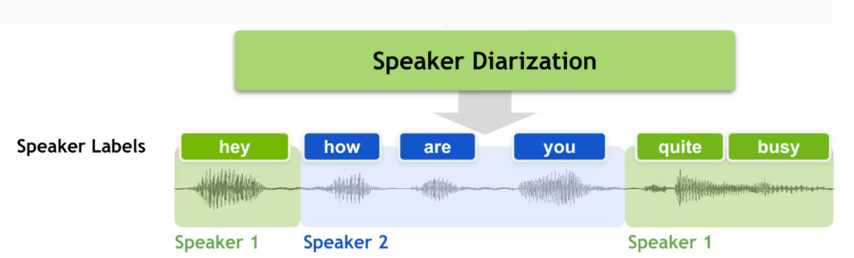
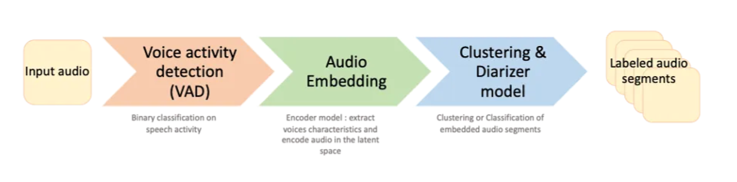
INTRODUCTION
Speaker diarization : The task of answering “who spoke when” in an audio recording.
Speaker Diarization pipeline

Slide 4
DATASET
Dataset: audio6min.wav
Property | Value
Duration | 6 minutes
Number of Speakers | 3
Sampling Rate | 16 kHz
Format | WAV (Mono)
Annotation Format | RTTM
Prepared Using | Audacity

Slide 5
SYSTEM ARCHITECTURE / PIPELINE
  Audio Input
  ↓
  [Preprocessing] → Stereo to Mono, Resample to 16kHz
  ↓
  [Voice Activity Detection] → WebRTC VAD
  ↓
  [Speaker Change Detection] → Bidirectional LSTM
  ↓
  [Embedding Extraction] → pyannote.audio (512-D)
  ↓
  [Clustering] → Mean Shift / K-Means
  ↓
  [RTTM Output] → Evaluation (DER)

Slide 6
PREPROCESSING & VAD
Preprocessing Steps:
  Stereo → Mono conversion using pydub
  Resampling to 16 kHz
  PCM conversion for VAD compatibility
Voice Activity Detection:
  Tool: webrtcvad (WebRTC VAD)
  Output: NumPy array of time intervals where speech is detected
  Removes silence regions from audio
python
  sound = AudioSegment.from_wav(stereo_audio_path)
  sound = sound.set_channels(1)
  sound = sound.set_frame_rate(16000)

Slide 7
SPEAKER CHANGE DETECTION
Feature Extraction:
  11 MFCC coefficients
  First-order derivatives (Δ)
  Second-order derivatives (ΔΔ)
  Total: 35-dimensional features per frame
  Normalization applied
Model Architecture:
  Bidirectional LSTM (128 units)
  TimeDistributed Dense layer (32 units)
  Sigmoid output for frame-level probability
  Saved as: my_trained_model.h5
python
  model.add(Bidirectional(LSTM(128, return_sequences=True)))
  model.add(TimeDistributed(Dense(32)))
  model.add(TimeDistributed(Dense(1, activation='sigmoid')))

Slide 8
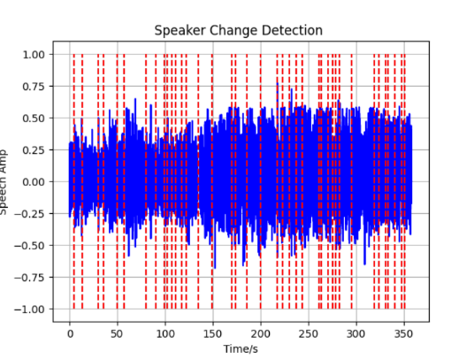
SPEAKER CHANGE DETECTION
Training:
  Frame-level speaker change labels
  Output: Probability of speaker change at each frame
Inference:
  Load pretrained bidirectional LSTM model
  Apply to unseen audio
  Localize speaker change points
  Segment audio based on detected changes

Slide 9
EMBEDDING EXTRACTION
pyannote.audio
  Open-source toolkit for speaker diarization
  Pretrained neural embedding models
Embedding Details:
  Dimension: 512-D speaker embeddings
  Notation: Eᵢ ∈ ℝ⁵¹²
  Extracted for each speech segment
python
  from pyannote.audio import Inference
  embedding = inference.crop(file_dict, Segment(start, end))
Purpose: Represent speaker characteristics for clustering

Slide 10
CLUSTERING ALGORITHMS
Two Approaches Compared:
Algorithm | K-Means | Mean Shift
Requires # speakers | Yes | No
Automatic speaker count | No | Yes
Bandwidth parameter | No | Yes

Slide 11
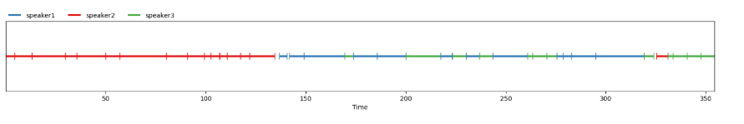
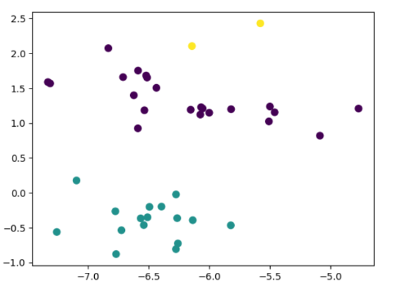
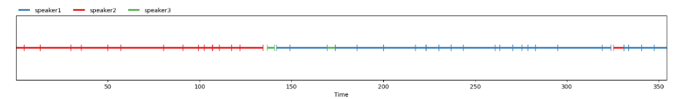
MEAN SHIFT CLUSTERING
Advantages:
  Does NOT require number of speakers as input
  Can automatically predict number of speakers
  Non-parametric clustering
Results:
Clusters found: 3 (correctly identified)
Predicted & above is reference

Slide 12
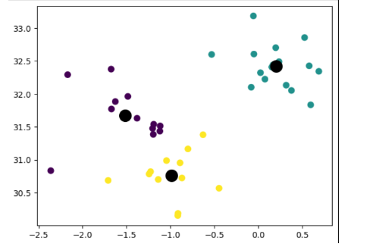
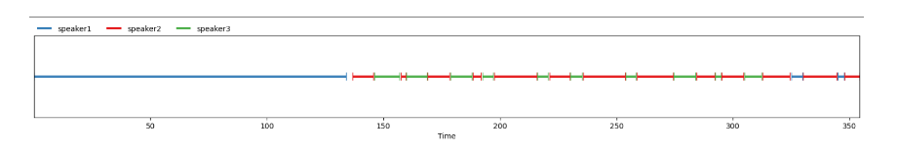
K-MEANS CLUSTERING
Characteristics:
  Requires number of speakers (K) as prior knowledge
  K = 3 for this experiment
  Faster computation

Slide 13
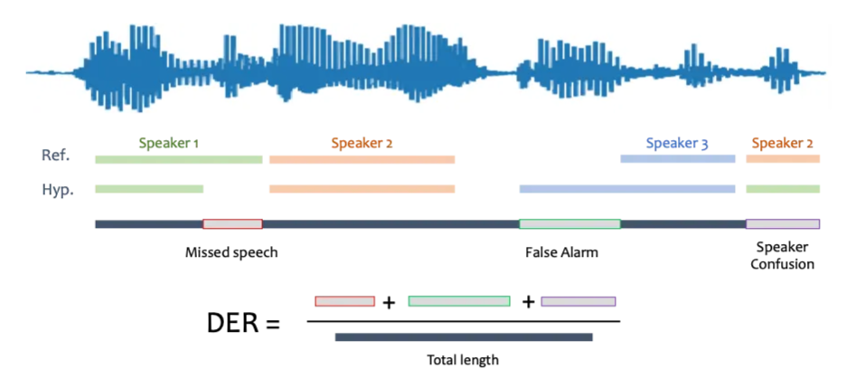
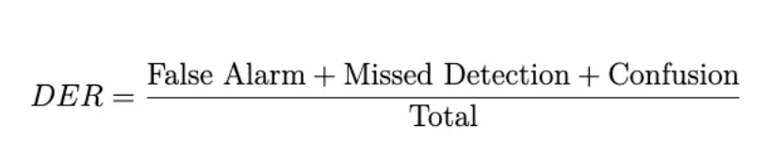
EVALUATION METRICS
  Diarization Error Rate (DER): Ratio of missed speech, false alarm, and speaker confusion to total time.
  A perfectly aligned hypothesis and reference diarization would result in DER=0

Slide 14
EXPERIMENTAL RESULTS
Comparison Table:
Key Finding: K-Means achieves ~5% lower DER than Mean Shift
Metric | Mean Shift | K-Means
Confusion | 65.37 sec | 51.77 sec
False Alarm | 7.62 sec | 7.62 sec
Missed Detection | 1.40 sec | 1.40 sec
DER | 25.64% | 20.95%

Slide 15
RESULTS ANALYSIS
Observations:
  K-Means performed better (DER: 20.95%)
  Lower speaker confusion errors (51.77s vs 65.37s)
Mean Shift advantage
  Automatically detected 3 speakers without prior knowledge
  Useful when speaker count is unknown
Both methods
  Similar false alarm rates (7.62s)
  Similar missed detection (1.40s)
  Main difference in confusion errors

Slide 16
CHALLENGES
Accurate handling of overlapping speech
  Multiple speakers speaking simultaneously
Robustness in low-resource/noisy environments
  Background noise affects performance
Scalability to long recordings and large datasets
  Computational efficiency for real-world deployment

Slide 17


