Slide 1
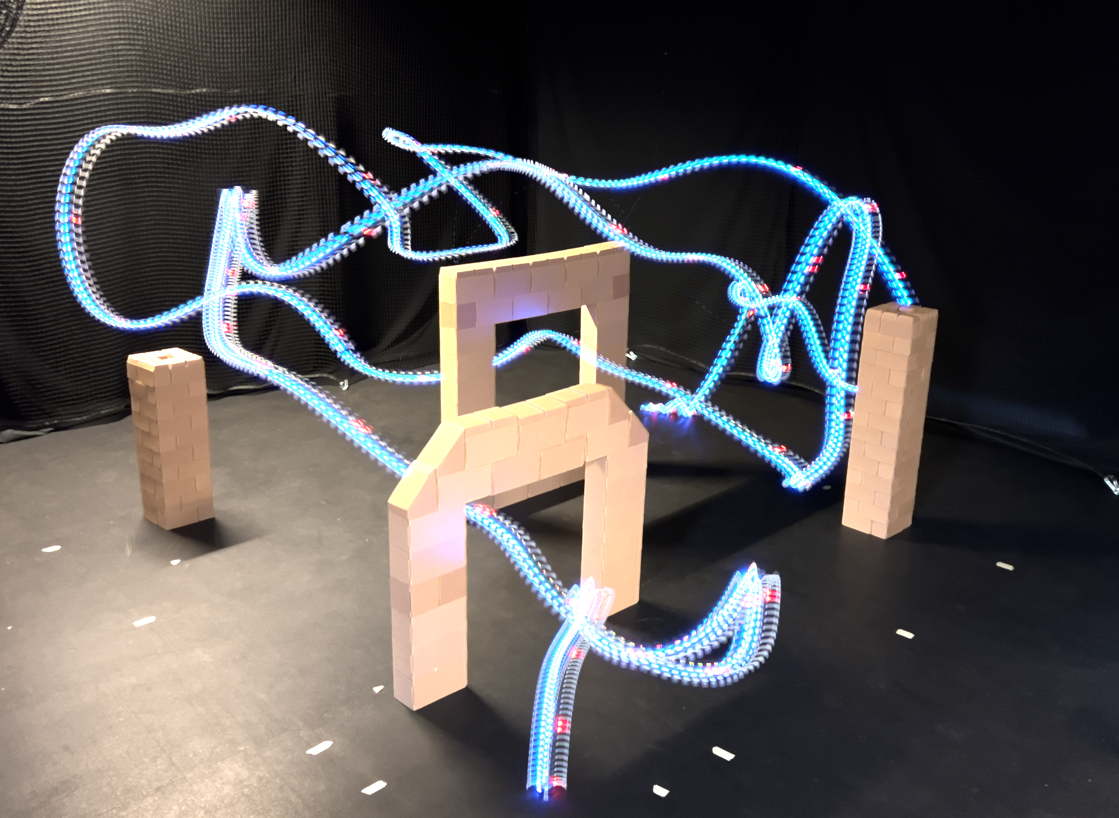


Time Optimal Ergodic Search Trajectory

