Slide 1
IED Robot Mobility: Stepper motor, getting useful motion from motors, wheel encoder
Jyoti V. Sinha
Feb 6, 2015
Notes:
Linear atrai

Slide 2
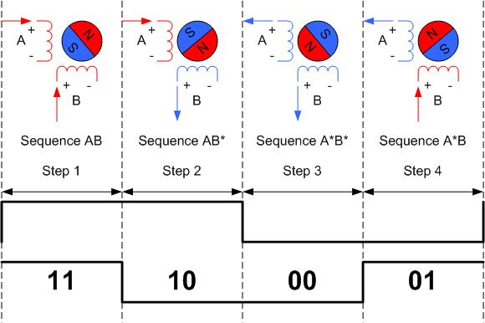
Stepper Motor
Needed when you want to translate rotary motion in to precise linear motion
Various coils inside
Coils around the shaft are alternatively given current or no, creating varying magnetic field that is changing in time and space
Types of stepper motor
Unipolar
Bipolar

Slide 3
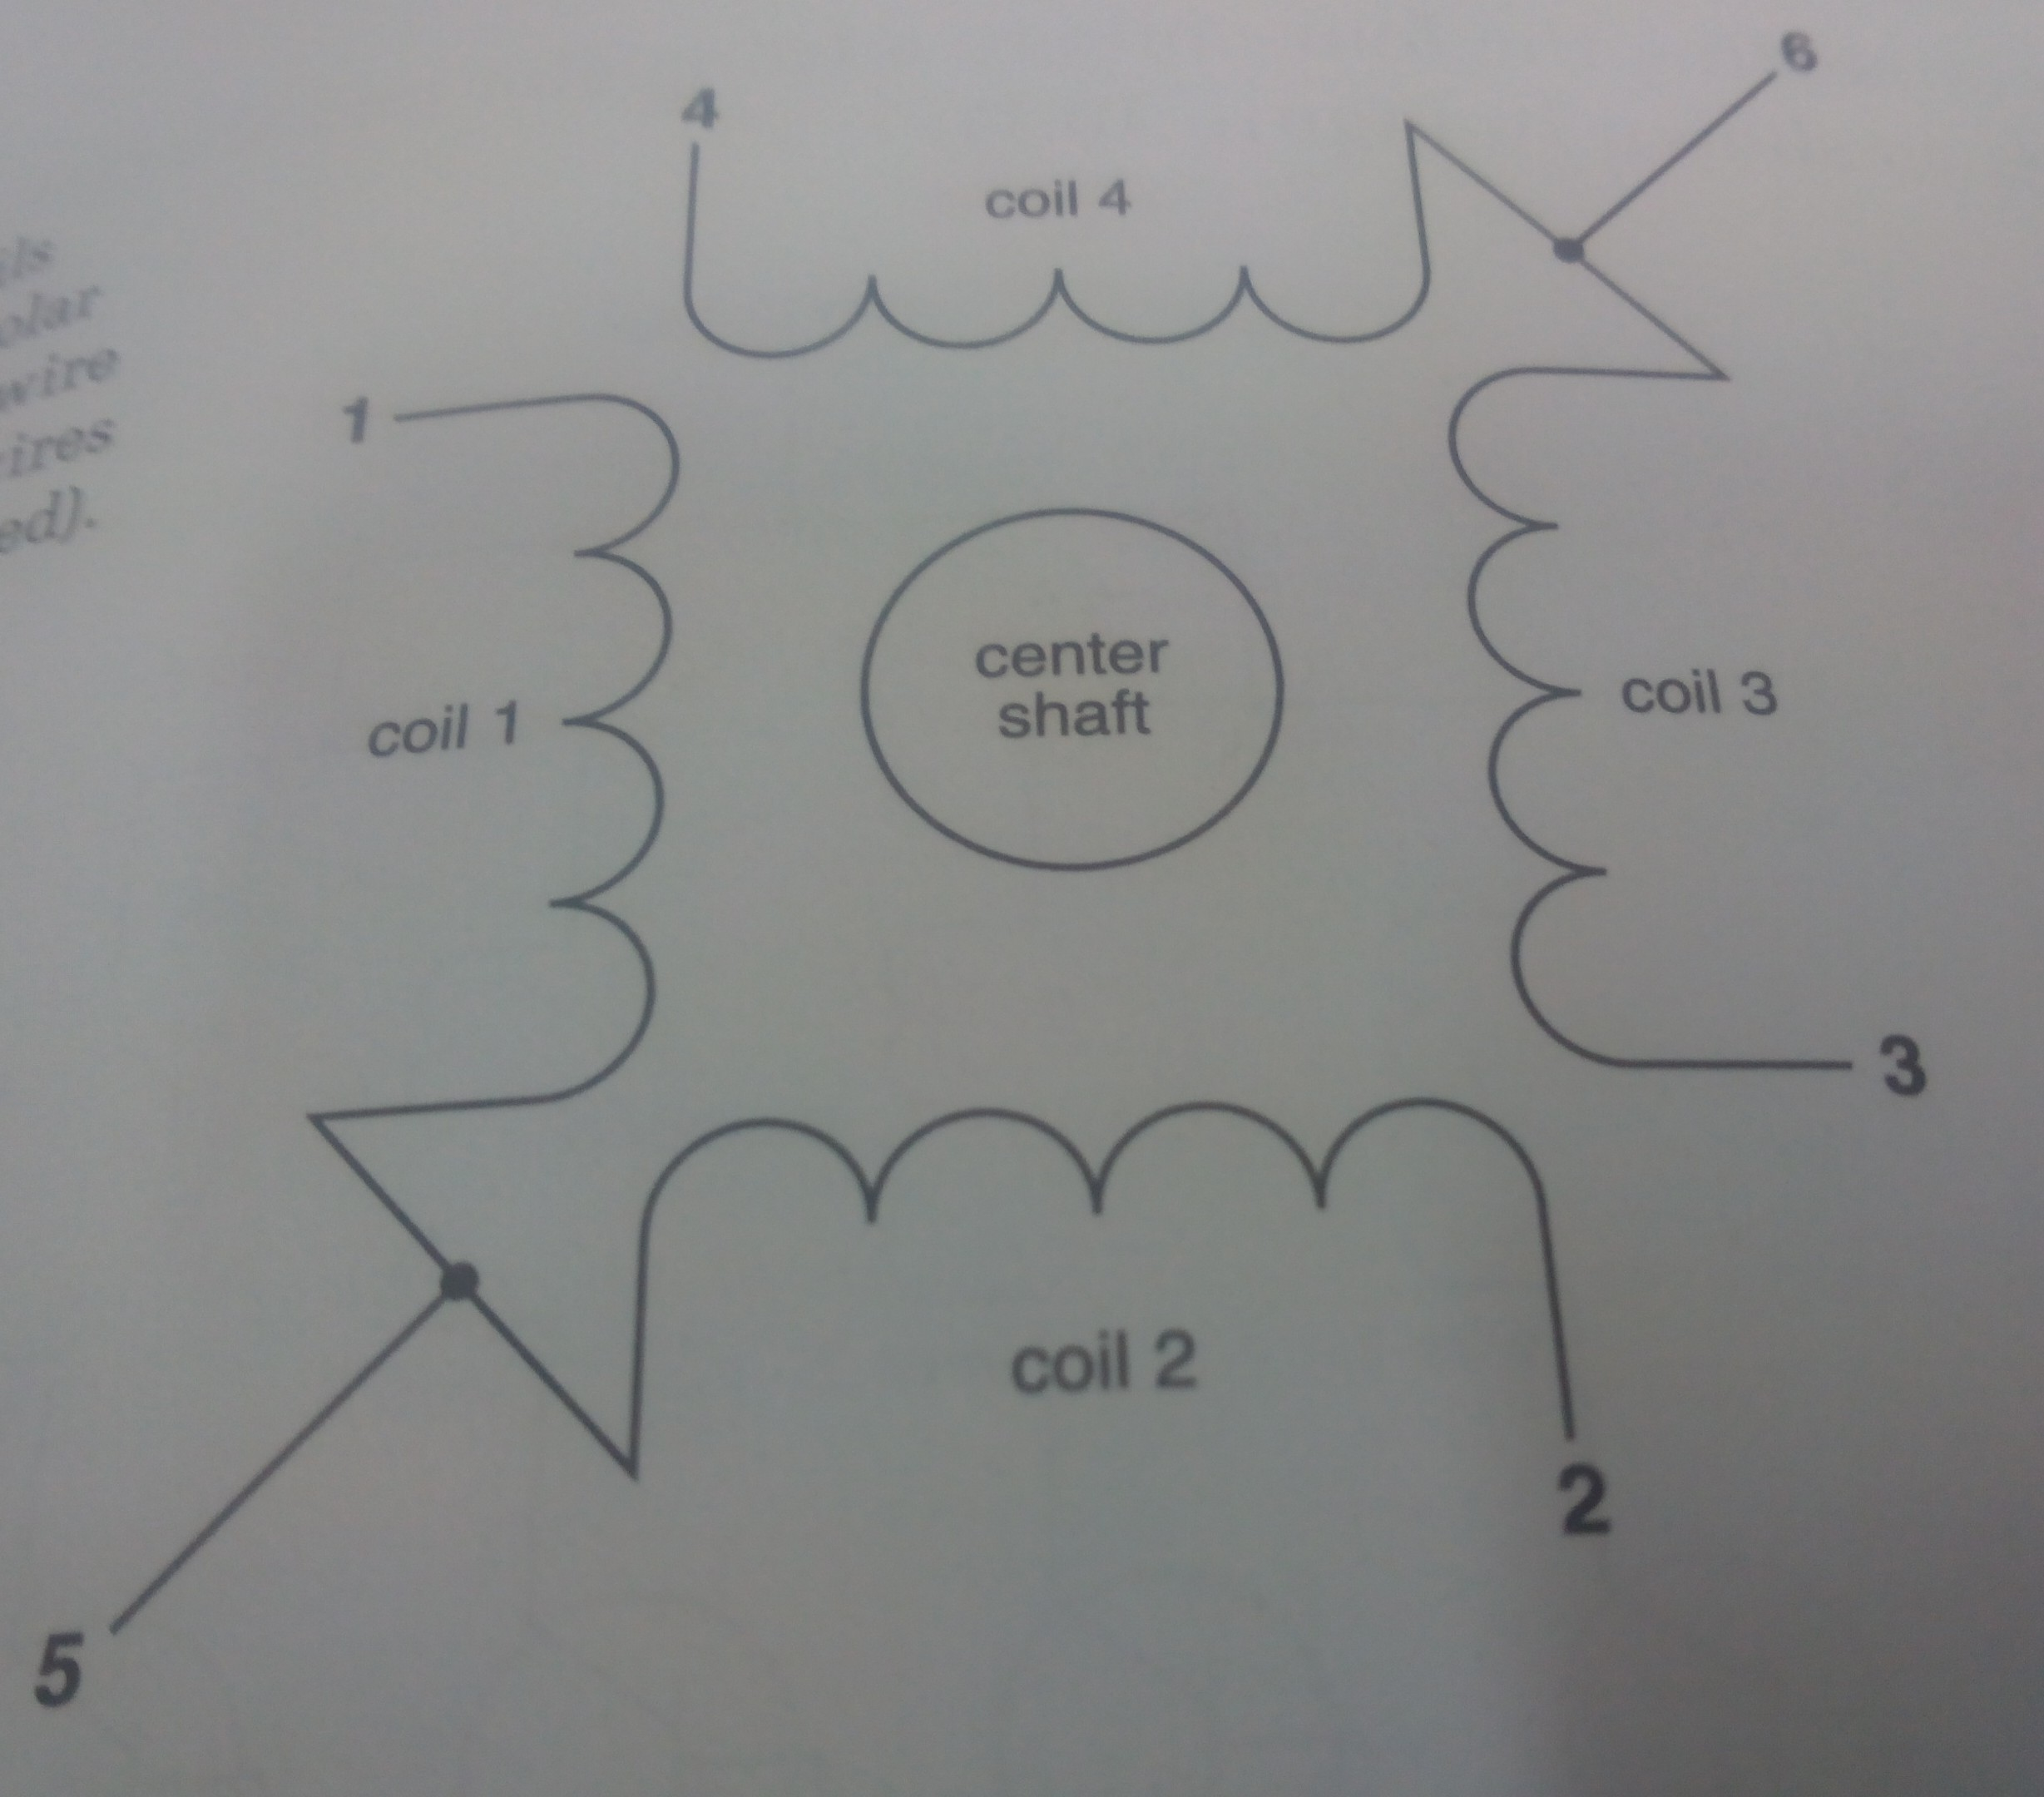
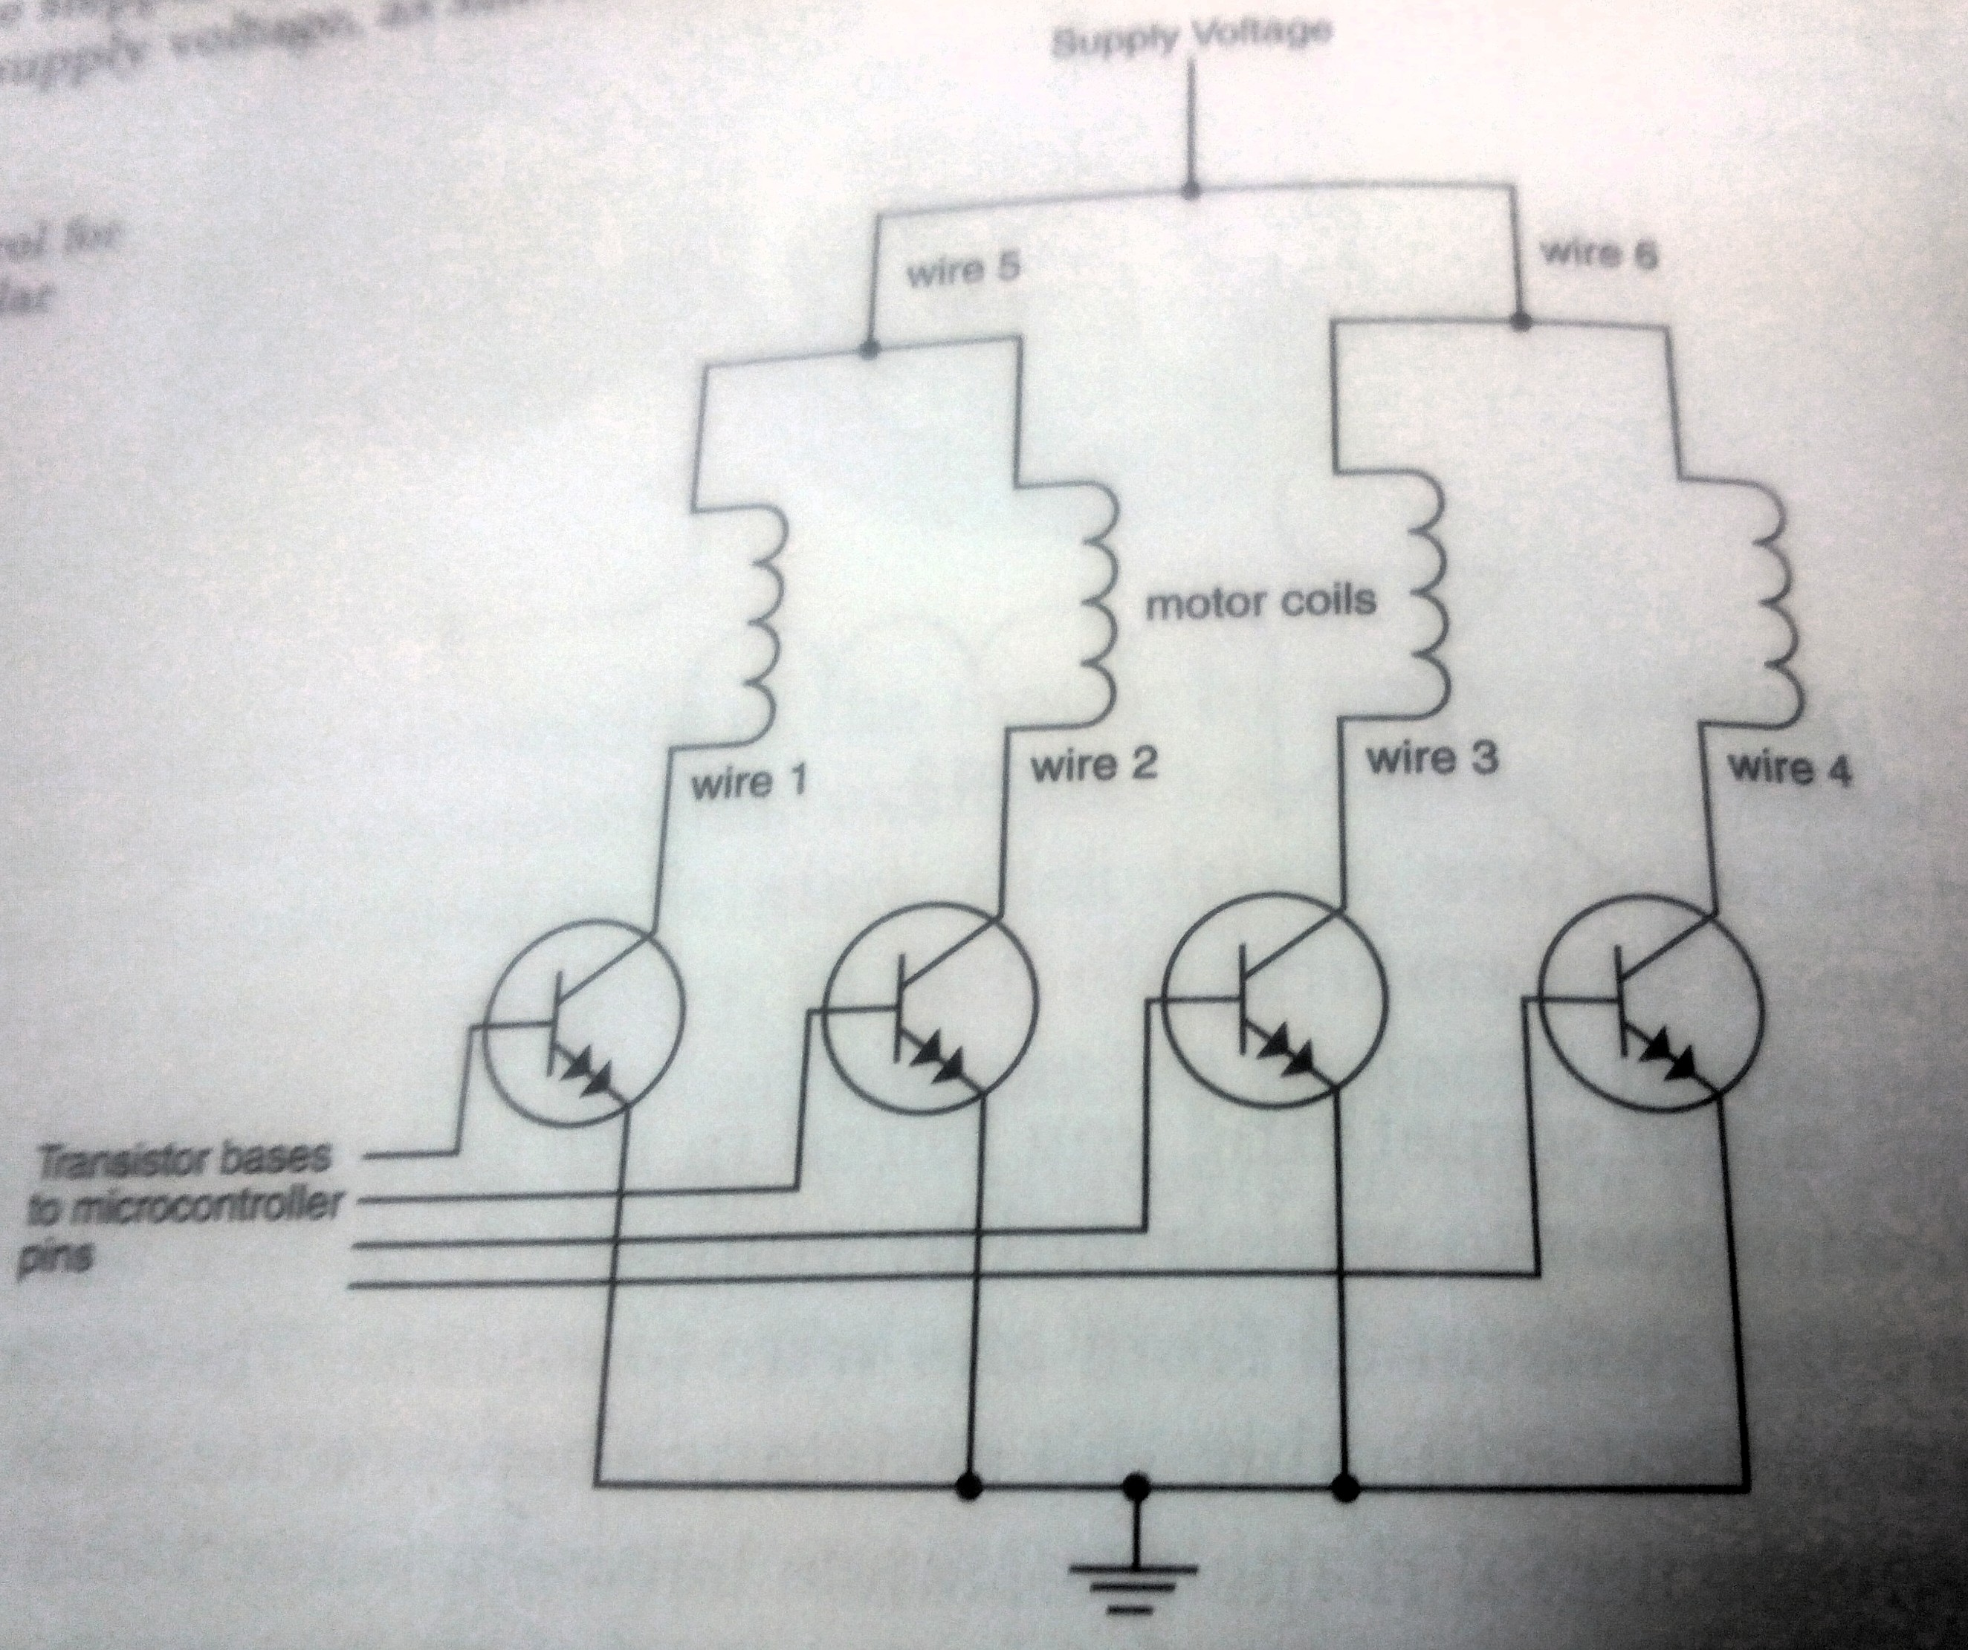
Unipolar connections
Four coils
5/6 wires
Wires 5 and 6 wired to supply
voltage
Alternative stepping sequence
for four coils
Transistor control for four wire
unipolar stepper motor
Require more power than micro-
Controller can give
Control using applied voltage in
specific sequence

Slide 4
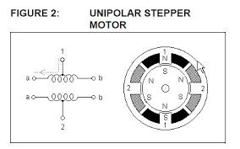
Unipolar Connections
Current flows only in half
of the coil
Less torque

Slide 5
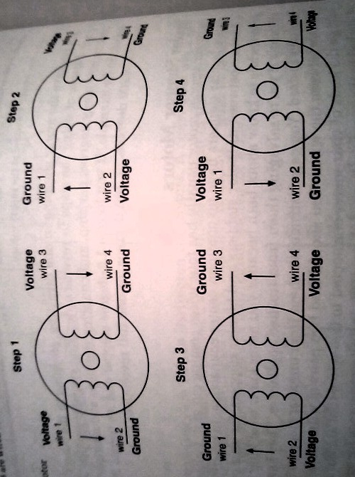
Bipolar stepper motor
No common center connection
Two independent sets of coils
How to find unipolar vs bipolar?
Measure resistance between
wires
Easiest way to reverse polarity
Use two H-bridge

Slide 6
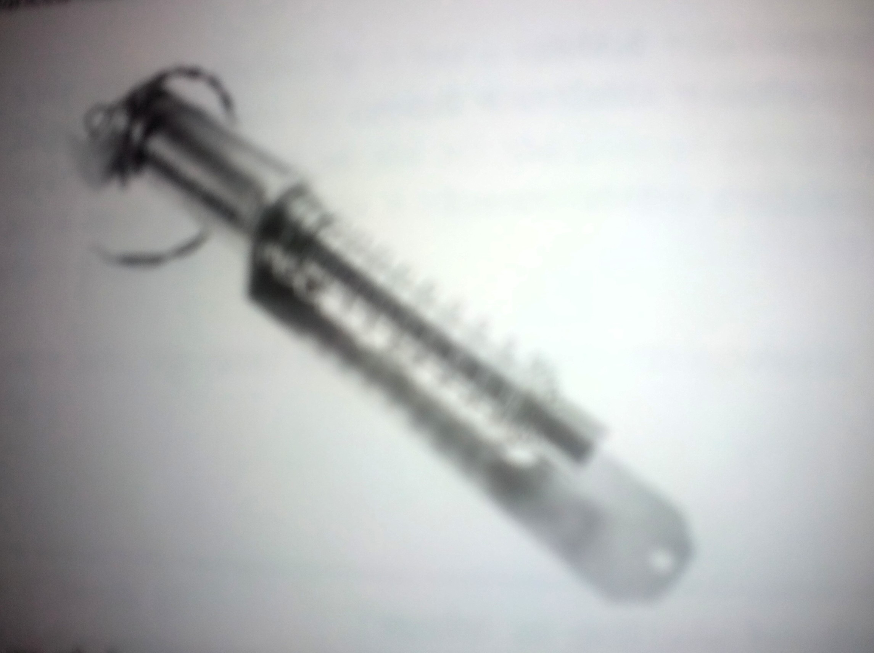
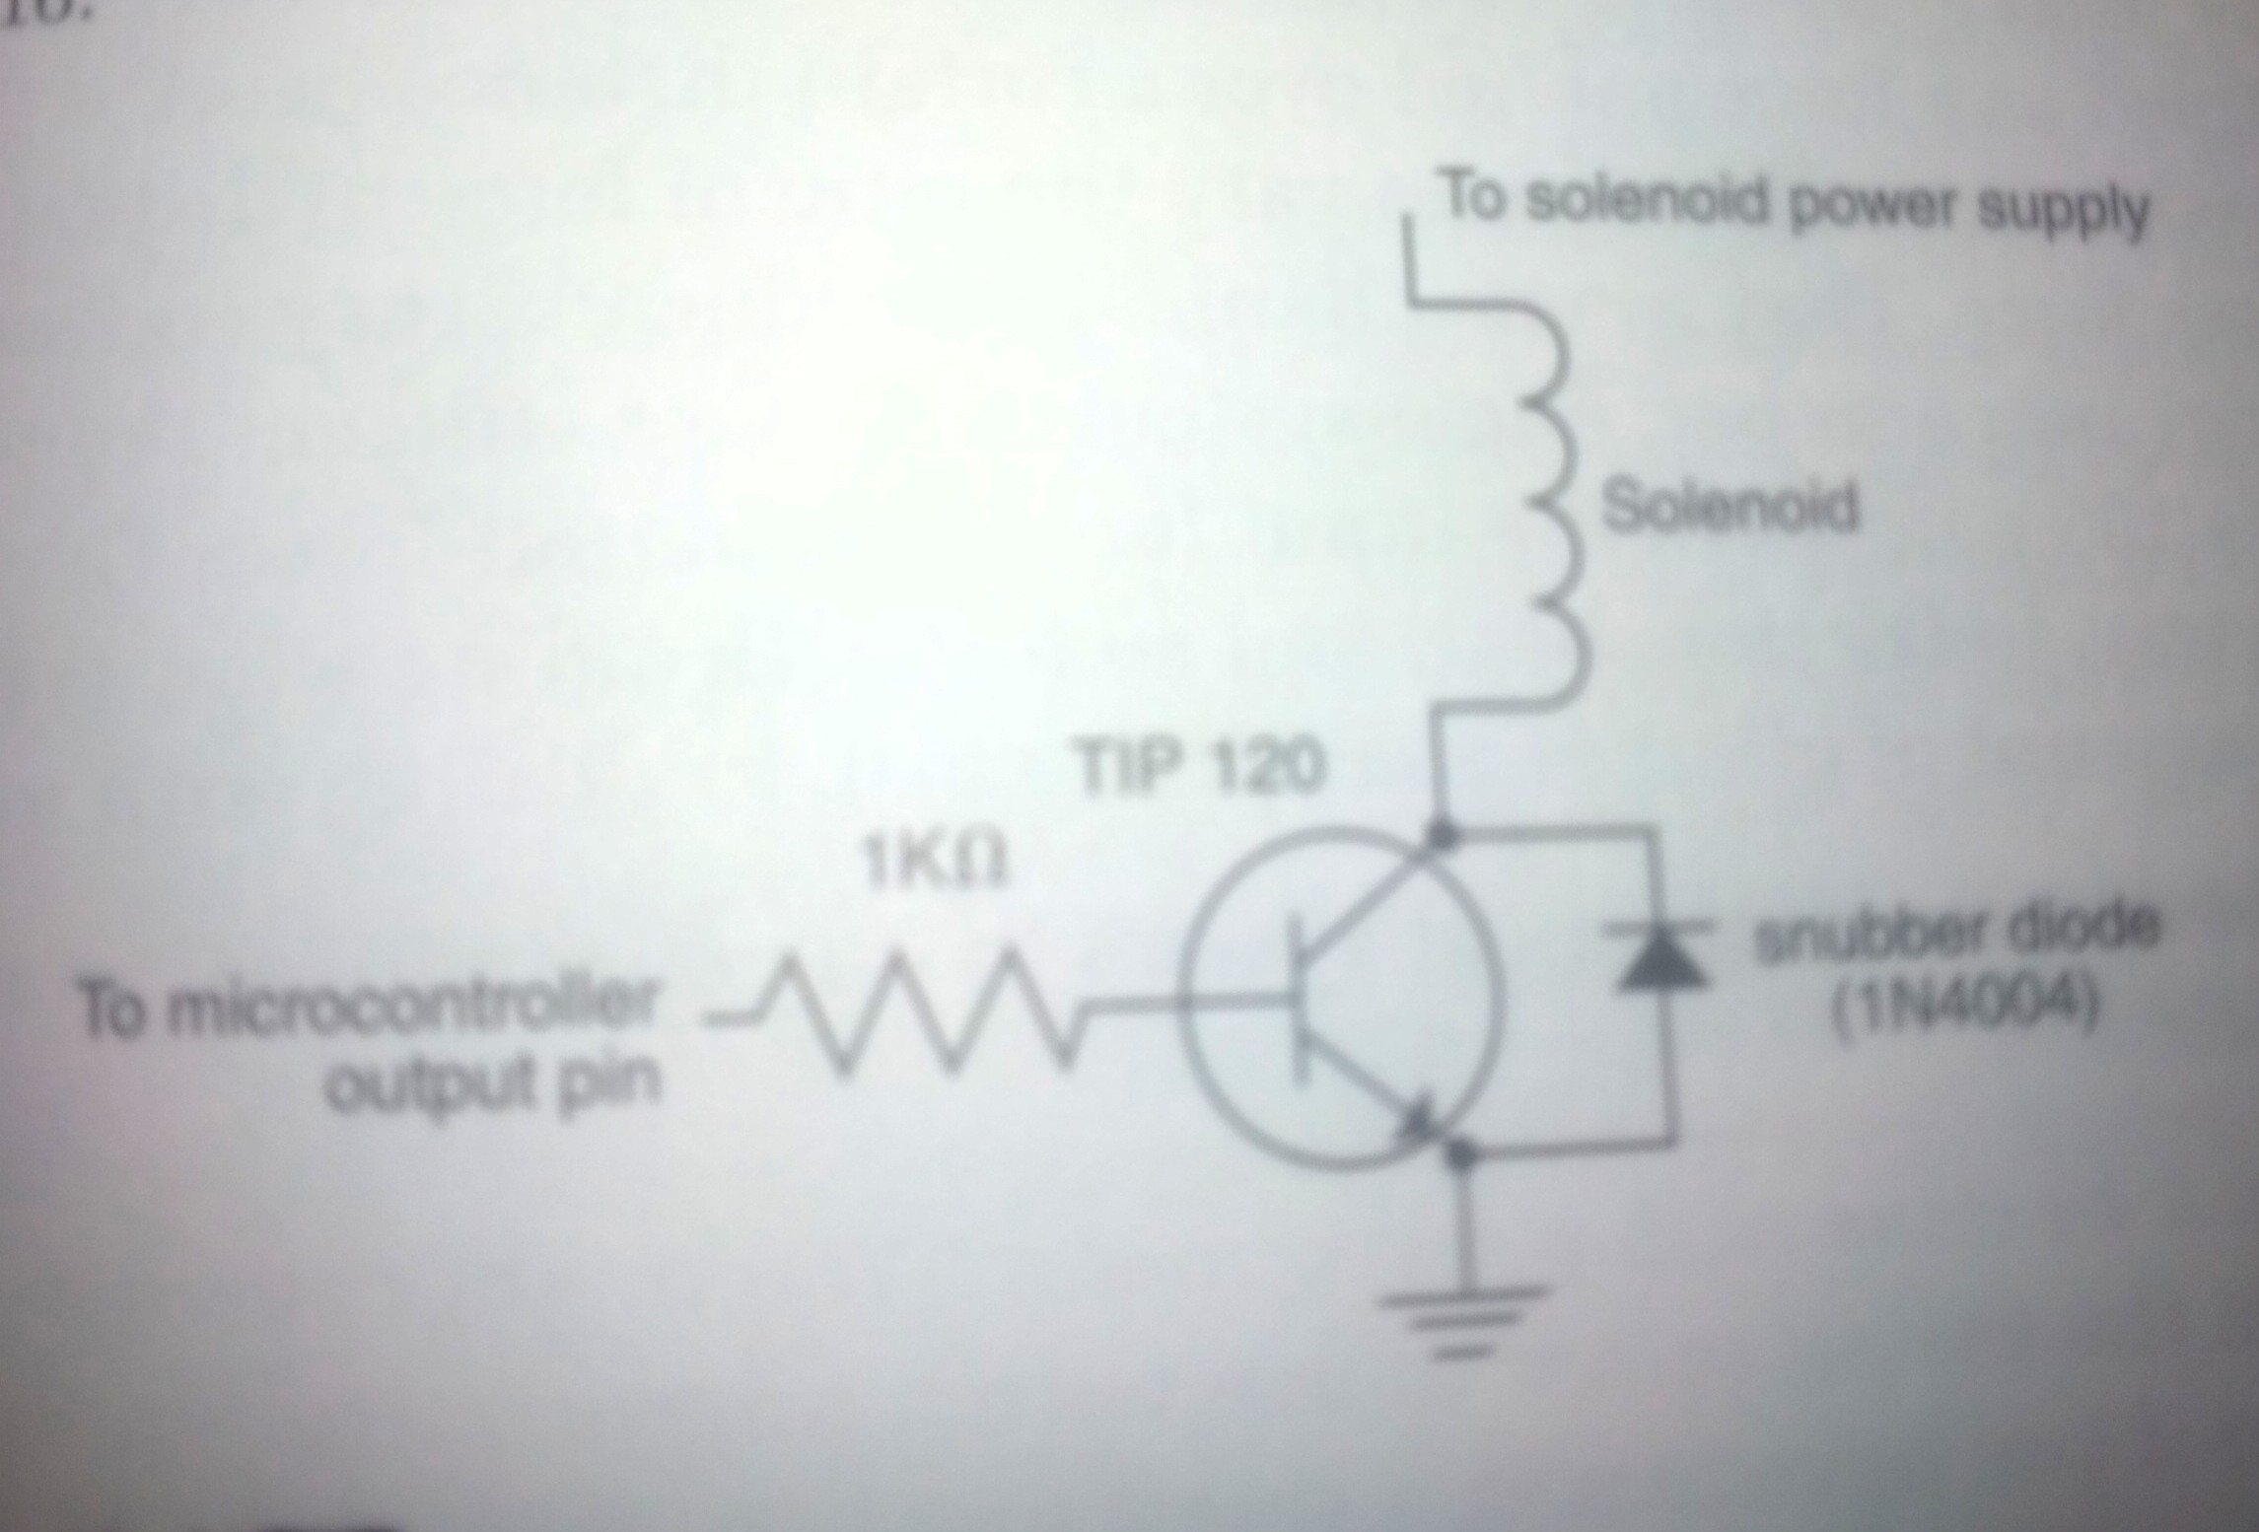
Solenoids
Two types
Push type
Pull type
When small linear movement
is needed
Automatic door lock
Valve closing
Various Duty cycle used to control
amount of motion
Relay or transistor to
Switch voltage
Snubber diode to control
back voltage
Notes:
Read the resistance of the pot and adjust the speed and direction of rotation towards commanded position

Slide 7
How to get useful motion from motors
How to lift more weight using less torque motors?
Lever
Pulleys
How to obtain oscillating or periodic motion action?
Cam
How to move all parts of a sturcture together with just one motor and
one shaft?
Cam shaft
How to restrict in only one direction?
Ratchet
How to get more torque at the cost of less speed?
Gear Train
How to convert rotary motion into linear motion?
Rack and Pinion, Piston( Rod and crank) based system
Joints
Bending joints or Hinges
Rotary Joints
Sliding Joints
Notes:
Current carrying Inductive load in a magnetic field
One side of the motor attracts and one side repels
Back EMF or back voltage
Can damage your electronics
Snubber diode parallel to the electronics you want to protect

Slide 8
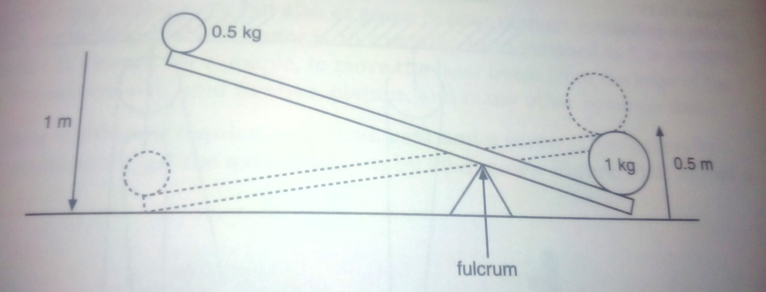
Using simple machines to usable motion from motors - Levers
Lever: Lift heavy weight with a small
force
Mechanical Advantage: ratio of
Long arm to short arm
Used when small motor and lot of
configuration/working space
Notes:
Current carrying Inductive load in a magnetic field
One side of the motor attracts and one side repels
Back EMF or back voltage
Can damage your electronics
Snubber diode parallel to the electronics you want to protect

Slide 9
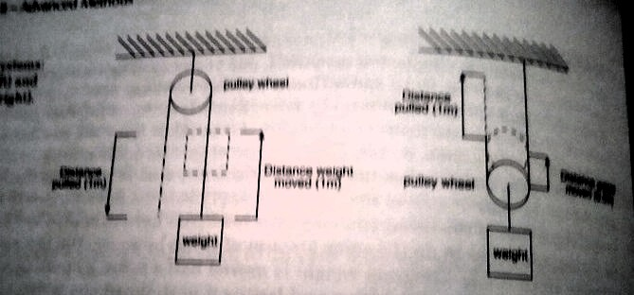
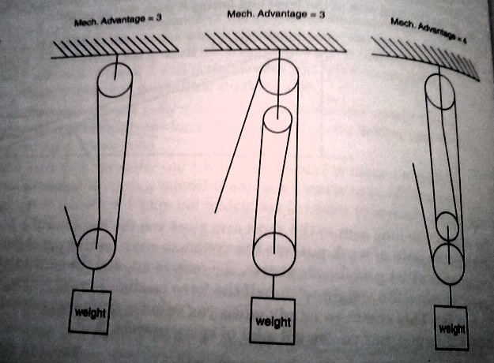
Using simple machines to usable motion from motors - Pulleys
Series of moving wheels,
ropes, chains and wires
Mechanical advantage
Depends upon fixed
vs moving pulleys
One can pull double the weight
because rope is pulled twice the
distance
With fixed pulley, only
direction is changed
More pulleys, more mech
advantage but more complexity
Notes:
Current carrying Inductive load in a magnetic field
One side of the motor attracts and one side repels
Back EMF or back voltage
Can damage your electronics
Snubber diode parallel to the electronics you want to protect

Slide 10
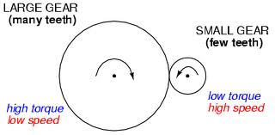
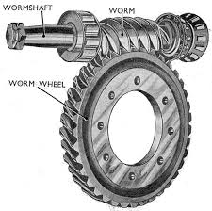
Using simple machines to usable motion from motors - Gears
Change direction
Trade speed for torque
Mechanical advantage
in this case is gear ratio
Worm gears combine
Regular gears with screw
Shift axis of motion
by 90 degrees
Rack and Pionion
Converts rotary to linear
mechanism
Rack-linear track
Pionion- normal gear
Car steering mechanism
Notes:
Current carrying Inductive load in a magnetic field
One side of the motor attracts and one side repels
Back EMF or back voltage
Can damage your electronics
Snubber diode parallel to the electronics you want to protect

Slide 11
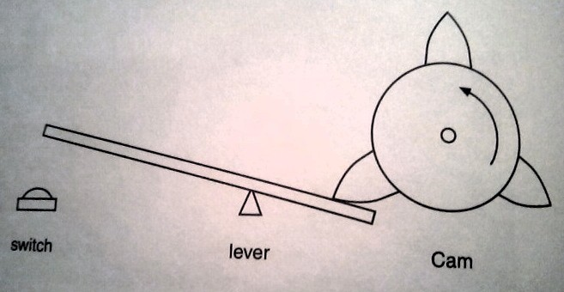
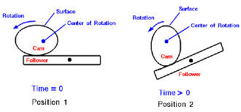
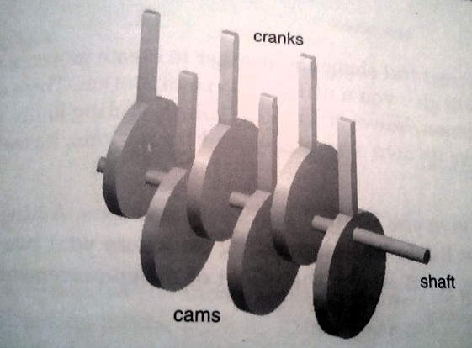
Using simple machines to usable motion from motors – The Cam
Wheel mounted off center
on a shaft
While spinning the weight of
of the motor causes motor's
axis to shift
Can produce vibratory or periodic
motion
Cell phone vibrators
pagers
Camshaft: moving several objects
from one motor
Notes:
Current carrying Inductive load in a magnetic field
One side of the motor attracts and one side repels
Back EMF or back voltage
Can damage your electronics
Snubber diode parallel to the electronics you want to protect

Slide 12
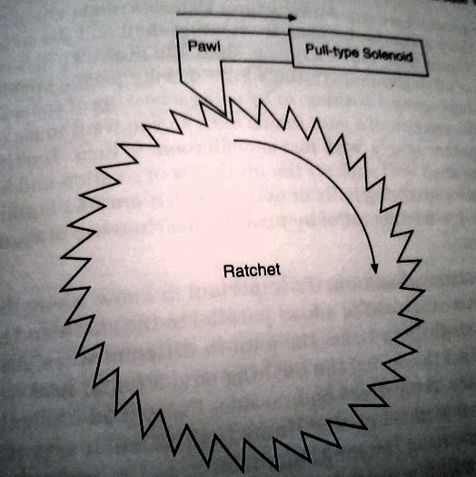
Using simple machines to usable motion from motors – The Ratchet
Wheel with a teeth
Allows wheel to move in one
direction and not the other
Teeth: One vertical edge, one
diagonal edge
External lever pawl can slide on the
diagonal side and catch against the
vertical side
Pawl movement can be controlled using
a solenoid

Slide 13
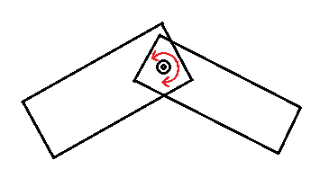
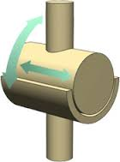
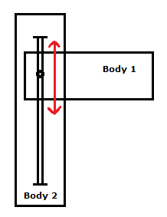
Ways to join structural elements together-
Types of Joints
Hinges
Rotating Joints
Sliding Joints

Slide 14
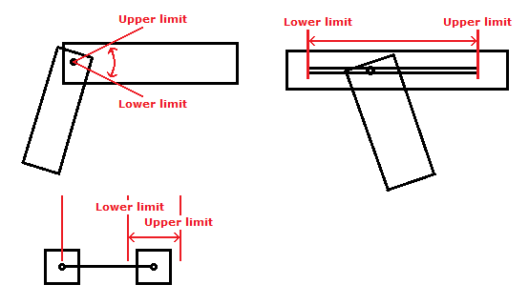
Limits in Joints

Slide 15
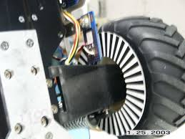
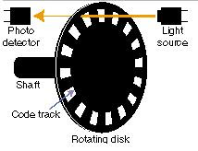
Wheel Encoders - (1)
Gives feedback about the position
of the wheel
Notes:
Current carrying Inductive load in a magnetic field
One side of the motor attracts and one side repels
Back EMF or back voltage
Can damage your electronics
Snubber diode parallel to the electronics you want to protect

Slide 16
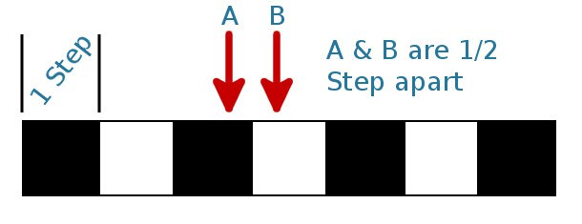
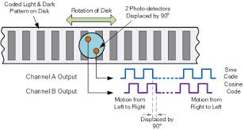
Wheel Encoders - (2)
How to detect direction of
movement
Use two light source
seperate by fixed
distance
Notes:
Current carrying Inductive load in a magnetic field
One side of the motor attracts and one side repels
Back EMF or back voltage
Can damage your electronics
Snubber diode parallel to the electronics you want to protect

