Slide 1
The processor:
The Main Controller and ALU Controller
Computer Architecture
By
Dr.Hadi Hassan

Slide 2
Main Control and ALU Control
Instruction
Memory
Datapath
32
A
L
U
Instruction
Address
MemRead
MemtoReg
RegDst
MemWrite
RegWrite
ExtOp
ALUSrc
Beq
Bne
J
Op⁶
ALUCtrl
Main
Control
funct⁶
ALU
Control
Op⁶
Main Control Input:
6-bit opcode field from instruction
Main Control Output:
10 control signals for the Datapath
ALU Control Input:
6-bit opcode field from instruction
6-bit function field from instruction
ALU Control Output:
ALUCtrl signal for ALU

Slide 3
Single-Cycle Datapath + Control
30
Jump or Branch Target Address
30
30
Next
PC
J, Beq, Bne
Imm26
PCSrc
+1
ALU result
Instruction
Memory
Registers
Imm16
zero
Rs
5
RA
BusA
Data
Memory
A
L
U
m
u
x
00
30
Instruction
32
E
0
32
m
u
x
Rt
5
Address
0
RB
BusB
m
u
x
32
Address
m
u
x
0
Data_out
1
PC
0
Data_in
1
RW
BusW
1
Rd
1
5
clk
func
ALUop
RegDst
RegWrite
ExtOp
ALU
Ctrl
Op
MemRead
ALUSrc
MemWrite
MemtoReg
Main
Control

Slide 4
Identified Control Signals
Control Signal | Execution Stage | Purpose
RegDst | Decode / Operand Fetch | Select the destination register number
RegWrite | Decode/Operand Fetch Result Write | Enable writing of register
ALUSrc | ALU | Select the 2nd operand for ALU
ALUControl | ALU | Select the operation to be performed
MemRead / MemWrite | Memory | Enable reading/writing of data memory
MemToReg | Result Write | Select the result to be written back to register file
PCSrc | Memory / Result Write | Select the next PC value

Slide 5
Main Control Signals
Signal | Effect when ‘0’ | Effect when ‘1’
RegDst | Destination register = Rt | Destination register = Rd
RegWrite | None | Destination register is written with the data value on BusW
ExtOp | 16-bit immediate is zero-extended | 16-bit immediate is sign-extended
ALUSrc | Second ALU operand comes from the second register file output (BusB) | Second ALU operand comes from the extended 16-bit immediate
MemRead | None | Data memory is read Data_out ← Memory[address]
MemWrite | None | Data memory is written Memory[address] ← Data_in
MemtoReg | BusW = ALU result | BusW = Data_out from Memory
Beq, Bne | PC ← PC + 4 | PC ← Branch target address If branch is taken
J | PC ← PC + 4 | PC ← Jump target address

Slide 6
Main Control Signal Values
Op | Reg Dst | Reg Write | Ext Op | ALU Src | Beq | Bne | J | Mem Read | Mem Write | Mem toReg
R-type | 1 = Rd | 1 | x | 0=BusB | 0 | 0 | 0 | 0 | 0 | 0
addi | 0 = Rt | 1 | 1=sign | 1=Imm | 0 | 0 | 0 | 0 | 0 | 0
slti | 0 = Rt | 1 | 1=sign | 1=Imm | 0 | 0 | 0 | 0 | 0 | 0
andi | 0 = Rt | 1 | 0=zero | 1=Imm | 0 | 0 | 0 | 0 | 0 | 0
ori | 0 = Rt | 1 | 0=zero | 1=Imm | 0 | 0 | 0 | 0 | 0 | 0
xori | 0 = Rt | 1 | 0=zero | 1=Imm | 0 | 0 | 0 | 0 | 0 | 0
lw | 0 = Rt | 1 | 1=sign | 1=Imm | 0 | 0 | 0 | 1 | 0 | 1
sw | x | 0 | 1=sign | 1=Imm | 0 | 0 | 0 | 0 | 1 | x
beq | x | 0 | x | 0=BusB | 1 | 0 | 0 | 0 | 0 | x
bne | x | 0 | x | 0=BusB | 0 | 1 | 0 | 0 | 0 | x
j | x | 0 | x | x | 0 | 0 | 1 | 0 | 0 | x

Slide 7
Logic Equations for Control Signals
RegDst = R-type
RegWrite = (sw + beq + bne + j)
ExtOp = (andi + ori + xori)
ALUSrc = (R-type + beq + bne)
MemRead = lw
MemtoReg = lw
MemWrite = sw
Op⁶
Decoder
R-type
slti
addi
andi
ori
xori
lw
sw
Logic Equations
RegDst
RegWrite
ExtOp
ALUSrc
MemRead
MemtoReg
MemWrite
Bne
Beq
J

Slide 8
ALU Control Truth Table
Input |  | Output | 4-bit Encoding
Op⁶ | funct⁶ | ALUCtrl
R-type | add | ADD | 0000
R-type | sub | SUB | 0010
R-type | and | AND | 0100
R-type | or | OR | 0101
R-type | xor | XOR | 0110
R-type | slt | SLT | 1010
addi | x | ADD | 0000
slti | x | SLT | 1010
andi | x | AND | 0100
ori | x | OR | 0101
xori | x | XOR | 0110
lw | x | ADD | 0000
sw | x | ADD | 0000
beq | x | SUB | 0010
bne | x | SUB | 0010
j | x | x | x
The 4-bit ALUCtrl is encoded according to the ALU implementation
Other ALU control encodings are also possible. The idea is to choose a binary encoding that will simplify the logic

Slide 9
Generating Control Signals: Idea
The control signals are generated based on the instruction to be executed:
Opcode ➔ Instruction Format
Example:
R-Format instruction ➔ RegDst = 1 (use Inst[15:11]) )
R-Type instruction has additional information:
The 6-bit "funct" (function code, Inst[5:0]) field
Idea:
Design a combinatorial circuit to generate these signals based on Opcode and possibly Function code
A control unit is needed (a draft design is shown next)
[15:11]
[5:0]
opcode
rs
rt
rd
shamt
funct

Slide 10
The Control Unit (draft)
Instruction
Memory
PC
Add
MUX
Instruction
4
Left Shift 2-bit
Add
Address
Control
PCSrc
ALUcontrol
Inst [25:21]
5
4
RR1
RD1
Inst [20:16]
5
RR2
is0?
MemWrite
Registers
ALUSrc
ALU
opcode
31:26
rs
25:21
rt
20:16
rd
15:11
shamt
10:6
5
funct
5:0
WR
ALU
result
MUX
Address
RD2
MUX
WD
Data
Memory
MemToReg
Inst [15:11]
RegWrite
Read
Data
MUX
RegDst
Write
Data
Inst [15:0]
Sign Extend
MemRead

Slide 11
Review: MIPS Instruction Subset
opcode
shamt
funct
31
25
20
15
10
5
add
0₁₆
rs
rt
rd
0
20₁₆
sub
0₁₆
rs
rt
rd
0
22₁₆
and
0₁₆
rs
rt
rd
0
24₁₆
R-type
or
0₁₆
rs
rt
rd
0
25₁₆
slt
0₁₆
rs
rt
rd
0
2A₁₆
31
25
20
15
lw
23₁₆
rs
rd
offset
sw
2B₁₆
rs
rd
offset
I-type
beq
4₁₆
rs
rd
offset

Slide 12
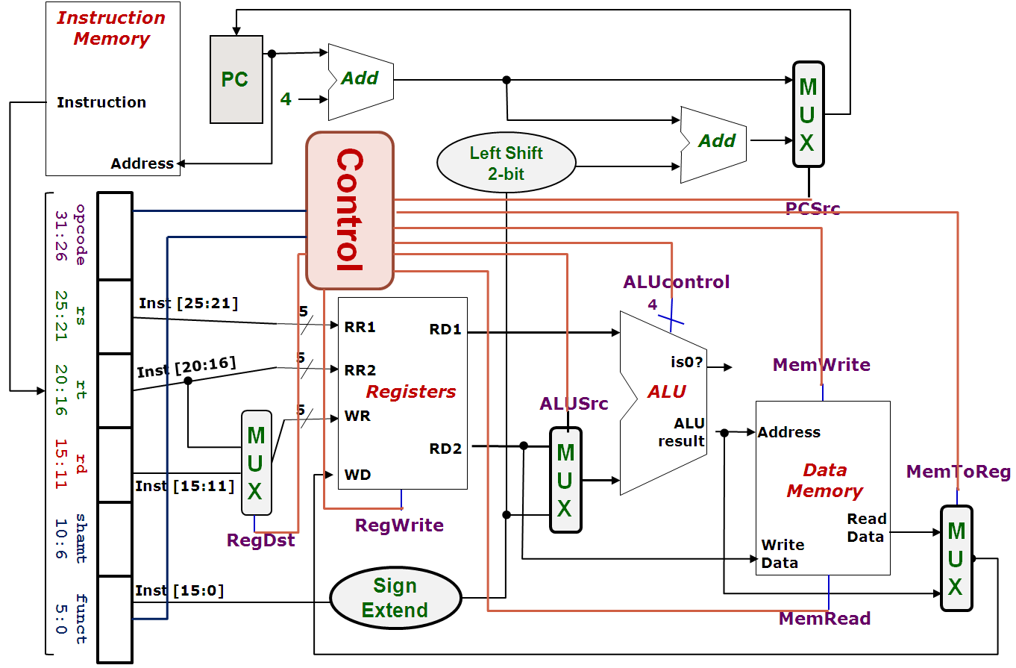
Control Signal: RegDst
False (0): Write register = Inst[20:16]
True (1): Write register = Inst[15:11]
0
MUX
1
Signal

Slide 13
Control Signal: RegWrite
False (0): No register write
True (1): New value will be written

Slide 14
Control Signal: ALUSrc
False (0): Operand2 = Register Read Data 2
True (1): Operand2 = SignExt(Inst[15:0])
0
MUX
1
Signal

Slide 15
Control Signal: MemRead
False (0): Not performing memory read access
True (1): Read memory using Address

Slide 16
Control Signal: MemWrite
False (0): Not performing memory write operation
True (1): memory[Address] ⬅ Register Read Data 2

Slide 17
Control Signal: MemToReg
True (1): Register write data = Memory read data
False (0): Register write data = ALU Result
1
MUX
0
Signal
IMPORTANT:
The input of MUX is swapped in this case

Slide 18
Control Signal: PCSrc
The "isZero?" signal from the ALU gives us the actual branch outcome (taken / not taken)
Idea: "If instruction is a branch AND taken, then…"
0
MUX
1
Signal

Slide 19
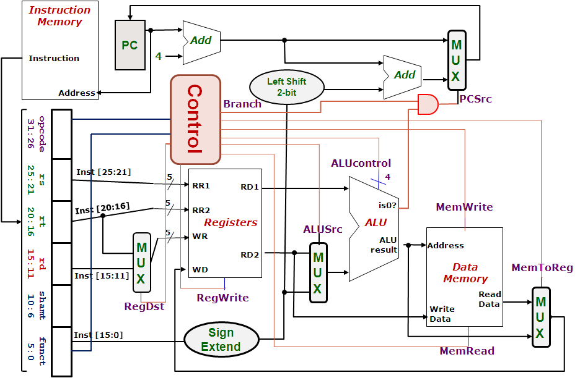
Control Signal: PCSrc
False (0): Next PC = PC + 4
True (1): Next PC = SignExt(Inst[15:0]) << 2 + (PC + 4)
PCSrc =
( Branch AND isZero)

Slide 20
Midpoint Check
We have gone through almost all of the signals:
Left with the more challenging ALUControl signal
Observation so far:
The signals discussed so far can be generated by opcode directly
Function code is not needed up to this point
A major part of the controller can be built based on opcode alone

Slide 21
The Control Unit v0.5
Instruction
Memory
PC
Add
MUX
Instruction
4
Left Shift 2-bit
Add
Address
PCSrc
Control
Branch
Inst [31:26]
Inst [25:21]
5
RR1
RD1
Inst [20:16]
5
RR2
is0?
MemWrite
Registers
ALUSrc
ALU
opcode
31:26
rs
25:21
rt
20:16
rd
15:11
shamt
10:6
5
funct
5:0
WR
ALU
result
MUX
Address
RD2
MUX
WD
Data
Memory
MemToReg
Inst [15:11]
4
RegWrite
ALUcontrol
Read
Data
MUX
RegDst
Write
Data
Inst [15:0]
Sign Extend
MemRead

Slide 22
Closer Look at ALU Unit
The ALU Unit is a combinatorial circuit:
Capable of performing several arithmetic operations
Question:
How is the ALUcontrol signal designed?
ALUcontrol | Function
0000 | AND
0001 | OR
0010 | add
0110 | subtract
0111 | slt
1100 | NOR

Slide 23
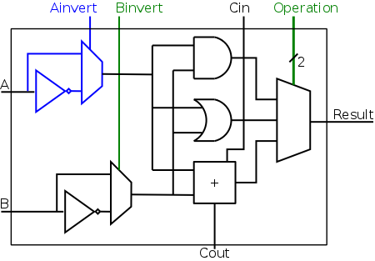
One Bit At A Time
A simplified 1-bit MIPS ALU can be implemented as follows:
4 control bits are needed:
Ainvert:
1 to invert input A
Binvert:
1 to invert input B
Operation (2-bit)
To select one of the 3 results

Slide 24
One Bit At A Time
Can you see how the ALUcontrol (4-bits) signal controls the ALU?
Note: implementation for slt not shown
ALUcontrol |  |  | Function
Ainvert | Binvert | Operation
0 | 0 | 00 | AND
0 | 0 | 01 | OR
0 | 0 | 10 | add
0 | 1 | 10 | subtract
0 | 1 | 11 | slt
1 | 1 | 00 | NOR

Slide 25
Intermediate Signal: ALUop
Basic Idea:
Use Opcode to generate a 2-bit ALUop signal
Represents classification of the instructions:
Use ALUop signal and Function Code field (for R-type instructions) to generate the 4-bit ALUcontrol signal
Instruction Type | ALUop
lw / sw | 00
beq | 01
R-type | 10

Slide 26
2-Level Implementation
Step 1.
Generate 2-bit ALUop signal from 6-bit Opcode field.
6
Control
Step 2.
Generate 4-bit ALUctrl signal from 2-bit ALUop and optionally 6-bit Funct field.
ALUop
2
00: lw, sw
01: beq
10: add, sub, and, or, slt
opcode
31:26
rs
25:21
rt
20:16
rd
15:11
shamt
10:6
funct
5:0
ALU
4
ALUcontrol
0000: and
0001: or
0010: add
0110: sub
0111: set on less than
ALU Control
6

Slide 27
Generating ALUControl Signal
Opcode | ALUop | Instruction Operation | Funct field | ALU action | ALU control
lw | 00 | load word | XXX XXX | add | 0010
sw | 00 | store word | XXX XXX | add | 0010
beq | 01 | branch equal | XXX XXX | subtract | 0110
R-type | 10 | add | 100 000 | add | 0010
R-type | 10 | subtract | 100 010 | subtract | 0110
R-type | 10 | AND | 100 100 | AND | 0000
R-type | 10 | OR | 100 101 | OR | 0001
R-type | 10 | set on less than | 101 010 | set on less than | 0111
J-type | xx
Instruction Type | ALUop
lw / sw | 00
beq | 01
R-type | 10
ALUcontrol | Function
0000 | AND
0001 | OR
0010 | add
0110 | subtract
0111 | slt
1100 | NOR
Generation of 2-bit ALUop signal will be discussed later

Slide 28
Design of ALU Control Unit
Input: 6-bit Funct field and 2-bit ALUop
Output: 4-bit ALUcontrol
Find the simplified expressions
 | ALUop |  | Funct Field ( F[5:0] == Inst[5:0] ) |  |  |  |  |  | ALU control
 | MSB | LSB | F5 | F4 | F3 | F2 | F1 | F0
lw
sw
beq
add
sub
and
or
slt

Slide 29
Finale: Control Design
We have now considered all individual signals and their expected values
Ready to design the controller itself
Typical digital design steps:
Fill in truth table
Input: Opcode
Output: Various control signals as discussed
Derive simplified expression for each signal

Slide 30
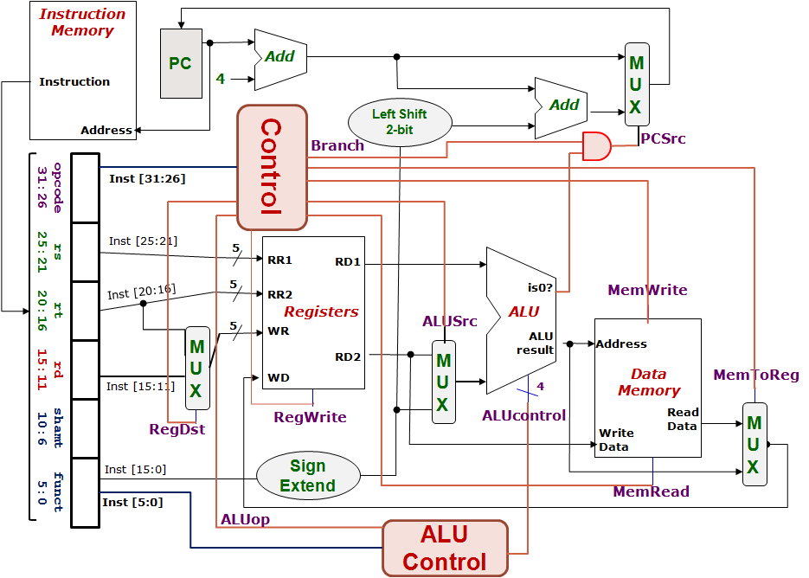
Control Design: Outputs
 | RegDst | ALUSrc | MemToReg | Reg Write | Mem Read | Mem Write | Branch | ALUop
 |  |  |  |  |  |  |  | op1 | op0
R-type
lw
sw
beq

Slide 31
Control Design: Inputs
 | Opcode ( Op[5:0] == Inst[31:26] )
 | Op5 | Op4 | Op3 | Op2 | Op1 | Op0 | Value in Hexadecimal
R-type
lw
sw
beq
0
0
0
0
0
0
0
1
0
0
0
1
1
23
1
0
1
0
1
1
2B
0
0
0
1
0
0
4
With the input (opcode) and output (control signals), let’s design the circuit

Slide 32
Combinational Circuit Implementation
Opcode
Control Signals
Control Logic

Slide 33
Big Picture: Instruction Execution
Instruction Execution =
Read contents of one or more storage elements (register/memory)
Perform computation through some combinational logic
Write results to one or more storage elements (register/memory)
All these performed within a clock period
Clock Period
Clock
Read
Compute
Write
Don’t want to read a storage element when it is being written.

Slide 34
Single Cycle Implementation: Shortcoming
Calculate cycle time assuming negligible delays: memory (2ns), ALU/adders (2ns), register file access (1ns)
Instruction | Inst Mem | Reg read | ALU | Data Mem | Reg write | Total
ALU | 2 | 1 | 2 |  | 1 | 6
lw | 2 | 1 | 2 | 2 | 1 | 8
sw | 2 | 1 | 2 | 2 |  | 7
beq | 2 | 1 | 2 |  |  | 5
All instructions take as much time as the slowest one (i.e., load)
➔ Long cycle time for each instruction

Slide 35
Solution 1: Multicycle Implementation
Break up the instructions into execution steps:
Instruction fetch
Instruction decode and register read
ALU operation
Memory read/write
Register write
Each execution step takes one clock cycle
➔ Cycle time is much shorter, i.e., clock frequency is much higher
Instructions take variable number of clock cycles to complete execution
Not covered in class

Slide 36
Solution 2: Pipelining
Break up the instructions into execution steps one per clock cycle
Allow different instructions to be in different execution steps simultaneously
It will be covered if we will have a time.

Slide 37
Performance Example
Assume the following operation times for components:
Instruction and data memories: 200 ps
ALU and adders: 180 ps
Decode and Register file access (read or write): 150 ps
Ignore the delays in PC, mux, extender, and wires
Which of the following would be faster and by how much?
Single-cycle implementation for all instructions
Multicycle implementation optimized for every class of instructions
Assume the following instruction mix:
40% ALU, 20% Loads, 10% stores, 20% branches, & 10% jumps

Slide 38
Alternative: Multicycle Implementation
Break instruction execution into five steps
Instruction fetch
Instruction decode, register read, target address for jump/branch
Execution, memory address calculation, or branch outcome
Memory access or ALU instruction completion
Load instruction completion
One clock cycle per step (clock cycle is reduced)
First 2 steps are the same for all instructions
Instruction | # cycles | Instruction | # cycles
ALU & Store | 4 | Branch | 3
Load | 5 | Jump | 2

Slide 39
Solution
Instruction Class | Instruction Memory | Register Read | ALU Operation | Data Memory | Register Write | Total
ALU | 200 | 150 | 180 |  | 150 | 680 ps
Load | 200 | 150 | 180 | 200 | 150 | 880 ps
Store | 200 | 150 | 180 | 200 |  | 730 ps
Branch | 200 | 150 | 180 |  |  | 530 ps
Jump | 200 | 150 |  |  |  | 350 ps
Compare and write PC
Decode and write PC
For fixed single-cycle implementation:
Clock cycle =
For multi-cycle implementation:
Clock cycle =
Average CPI =
Speedup =
880 ps determined by longest delay (load instruction)
max (200, 150, 180) = 200 ps (maximum delay at any step)
0.4×4 + 0.2×5 + 0.1×4+ 0.2×3 + 0.1×2 = 3.8
880 ps / (3.8 × 200 ps) = 880 / 760 = 1.16

