Slide 1
Integer Multiplication and Division
Computer Architecture
By
Dr.Hadi Hassan

Slide 2
Unsigned Multiplication
Paper and Pencil Example:
Multiplicand 1100₂ = 12
Multiplier × 1101₂ = 13
1100
0000
1100
1100
Product 10011100₂ = 156
m-bit multiplicand × n-bit multiplier = (m+n)-bit product
Accomplished via shifting and addition
Consumes more time and more chip area than addition
Binary multiplication is easy
0 × multiplicand = 0
1 × multiplicand = multiplicand

Slide 3
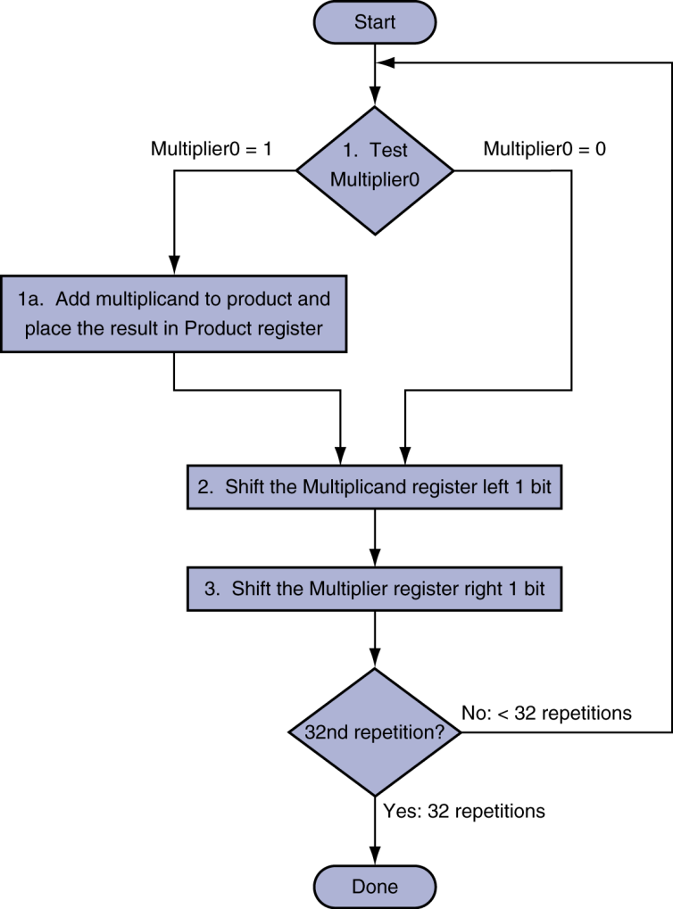
Evolution of Multiplication Algorithms
First version of multiplication:
Initialize Product = 0
For each iteration ,check the first bit of the Multiplier
If Multiplier bit = 1 then Product = Product + Multiplicand
Shift the multiplier to right and multiplicand to the left
The product of multiplication of 32-bit register by 32-bit register is ≤ 64 bits.

Slide 4
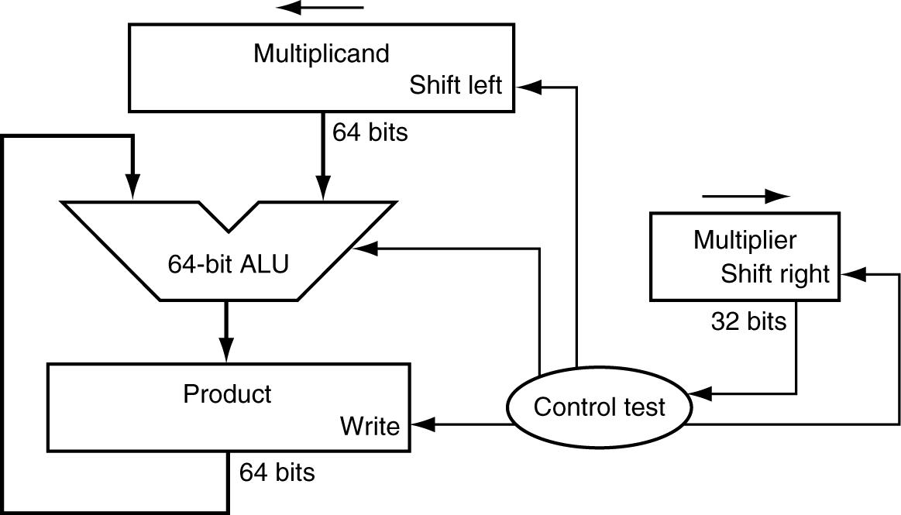
01100000
Multiplication Hardware
00110000
00011000
00111100
00001100
At each bit we need to have the following operations:
Product=Product+Multiplicand.
Shift Multiplicand left.
Shift Multiplier right.
If each of the above operation requires one clock cycle, we need 96 cycles to multiply two 32-bit registers (3x32=96).
00001100
1
00001100
11
00000000
01100000
110
00110000
1101
00001100
00011000
1
00111100
1
00001100
1
0
00001100
10011100
00000000
Initially 0
Control decides when to
Shift the Multiplicand and Multiplier.
When to write new values into the Prod.

Slide 5
$Mcand=0110; $Mplier=0101; $Prod= 00011110
Iteration | Step | $Mplier | $Mcand | $Product
0 | initial | 0101 | 0000 0110 | 0000 0000
1 | a. $Mplier0= 1; $Prod=$Prod+$Mcand b. $Mplier (Shift Right) c.$Mcand ( Shift left ) | ------ 0010 ------- | ---- ---- ---- ---- 0000 1100 | 0000 0110 0000 0110 ---- ---- ----- -----
 | End of iteration 1 | 0010 | 0000 1100 | 0000 0110
2 | a.$Mplier0= 0; no operation b. $Mplier (Shift Right) c.$Mcand ( Shift left ) | ----- 0001 ----- | ---- ---- ---- ---- 0001 1000
 | End of iteration 2 | 0001 | 0001 1000 | 0000 0110
3 | a. $Mplier0= 1; $Prod=$Prod+$Mcand b. $Mplier (Shift Right) c.$Mcand ( Shift left ) | ----- 0000 | ---- ---- ---- ---- 0011 0000 | 0001 1000 0001 1110 ---- ---- ---- ----
 | End of iteration 3 | 0000 | 0011 0000 | 0001 1110
4 | a.$Mplier0= 0; no operation b. $Mplier (Shift Right) c.$Mcand ( Shift left ) | ------- 0000 ----- | -------------- --------------- 0110 0000
END | End of iteration 4 | 0000 | 0110 0000 | 0001 1110

Slide 6
Optimized Multiplier
2. Second Version of Multiplication
Instead of shifting Multiplicand and product . The
digits of the two number will be the same.

Slide 7
Critique
Registers needed for
multiplicand
multiplier
product
Use lower 32 bits of product register:
place multiplier in lower 32 bits
add multiplicand to higher 32 bits
product = product >> 1
repeat

Slide 8
Version 1 versus Version 2

Slide 9
$Mcand=0110; $Mplier=0101; $Prod= 00011110
Iteration | Step | $Mplier | $Mcand | $Product
0 | initial | 0101 | 0110 | 0000 0000
1 | a. $Mplier0= 1; (L.H )$Prod=(L.H)$Prod+$Mcand b. $Mplier (Shift Right) C $Prod ( Shift Right ) | ------ 0010 ------- | ------- ---- ---- ------- | 0110 0110 0000 ---- ---- 0011 0000
 | End of iteration 1 | 0010 | 0110 | 0011 0000
2 | a.$Mplier0= 0; no operation b. $Mplier (Shift Right) C $Prod ( Shift Right ) | ----- 0001 ----- | ---- ---- ---- ---- --------- | 0001 1000
 | End of iteration 2 | 0001 | 0110 | 0001 1000
3 | a. $Mplier0= 1; (L.H )$Prod=(L.H)$Prod+$Mcand b. $Mplier (Shift Right) c.$Mcand ( Shift Right ) | ----- 0000 | ---- ---- ---- ---- -------- | 0110 0111 1000 ------------- 0011 1100
 | End of iteration 3 | 0000 | 0110 | 0011 1100
4 | a.$Mplier0= 0; no operation b. $Mplier (Shift Right) c.$Prod ( Shift Right ) | ------- 0000 ----- | ------------ ------------ ------------- | -------- -------- --------- -------- 0001 1110
END | End of iteration 4 | 0000 | 0110 | 0001 1110

Slide 10
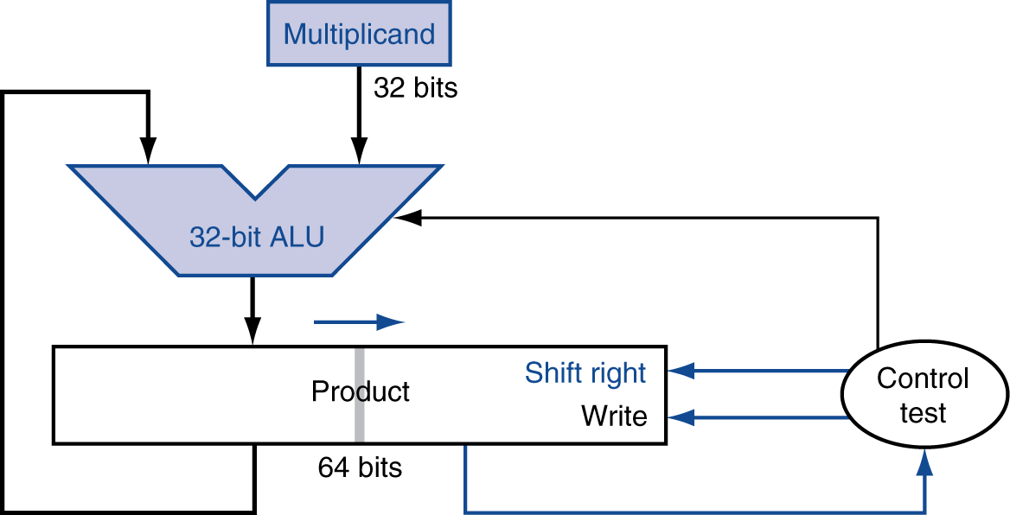
3. Third Version of Multiplication
Since both $prod and $Mplier are shifted right, and the L.H. $prod is 0’s at initial state, the $Mplier can be loaded in the right half of the $prod. This eliminates the $Mplier register, and therefore simplify the hardware.
Multiplier (shifts right)

Slide 11
$Mcand=0110; $Mplier=0101; $Prod= 00011110
Iteration | Step |  | $Mcand | $Product
0 | initial |  | 0110 | 0000 0101
1 | a. $Mplier0= 1; (L.H )$Prod=(L.H)$Prod+$Mcand b. $Prod ( Shift Right ) |  | ------- ---- ---- ------- | 0110 0110 0101 ---- ---- 0011 0010
 | End of iteration 1 |  | 0110 | 0011 0010
2 | a.$Mplier0= 0; no operation b. $Prod ( Shift Right ) |  | ---- ---- ---- ---- --------- | ------- -------- 0001 1001
 | End of iteration 2 |  | 0110 | 0001 1001
3 | a. $Mplier0= 1; (L.H )$Prod=(L.H)$Prod+$Mcand b.$Prod ( Shift Right ) |  | ---- ---- ---- ---- -------- | 0110 0111 1001 ---- ---- 0011 1100
 | End of iteration 3 |  | 0110 | 0011 1100
4 | a.$Mplier0= 0; no operation b.$Prod ( Shift Right ) |  | ------------ ------------ ------------- | -------- -------- --------- -------- 0001 1110
END | End of iteration 4 |  | 0110 | 0001 1110

Slide 12
Signed Multiplication
So far, we have dealt with unsigned integer multiplication
First Attempt:
Convert multiplier and multiplicand into positive numbers
If negative then obtain the 2's complement and remember the sign
Perform unsigned multiplication
Compute the sign of the product
If product sign < 0 then obtain the 2's complement of the product
Better Version:
Use the unsigned multiplication hardware
When shifting right, extend the sign of the product
If multiplier is negative, the last step should be a subtract

Slide 13
Signed Multiplication (Pencil & Paper)
Case 1: Positive Multiplier
Multiplicand 1100₂ = -4
Multiplier × 0101₂ = +5
11111100
111100
Product 11101100₂ = -20
Case 2: Negative Multiplier
Multiplicand 1100₂ = -4
Multiplier × 1101₂ = -3
11111100
111100
00100 (2's complement of 1100)
Product 00001100₂ = +12
Sign-extension
Sign-extension

Slide 14
Sequential Signed Multiplier
Start
ALU produces 32-bit result + Sign bit
Check for overflow
No overflow ➔ Extend sign-bit of result
Overflow ➔ Invert extended sign bit
HI = 0, LO = Multiplier
= 1
LO[0]?
= 0
Multiplicand
First 31 iterations: HI = HI + Multiplicand
Last iteration: HI = HI – Multiplicand
32 bits
32 bits
32-bit ALU
add, sub
Shift Right (Sign, HI, LO) 1 bit
sign
32 bits
32nd Repetition?
No
shift right
HI
LO
Control
Yes
write
Done
64 bits
LO[0]

Slide 15
Start
Signed Multiplication Example
HI = 0, LO = Multiplier
Consider: 1100₂ (-4) × 1101₂ (-3), Product = 00001100₂
Check for overflow: No overflow ➔ Extend sign bit
Last iteration: add 2's complement of Multiplicand
= 1
LO[0]?
= 0
First 31 iterations: HI = HI + Multiplicand
Last iteration: HI = HI – Multiplicand
Iteration
Multiplicand
Sign
Product = HI, LO
0
Initialize (HI = 0, LO = Multiplier)
1 1 0 0
0 0 0 0 1 1 0 1
Shift Right (Sign, HI, LO) 1 bit
1
LO[0] = 1 => ADD
+
1
1 1 0 0 1 1 0 1
Shift (Sign, HI, LO) right 1 bit
1 1 0 0
1 1 1 0 0 1 1 0
32nd Repetition?
No
2
LO[0] = 0 => Do Nothing
Yes
Shift (Sign, HI, LO) right 1 bit
1 1 0 0
1 1 1 1 0 0 1 1
Done
3
LO[0] = 1 => ADD
+
1
1 0 1 1 0 0 1 1
Shift (Sign, HI, LO) right 1 bit
1 1 0 0
1 1 0 1 1 0 0 1
4
LO[0] = 1 => SUB (ADD 2's compl)
0 1 0 0
0
0 0 0 1 1 0 0 1
+
Shift (Sign, HI, LO) right 1 bit
0 0 0 0 1 1 0 0

Slide 16
The Booth Multiplier
Booth algorithm is an elegant way to multiply signed numbers using same hardware as before and save cycles
Observation: if we can both add and subtract, there are multiple ways to create a product
Example: multiply 2_{ten} by 6_{ten} (0010_{two} X 0110_{two})
Product = (2 X 2) + (2 X 4) OR
Product = (2 X -2) + (2 X 8)
6=-2+8 0110 = – 00010 + 01000 = 11110 + 01000
Regular Algorithm
Booth’s Algorithm
0010
X 0110
+ 0000 shift
+ 0010 shift + add
+ 0010 shift + add
+ 0000 shift
00001100
0010
X 0110
0000 shift
- 0010 shift + subtract
0000 shift
+ 0010 shift + add
00001100

Slide 17
Implementing Booth’s Algorithm
Scan multiplier bits from right to left
Test 2 bits of multiplier at once
“Current” bit a_{i}
Bit to right of “current” bit a_{i-1}
Bit a_{i}
Bit a_{i-1}
Explanation
1
0
Begin Run of 1’s
1
1
Middle of Run of 1’s
0
1
End of Run
0
0
Middle of Run of 0’s
Key idea: test 2 bits of multiplier at once
10 - subtract (beginning of run of 1’s)
01 - add (end of run of 1’s)
00, 11 - do nothing (middle of run of 0’s or 1’s)
Multiplicand
(32 bits)
ADD/ SUB
32-bit ALU
Control
0
1
1
0
0
1
1
1
0
0
Shift Left
Product (64 bits)
LHPROD
(32 bits)
MP/RHPROD (32 bits)
Write
End
Of Run
Middle
Of Run
Beginning
Of Run
Bits 1:0
2

Slide 18
Booths Example (2 x 7)
Operation Multiplicand Product next?
0. initial value 0010 0000 0111 0 10 -> sub
1a. P = P - m 1110 + 1110 1110 0111 0 shift P (sign ext)
1b. 0010 1111 0011 1 11 -> nop, shift
2. 0010 1111 1001 1 11 -> nop, shift
3. 0010 1111 1100 1 01 -> add
4a. 0010 + 0010
0001 1100 1 shift
4b. 0010 0000 1110 0 done

Slide 19
Booths Example (2 x -3)
Operation Multiplicand Product next?
0. initial value 0010 0000 1101 0 10 -> sub
1a. P = P - m 1110 + 1110 1110 1101 0 shift P (sign ext)
1b. 0010 1111 0110 1 01 -> add + 0010
2a. 0001 0110 1 shift P
2b. 0010 0000 1011 0 10 -> sub + 1110
3a. 0010 1110 1011 0 shift
3b. 0010 1111 0101 1 11 -> nop
4a 1111 0101 1 shift
4b. 0010 1111 1010 1 done

Slide 20
Booths Example (2 x 6)
Iteration | Mcand | Step | Product
0 | 0010 | Initial values | 0000 0110,0
1 | 0010 0010 | 00: no op arith>> 1 | 0000 0110,0 0000 0011,0
2 | 0010 0010 | 10: prod-=Mcand arith>> 1 | 1110 0011,0 1111 0001,1
3 | 0010 0010 | 11: no op arith>> 1 | 1111 0001,1 1111 1000,1
4 | 0010 0010 | 01: prod+=Mcand arith>> 1 | 0001 1000,1 0000 1100,0

Slide 21
MIPS Instructions
mult $s2, $s3 computes the product and stores
it in two “internal” registers that
can be referred to as hi and lo
mfhi $s0 moves the value in hi into $s0
mflo $s1 moves the value in lo into $s1
Similarly for multu

Slide 22
Unsigned Division (Paper & Pencil)
1
0
0
1
1₂
= 19 Quotient
Divisor 1011₂ 11011001₂ = 217 Dividend
-1011
10
101
1010
10100
-1011
1001
10011
-1011
1000₂ = 8 Remainder
Try to see how big a number can be subtracted, creating a digit of the quotient on each attempt
Dividend =
Quotient × Divisor
+ Remainder
217 = 19 × 11 + 8
Binary division is accomplished via shifting and subtraction

Slide 23
Unsigned Division (Paper & Pencil)
Division
1001_{ten} Quotient
Divisor 1000_{ten} | 1001010_{ten} Dividend
-1000
10
101
1010
-1000
10_{ten} Remainder
At every step,
shift divisor right and compare it with current dividend
if divisor is larger, shift 0 as the next bit of the quotient
if divisor is smaller, subtract to get new dividend and shift 1 as the next bit of the quotient

Slide 24
Unsigned Division (Paper & Pencil)
1001_{ten} Quotient
Divisor 1000_{ten} | 1001010_{ten} Dividend
0001001010 0001001010 0000001010 0000001010
100000000000 → 0001000000→ 0000100000→0000001000
Quo: 0 000001 0000010 000001001
At every step,
shift divisor right and compare it with current dividend
if divisor is larger, shift 0 as the next bit of the quotient
if divisor is smaller, subtract to get new dividend and shift 1 as the next bit of the quotient

Slide 25
Sequential Division
Uses two registers: HI and LO
Initialize: HI = Remainder = 0 and LO = Dividend
Shift (HI, LO) LEFT by 1 bit (also Shift Quotient LEFT)
Shift the remainder and dividend registers together LEFT
Has the same net effect of shifting the divisor RIGHT
Compute: Difference = Remainder – Divisor
If (Difference ≥ 0) then
Remainder = Difference
Set Least significant Bit of (Lo) Quotient
Observation to Reduce Hardware:
LO register can be also used to store the computed Quotient

Slide 26
Sequential Division Hardware
Initialize:
HI = 0, LO = Dividend
Results:
HI = Remainder
LO = Quotient
Start
Shift (HI, LO) Left
Difference = HI – Divisor
≥ 0
< 0
Difference?
Divisor
2. HI = Remainder = Difference
Set least significant bit of LO
32 bits
32-bit ALU
sub
sign
32nd Repetition?
No
Difference
write
Yes
HI
LO
Control
Done
shift left
32 bits
32 bits
set lsb

Slide 27
Division Example
Start
Example: 1110₂ / 0011₂ (4-bit dividend & divisor)
Result Quotient = 0100₂ and Remainder = 0010₂
4-bit registers for Remainder and Divisor (4-bit ALU)
Shift (HI, LO) Left
Difference = HI – Divisor
≥ 0
< 0
Difference?
Iteration
HI
LO
Divisor
Difference
0
Initialize
0 0 0 0
1 1 1 0
0 0 1 1
2. HI = Remainder = Difference
Set least significant bit of LO
1
1: Shift Left, Diff = HI - Divisor
0 0 0 1
1 1 0 0
0 0 1 1
1 1 1 0
2: Diff < 0 => Do Nothing
2
1: Shift Left, Diff = HI - Divisor
0 0 1 1
1 0 0 0
0 0 1 1
0 0 0 0
2: Rem = Diff, set lsb of LO
0 0 0 0
1 0 0 1
32nd Repetition?
No
3
1: Shift Left, Diff = HI - Divisor
0 0 0 1
0 0 1 0
0 0 1 1
1 1 1 0
Yes
2: Diff < 0 => Do Nothing
Done
4
1: Shift Left, Diff = HI - Divisor
0 0 1 0
0 1 0 0
0 0 1 1
1 1 1 1
2: Diff < 0 => Do Nothing

Slide 28
Divide Example
Divide 7_{ten} (0111_{two}) by 2_{ten} (0010_{two})
Iter | Step | Hi | L0 | Divisor | Difference
0 | Initial values | 0000 | 0111 | 0010
1
2
3
4
5
Start
Shift (HI, LO) Left
Difference = HI – Divisor
≥ 0
< 0
Difference?
2. HI = Remainder = Difference
Set least significant bit of LO
32nd Repetition?
No
Yes
Done

Slide 29
Signed Division
Simplest way is to remember the signs
Convert the dividend and divisor to positive
Obtain the 2's complement if they are negative
Do the unsigned division
Compute the signs of the quotient and remainder
Quotient sign = Dividend sign XOR Divisor sign
Remainder sign = Dividend sign
Negate the quotient and remainder if their sign is negative
Obtain the 2's complement to convert them to negative

Slide 30
Signed Division Examples
Positive Dividend and Positive Divisor
Example: +17 / +3 Quotient = +5 Remainder = +2
Positive Dividend and Negative Divisor
Example: +17 / –3 Quotient = –5 Remainder = +2
Negative Dividend and Positive Divisor
Example: –17 / +3 Quotient = –5 Remainder = –2
Negative Dividend and Negative Divisor
Example: –17 / –3 Quotient = +5 Remainder = –2
The following equation must always hold:
Dividend = Quotient × Divisor + Remainder

