Slide 1
Conditional Processing
Assembly Language Programming
Petra University
Dr. Hadi Hassan

Slide 2
Unconditional Jump
JMP [operator] destination
Instruction Label
A symbolic name defined to be an address in the code segment of a program
A label may be attached to any point in the code of a program
a_Label: jmp a_Label
Labels definitions usually have a colon at the end

Slide 3
Conditional Jumps
A conditional jump instruction branches to a label when specific register or flag conditions are met
Jxxx destination
There are 30 some variations that interrupt sequential flow based on various flag settings
JNZ - Jump if zero flag is clear (0) meaning the result of a previous operation was non-zero
JC - Jump if a previous operation caused the carry flag to be set (1)

Slide 4
Range of Conditional Jumps
All conditional jumps are SHORT
range is -128 to +127 bytes
80386+ allow larger distances
Combine a conditional and unconditional jump to overcome this range limitation

Slide 5
Unconditional Jump Instruction JMP:
Syntax: JMP destination_label
Cause Unconditional transfer of control to destination label , usually a label in the same segment as the JMP itself.
Can be used to avoid Range restriction of conditional Jumps (-128 and 127 byte) for example if the body contain so many instructions that label TOP is out of range for JNZ , then JMP unconditional jump alternative is used thus:
TOP: TOP:
.; body of the loop ; body of the loop
DEC CX DEC CX
JNZ TOP JNZ BOTTOM
MOV AX,BX JMP EXIT
BOTTOM:
JMP TOP
EXIT:
MOV AX,BX

Slide 6
Using Conditional Jumps
Conditional jumps typically follow an instruction that alters the flag bits
CMP destination, source
Computes (destination-source) and sets flag bits
result is not stored
flags allow us to decide <, <=, >, >=, ==, <>, etc
we can also interpret the results meaningfully for signed or unsigned data
Like SUB inst. Except destination content will not changed
CMP AX,BX ; where AX= 7FFF and BX=0001 h, thus
JG BELOW ; result = 7FFF-0001h= 7FFEh
From table in the next slide it is clear that jump condition is satisfied, since : flags Z=S=O=0 control is transferred to Label BELLOW , if signed interpretation is used.

Slide 7
When two unsigned operands are compared , the Zero, and carry Flags indicate the following relation between operands
CMP Results | ZF | CF
Destination <source | 0 | 1
Destination > source | 0 | 0
Destination =source | 1 | 0
When two signed operands are compared , the sign , and overflow Flags indicate the following relation between operands
CMP Results | Flags
Destination <source | SF≠ OF
Destination > source | SF=OF
Destination =source | ZF=1

Slide 8
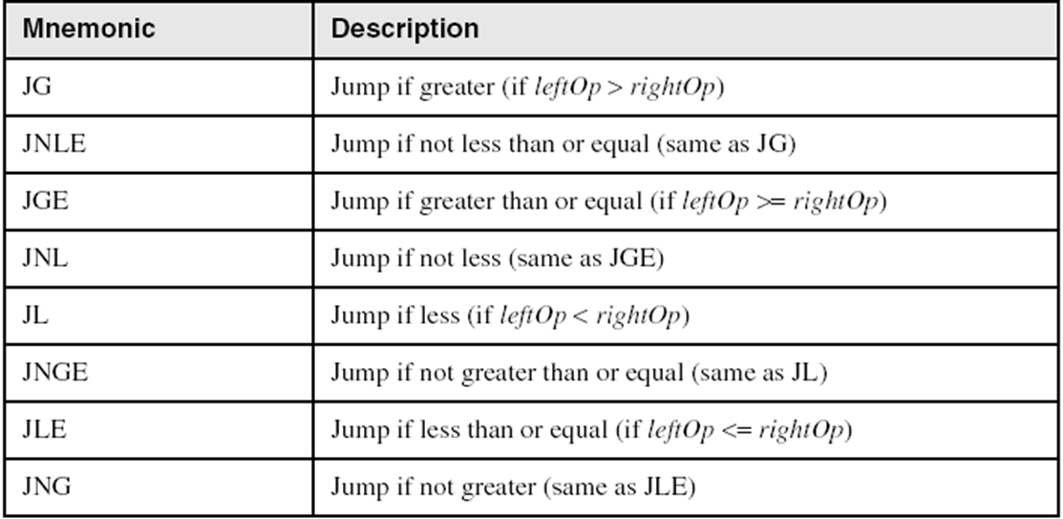
Conditional Jump
Signed Jumps:

Slide 9
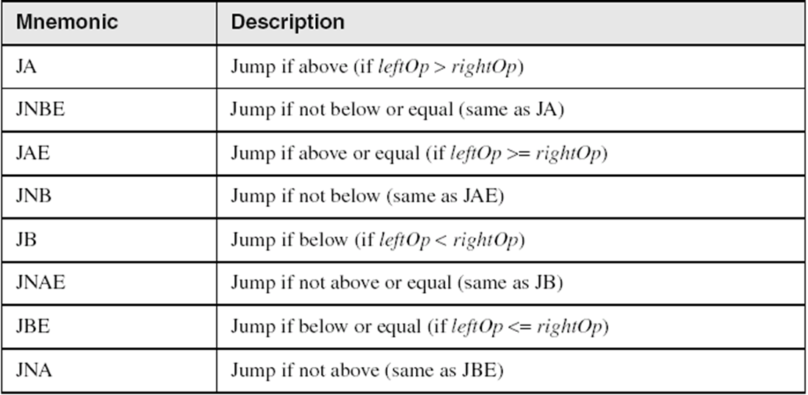
Unsigned conditional Jumps :

Slide 10
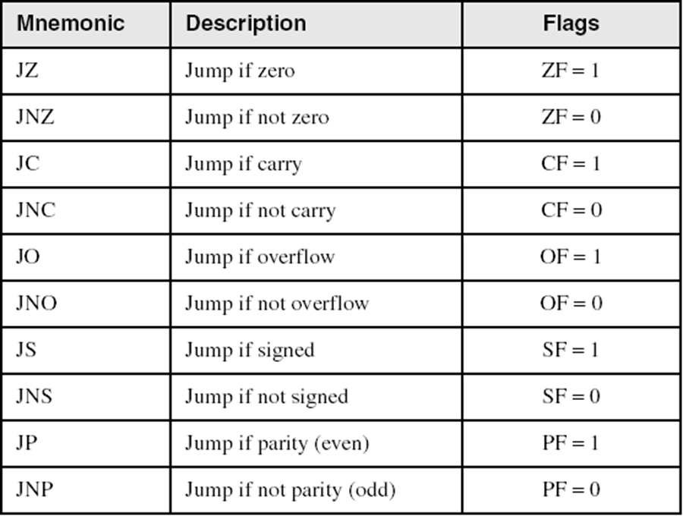
Single–Flag Jumps

Slide 11
Applications
Task: Jump to a label if unsigned AX is greater than BX
Solution: Use CMP, followed by JA
cmp ax,bx
ja Larger
Task: Jump to a label if signed AX is greater than BX
Solution: Use CMP, followed by JG
cmp ax,bx
jg Greater

Slide 12
Applications
Compare unsigned AX to BX, and copy the larger of the two into a variable named Large
mov Large,bx
cmp ax,bx
jna Next
mov Large,ax
Next:
Compare signed AX to BX, and copy the smaller of the two into a variable named Small
mov Small,ax
cmp bx,ax
jnl Next
mov Small,bx
Next:

Slide 13
How The CPU Implement the Conditional Jump?
To implement a conditional jump, the CPU looks at the FLAGS register . You already know it reflects the result of the last thing the processor did. If the conditions for the Jump ( expressed as a combination of status flag settings ) are true, the CPU adjust the IP to point to the destination label, so that the instruction at this label will be done next. If the Jump condition if false, then IP is not altered; this means that next instruction in line be done.
Example: Program to display the IBM -256 ASCII code using : Conditional Jump Inst. JNZ , Jump if not zero.
Counter Register –CX is the loop counter, its initialized by 256 and is decremented after each character ,is displayed
JNZ inst. Is used to control the Print_Loop,
CPU execute it by testing ZF, if ZF=0, control transfer to Print_Loop otherwise ,ZF=1 , the program execute the inst. : MOV Ah,4ch

Slide 14
TITTLE PGM6_1: IBM Character Display
. Model Small
.Stack 100h
.code
MAIN PROC
MOV Ah,2
MOV CX, 256d
MOV DL,0
Print_Loop:
INT 21h
INC DL
DEC CX
JNZ Print_Loop
MOV Ah,4ch
INT 21h
MAIN ENDP
END MAIN

Slide 15
Block-Structured IF Statements
Assembly language programmers can easily translate logical statements written in C++/Java into assembly language. For example:
False
Condition
True
IF condition is true
THEN
execute true-branch statement
END_IF
True-branch
Statement
mov ax,op1
cmp ax,op2
jne L1
mov X,1
jmp L2
L1: mov X,2
L2:
if( op1 == op2 )
X = 1;
else
X = 2;

Slide 16
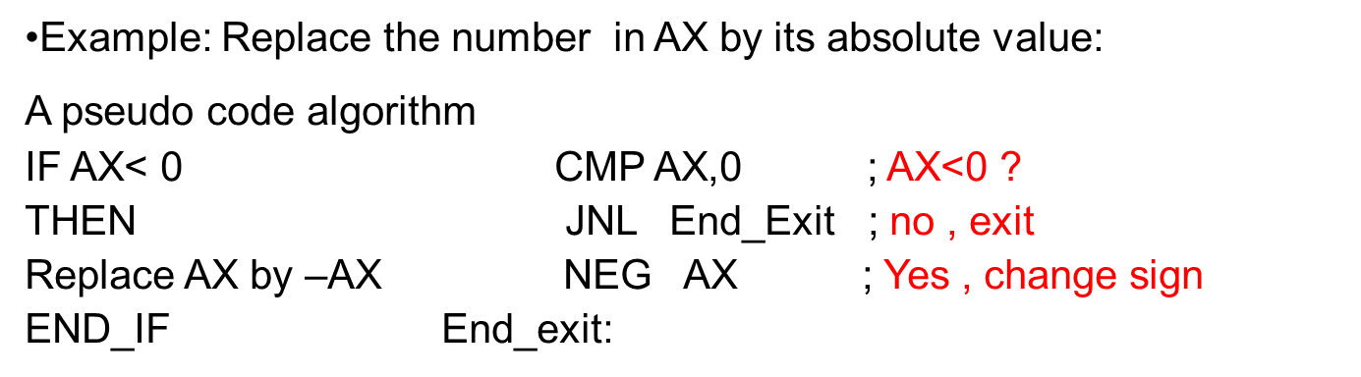
Example; Implement the following pseudocode in assembly language. All values are unsigned:
if( bx <= cx )
{
ax = 5;
dx = 6;
}
cmp bx,cx
ja next
mov ax,5
mov dx,6
next:

Slide 17
Implementing an IF-THEN
unsigned int n;
if (n>7) do_it();
If n is a signed int, use jng (not greater)
unsigned:
above, below
signed
less, greater
;if (n>7)
mov ax,n
cmp ax,7
jna skip_it
;then-part
call do_it
;end if
skip_it:

Slide 18
Implementing an IF-ELSE
char n;
if (n=='7')
do_it();
else
do_that();
Document the control structures and keep the parts in the usual order
;if (n=='7')
cmp n,'7'
jne else_
;then-part
call do_it
jmp short endif
else_:
call do_that
endif:

Slide 19
IF-THEN-ELSE
IF condition is True
THEN
Execute TRUE-BRANCH statement
ELSE
Execute TRUE-BRANCH statement
FALSE
Condition
TRUE
False Branch
Statement
True Branch
Statement

Slide 20
Example: Suppose AL and BL contain extended ASCII characters. Display the one that comes first in the character sequence.
Solution:
If AL<= BL MOV AH,2 ; prepare for display
THEN CMP AL,BL ; AL<=BL ?
Display the char. In AL JNBE ELS_ ; No,display char in BL
ELSE MOV DL,AL
Display the Char. In BL JMP Display
End_IF ELS_: MOV DL,BL ; BL<AL
Display :
INT 21h ; Display it
End_IF:
The condition AL<=BL is expressed by (CMP AL,BL) , JNBE is used because we are comparing extended characters. If AL<=BL is true ,the true branch statements are done. Note that JMP Display is needed to skip the false branch. This is different from that high-level language IF_THEN_Statement in which false branch is automatically skipped if the true branch statements are done.

Slide 21
Your turn . . .
Implement the following pseudocode in assembly language. All values are 16-bit signed integers:
if( var1 <= var2 )
var3 = 10;
else
{
var3 = 6;
var4 = 7;
}
mov ax,var1
cmp ax,var2
jle L1
mov var3,6
mov var4,7
jmp L2
L1: mov var3,10
L2:

Slide 22
CASE:
Is a Multi-ways branch structure
that tests a register variable or
Expression for certain value,
Syntax:
CASE expression
Value_1: Statement-1
Value_2: Statement-2
Value_n: Statement-n
END-CASE
Expression
Value 1
Value 2
Value n
Statement1
Statement2
Statement n

Slide 23
Example : if A contain negative number put -1 in BX; AX contain 0, put 0 in BX, if AX contains a positive number , put in BX:
Pseudo Algorithm: ASSEMBL CODE
CASE AX ; case AX
< 0: put -1 in BX CMP AX,0
=0 : put 0 in BX JL NEGATIVE ; AX<0
>0 : put 1 in BX JE ZERO ; AX=0
END_CASE JG POSITIVE ; AX>0
NEGATIVE: MOV BX,-1
JMP END_CACE
ZERO: MOV BX,0
JMP END_CACE
POSITIVE: MOV BX, 1
END_CACE :

Slide 24
Example: Assembly Code
If AL contains 1 or 3 , display “O” ;case AL=1,3
If AL contains 2 or 4, display “e” CMP AL,1 ; AL=1 ?
Pseudo Algorithm: JE ODD ; yes display “O”
CASE AL CMP AL,3 ; AL=3
1,3: display “O” JE ODD ; yes display “O’
2,4: display “e” ; case AL=2,4
END_CASE CMP AL,2
JE EVEN ; yes, display “e”
CMP AL,4
JE EVEN ; yes, display “e”
JMP END_CASE
ODD: MOV DL,”O”
JMP DISPLAY
EVEN: MOV DL,”e”
DISPLAY: MOV AH,2
INT 21H
END_CASE:

Slide 25
WHILE_LOOP:
Entry to this loop depends on a condition , the loop pseudo algorithm
WHILE condition DO
Statements
END_WHILE
False
Condition
True
Statements
The condition is checked at the top , before entry of the loop. If true , the statements are executed else the program bypass the loop-body to following code. It is possible that condition is false initially , in which case the loop –body is not executed at all
The loop executes as long as the condition is true.

Slide 26
WHILE Loops
A WHILE loop is really an IF statement followed by the body of the loop, followed by an unconditional jump to the top of the loop. Consider the following example:
while( ax < bx)
ax = ax + 1;
This is a possible implementation:
top:
cmp ax,bx ; check loop condition
jae next ; false? exit loop
inc ax ; body of loop
jmp top ; repeat the loop
next:

Slide 27
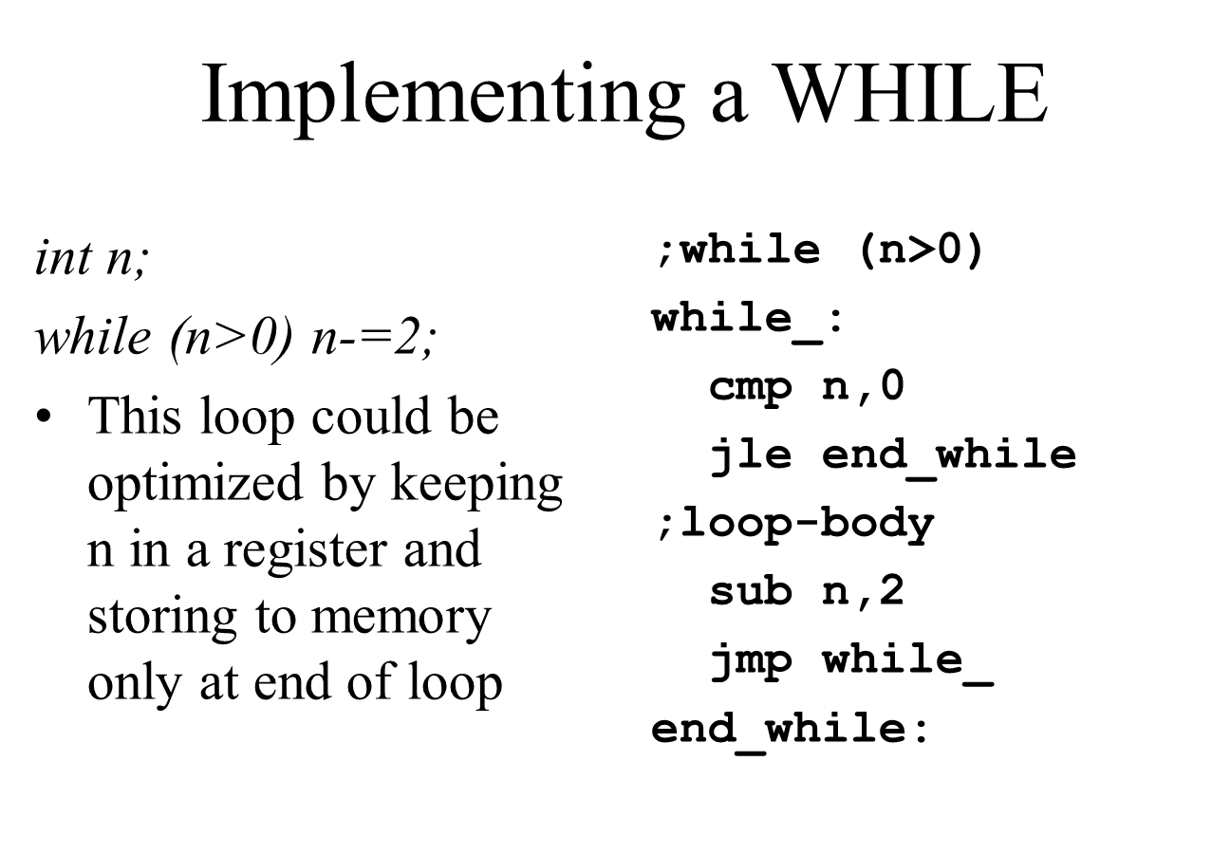

Slide 28
Your turn . . .
Implement the following loop, using unsigned 16-bit integers:
while( bx <= val1)
{
bx = bx + 5;
val1 = val1 - 1
}
top:
cmp bx,val1 ; check loop condition
ja next ; false? exit loop
add bx,5 ; body of loop
dec val1
jmp top ; repeat the loop
next:

Slide 29
Example: Write a code to count the number of characters in an input line.
Assembly Code :
MOV DX,0 ; DX counts chars
MOV AH,1 ; prepare to read
INT 21 h ; char in AL
WHILE_:
CMP AL, 0DH ; CR?
JE END_WHILE
INC DX
INT 21 H
JMP WHILE_
END_WHILE:
Initialize count to 0
Read a character
While Char <>carriage return DO
Count=Count+1
Read a character
END_While
NOTE:
because WHILE loop checks terminating condition at top of loop , any variable in the condition , must be initialized before the loop is entered thus must read a char , before entering the loop ,
The label WHILE_: is used because WHILE is reserved word

Slide 30
REPEAT LOOP:
The Repeat Loop pseudo algorithm
REPEAT
Statements
UNTIL Condition
Repeat until loop , the statements are executed , and then the condition is checked . If true , the loop terminate else control transfers to the top of the loop. Thus statement be executed at least once
Statement
Condition
False
True

Slide 31
Example: write a code to read characters Until a blank is read
Assembly Code:
MOV AH,1 ; prepare to read a char
REPEAT:
INT 21 h ; char in AL
CMP AL,” ” ; is it Blank
JNE REPEAT ; no, keep reading a
;char Until Char is
;blank
Pseudo Code
REPEAT
Read a character
UNTIL char is blank

Slide 32
Branches with compound conditions
Condition_1 AND Condition_2 , called AND condition , or
Condition_1 OR Condition_2 , called OR condition
Where condition_1 and condition_2 are either TRUE or FALSE
AND Conditions:
AND condition is True if and only IF condition_1 and condition_2 are both True, otherwise it will be False if one of the condition or both of them are False.
Example: Read a character , and check it is an uppercase letter display it.
Pseudo Algorithm:
Read a Character (into AL)
If (char ≥ “A”) AND (char ≤ “Z”) ; if char is A or follows it
Then display it ; if char is Z or preceedes it
END_IF

Slide 33
Assembly Code:
; read a character
MOV Ah,1 ; read a character in AL
INT 21h
; If (char ≥ “A”) AND (char ≤ “Z”)
CMP AL, “A” ; If (char ≥ “A”)
JNGE END_IF ; no, it precedes “A”, Exit
CMP AL, “Z” ; char ≤ “Z”
JNLE END_IF
; then display char
MOV DL,AL
MOV AH,2
INT 21h
END_IF:

Slide 34
Compound Expression with AND
if (al > bl) AND (bl > cl)
X = 1;
This is one possible implementation . . .
cmp al,bl ; first expression...
ja L1
jmp next
L1:
cmp bl,cl ; second expression...
ja L2
jmp next
L2: ; both are true
mov X,1 ; set X to 1
next:

Slide 35
Your turn . . .
Implement the following pseudocode in assembly language. All values are unsigned:
if( bx <= cx
&& cx > dx )
{
ax = 5;
dx = 6;
}
cmp bx,cx
ja next
cmp cx,dx
jbe next
mov ax,5
mov dx,6
next:

Slide 36
Compound Expression with OR
OR condition is True if either Condition_1 or Condition_2 is True or both of them is True. Its only False when both conditions are false
if (al > bl) OR (bl > cl)
X = 1;
We can use "fall-through" logic to keep the code as short as possible:
cmp al,bl ; is AL > BL?
ja L1 ; yes
cmp bl,cl ; no: is BL > CL?
jbe next ; no: skip next statement
L1: mov X,1 ; set X to 1
next:

Slide 37
Compound Expression with OR
char n,k; unsigned int w;
if (n<>k || w<=10)
whatever();
This example uses short-circuit evaluation
if the first condition is true it immediately skips to the then-part
;if(n<>k||w<=10)
mov ah,n
cmp ah,k
jne then_
cmp w,10
ja end_if
then_:
call whatever
end_if:

Slide 38
Example: Read a character , and if its “y” OR “Y” , display it ; else the program.
Pseudo Algorithm:
.model small Read a character ( into AL)
.stack 100 h IF ( character=“y”) OR ( character=“Y”)
.code THEN display it
Main proc ELSE terminate the program
Mov Ah,1 End_if
Int 21h
CMP AL,”y” ; IF ( character=“y”) OR ( character=“Y”)
JE THEN
CMP AL , “Y”
JE THEN
JMP ELSE_
THEN: MOV AH,2
MOV DL,AL
INT 21h
ELSE_: MOV AH,4Ch
INT 21h
END_IF
main Endp
end main

Slide 39
Looping Structures:
A loop is a sequence of instructions that is repeated . The number of times to repeat may be known in advance or it may depend on condition
FOR- LOOP:
In this loop structure, the loop statements are repeated a known number of times called count_controlled loop,
FOR loop_count DO
Statement;
END_ FOR
The LOOP is used to implement FOR loop . The syntax is:
LOOP destination_label
Initialize
Count
Statement
Count=Count-1
Count=0

Slide 40
The counter for loop is register CX , which is initialized to the value (loop_count) . Execution of the LOOP instruction cause CX to be decremented automatically. And if CX ≠ 0 , control transfers to destination_label .If CX =0, the next transition after LOOP is executed . The destination_label must precedes the LOOP instruction by more than 126 bytes as follows :
; initialize CX to loop_count
TOP:
; the body of the loop
LOOP TOP
Example: Write a count-controlled loop to display a raw of 80 asterisks
FOR 80 time DO MOV CX,80 ; number of star to display
Display “*” MOV AH,2
END_FOR MOV DL,”*”
TOP: INT 21 h
LOOP TOP

Slide 41
NOTE : The for LOOP is executed at least once. If CX contain 0 when the loop is entered , then the LOOP instruction cause CX to be decremented to FFFFh , and the LOOP then executed 65535 more times . To prevent this , the instruction JCXZ (Jump if CX is zero ) is used before the loop, thus:
Syntax: JCXZ destination _label
Now if CX=0, control transfers to destination_label by passing the loop, thus:
JCXZ SKIP
TOP:
; body of the loop
LOOP TOP
SKIP:

Slide 42
LOOP
LOOP destination
decrements CX but does not change any flags
if CX is not zero after the decrement, control is transferred to the destination label
This is a SHORT jump only
for (x=9;x>0;x--) n+=x;
;for(x=9;x>0;x--)
mov cx,9
top_loop:
add n,cx ;n=n+x
loop top_loop

Slide 43
LOOPZ and LOOPE
Syntax:
LOOPE destination
LOOPZ destination
Logic:
CX ← CX – 1
if CX > 0 and ZF=1, jump to destination
Useful when scanning an array for the first element that does not match a given value.
In 16-bit real-address mode, CX is the counter,

Slide 44
LOOPZ Example
This program accepts at most 9 characters from the keyboard
When the 9th character is pressed (or the enter key is used) the number of keypresses is displayed
mov ah,1
mov cx,9
next_char:
int 21h
cmp al,13
loopne next_char
;determine count
mov ax, 0239h
sub al,cl
mov dl,al
int 21h

Slide 45
LOOPNZ and LOOPNE
LOOPNZ (LOOPNE) is a conditional loop instruction
Syntax:
LOOPNZ destination
LOOPNE destination
Logic:
CX ← CX – 1;
if CX > 0 and ZF=0, jump to destination
Useful when scanning an array for the first element that matches a given value.

Slide 46
; PROGRAM TO CONVERT THE 2-DIGIT HEXADECIMAL NUMBER WHOSE
; ASCII CODES ARE STORED IN THE DX REGISTER (DL=LEAST
; SIGNIFICANT DIGIT, DH=MOST SIGNIFICANT DIGIT) INTO A
; BYTE VALUE IN THE AL REGISTER. THIS PROGRAM IS NOT
; WRITTEN VERY WELL BECAUSE WE HAVEN'T LEARNED ALL OF THE
; INSTRUCTIONS NEEDED TO DO IT WELL.
; FIRST, LET'S PUT SOME CHARACTERS IN DX, SO THE PROGRAM
; WILL HAVE SOME DATA TO WORK ON:
MOV DH,'7'
MOV DL,'F'
; THAT IS, LET'S CONVERT THE NUMBER 7F (HEX).
; THE PROGRAM.
; FIRST, WORK ON THE UPPER DIGIT:
; IF THE DIGIT IS "0"-"9", WE MUST CONVERT IT TO THE
; BYTE 0-9, ELSE IF THE DIGIT IS "A"-"F" WE MUST CONVERT

Slide 47
; IT TO THE BYTE 10-15. THEN, SINCE THIS IS THE MOST
; SIGNIFICANT DIGIT, IT MUST BE MULTIPLIED BY 16 AND STORED.
MOV AL,DH ; GET THE DIGIT
SUB AL,'A' ; IS THE DIGIT BIGGER OR EQUAL TO "A"?
JC NUMERIC_1 ; IF "0"-"9", JUMP TO ANOTHER ROUTINE
ADD AL,10 ; IS "A"-"F", SO CONVERT TO 10-15
JMP CONTINUE_1
; THIS PART IS EXECUTED IF THE DIGIT IS "0"-"9"
NUMERIC_1:
MOV AL,DH ; GET THE DIGIT AGAIN
SUB AL,'0' ; CONVERT TO 0-9
; AT THIS POINT, AL CONTAINS A VALUE 0-15
CONTINUE_1:
ADD AL,AL ; DOUBLE AL
ADD AL,AL ; QUADRUPLE IT
ADD AL,AL ; OCTUPLE IT
ADD AL,AL ; NOW AL CONTAINS 16*UPPER DIGIT OF HEX

Slide 48
; NOW WORK ON THE LOWER DIGIT USING SAME TYPE OF ALGORITHM
MOV AH,DL ; GET THE DIGIT
SUB AH,'A' ; IS THE DIGIT BIGGER OR EQUAL TO "A"?
JC NUMERIC_2 ; IF "0"-"9", JUMP TO ANOTHER ROUTINE
ADD AH,10 ; IS "A"-"F", SO CONVERT TO 10-15
JMP CONTINUE_2
; EXECUTE THIS ONLY IF LOWER DIGIT IS "0"-"9"
NUMERIC_2:
MOV AH,DL ; GET THE DIGIT AGAIN
SUB AH,'0' ; CONVERT TO 0-9
; AT THIS POINT, AH CONTAINS A VALUE 0-15
CONTINUE_2:
ADD AL,AH ; ADD LOWER HEX DIGIT TO 16*UPPER

Slide 49
Problem:
Prompt for single Hex digit
'0' through '9', 'A' through 'F', 'a' through 'f'
Illegal entries must be detected
Display entry in decimal
0 through 15
Ask to repeat the program
'y' or 'Y' will repeat, anything else exits

Slide 50
Approach :
The major task is data translation
Given an ASCII code for a Hex digit, determine the numeric equivalent (unsigned byte)
Given an unsigned byte (0-15), display one or two character decimal representation
The input/process/output step must be embedded in a do until loop controlled by the yes/no response of the user

Slide 51
.Model Small
.Stack 100h
.data
input_message db 0Dh,0Ah, 'Enter alegal hex digit: $'
output_message db 0Dh,0Ah,'in decimal this is $'
illegal_message db 'Illegal entry!$'
continue_message db 0Dh,0Ah,'Try again? (Y/N): $‘
.code
Hexable proc
mov ax,@data ;ax gets segment number
mov ds,ax ;transfer to segment reg
begin_process:
;prompt and accept single char input
lea dx,input_message
mov ah,9 ;display input prompt
int 21h

Slide 52
mov ah,1 ;DOS input function
int 21h ;get single char response
mov bl,al ;for safe keeping
lea dx,output_message
mov ah,9 ;move to new line and get
int 21h ;ready to display result
;convert ASCII hex digit (bl) to unsigned
cmp bl,'9' ;check if decimal digit
jle decimal_size
cmp bl,'F' ;uppercase or lowercase?
jle uppercase
sub bl,'a'-'A' ;lower to uppercase
uppercase: ;handle 'A'-'F' case
sub bl,'A'-10; 'A'-'F' to unsigned
jmp conversion_complete
decimal_size: ;handle '0'-'9' case
sub bl,'0' ;convert to unsigned
conversion_complete:

Slide 53
;verify byte in BL is legal (0-15)
cmp bl,0 ;if <0, illegal
jl illegal
cmp bl,15 ;here if >=0
jle legal ;if also <=15, OK
illegal:
mov ah,9 ;display error message
lea dx,illegal_message
int 21h
jmp begin_process ;start over
legal:
;output byte in BL (0-15) as decimal
mov ah,2 ;DOS output function
cmp bl,10
jl ones_place ;jmp if single digit
mov dl,'1' ;output leading '1'
int 21h
sub bl,10 ;isolate ones place
ones_place:
add bl,'0' ;convert to ASCII
mov dl,bl ;prepare to output
int 21h

Slide 54
begin_process:
;main processing task goes here
lea dx,continue_message
mov ah,9 ;display continue prompt
int 21h
mov ah,1
int 21h ;get response
cmp al,'y' ;y means do again
je begin_process
cmp al,'Y' ;Y means do again
je begin_process
mov ah,4ch ;DOS return, no error
int 21h
hexable endp
end hexable

