Slide 1
Car Price Predictions
Ismail AlKamal
Oct 29, 2021

Slide 2
Introduction
Business Case:
A Chinese car manufacturer wants to enter the US market. We are required to model the price of cars. This will help management understand how exactly the price varies across different features. They can then accordingly manipulate the design of the cars, the business strategy etc. to meet certain price levels.
Dataset:
[1] Large dataset of different type of cars across the US market.
[2] 205 entries and 26 features
[3] Target variable is the Price
[4] Source: https://www.kaggle.com/hellbuoy/car-price-prediction

Slide 3
Features
DATA DICTONARY
1 | Car_ID | Unique id of each observation (Numeric)
2 | Symboling | Its assigned insurance risk rating, A value of +3 indicates that the auto is risky, -3 that it is probably pretty safe.(Categorical)
3 | CarName | Name of car company (Categorical)
4 | fueltype | Car fuel type i.e gas or diesel (Categorical)
5 | aspiration | Aspiration used in a car (Categorical)
6 | doornumber | Number of doors in a car (Categorical)
7 | carbody | body of car (Categorical)
8 | drivewheel | type of drive wheel (Categorical)
9 | enginelocation | Location of car engine (Categorical)
10 | wheelbase | Weelbase of car (Numeric)
11 | carlength | Length of car (Numeric)
12 | carwidth | Width of car (Numeric)
13 | carheight | height of car (Numeric)
14 | curbweight | The weight of a car without occupants or baggage. (Numeric)
15 | enginetype | Type of engine. (Categorical)
16 | cylindernumber | cylinder placed in the car (Categorical)
17 | enginesize | Size of car (Numeric)
18 | fuelsystem | Fuel system of car (Categorical)
19 | boreratio | Boreratio of car (Numeric)
20 | stroke | Stroke or volume inside the engine (Numeric)
21 | compressionratio | compression ratio of car (Numeric)
22 | horsepower | Horsepower (Numeric)
23 | peakrpm | car peak rpm (Numeric)
24 | citympg | Mileage in city (Numeric)
25 | highwaympg | Mileage on highway (Numeric)
26 | price | Price of car (Numeric)

Slide 4
Data Cleaning
Data has no missing values
Data has no duplicates
Car_Name feature can be engineered into Car_Model and Car_Manufacturer.
Example:
alfa-romero Quadrifoglio
Fixed a number of Car_Manufacturer misspellings such as “maxda” , “vokswagen”, “toyouta”, etc..
Fixed Audi car model “100 ls” and “100ls” by stripping the whitespace.
Car Name
# Splitting Car_Name into Car_Manufacturer and Car_Model
car_manufacturer = pd.Series(ds1["Car_Name"].map(lambda x:x.split(" ")[0]),name="Car_Manufacturer")
car_model = pd.Series(ds1["Car_Name"].map(lambda x:" ".join(x.split(" ")[1:])),name="Car_Model")
df = pd.concat([car_manufacturer,car_model,ds1],axis=1)
df.drop(columns="Car_Name",inplace=True)
Car
Manufacturer
Car Model

Slide 5
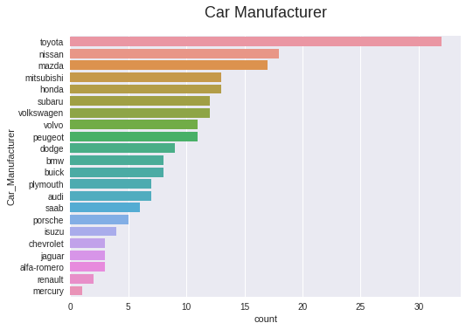
Exploratory Data Anaylsis
Japanese car manufacturers make about half the samples in the dataset. Toyota being the most frequent.

Slide 6
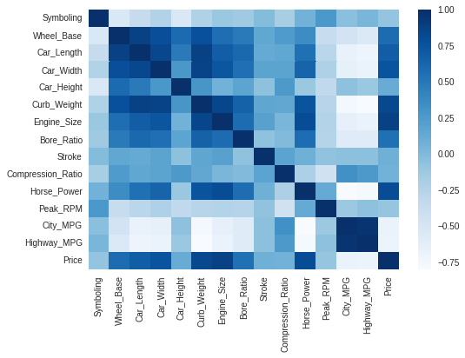
Exploratory Data Anaylsis
Correlation Heatmap (Numerical Only)
Top Factors affecting price:
Engine Size (+)
Curb Weight (+)
Horse Power (+)
Car Width (+)
Four Cylinder Type (-)
Highway MPG (-)
City MPG (-)
Car Length (+)
Rear Wheel Drive (-)
Forward Wheel Drive (+)

Slide 7
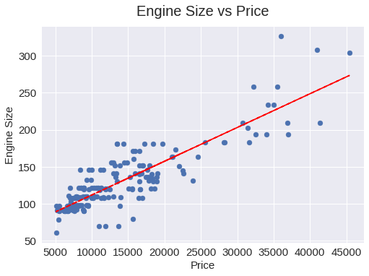
Exploratory Data Anaylsis
Engine Size is the most important feature in determining car price with a correlation of 87.4%
# Drawing a trendline on the plot.
z = np.polyfit(df["Price"], df["Engine_Size"], 1)
p = np.poly1d(z)
plt.plot(df["Price"], p(df["Price"]), "r--")

Slide 8
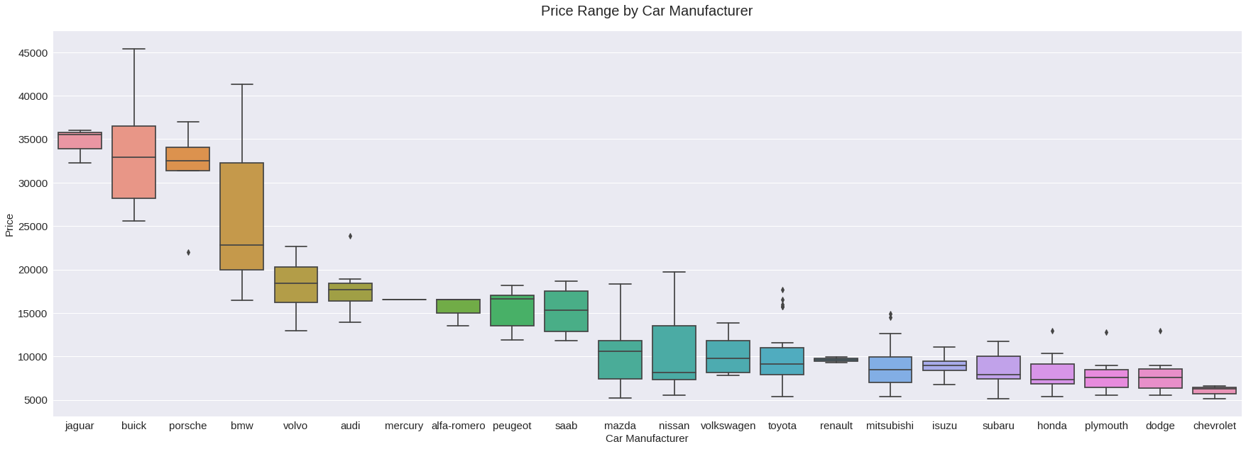
Exploratory Data Anaylsis
- Jaguars, Buicks, Porsches and BMWs are the most expensive.
- Hondas, Plymouths, Dodges and Chevrolets are the least expensive
# Plotting Price boxplots grouped by Car Manufacturer
ordered_by_mean = df.groupby("Car_Manufacturer")["Price"].mean().sort_values(ascending=False).keys()
plt.figure(figsize=(30,10))
sns.boxplot(data=df,x="Car_Manufacturer",y="Price",order=ordered_by_mean)
plt.title("Price Range by " + "Car_Manufacturer".replace("_", " "),size=20,y=1.03)
plt.xlabel("Car_Manufacturer".replace("_", " "),size=15)
plt.ylabel("Price",size=15)
plt.xticks(fontsize=15)
plt.yticks(fontsize=15)
plt.show()

Slide 9
THANKS!
Do you have any questions?

