Slide 1

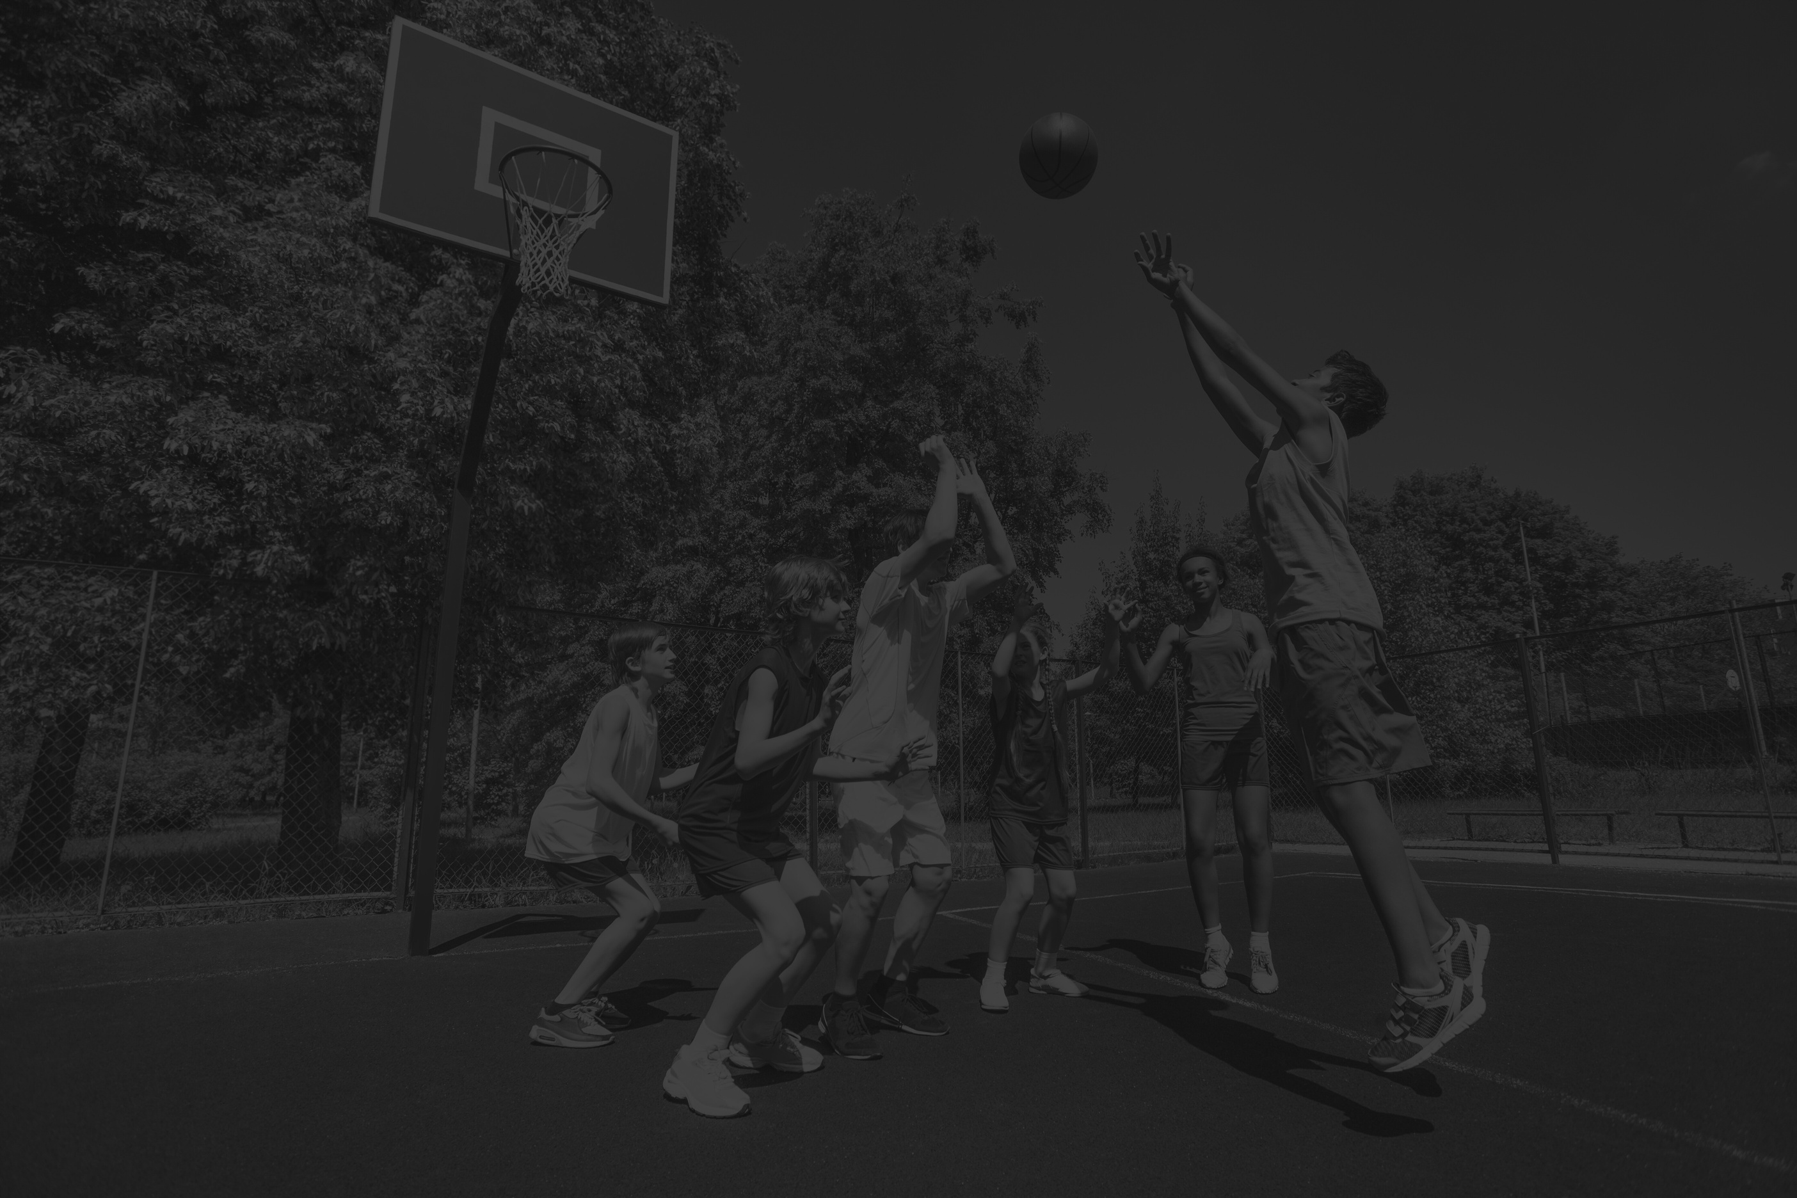
PLAY, LEARN, LEAD
Academic, Athletic & Social-Emotional Enrichment (2025–2026)
Prepared for: Heisman Trophy Youth Development Fund
Organization: [Your Nonprofit Name]
Date 9-0-2025

Slide 2

About Us / Organization Capacity
Mission: Empower Newark youth to succeed academically, physically, and socially.
Experience: [X years] in youth programs.
Reach: Serving [X number] youth annually.
Expertise: Staff with backgrounds in education, youth development, sports coaching.

Slide 3





PROBLEM STATEMENT
NEWARK YOUTH FACE:
Academic underperformance
Lack of affordable athletics
Social-emotional challenges (trauma, low confidence, risky behaviors
01

Slide 4

PROJECT SNAPSHOT
Funder: Heisman Trophy Youth Development Fund
Project Title: Play, Learn, Lead
Duration: 1 Year (July 2025 – June 2026)
Funding Requested: $40,000
In-kind Support: Meals & Snacks
01

Slide 5

Project Overview
Serving 150 Newark youth (ages 12–18)
Year-long program (July 2025 – June 2026)
Integrated supports:
Academics (≥4 hrs tutoring/week, workshops)
Athletics (weekly practices, tournaments, clinics)
SEL (reflection circles, peer mentorship)
Equity Supports (uniforms, snacks, transport)

Slide 6


PROGRAM COMPONENTS
Academic Enrichment → Tutoring + college/career workshops
Athletics → Practices, tournaments, guest clinics
SEL → Reflection circles + peer mentoring
Equity Supports → Uniforms, snacks, transport stipends

Slide 7

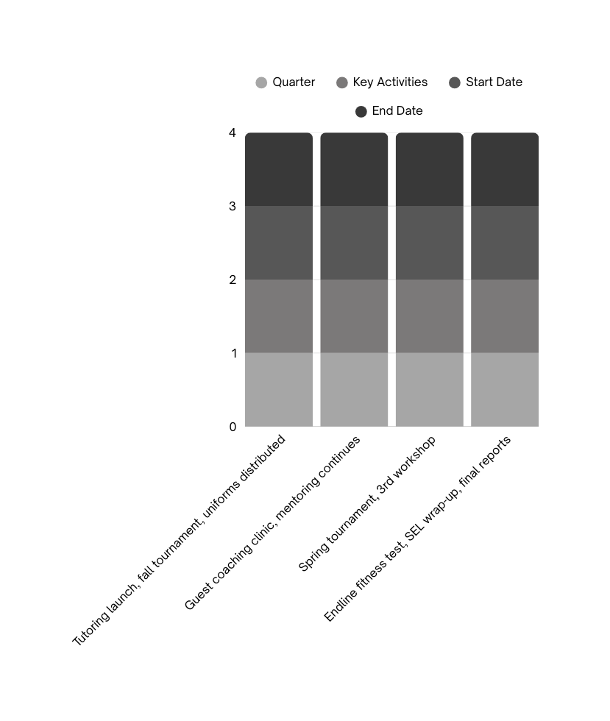
PROGRAM TIMELINE
Q1 (Jul–Sep 2025): Tutoring launch, fall tournament, uniforms distributed
Q2 (Oct–Dec 2025): Guest coaching clinic, mentoring continues
Q3 (Jan–Mar 2026): Spring tournament, 3rd workshop
Q4 (Apr–Jun 2026): Endline fitness test, SEL wrap-up, final reports

Slide 8


EXPECTED OUTCOMES
70% of participants → measurable academic gains
90% → improved athletic skills/conditioning
80% → stronger teamwork, confidence, SEL growth
100% → fully equipped with uniforms, meals, transport

Slide 9








STAFFING PLAN
Project Director
Leadership & compliance
Academic Coordinator
2 Coaches
SEL Facilitator
Data & Evaluation Coordinator
Mentorship Lead
Practices, tournaments
Reflection circles & mentoring
Alumni mentor program
Tutoring & workshops
Tracks progress
01

Slide 10
EVALUATION PLAN
Domains & Indicators:
Academics → GPA change, tutoring attendance, homework completion
Athletics → Practice/tournament attendance, fitness assessments
SEL → Surveys (Hello Insight), peer reflections
Methods
Frequency
Responsible Staff
Report cards, surveys, focus groups
Baseline, mid-year, endline
Academic Coordinator, Coaches, Data & Evaluation Coordinator

Slide 11
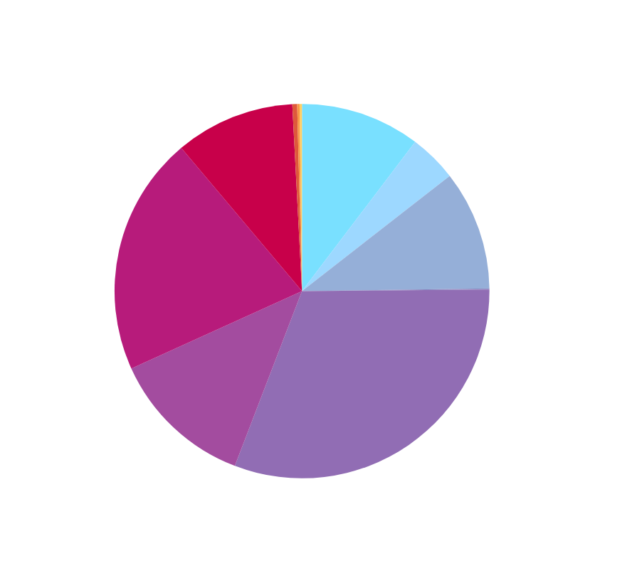
BUDGET SUMMARY
CATEGORY
Personnel: Project Director ($5,500 + other staff)
Transport Stipends: $1,000
Uniform Kits: $6,000
Shared Sports Gear: $2,000
Meals & Snacks: [in-kind contribution]

Slide 12
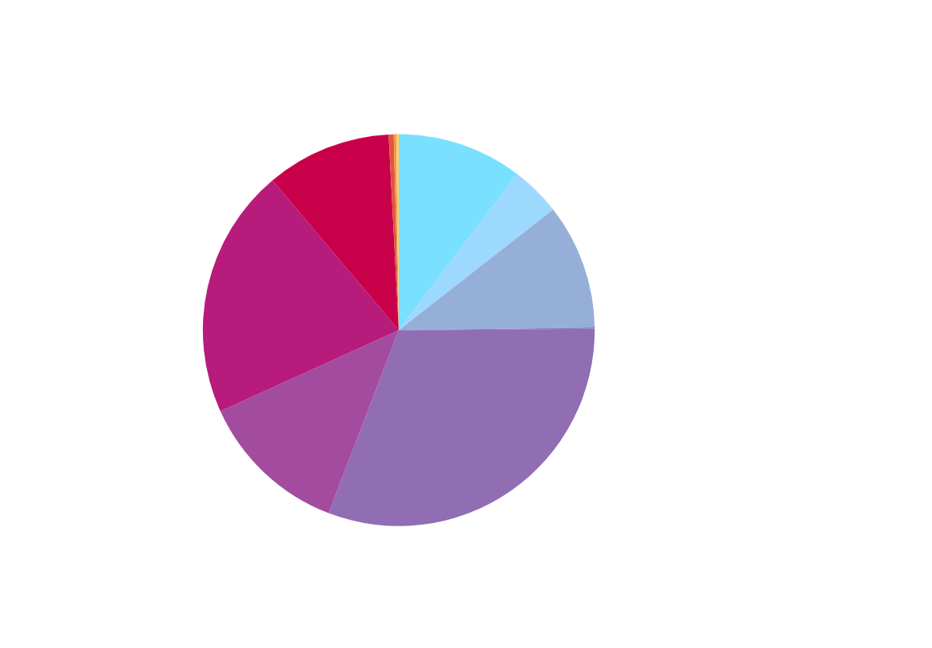
BUDGET SUMMARY
SUB CATEGORY
Personnel: Project Director ($5,500 + other staff)
Transport Stipends: $1,000
Uniform Kits: $6,000
Shared Sports Gear: $2,000
Meals & Snacks: [in-kind contribution]

Slide 13

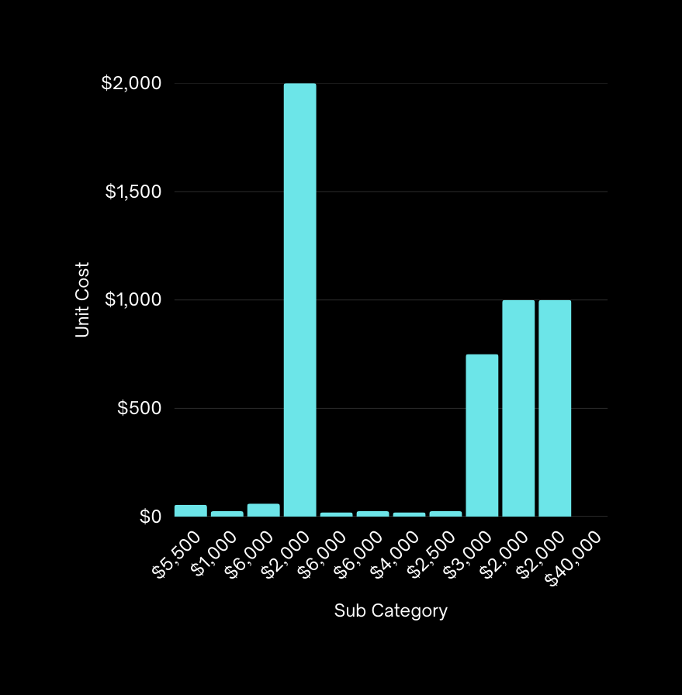
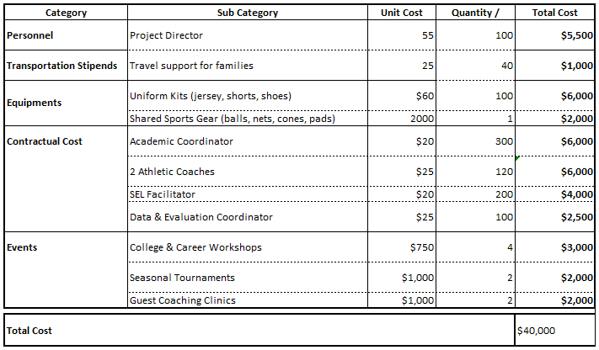
BUDGET SUMMARY

Slide 14
WHY SUPPORT THIS PROJECT?
Breaks academic, athletic, and social barriers.
Equips 150 youth with resilience, confidence, and life skills.
Evidence-based program with measurable outcomes.
Leverages in-kind community support (meals, snacks).

Slide 15

CLOSING
Join us in empowering Newark youth to Play, Learn, and Lead.

