Slide 1
Simulated Annealing Based Non-Slicing Floorplanning
Imam Al Razi & Md. Arafat kabir

Slide 2
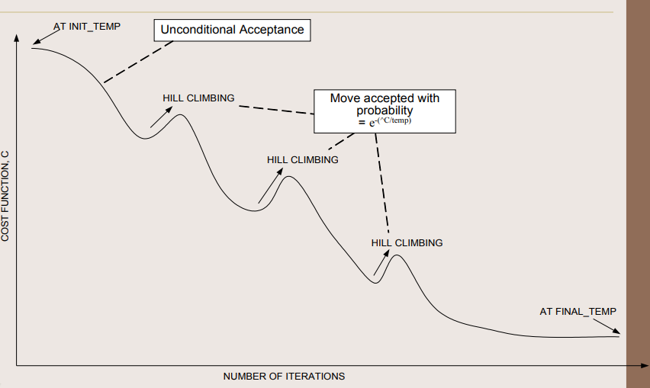
Simulated Annealing Using Sequence Pair
Iterative improvement algorithm to find global optimum solution.
Allows hill climbing depending on temperature of the system.
Sequence Pair is used for non-slicing
floorplan representation and manipulation.
Positive and negative sequences can
represent a floorplan.
Sequence pair gives P-admissible
solution space.

Slide 3
Tool organization
GUI in PyQt
Algorithm implementation in C++
Result Generation
GNUPlot for image generation
Matplotlib for interactive solution browser

Slide 4
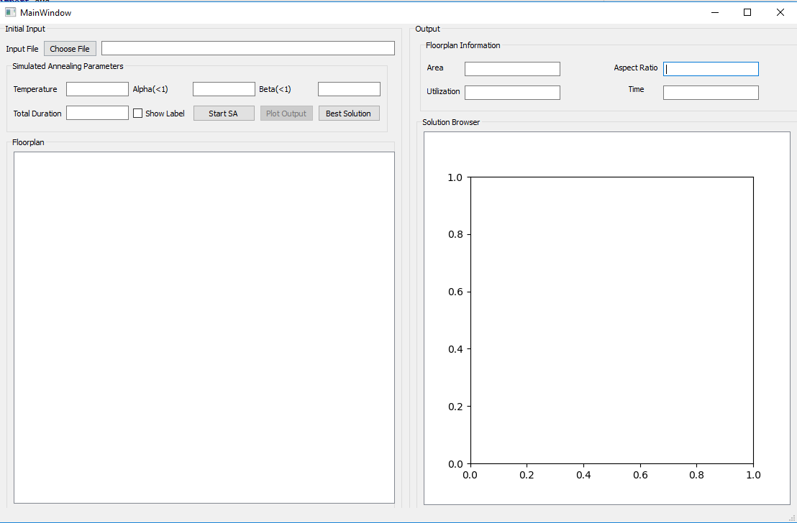
Tool Flow
A GUI is used to interact with user. The GUI has four parts.
Input file (.fp)
Simulated annealing parameters
Solution browser
Output parameters
Floorplan visualization
Generate Initial Sequence Pair
Run Simulated Annealing
4
1
2
3
Populate Data Structure
Collect Solutions
5
Read Input Script (.fp)
Show Floorplans and Other Relevant Information

Slide 5
Implementation Details (Datastructures)
Block table: All the information of a block can be accessed using the index only in constant time
No dedicated graph structure
Adjacency list implemented as hashtable (unordered_map, C++11)
Sequence Pair: Holds the current sequence pair and manipulates the block information whenever there is a change in the SP
Can build the constraint graphs based on given sequence pair
Can update the constraint graphs when a move is applied, can undo the moves as well
Evaluate the locations of the blocks
Furnace: implements the “Annealing” process
Generates random moves based on temperature
Stores the snapshots of the solutions at different temperatures
Generates the plot information to visualize the annealing process

Slide 6
Implementation Details (Algorithms)
Moves: 3 types of moves,
Swap blocks of two locations in Positive Sequence, O(V+E)
Swap blocks of two locations in Negative Sequence , O(V+E)
Rotate a random block, O(1)
Swap range is proportional to the temperature. Only the affected regions of the constraint graphs are updated.
Update Locations: Locations are updated in topological sorted order (longest path algorithm), O(V+E)
Saving snapshots: Snapshots are saved in text format (gnuplot script). Later gnuplot is used to convert the text into images for plotting

Slide 7
Outputs for Benchmarks
Benchmarks | Number of Modules | Best Solution Properties
 |  | Area | Utilization | Aspect Ratio | Runtime (s)
processor.fp | 18 | 1930500 | 92.87% | 0.944(1.06) | 1
Industry.fp | 32 | 4458795 | 93.71% | 0.90 (1.1) | 74
rca.fp | 95 | 407520 | 92.07% | 0.786 (1.27) | 35
mult.fp | 127 | 4384800 | 95.29% | 0.9298 (1.06) | 80

Slide 8
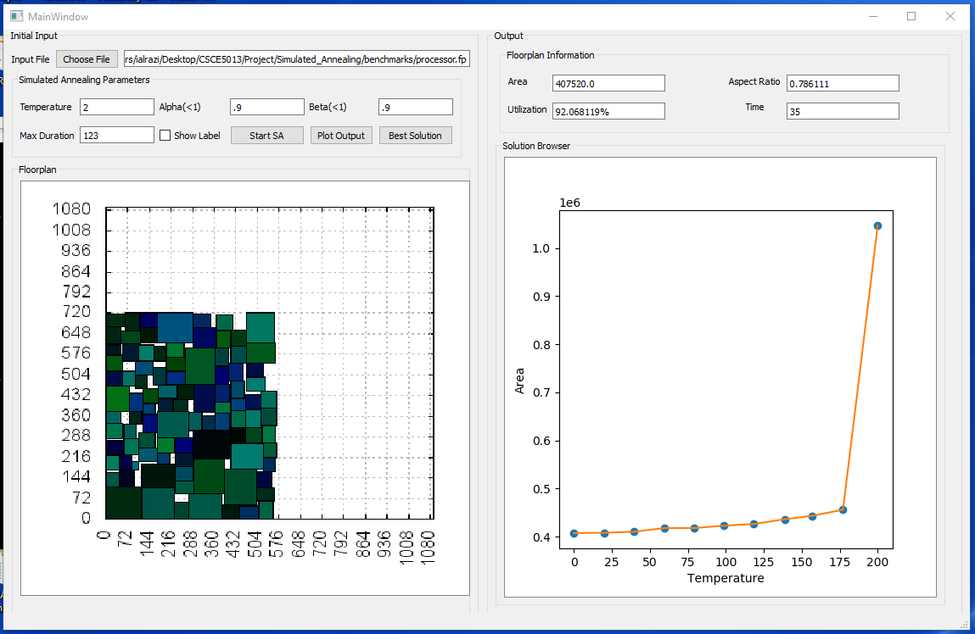
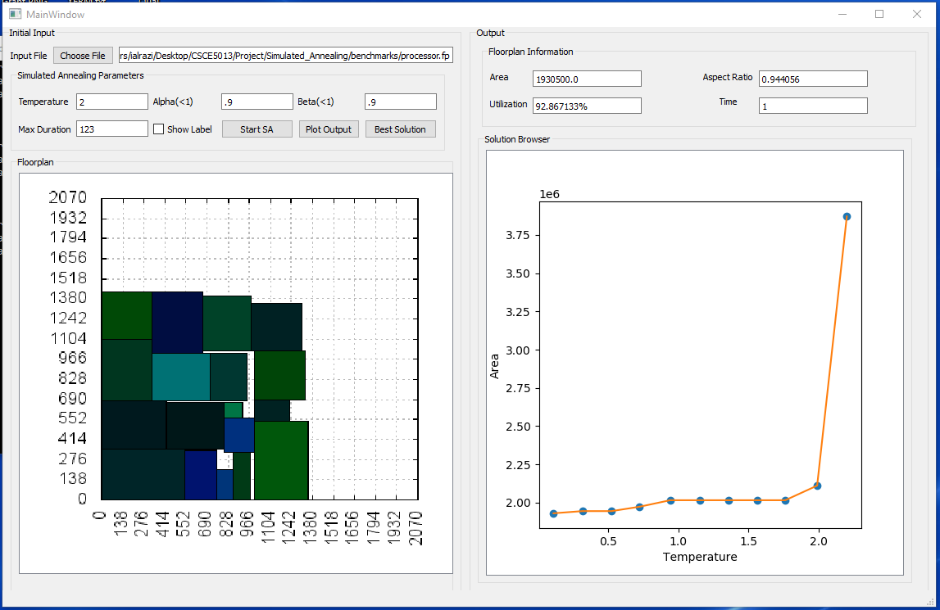
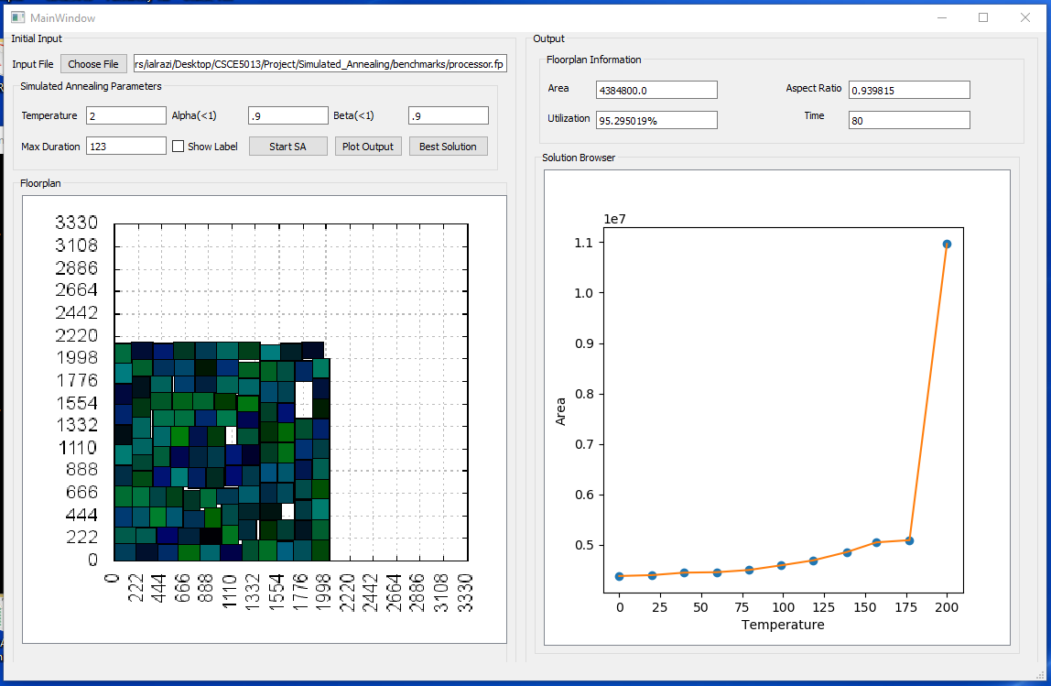
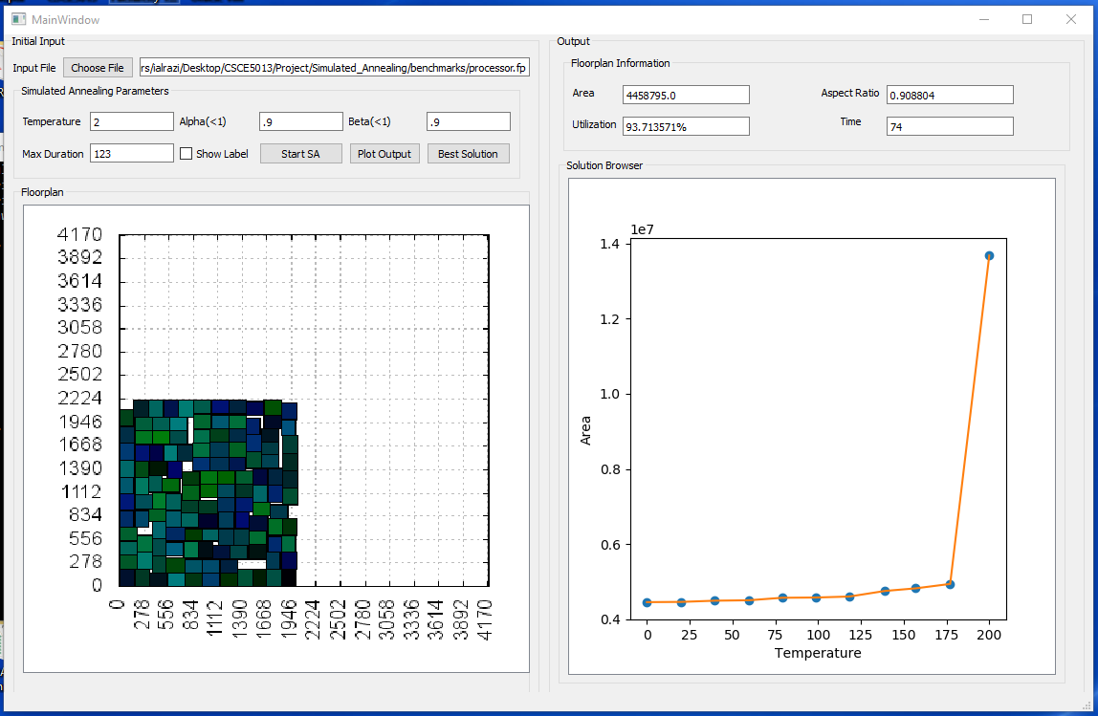
rca.fp
processor.fp
mult.fp
industry.fp

Slide 9
Contribution
Steps | Imam | Arafat
Parser.exe: Read input file Create initial sequence pair Populate initial HCG and VCG information | X
Furnace.exe: Apply annealing routine Calculate new floorplan area Plot floorplans |  | X
GUI and Visualization | X | X

Slide 10
Demo

Slide 11
Potential Improvements
Updating locations:
After a move is applied we evaluated the locations of all blocks. But it would be sufficient to update only the blocks who are successor of the affected blocks only
Cost calculation:
For cost calculation we evaluated the locations of all the blocks. But it would be sufficient to evaluate the locations of the blocks only in the longest path
Wire length considerations:
We did not consider the wire length while calculating the cost. A balance between area and wire length could have been achieved using a balance factor.

Slide 12

Questions

