Slide 1
Geomática Básica
Practical 1
Introduction to QGIS
Esta práctica debe realizarze en su computador
Alternativamente, use la sala de informática

Slide 2
Topics for Today
1. What is QGIS
2. Pre-requisites
3. Basic Operations in QGIS
4. Homework 1

Slide 3

What is QGIS
https://qgis.org/

Slide 4

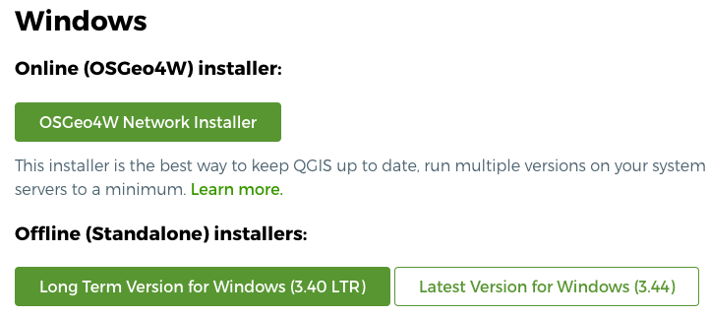
Pre-requisites
Pre-requisite 1: You have installed QGIS in your computer
https://qgis.org/resources/installation-guide/#windows

Slide 5
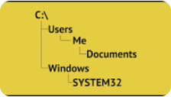
Pre-requisites
Pre-requisite 2: You have created folders for your work in GB2
1. Under Documents create a folder named GB2
2. Under GB2 create a folder named Proyecto1
3. Under Proyecto1 create a folder named Datos

Slide 6
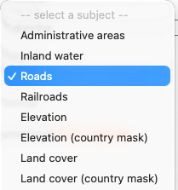
Pre-requisites
Pre-requisite 3: You have downloaded geospatial data
- Go to https://diva-gis.org/data.html
- In Country, select Colombia
- In Subject, select Administrative Areas
- Download COL_adm.zip
✓
Repeat the process for the following subjects:
✓
✓

Slide 7
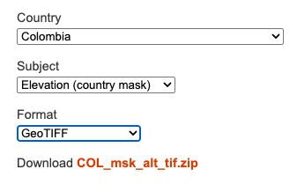
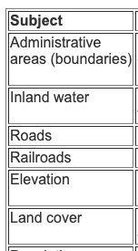
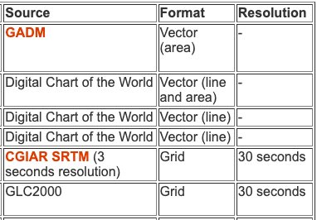
Pre-requisites
Pre-requisite 3: You have downloaded geospatial data
Download raster data
in GeoTIFF format

Slide 8
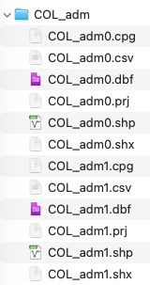
Pre-requisites
Pre-requisite 4: You have unzipped geospatial data in GB2
7-Zip
WinRAR
WinZip
Zipped
Unzipped

Slide 9
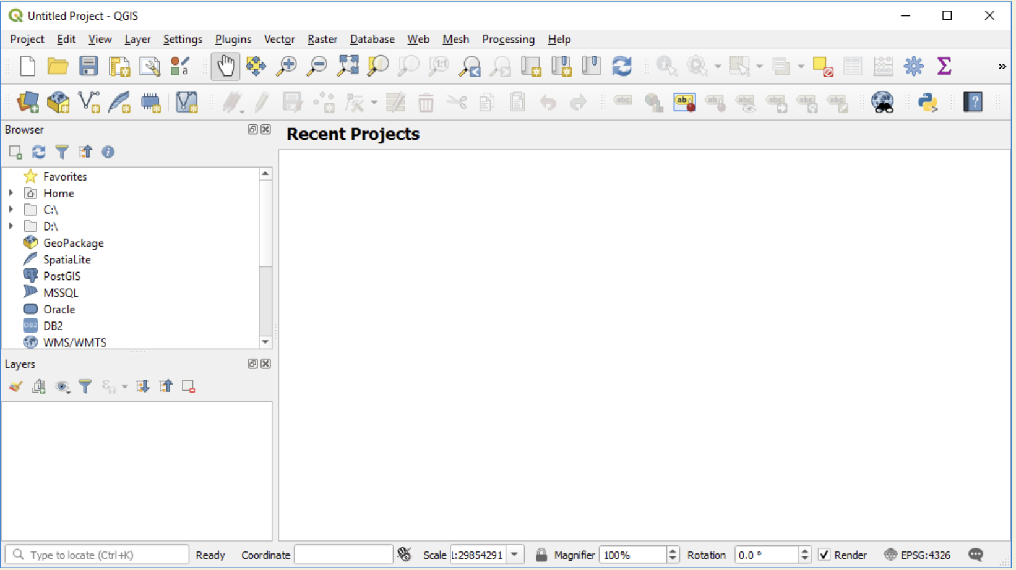
Basic Operations
QGIS Graphic Interface

Slide 10
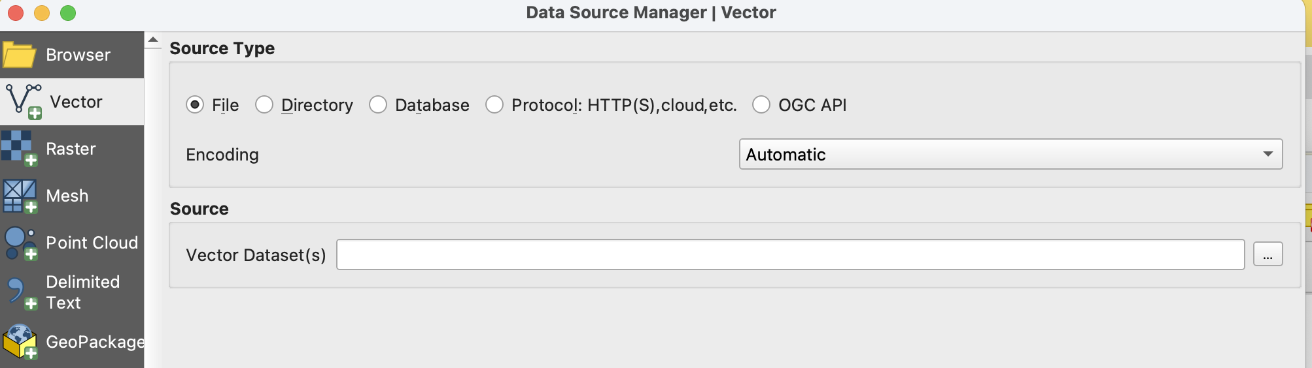
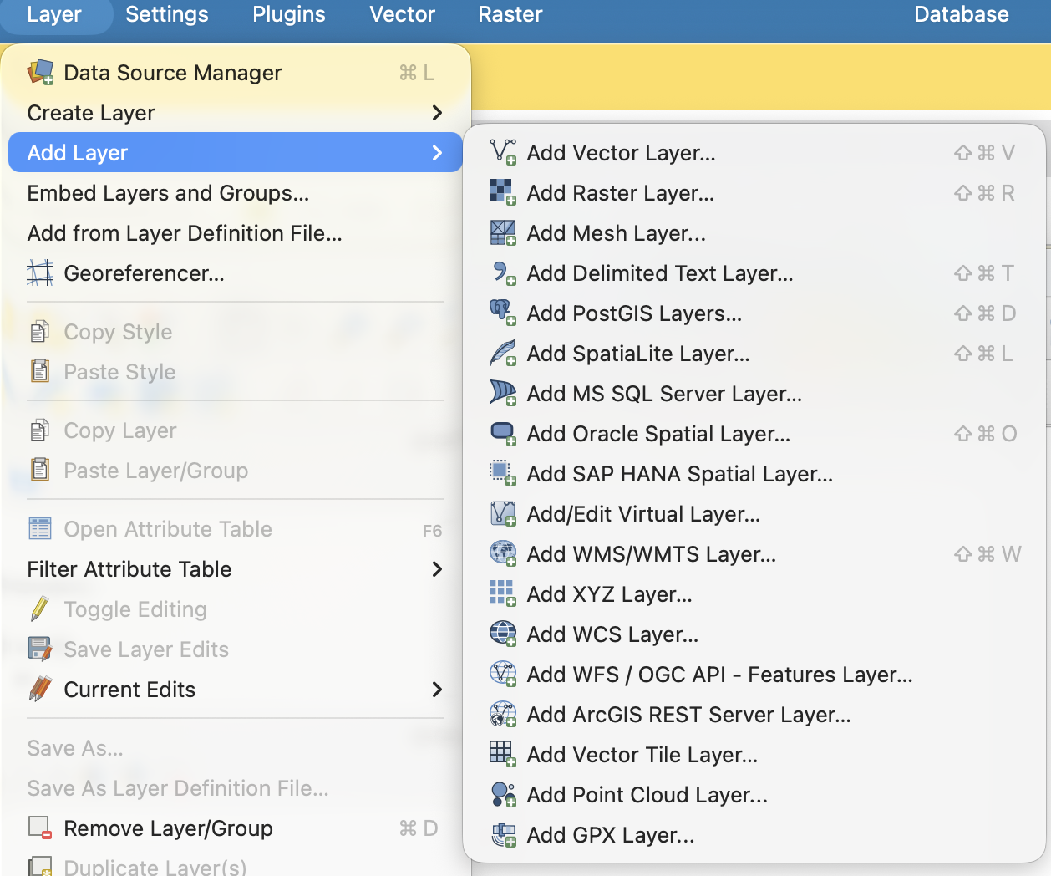
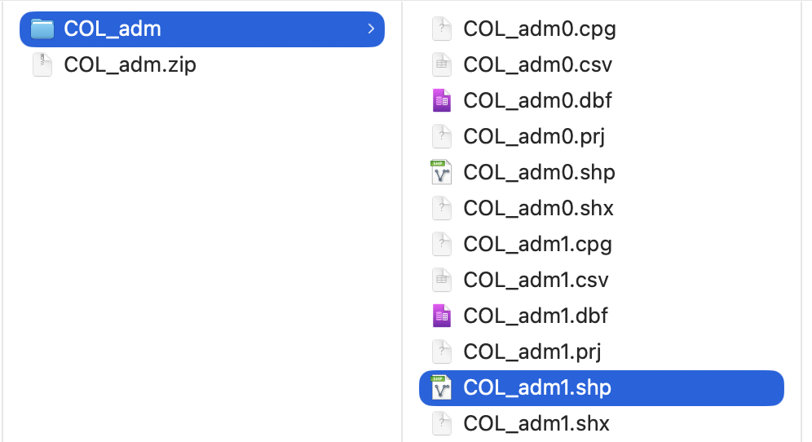

Basic Operations
2
1
3

Slide 11
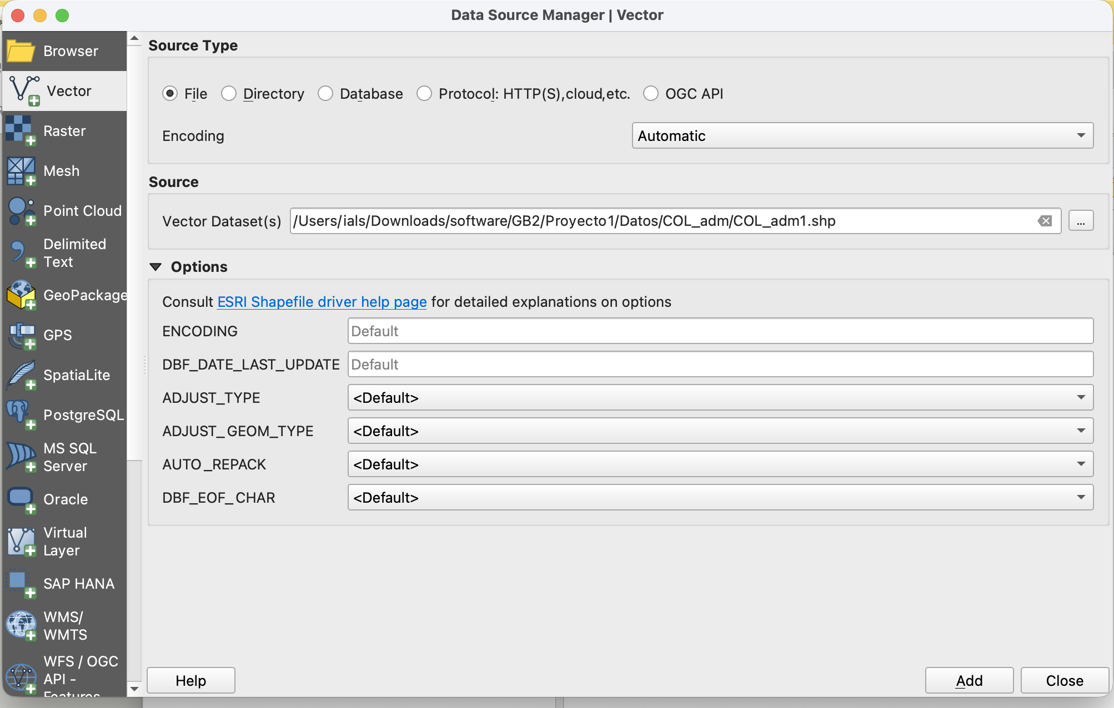
Basic Operations
4

Slide 12
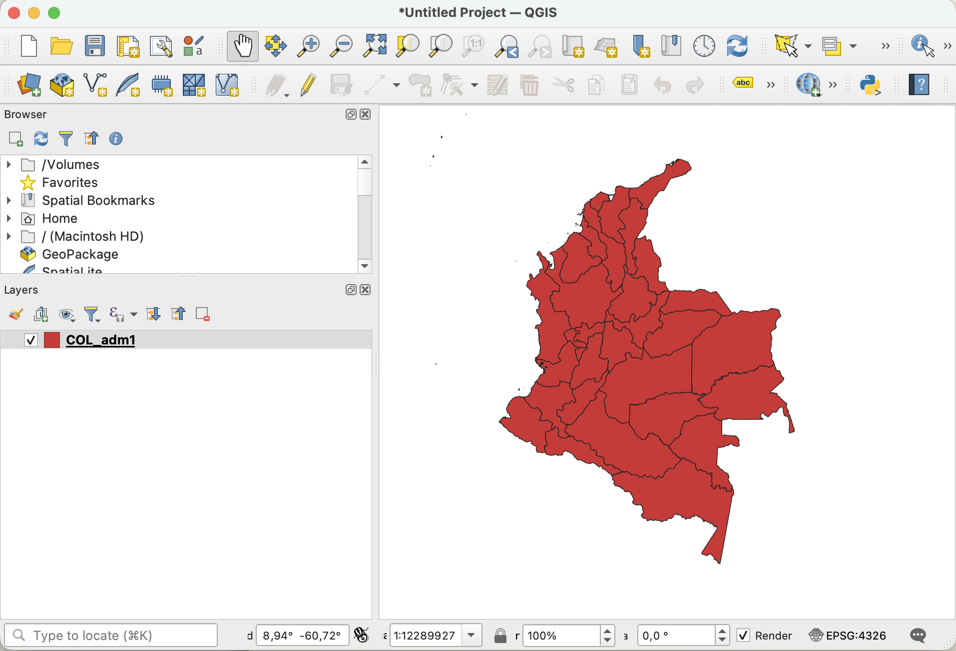
Basic Operations

Slide 13
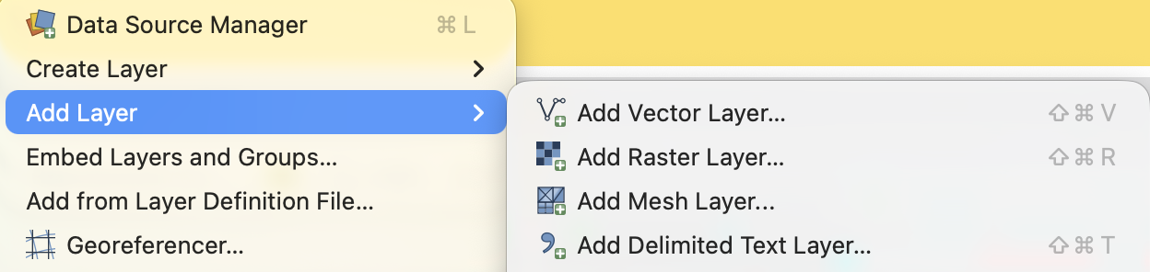

Basic Operations
Repeat the procedure to add the remaining layers
✓
✓
✓
Note that Elevation is a raster layer

Slide 14
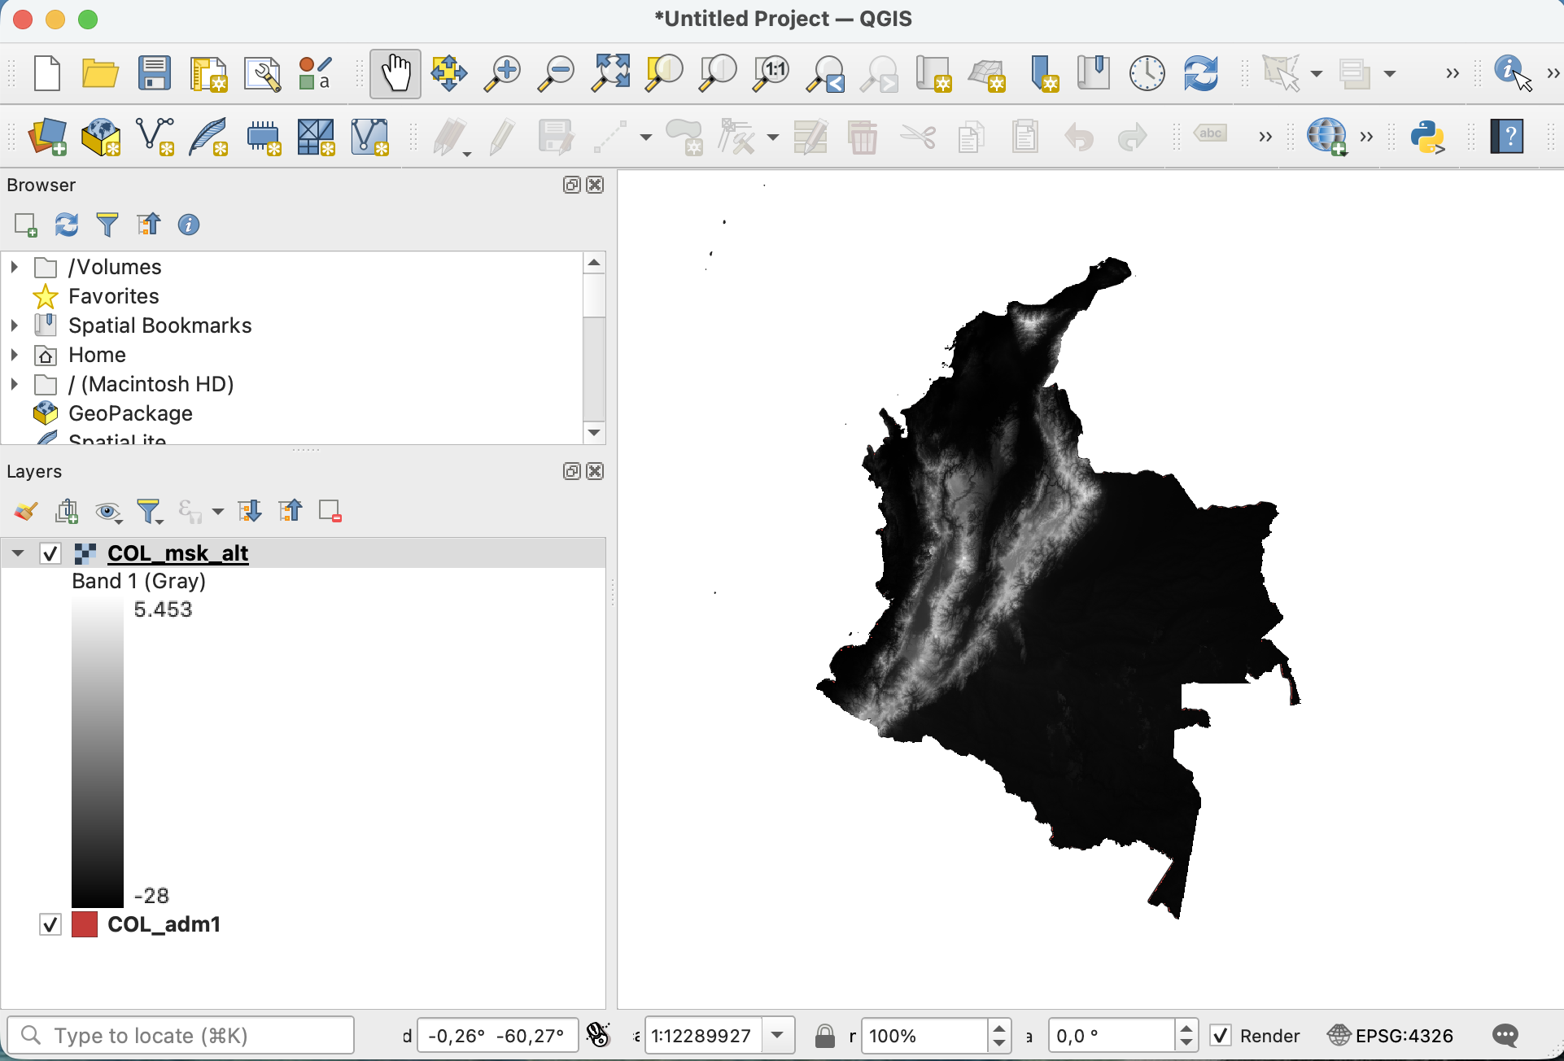
Basic Operations

Slide 15
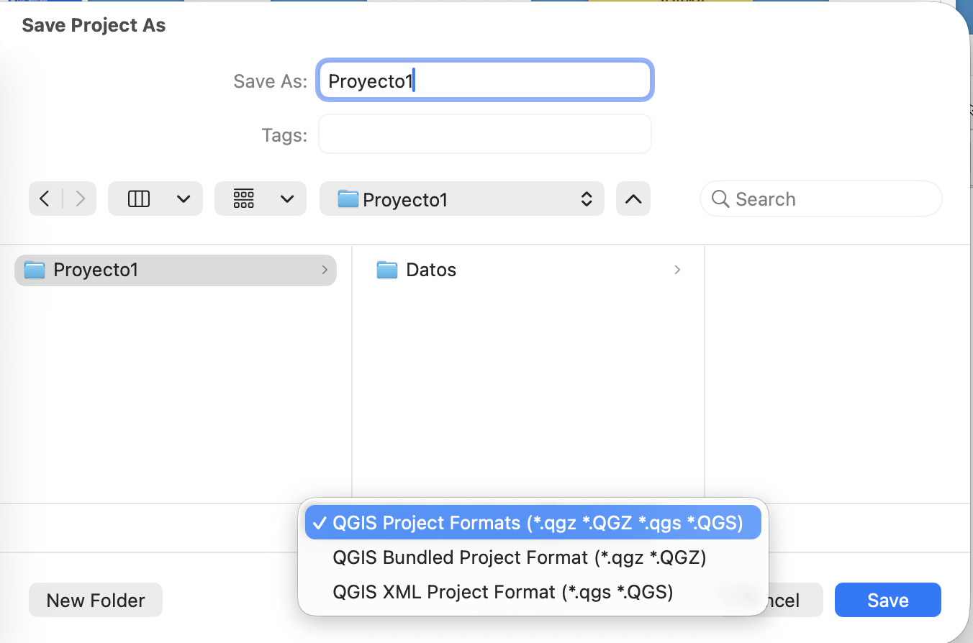
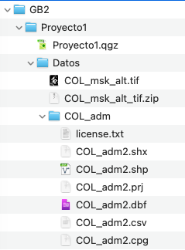
Basic Operations
Save your project:
Your files should look:

Slide 16
Homework
Bring an USB with the folder GB2
to the classroom on 11 February

