Slide 1
Geomática Básica
Practical 2
QGIS - Basic operations
Esta práctica debe realizarze en la segunda semana

Slide 2
Topics for Today
Metadata
Clipping and Extracting
3. Vector & Raster Symbology
4. Homework 2
IALS, 2026

Slide 3
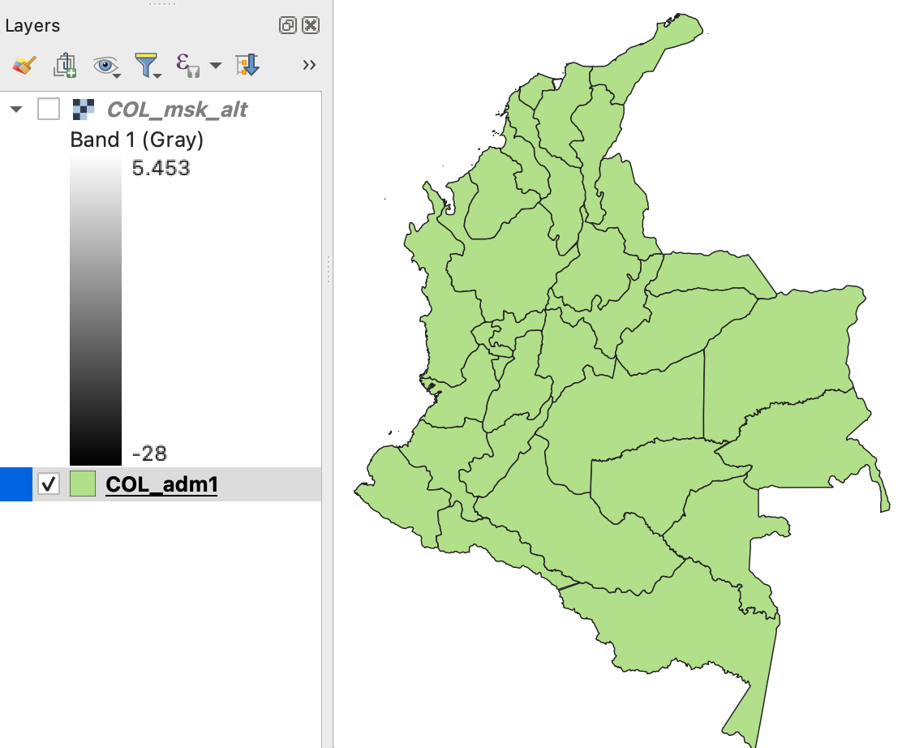
Metadata
Open Proyecto1.qgz

Slide 4
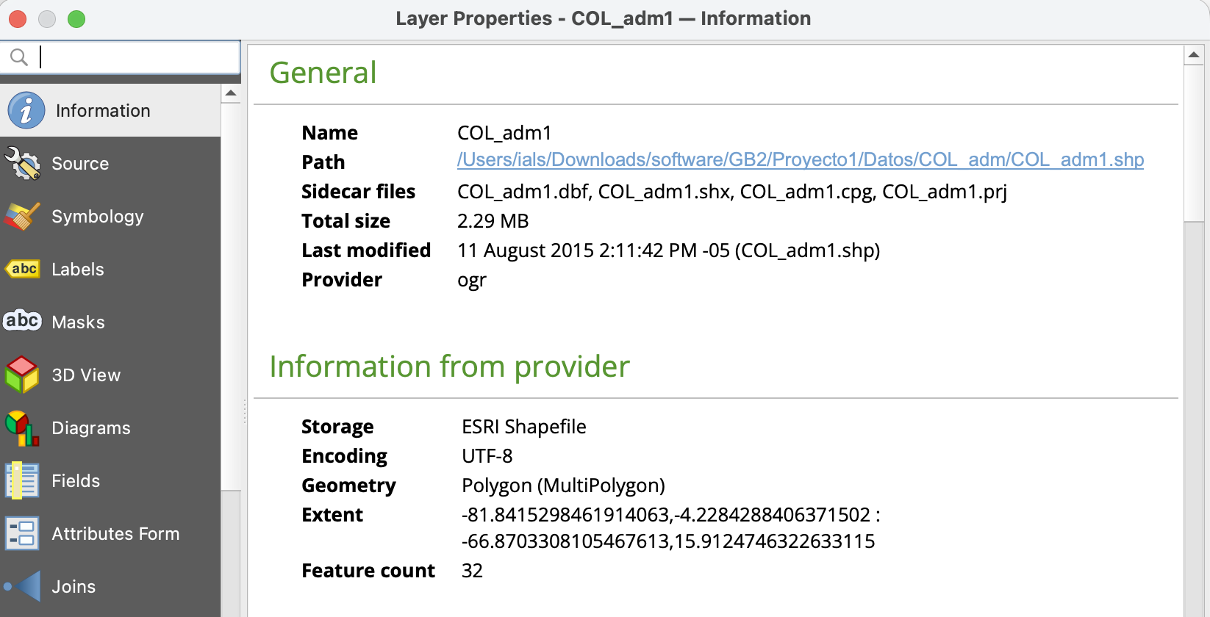
Metadata
2. In the Layers tab, double click on COL_adm1 to get metadata

Slide 5
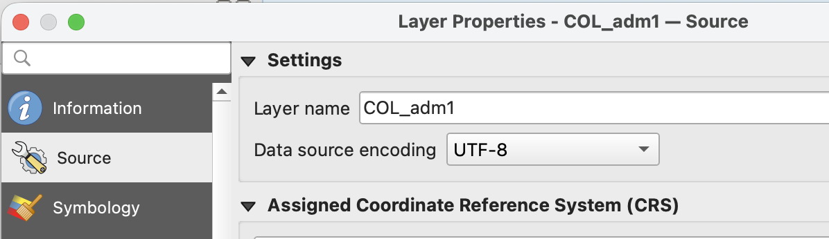
Metadata
3. Click on Source to change layer’s name:
Rename the Layer as “Departamentos”

Slide 6
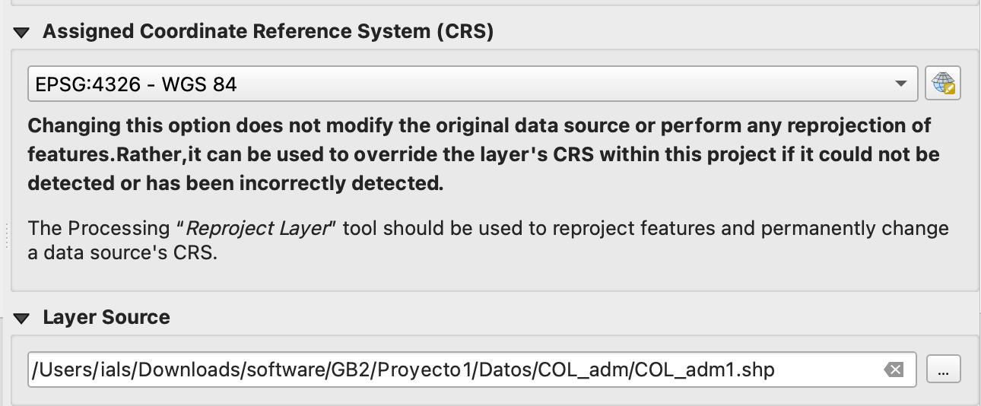
Metadata
4. Review CRS and Layer Source:

Slide 7
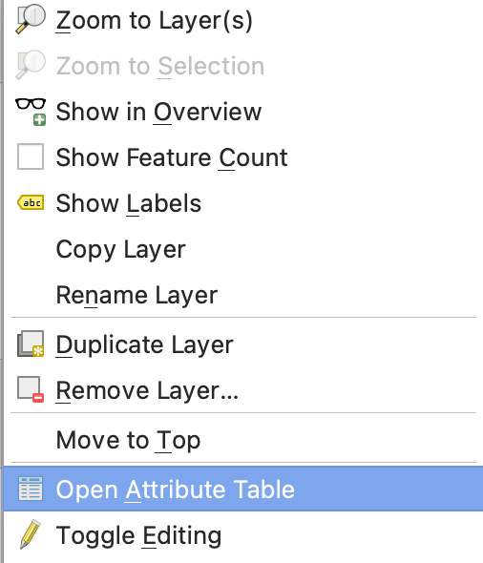
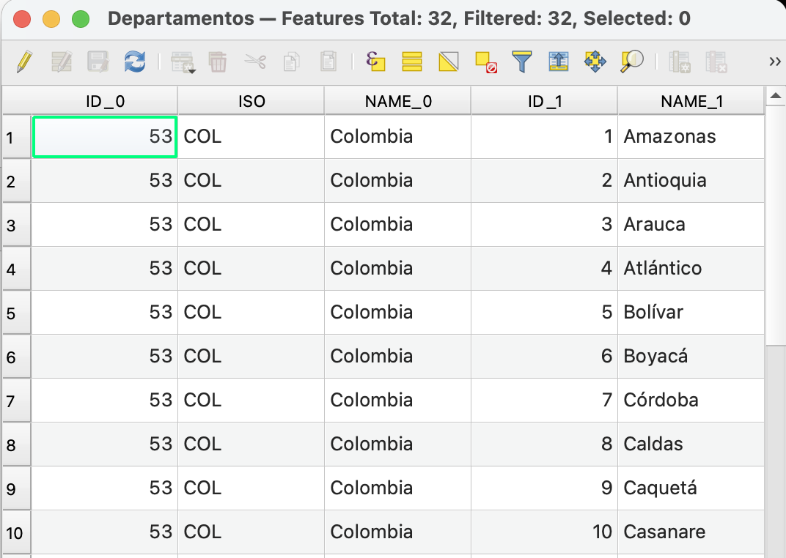
Extracting vector data
1. Right click on Departamentos:
2. Click on the Select by Expression icon:

Slide 8
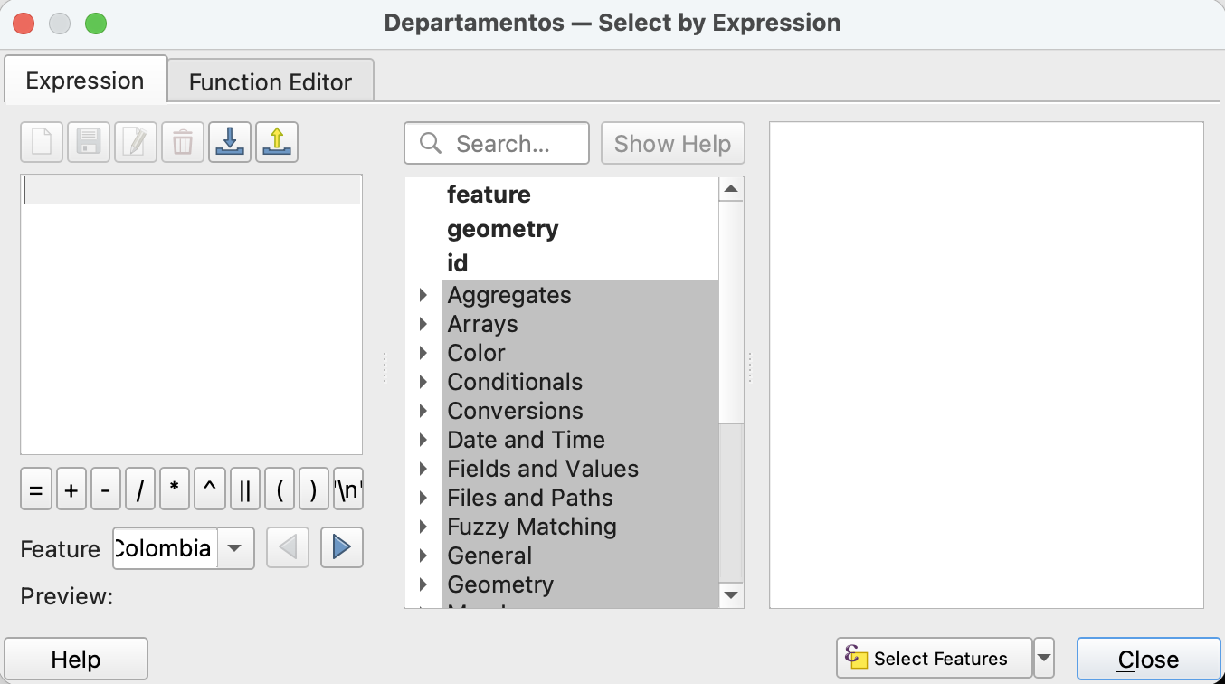
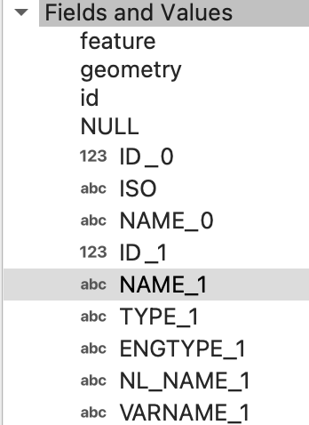
Extracting vector data
3. In the new window:

Slide 9
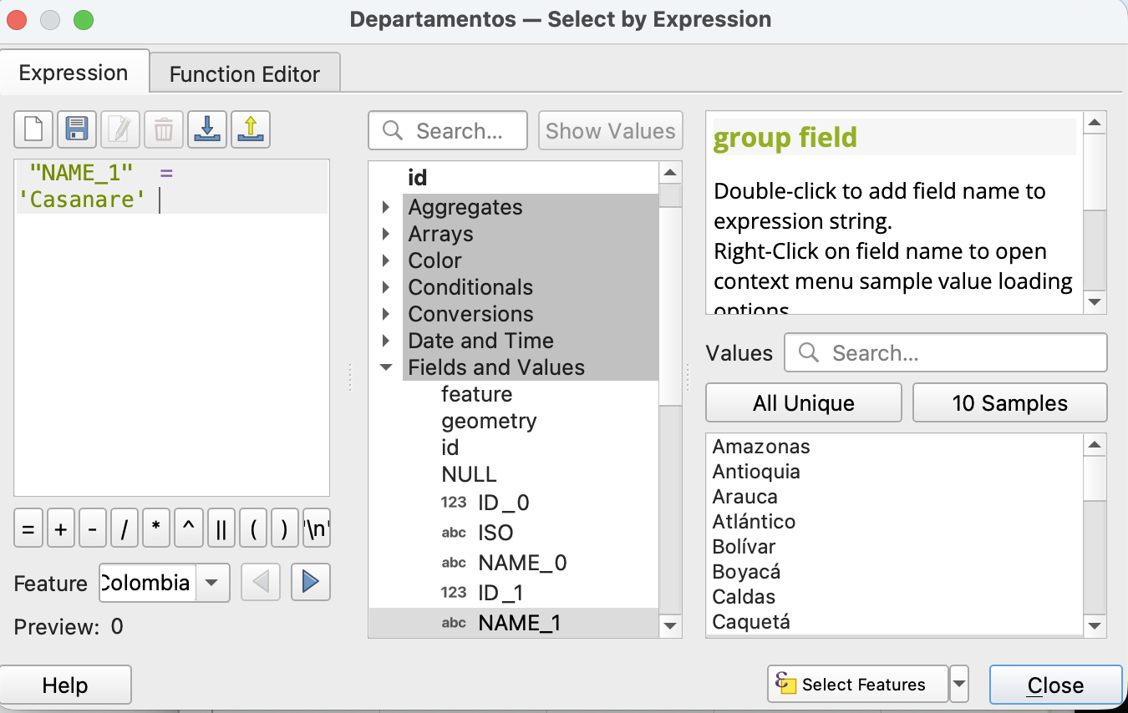
Extracting vector data
4. Write the expression to select your Departamento:
5. Click on
“Select Features”

Slide 10

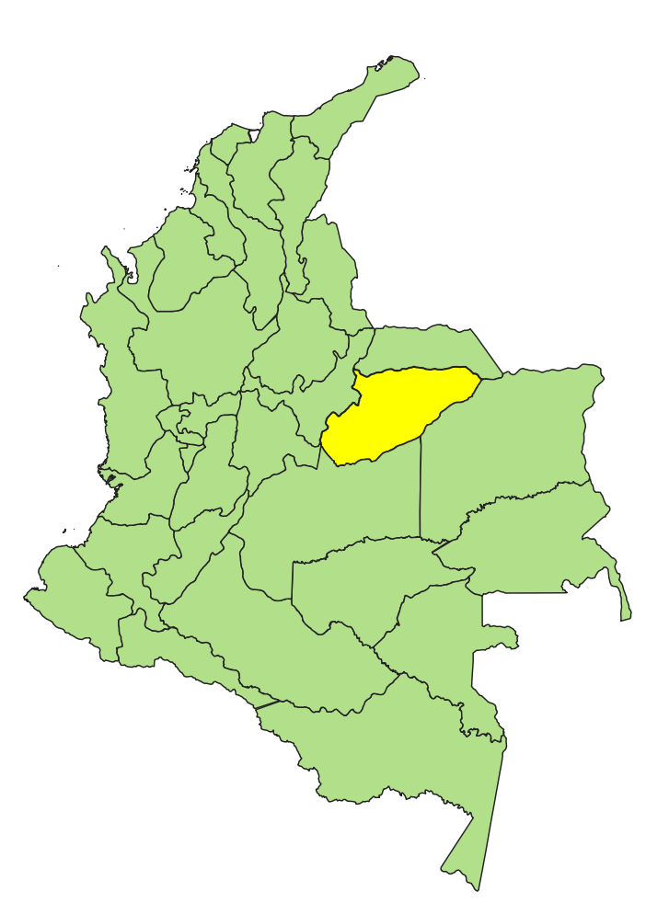
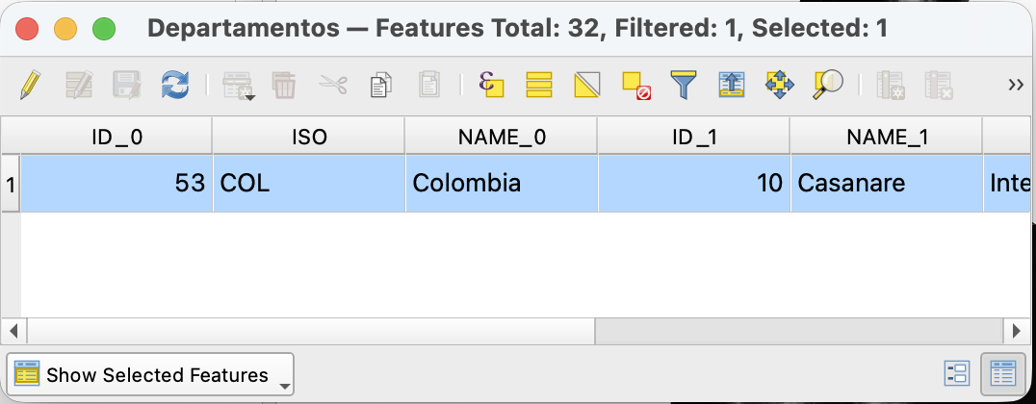
Extracting vector data
6. Check the result:
Attribute Table
Map Display

Slide 11
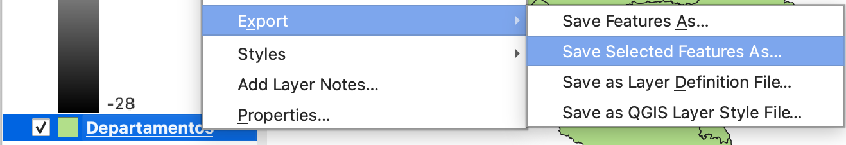
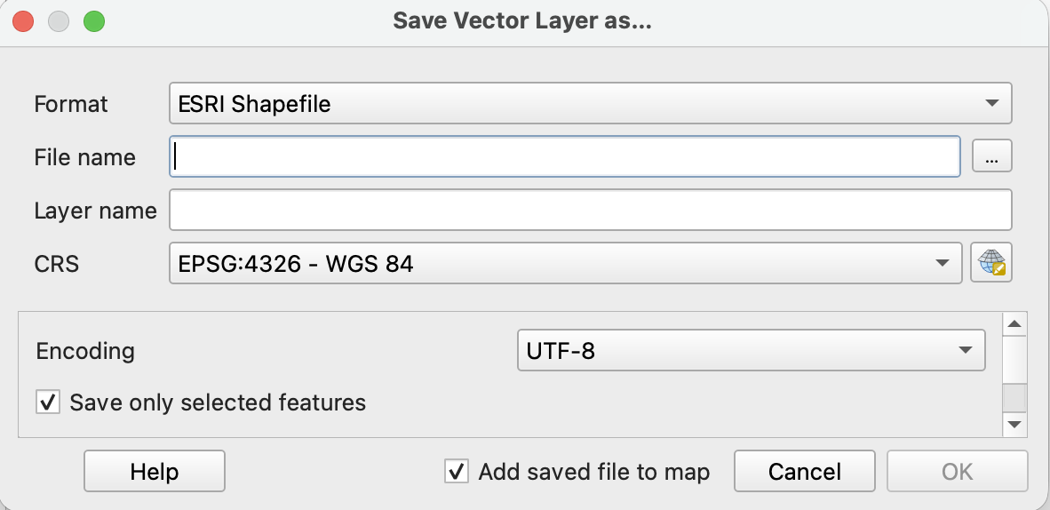
Extracting vector data
7. Export the selected Departamento:
Save it
under GB2/Proyecto1/Datos

Slide 12
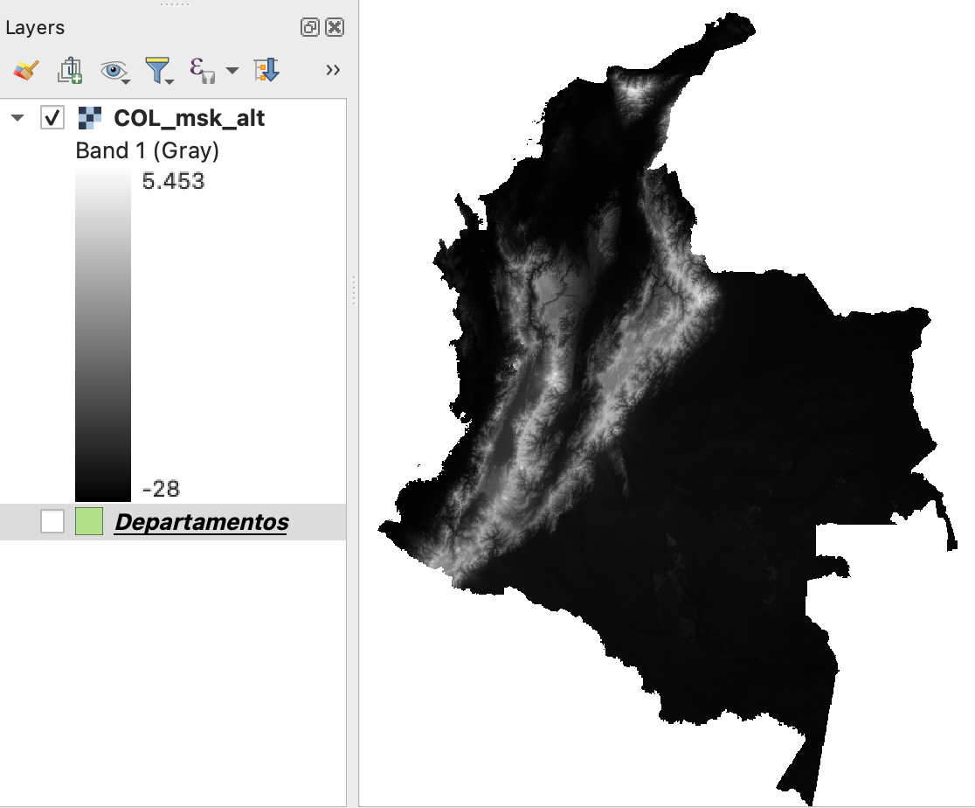
Extracting raster data

Slide 13
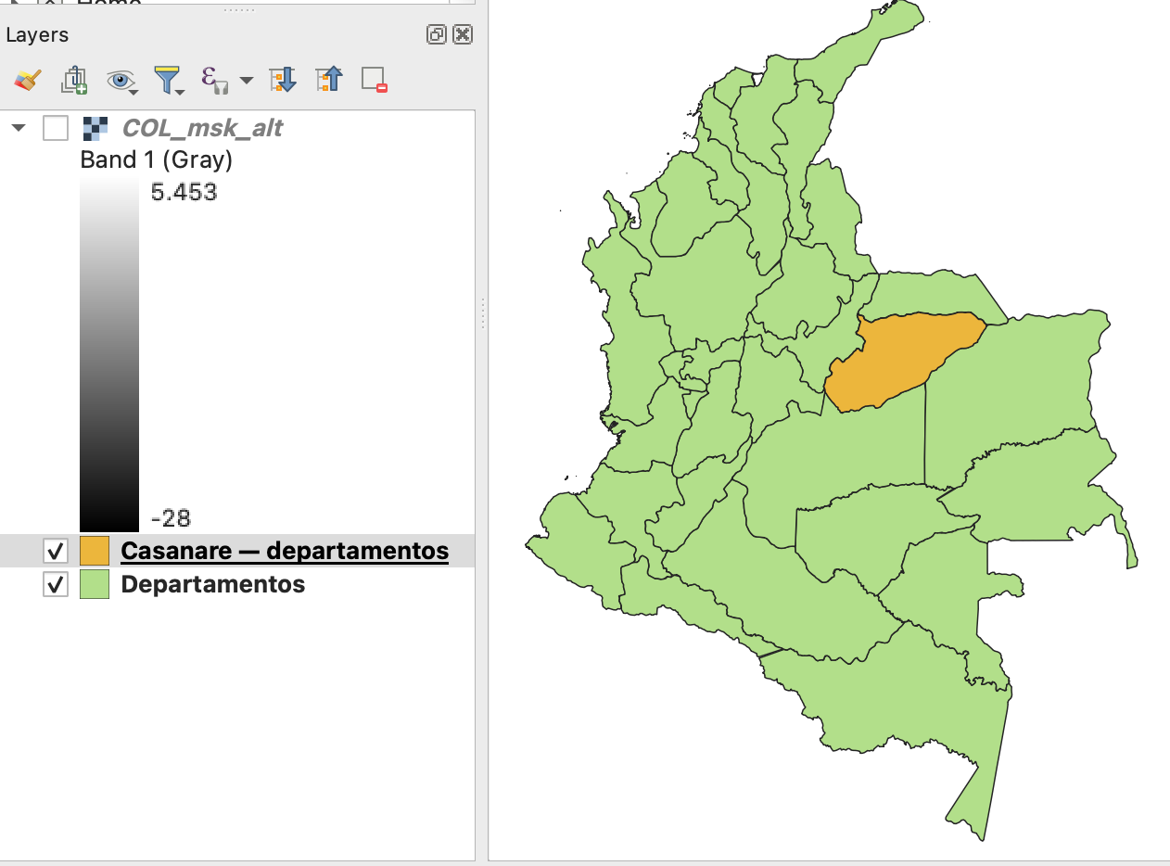
Extracting raster data

Slide 14
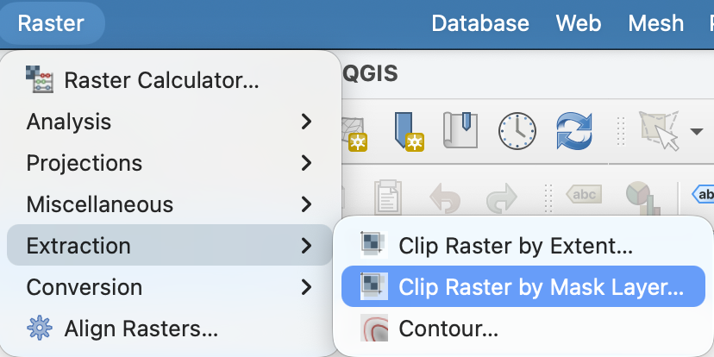
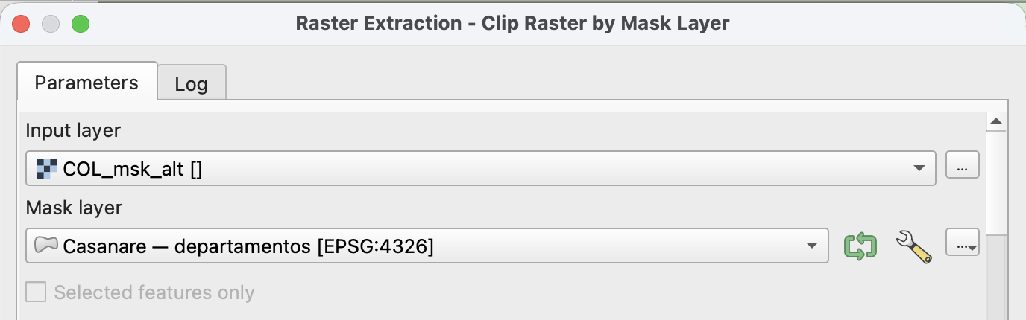
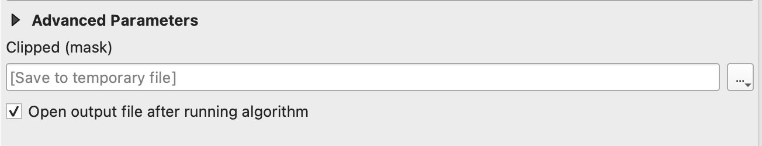
Extracting raster data
In the Menu bar, go to Raster
Select Input layer and Mask layer:
Save it as a TIF file:
e.g. Casanare.TIF

Slide 15
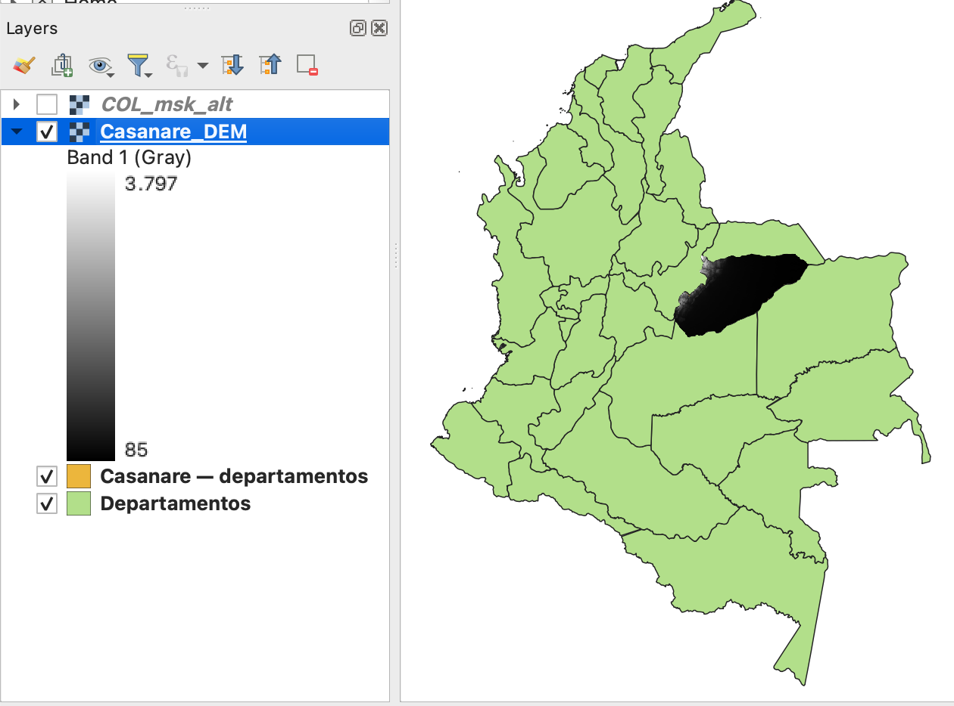
Extracting raster data

Slide 16
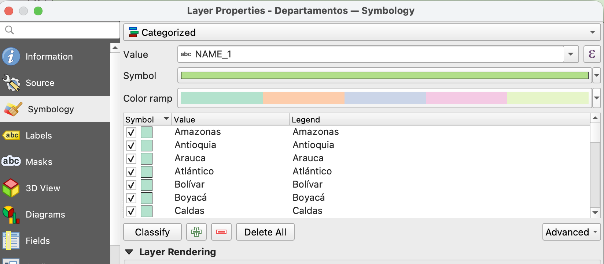
Vector Symbology

Slide 17
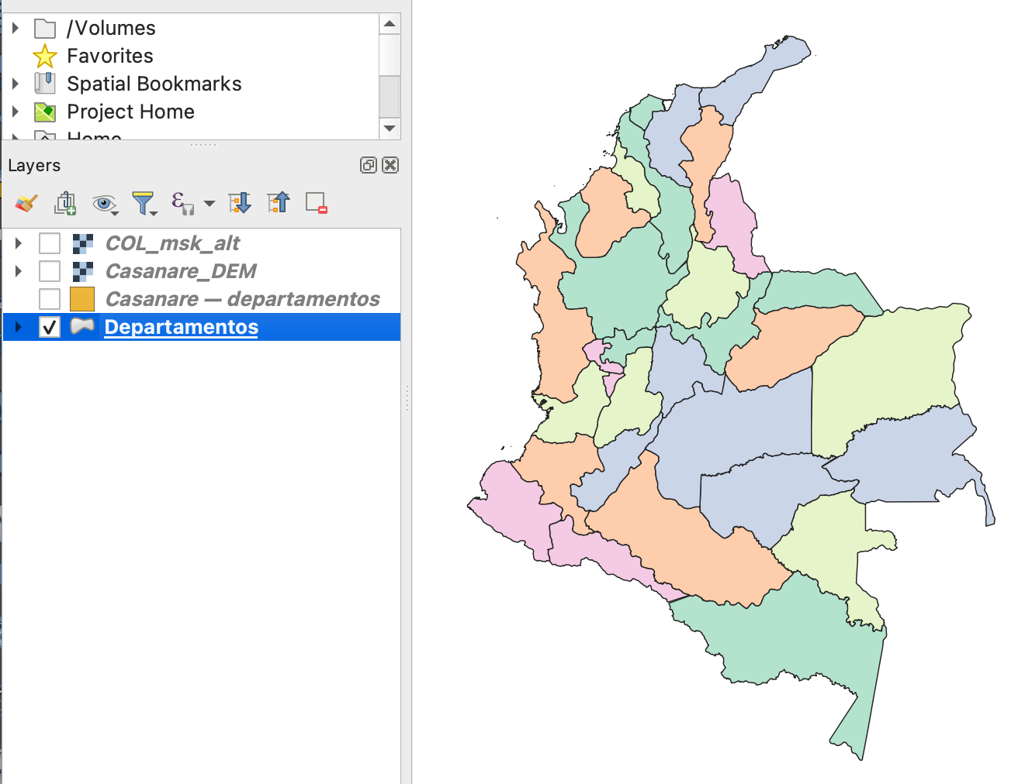
Vector Symbology

Slide 18
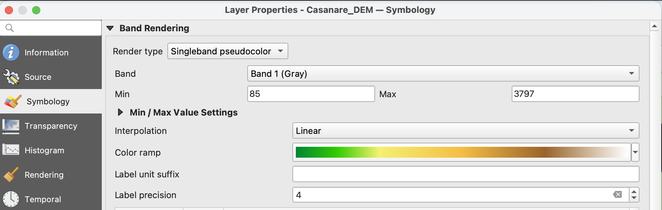
Raster Symbology

Slide 19
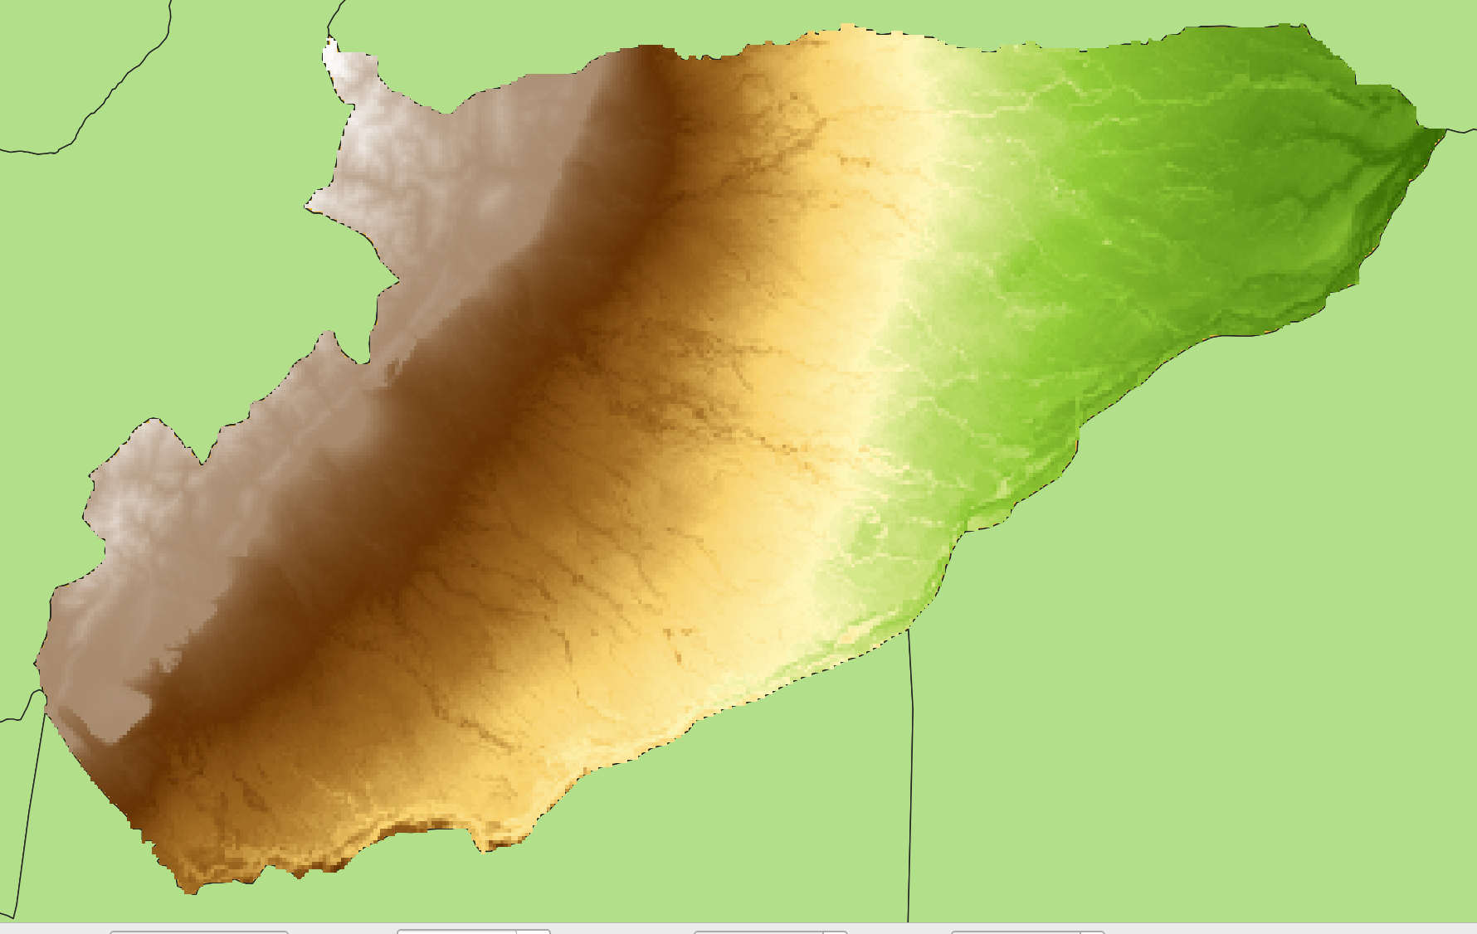
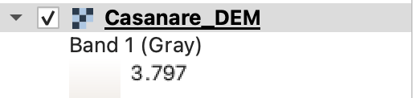
Raster Symbology

Slide 20
Homework
Save your project
Bring an USB with the folder GB2
to the classroom on 18 February
IALS, 2026

