Slide 1


BRAIN TUMOR DETECTION USING ML & DL MODELS
Presented By
Student Name: K.ABHILASH REDDY
College Name: KAKATIYA INSTITUTE OF TECHNOLOGY AND SCIENCE
Department: COMPUTER SCIENCE AND ENGINEERING(NETWORKS)
Email ID: k.Abhilashreddy0312@gmail.com
AICTE Student ID:STU67fe6d529fc7f1744727378

Slide 2
OUTLINE
Problem Statement
Proposed System/Solution
System Development Approach (Technology Used)
Algorithm & Deployment
Result (Output Image)
Conclusion
Future Scope
References

Slide 3
Problem Statement
Brain tumors are life-threatening conditions that arise due to the abnormal growth of cells within the brain. Accurate and early diagnosis is critical for effective treatment and improved survival rates. Traditional methods of diagnosis, such as manual inspection of MRI scans by radiologists, are time-consuming and prone to human error due to the complexity and variability in tumor appearance, size, and location. With the growing availability of medical imaging data and advancements in artificial intelligence, there is a pressing need to develop automated tools that can assist in the detection and classification of brain tumors with high accuracy and reliability.
This project aims to develop a machine learning and deep learning-based system to automatically detect and classify brain tumors from MRI images. The objective is to create a model that can differentiate between tumor types (such as glioma, meningioma, and pituitary tumors) or distinguish tumor presence from normal brain tissue. By leveraging image processing, feature extraction, and advanced classification algorithms, the model will serve as a decision-support tool for medical professionals. The solution should achieve high precision, sensitivity, and specificity while being robust enough to generalize across different patient data, ultimately helping in faster diagnosis and better treatment planning.

Slide 4
Proposed Solution
To tackle the challenge of early and accurate brain tumor detection, we propose a deep learning-based classification model using MRI scans. The approach leverages convolutional neural networks (CNNs) for automatic feature extraction and classification.
Data Collection:
Used dataset from kaggle containing labeled brain MRI images.
Preprocessing:
Apply grayscale conversion, resizing, normalization, and noise removal for consistency.
Data Augmentation:
Introduce image variations (rotation, flipping, scaling) to expand training data and reduce overfitting.
Model Architecture:
Build a custom CNN or use transfer learning with pretrained models like VGG16 and train the model to detect tumors or classify tumor types (glioma, meningioma, pituitary).
Deployment:
Web App Interface: Build a simple and interactive front-end using PycharmUser Input: Upload MRI images via the interface for real-time prediction.
Evaluation:
Metrics: Accuracy, Precision, Recall, F1-Score, Confusion Matrix.

Slide 5
System Approach
Technologies used :
Python Programming Language
Libraries required:
NumPy, Pandas, Matplotlib, Scikit-learn, Tensorflow, keras
Development Tools:
GoogleColab, Pycharm, GitHub

Slide 6
Algorithm & Deployment
Algorithm Selection:
A Convolutional Neural Network (CNN) and VGG16 are chosen for its strength in automatically extracting features from MRI images, making it ideal for tumor detection. Transfer learning with pretrained models like VGG16 can further improve accuracy and reduce training time.
Data Input:
The model uses preprocessed and normalized brain MRI scans resized to a standard dimension, along with labeled tumor classes (glioma, meningioma, pituitary, or normal). Data augmentation techniques increase training data diversity and robustness.
Training Process:
The CNN is trained on labeled MRI images using cross-validation and early stopping to avoid overfitting. Hyperparameters like learning rate and batch size are tuned to optimize performance on validation data.
Prediction Process:
The trained model predicts tumor presence and type by analyzing new MRI scans, outputting class probabilities. Grad-CAM visualizations help highlight important image regions, aiding interpretability for clinicians.

Slide 7
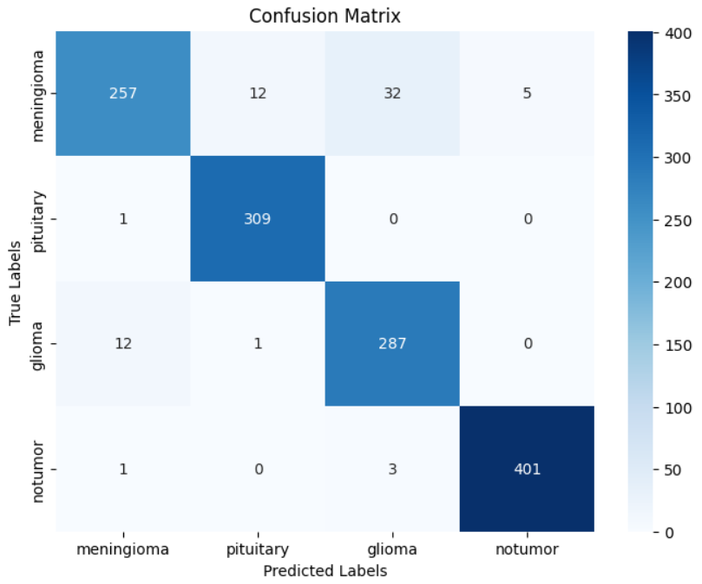
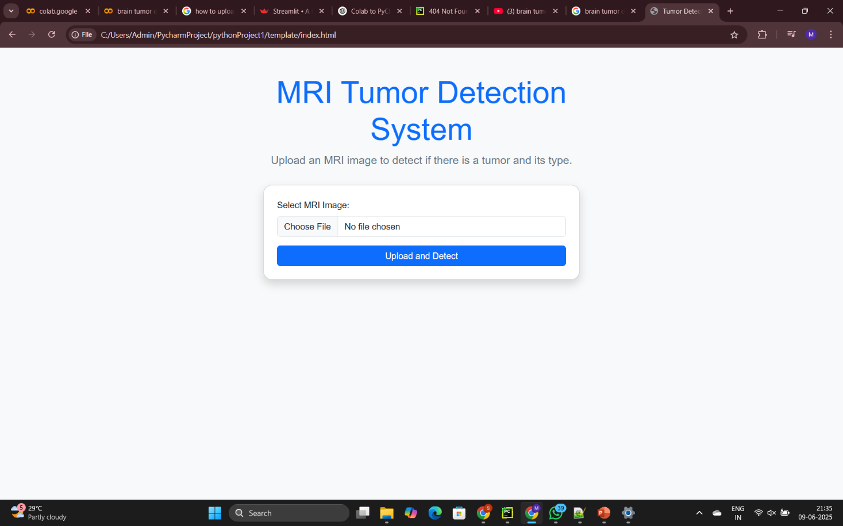
Result

Slide 8
Conclusion
The brain tumor detection system developed using convolutional neural networks has demonstrated strong potential in accurately identifying and classifying brain tumors from MRI images. By automating this process, the system can significantly reduce the time and effort required by radiologists, helping to speed up diagnosis and improve the overall efficiency of medical workflows.
Overall, this project highlights the power of artificial intelligence in medical imaging and its potential to transform clinical practices. With further refinement and validation, such AI-driven tools can become an indispensable part of healthcare, contributing to earlier detection and better prognosis for patients with brain tumors.

Slide 9
Future scope
Future enhancements could include incorporating larger and more diverse datasets to improve model generalization, integrating other imaging modalities like CT scans for comprehensive analysis, and implementing advanced explainability methods to increase clinical trust. Additionally, deploying the model in real-time clinical environments with user-friendly interfaces will be critical for practical adoption and ongoing validation.

Slide 10
References
Dataset Link : https://www.kaggle.com/datasets/masoudnickparvar/brain-tumor-mri-dataset
Python : file:///C:/Users/Admin/PycharmProject/pythonProject1
GitHub Link: Link

Slide 11
Thank you

