Slide 1
Learning patterns in rice leaf disease detection using deep learning architectures
Presented by: Abrar Al Sayem- 18201194
MD Abrar Murshed- 23241095 Rifah Tasnim Mahin- 20101389 Nazrin Islam Ritu- 21201504
Presented to: Annajiat Alim Rasel
Course: Pattern Recognition (CSE424)
Section: 2
Group: 34
Submission Date: 24/04/2024

Slide 2
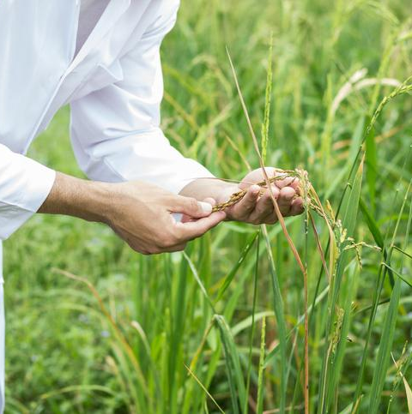
Introduction
Rice, vital for Bangladesh's food security and livelihoods Rice diseases like blast, Tungro and blight pose threats to Bangladesh's staple crop, impacting yields and farmer livelihoods.
The objective of plant disease detection is to identify the presence of infections, but certain unique leaf images present challenges to the human eye and are not easily distinguishable without assistance. We will be using several deep learning models and evaluate their performance in detecting the diseases.

Slide 3
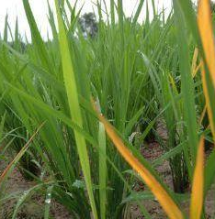
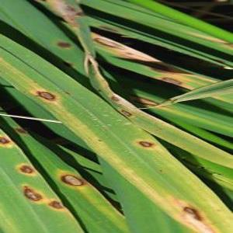
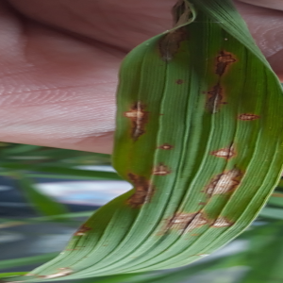
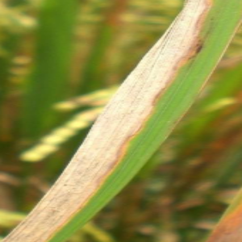
Dataset
The data set contains 5932 number images includes four kinds of Rice leaf diseases i.e. Bacterial blight, Blast, Brown Spot and Tungro.
Tungro
Brown Spot
Blast
Bacterial Blight
Citation: Sethy, P. K., Barpanda, N. K., Rath, A. K., & Behera, S. K. (2020). Deep feature based rice leaf disease identification using support vector machine. Computers and Electronics in Agriculture, 175, 105527. doi:10.1016/j.compag.2020.105527.

Slide 4
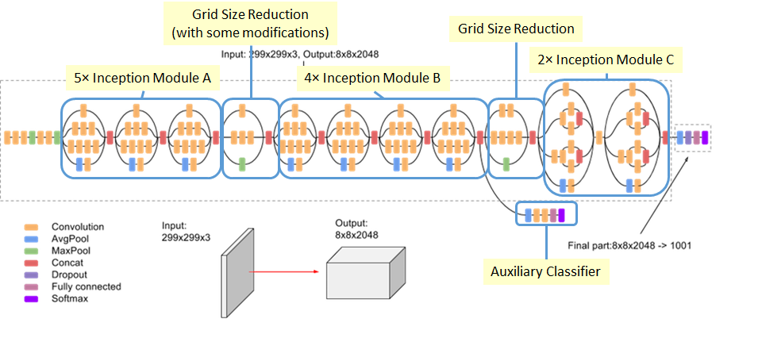
Reviewed Model: Inception_v3
We have implemented a CNN network on Inception_v3 model because:
It uses a series of convolutional, pooling, and inception modules
State-of-the-art results on a variety of computer vision tasks
Figure: Inception_v3 architecture

Slide 5
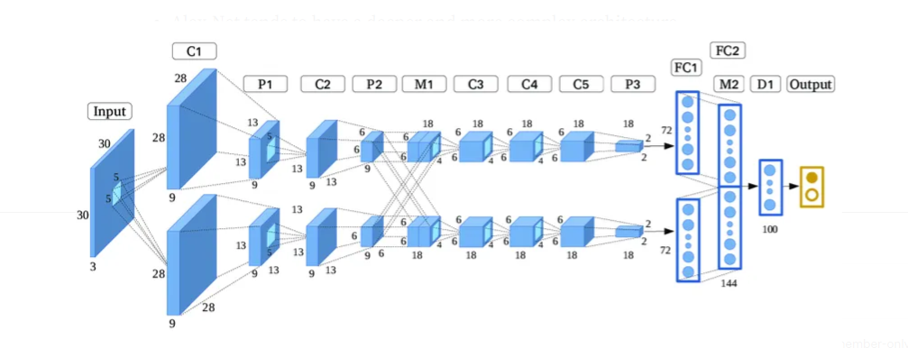
Reviewed Model: AlexNet
We have implemented a CNN network on AlexNet model because:
Pioneering architecture in computer vision
Demonstrated high performance on ImageNet challenge
Figure: AlexNet architecture

Slide 6
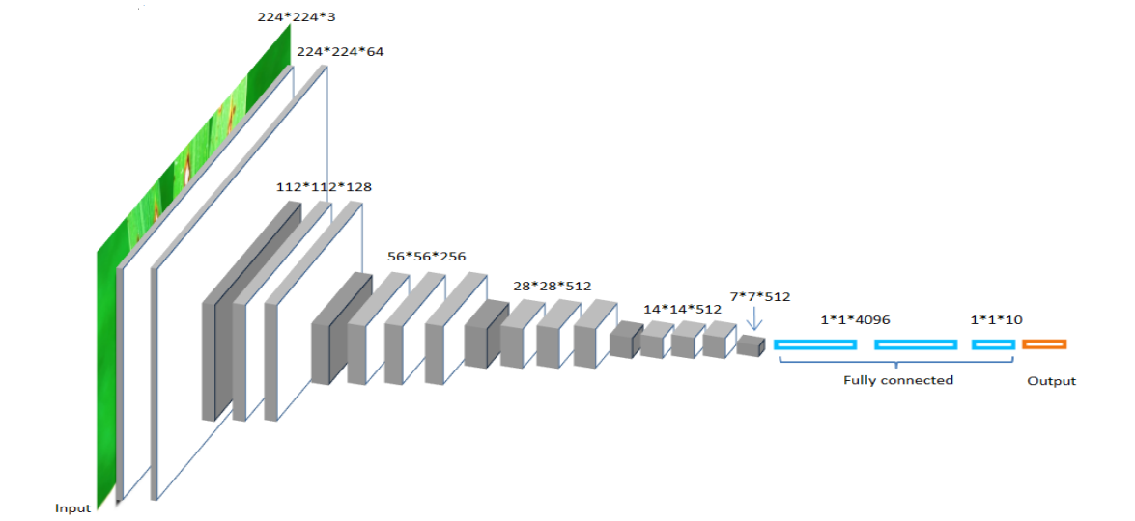
Reviewed Model: VGG-16
We have implemented a CNN network on VGG-16 model because:
Good performance in spite of its simplicity
Serves as a good baseline for comparing newer and complex architectures
Figure: VGG-16 architecture

Slide 7
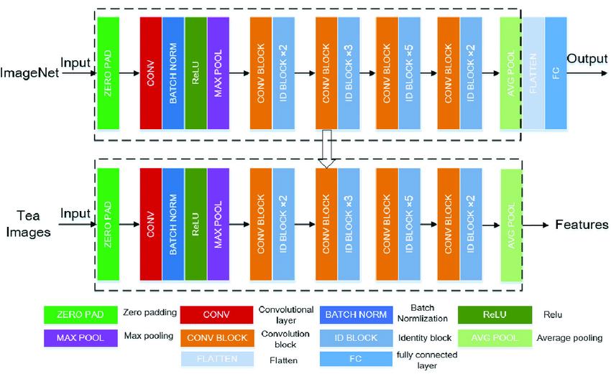
Reviewed Model: ResNet50
We have implemented a CNN network on ResNet50 model because:
It has been designed to be computationally efficient
It can be fine-tuned and adapted for various tasks other than image classification
Figure: ResNet50 architecture

Slide 8
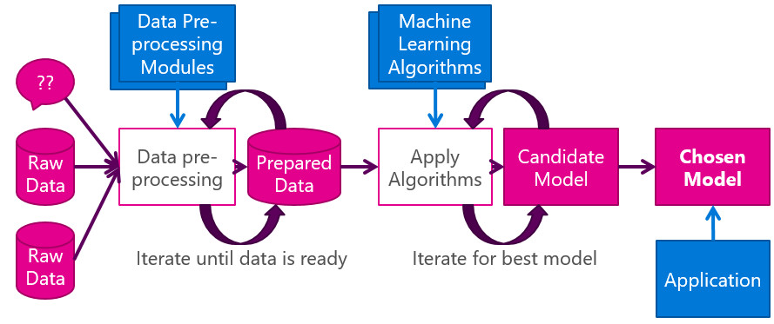
Reviewed Code And Methodology :
Applying CNN network using Inception_v3 and AlexNet models in Tensorflow:
Our code explores the dataset and uses preprocessing techniques
Then it selects a model for feature extraction
Then the data is sent into the model for training and classification of the diseases
Figure: Data Processing and Model Selection

Slide 9
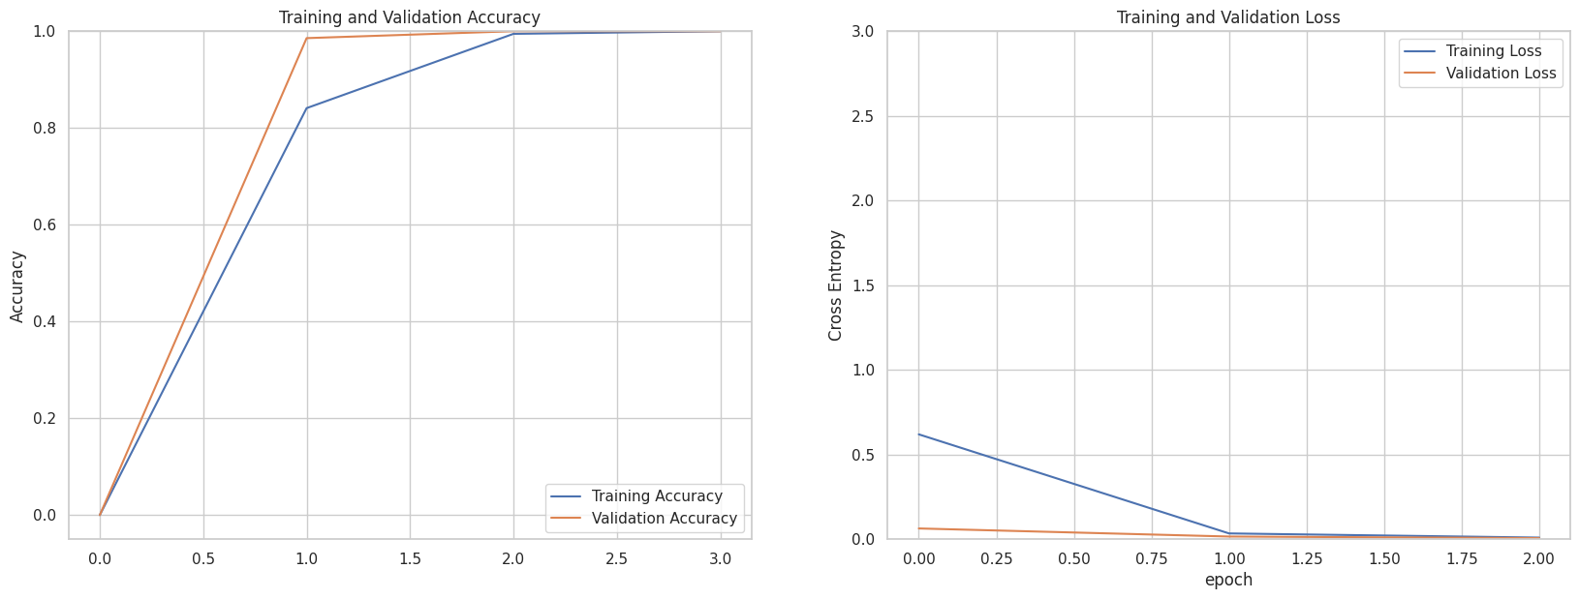
Model Result:
We have implemented a CNN network on Inception_v3 model because:
It uses a series of convolutional, pooling, and inception modules
State-of-the-art results on a variety of computer vision tasks
Figure: Inception_v3 Model result

Slide 10
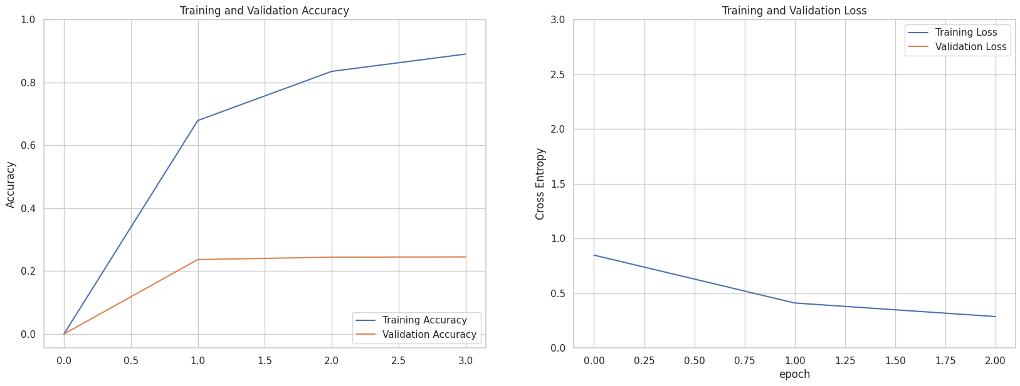
Model Result:
We have implemented a CNN network on Alexnet model because:
Pioneering architecture in deep learning for image recognition
Achieved breakthrough performance in ImageNet competition
Figure: Model result

Slide 11
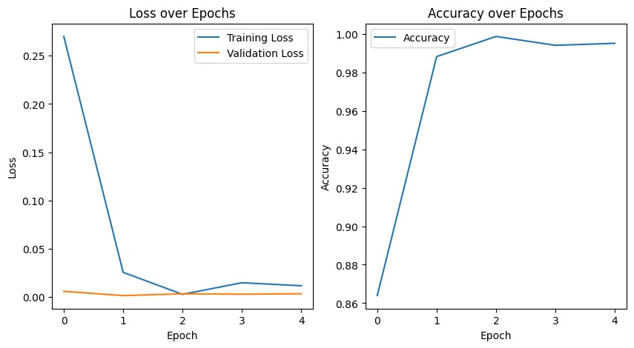
Model Result:
We have implemented a CNN network on VGG-16 model because:
Good performance in spite of its simplicity
Serves as a good baseline for comparing newer and complex architectures
Figure: VGG-16 Model result

Slide 12
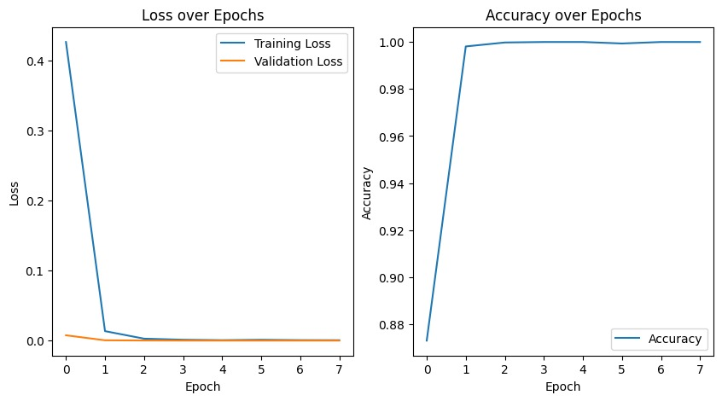
Model Result:
We have implemented a CNN network on ResNet50 model because:
It has been designed to be computationally efficient to save time
It can be fine-tuned and adapted for various tasks other than image classification
Figure: ResNet50 Model result

Slide 13
Future aspects:
Here’s are future aspects:
We will implement several other models (VGG, ResNet, MobileNet etc.) and compare between them.
We can observe on features and hypertuning for better results
Determining the best model for our application

