Slide 1
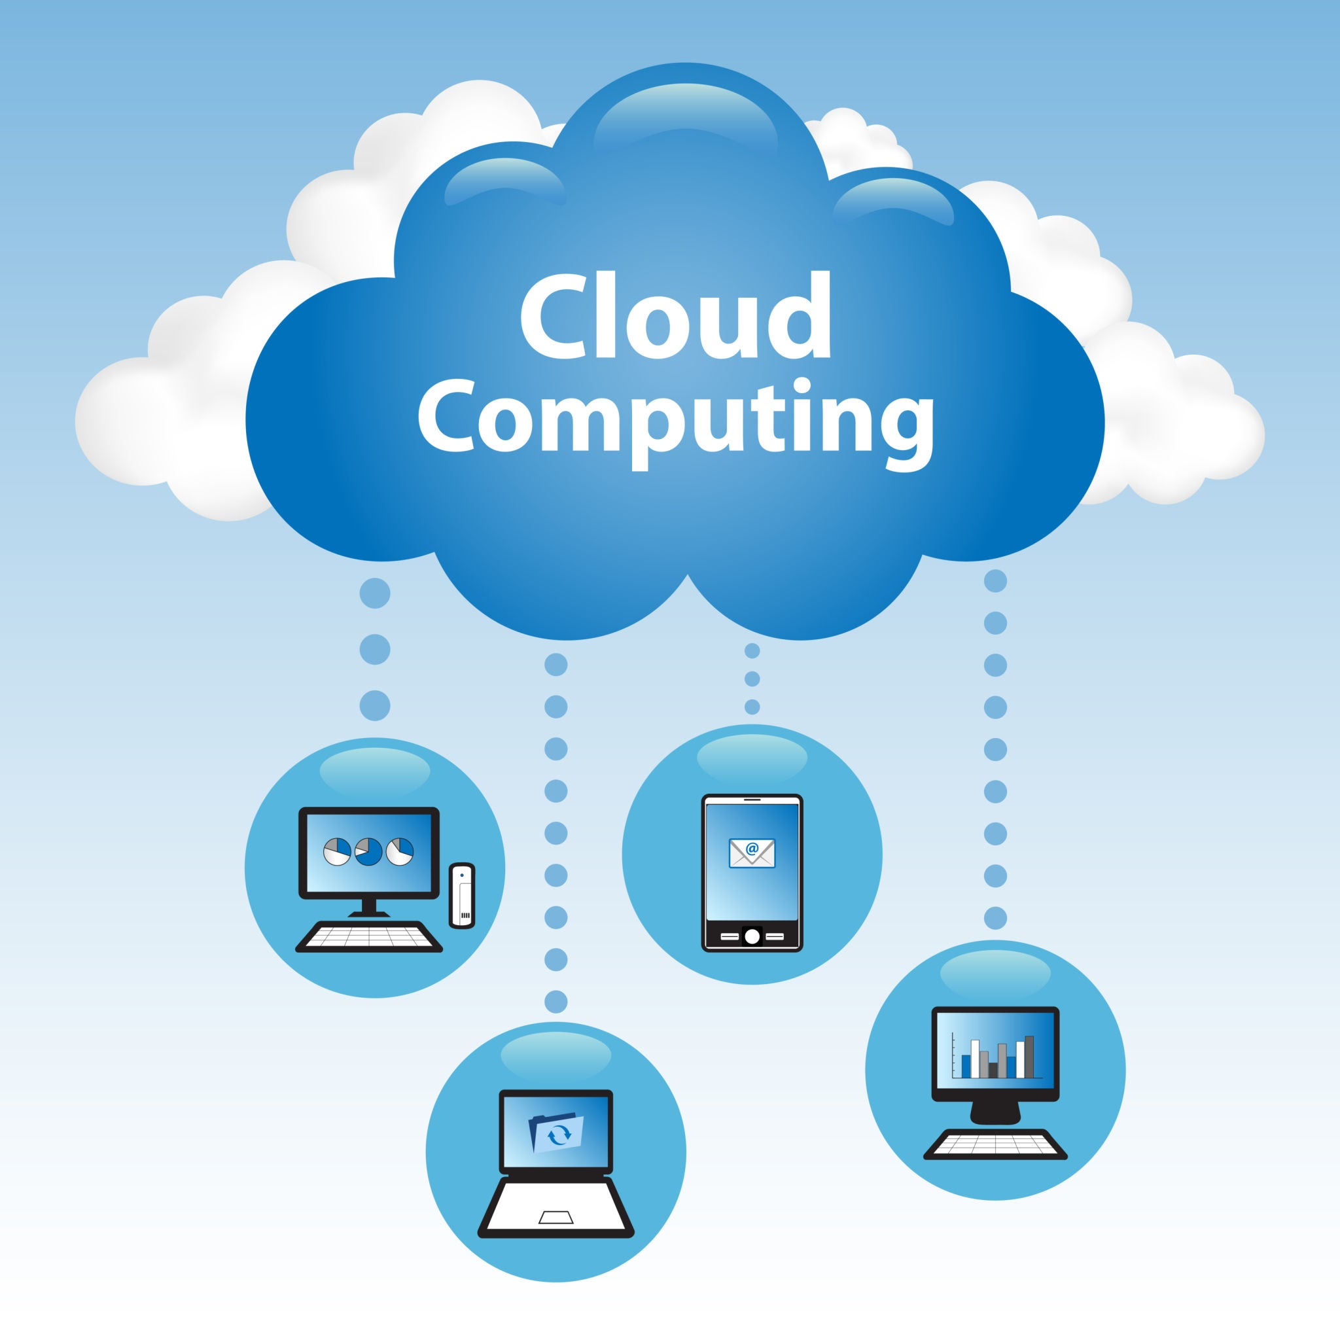
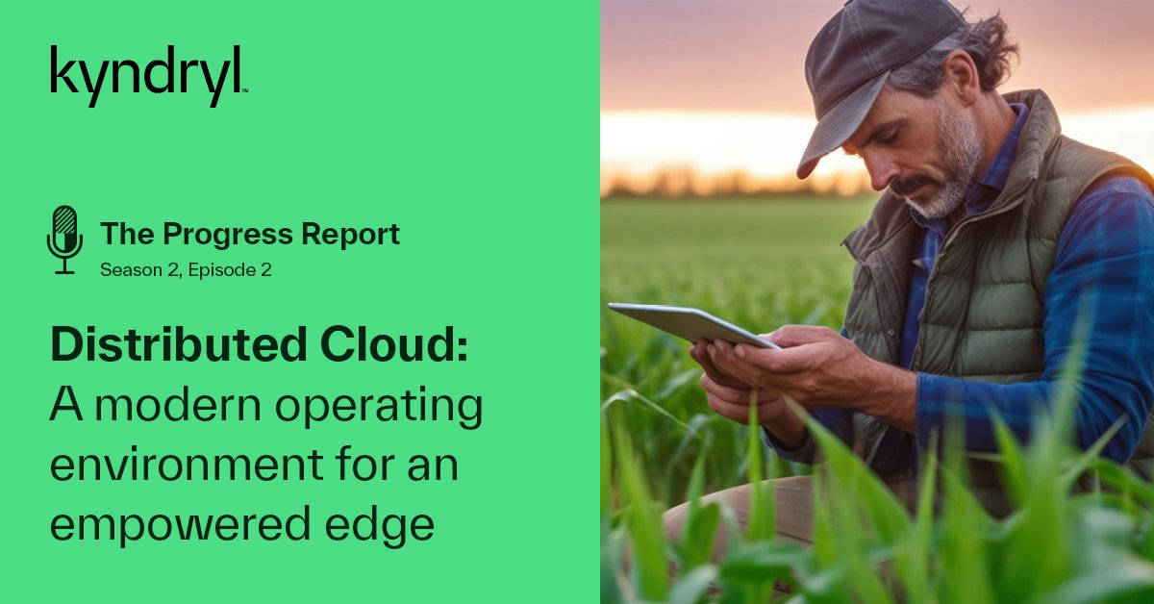
TITLE: Cloud and distributed architectures for data management in agriculture 4.0 : Review and future trends
Authors: Olivier Debauche, Saïd Mahmoudi, Pierre Manneback, Frédéric Lebeau
PRESENTATION BY: ABRAR AL SAYEM

Slide 2
Evolution to Agriculture 4.0
IoT Explosion in Agriculture
Challenges and Opportunities
Related Works and Future Directions
Introduction & Related works

Slide 3
Application Categorization
Platform Utilization
Decision Support Systems (DSS)
Frameworks in Smart Farming

Slide 4
Systematic Review Methodology
Data Treatment Approaches
Architecture Comparison Criteria
Architectural Diversity in Agriculture 4.0:
Methodology

Slide 5
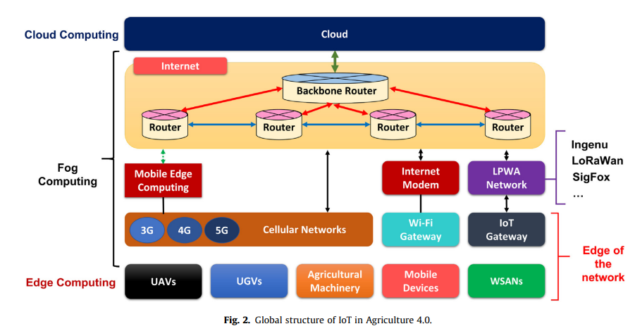
Batch processes entire datasets offline before producing results
Real-time (Streaming) processes data as it arrives, making results progressively available
Architectures
-Batch and Real-time Architectures:

Slide 6
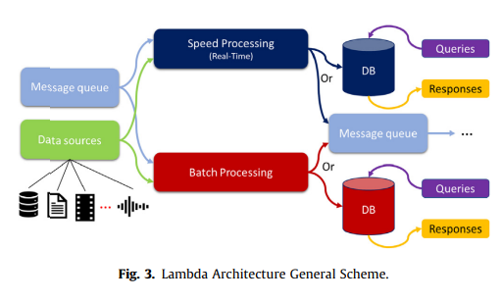
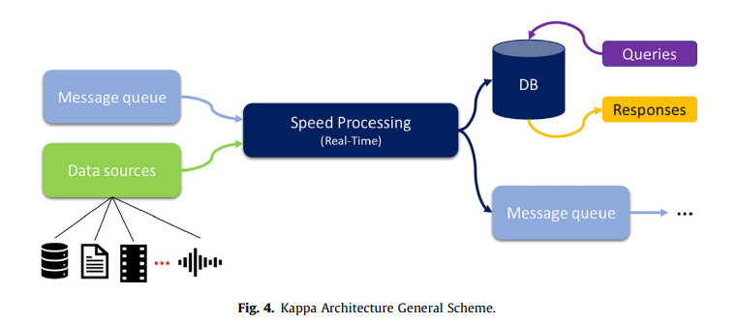
Lambda Architecture merges batch and real-time processing to handle massive streaming data efficiently
And Kappa Simplifies Lambda by combining real-time and batch layers
Architectures
-Lambda & Kappa Architectures:

Slide 7
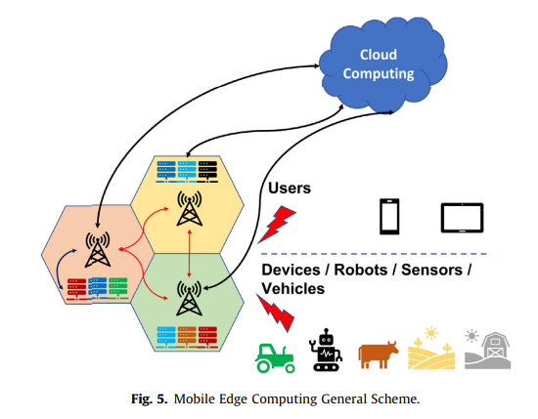
Fog Computing: Utilizes physical or virtual fog nodes for closer data
Mobile Edge Computing (MEC):Enables real-time, high-bandwidth access to cloud computing
MicroData Centers (MDCs) And Cloudlets: Both provide high computational power and storage
Distributed Architectures

Slide 8
Microservices Architecture (MA):Decomposes complex applications into smaller, function-specific services
Data Lake Architecture (DLA): Facilitates cost-effective storage of large, diverse data volumes
Osmotic Computing (OC): Introduces Micro Elements (MELS) for decoupling user data and applications
Dew Computing (DC): Enriches Cloud-Fog-Edge Computing scheme by enabling more localized processing
Blockchain Technology: Enhances transparency and traceability in agricultural supply chains
New Trends

Slide 9
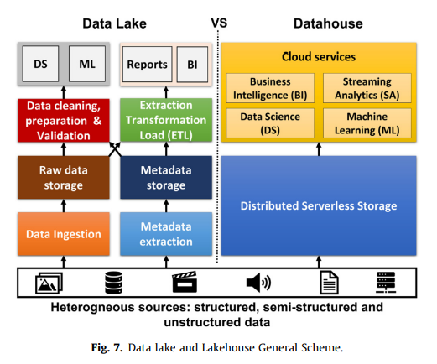
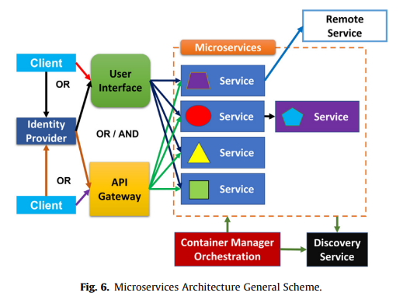
New Trends

Slide 10
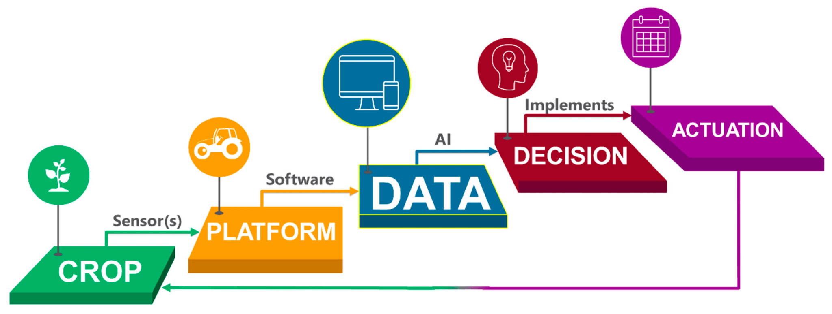
Agriculture 5.0 aims to boost production sustainably, with robots integrating machine learning to compensate for labor shortages and enhance productivity.
Challenges like the high cost of early technologies for small farms are acknowledged
Towards Agriculture 5.0

Slide 11

SUMMARY
The paper divesinto the integration of advanced computing architectures and technologies to meet the projected 70% increase in food production needed by 2050 for a global population of 9.7 billion. It explores various architectures like cloud, fog, and edge computing, and their roles in data processing and storage for agricultural applications. New trends like Data Lake, Osmotic Computing, and Microservice Architecture are discussed for their potential in improving data management, processing distribution, and service delivery.

Slide 12

THANK YOU
ABRAR AL SAYEM
18201194| CSE449

