Slide 1

Title: Application of Digital Twins in multiple fields
Authors: Jinkang Guo & Zhihan Lv
PRESENTATION BY: ABRAR AL SAYEM

Slide 2
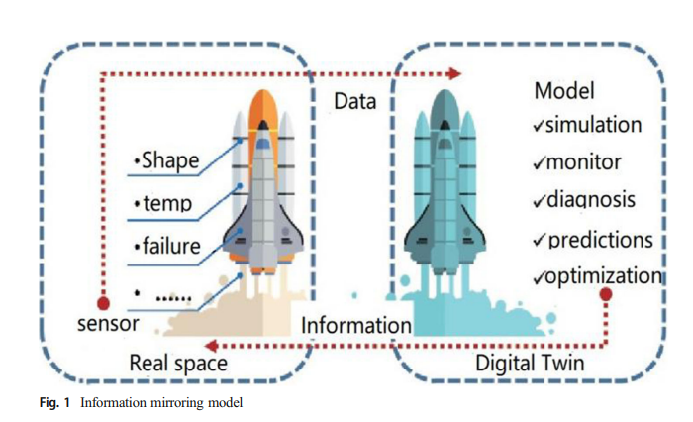
History of DT Development: Originated with the US Apollo 13 mission in 1970
Definition of DT: Many definitions were given by many experts of industries
Characteristics of DT: Concentration, Integrity, Dynamic
Introduction & DT

Slide 3
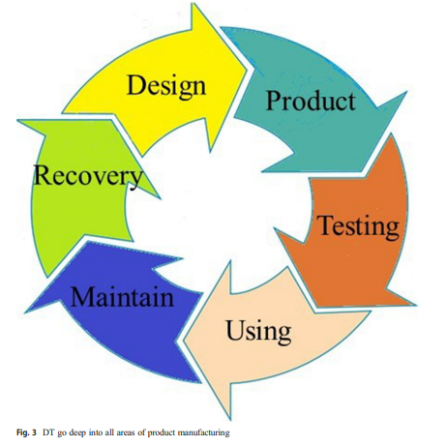
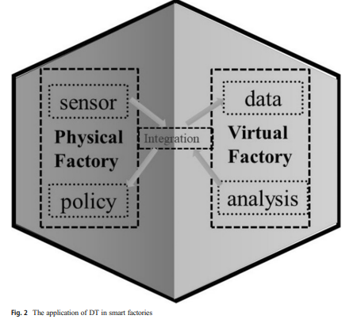
Design Stage
Manufacturing
Maintenance
Users
Digital Twins in Industrial Production
Digital Twins play a critical role in multiple stages of the product life cycle:

Slide 4
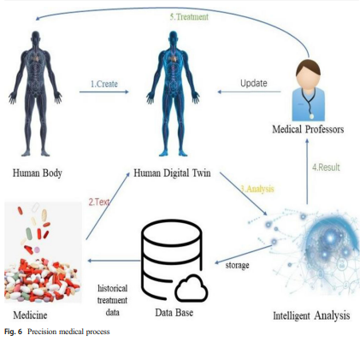
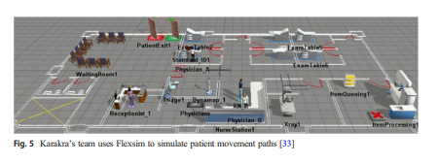
Digital Twin and Virtual Reality
Treatment of Diseases
Precision Medicine with DT
Health Management
Sports Planning
Digital Twin (DT) in the Medical Field

Slide 5
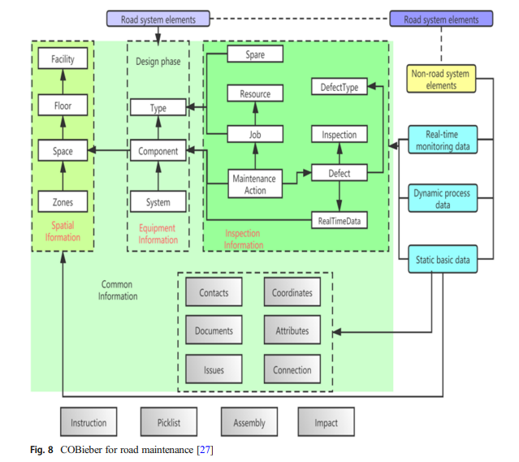
Definition of Smart City
DT in Smart City Applications
Technologies Supporting DT in Smart Cities
Future Prospects
Digital Twins in Smart Cities

Slide 6
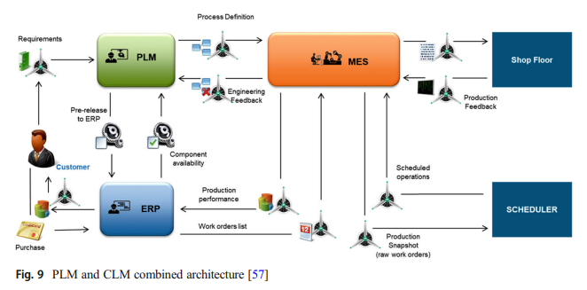
Quality Assurance
Manufacturing
Monitoring & Maintenance
Design & Development
Integration with Other Systems
Challenges in DT Aerospace Applications
Digital Twin (DT) in Aerospace
From an aerospace perspective, DT acts as an advanced reality simulation tool for many aspects:

Slide 7
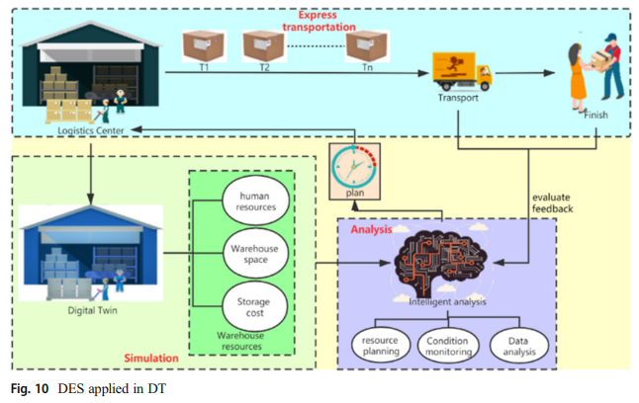
Offline Sales and DT
Interactivity & Immersion
Virtual Touch
Online Sales and DT
Psychological Influence
Logistics & Warehousing
Logistics & Warehousing
Digital Twin (DT) in the Business Realm

Slide 8

SUMMARY
Digital Twins are revolutionizing various sectors, including industrial production, healthcare, education, urban planning, space exploration, and business. Whether it's enhancing machine maintenance in industries, personalized patient care in healthcare, individualized learning plans in education, or boosting sales in business - DT is at the forefront.
11

Slide 9

THANK YOU
ABRAR AL SAYEM
18201194| CSE474

