Slide 1

SHRI VAISHNAV INSTITUTE OF INFORMATION TECHNOLOGY
B.TECH – CSE – ICS
2024-25
Project presentation
University Social Networking Platform
Mentor :
Presented by :
DR. GAURAV SHRIVASTAVA
HARSH PRAJAPAT (21100BTCSICS09534)
KANISHK CHOUHAN (21100BTCSICS09538)
PARV KANUNGO (21100BTCSICS09547)
PRIYANKA PATEL (21100BTCSICS09551)
Presented to :
PROF. PRIYANKA GUPTA
PROF. DEVENDRA KURIL

Slide 2
Table of Content
Introduction
Purpose of the platform
Platform Overview
Environmental Characteristics
Hardware requirement
Goal of Implementation
Constraints
Functional Requirement
Non-Functional Requirement
Diagrams

Slide 3
Introduction
The University Student Networking Platform (USNP) is designed to facilitate seamless academic and social interaction within a university environment. The platform enables students to create and maintain personal profiles, share academic notes, and collaborate with peers as well as faculty members. It offers a centralized digital space where students can discuss academic subjects, post queries, seek advice, and receive university updates.

Slide 4
Introduction
Purpose:
Connect with peers and faculty members for academic assistance.
Share and access educational materials.
Participate in real-time discussions on various academic topics.
Stay updated on college events and announcements.

Slide 5
Introduction
Overview:
Platform Scope: USNP is a comprehensive platform for university students and faculty.
Modules: It offers modules for content sharing, social engagement, and academic discussions.
Event Management: Includes features for event management and notifications, informing students about upcoming events, seminars, and academic activities.

Slide 6
Introduction
Overview:
User-Friendly Design: Focuses on ease of navigation through features like:
Discussion forums
Profile management
Event notifications
Resource sharing

Slide 7
Purpose of the Platform
Objective:
Connect students with peers and faculty.
Share educational materials.
Engage in discussions.
Get university updates.

Slide 8
Platform Overview
Target Audience:
University students and faculty.
Modules:
Notes/Resources sharing
Live discussion forum
Post, Like, Comment
Profile management
Communication
Interaction with other users (connections)

Slide 9
Environmental Characteristics
Platform Environment:
Hardware: Servers, Desktops, Laptops, Smartphones, Tablets, Backup Solutions.
Users: Students, Faculty, Admins.

Slide 10
Hardware Requirements
Servers: For hosting the platform and database.
User Devices: Desktops, laptops, smartphones, and tablets.
Backup: Cloud or physical backups for data recovery.

Slide 11
User Roles
Students: Create profiles, share resources, and engage in discussions.
Faculty: Provide academic support, contribute to forums.
Admin: Ensure smooth operations and content moderation.

Slide 12

Data Security and Scalability
Real-time Engagement
Goals of Implementation
Forum-based Discussions
Student-Faculty Collaboration
Academic Resource Sharing
Single Academic Platform

Slide 13
Constraints
Performance Constraints:
system should support a maximum of 10,000 concurrent users to maintain efficiency and performance.
Server response time for key features (e.g., user login, feed loading, note uploads) should be under 3 seconds under normal load.
The system should be scalable to accommodate increasing traffic during peak times such as semester starts, exam periods, or major events.

Slide 14
Constraints
2. Security Constraints
User data, including personal information, passwords, and notes, must be encrypted in transit and at rest.
Authentication must use OTP verification for both user and admin logins, with specific limits on the number of failed attempts and resend attempts (e.g., 4 failed attempts, 4 OTP resends).
Admins must undergo additional security with OTP verification at each login, and their sessions expire after 24 hours.
The platform should automatically log out inactive users after a predetermined time to prevent unauthorized access.

Slide 15
Constraints
6 Usability Constraints
Users should have easy access to all core features (e.g., profile, notes, events) with minimal navigation depth, limiting actions to 2-3 clicks from the main dashboard.
The OTP verification process for login and registration must be clear, with notifications informing users about limits (e.g., resending OTP) and block time after failed attempts.
The platform should support a user-friendly feed that loads posts, comments, and likes efficiently, even under high data loads.

Slide 16
Functional Requirements
Authentication:
1.1. User Login: User can login by entering his email/enrollment and password.
1.2 User Registration: User can register with email and other necessary details along with OTP sent on his email.
1.3 Admin Login: Admin can login by using his email and password along with OTP sent on his email.

Slide 17
Functional Requirements
2. Admin Panel:
2.1. Admin Approval / Rejection: Admin can verify user by validation his details and can approve or reject user accordingly, user can only login is he is approved from admin.
2.2. Blocking or Restricting: Admin can block user from the website if find him vulnerable.
2.3. Insights: Admin can see insights for analysis purpose.

Slide 18
Functional Requirements
3. Notes / Resources Sharing:
3.1. Uploading: User can upload notes in frequently user formats.
3.2. Downloading: User can download notes from the website.
3.2. Notes Classification: Notes are classified forming a well structure. Notes is classified according to course/program, semester, subjects

Slide 19
Functional Requirements
4. Interaction:
4.1. Profile Management: User has profile associated, he can update his information, profile pictures etc.
4.2. Post: User can post images as well as text thoughts or problems. Post has likes and comments associated with it.
4.3. Connections: User can make a connection by sending request to the other user and can accept another user accept.

Slide 20
Functional Requirements
5. Discussion Forum:
5.1. Post: Separate section for posting problems and queries for user.
5.2. Replies: User can reply on the other user post in the form of solution.

Slide 21
Non-functional Requirements
Performance: Optimized time complexity, fast response.
Scalability: Horizontal and vertical scaling, load balancing.
Security: Encryption, authentication, role-based access.
Usability: Intuitive UI, accessibility.
Reliability: Uptime, backups.
Maintainability: Modular architecture, detailed logging.

Slide 22
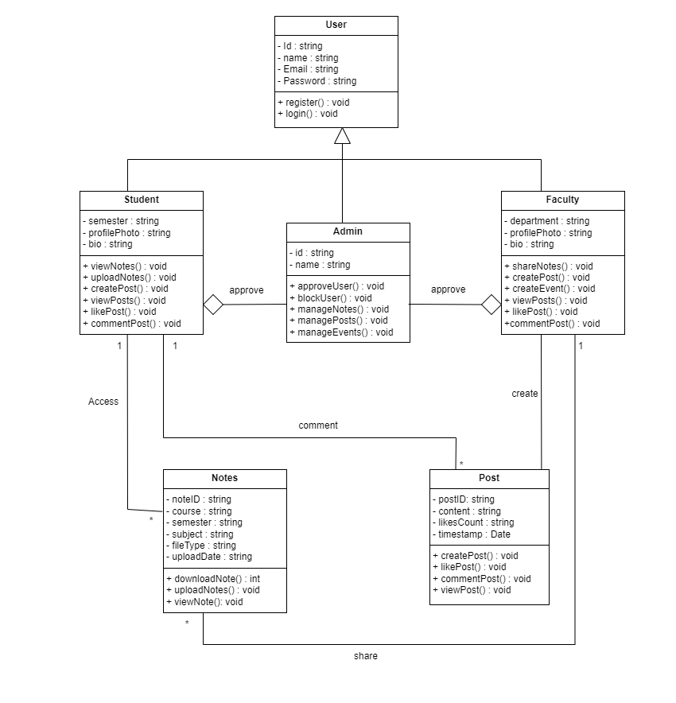
Figure 1: Class Diagram

Slide 23
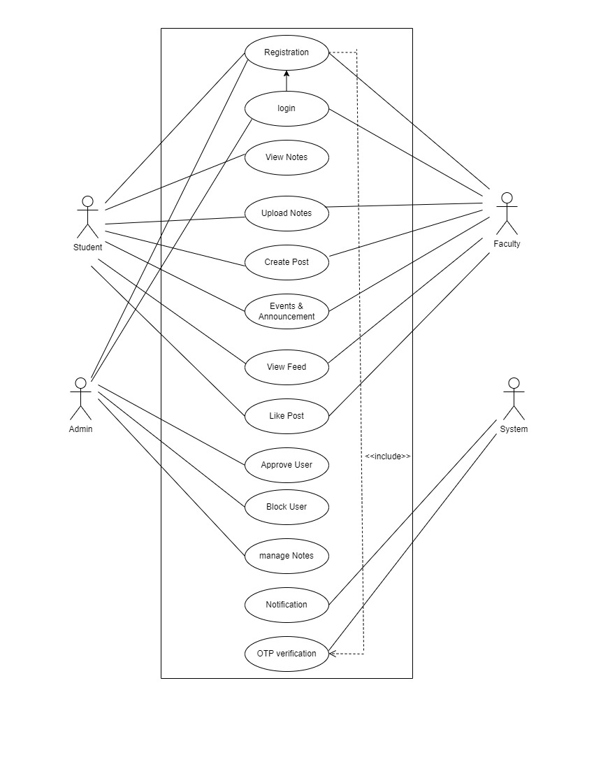
Figure 2: Use-Case Diagram

Slide 24
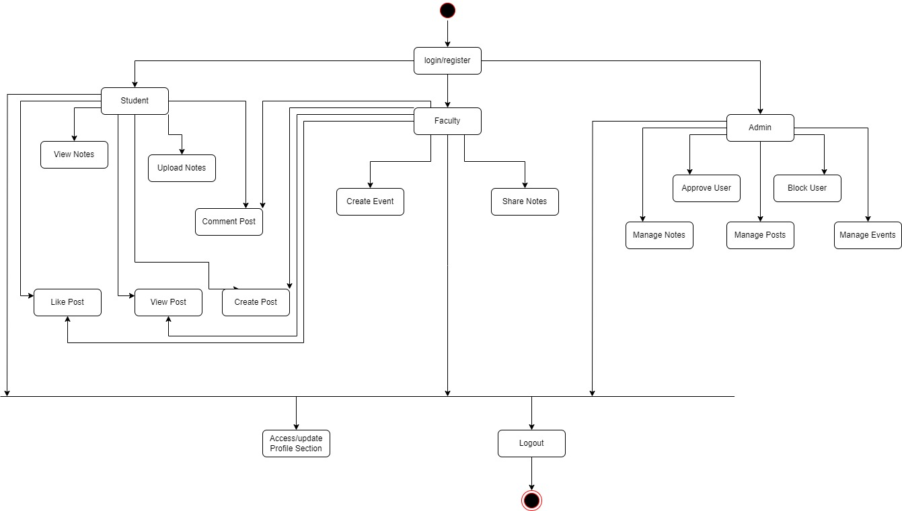
Figure 3: Activity Diagram

Slide 25
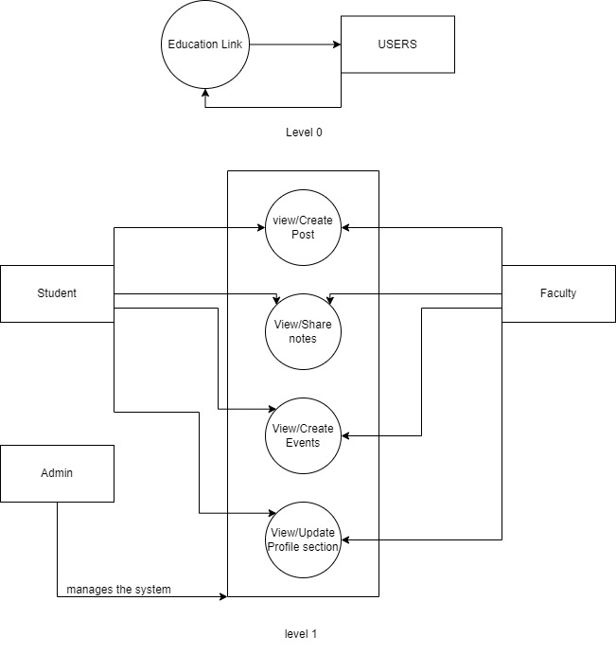
Figure 3: Level-1 DFD Diagram

Slide 26
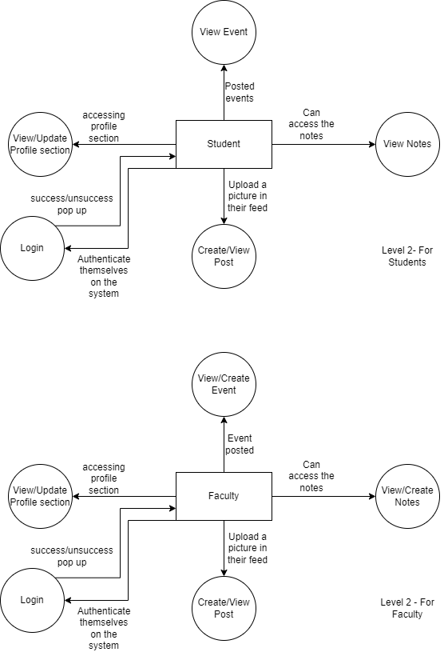
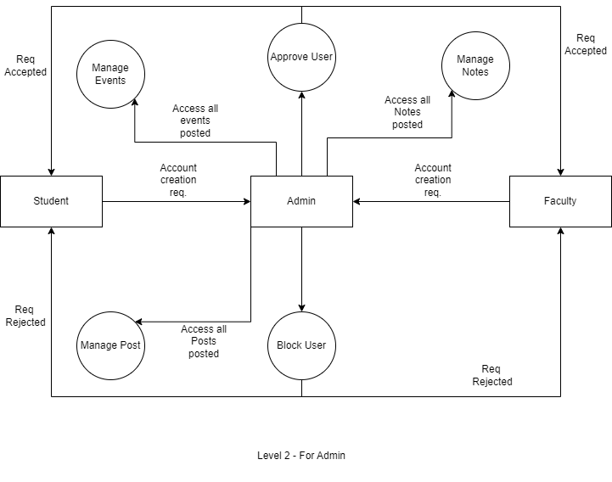
Figure 3: Level-2 DFD Diagram

Slide 27
Thank you !

