Slide 1
Facial Emotions and Hand Gestures Detection Model
By
Ch. Sripadh
J. Shreesht K. Naga Balaji

Slide 2
Project Vision
Develop a real-time face and hand gesture recognition system
Detect and extract facial and hand landmarks using MediaPipe
Classify facial expressions and hand gestures accurately using machine learning
Enable automated interpretation of user emotions and gestures
Facilitate natural and interactive human-computer communication
Ensure the system works efficiently on webcam-enabled devices in real time

Slide 3

Tools and Technologies
Programming Language:
Python
HTML
Javascript
CSS
Libraries & Frameworks:
MediaPipe – Real-time face & hand landmark detection
OpenCV – Video capture & frame processing
Scikit-learn – Model training & evaluation
Joblib – Model serialization and saving
Matplotlib – Visualization (plots, confusion matrix)
Hardware Requirements:
Webcam-enabled device (Built-in or external camera for real-time gesture and facial expression capture)

Slide 4
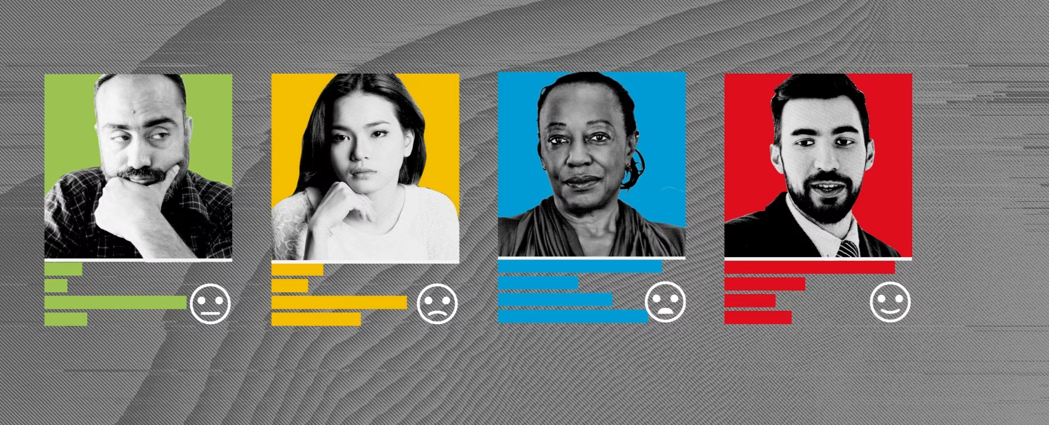
Facial Emotion Detection
Media Pipe Face Mesh detects 468 facial landmarks, offering high-resolution facial tracking.
Key regions like eyes, eyebrows, and mouth are targeted for feature extraction.
These regions capture subtle geometric variations associated with different emotions.
The extracted features are converted into numerical vectors for processing.
This approach ensures real-time, accurate emotion recognition using facial landmarks.

Slide 5
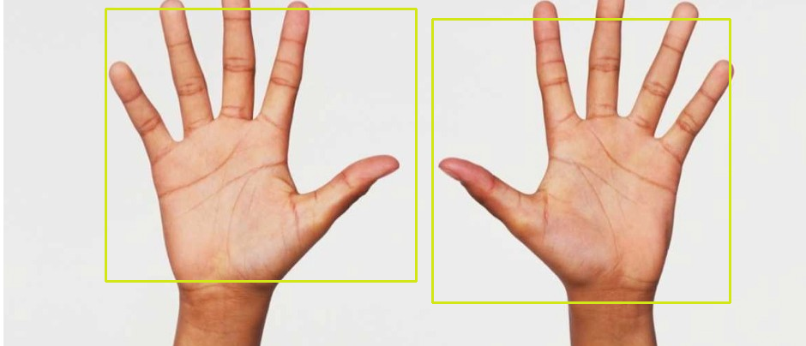
Hand Gesture Detection
Media Pipe Hands detects 21 key landmarks on each hand, including finger joints and wrist.
It provides real-time tracking of hand position, finger movement, and palm orientation.
These landmarks help in understanding hand posture and gesture dynamics.
Custom gestures (like thumbs up, peace sign) are recognized using distances and angles between landmarks.
This enables fast, accurate, and flexible hand gesture recognition in real-time applications.

Slide 6
Workflow
Data Collection
Data Preprocessing
Model Training
Real-time Detection
Performance Evaluation
Web Integration / Deployment

Slide 7
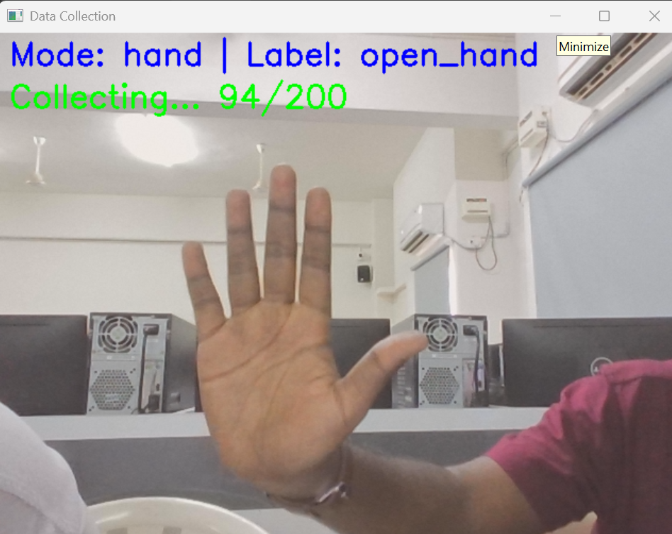
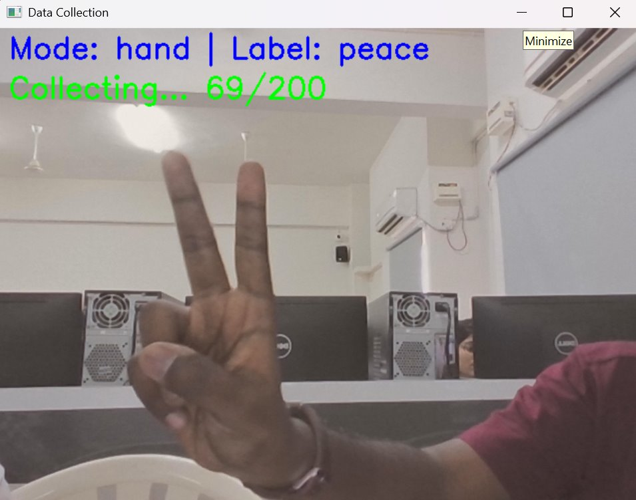
Data Acquisition and Preprocessing

Slide 8
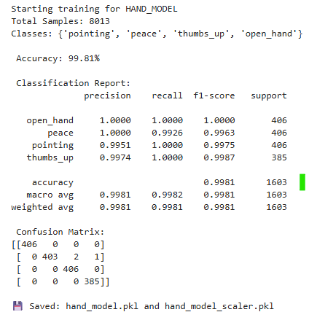
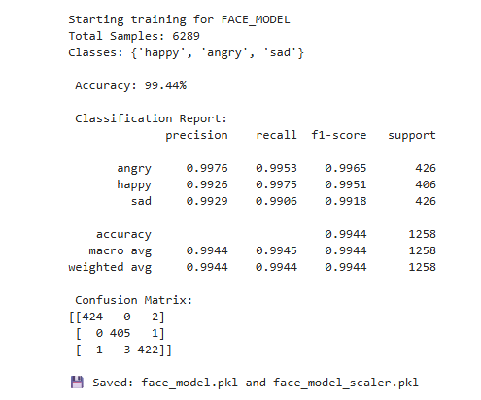
Trained Data Analysis

Slide 9
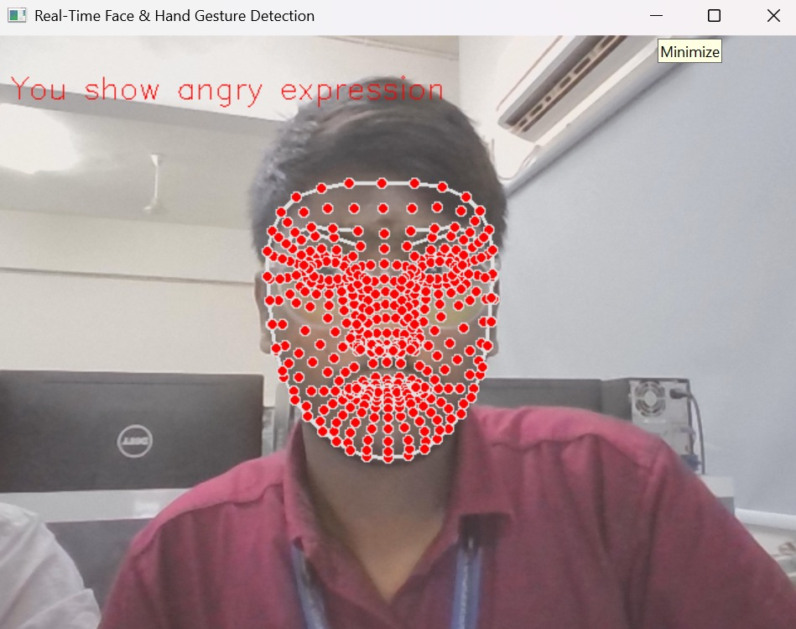
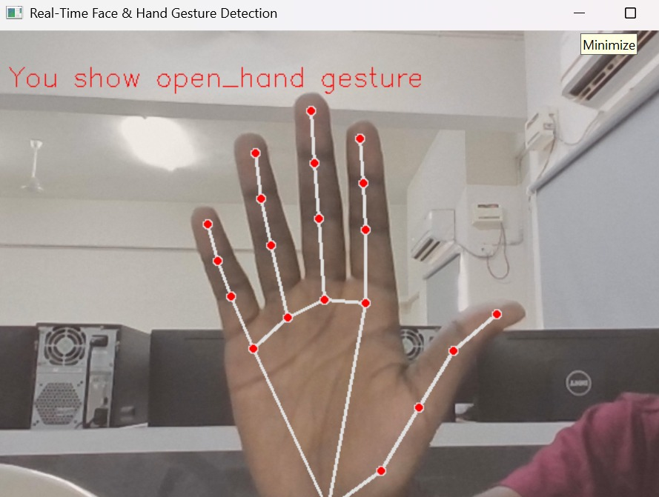
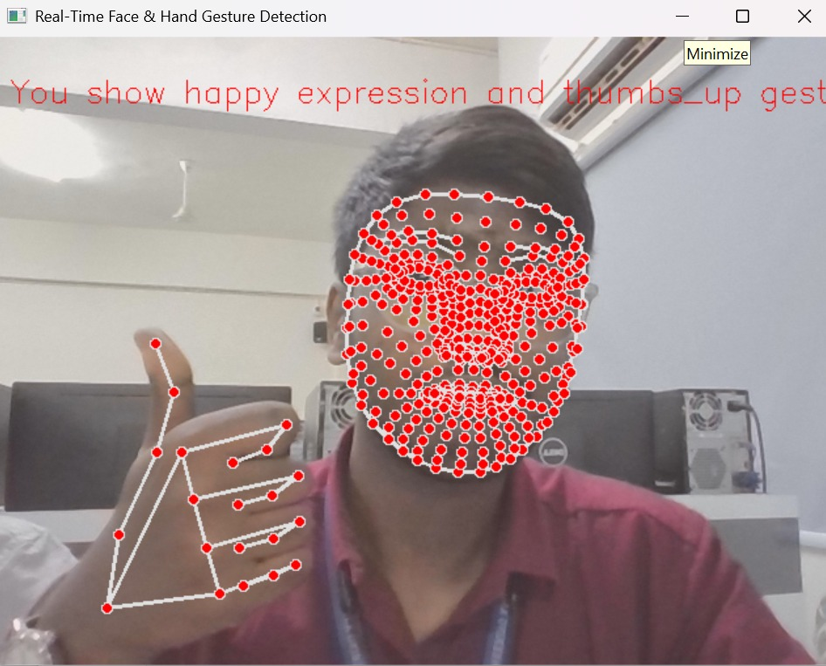
Real Time Detection Model

Slide 10
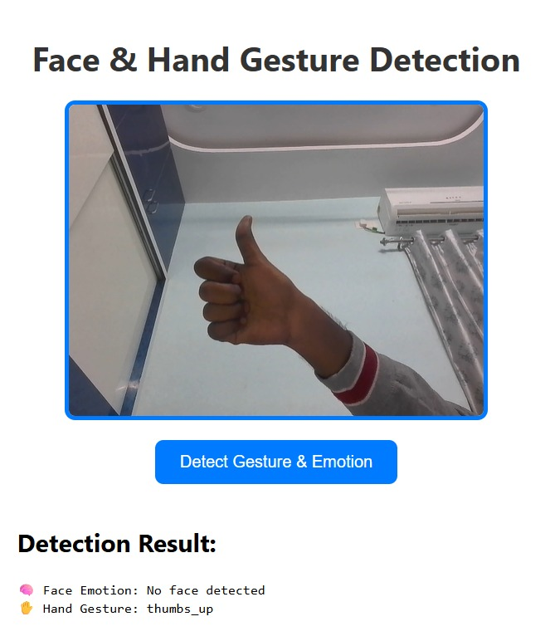
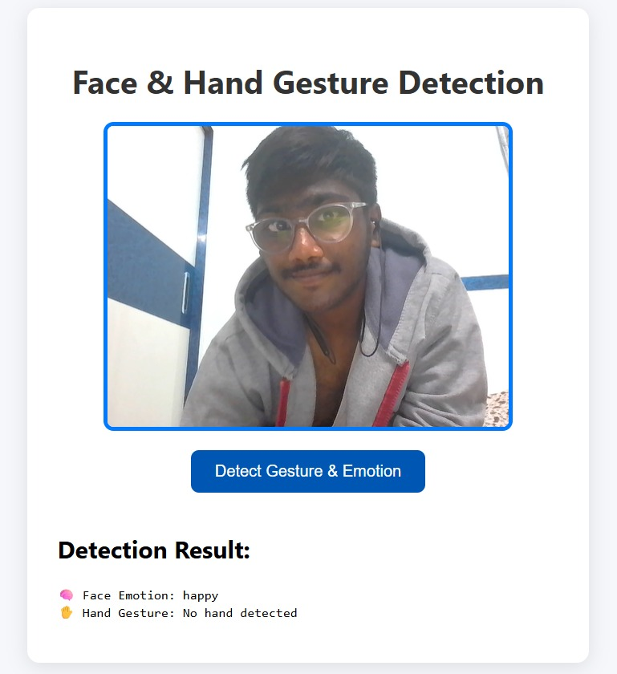
Real Time Emotion and Gesture Recognition with GUI

Slide 11
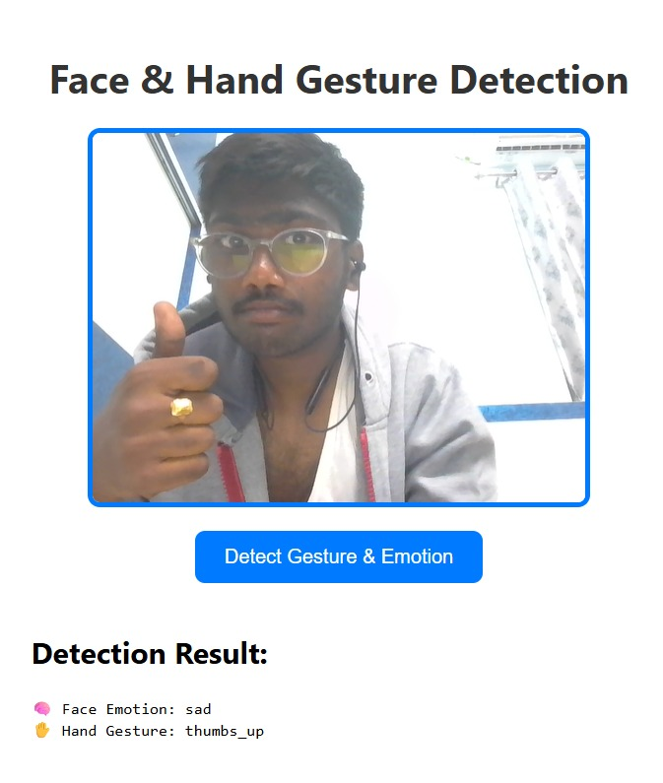
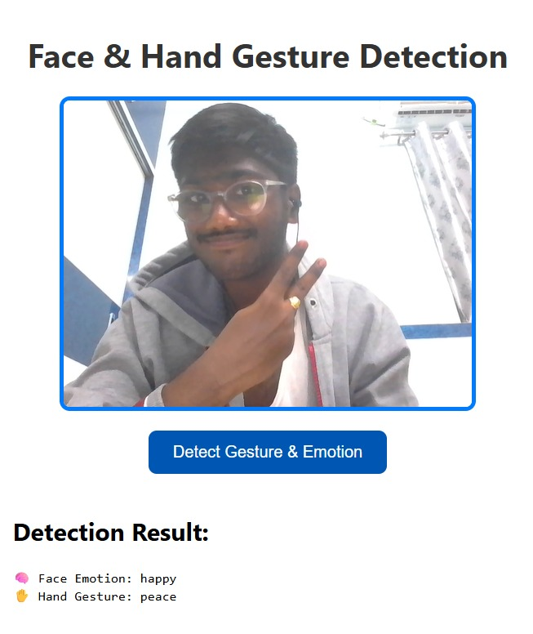
Real Time Emotion and Gesture Recognition with GUI

Slide 12
Applications
Augmented Reality (AR) Filters Apply real-time facial and hand tracking for interactive AR effects on social media apps.
Driver Safety Systems Monitor driver’s face for drowsiness and hand position for distraction detection.
Virtual Meetings and Conferencing Use facial and hand tracking to enable gesture-based controls and improve communication clarity.
Healthcare Monitoring Detect patient facial cues and hand movements for non-verbal communication and physical therapy.
Robotics Control Use hand gestures and facial cues to guide robots or drones.

Slide 13

Reference Links
MediaPipe Documentation : https://google.github.io/mediapipe/solutions/face_mesh.html
OpenCV Python Tutorials : https://docs.opencv.org/master/d6/d00/tutorial_py_root.html
Scikit-learn Documentation :
https://scikit-learn.org/stable/documentation.html
Random Forest Classifier Explained : https://machinelearningmastery.com/random-forest-ensemble-in-python/

Slide 14
Thank You

