Slide 1
Synthetic Data Generation for Food Waste Pelletizer using TGANs, TVAEs.
Presented by: Guide:
Pattan Afrid Ahmed Dr. Priyadarshini J
(20MAI1016) (Assoc. Professor)

Slide 2
Problem Statement
Prepared and raw food waste materials often establish challenges to the food makers in its dumping and prompt transportation. The proposed project aims at clean dumping of the food wastes with a significantly reduced space and its usage as cattle-feed.

Slide 3
Introduction

Slide 4
Introduction
In last semester, we deduced the motors and the other components of the “Food Waste Pelletizer” .
By using the fuzzy logic and defined membership functions, we automate the pelletizing and the heating process of the waste pelletizer.
This waste is should be automatically converted to semi-solid or powdered form which will be harmless and easy to transport.
The problem arose while defining the rules that we apply to fuzzy through fuzzy set are very less because of lower manually generated data.
We’ll solve this issue by generating synthetic data of same distribution which could be used for further simulations.

Slide 5
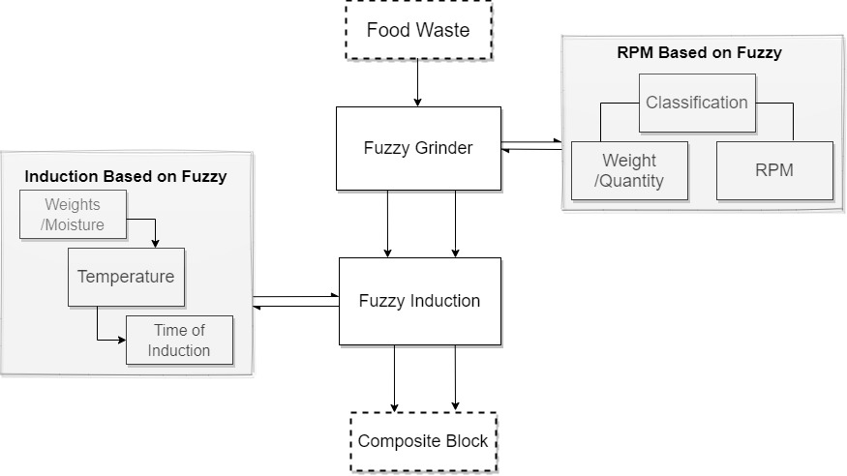
Architecture of Food Waste Pelletizer

Slide 6
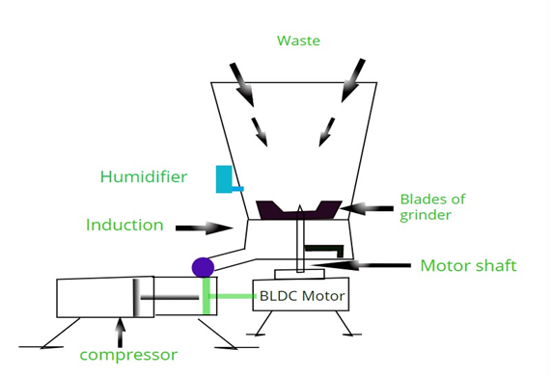
Design of Food Waste Pelletizer

Slide 7
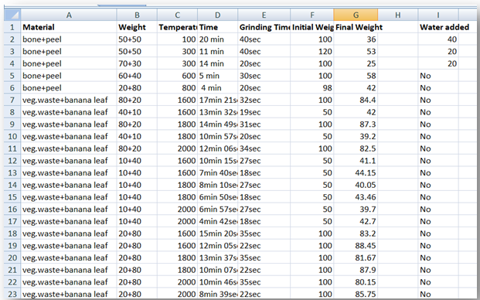
Manually Generated Data

Slide 8
What is synthetic data ?
Methods for synthetic data generation:
Synthetic data, as the name suggests, is data that is artificially created rather than being generated by actual events. It is often created with the help of algorithms and is used for a wide range of activities, including as test data for new products and tools, for model validation, and in AI model training.
Using deep learning -
Deep generative models such as Variational Autoencoder(VAE) and Generative Adversarial Network (GAN) can generate synthetic data.

Slide 9
Literature Survey

Slide 10

Paper-1 : Synthesizing Tabular Data using Generative Adversarial Networks - Lei Xu, Kalyan Veeramachaneni (2018)
Lei Xu[16] and his team worked on neural networks using the tanh activation function, TGANs can successfully produce values with a distribution that is centered. It is determined that the probability distribution may well be constructed directly using softmax due to the low cardinality. However, category values must be converted to binary variables using a one-hot-encoding representation with noise. It transform T vector with d after prepossessing the discrete and continuous columns to V, U, D vectors. The LSTM with attention technique is used to generate the appropriate row. Random variable z, weighted context vector with previous hidden, and embedding vector are the inputs for each step of the LSTM.
The Multi-Layer Perceptron (MLP) is implemented, alongwith LeakyReLU and BatchNorm. Concatenated vectors were applied in the first layer, coupled with mini-batch diversity using LSTM feature vectors. The loss function is the sum ordinal log loss function with the KL divergence term of input variables.

Slide 11
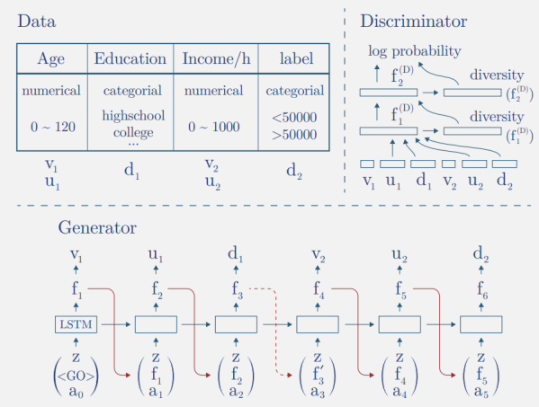
TGAN architecture

Slide 12
Paper-2 : Modeling Tabular data using Conditional GAN - Lei Xu, Maria Skoularidou, Alfredo, Kalyan Veeramachaneni(2019).
Lei Xu, Kalyan[17] and team worked on TGAN and proposed Conditional TGAN to deal with the non-Gaussian and multimodal data. Variational Gaussian Mixture Models (VGMM) are used to generate continuous data in the tabular vectors. It first detects a number of modes in data and then fit GMM. After the vector is normalized with each mode, it works similar to TGAN.
Conditional vector, Generator loss, and training-by-sampling approaches are the three essential components of the approach. The model structure does not consist of LSTM, instead it is trained with WGAN loss with gradient penalty.
They also proposed a model Variational Auto-encoder, which outperformed CTGAN. The major key between TVAE and CTGAN is that, generator network does not have direct access to the real data distribution during training, unlike TVAE. It works by approximating the data distribution. While, TVAEs just take the original data distribution in the latent space and try to recreate or generate the synthetic data which is more close to the original data distribution.

Slide 13
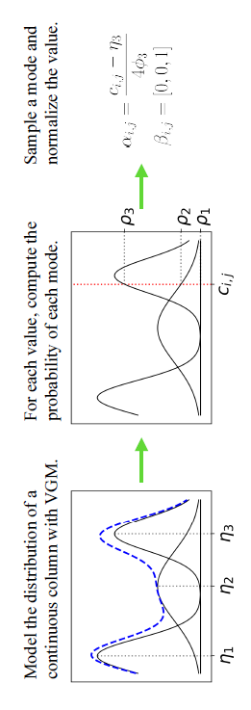
Mode specific normalization for CTGANs

Slide 14
Generative Models

Slide 15
Generative Adversarial Network
In GAN model, two networks, generator(G) and discriminator(D), train model iteratively.
The generator takes random sample data and generates a synthetic dataset.
Discriminator compares synthetically generated data with a real dataset based on conditions that are set before.
Both networks build new nodes and layers to learn to become better at their tasks.
The GAN algorithm defines the generator model’s loss as minimizing the log of the inverted probability of the discriminators prediction of fake images, averaged over a mini-batch.

Slide 16
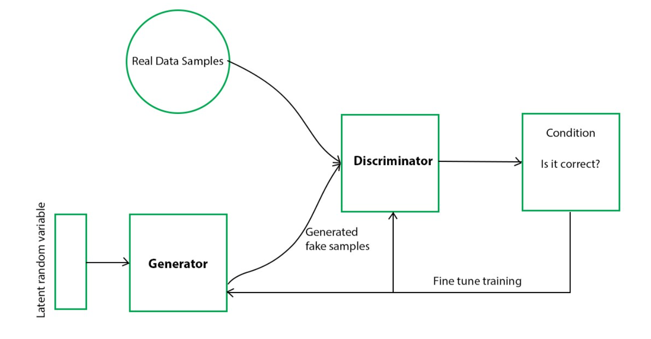
SOURCE : MEDIUM

Slide 17
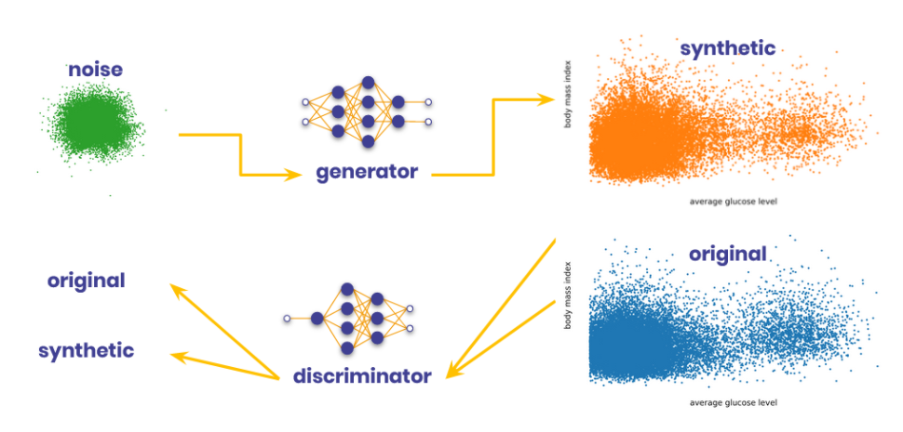
SOURCE : STATICE.AI

Slide 18
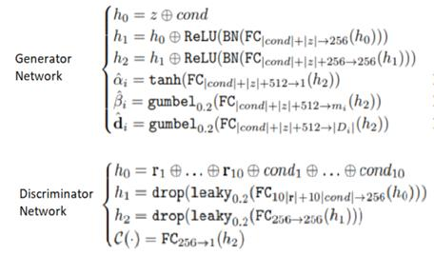
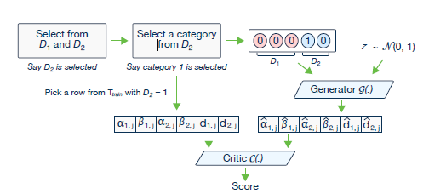
CTGAN Architecture

Slide 19
Variational Autoencoder
VAE is an unsupervised method where encoder compresses the original dataset into a more compact structure and transmits data to the decoder. Then the decoder generates an output which is a representation of the original dataset. The system is trained by optimizing the correlation between input and output data.
VAEs function in two steps:
At first, an encoder network transforms an original complex distribution into a latent distribution.
A decoder network then transforms the distribution back to the original space.

Slide 20
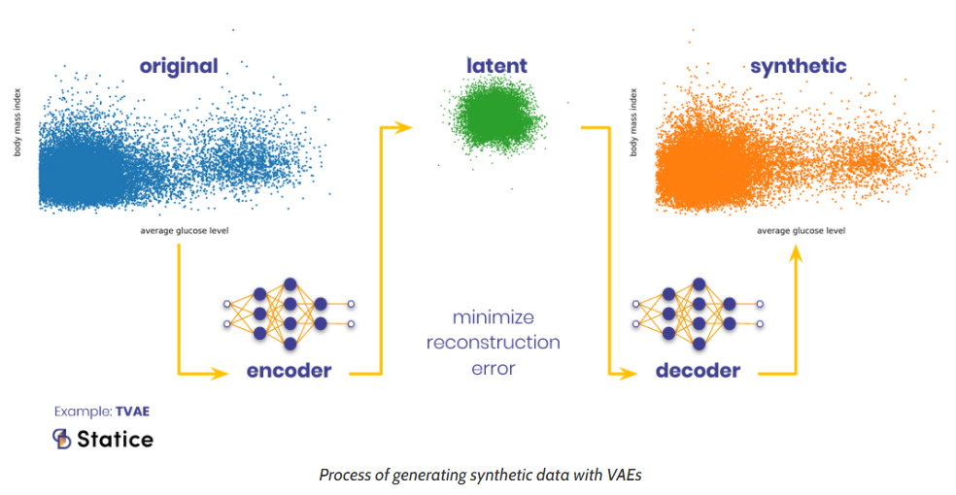
SOURCE : STATICE.AI

Slide 21
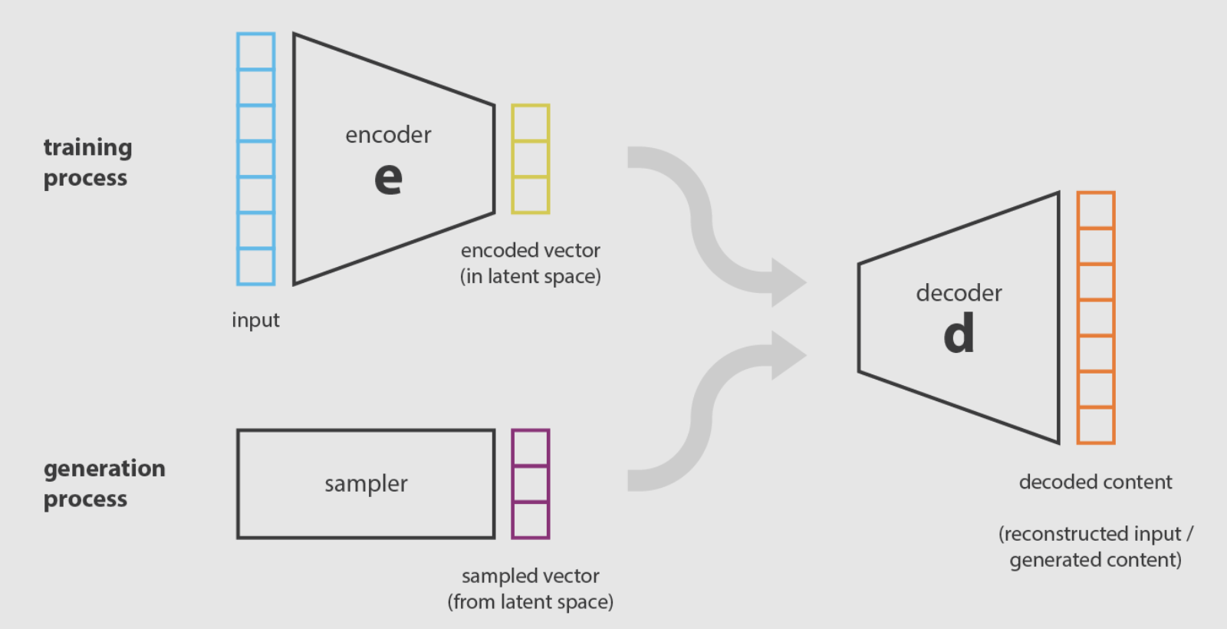
SOURCE : TOWARDS DATA SCIENCE

Slide 22
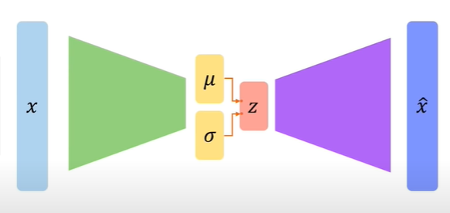
VAEs are different from traditional Autoencoders. We try to solve the problem in a stochastic way rather the deterministic way by introducing μ and 𝜎.

Slide 23
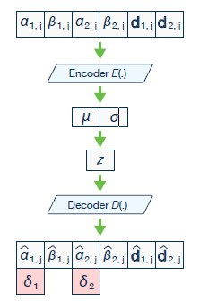
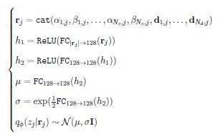
TVAE Architecture

Slide 24
Evaluation

Slide 25
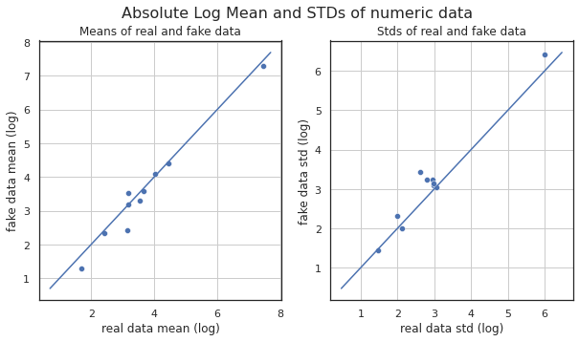
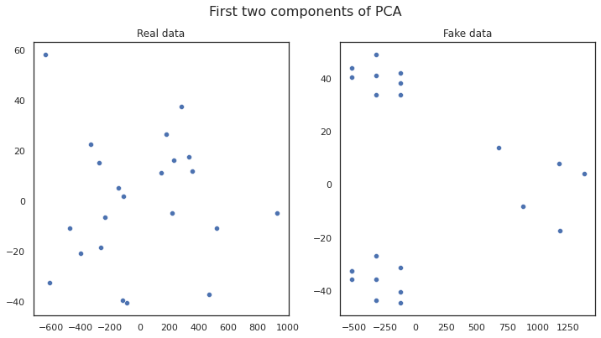
CTGAN generated data distribution

Slide 26
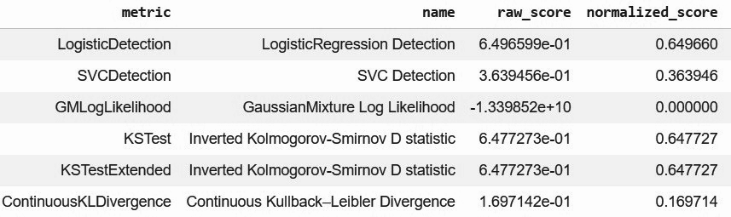
CTGAN with aggregate score of 0.46

Slide 27
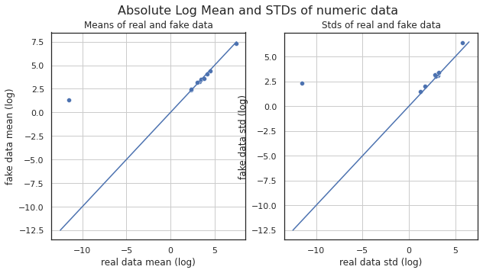
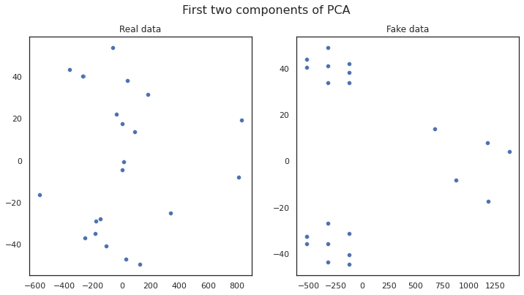
TVAE generated data distribution

Slide 28
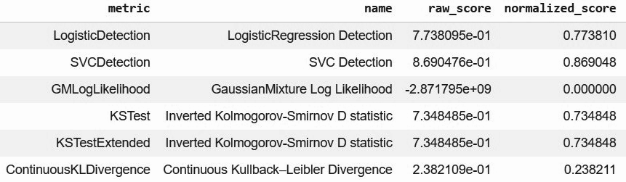
TVAE with aggregate score of 0.55

Slide 29
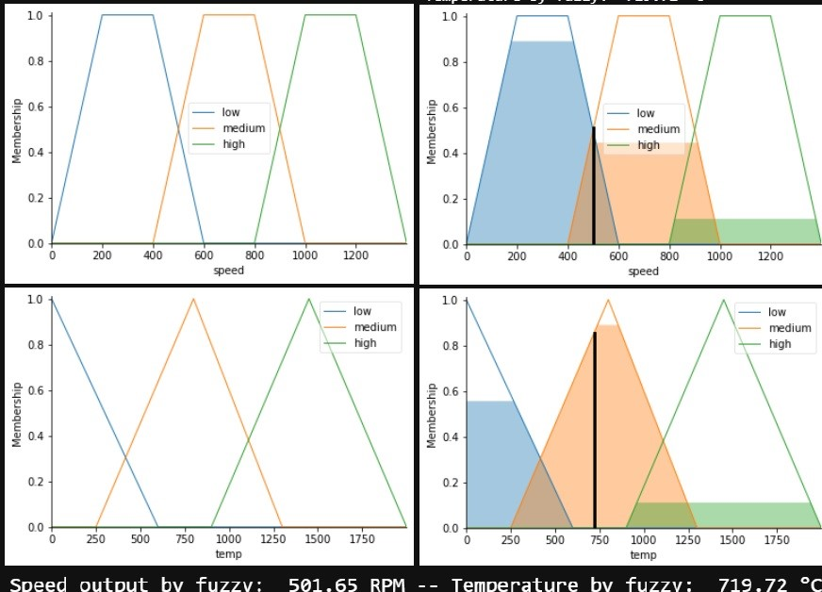
Simulation with respect to speed and temperature

Slide 30
Conclusion

Slide 31
Conclusion
Synthetic data is generated using TGANs, CTGANs
Evaluated by using Absolute log mean , std and PCAs.
CTGANs can achieve better constraint data distributions than TGANs.
Compared score of generated data by TVAE and CTGAN.
TVAE generated data which is more similar to original data.
Generated data is fed to the fuzzy control system where set of rules/membership functions are defined.
Simulation with respect to speed and temperature using generated data.
Lastly, with the help of simulations we concluded how good automation of food waste pelletizer works on Fuzzy logic.

Slide 32
References
[1] Synthesizing Tabular Data using Generative Adversarial Networks - Lei Xu, Kalyan Veeramachaneni (2018)
[2] Martin Arjovsky, Soumith Chintala, and Léon Bottou. Wasserstein generative adversarial networks. In International Conference on Machine Learning, (2017).
[3] Edward Choi, Siddharth Biswal, Bradley Malin, Jon Duke, Walter F. Stewart, and Jimeng Sun. Generating multi-label discrete patient records using generative adversarial networks. In Machine Learning for Healthcare Conference. PMLR, 2017.
[4] Zanje, Tushar, Aniruddha Kadam, G. Vidhate, P. Yadav and G. Gurjar. “Speed Control of BLDC Motor using Fuzzy Logic.” International journal of engineering research and technology(2018).
[5] IoT Based Smart Garbage and Waste Collection Bin by S.S.Navghane, M S Killedar, Dr.V.M.Rohokale, (IJARECE) Volume 5, Issue 5, ISSN: 2278 – 909X - May 2016.
[6] Modeling Tabular data using Conditional GAN - Lei Xu, Maria Skoularidou, Alfredo Cuesta-Infante, Kalyan Veeramachaneni- (2019).
[7] Synthesizing Tabular Data using Conditional GAN - Lei Xu, MIT (2020).
Code ref: https://github.com/iam-pattan/Fuzzy_and_GANs

Slide 33
Thank You !

