Slide 1
Wind Data Cleaning and Prediction
Team Members:
Kalpalathika N 20MAI1006
Poorvaja P 20MAI1009
Pattan Afrid Ahmed 20MAI1016
Guided by: Dr. Sajidha S A

Slide 2
Abstract
Renewable energy resources are environmentally clean and found abundant in nature.
To increase green energy penetration and reduce global warming, Wind energy is one of the promising technology that is developing and promising to satisfy our future energy needs.
In this project, The data collected from the mast are analyzed for missing or erroneous values. Data cleaning is done to improve the quality of that data and use the cleaned data for wind speed prediction to improve the accuracy and reliability in the result.

Slide 3
Requirements
Items | Description | Remarks
Software | Python, PostgreSQL
Data | Renewable energy data (Wind data sources are getting identified) | 10 min of data for around 2 years are used.

Slide 4
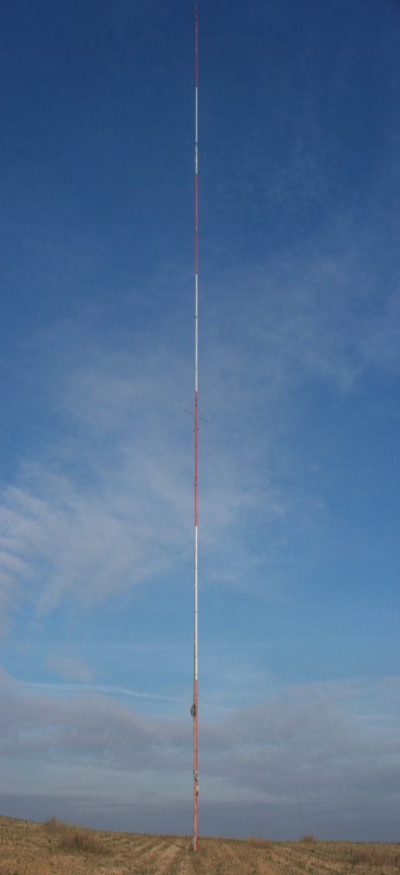
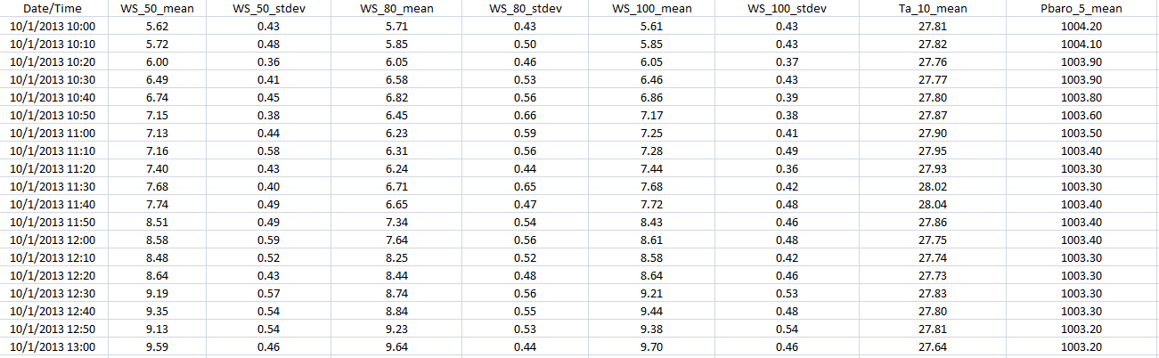
Description of Data set
In this project the data set used is from measurement mast, the wind data has 10 mins interval and contains Date&Time, mean and standard deviation of the wind speed at different heights, pressure and temperature.
The period of the data is 2 year. (i.e.) from 2013 October to 2015 September.

Slide 5
Introduction
In this project, we used real-time data for cleaning and prediction.
Dataset contains aesthetics like Date/time, pressure, temperature, wind speed at different heights of 50m, 80m, 100 m.
We consider the mean of wind speed at different heights.
For cleaning, we have used interpolation method.
For prediction, we labeled the wind speed.

Slide 6
modules
Wind Data Cleaning Module
Database Module
Prediction Module

Slide 7
Wind data cleaning module
Our first aim is to clean the missing values using pandas library in python.
To deal with missing values, either we can use fillna(), interpolate(), imputer() methods.
we have used interpolate() method through padding.
Interpolation through padding means copying the value just before a missing/error entry.
First we loaded the excel file as dataset and storing the original data in the database.
Then we identify the columns with missing/error values and replace it with the error code based on the error value.

Slide 8
Identified error rows with error status are stored separately in another table for future reference.
Then we perform interpolation on the dataset and the dataset is cleaned now.
Store the cleaned dataset into the database and retrieve it whenever we need to perform wind speed prediction for that dataset.

Slide 9
Database module
We are using PostgreSQL for storing wind data.
The tables are created and the values are inserted by connecting python and PostgreSQL.
We have created three tables: 1. uncleaned data table 2. Error Log table and 3.cleaned data table
The Uncleaned data table consists of original data dataset which contains missing or error values.
The Error log contains the error rows with error code status for future reference.
The cleaned data table consists of the data with interpolated values.

Slide 10
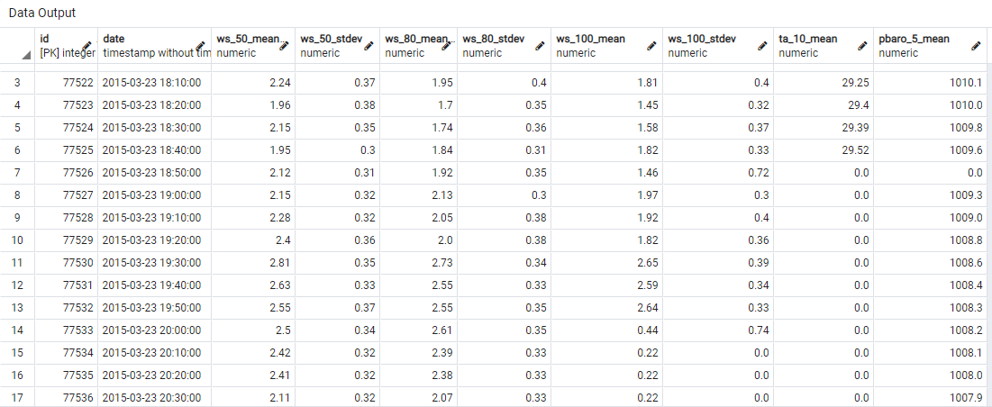

Slide 11
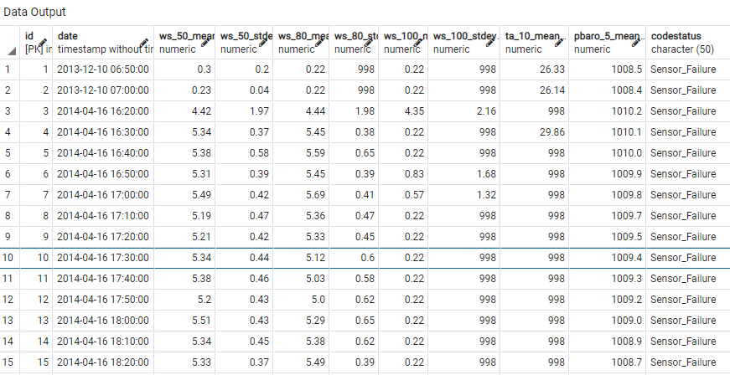

Slide 12
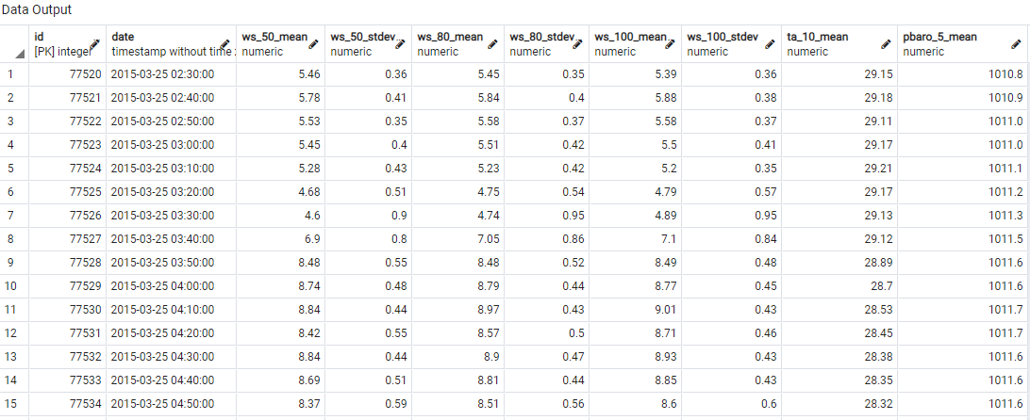

Slide 13
Prediction module
We mainly focused on Autoregressive Integrated Moving Average (ARIMA), fbprophet and Long-short Time Memory(LSTM), RandomForestRegressor(RFR) prediction models.
fbprophet is improvement to the ARMA/ARIMA model.
It has inbuilt functions for seasonality and trends.
By training the model with proper tuning, we predict the wind speed.
When it comes to LSTM, it’s special kind of RNN which overcome the vanishing gradient problem.

Slide 14
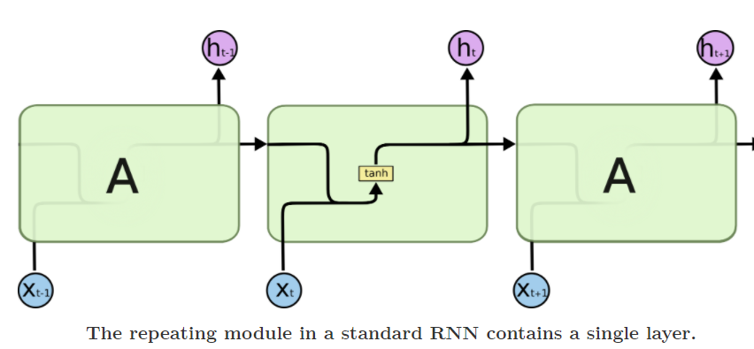
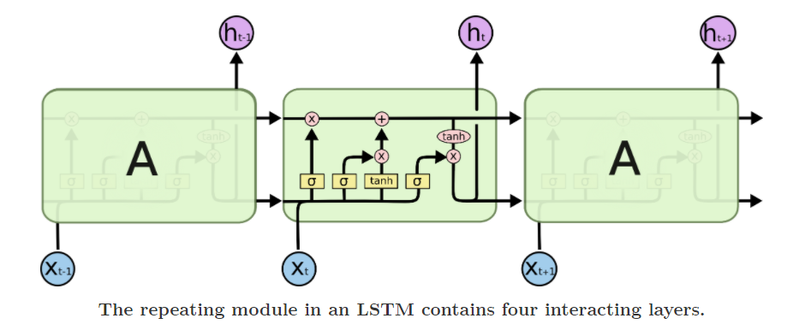

Slide 15
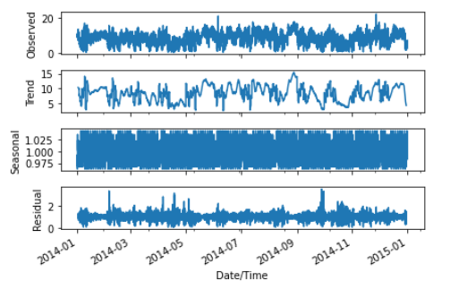
Decompose Graph :

Slide 16
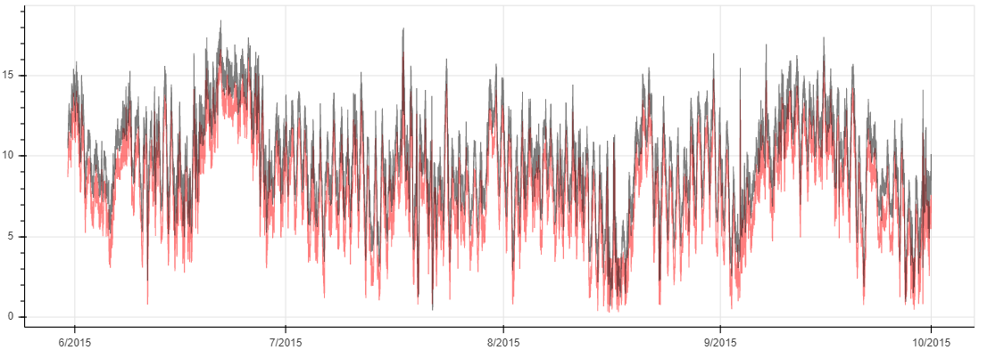
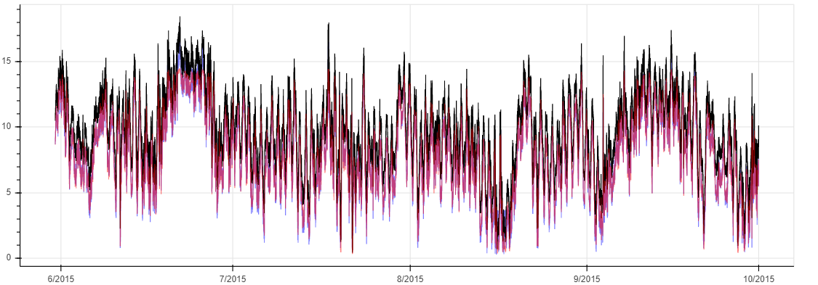
RandomForestRegressor Plot
LSTM, RFR Plot

Slide 17
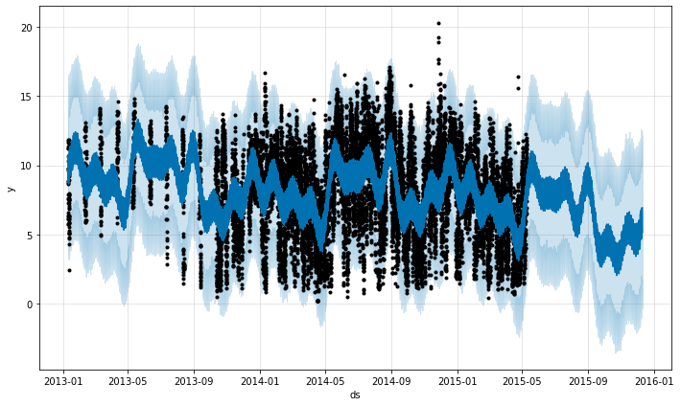
fb_prophet Plot

Slide 18
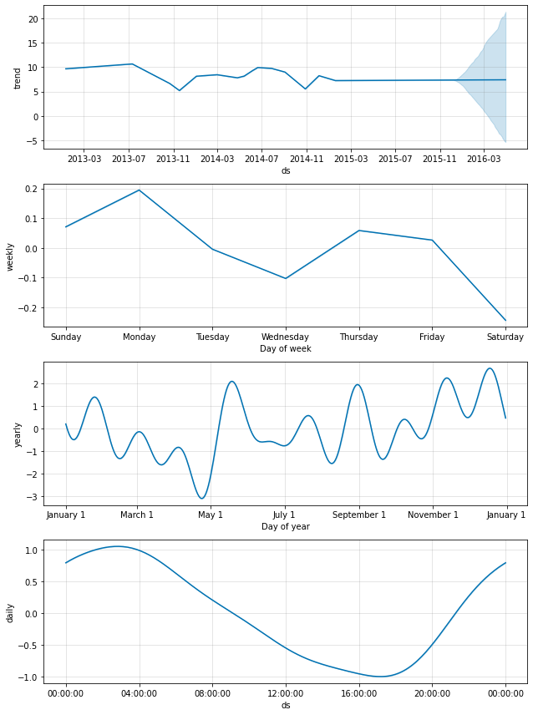

Slide 19
Conclusion
From all the above machine learning models, we got accuracies:
LSTM with RMSE : 0.513
fbprophet with RMSE : 0.768
ARIMA with RMSE : 0.816
RFR with RMSE : 1.895
According to our study, LSTM is suitable for time-series wind speed data predictions.

Slide 20
References
David Barbosa de Alencar,Carolina de Mattos Affonso , Roberto, Jorge Laureano Moya Rodríguez, et al.. (2017) Different Models for Forecasting Wind Power Generation
G. V. Drisya a , Valsaraj P. a , K. Asokan b , K. Satheesh Kumar.. (2017) Wind speed forecast using random forest learning method

Slide 21
Thank You !

