Slide 1
AMAZON RECOMMENDATION ENGINE
team: code riders
Y. s. s. siva prasad
G. giridhar
G pavan dileep

Slide 2
Introduction
In computer science, artificial intelligence (AI), sometimes called machine intelligence, is intelligence demonstrated by machines, in contrast to the natural intelligence displayed by humans. Colloquially, the term "artificial intelligence" is used to describe machines/computers that mimic "cognitive" functions that humans associate with other human minds, such as "learning" and "problem solving".
Artificial intelligence can be classified into three different types of systems:
Analytical
Human-inspired
Humanized artificial intelligence.

Slide 3
Applications of artificial intelligence
Knowledge reasoning.
Planning.
Machine learning.
Natural language processing.
Computer vision.
Robotics.
Artificial general intelligence.

Slide 4
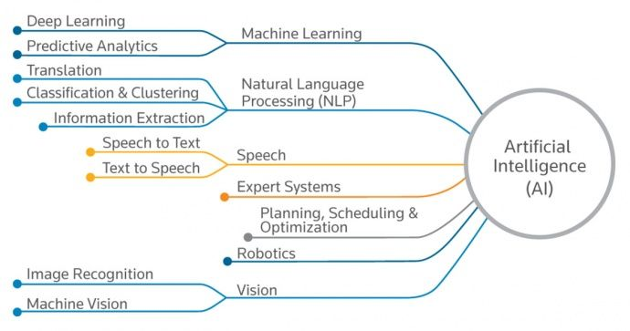
Applications of AI(cont)

Slide 5
Objectives
Online shopping is all over the internet. All our needs are just a click away. The biggest online shopping website is Amazon. Amazon is known not only for its variety of products but also for its strong recommendation system.
We are considering the reviews and ratings given by the user to different products as well as his/her reviews about his/her experience with the product(s).
Based on these input factors, sentiment analysis is performed on predicting the helpfulness of the reviews. Moreover, we also designed item-based collaborative filtering model based on k-Nearest Neighbors to find the 2 most similar items

Slide 6
Problem Statement
The most daunting aspect of building a recommendation engine is knowing where to start. This is even more difficult when you have limited or little experience with ML. However, you may be lucky enough to know what you don’t know, such as:
What data to use.
How to structure it.
How to train it with data.
How to know if it’s accurate.
How to use it within a real-time application.
How to get similar products

Slide 7
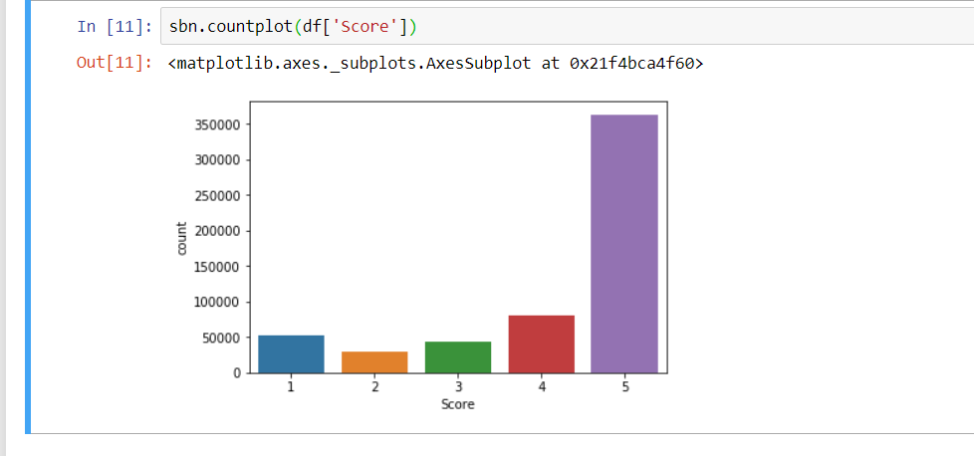
Tables/Graphs
Graph

Slide 8
Algorithm
K-Nearest Neighbours is one of the most basic yet essential classification algorithms in Machine Learning. It belongs to the supervised learning domain and finds intense application in pattern recognition, data mining and intrusion detection.
It is widely disposable in real-life scenarios since it is non-parametric, meaning, it does not make any underlying assumptions about the distribution of data (as opposed to other algorithms such as GMM, which assume a Gaussian distribution of the given data).

Slide 9
Algorithm (cont):
Let m be the number of training data samples. Let p be an unknown point.
Store the training samples in an array of data points arr[]. This means each element of this array represents a tuple (x, y).
for i=0 to m: Calculate Euclidean distance d(arr[i], p).
Make set S of K smallest distances obtained. Each of these distances correspond to an already classified data point.
Return the majority label among S.

Slide 10
What actual a Recommendation system is?
Recommendation System belongs to the class of Information Retrieval, Data Mining and Machine Learning. Recommender systems play a major role in today's ecommerce industry. Recommender systems recommend items to users such as books, movies, videos, electronic products and many other products in general. Recommender systems help the users to get personalized recommendations, helps users to take correct decisions in their online transactions, increase sales and redefine the users web browsing experience, retain the customers, enhance their shopping experience. Information overload problem is solved by search engines, but they do not provide personalization of data.

Slide 11
Recommendation engines provide personalization.
There are different type of recommender systems such as
content-based
collaborative filtering
hybrid recommender system,
demographic and keyword based recommender system.
Variety of algorithms are used by various researchers in each type of recommendation system. Lot of work has been done on this topic, still it is a very favourite topic among data scientists. It also comes under the domain of data Science.

Slide 12
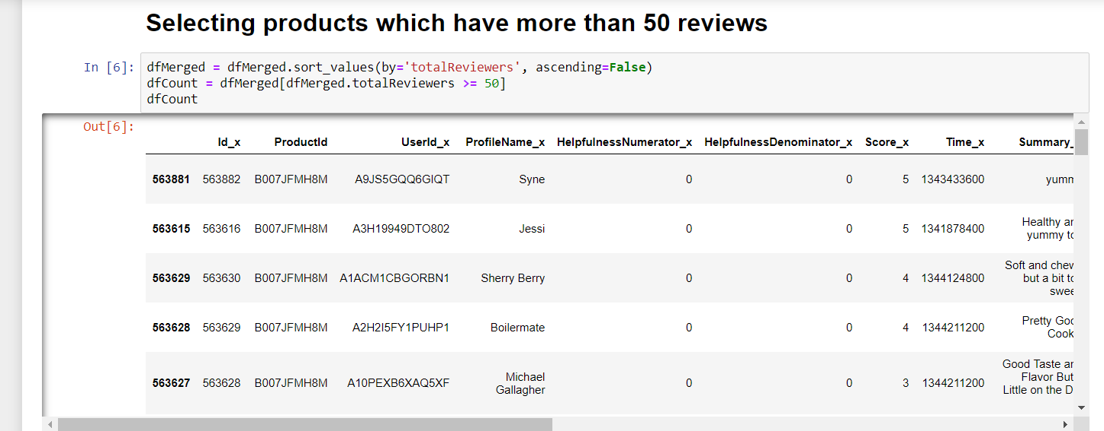

Slide 13
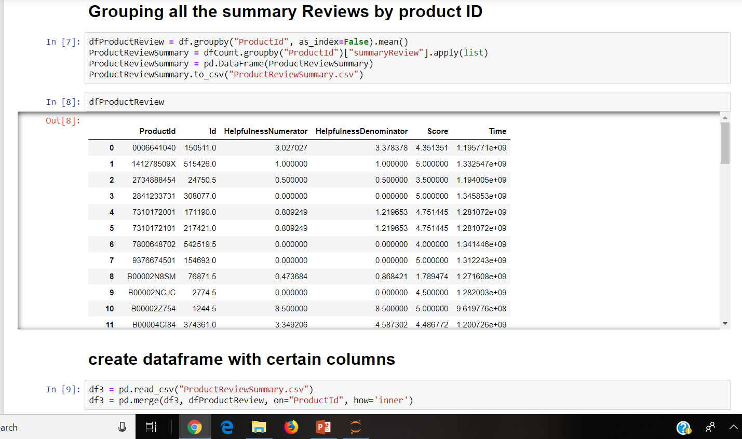

Slide 14
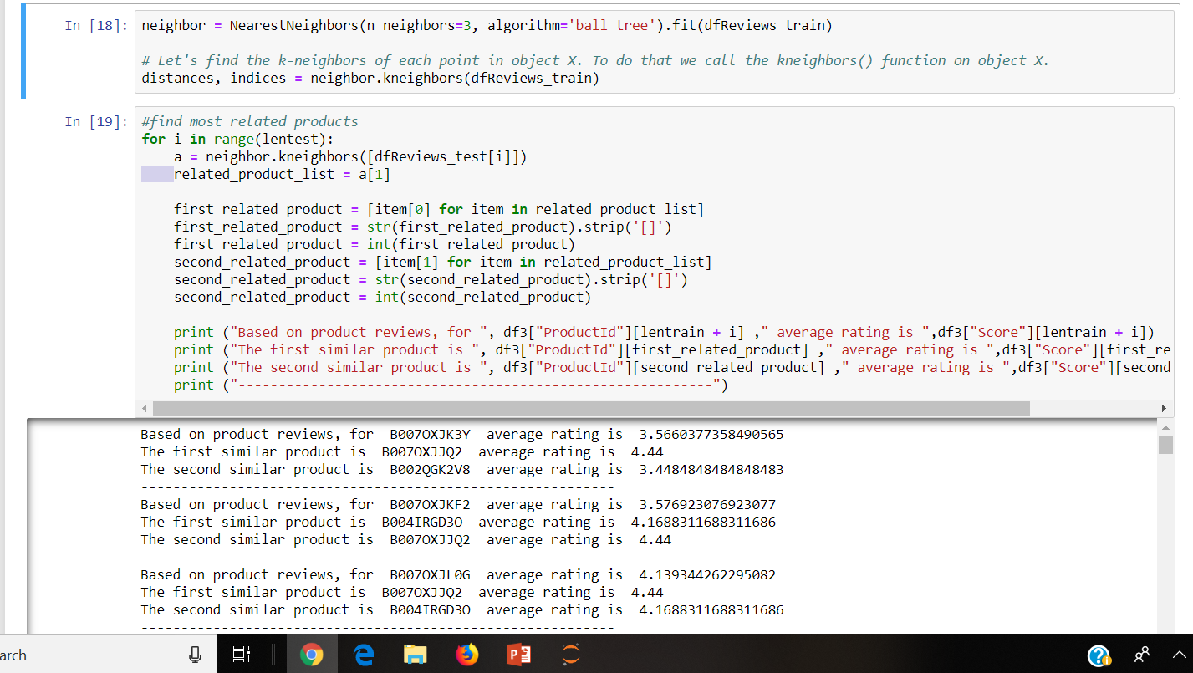

Slide 15
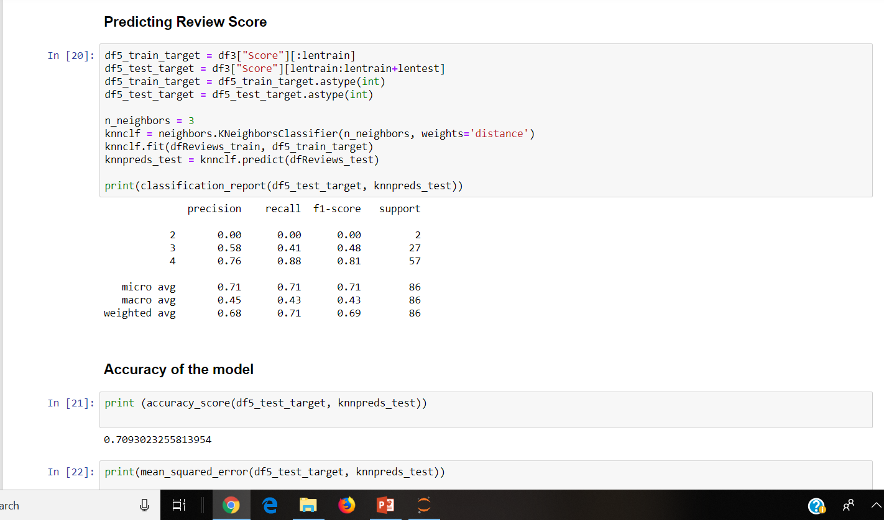

Slide 16
Conclusion
Recommendation algorithms provide an effective form of targeted marketing by creating a personalized shopping experience for each customer. For large retailers like Amazon.com, a good recommendation algorithm is scalable over very large customer bases and product catalogs, requires only subsecond processing time to generate online recommendations, is able to react immediately to changes in a user’s data, and makes compelling recommendations for all users regardless of the number of purchases and ratings. In the future, we expect the retail industry to more broadly apply recommendation algorithms for targeted marketing, both online and offline.

