Slide 1
M.TECH. • DATA SCIENCE
N24News
24-Class News Article Classification
Comparative Evaluation of Traditional Machine Learning and Fine-Tuned BERT
Shreyansh Jain
264161020
M.Tech. Programme in Data Science
Indian Institute of Technology Guwahati, Assam, India
DA 624 — NLP with Large Language Models
Course Instructor: Chiranjib Sur • Assistant Professor, DSAI
Project Presentation • November 2026
N24News • M.Tech. Data Science • IIT Guwahati
1

Slide 2
OVERVIEW
Presentation roadmap
• Problem statement, objectives and dataset
• Preprocessing and feature engineering
• Three TF-IDF baselines versus fine-tuned BERT
• Experimental setup, results, analytics and error analysis
• Live inference workflow, example scenarios and limitations
• Complete notebook source code in the appendix
N24News • M.Tech. Data Science • IIT Guwahati
2

Slide 3
01 • MOTIVATION
Problem statement
THE CHALLENGE
THE TASK
News articles span many topics. Manually assigning a category is time-consuming and may be inconsistent as article volume grows.
Given a headline and article body, predict exactly one of 24 predefined N24News sections.
Input → headline + article text Output → one topical label
N24News • M.Tech. Data Science • IIT Guwahati
3

Slide 4
01 • STUDY DESIGN
Research question and objectives
Research question
Does fine-tuned BERT improve on strong TF-IDF classifiers for this 24-class dataset?
Objectives
• Prepare reproducible train, validation and held-out test splits.
• Train Multinomial Naive Bayes, Logistic Regression and Linear SVM.
• Fine-tune bert-base-uncased for the same 24 labels.
• Compare accuracy, weighted precision/recall/F1 and macro F1.
• Provide a prediction interface that displays all four model outputs.
N24News • M.Tech. Data Science • IIT Guwahati
4

Slide 5
02 • DATA
Dataset overview
TRAIN
VALIDATION
TEST
48,984
6,123
6,124
after removing 4 duplicates
model development
held-out evaluation
TOTAL EXAMPLES
INPUT FIELDS
61,231 records across 24 categories.
section (target), headline, article body, article identifiers and supporting metadata.
Split checks: 4 duplicate training rows removed; no article_id overlap across train, validation and test.
N24News • M.Tech. Data Science • IIT Guwahati
5

Slide 6
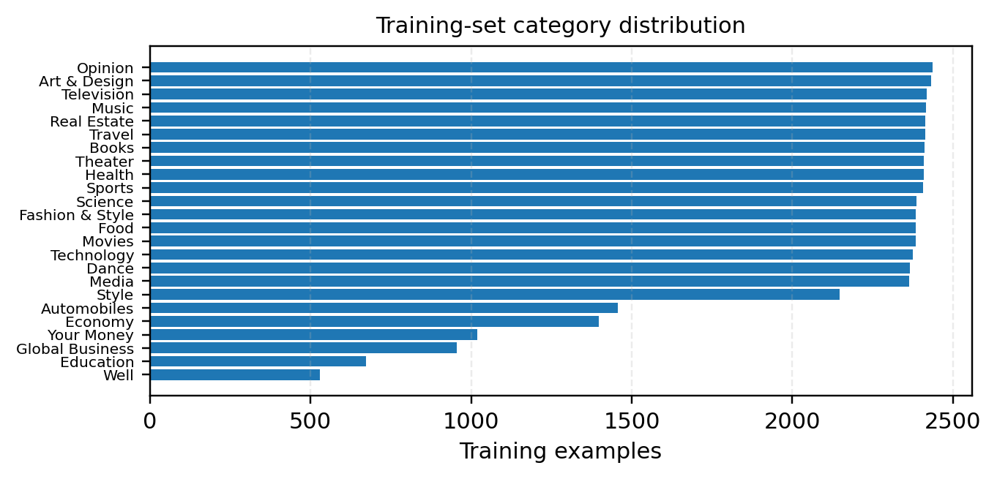
02 • DATA
Category distribution
Training split only • class counts are uneven
LARGEST
Opinion: 2,437
Art & Design: 2,431
SMALLEST
Well: 529
Education: 672
Why it matters: macro F1 gives each class equal weight; weighted metrics reflect class support.
N24News • M.Tech. Data Science • IIT Guwahati
6

Slide 7
03 • METHOD
End-to-end workflow
01
02
03
→
→
Load & inspect
Deduplicate & split-check
Combine headline + article
04
05
06
→
→
TF-IDF / BERT tokenization
Train four classifiers
Evaluate on held-out test
Same 6,124 test examples and same 24-label mapping for all four models.
N24News • M.Tech. Data Science • IIT Guwahati
7

Slide 8
03 • METHOD
Text preprocessing and representations
TRADITIONAL ML
BERT
• Concatenate headline + article
• Lowercase text
• Replace non a–z characters with spaces
• Normalize whitespace
• TF-IDF: 20,000 features, unigrams + bigrams
• English stop-word removal; min_df=2; max_df=0.95
• Use original concatenated text
• bert-base-uncased tokenizer
• Truncate/pad to 384 tokens
• Attention masks distinguish padding
• LabelEncoder maps 24 sections to IDs
• Fine-tune sequence-classification head
Leakage control: TF-IDF vocabulary and IDF weights are fitted on training text only.
N24News • M.Tech. Data Science • IIT Guwahati
8

Slide 9
04 • MODELS
Models compared
Multinomial Naive Bayes Probabilistic baseline; library defaults.
Probabilistic baseline; library defaults.
Logistic Regression Linear discriminative classifier; C=1.0, max_iter=1000.
Linear discriminative classifier; C=1.0, max_iter=1000.
Linear SVM Margin-based linear classifier; C=1.0, max_iter=2000.
Margin-based linear classifier; C=1.0, max_iter=2000.
BERT bert-base-uncased; fine-tuned for 24 output labels.
bert-base-uncased; fine-tuned for 24 output labels.
N24News • M.Tech. Data Science • IIT Guwahati
9

Slide 10
04 • MODELS
BERT fine-tuning configuration
Pretrained model : bert-base-uncased
Learning rate : 1x10⁻⁵
Labels : 24
Weight decay : 0.01
Maximum sequence length : 384 Tokens
Warmup steps : 918
Epochs 3
Gradient clipping : 1.0
Train / evaluation batch size 8/16
Precision / random seed : FP16/42
Gradient accumulation 2
Checkpoint selection : Best weighted F1
N24News • M.Tech. Data Science • IIT Guwahati
10

Slide 11
05 • EXPERIMENT
Experimental environment
COMPUTE
FRAMEWORKS
EVALUATION
Google Colab
NVIDIA Tesla T4
~15 GB reported GPU memory
PyTorch 2.11.0+cu130
Hugging Face Transformers
Datasets + scikit-learn
6,124 held-out test rows
Five metrics per model
Same labels and test rows
The report does not include a controlled training-time or inference-latency benchmark.
N24News • M.Tech. Data Science • IIT Guwahati
11

Slide 12
05 • EVALUATION
How performance is measured
ACCURACY
WEIGHTED F1
MACRO F1
Correct predictions / all examples
Class F1 values weighted by support
Unweighted mean across 24 classes
Precision: how many predicted examples are correct.
Recall: how many true examples are retrieved.
F1: harmonic mean of precision and recall.
Macro F1 is important because the class distribution is imbalanced.
N24News • M.Tech. Data Science • IIT Guwahati
12

Slide 13
06 • RESULTS
Final held-out test results
Model | Accuracy | W. Prec. | W. Recall | W. F1 | Macro F1
Naive Bayes | 82.02 | 81.09 | 82.02 | 81.17 | 78.26
Logistic Reg. | 85.99 | 85.96 | 85.99 | 85.81 | 84.68
Linear SVM | 87.12 | 86.89 | 87.12 | 86.88 | 86.00
BERT | 86.81 | 86.72 | 86.81 | 86.71 | 85.25
All values are percentages • Test set: 6,124 examples
BEST MODEL
CLOSE SECOND
Linear SVM leads on all five reported metrics.
BERT is only 0.31 percentage points behind in accuracy.
N24News • M.Tech. Data Science • IIT Guwahati
13

Slide 14
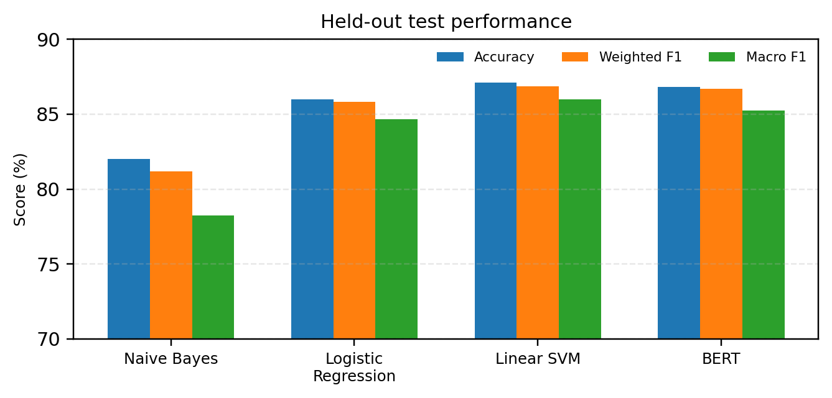
06 • RESULTS
Visual comparison of test performance
SVM ACCURACY
87.12%
BERT ACCURACY
86.81%
Gap: 0.31 percentage points. No confidence intervals or repeated-seed tests were reported.
N24News • M.Tech. Data Science • IIT Guwahati
14

Slide 15
06 • RESULTS
Validation versus test performance
Model | Validation accuracy | Test accuracy
Naive Bayes | 82.33% | 82.02%
Logistic Regression | 86.72% | 85.99%
Linear SVM | 87.93% | 87.12%
BERT | 87.13% | 86.81%
Validation was used during development and checkpoint selection. Test results are the final held-out comparison.
N24News • M.Tech. Data Science • IIT Guwahati
15

Slide 16
07 • OBSERVATIONS
What the numbers tell us
• Linear SVM is the top model across accuracy, weighted precision, weighted recall, weighted F1 and macro F1.
• BERT is competitive, but does not surpass Linear SVM in this experiment.
• Linear SVM exceeds BERT by 0.31 points in accuracy and 0.75 points in macro F1.
• Logistic Regression improves substantially over Naive Bayes, especially in macro F1 (+6.42 points).
• Macro F1 is below weighted F1 for every model, suggesting uneven class-level performance.
N24News • M.Tech. Data Science • IIT Guwahati
16

Slide 17
07 • OBSERVATIONS
Class imbalance and macro-F1 insight
WELL
529 training examples
OPINION
2,437 training examples
The largest class has about 4.6× as many examples as the smallest. Macro F1 helps expose weaker performance on smaller classes.
N24News • M.Tech. Data Science • IIT Guwahati
17

Slide 18
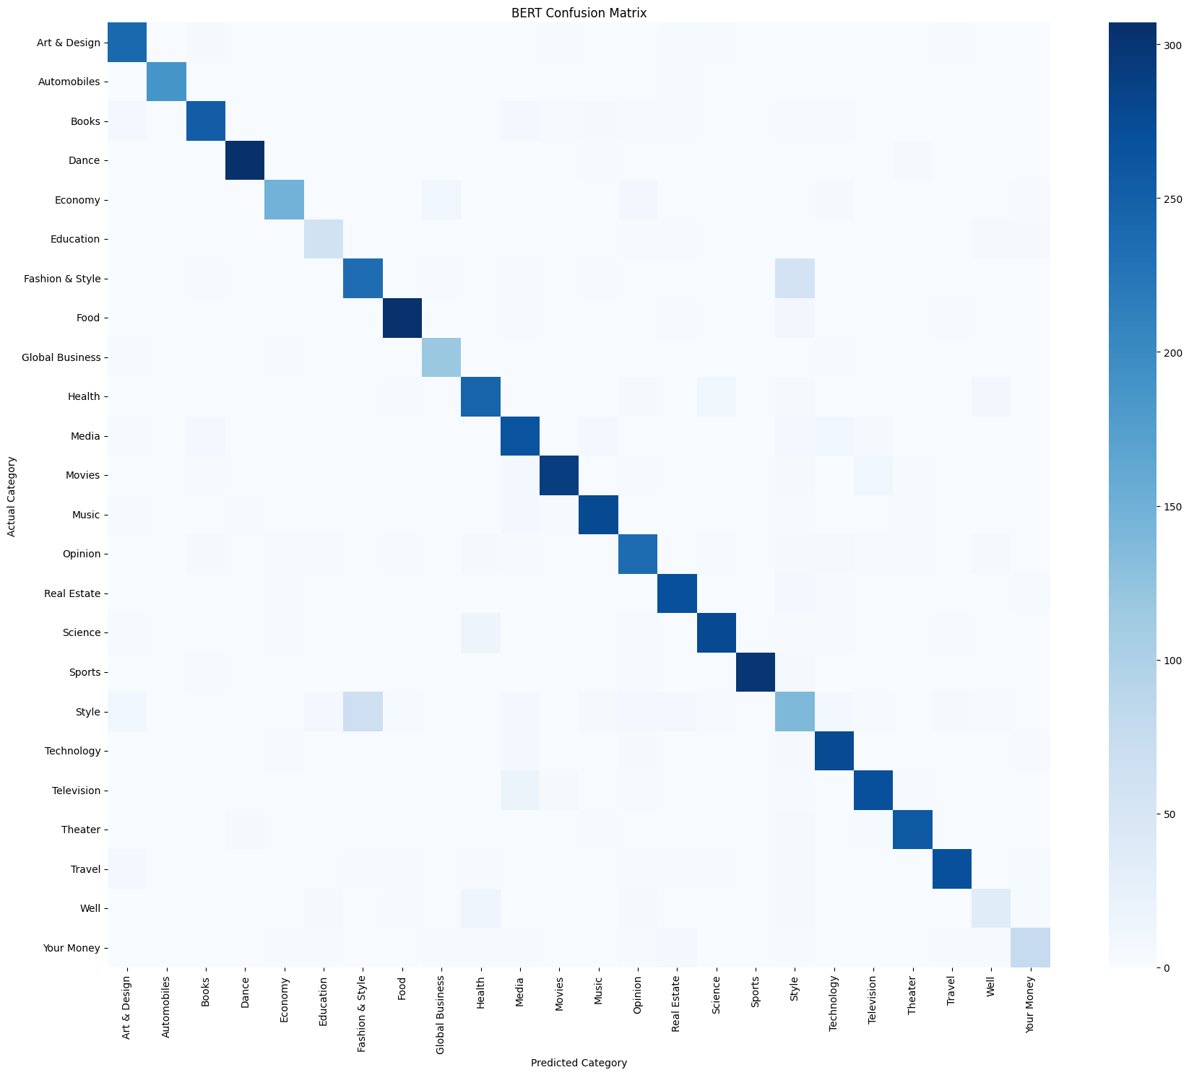
07 • OBSERVATIONS
BERT error analysis: validation confusion matrix
MAIN DIAGONAL
Most examples fall on the correct-class diagonal.
VISIBLE OVERLAP
Fashion & Style and Style show notable overlap.
Important: this is a BERT validation-set matrix, not a test-set confusion matrix.
N24News • M.Tech. Data Science • IIT Guwahati
18

Slide 19
07 • OBSERVATIONS
Interpreting likely category confusions
• Fashion & Style ↔ Style: shared vocabulary around clothing, designers, trends and lifestyle.
• Health ↔ Well: articles may share language about medicine, nutrition and personal wellness.
• Media / Movies / Television: entertainment terms and personalities can cross category boundaries.
• Science ↔ Technology: technical topics may span research and computing.
• These are plausible semantic overlaps; only Fashion & Style / Style is specifically noted as visible in the supplied validation matrix.
Do not interpret these examples as measured top test-set error pairs.
N24News • M.Tech. Data Science • IIT Guwahati
19

Slide 20
08 • DEMO
Example inputs for a live demonstration
SPORTS
TECHNOLOGY
A report on a cricket final, player performance and tournament result.
Expected topic: Sports
A new AI model is released with features for software developers.
Expected topic: Technology
HEALTH
AMBIGUOUS
A clinical study evaluates a new treatment approach.
Expected topic: Health
A story on fashion designers and seasonal clothing collections.
Possible boundary: Fashion & Style / Style
These are illustrative demonstration prompts, not additional test-set observations.
N24News • M.Tech. Data Science • IIT Guwahati
20

Slide 21
08 • DEMO
Interactive inference workflow
USER INPUT
↓
Headline + article body
Majority label is a simple agreement summary—not a separately trained ensemble or calibrated probability.
TRADITIONAL PATH
↓
Clean text → saved TF-IDF → NB / LR / SVM
BERT PATH
↓
Original text → tokenizer (384) → BERT
The notebook uses ipywidgets for headline entry, article text, a classify button and prediction output.
OUTPUT
Four predictions + majority agreement
N24News • M.Tech. Data Science • IIT Guwahati
21

Slide 22
09 • IMPLEMENTATION
Saved artifacts and reproducibility
Traditional_ML
BERT
Datasets / Results
naive_bayes.joblib
logistic_regression.joblib
linear_svm.joblib
tfidf_vectorizer.joblib
label_encoder.joblib
config.json
model.safetensors
tokenizer files
label_encoder.joblib
training checkpoints
train.csv
validation.csv
test.csv
model_comparison.csv
final_test_comparison.csv
Inference loads saved artifacts; it does not need to retrain the models.
N24News • M.Tech. Data Science • IIT Guwahati
22

Slide 23
10 • DISCUSSION
Limitations and threats to validity
• One dataset and one fixed split; repeated random-seed runs were not reported.
• Traditional models and BERT use different text representations and preprocessing paths.
• BERT truncates long articles after 384 tokens.
• Final test comparison contains aggregate metrics; full per-class test metrics and per-model test confusion matrices are not supplied.
• No controlled benchmark of training time, inference latency, throughput, energy, or model size.
• Class frequencies are uneven; class weighting, resampling and hierarchical classification were not tested.
N24News • M.Tech. Data Science • IIT Guwahati
23

Slide 24
11 • TAKEAWAYS
Conclusion
MAIN RESULT
BERT RESULT
TF-IDF + Linear SVM achieved the best test accuracy: 87.12%.
Fine-tuned BERT achieved 86.81% accuracy and remained a close second.
• Strong traditional baselines remain highly competitive for this dataset.
• Model choice should consider class-level performance and deployment constraints—not accuracy alone.
• Future work: repeated seeds, per-class test analysis, tuning, longer-context experiments and controlled efficiency measurements.
N24News • M.Tech. Data Science • IIT Guwahati
24

Slide 25
INTERACTIVE DEMO
Observed predictions from the live classifier
Four manually tested examples entered in the Google Colab inference interface.
Input example
Naive Bayes
Logistic Reg.
Linear SVM
BERT
Agreement
Science-fiction film
Movies
Movies
Movies
Movies
4 / 4
Type 2 diabetes treatment
Health
Science
Health
Health
3 / 4
Cricket World Cup final
Sports
Sports
Sports
Sports
4 / 4
New AI reasoning model
Technology
Technology
Technology
Technology
4 / 4
Key observation: all four models agreed on 3 of 4 examples. For the diabetes example, Logistic Regression predicted Science while the other three predicted Health.
These are live-demo outputs, not additional held-out test-set measurements.

Slide 26
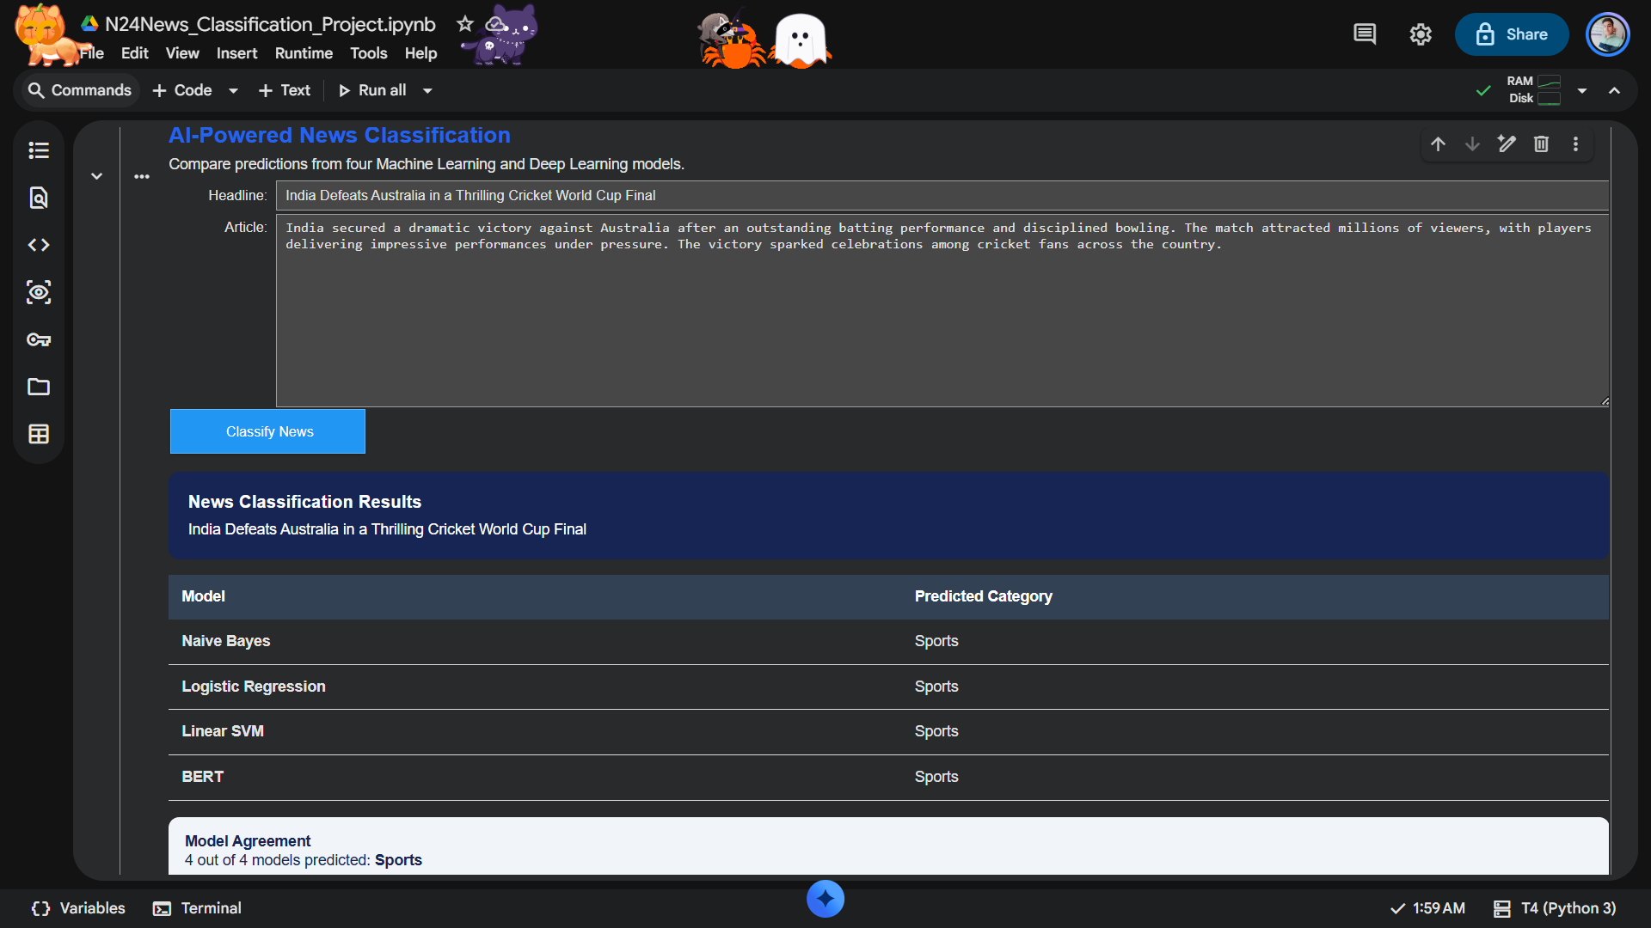
DEMO EXAMPLE 3
Cricket World Cup final
All four models predicted Sports.
N24News • Interactive classification demo

Slide 27
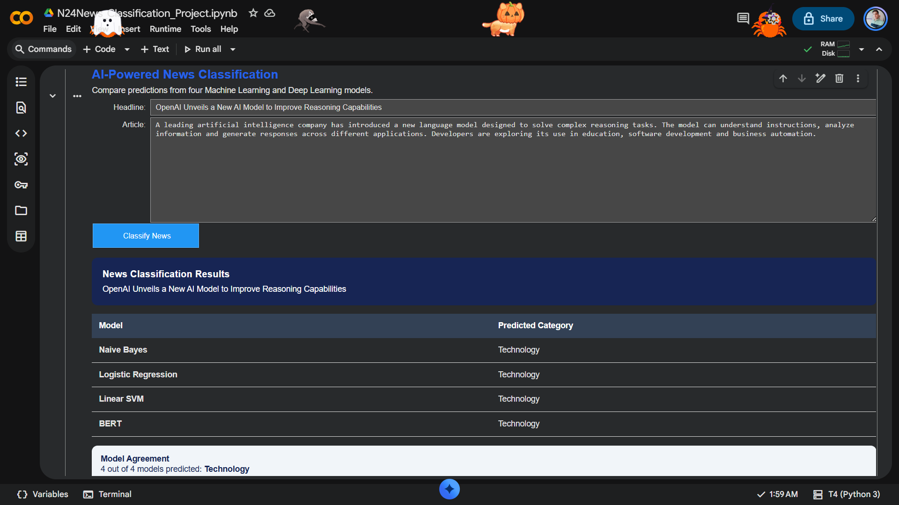
DEMO EXAMPLE 4
AI reasoning model
All four models predicted Technology.
N24News • Interactive classification demo

Slide 28
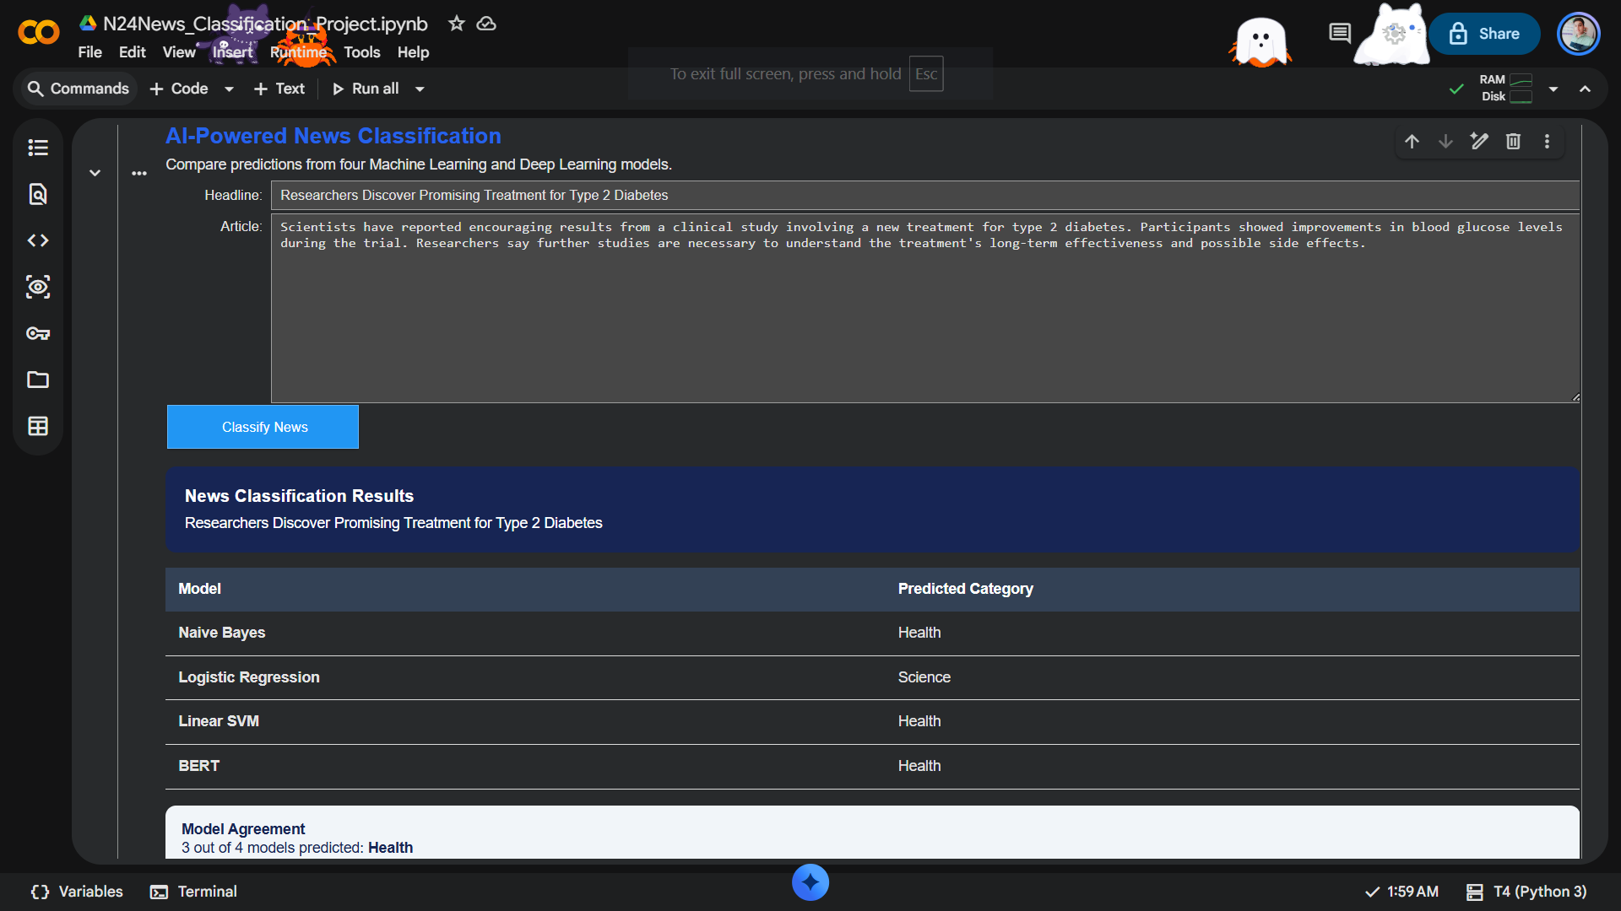
DEMO EXAMPLE 2
Type 2 diabetes treatment
Three models predicted Health; Logistic Regression predicted Science.
N24News • Interactive classification demo

Slide 29
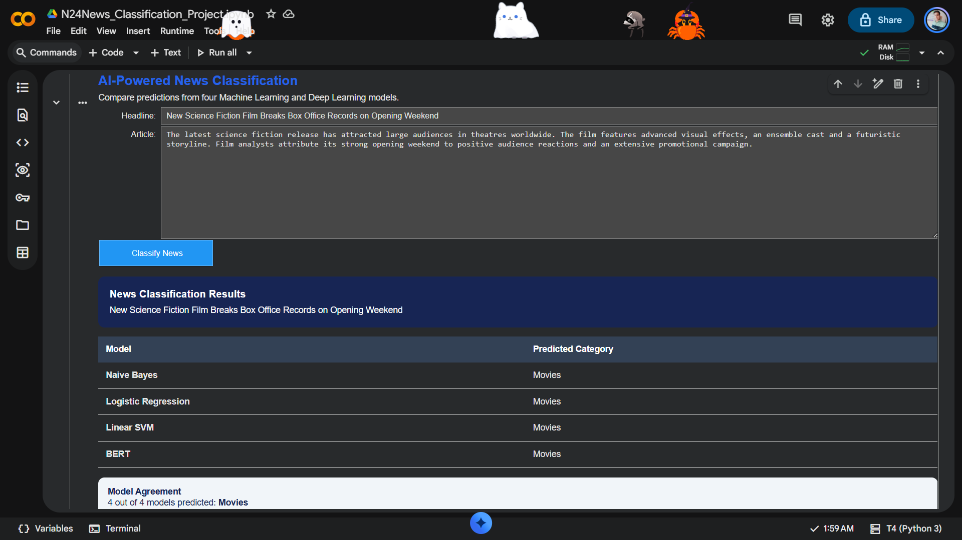
DEMO EXAMPLE 1
Science-fiction film
All four models predicted Movies.
N24News • Interactive classification demo

Slide 30

PROJECT RESOURCES
Code, execution instructions & repository
GitHub Repository
https://github.com/iam-shrey/N24News-Classification-Project
Project repository containing the .ipynb file with code and execution instructions.
Complete Extracted Code
N24News_Complete_Extracted_Code.txt ↗
Scan to open repository
Direct link to the complete notebook code.

Slide 31
Thank you
N24News • 24-Class News Article Classification
25
N24News • M.Tech. Data Science • IIT Guwahati
25
N24News • M.Tech. Data Science • IIT Guwahati

