Slide 1
CS60057
Speech &Natural Language Processing
Autumn 2007
Lecture 11
17 August 2007

Slide 2
Hidden Markov Models
Bonnie Dorr Christof Monz
CMSC 723: Introduction to Computational Linguistics
Lecture 5
October 6, 2004

Slide 3
Hidden Markov Model (HMM)
HMMs allow you to estimate probabilities of unobserved events
Given plain text, which underlying parameters generated the surface
E.g., in speech recognition, the observed data is the acoustic signal and the words are the hidden parameters

Slide 4
HMMs and their Usage
HMMs are very common in Computational Linguistics:
  Speech recognition (observed: acoustic signal, hidden: words)
  Handwriting recognition (observed: image, hidden: words)
  Part-of-speech tagging (observed: words, hidden: part-of-speech tags)
  Machine translation (observed: foreign words, hidden: words in target language)

Slide 5
Noisy Channel Model
In speech recognition you observe an acoustic signal (A=a₁,…,a_{n}) and you want to determine the most likely sequence of words (W=w₁,…,w_{n}): P(W | A)
Problem: A and W are too specific for reliable counts on observed data, and are very unlikely to occur in unseen data

Slide 6
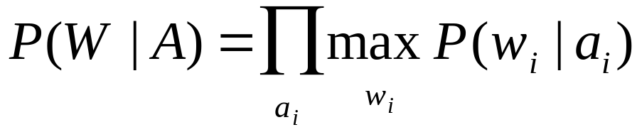
Noisy Channel Model
Assume that the acoustic signal (A) is already segmented wrt word boundaries
P(W | A) could be computed as
Problem: Finding the most likely word corresponding to a acoustic representation depends on the context
E.g., /'pre-z&ns / could mean “presents” or “presence” depending on the context

Slide 7
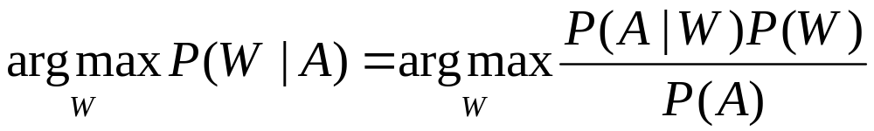
Noisy Channel Model
Given a candidate sequence W we need to compute P(W) and combine it with P(W | A)
Applying Bayes’ rule:
The denominator P(A) can be dropped, because it is constant for all W

Slide 8
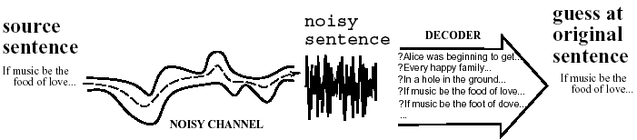
Noisy Channel in a Picture

Slide 9
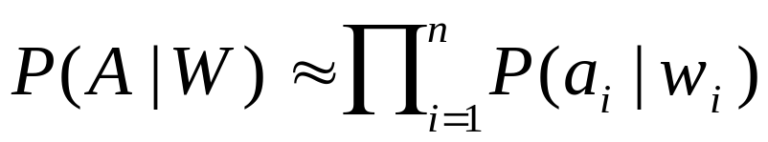
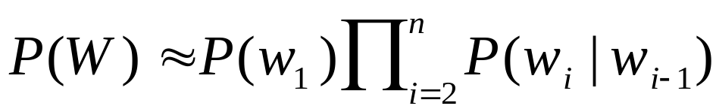
Decoding
The decoder combines evidence from
  The likelihood: P(A | W)
  This can be approximated as:
  The prior: P(W)
  This can be approximated as:

Slide 10


Search Space
Given a word-segmented acoustic sequence list all candidates
Compute the most likely path
'bot | ik-'spen-siv | 'pre-z&ns
boat | excessive | presidents
bald | expensive | presence
bold | expressive | presents
bought | inactive | press

Slide 11
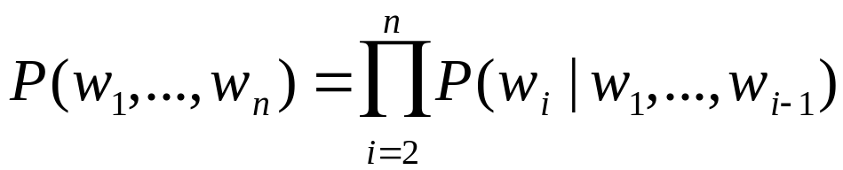
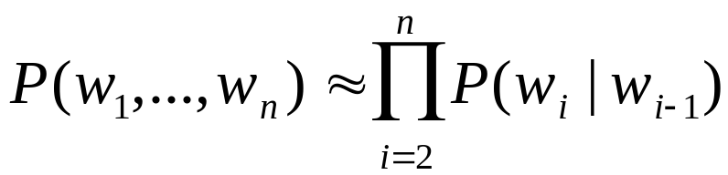
Markov Assumption
The Markov assumption states that probability of the occurrence of word w_{i} at time t depends only on occurrence of word w_{i-1} at time t-1
  Chain rule:
  Markov assumption:

Slide 12
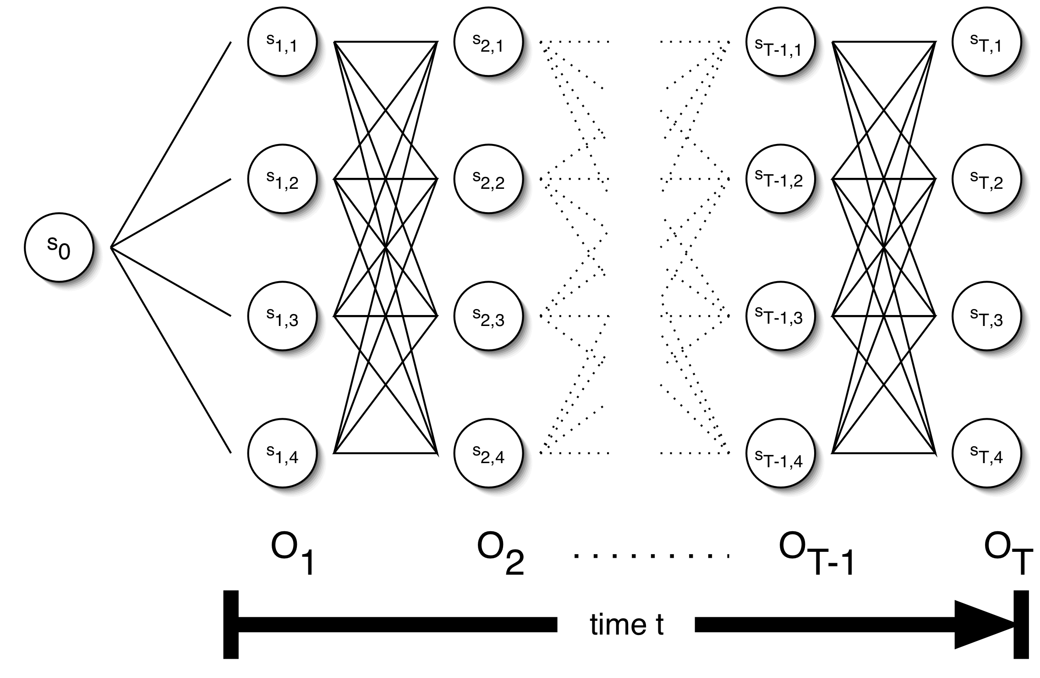
The Trellis

Slide 13

Parameters of an HMM
States: A set of states S=s₁,…,s_{n}
Transition probabilities: A= a_{1,1},a_{1,2},…,a_{n,n} Each a_{i,j} represents the probability of transitioning from state s_{i} to s_{j}.
Emission probabilities: A set B of functions of the form b_{i}(o_{t}) which is the probability of observation o_{t} being emitted by s_{i}
Initial state distribution: is the probability that s_{i} is a start state

Slide 14

The Three Basic HMM Problems
Problem 1 (Evaluation): Given the observation sequence O=o₁,…,o_{T} and an HMM model
, how do we compute the probability of O given the model?
Problem 2 (Decoding): Given the observation sequence O=o₁,…,o_{T} and an HMM model
, how do we find the state sequence that best explains the observations?

Slide 15

The Three Basic HMM Problems
Problem 3 (Learning): How do we adjust the model parameters , to maximize
?

Slide 16
Problem 1: Probability of an Observation Sequence
What is ?
The probability of a observation sequence is the sum of the probabilities of all possible state sequences in the HMM.
Naïve computation is very expensive. Given T observations and N states, there are N^{T} possible state sequences.
Even small HMMs, e.g. T=10 and N=10, contain 10 billion different paths
Solution to this and problem 2 is to use dynamic programming

Slide 17

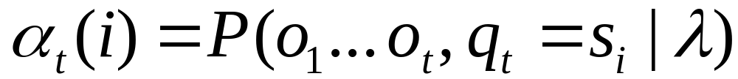
Forward Probabilities
What is the probability that, given an HMM , at time t the state is i and the partial observation o₁ … o_{t} has been generated?

Slide 18

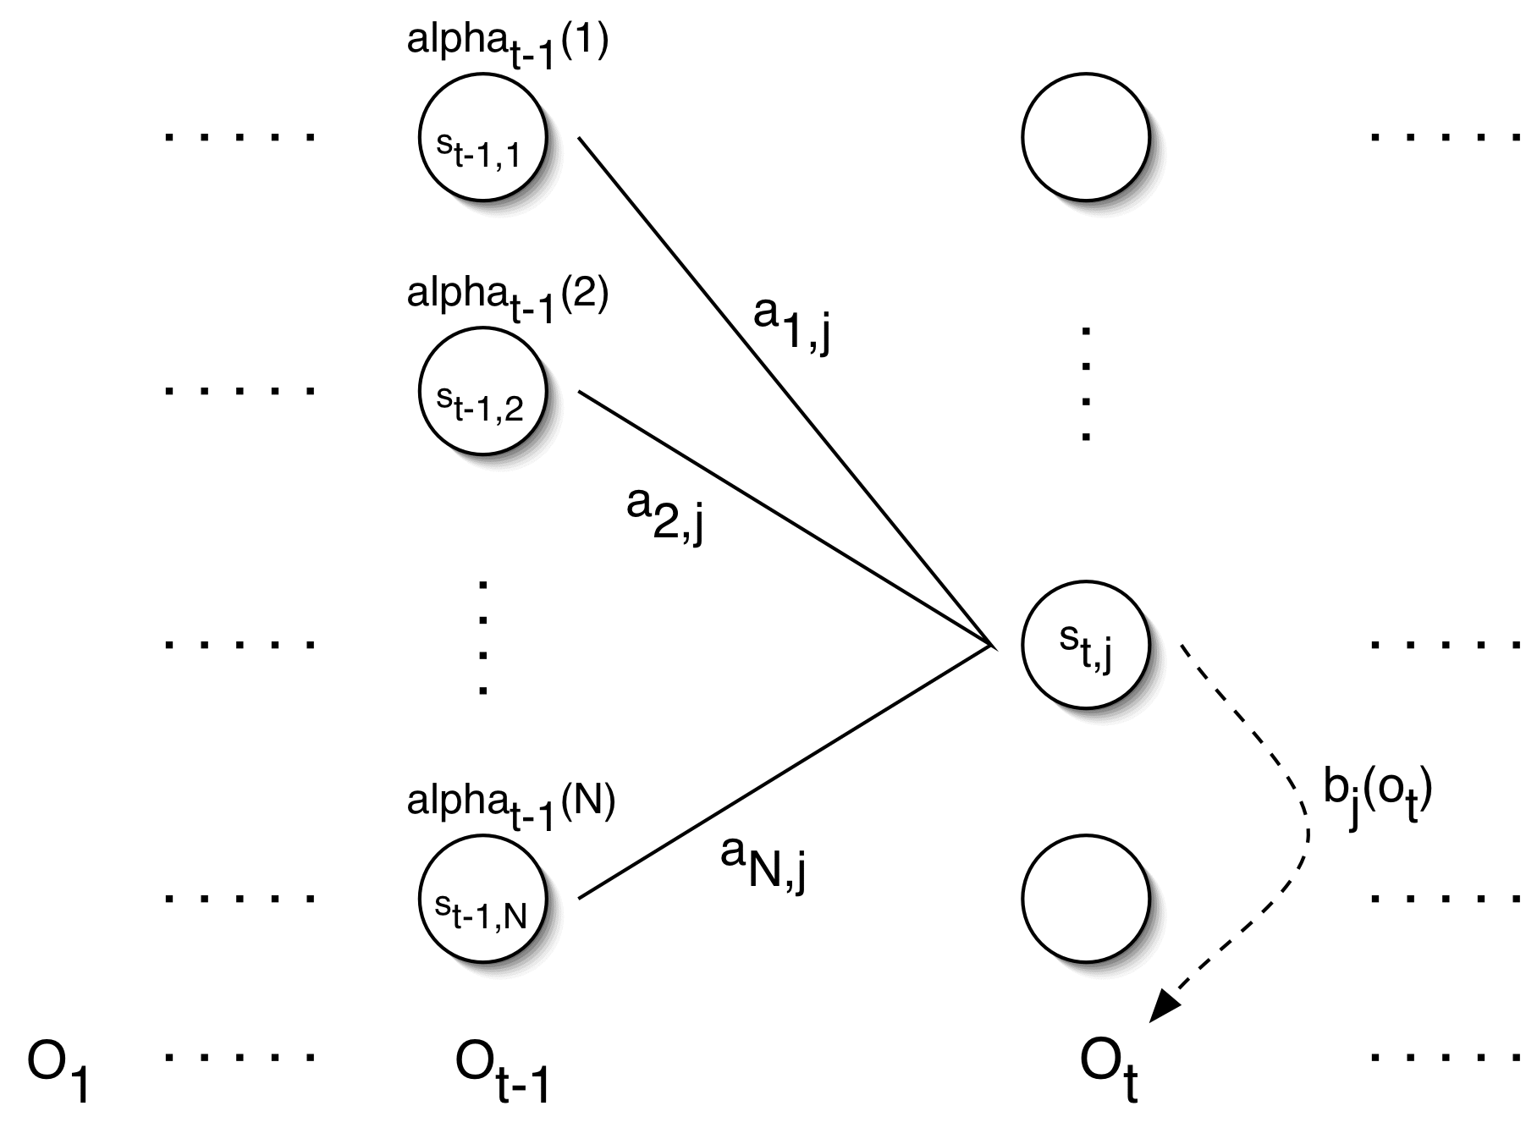
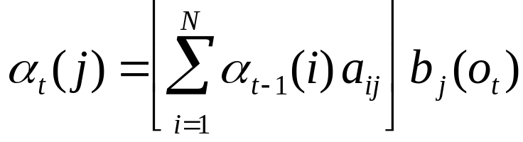
Forward Probabilities

Slide 19

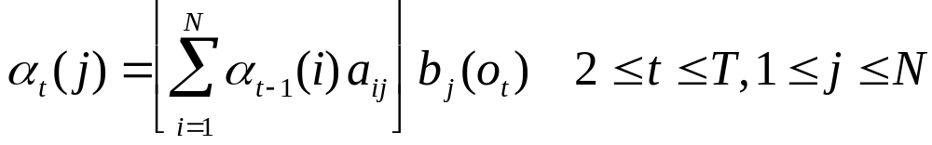
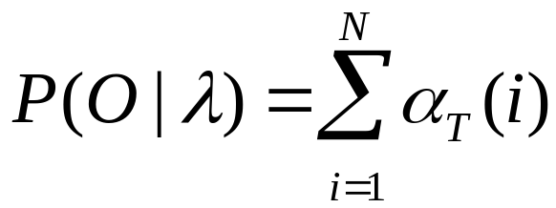
Forward Algorithm
Initialization:
Induction:
Termination:

Slide 20
Forward Algorithm Complexity
In the naïve approach to solving problem 1 it takes on the order of 2T*N^{T} computations
The forward algorithm takes on the order of N²T computations

Slide 21
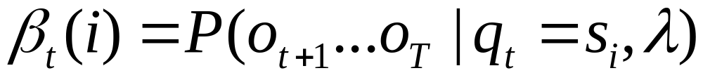
Backward Probabilities
Analogous to the forward probability, just in the other direction
What is the probability that given an HMM and given the state at time t is i, the partial observation o_{t+1} … o_{T} is generated?

Slide 22
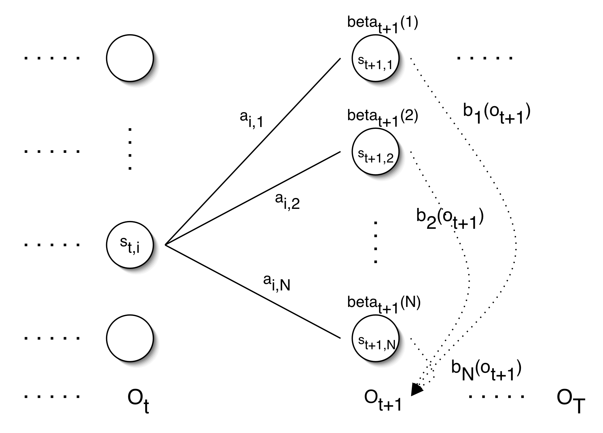
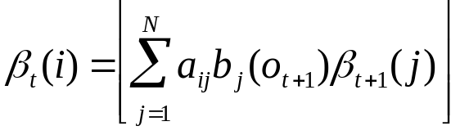
Backward Probabilities

Slide 23
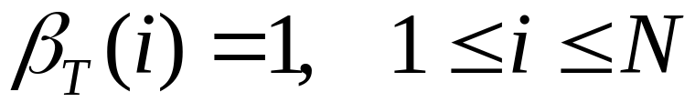
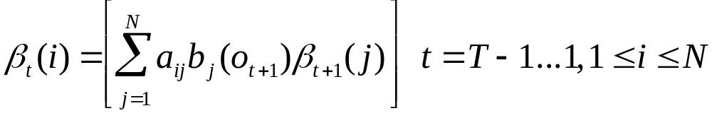
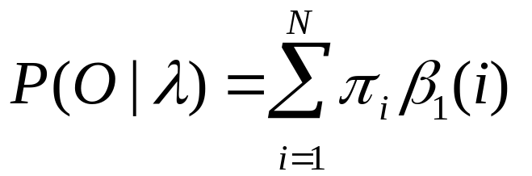
Backward Algorithm
Initialization:
Induction:
Termination:

Slide 24
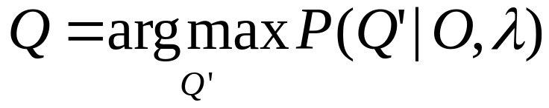
Problem 2: Decoding
The solution to Problem 1 (Evaluation) gives us the sum of all paths through an HMM efficiently.
For Problem 2, we wan to find the path with the highest probability.
We want to find the state sequence Q=q₁…q_{T}, such that

Slide 25
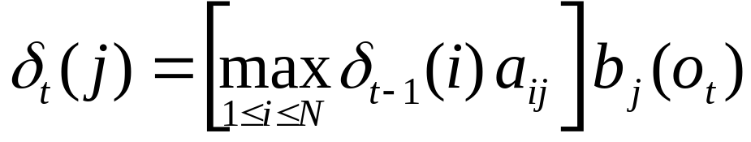
Viterbi Algorithm
Similar to computing the forward probabilities, but instead of summing over transitions from incoming states, compute the maximum
Forward:
Viterbi Recursion:

Slide 26
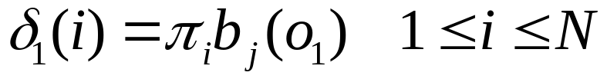
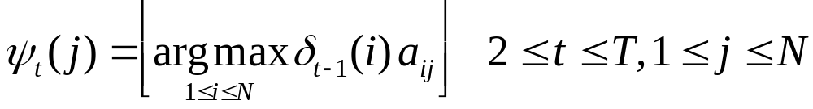
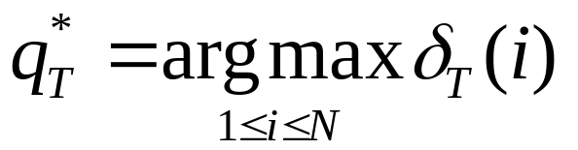
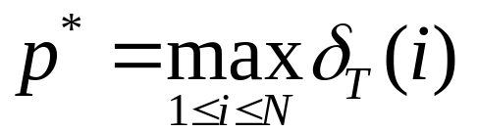
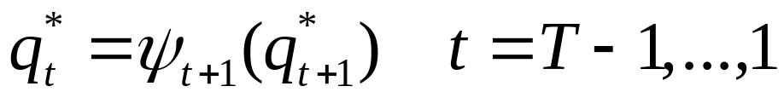
Viterbi Algorithm
Initialization:
Induction:
Termination:
Read out path:

Slide 27

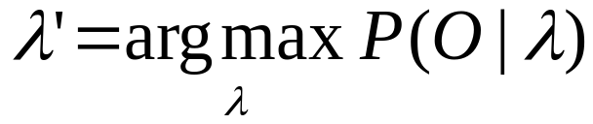
Problem 3: Learning
Up to now we’ve assumed that we know the underlying model
Often these parameters are estimated on annotated training data, which has two drawbacks:
  Annotation is difficult and/or expensive
  Training data is different from the current data
We want to maximize the parameters with respect to the current data, i.e., we’re looking for a model , such that

Slide 28


Problem 3: Learning
Unfortunately, there is no known way to analytically find a global maximum, i.e., a model , such that
But it is possible to find a local maximum
Given an initial model , we can always find a model , such that

Slide 29
Parameter Re-estimation
Use the forward-backward (or Baum-Welch) algorithm, which is a hill-climbing algorithm
Using an initial parameter instantiation, the forward-backward algorithm iteratively re-estimates the parameters and improves the probability that given observation are generated by the new parameters

Slide 30

Parameter Re-estimation
Three parameters need to be re-estimated:
  Initial state distribution:
  Transition probabilities: a_{i,j}
  Emission probabilities: b_{i}(o_{t})

Slide 31
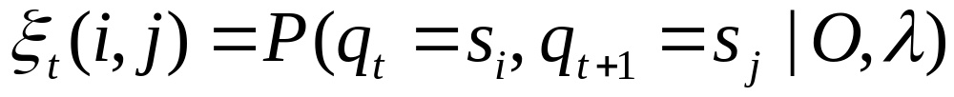
Re-estimating Transition Probabilities
What’s the probability of being in state s_{i} at time t and going to state s_{j}, given the current model and parameters?

Slide 32
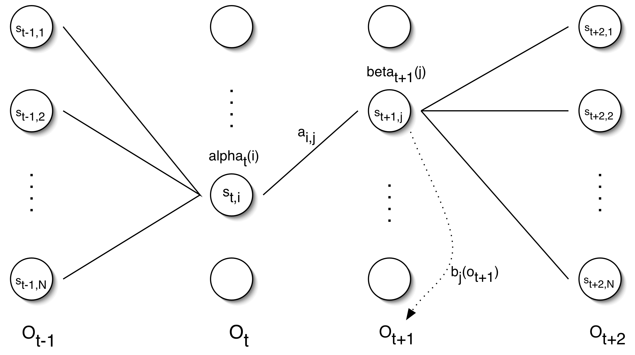
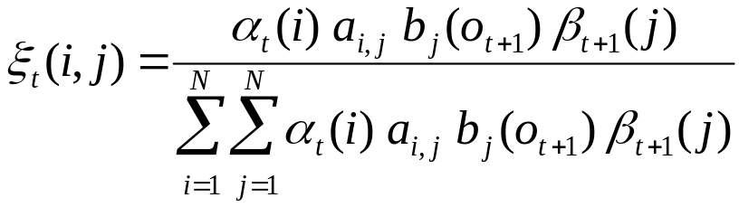
Re-estimating Transition Probabilities

Slide 33
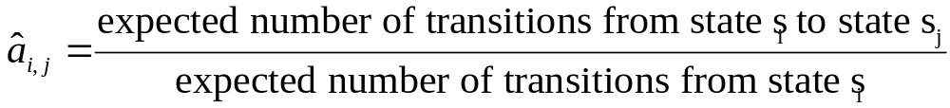
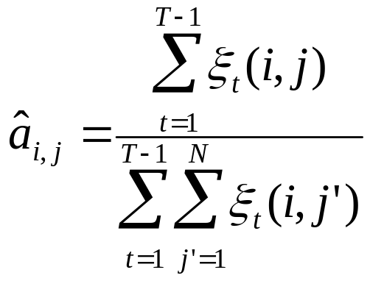
Re-estimating Transition Probabilities
The intuition behind the re-estimation equation for transition probabilities is
Formally:

Slide 34
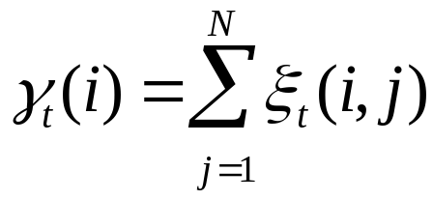
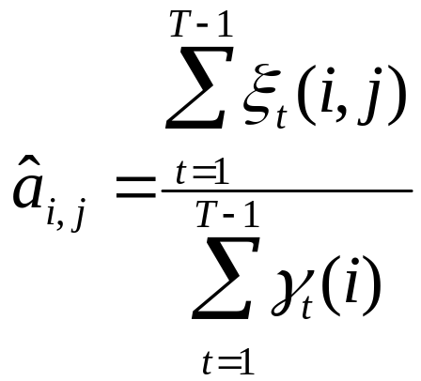
Re-estimating Transition Probabilities
Defining
As the probability of being in state s_{i}, given the complete observation O
We can say:

Slide 35
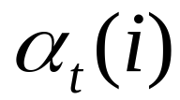


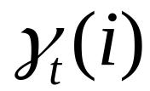
Review of Probabilities
Forward probability:
The probability of being in state s_{i}, given the partial observation o₁,…,o_{t}
Backward probability:
The probability of being in state s_{i}, given the partial observation o_{t+1},…,o_{T}
Transition probability:
The probability of going from state s_{i}, to state s_{j}, given the complete observation o₁,…,o_{T}
State probability:
The probability of being in state s_{i}, given the complete observation o₁,…,o_{T}

Slide 36

Re-estimating Initial State Probabilities
Initial state distribution: is the probability that s_{i} is a start state
Re-estimation is easy:
Formally:

Slide 37
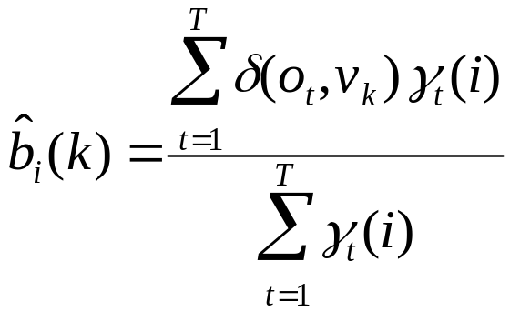

Re-estimation of Emission Probabilities
Emission probabilities are re-estimated as
Formally:
Where
Note that here is the Kronecker delta function and is not related to the in the discussion of the Viterbi algorithm!!

Slide 38
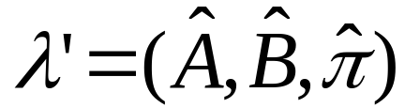
The Updated Model
Coming from we get to
by the following update rules:

Slide 39
Expectation Maximization
The forward-backward algorithm is an instance of the more general EM algorithm
  The E Step: Compute the forward and backward probabilities for a give model
  The M Step: Re-estimate the model parameters

Slide 40
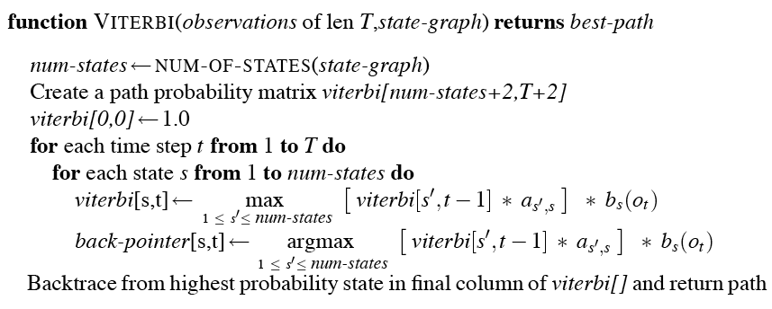
The Viterbi Algorithm

Slide 41
Intuition
The value in each cell is computed by taking the MAX over all paths that lead to this cell.
An extension of a path from state i at time t-1 is computed by multiplying:
  Previous path probability from previous cell viterbi[t-1,i]
  Transition probability a_{ij} from previous state I to current state j
  Observation likelihood b_{j}(o_{t}) that current state j matches observation symbol t

Slide 42
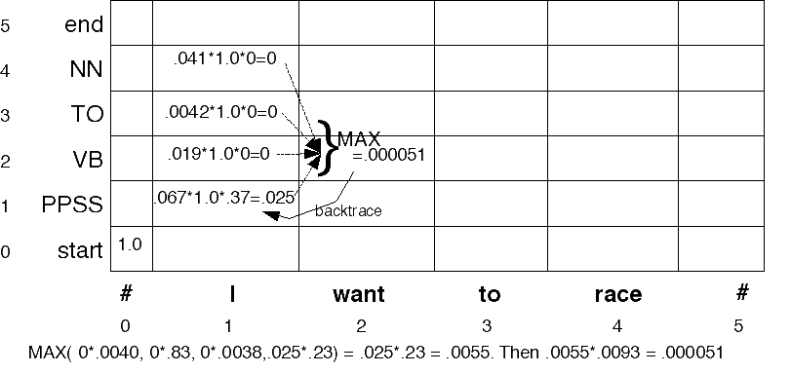
Viterbi example

Slide 43
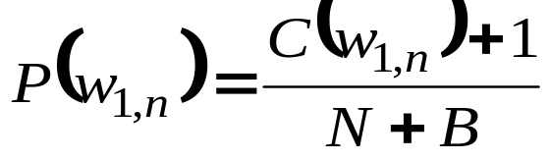
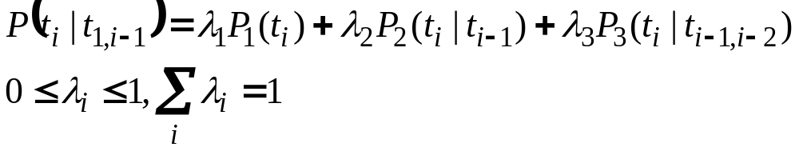
Smoothing of probabilities
Data sparseness is a problem when estimating probabilities based on corpus data.
The “add one” smoothing technique –
C- absolute frequency
N: no of training instances
B: no of different types
Linear interpolation methods can compensate for data sparseness with higher order models. A common method is interpolating trigrams, bigrams and unigrams:
The lambda values are automatically determined using a variant of the Expectation Maximization algorithm.

Slide 44
Viterbi for POS tagging
Let:
  n = nb of words in sentence to tag (nb of input tokens)
  T = nb of tags in the tag set (nb of states)
  vit = path probability matrix (viterbi)
  vit[i,j] = probability of being at state (tag) j at word i
  state = matrix to recover the nodes of the best path (best tag sequence)
  state[i+1,j] = the state (tag) of the incoming arc that led to this most probable state j at word i+1
// Initialization
vit[1,PERIOD]:=1.0 // pretend that there is a period before
// our sentence (start tag = PERIOD)
vit[1,t]:=0.0 for t ≠ PERIOD

Slide 45
Viterbi for POS tagging (con’t)
// Induction (build the path probability matrix)
for i:=1 to n step 1 do // for all words in the sentence
for all tags t_{j} do // for all possible tags
// store the max prob of the path
vit[i+1,t_{j}] := max_{1≤k≤T}(vit[i,t_{k}] x P(w_{i+1}|t_{j}) x P(t_{j}| t_{k}))
// store the actual state
path[i+1,t_{j}] := argmax_{1≤k≤T} ( vit[i,t_{k}] x P(w_{i+1}|t_{j}) x P(t_{j}| t_{k}))
end
end
//Termination and path-readout
bestState_{n+1} := argmax_{1≤j≤T} vit[n+1,j]
for j:=n to 1 step -1 do // for all the words in the sentence
bestState_{j} := path[i+1, bestState_{j+1}]
end
P(bestState₁,…, bestState_{n} ) := max_{1≤j≤T} vit[n+1,j]
emission
probability
state transition
probability
probability of best path
leading to state t_{k} at word i

Slide 46
Possible improvements
in bigram POS tagging, we condition a tag only on the preceding tag
why not...
  use more context (ex. use trigram model)
    more precise:
      “is clearly marked” --> verb, past participle
      “he clearly marked” --> verb, past tense
    combine trigram, bigram, unigram models
  condition on words too
but with an n-gram approach, this is too costly (too many parameters to model)

Slide 47
Next Time
Minimum Edit Distance
A “dynamic programming” algorithm
A probabilistic version of this called “Viterbi” is a key part of the Hidden Markov Model!

Slide 48
Further issues with Markov Model tagging
Unknown words are a problem since we don’t have the required probabilities. Possible solutions:
  Assign the word probabilities based on corpus-wide distribution of POS
  Use morphological cues (capitalization, suffix) to assign a more calculated guess.
Using higher order Markov models:
  Using a trigram model captures more context
  However, data sparseness is much more of a problem.

Slide 49
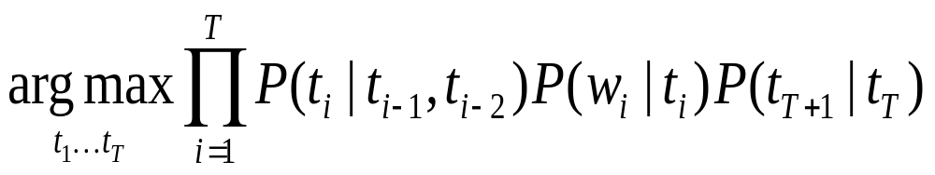
TnT
Efficient statistical POS tagger developed by Thorsten Brants, ANLP-2000
Underlying model:
Trigram modelling –
  The probability of a POS only depends on its two preceding POS
  The probability of a word appearing at a particular position given that its POS occurs at that position is independent of everything else.

Slide 50
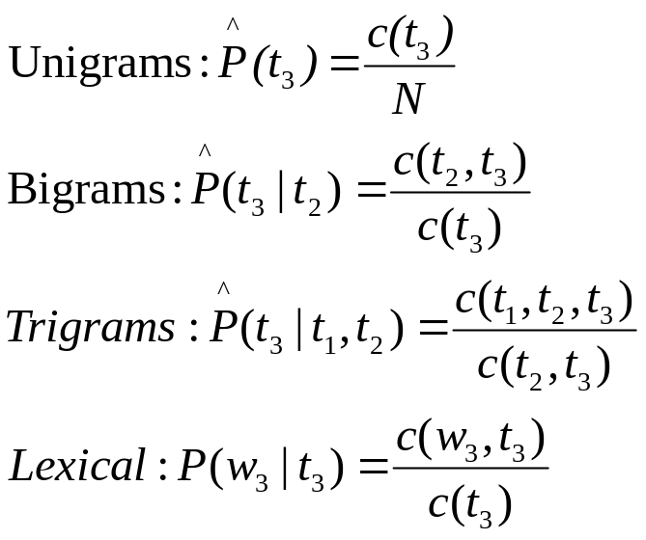
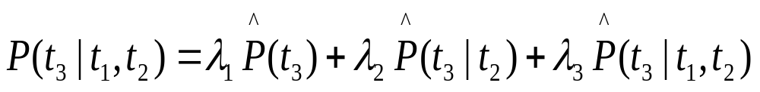
Training
Maximum likelihood estimates:
Smoothing : context-independent variant of linear interpolation.

Slide 51
Smoothing algorithm
Set λ_{i}=0
For each trigram t₁ t₂ t₃ with f(t₁,t₂,t₃ )>0
  Depending on the max of the following three values:
    Case (f(t₁,t₂,t₃ )-1)/ f(t₁,t₂) : incr λ₃ by f(t₁,t₂,t₃ )
    Case (f(t₂,t₃ )-1)/ f(t₂) : incr λ₂ by f(t₁,t₂,t₃ )
    Case (f(t₃ )-1)/ N-1 : incr λ₁ by f(t₁,t₂,t₃ )
Normalize λ_{i}

Slide 52
Evaluation of POS taggers
compared with gold-standard of human performance
metric:
  accuracy = % of tags that are identical to gold standard
most taggers ~96-97% accuracy
must compare accuracy to:
  ceiling (best possible results)
    how do human annotators score compared to each other? (96-97%)
    so systems are not bad at all!
  baseline (worst possible results)
    what if we take the most-likely tag (unigram model) regardless of previous tags ? (90-91%)
    so anything less is really bad

Slide 53
More on tagger accuracy
is 95% good?
  that’s 5 mistakes every 100 words
  if on average, a sentence is 20 words, that’s 1 mistake per sentence
when comparing tagger accuracy, beware of:
  size of training corpus
    the bigger, the better the results
  difference between training & testing corpora (genre, domain…)
    the closer, the better the results
  size of tag set
    Prediction versus classification
  unknown words
    the more unknown words (not in dictionary), the worst the results

Slide 54
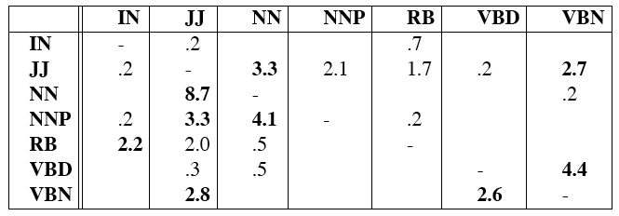
Error Analysis
Look at a confusion matrix (contingency table)
E.g. 4.4% of the total errors caused by mistagging VBD as VBN
See what errors are causing problems
  Noun (NN) vs ProperNoun (NNP) vs Adj (JJ)
  Adverb (RB) vs Particle (RP) vs Prep (IN)
  Preterite (VBD) vs Participle (VBN) vs Adjective (JJ)
ERROR ANALYSIS IS ESSENTIAL!!!

Slide 55
Tag indeterminacy

Slide 56
Major difficulties in POS tagging
Unknown words (proper names)
  because we do not know the set of tags it can take
  and knowing this takes you a long way (cf. baseline POS tagger)
  possible solutions:
    assign all possible tags with probabilities distribution identical to lexicon as a whole
    use morphological cues to infer possible tags
      ex. word ending in -ed are likely to be past tense verbs or past participles
Frequently confused tag pairs
  preposition vs particle
    <running> <up> a hill (prep) / <running up> a bill (particle)
  verb, past tense vs. past participle vs. adjective

Slide 57
Unknown Words
Most-frequent-tag approach.
What about words that don’t appear in the training set?
Suffix analysis:
  The probability distribution for a particular suffix is generated from all words in the training set that share the same suffix.
Suffix estimation – Calculate the probability of a tag t given the last i letters of an n letter word.
Smoothing: successive abstraction through sequences of increasingly more general contexts (i.e., omit more and more characters of the suffix)
Use a morphological analyzer to get the restriction on the possible tags.

Slide 58
Unknown words

Slide 59
Alternative graphical models for part of speech tagging

Slide 60
Different Models for POS tagging
HMM
Maximum Entropy Markov Models
Conditional Random Fields

Slide 61
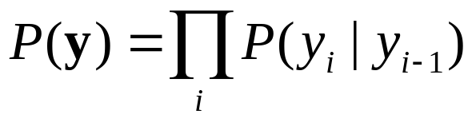
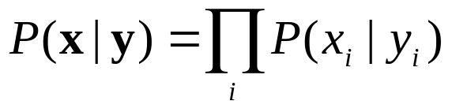
Hidden Markov Model (HMM) : Generative Modeling
Source Model P(Y)
y
Noisy Channel P(X|Y)
x

Slide 62















Dependency (1st order)

Slide 63
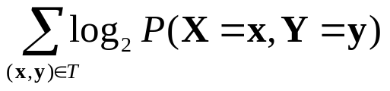
Disadvantage of HMMs (1)
No Rich Feature Information
  Rich information are required
    When x_{k} is complex
    When data of x_{k} is sparse
Example: POS Tagging
  How to evaluate P(w_{k}|t_{k}) for unknown words w_{k} ?
  Useful features
    Suffix, e.g., -ed, -tion, -ing, etc.
    Capitalization
Generative Model
  Parameter estimation: maximize the joint likelihood of training examples

Slide 64
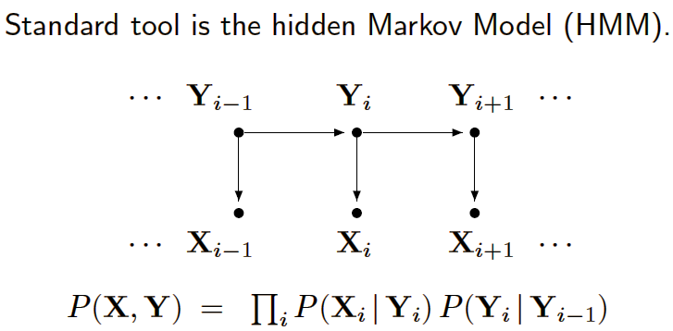
Generative Models
Hidden Markov models (HMMs) and stochastic grammars
  Assign a joint probability to paired observation and label sequences
  The parameters typically trained to maximize the joint likelihood of train examples

Slide 65
Generative Models (cont’d)
Difficulties and disadvantages
  Need to enumerate all possible observation sequences
  Not practical to represent multiple interacting features or long-range dependencies of the observations
  Very strict independence assumptions on the observations

Slide 66

Better Approach
  Discriminative model which models P(y|x) directly
  Maximize the conditional likelihood of training examples

Slide 67
Maximum Entropy modeling
N-gram model : probabilities depend on the previous few tokens.
We may identify a more heterogeneous set of features which contribute in some way to the choice of the current word. (whether it is the first word in a story, whether the next word is to, whether one of the last 5 words is a preposition, etc)
Maxent combines these features in a probabilistic model.
The given features provide a constraint on the model.
We would like to have a probability distribution which, outside of these constraints, is as uniform as possible – has the maximum entropy among all models that satisfy these constraints.

Slide 68




Maximum Entropy Markov Model
Discriminative Sub Models
  Unify two parameters in generative model into one conditional model
    Two parameters in generative model,
    parameter in source model and parameter in noisy channel
    Unified conditional model
  Employ maximum entropy principle
Maximum Entropy Markov Model

Slide 69
General Maximum Entropy Principle
Model
  Model distribution P(Y |X) with a set of features {f₁, f₂, …, f_{l}} defined on X and Y
Idea
  Collect information of features from training data
  Principle
    Model what is known
    Assume nothing else
      ⬄ Flattest distribution
      ⬄ Distribution with the maximum Entropy

Slide 70
Example
(Berger et al., 1996) example
  Model translation of word “in” from English to French
    Need to model P(word_{French})
    Constraints
      1: Possible translations: dans, en, à, au course de, pendant
      2: “dans” or “en” used in 30% of the time
      3: “dans” or “à” in 50% of the time

Slide 71


Features
Features
  0-1 indicator functions
    1 if (x, y) satisfies a predefined condition
    0 if not
Example: POS Tagging

Slide 72



Constraints
Empirical Information
  Statistics from training data T
Expected Value
  From the distribution P(Y |X) we want to model
Constraints

Slide 73


Maximum Entropy: Objective
Entropy
Maximization Problem

Slide 74


Dual Problem
Dual Problem
  Conditional model
  Maximum likelihood of conditional data
Solution
  Improved iterative scaling (IIS) (Berger et al. 1996)
  Generalized iterative scaling (GIS) (McCallum et al. 2000)

Slide 75

Maximum Entropy Markov Model
Use Maximum Entropy Approach to Model
  1st order
Features
  Basic features (like parameters in HMM)
    Bigram (1st order) or trigram (2nd order) in source model
    State-output pair feature (X_{k} = x_{k}, Y_{k} = y_{k})
  Advantage: incorporate other advanced features on (x_{k}, y_{k})

Slide 76

HMM vs MEMM (1st order)
Maximum Entropy Markov Model (MEMM)
HMM

Slide 77
Performance in POS Tagging
POS Tagging
  Data set: WSJ
  Features:
    HMM features, spelling features (like –ed, -tion, -s, -ing, etc.)
Results (Lafferty et al. 2001)
  1st order HMM
    94.31% accuracy, 54.01% OOV accuracy
  1st order MEMM
    95.19% accuracy, 73.01% OOV accuracy

Slide 78

ME applications
Part of Speech (POS) Tagging (Ratnaparkhi, 1996)
  P(POS tag | context)
  Information sources
    Word window (4)
    Word features (prefix, suffix, capitalization)
    Previous POS tags

Slide 79
ME applications
Abbreviation expansion (Pakhomov, 2002)
  Information sources
    Word window (4)
    Document title
Word Sense Disambiguation (WSD) (Chao & Dyer, 2002)
  Information sources
    Word window (4)
    Structurally related words (4)
Sentence Boundary Detection (Reynar & Ratnaparkhi, 1997)
  Information sources
    Token features (prefix, suffix, capitalization, abbreviation)
    Word window (2)

Slide 80
Solution
Global Optimization
  Optimize parameters in a global model simultaneously, not in sub models separately
Alternatives
  Conditional random fields
  Application of perceptron algorithm

Slide 81
Why ME?
Advantages
  Combine multiple knowledge sources
    Local
      Word prefix, suffix, capitalization (POS - (Ratnaparkhi, 1996))
      Word POS, POS class, suffix (WSD - (Chao & Dyer, 2002))
      Token prefix, suffix, capitalization, abbreviation (Sentence Boundary - (Reynar & Ratnaparkhi, 1997))
    Global
      N-grams (Rosenfeld, 1997)
      Word window
      Document title (Pakhomov, 2002)
      Structurally related words (Chao & Dyer, 2002)
      Sentence length, conventional lexicon (Och & Ney, 2002)
  Combine dependent knowledge sources

Slide 82
Why ME?
Advantages
  Add additional knowledge sources
  Implicit smoothing
Disadvantages
  Computational
    Expected value at each iteration
    Normalizing constant
  Overfitting
    Feature selection
      Cutoffs
      Basic Feature Selection (Berger et al., 1996)

Slide 83
Conditional Models
Conditional probability P(label sequence y | observation sequence x) rather than joint probability P(y, x)
  Specify the probability of possible label sequences given an observation sequence
Allow arbitrary, non-independent features on the observation sequence X
The probability of a transition between labels may depend on past and future observations
  Relax strong independence assumptions in generative models

Slide 84


Discriminative Models
Maximum Entropy Markov Models (MEMMs)
Exponential model
Given training set X with label sequence Y:
  Train a model θ that maximizes P(Y|X, θ)
  For a new data sequence x, the predicted label y maximizes P(y|x, θ)
  Notice the per-state normalization

Slide 85
MEMMs (cont’d)
MEMMs have all the advantages of Conditional Models
Per-state normalization: all the mass that arrives at a state must be distributed among the possible successor states (“conservation of score mass”)
Subject to Label Bias Problem
  Bias toward states with fewer outgoing transitions

Slide 86

Label Bias Problem
Consider this MEMM:
P(1 and 2 | ro) = P(2 | 1 and ro)P(1 | ro) = P(2 | 1 and o)P(1 | r)
P(1 and 2 | ri) = P(2 | 1 and ri)P(1 | ri) = P(2 | 1 and i)P(1 | r)
Since P(2 | 1 and x) = 1 for all x, P(1 and 2 | ro) = P(1 and 2 | ri)
In the training data, label value 2 is the only label value observed after label value 1
Therefore P(2 | 1) = 1, so P(2 | 1 and x) = 1 for all x
However, we expect P(1 and 2 | ri) to be greater than P(1 and 2 | ro).
Per-state normalization does not allow the required expectation

Slide 87

Solve the Label Bias Problem
Change the state-transition structure of the model
  Not always practical to change the set of states
Start with a fully-connected model and let the training procedure figure out a good structure
  Prelude the use of prior, which is very valuable (e.g. in information extraction)

Slide 88

Random Field

Slide 89
Conditional Random Fields (CRFs)
CRFs have all the advantages of MEMMs without label bias problem
  MEMM uses per-state exponential model for the conditional probabilities of next states given the current state
  CRF has a single exponential model for the joint probability of the entire sequence of labels given the observation sequence
Undirected acyclic graph
Allow some transitions “vote” more strongly than others depending on the corresponding observations

Slide 90

Definition of CRFs
X is a random variable over data sequences to be labeled
Y is a random variable over corresponding label sequences

Slide 91

Example of CRFs

Slide 92

Graphical comparison among
HMMs, MEMMs and CRFs
HMM MEMM CRF

Slide 93

Conditional Distribution
If the graph G = (V, E) of Y is a tree, the conditional distribution over the label sequence Y = y, given X = x, by fundamental theorem of random fields is:
x is a data sequence
y is a label sequence
v is a vertex from vertex set V = set of label random variables
e is an edge from edge set E over V
f_{k} and g_{k} are given and fixed. g_{k} is a Boolean vertex feature; f_{k} is a Boolean edge feature
k is the number of features
are parameters to be estimated
y|_{e} is the set of components of y defined by edge e
y|_{v} is the set of components of y defined by vertex v

Slide 94

Conditional Distribution (cont’d)
CRFs use the observation-dependent normalization Z(x) for the conditional distributions:
Z(x) is a normalization over the data sequence x

Slide 95
Parameter Estimation for CRFs
The paper provided iterative scaling algorithms
It turns out to be very inefficient
Prof. Dietterich’s group applied Gradient Descendent Algorithm, which is quite efficient

Slide 96


Training of CRFs (From Prof. Dietterich)
First, we take the log of the equation
Then, take the derivative of the above equation
For training, the first 2 items are easy to get.
For example, for each λ_{k}, f_{k} is a sequence of Boolean numbers, such as 00101110100111.
      is just the total number of 1’s in the sequence.
The hardest thing is how to calculate Z(x)

Slide 97

Training of CRFs (From Prof. Dietterich) (cont’d)
Maximal cliques
y₁
y₂
y₃
y₄
c₁
c₂
c₃
c₁
c₂
c₃

Slide 98

POS tagging Experiments

Slide 99

POS tagging Experiments (cont’d)
Compared HMMs, MEMMs, and CRFs on Penn treebank POS tagging
Each word in a given input sentence must be labeled with one of 45 syntactic tags
Add a small set of orthographic features: whether a spelling begins with a number or upper case letter, whether it contains a hyphen, and if it contains one of the following suffixes: -ing, -ogy, -ed, -s, -ly, -ion, -tion, -ity, -ies
oov = out-of-vocabulary (not observed in the training set)

Slide 100
Summary
Discriminative models are prone to the label bias problem
CRFs provide the benefits of discriminative models
CRFs solve the label bias problem well, and demonstrate good performance

