Slide 1
ACCENT CLASSIFICATION AND CONVERSION
Arvind Raghavendran (MDS202214)
Swastika Mohapatra (MDS202245)

Slide 2
Introduction to Audio Data
Speech Recognition
Voice Translations
Music Analysis
Versatile medium utilized across various domains
Multiple file formats like .mp3, .wav, etc.
Challenges:
Raw data
Device/environmental/random noise additions
Variable durations
Aim: explore the application of machine learning techniques to audio data

Slide 3
Mel-Filter Cepstrum Coefficients (MFCC)
Windowing
DFT
Mel-Filter mappings
Logarithm
DCT
Based on human auditory system's response to audio
Effective for capturing spectral features, such as the shape of the vocal tract and mimic human voice system
We can generate as many coefficients as we want but empirically is observed that the 13 coefficients are enough for most problems
Advantages:
Dimensionality Reduction
Robust to Noise
Computationally Efficient
Drawbacks:
Cannot capture finer temporal differences like pitch, etc. effectively

Slide 4
Spectrograms
STFT
Squared Frequency
Windowing
Visualization
Visual representation of the frequency content of an audio signal over time
The resulting magnitude values are represented using a color scale, where brighter colors indicate higher magnitudes, capturing both temporal and spectral information.
Suitable for tasks requiring detailed analysis of audio features, such as accent classification and music genre classification.
Advantages:
Captures subtle changes in frequency content
Drawbacks:
Computationally expensive
Require careful hyperparameter tuning

Slide 5
Accent classification via MFCCs
Task 1

Slide 6
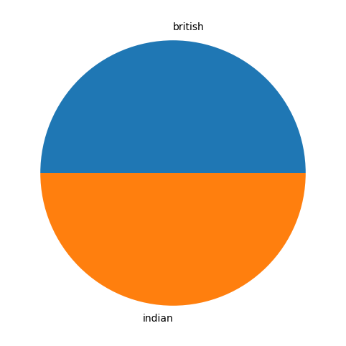
Data Description
Consists of audio recordings of speakers from different countries having diverse range of accents like UK, India, US, Australia, etc. Our focus is on Indian and British.
742 recordings , speaking the same passage
Extracted 13 MFCCs across windowed timestamps to generate (13,n) feature matrices, where n depends on length of audio
Compressed information by taking row-wise average to get feature vector of length 13

Slide 7
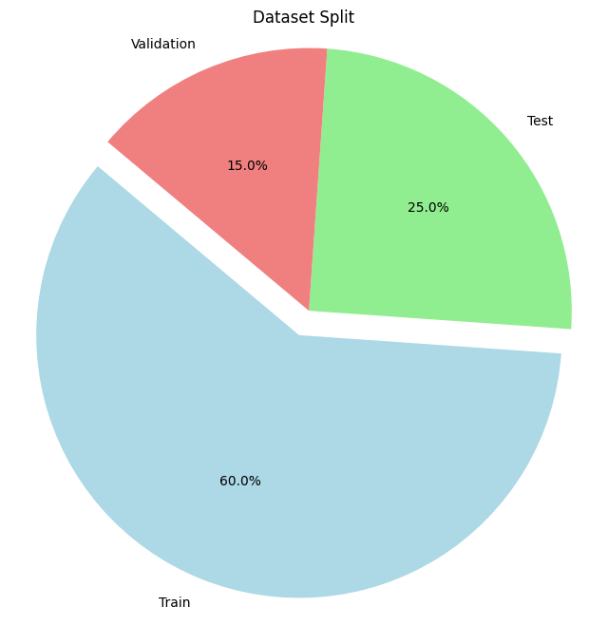
Model Constructions
Experimented with simple linear models and 1-D Convolutional layers to capture contextual information
Batch Normalizations to ensure steady training and convergence
Dropout to prevent overfitting
Added padding for deeper networks with ReLU activations
Compiled model with Cross entropy loss and Adam optimizer
Prevented overfitting via early stopping and adding model checkpoints

Slide 8
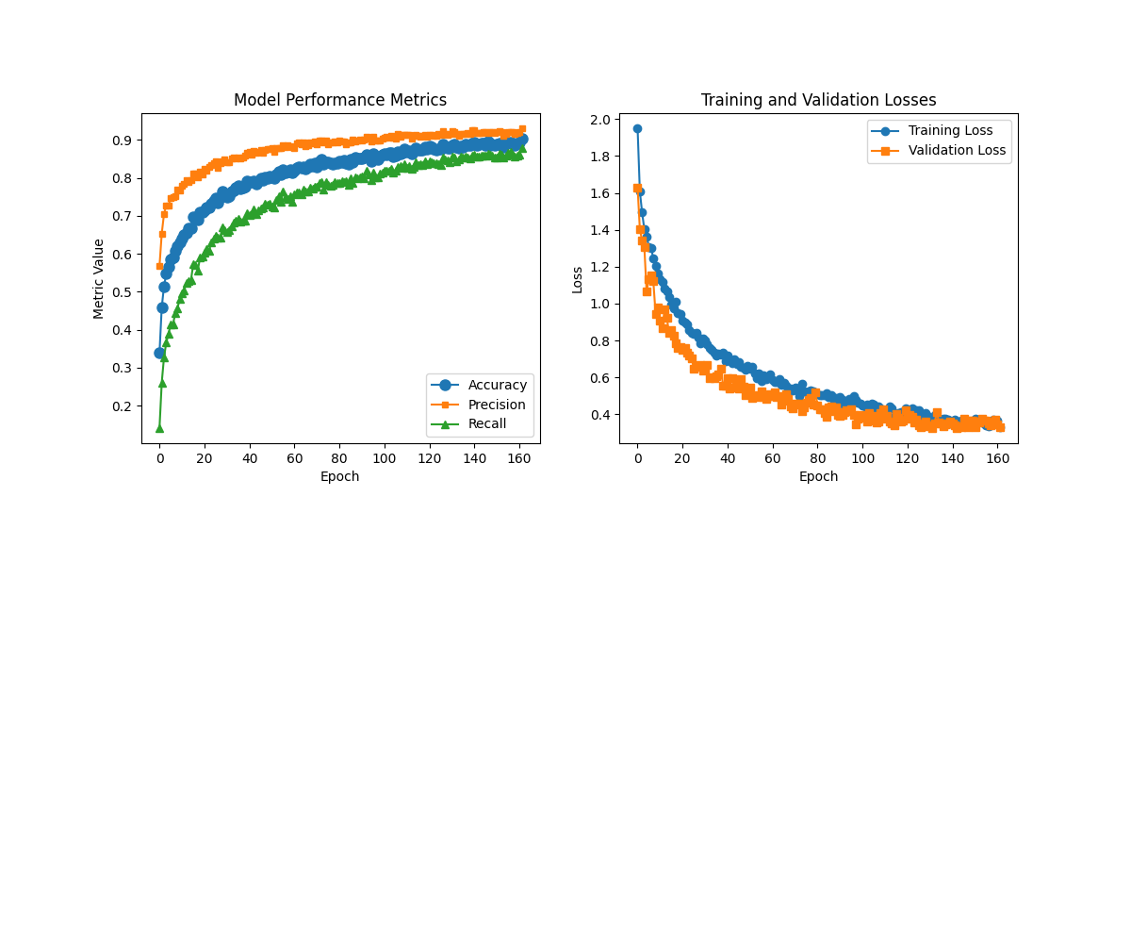
Training and Evaluation
Best model had 4 convolutional layers of sizes 1024, 512, 512, 256 followed by GlobalAveragePooling and then 3 Dense layers of size 2048, 512, 512
Trained in batches of 32 for 1000 epochs, with patience of 15 epochs
Out-sample metrics:
Precision: 91%
Recall: 86%
Accuracy: 88%
Diagnosis:
Model rarely misclassifies true-negatives, but does so for some true-positives
Model unable to capture finer nuances in accents

Slide 9
Accent classification via Spectrograms
Task 2

Slide 10
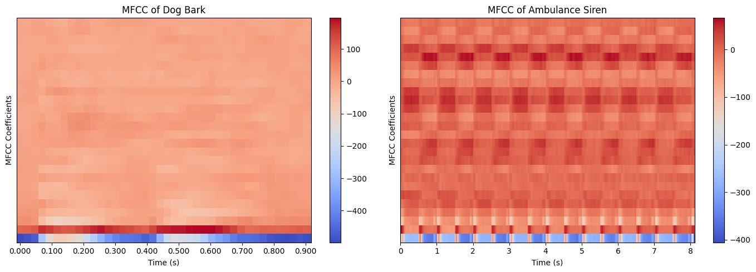
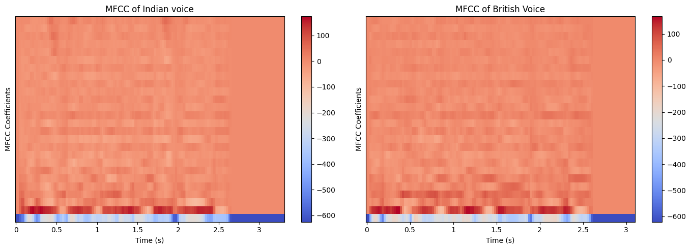
ISSues with using MFFCs
MFCCs capture high-level, vocal tract information that might not capture subtle pitch and frequency changes crucial for accent classification
Issue persisted even without averaging the features
MFCCs are more useful if audios are very distinct, for example a dog barking vs an ambulance siren
Accents are copies of the same waveform with slight nuances in pitch, temporal frequencies, etc and hence MFCCs fail to be distinctive

Slide 11
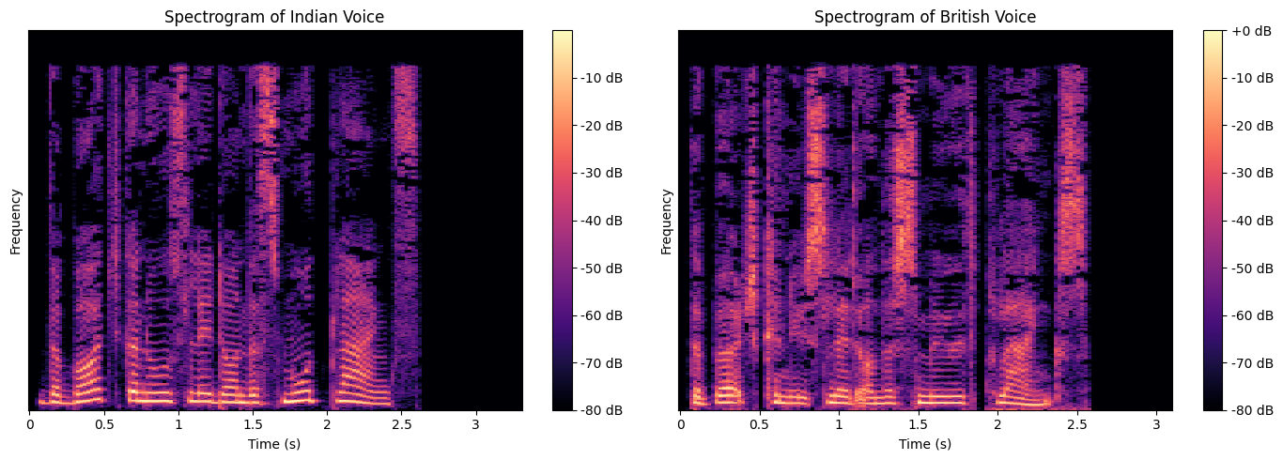
Spectrograms as a solution
They represent audio signals in the time-frequency domain, capturing both temporal and spectral features simultaneously.
High dimensionality is advantageous here since that is what the task demands
Offer precise time-frequency localization and identify rapid changes in speech characteristics

Slide 12
Data construction
Experimented with various hyperparameters like window length (512), hop length(1024), sampling rate(22.05 KHz)
Hanning algorithm to obtain the windows for applying STFT
The result was 513 spectral frequencies distributed across n timesteps, that vary depending upon audio length.
We padded the matrices with zeros to have all inputs of the same size (513, 229)

Slide 13
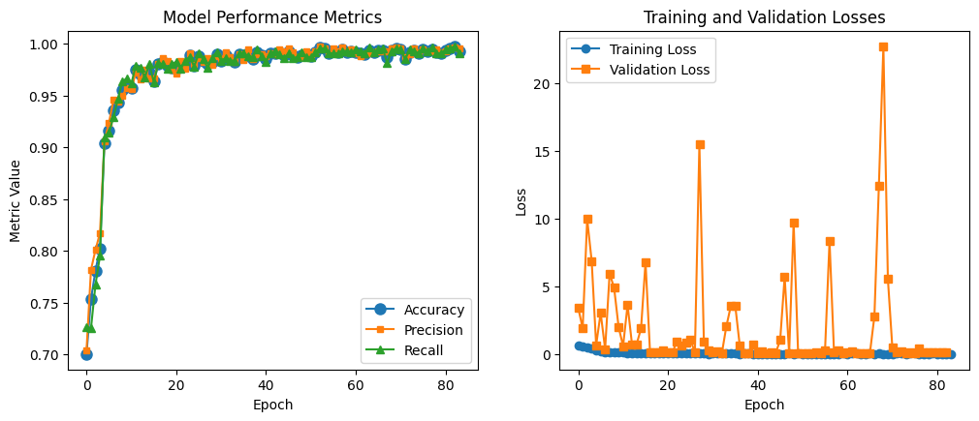
Training and evaluation
We used the same earlier model with the same training steps except that the 1D layers are replaced with 2D layers
We also introduced MaxPooling at each layer to reduce size of feature maps
Out-sample metrics:
Precision: 97.68%
Recall: 98.13%
Accuracy: 97.97%
Diagnosis:
Model able to identify subtle changes in accents via spectrograms
Does a much better job generalizing to test set

Slide 14
Accent conversion
Task 3

Slide 15
Model Considerations
Involves compressing input audio into latent space and reconstructing back to target domain
CNN-Dense models would not work well since reconstruction is poor
Autoencoder frameworks or CNN+LSTMs would be a better match because they capture spatial context while reconstructing
Best possible model on a spectrogram was quite shallow having encoder and decoders as 3 layer CNNs with 256 filters at most. Model performed poorly, highlighting need for deeper architecture

Slide 16
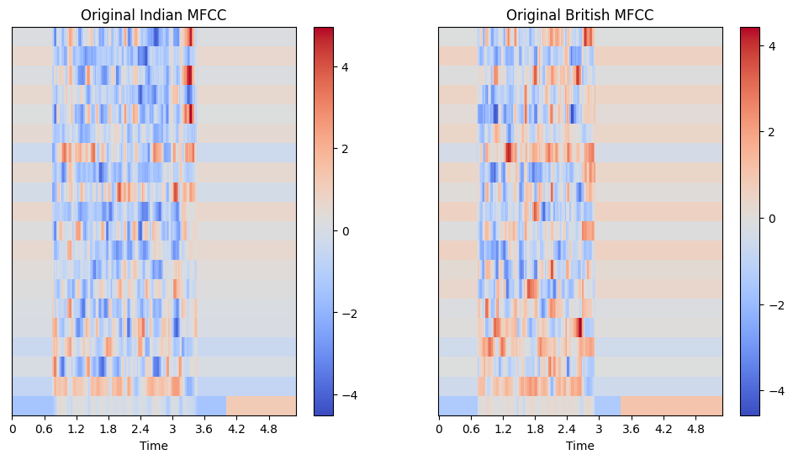
Data Description
Although spectrograms captured accent nuances more than MFCCs, high dimensionality combined with deep architectures make training infeasible
Low dimensionality of MFCC makes it a good choice, so we proceed to extract 26 MFCCs for higher representation
We don't want to compress the matrices since we cannot reconstruct audio back from averaged features.
So we pad using zeros to obtain (26, 229) feature matrices for all audios.
We also normalized the data to reduce overhead and stored mean, variances

Slide 17
Model Constructions
The core training ideas were the same, like Dropout, BN, Pooling, etc
Additionally, we Normalized inputs for smoother training. This was a key step in the process that countered the high dimensionality
We experimented with MSE as the loss function, with a possible extension to using Huber Loss that combines both L1 and L2 losses.
We also experimented with multiple model architectures including LSTMs, GRUs, RNNs, etc. into the autoencoder framework.
The best model chosen had an encoder having 3 CNN layers with 1024, 512, 256 filters and a mirror architecture for the decoder. The latent embedding was a GRU having 8 units.

Slide 18
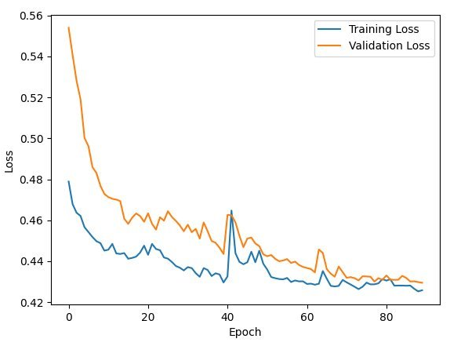
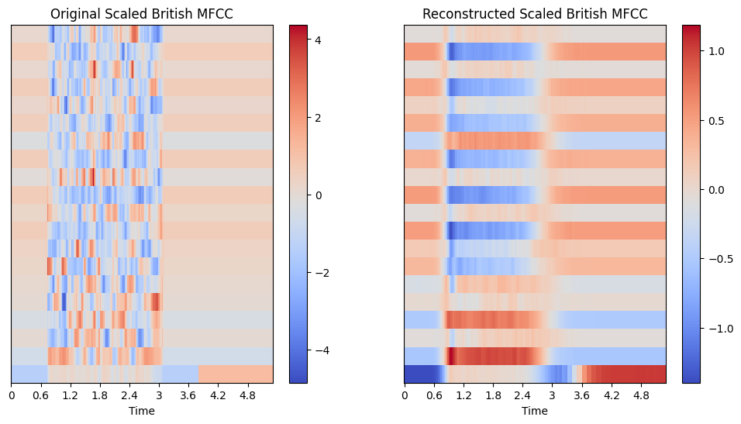
Training and evaluation
We observed that the model is learning, and loss reduces to some extent
Reconstruction shows that model has learnt high level features but is smoothening out the features
This stems from the nature of choosing MSE as the loss, as a pixel level MSE will start to smoothen the other features out to obtain a lower loss

Slide 19
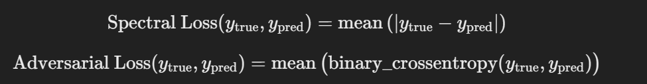
Improving the Loss function
We replaced the vanilla p-norm losses with an adversarial loss that aims to minimize both the p-norm loss and also preserves pixel information
This new loss was a weighted combination of MAE+ mean pixel-level CCE
We chose alpha=0.7, beta=0.1

Slide 20
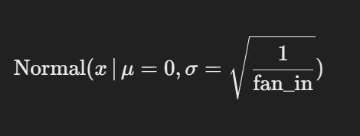
Improving the models
Skip connections were added to ensure that subsequent model layers did not lose context of the previous information
We read about different kernel initializations and used the LeCun method where weights are sampled from
Latent Space representation was now 2 GRUs with 16 units. This was to see if deeper bottlenecks could add more information while reconstruction
ReLU activation was now replaced with GeLU activation to ensure gradients can flow all the way back to encoder

Slide 21
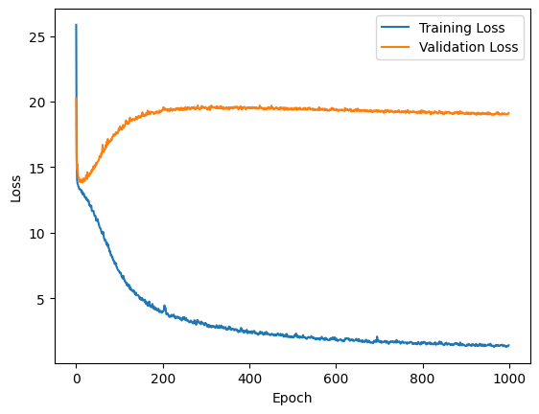
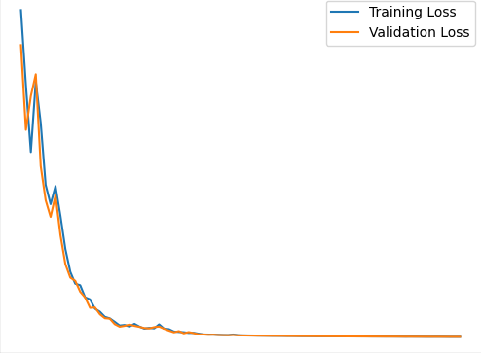
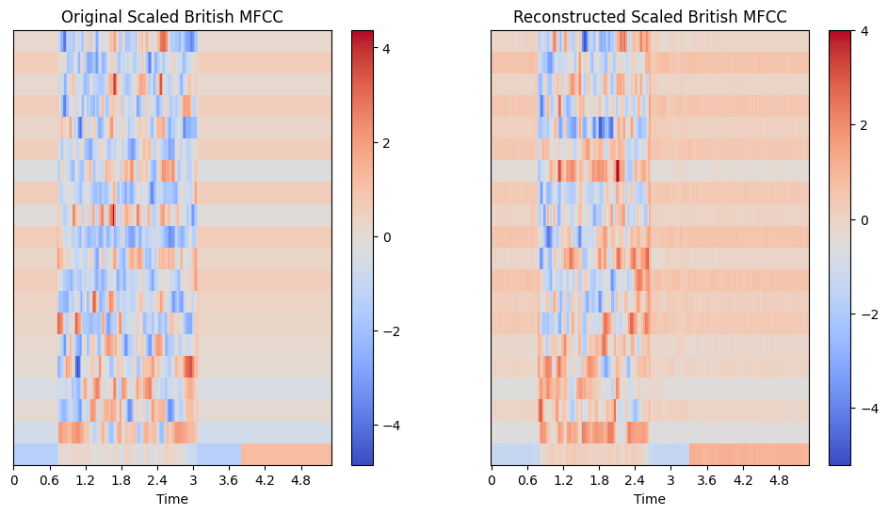

Training and evaluation
We trained for 1000 epochs, with a patience of 30 epochs
Reconstruction shows that model has significantly improved learning, and has also matched pixel semantics to a good extent
Original Audio
Reconstructed Audio

Slide 22
Further improvements
We achieved significant improvement from the earlier model, but this can certainly be improved. We can search for more datasets, but have to consider the quality as well.
We hypothesize that using spectrogram data coupled with deeper architectures can improve the model performance significantly. However we cannot explore this due to limited computational resources.
We also hypothesize that a higher sampling rate with higher fft components can results in wider and higher spectrogram resolutions, allowing the model to capture finer details.
We can also experiment with transfer learning on audio data (VGGish) for faster and powerful latent representations and then reconstruct it.

Slide 23
Q&A Session
Thank you!

