Slide 1

Mid Semester Presentation
2019HC04183 Sundar T

Slide 2
Problem statement
Title: Data driven mitigation of human errors in Safety Matches manufacturing unit
Description: Trying to solve 2 major problems in Safety Matches manufacturing MSME unit which are product counting and perfection issues.

Slide 3
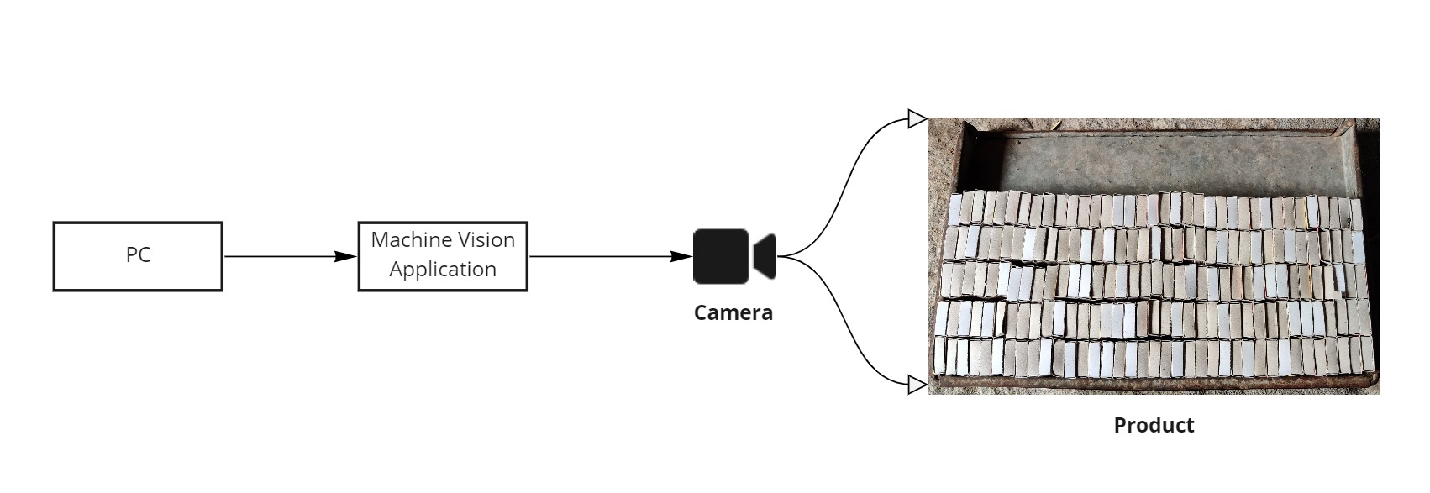
System Overview
PC – User Interface to view output.
Machine Vision Application – application with trained ML model code to predict final output.
Camera – Either phone camera or Fitted camera for image capturing.
Product – Input

Slide 4
Work done so far ..
Questionnaire to company owners. - Done
Test data collection from various places. - Done
Dataset preparation - Done
Data labelling – In-progress

Slide 5
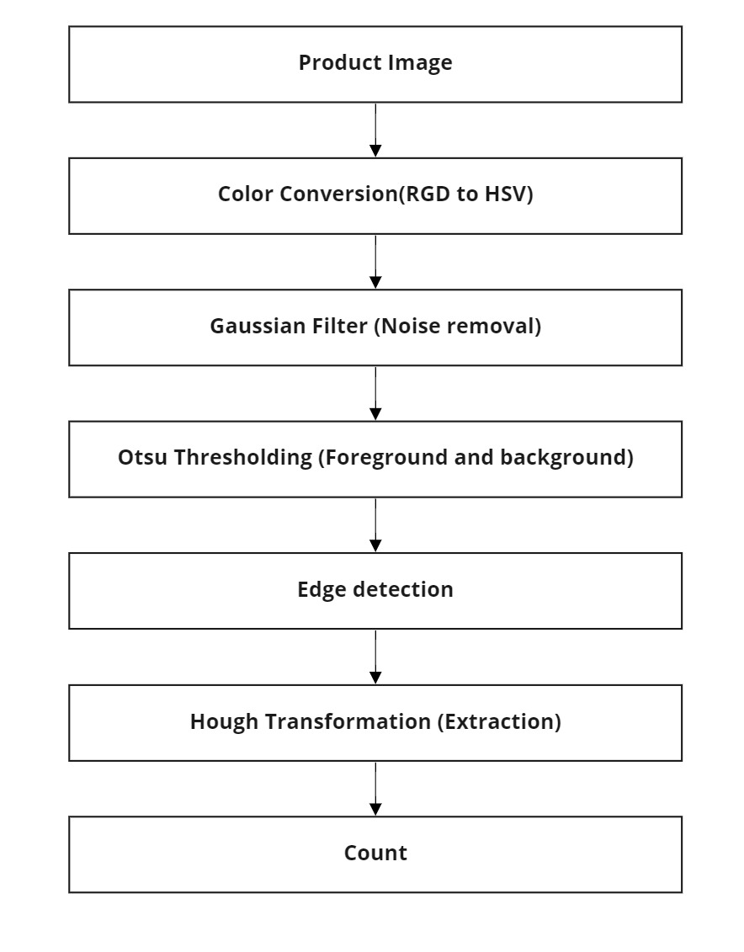
Workflow diagram

Slide 6
Approaches
Language - Python
Otsu thresholding – intensity images to separate foreground and background.
Hough Transformation – feature extraction technique
Gaussian filter
Color conversion – RGB to HSV

Slide 7
Next action items
ML Model development - Yet to start
Train Model - Yet to Start
Validation - Yet to Start
Final report preparation - Yet to Start

Slide 8
Advantages
Low cost and high precision measurement system.
Contactless measurement.
Improve production volumes.
Get fast, accurate and reliable output

Slide 9

Thank you

