Slide 1
CIS CRD Alpha
Custom Resource - Virtual Server Draft 1.0

Slide 2
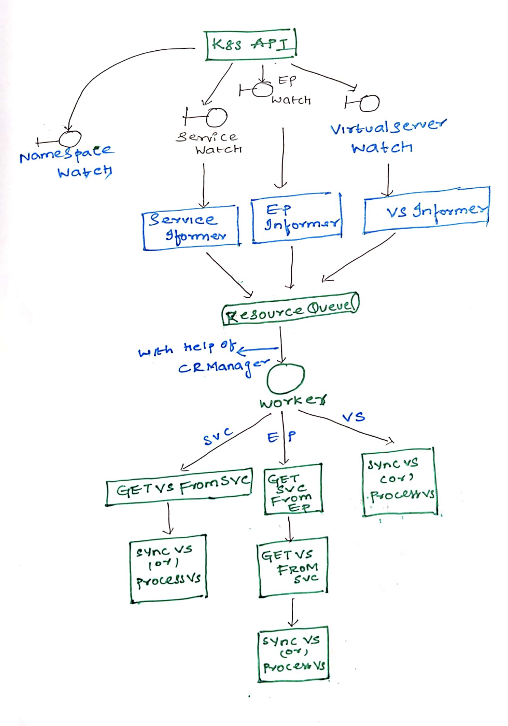
F5 CRD Custom Controller
Controllers registers to the kubernetes client-go using informers to retrieve service, endpoint, virtual server and node changes.
Resource Queue holds the resources to be processed.
Virtual Server is the primary citizen. Any changes in Service, Endpoint, Node will indirectly affect Virtual Server.
Worker fetches the affected Virtual Servers from Resource Queue to process them.

Slide 3
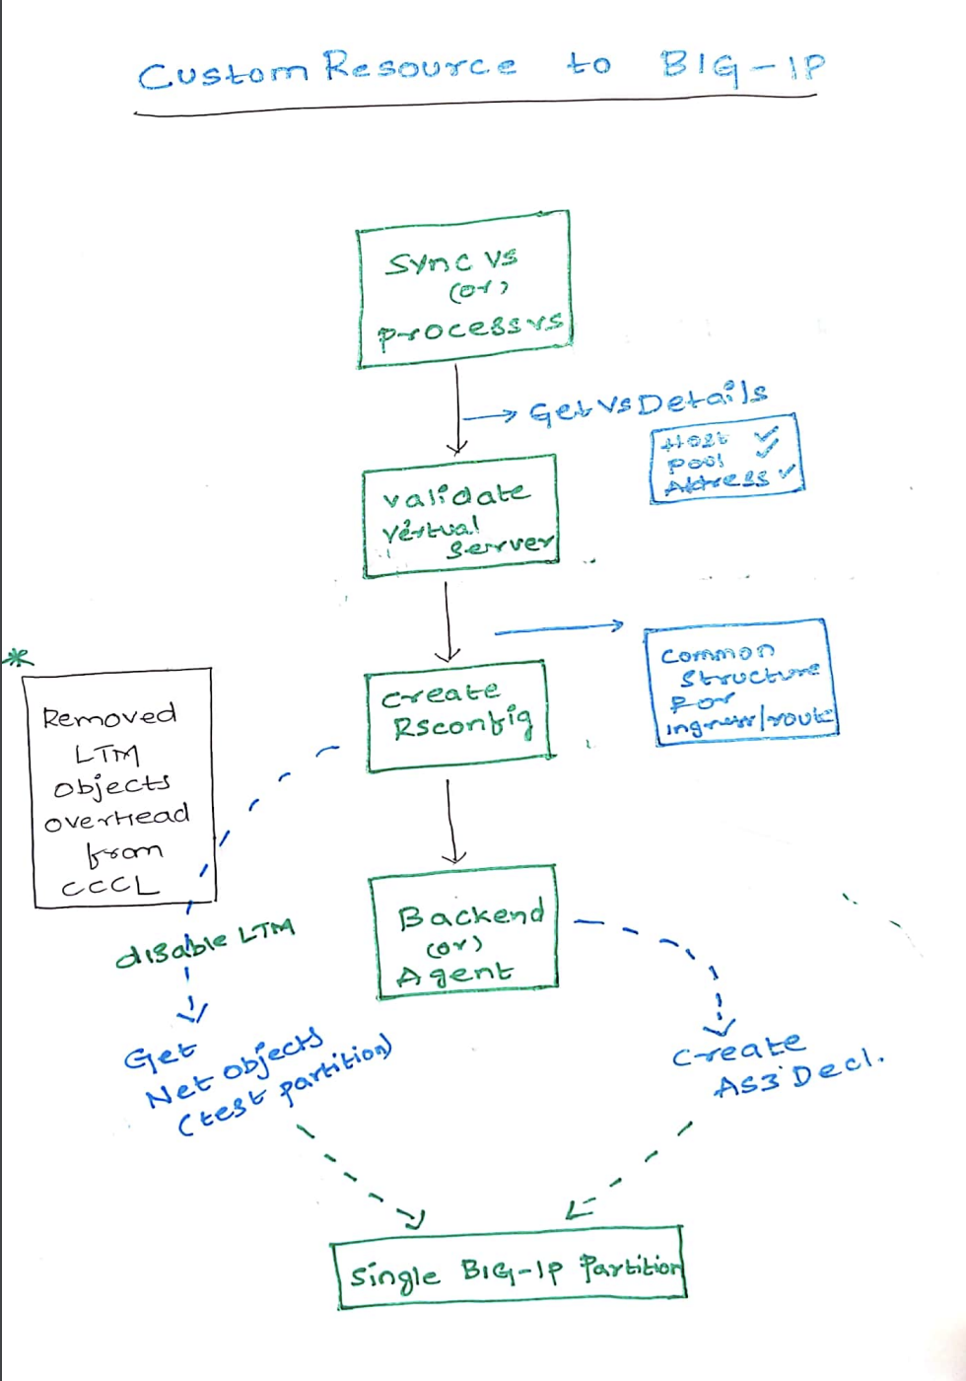
Custom Resource to BIG-IP
Validate the Virtual Server.
Process each valid Virtual Server to populate to a common structure that holds all the Virtual Servers.
Update Pool Members and L7 LTM policy actions for each Virtual Server.
Controller with help of Vxlan Manager to create only NET configuration in CCCL as AS3 cannot update L2-L3.
All the overhead of LTM CCCL processing is removed.
** LTM(from AS3) and NET(from CCCL) will be created in CIS Managed Partition, which is created by User.

Slide 4
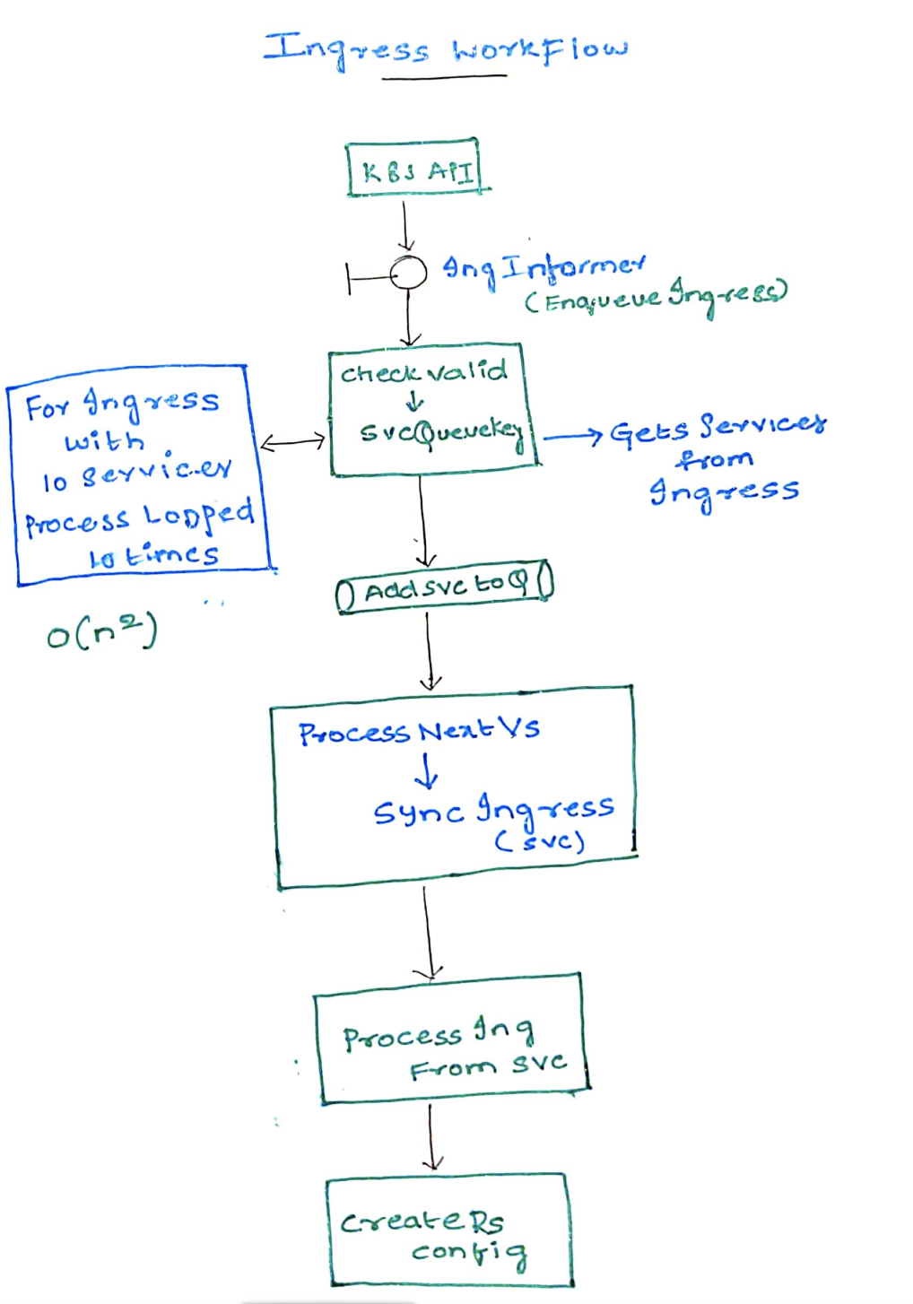
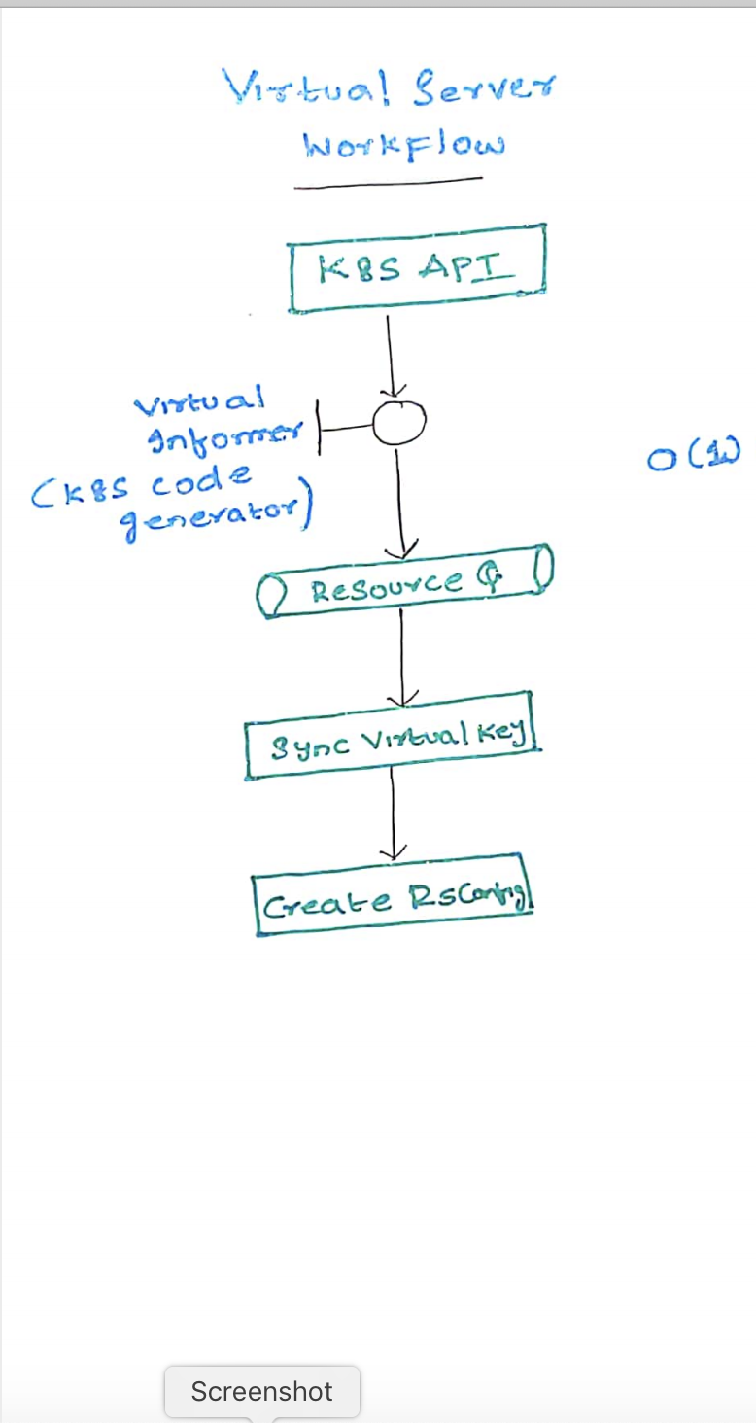
Ingress
vs
Virtual Server

Slide 5
Single Partition (Back to Awesome)
What you Configure is What you see.
Many complaints from Customer moving to AS3. Useless API Calls and Multiple Logs.
Ideal Behavior.
Do we still need GO-SDK?

Slide 6
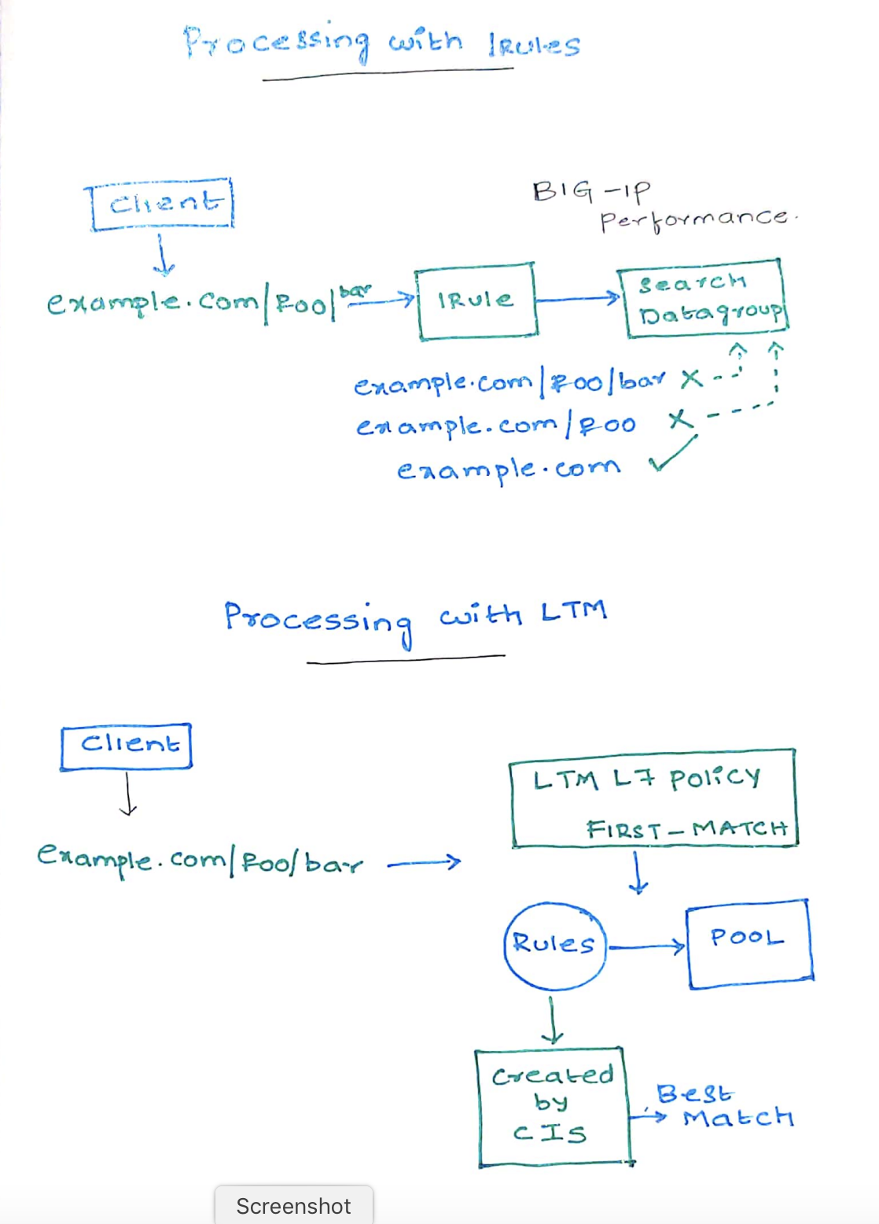
LTM Policies
Improved LTM Policies and Policy Rules to a
effective best-match
Why Irule for Edge Termination??
Irule Vs Policies (Which is better for us)
Handle L7 (Host and Path Based) by Policies not
Irule (Why?)

Slide 7
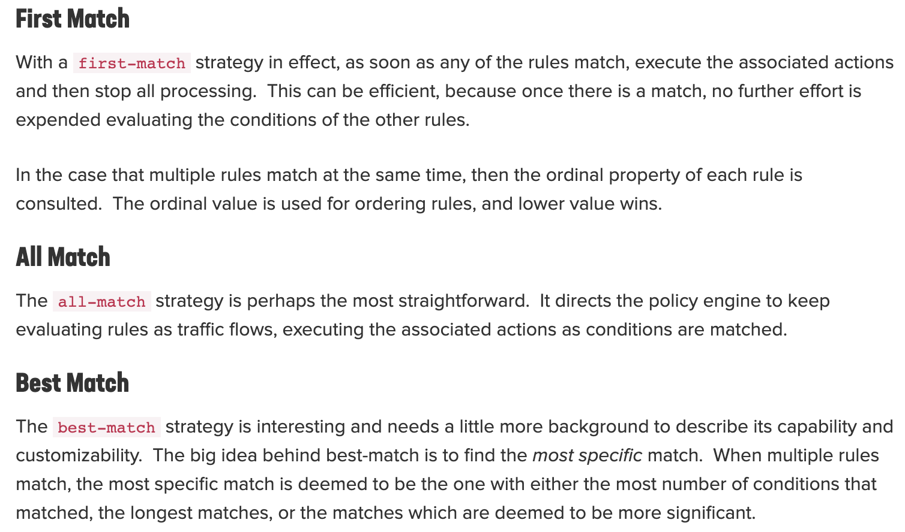
More About LTM Policies

Slide 8
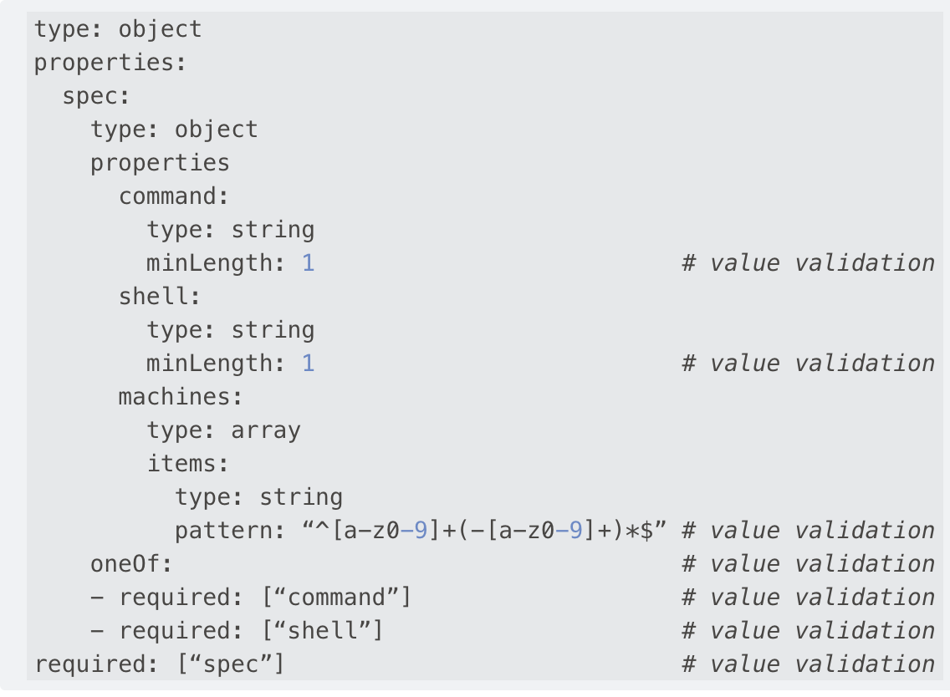
CIS CRD Schema Validation using OpenAPI

Slide 9
Additional Features
K8s Code Generator for Informers (More info in Dev Guide)
New Attributions Generator
Migration to Go Mods
TLS experimental support

Slide 10
DEMO
Create k8s services
Create F5 k8s-bigip-ctlr CRD
Create Virtual Server Custom Resource
Check Expected Objects in BIG-IP
Verify Traffic

Slide 11
Questions ????

Slide 12
Thank You
- Team CIS

