Slide 1
CRD’s
Custom Resource Definition

Slide 2
What are CRD’s ?
In the Kubernetes API, a resource is an endpoint that stores a collection of API objects of a certain kind. For example, the built-in pods’ resource contains a collection of Pod objects. The standard Kubernetes distribution ships with many inbuilt API objects/resources.
CRD comes into picture when we want to introduce our own object into the Kubernetes cluster to full fill our requirements. Once we create a CRD in Kubernetes we can use it like any other native Kubernetes object thus leveraging all the features of Kubernetes like its CLI, security, API services, RBAC etc.

Slide 3
Use of CRD’s
CRD allows us to use all the functionalities provided by a Kubernetes cluster for our custom objects and saves us the overhead of implementing them on our own.

Slide 4
Why CRD’s in CIS ?
There are various BIG-IP feature and functionalities which can be extended, or CIS can better serve their customers requirement or use-cases with these CRD’s implementation.
Few Examples : Reverse proxy ,SSL ,SNAT ,WAF, Whitelisting etc.

Slide 5
Thumb Rules for CRD’s Implementation for CIS Rule : 1
1 Domain 1 Virtual Server in BIG-IP
CRD-1
CRD-2
So as the host has two termination strategies, we can have two CRD’s. One crd for login and logout and other crd for transaction.
As login and logout doesn’t need any secure path where as fetching some transaction related details should be a secure path.
LOGIN
EDGE TERMINATION
www.aws.com
LOGOUT
RE-ENCRYPT TERMINATION
TRANSACTION

Slide 6
Rule : 2
Group of homogenous service 1 CRD
Rule : 3
Group of CRD’s 1 Virtual Server in BIG-IP

Slide 7
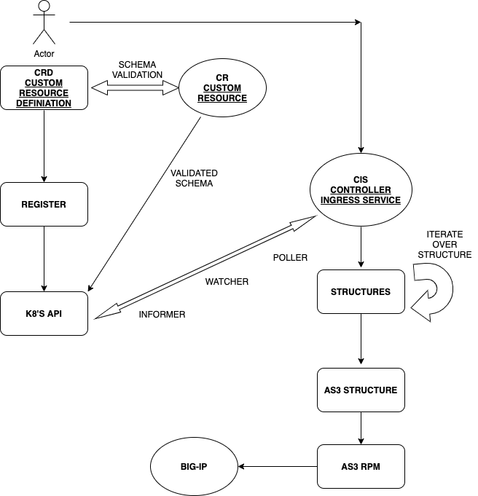
High level flow of CRD

