Slide 1
Introduction to Ansible
Abhishek Veeramalla

Slide 2
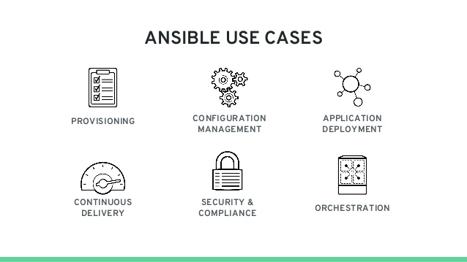
What is Ansible
Ansible is an open source software that automates software provisioning, configuration management, and application deployment. Ansible connects via SSH, remote PowerShell.
Use the same code to install software on different OS using ansible modules
Deploy applications on multiple servers irrespective of OS simultaneously
Configuration Management tool
Ansible modules are Idempotent so no need to worry about running tasks multiple times

Slide 3
Why Ansible ?
Opensource
Agentless
Works on simple protocols like ssh
Easy to code and understand
Easy orchestration
Develop your own modules
Dynamic Inventory

Slide 4

How Ansible Works ?
Centos
Ansible Host Server
Using ssh
No Changes
Needed at network
device
Using ssh
Ubuntu
Using winrm
Windows
Playbooks
Inventory File
Variables/Templates

Slide 5
Start it simple (Adhoc commands)
Install Ansible (yum install ansible)
Python is a pre-requisite to install
Establish a password less authentication with device you want to configure
Start working with simple ansible Adhoc commands
Example: ansible <host-name> -m ping
https://docs.ansible.com/ansible/2.5/user_guide/intro_adhoc.html

Slide 6
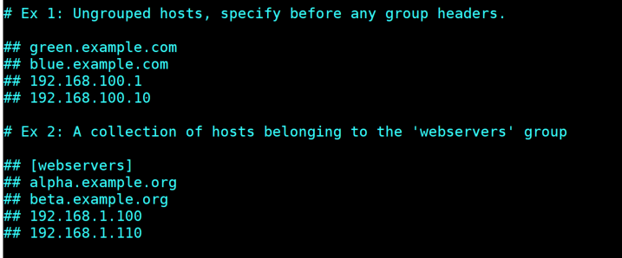
Inventory
Default location
/etc/ansible/hosts file
Sample Inventory file:
holds a list of Ansible-managed
servers

Slide 7
Playbook
Group of ansible tasks which are targeted at a specific set of hosts.
Uses YAML format
Each playbook is composed of one or more ‘plays’ in a list.
The goal of a play is to map a group of hosts to some roles, represented by things ansible calls tasks.
At a basic level, a task is nothing more than a call to an ansible module

Slide 8
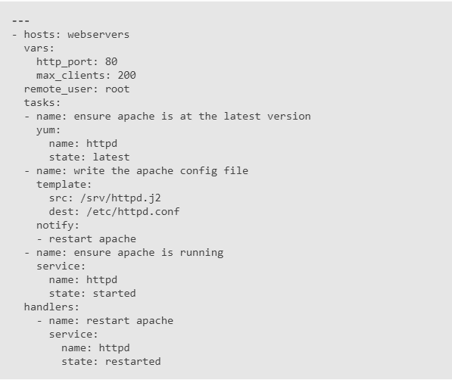
Sample Playbook
hosts : a list of one or more groups or hosts
remote_user : user with which you want to connect
tasks: executed in order, one at a time, against all machines matched by the host pattern, before moving on to the next task.
Note: You can have multiple plays in one playbook.

Slide 9
Roles
You can execute playbooks without creating roles but as we add more functionality it becomes unreadable and complex.
allow you to create very minimal playbooks that then look to a directory structure to determine the actual configuration steps they need to perform.
Ensures modularity.
You can create a roles using ansible-galaxy command, it will create all the required folders for your playbook
Example: ansible-galaxy init <role-name>

Slide 10
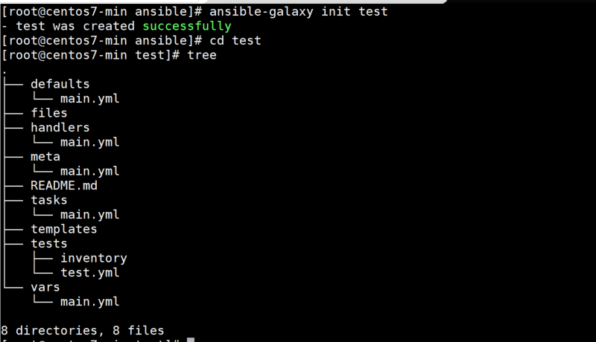
Understanding Roles
files : Scripts that need to be transferred to the hosts.
handlers : All handlers that were in your playbook previously can now be added here.
templates : Place all files that use variables to substitute information during creation here.
tasks : Contains all of the tasks in a playbook.
vars : Variables for the roles can be specified in this directory and used in your configuration files.
defaults: Defaults are similar to variables but it has lesser precedence and can be overridden by vars.
Note: It is not mandatory to use all these to run a playbook.

Slide 11
References
http://docs.ansible.com/ansible/intro_adhoc.html
http://docs.ansible.com/ansible/intro_inventory.html
http://docs.ansible.com/ansible/intro_patterns.html
http://docs.ansible.com/ansible/playbooks.html
http://docs.ansible.com/ansible/playbooks_roles.html
http://docs.ansible.com/ansible/modules.html
http://docs.ansible.com/ansible/YAMLSyntax.html

Slide 12
Demo
Run a sample ansible playbook to ping a list of servers
Connect to AWS and create a list of servers
Questions ?
Would be happy to answer them!

