Slide 1

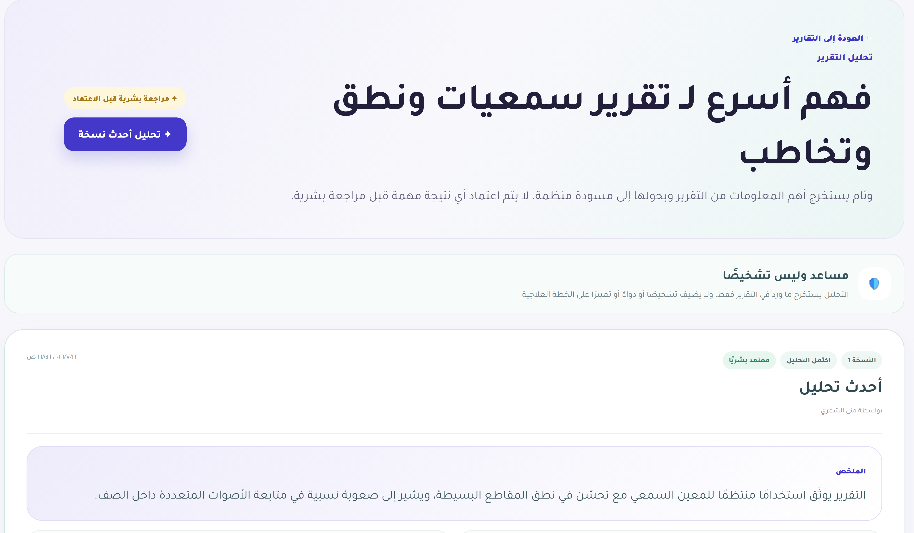

TEAM NUMBER [KSCDR_Hackathon_114 ]
AI HACKATHON FOR PEOPLE WITH DISABILITIES
Weam
TEAM MEMBERS
[Amal Aljohani · Ghaida Alhadi · Tarfaa Alokur · Moudah AlSubhi]
AFFILIATION
King Abdulaziz University
TRACK · CATEGORY
Everyday Life · Individuals
Introduction and problem statement
Methodology and system design
A child's care journey is split across guardians, specialists, teachers, and centers, with no shared record between them.
Families repeat the same history at every visit; specialists work from partial context.
Reports, goals, and follow-ups live in different places and often go untracked.
Existing tools are either generic file storage or single-purpose apps.
Weam is built for different needs, not one diagnosis: hearing, mobility, learning, and early-intervention support.
FastAPI + PostgreSQL backend, React + TypeScript frontend.
Access control enforced on every server request.
Hosted LLM for summarization and Q&A, with a local fallback.
Identity kept separate from care data by design.
Guardian
Care Specialist
Center
Weam Platform — FastAPI + PostgreSQL
Access control enforced on every request
AI Assistant
Hosted LLM + local fallback
18 Versioned
DB Migrations
Figure 1. Weam's architecture — one permission-controlled record, shared safely.
Objectives and target users
Results and evaluation
Give guardians one permission-controlled record for their child's reports, goals, and care team.
Let authorized specialists contribute and view only what they are granted.
Provide explainable, non-diagnostic AI assistance that summarizes and retrieves, never decides.
Primary users: guardians, care providers, centers, and administrators.
Demonstrated across four synthetic care journeys with different needs.
111 of 111 backend tests passing, including new security regression tests.
All 18 database migrations verified from empty on a real PostgreSQL instance.
Zero horizontal-overflow issues found across five required screen sizes.
Every text/background color pairing checked against WCAG AA; worst case 5.18:1 contrast.
Engineering and QA evidence — no user study has been conducted yet.
5.18 : 1
Contrast ratio achieved
(WCAG AA requires 4.5 : 1)
Proposed solution
Figure 2. Every automated QA gate passed on real infrastructure.
One responsive web app for laptop and phone, Arabic-first RTL layout.
A unified child record, identity kept separate from care data.
Guardian-controlled care-team permissions, with expiry and revocation.
Every AI-generated output stays a labeled draft until a human reviews it.
Discussion, impact and ethics
Designed for guardian consent and least-privilege access from the data model up.
AI never diagnoses or prescribes treatment; every AI-influenced output requires human review before it can affect the record.
Center recommendations are explainable and never claim medical superiority.
All demonstration data in this prototype is synthetic; no real child information is used.
Next steps: broaden verified center coverage, pilot with a small guardian and specialist group, and formalize the sustainability model.
Figure 3. Every AI finding stays a draft until a human reviews it.
Contact:
name Ghaida Alhadi
email ghaidaalhadi217@gmail.com
mobile 0559216346
AI Hackathon for People with Disabilities · King Salman Center for Disability Research · Riyadh, 11–13 October
hackathon.kscdr.org

