Slide 1

VueJS
By Ahmed Ghoraba

Slide 2

What’s
VueJS?
Vue is a Progressive web framework by Evan You – a former Google developer who had the idea of taking out the best parts of the then JS frameworks and making a lightweight and easy-to-use framework for his own personal use.

Slide 3
Why to use VueJS …..
Well…. It’s a relatively easy framework
It was made especially for people like you .. And me
It will give you a good grasp for the other FE framework concepts
Great for prototyping fast
AI understands it

Slide 4
Terms you will hear…. A lot
Component Single unit of function in a front-end app
SPA app we will get to that …
PWA (progressive web app)
CSR (Client-side render)

Slide 5

What’s SPA apps ?
A SPA is a web application that loads a single HTML page and dynamically updates content as the user interacts.
No full page reloads—provides a smoother experience
Examples: Netflix, X(twitter), GoogleDocs…etc
Real projects: GitLab, Adobe, Xiaomi And Trivago

Slide 6

Why and when to use a SPA app?
Why?
Faster navigation and improved user experience
Reduced server load
Seamless transitions between views
Where?
Dashboards
Social media platforms
Interactive web apps

Slide 7
Creating a VueJS (vite) app
1- Create a vue app:
- npm create vue@latest
2- Install the dependencies:
- npm I
3- Run the project
- npm run dev

Slide 8
Let’s C reate a VueJs app!

Slide 9

Demo time

Slide 10
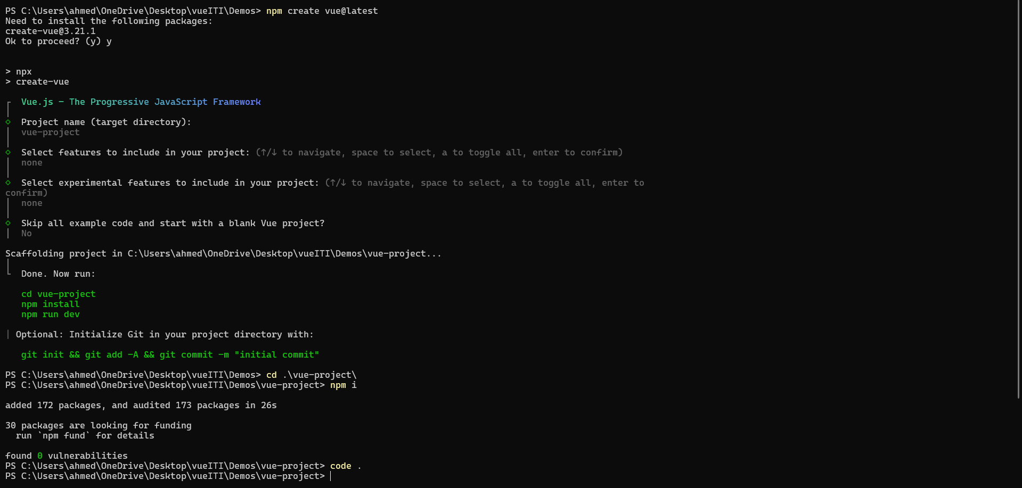
What you should see

Slide 11
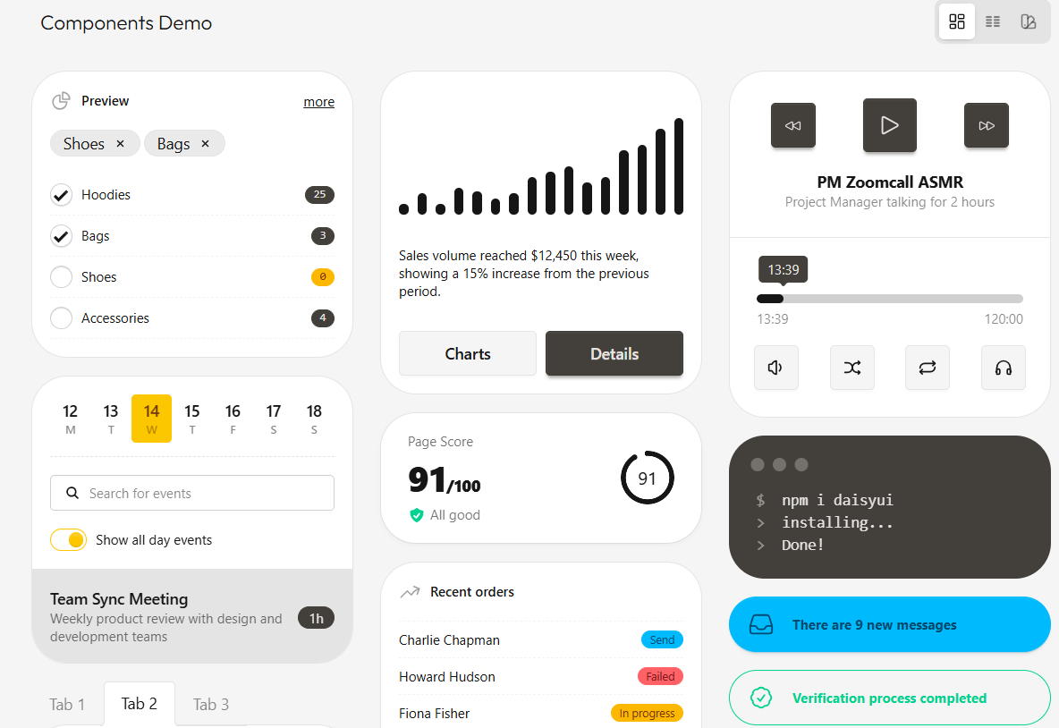
(Optional) install a UI library e.g. daisyUI (Please do it)
Fast prototyping
Shared language from figma to the FE
Consistent look and feel through the app

Slide 12
Installing daisyUI
npm install tailwindcss@latest @tailwindcss/vite@latest daisyui@latest
Add it in vite
Install daisyUI for Vue — daisyUI Tailwind CSS Component UI Library

Slide 13
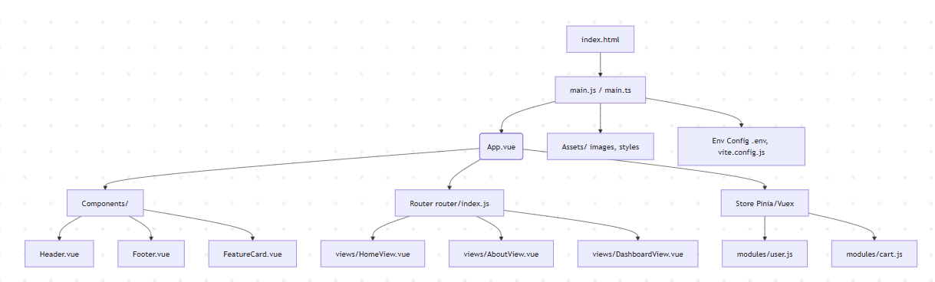
VueJS App Sturcture

Slide 14
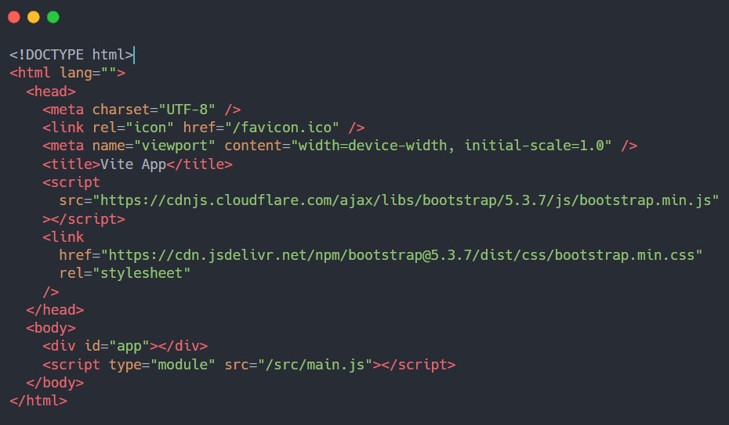
1. Index.html
Normal HTML
You can link normal frameworks/ libraries here (Not recommended)
The fun part where magic happens

Slide 15
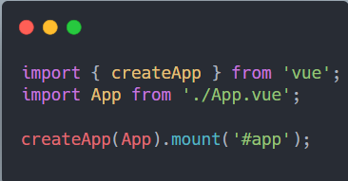
2. main.js
What’s Happening Here?
createApp(App): Creates a Vue instance using the root component.
.mount('#app'): Tells Vue where to render the app in the DOM (usually a <div id="app"> in index.html).
What’s it?
It’s the file that starts your Vue app.
It connects your root component (App.vue) to the HTML (index.html).

Slide 16
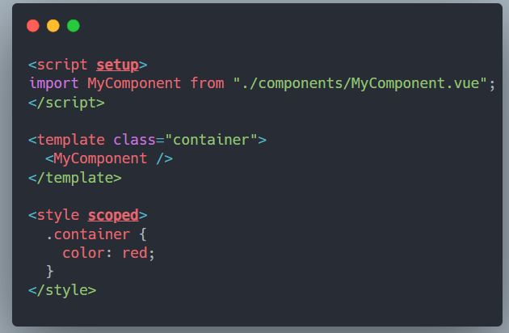
App.Vue
t’s the main component of your Vue app.
Acts as the entry point for your component tree.
Gets rendered inside <div id="app"> in index.html via main.js.
What’s Happening Here?
<template>: Defines the HTML structure.
<script>: Imports and registers child components.
<style>: Scoped or global styles for the component.

Slide 17
What Are Directives?
Directives are special attributes in Vue that start with v-. They tell Vue to do something dynamic with the DOM — like showing, hiding, looping, or binding values.
They bridge HTML (structure) and JavaScript (logic) — allowing you to make your UI respond instantly to data changes.

Slide 18
Common Directives You’ll Use Daily:
Directive | Purpose | Example
v-bind | Bind data dynamically to HTML attributes | v-bind:src="imageUrl" or shorthand :src="imageUrl"
v-model | Two-way data binding (form inputs, etc.) | v-model="user.name"
v-if / v-else / v-show | Conditional rendering | v-if="isLoggedIn"
v-for | Loops over lists | v-for=“product in products"
v-on | Listen for DOM events | v-on:click="handleClick" or shorthand: @click="handleClick"

Slide 19

Connecting your logic to your UI
Data binding is the mechanism that links your script data to what's rendered on screen
Without it — static HTML, nothing reacts, nothing updates
With it — your UI becomes a live reflection of your state (variables in code)
Vue gives you three ways to do it, each for a different purpose
Think of it as the bridge between <script> and <template>

Slide 20
Three Ways to Bind Data
 | {{ }} | v-bind / : | v-model
Direction | One way | One way | Two way
Used for | Text content | HTML attributes | Form inputs
User can change data? | No | No | Yes

Slide 21

So far... Vue looks like a glorified HTML What tips the scale?
It’s Vue Reactivity system
Vue knows when you update the value in the code and updates the code automatically
No more querySelector , setInnerHTML …..

Slide 22
Vue Reactivity system Ref vs Computed
 | ref | computed
What is it? | A reactive variable you control | A reactive value that controls itself
You set it? | Yes, manually | Never — Vue sets it
Depends on other state? | No | Yes, always
Read only? | No | Yes
Cached? | No | Yes
.value needed? | Yes | Yes (in script)
Use when | Storing state | Calculating from state

Slide 23
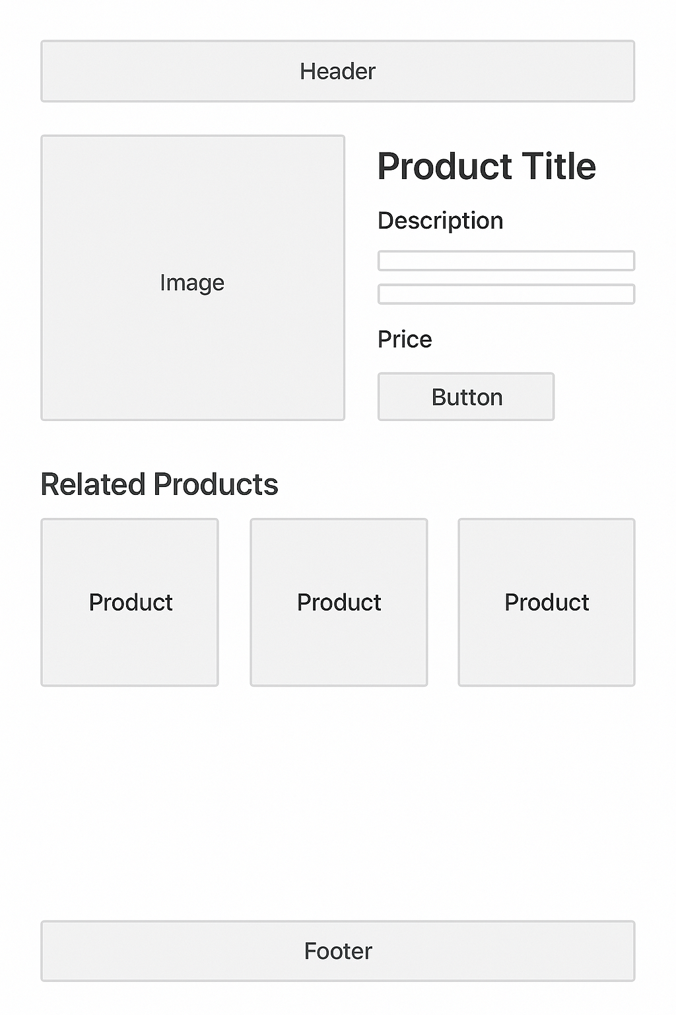
What’s a component?
A component is a
reusable,
self-contained unit of UI in a Vue app.
Each component has its own: Template (HTML) Script (JavaScript logic) Style (CSS)

Slide 24
What’s a component?
Component Highlights
HeaderComponent: Navigation bar, logo, cart icon.
ProductPage: Parent component that holds all product-related subcomponents.
ImageGallery: Carousel or grid of product images. ProductDetails: Title, price, description, availability.
ReviewsSection: User reviews and ratings.
RelatedProducts: Suggestions based on current product.
FooterComponent: Contact info, links, etc.

Slide 25
Demo time

Slide 26
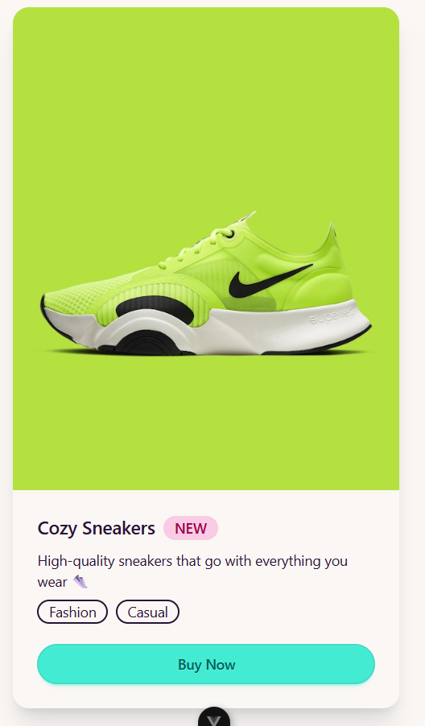
Let’s make a card …. A simple stupid card
Notes:
<template>
<div class="min-h-screen flex items-center justify-center">
<div class="card w-96 shadow-xl">
<figure>
<img
src="https://images.unsplash.com/photo-1503264116251-35a269479413?q=80&w=600"
alt="Shoes"
/>
</figure>
<div class="card-body">
<h2 class="card-title">
Cozy Sneakers
<div class="badge badge-secondary">NEW</div>
</h2>
<p>High-quality sneakers that go with everything you wear 👟</p>
<div class="card-actions justify-start">
<div class="badge badge-outline">Fashion</div>
<div class="badge badge-outline">Casual</div>
</div>
<button class="btn btn-primary mt-3">Buy Now</button>
</div>
</div>
</div>
</template>
<script setup></script>
<style scoped></style>

Slide 27

How can we make it a little smarter?
Notes:
<template>
<div
class="card w-full sm:w-80 shadow-xl bg-base-100 transition-all hover:shadow-2xl hover:scale-[1.02] cursor-pointer"
@click="handleCardClick"
>
<figure v-if="image">
<img :src="image" :alt="title" class="object-cover h-48 w-full" />
</figure>
<div class="card-body">
<div class="flex justify-between items-center">
<h2 class="card-title text-lg font-bold">{{ title }}</h2>
<div v-if="badge" class="badge badge-secondary">{{ badge }}</div>
</div>
<p v-if="description" class="text-sm text-gray-600">
{{ description }}
</p>
<div v-if="tags?.length" class="card-actions justify-start mt-2">
<div
v-for="(tag, i) in tags"
:key="i"
class="badge badge-outline"
>
{{ tag }}
</div>
</div>
<slot></slot>
<div v-if="buttonLabel" class="mt-4">
<button class="btn btn-primary w-full" @click.stop="handleButtonClick">
{{ buttonLabel }}
</button>
</div>
</div>
</div>
</template>
<script setup>
import { defineProps } from "vue";
const props = defineProps({
title: { type: String, required: true },
description: { type: String, default: "" },
image: { type: String, default: "" },
badge: { type: String, default: "" },
tags: { type: Array, default: () => [] },
buttonLabel: { type: String, default: "" },
// Optional callbacks
onCardClick: { type: Function, default: null },
onButtonClick: { type: Function, default: null },
});
function handleCardClick() {
props.onCardClick?.();
}
function handleButtonClick() {
props.onButtonClick?.();
}
</script>

Slide 28
Props and emits
What are Props?
Props (short for properties) are how a parent component passes data down to a child component.
Declared in the child using defineProps() (Composition API)
Props are reactive — if the parent changes a prop value, the child updates automatically.
Should be treated as read-only inside the child (never mutate directly). WHY?
Can have types, defaults, and validation.
Notes:
Should be treated as read-only inside the child (never mutate directly).

Slide 29
Props and Emits
What are Emits? Emits are how a child component sends events up to the parent component.
Declared in the child using defineEmits() (Composition API)
The parent listens using @event-name on the child tag
The child never touches parent data directly — it only announces that something happened
Can pass a payload with the event — a value, an object, anything
The child makes the request. The parent makes the decision. Always.
Notes:
Should be treated as read-only inside the child (never mutate directly).

Slide 30
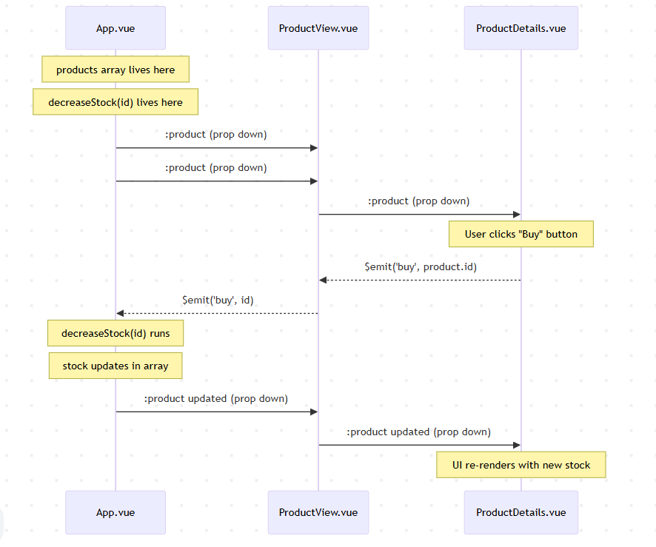
Emits and props flow:
Data
Buy Action
NEWData

Slide 31
Demo time Buy button that actually works!

Slide 32
Vue Router
Vue Router is Vue's official routing library
Maps URL paths to View components
URL changes, component swaps, page never reloads
Already a familiar concept — just like Express but for the frontend

Slide 33
Installing router
Selected during npm create vue@latest — recommended
Or manually: npm install vue-router
Three things Vue Router needs to work:
Route definitions — path → component mapping
Router instance installed in main.js
<RouterView /> in App.vue — the window where pages render

Slide 34
Basic Routing
<RouterLink to="/"> — declarative navigation in template
useRouter().push('/path') — programmatic navigation in script
<a> tags cause full page reload — defeats the entire purpose of SPA
:to with an object lets you navigate by route name

Slide 35
Dynamic routing
:id in path = dynamic segment
Access it with useRoute().params.id
This is how every detail page works — everywhere, in every framework
The ID comes from the URL, the data comes from using that ID

Slide 36
VueJS life cycle

Slide 37
How components are born and die?
Lifecycle Hooks | Vue.js ← Docs

Slide 38
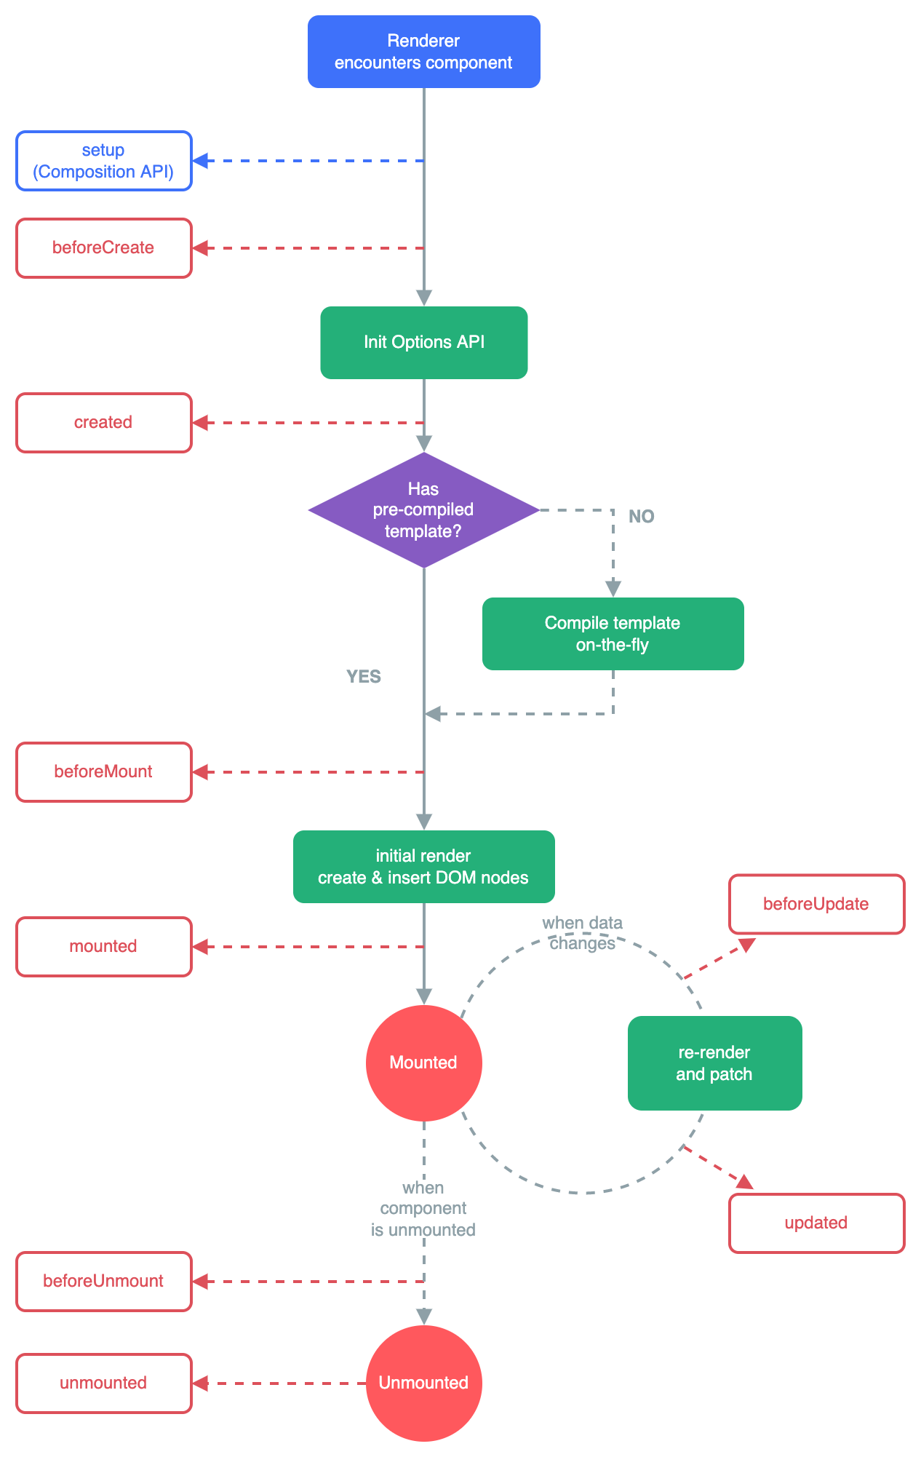
Focus on this part: But Why?

