Slide 1
Ai Cup Detector

Slide 2
Project Members
أرساني أشرف لطفي ميخائيل section 2
أحمد هشام فؤاد المنير section 2
إسلام السيد المتولي تميم section 2

Slide 3

Problem Statement

Slide 4
Related Work
https://www.datacamp.com/blog/yolo-object-detection-explained
https://kili-technology.com/data-labeling/machine-learning/yolo-algorithm-real-time-object-detection-from-a-to-z
https://arxiv.org/abs/1506.02640

Slide 5
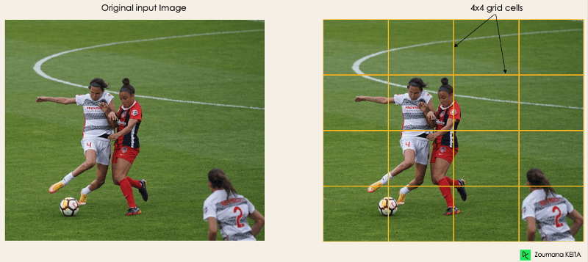
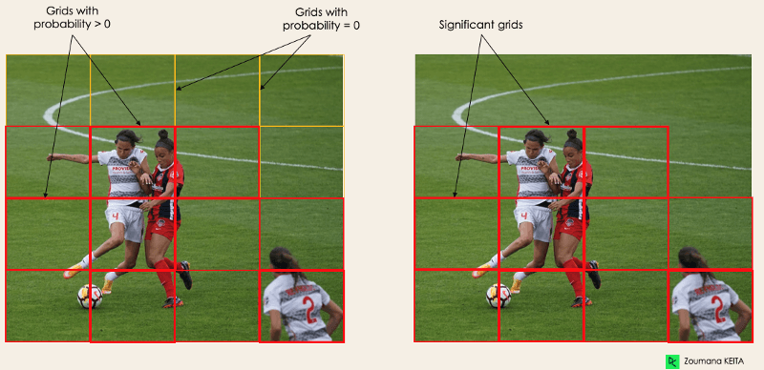
1
2

Slide 6
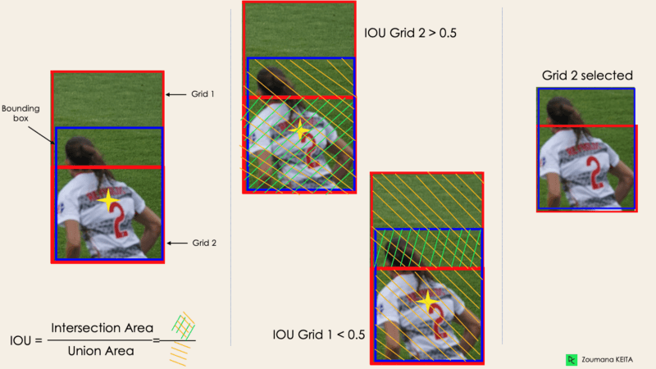
3
&
4

Slide 7
Proposed Methodology
Collect dataset from the internet
Train the yolo model
Check the accuracy
Repeat / Finish.

Slide 8
Results

Slide 9

Conclusion

