Slide 1
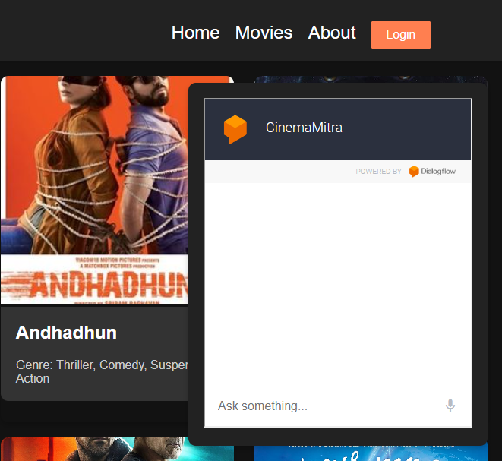
Cinema Mitra : Online Movie Ticket Booking System Chatbot
Using
Google Cloud ,AWS and FastAPI

Slide 2
Agenda
Team Members
Proposed System
Google Cloud Services
AWS
Architecture

Slide 3



Meet our team
Bilal Ansari
Affaan Arbani
Vivek Chouhan
3

Slide 4
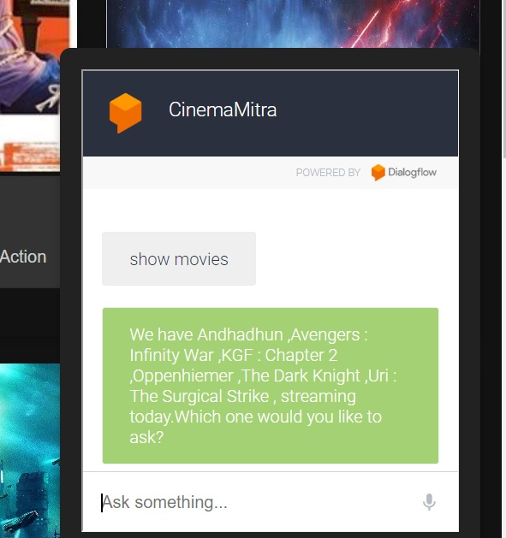
Proposed System
Our movie ticket booking system utilizes Dialogflow for the chatbot interface, AWS Lambda for backend logic written in python, AWS RDS(MySQL) for database storage, and AWS S3 for hosting the frontend. The system allows users to interact conversationally to book movie tickets, leveraging the power of natural language processing and cloud computing for a seamless experience.
4

Slide 5
Functionalities
View Ticket Through Gmail
Low Latency
Reply
Book a ticket with full customization
Track Ticket
View Currently Available Movies
5

Slide 6
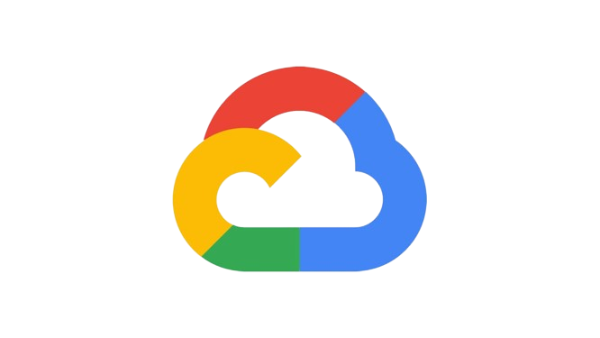
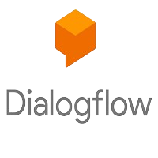
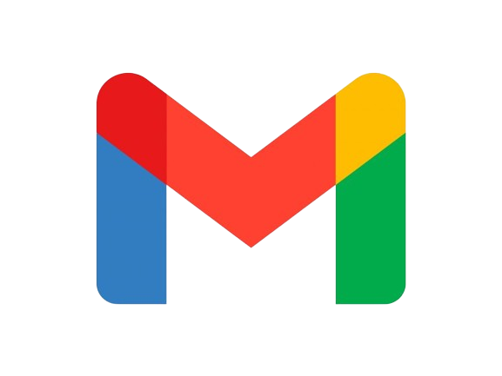
Google Cloud Services Used
Helps Creating Chatbot on cloud
Helps creating webhooks for dynamic replies.
Free for 400 requests per minute.
Email server for sending and receiving mails.
Interact with web servers to send dynamic mails for automation
6

Slide 7


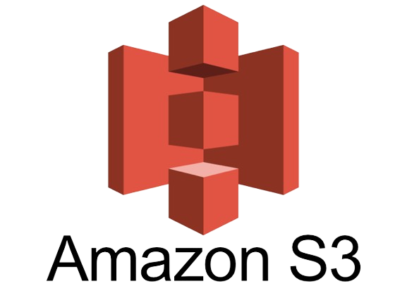


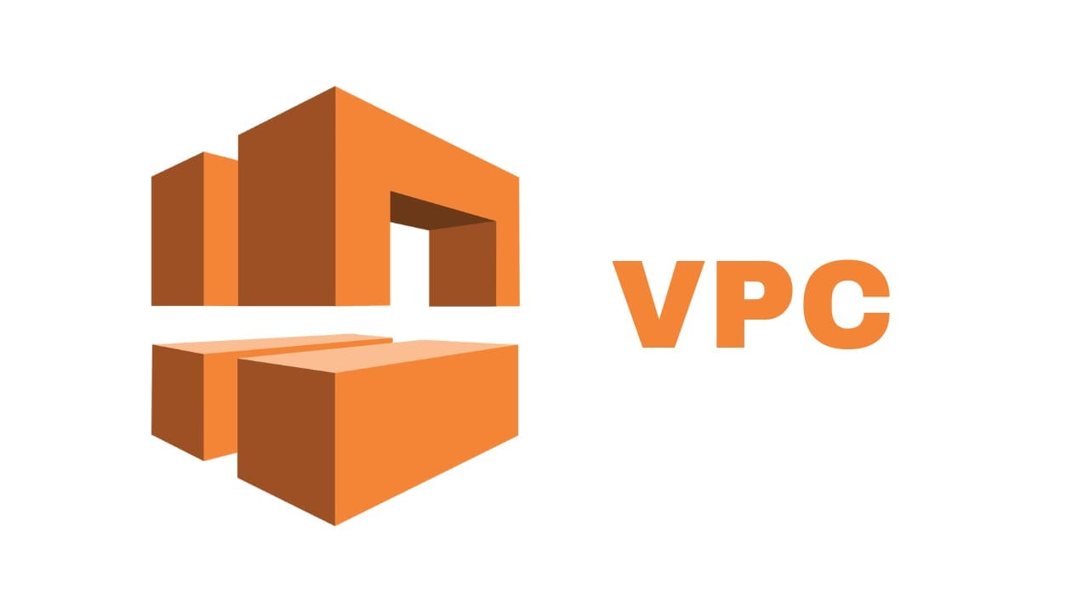
AWS Services Used
AWS LAMBDA
AWS S3
AWS RDS (MYSQL)
AWS Budgets
AWS VPC
Event based serverless services for small scale webservers
Storage service for hosting the static web application.
On cloud database server to store data and booked tickets
For cost and bill management
To manage create secure private space on cloud in MUMBAI

Slide 8
Architecture and Data Flow

Slide 9
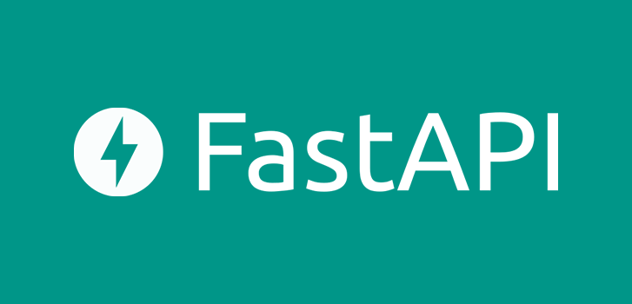
Thank you
Made in India …..For India ♥
By NoName.json

