Slide 1

12
Monopoly
CHAPTER CHECKLIST
When you have completed your study of this chapter, you will be able to
1 Explain how monopoly arises and distinguish between single-price monopoly and price-discriminating monopoly.
2 Explain how a single-price monopoly determines its output and price.
3 Compare the performance of a single-price monopoly with that of perfect competition.
Notes:
Notes and teaching tips: 5, 13, 16, 43, 52, 63, 76, 78, and 83.
To view a full-screen figure during a class, click the red “expand” button.
To return to the previous slide, click the red “shrink” button.
To advance to the next slide, click anywhere on the full screen figure.
To enhance your lecture, check out the Lecture Launchers, Land Mines, and Class Activities in the Instructor’s Manual.

Slide 2
16
Monopoly
CHAPTER CHECKLIST
When you have completed your study of this chapter, you will be able to
4 Explain how price discrimination increases profit.
5 Explain why natural monopoly is regulated and the a effects of regulation.

Slide 3
16.1 MONOPOLY AND HOW IT ARISES
How Monopoly Arises
Monopoly arises when there are
No close substitutes
Barriers to entry
No Close Substitutes
If a good has a close substitute, even though only one firm produces it, that firm effectively faces competition from the producers of substitutes.
Notes:
Did you ever set up a lemonade stand when you were a kid? Probably not, but you can bet your students have heard of this sort of endeavor and, depending on their circumstance, maybe even beseeched their parents to let them do so. And, even if they didn’t, they can easily identify with this sort of small business. Point out that if you were able to convince your folks to let you set up a lemonade stand, you probably ran a monopoly (at least for a day) as long as none of your friends set up a stand. Their parents provided the barrier to entry! You could determine your own price and sell a certain number of cups of lemonade. If you reduced your price, you could sell more. At the end of the day, you added up your revenues and found out you made money. By the next day (or weekend) after your friends saw your success, you lost your monopoly power as they opened competing stands. But for a little while, you were a monopolist! This easily understood story captures the essence of monopoly. Indeed, you can even embellish it to include price discrimination by pointing out how you might have charged your folks more—or less!— than other customers!

Slide 4
16.1 MONOPOLY AND HOW IT ARISES
A Barrier to Entry
Any constraint that protects a firm from competitors is a barrier to entry.
There are two types of barrier to entry:
Natural
Legal

Slide 5
16.1 MONOPOLY AND HOW IT ARISES
Natural Barrier to Entry
A natural monopoly exists when the technology for producing a good or service enables one firm to meet the entire market demand at a lower price than two or more firms could.
One electric power distributor can meet the market demand for electricity at a lower cost than two or more firms could.

Slide 6
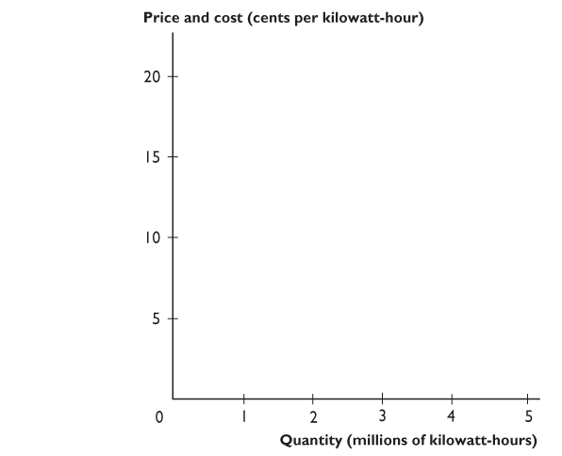
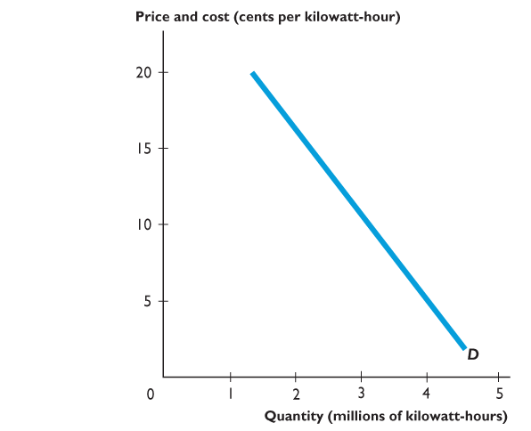
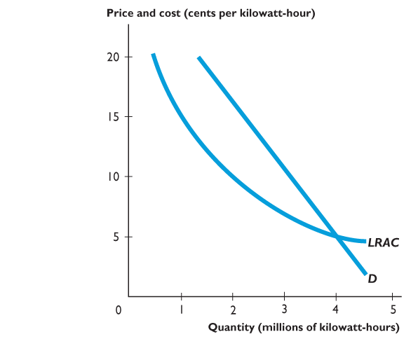
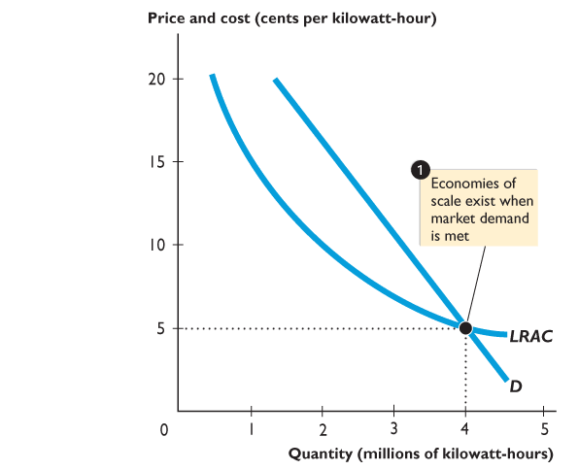
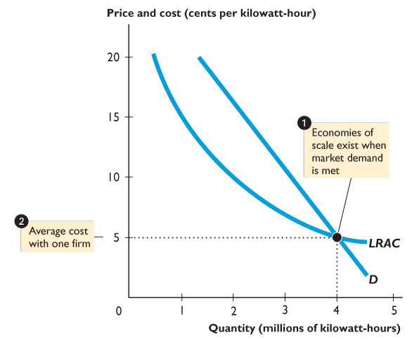
16.1 MONOPOLY AND HOW IT ARISES
Figure 16.1 shows a natural monopoly.
Economies of scale exist over the entire LRAC curve.
One firm can distribute 4 million kilowatt hours at a cost of 5 cents a kilowatt-hour.

Slide 7
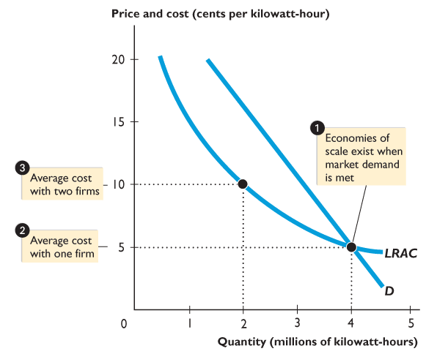
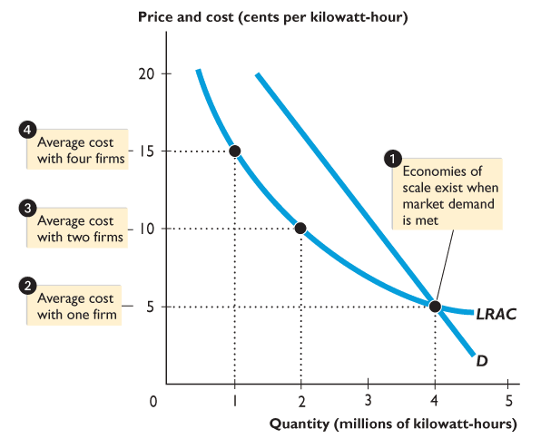

Slide 8
16.1 MONOPOLY AND HOW IT ARISES
This same total output costs 10 cents a kilowatt-hour with two firms,
and 15 cents a kilowatt-hour with four firms.
One firm can meet the market demand at a lower cost than two or more firms can, and the market is a natural monopoly.

Slide 9
16.1 MONOPOLY AND HOW IT ARISES
Legal Barrier to Entry
A legal barrier to entry creates legal monopoly.
A legal monopoly is a market in which competition and entry are restricted by granting of a public franchise, government license, patent, or copyright.

Slide 10
16.1 MONOPOLY AND HOW IT ARISES
A Public Franchise is an exclusive right granted to a firm to supply a good or service. For example: The U.S. Postal Service’s exclusive right to deliver first-class mail.
A government license controls entry into particular occupations, professions, and industries.
Patent is an exclusive right granted to the inventor of a product or service.
Copyright is an exclusive right granted to the author or composer of a literary, musical, dramatic, or artistic work.
In the United States, a patent is valid for 20 years.

Slide 11
16.1 MONOPOLY AND HOW IT ARISES
Monopoly Price-Setting Strategies
A monopoly faces a tradeoff between price and the quantity sold.
To sell a larger quantity, the monopolist must set a lower price.
There are two price-setting possibilities that create different tradeoffs:
Single price
Price discrimination
Notes:
Explain that the monopoly model is a benchmark model. Similar to the case of perfect competition, although no real-world industry satisfies the full definition of a monopoly market, the behavior of firms in many real world industries can be predicted by using the monopoly model. Mention that this chapter examines the least competitive end of the spectrum of markets, just like Chapter 13 discussed the most competitive end.

Slide 12
16.1 MONOPOLY AND HOW IT ARISES
Single Price
A single-price monopoly is a firm that must sell each unit of its output for the same price to all its customers.
DeBeers sell diamonds (quality given) at a single price.
Price Discrimination
A price-discriminating monopoly is a firm that is able to sell different units of a good or service for different prices.
Airlines offer different prices for the same trip.

Slide 13
16.2 SINGLE-PRICE MONOPOLY
Price and Marginal Revenue
Because in a monopoly there is only one firm, the firm’s demand curve is the market demand curve.
Total revenue
The price multiplied by the quantity sold.
Marginal revenue
The change in total revenue resulting from a one-unit increase in the quantity sold.
Figure 16.2 on the next slide illustrates the relationship between marginal revenue and demand.

Slide 14
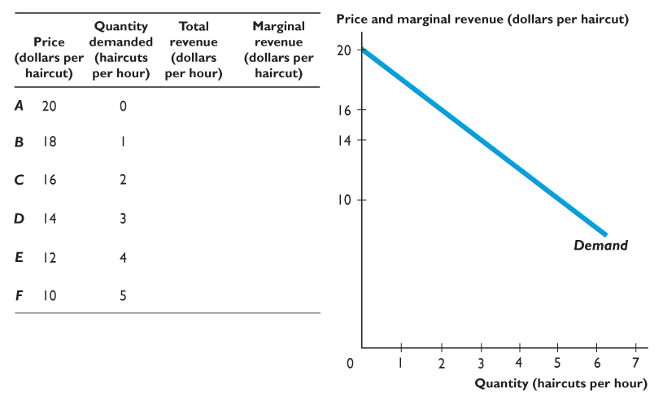
16.2 SINGLE-PRICE MONOPOLY
The table shows the demand schedule and the graph shows the demand curve.
Notes:
Marginal revenue can be a sticking point for many students. Students find it easier to see the difference between the monopoly’s demand and marginal revenue curves if you take two steps. First develop a total revenue schedule using price and quantity data. Then add another column showing marginal revenue. As the text shows, place the marginal revenue values between the quantity values. In the next step, draw the demand and marginal revenue curves. Again, emphasize that marginal revenue is plotted between two quantity levels. By explicitly graphing the data, you also have the framework for showing that the price of the good is always less than marginal revenue of a monopoly.

Slide 15
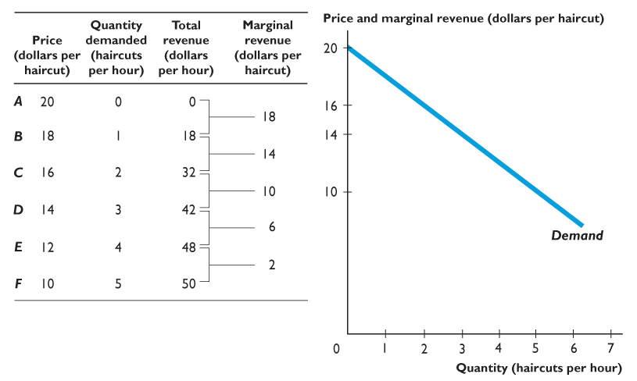
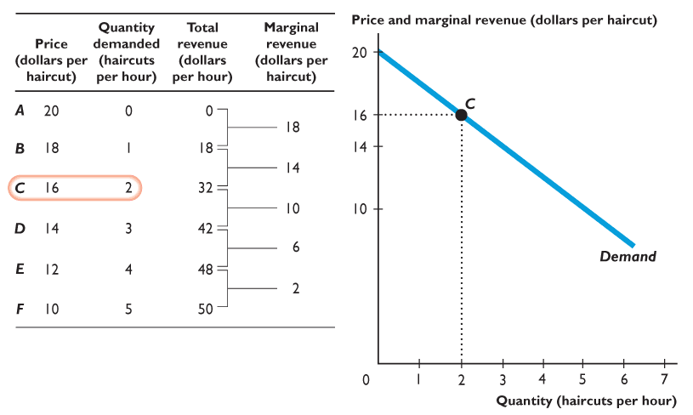
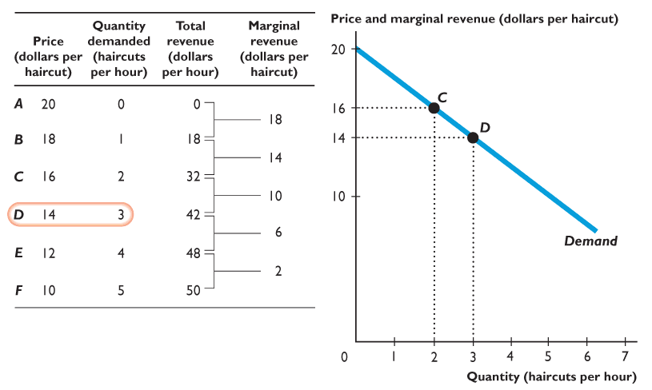
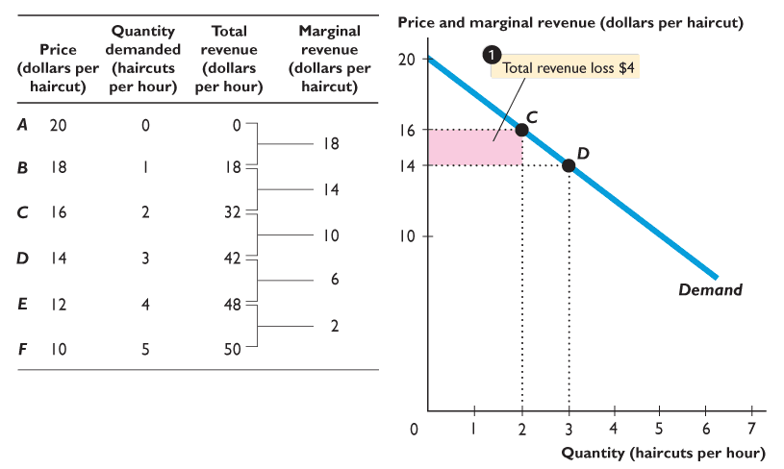
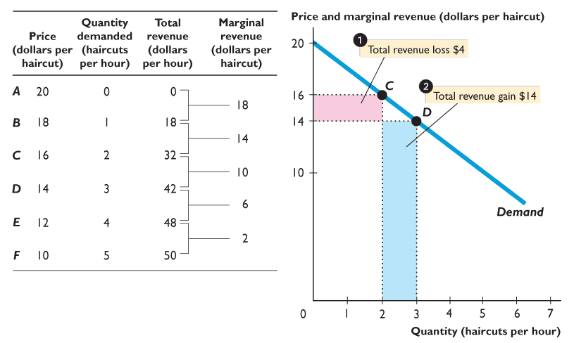
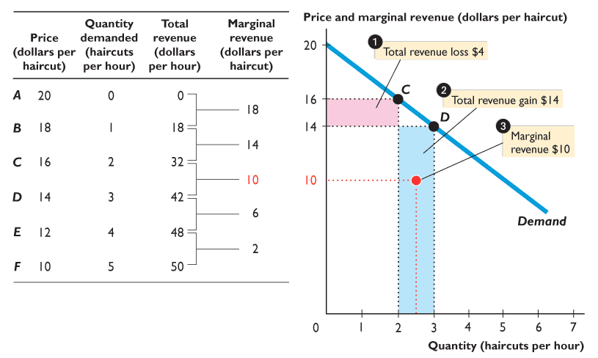
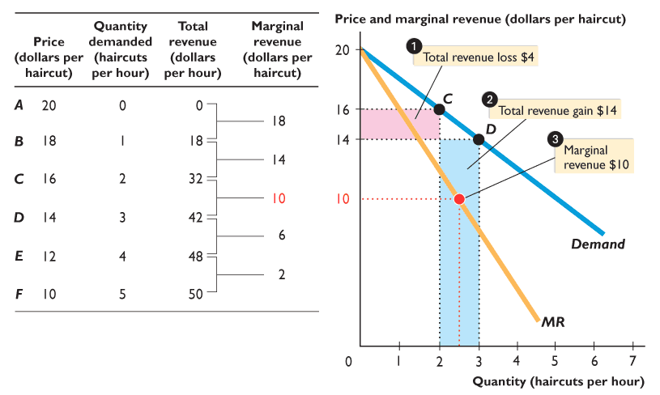

Slide 16
16.2 SINGLE-PRICE MONOPOLY
The table also calculates total revenue and marginal revenue.

Slide 17
16.2 SINGLE-PRICE MONOPOLY
When the price is $16, the quantity demanded is 2 haircuts an hour.

Slide 18
16.2 SINGLE-PRICE MONOPOLY
When the price falls to $14, the quantity demanded increases to 3 haircuts an hour.

Slide 19
16.2 SINGLE-PRICE MONOPOLY
Total revenue lost on the 2 haircuts previously sold is $4.

Slide 20
16.2 SINGLE-PRICE MONOPOLY
Total revenue gained on 1 additional haircut is $14.

Slide 21
16.2 SINGLE-PRICE MONOPOLY
Marginal revenue is $10 ($14 gain minus $4 loss).

Slide 22
16.2 SINGLE-PRICE MONOPOLY
The marginal revenue curve slopes downward and is below the demand curve. Marginal revenue is less than price.

Slide 23
16.2 SINGLE-PRICE MONOPOLY
Marginal Revenue and Elasticity
Recall the total revenue test, which determines whether demand is elastic or inelastic.
If a price fall increases total revenue, demand is elastic.
If a price fall decreases total revenue, demand is inelastic.
Use the total revenue test to see the relationship between marginal revenue and elasticity.

Slide 24
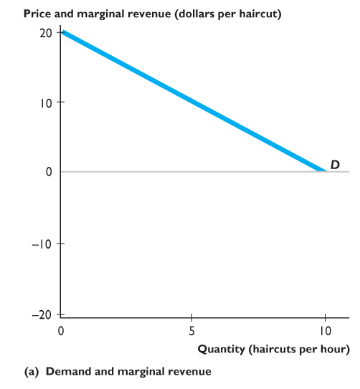
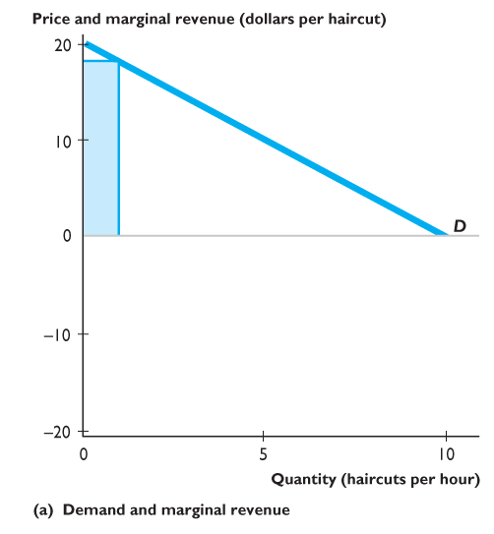
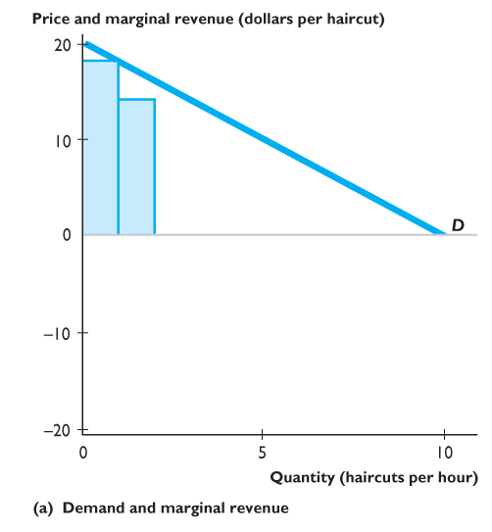
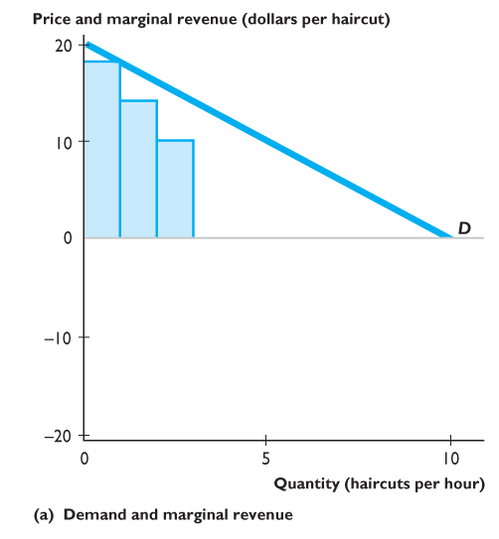
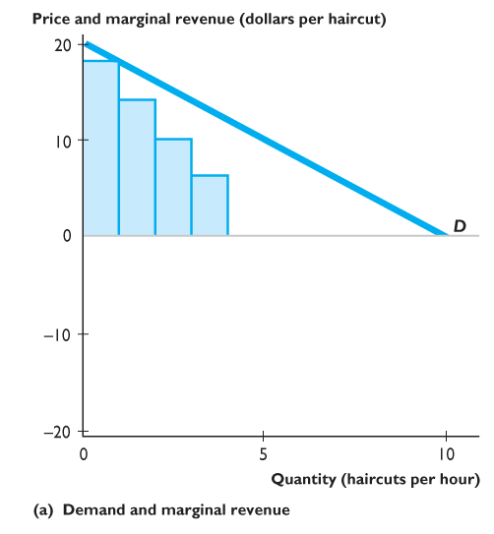
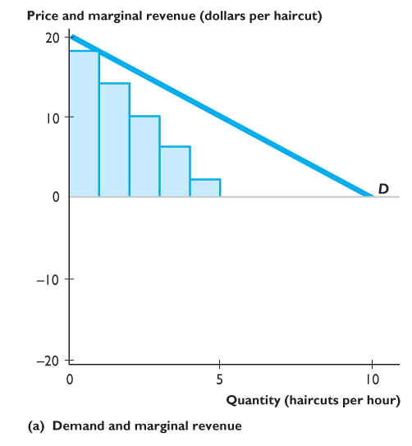
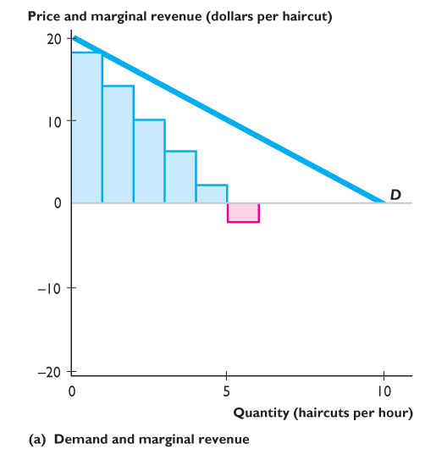
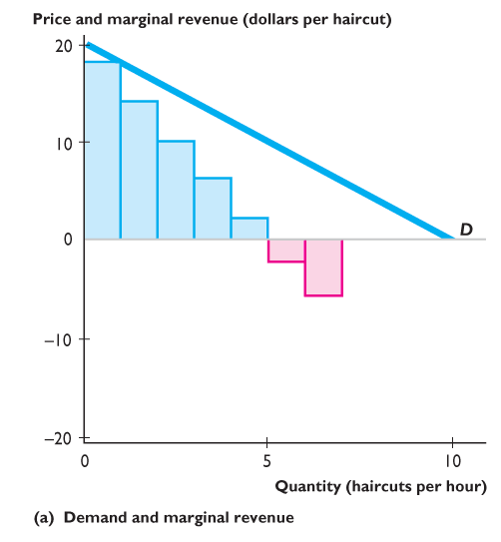
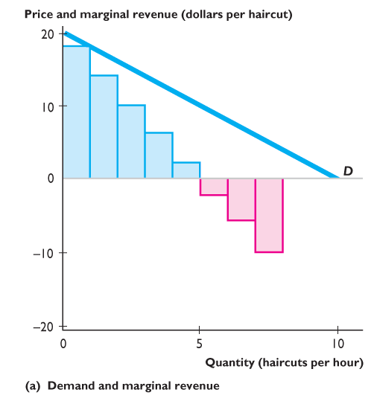
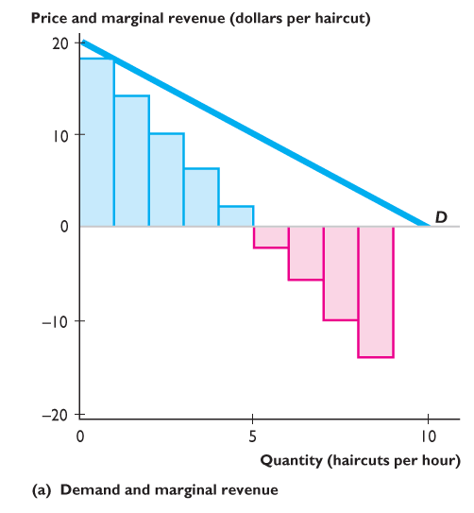
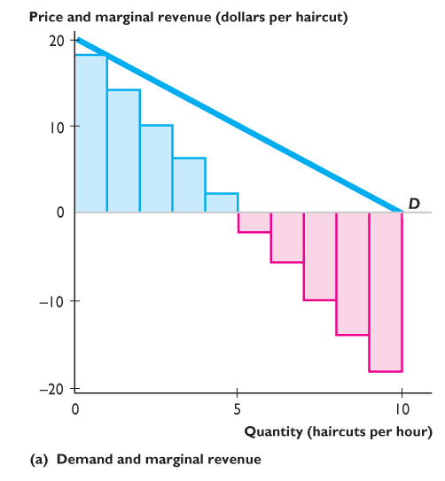
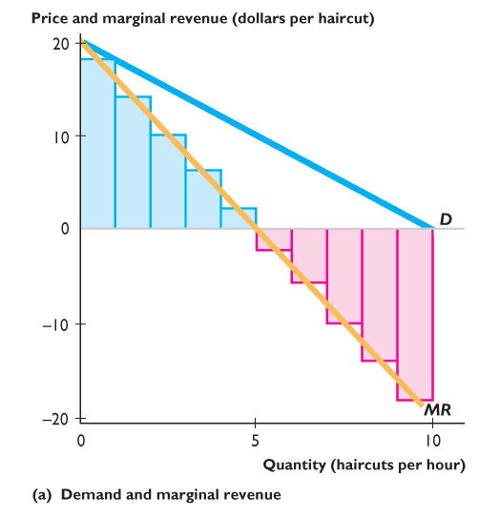
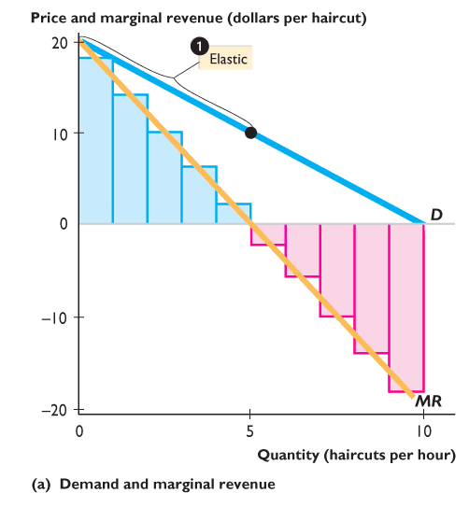
16.2 SINGLE-PRICE MONOPOLY
Figure 16.3(a) illustrates this relationship.
Over the range from zero to 5 haircuts an hour, marginal revenue is positive.
A price fall increases total revenue, so demand is elastic.

Slide 25
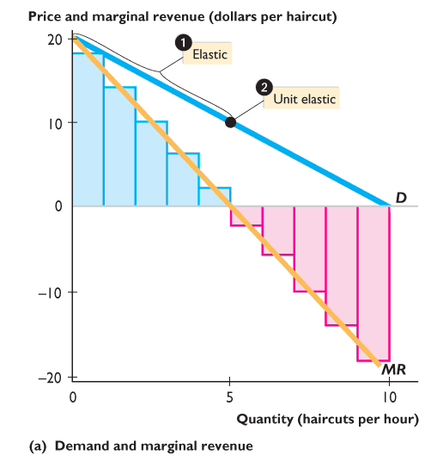
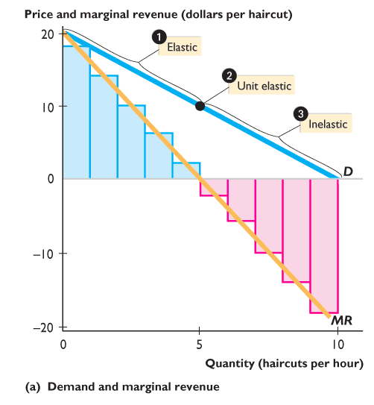
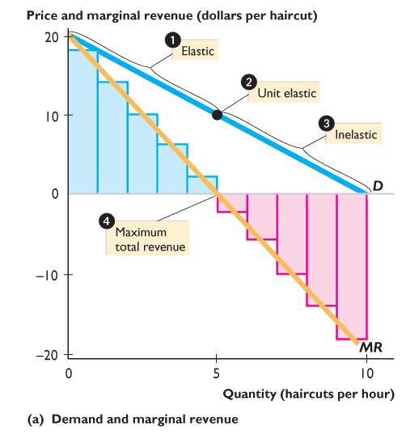
Notes:
<number>

Slide 26
16.2 SINGLE-PRICE MONOPOLY
At 5 haircuts an hour, marginal revenue is zero, so demand is unit elastic.
Over the range 5 to 10 haircuts an hour, marginal revenue is negative. A price fall decreases total revenue, so demand is inelastic.

Slide 27
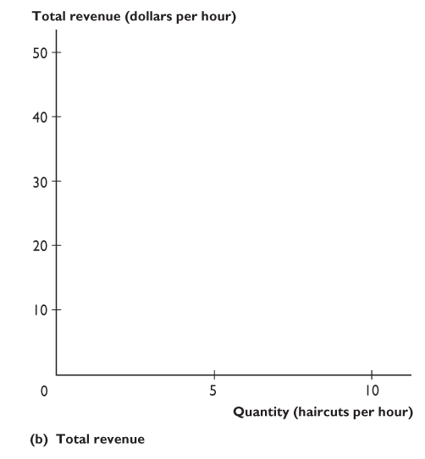
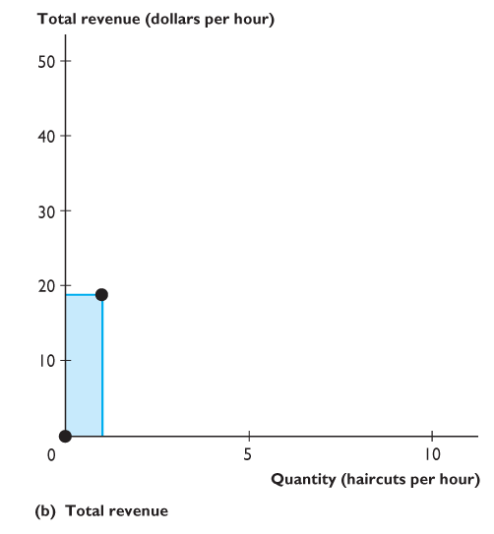
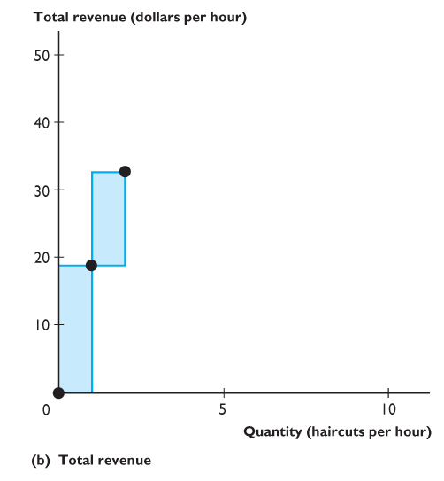
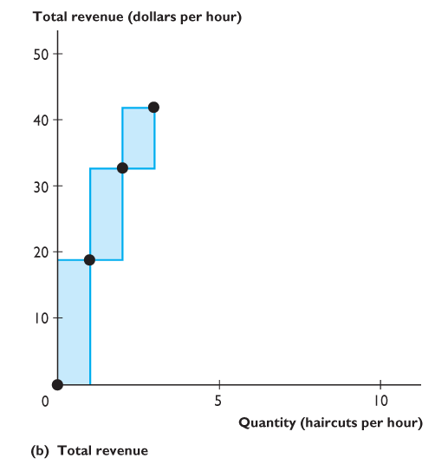
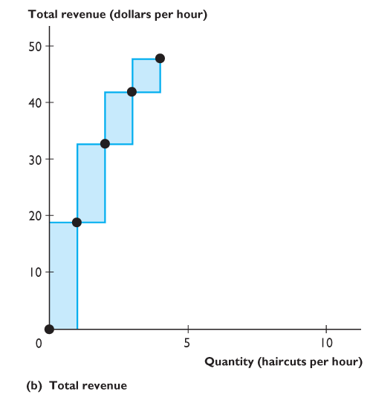
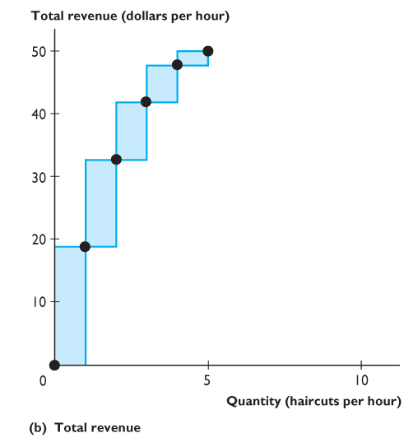
16.2 SINGLE-PRICE MONOPOLY
Figure 16.3(b) shows the same information about marginal revenue as steps running along the total revenue curve.
Over the range from zero to 5 haircuts an hour, marginal revenue is positive and total revenue increases as output increases.

Slide 28
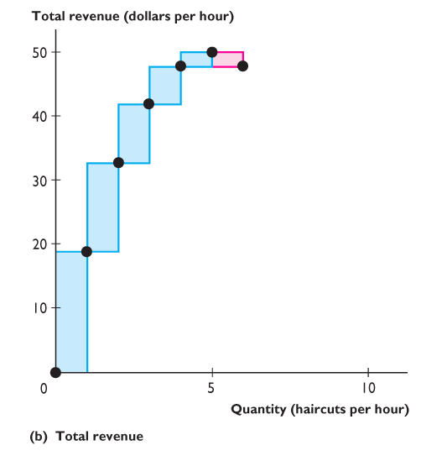
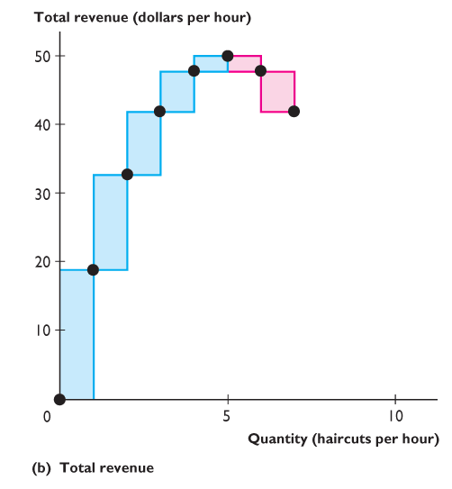
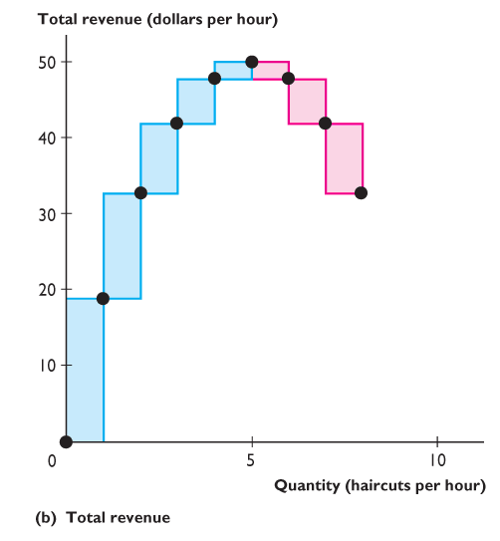
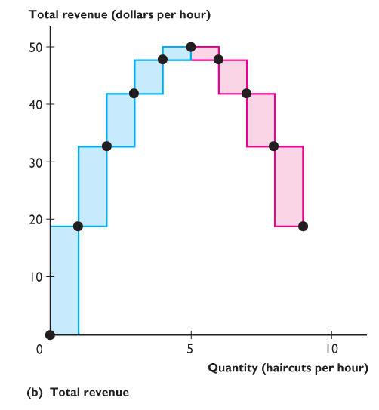
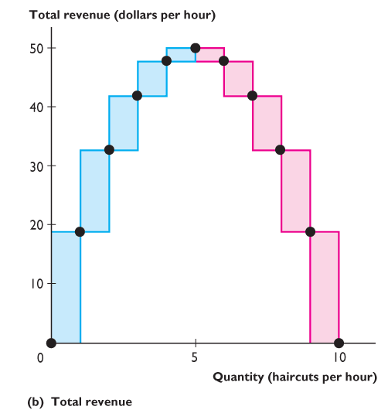
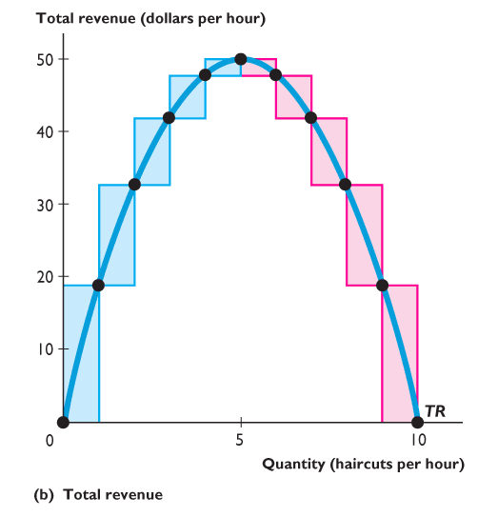
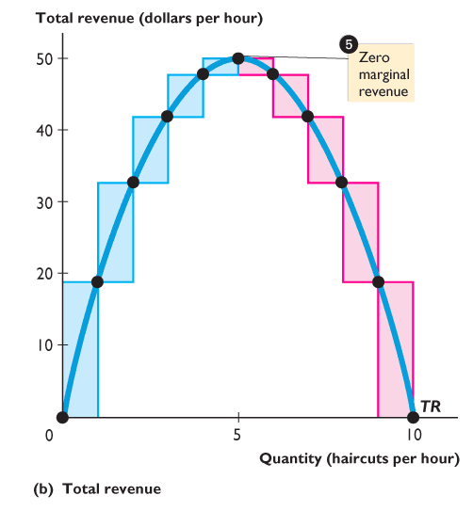
Notes:
<number>

Slide 29
16.2 SINGLE-PRICE MONOPOLY
Over the range from 5 to 10 haircuts an hour, marginal revenue is negative and total revenue decreases as output increases.
The blue line is the total revenue curve.
Total revenue is maximized at 5 haircuts an hour.

Slide 30
16.2 SINGLE-PRICE MONOPOLY
Flipping back to Figure 16.3(a),
Total revenue is maximized at 5 haircuts an hour, where marginal revenue is zero and demand is unit elastic.

Slide 31
16.2 SINGLE-PRICE MONOPOLY
In Figure 16.3(b),
Marginal revenue is zero at maximum total revenue.

Slide 32
16.2 SINGLE-PRICE MONOPOLY
The relationship between marginal revenue and elasticity implies that …
A monopoly never profitably produces an output in the inelastic range of its demand curve.

Slide 33
16.2 SINGLE-PRICE MONOPOLY
Output and Price Decision
To determine the output level and price that maximize a monopoly’s profit, we study the behavior of both revenue and costs as output varies.

Slide 34
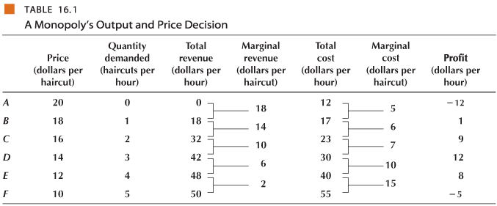
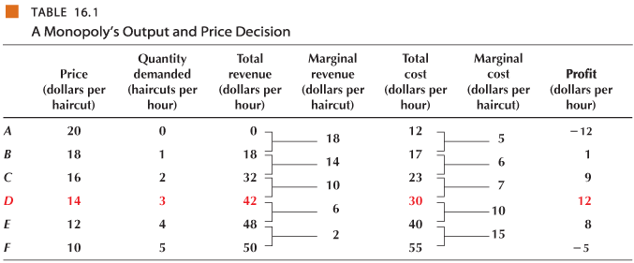
16.2 SINGLE-PRICE MONOPOLY
Table 16.1 summarizes the monopoly’s output and price decision that maximizes profit.

Slide 35
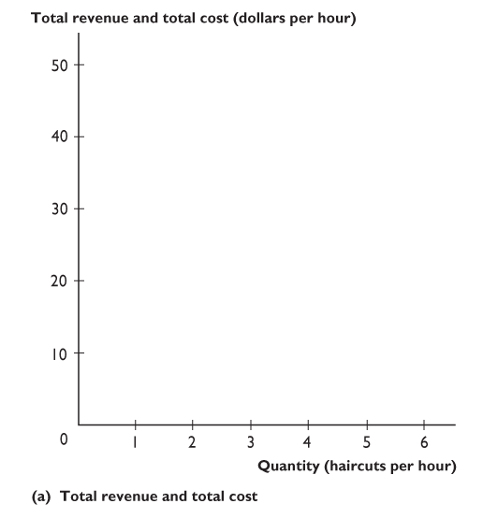
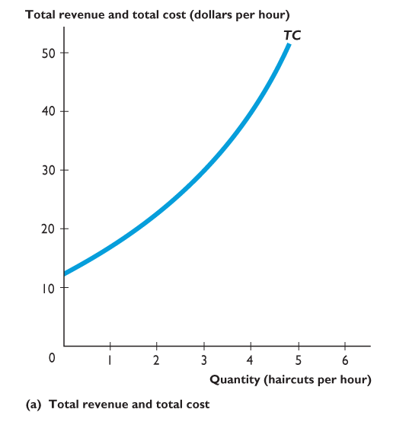
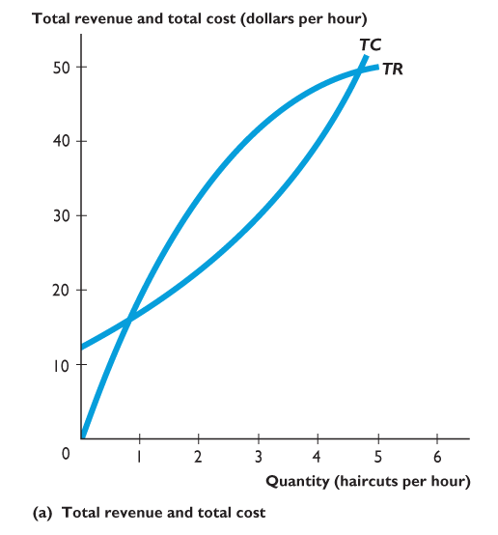
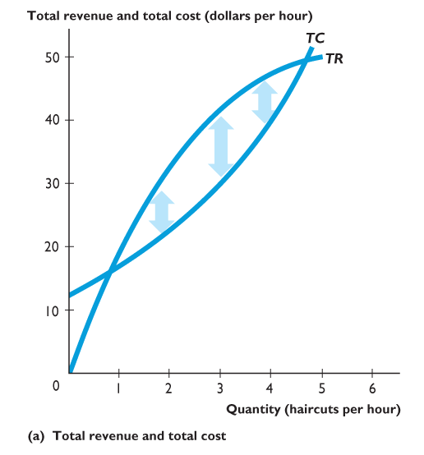
16.2 SINGLE-PRICE MONOPOLY
Figure 16.4 shows a monopoly’s profit-maximizing output and price.
The total cost curve is TC.
The total revenue curve is TR.
Economic profit is the vertical distance between the total revenue curve and the total cost curve.

Slide 36

16.2 SINGLE-PRICE MONOPOLY
Maximum profit is $12 an hour at 3 haircuts an hour.

Slide 38





16.2 SINGLE-PRICE MONOPOLY
Figure 16.4(b) shows the firm’s profit-maximizing output and price decision.
The average total cost curve is ATC.
The marginal cost curve is MC.
The demand curve is D.
The marginal revenue curve is MR.

Slide 39





Slide 40
16.2 SINGLE-PRICE MONOPOLY
Economic profit is maximized when marginal cost (MC) equals marginal revenue (MR).
The profit-maximizing quantity is 3 haircuts an hour.
The profit-maximizing price is determined by the demand curve (D) and is $14.

Slide 41
16.2 SINGLE-PRICE MONOPOLY
Average total cost is determined by the ATC curve and is $10.
Economic profit, the blue rectangle, is $12—the profit per haircut ($4) multiplied by 3 haircuts.
Notes:
Figure 16.4(b), the classic monopoly diagram, provides a good opportunity to tell your students about the contribution of one of the most brilliant economists of the 20th century, Joan Robinson. This diagram first appeared in her book The Economics of Imperfect Competition, published in 1933 when she was just 30 years old. You and your students can learn more about Joan Robinson at http://cepa.newschool.edu/het/profiles/robinson.htm . Women are still not attracted to economics on the scale that they’re attracted to most other disciplines. So the opportunity to talk about an outstanding female economist shouldn’t be lost. Joan Robinson was a formidable debater and reveled in verbal battles, a notable one of which was with Paul Samuelson on one of her visits to MIT. Anxious to make and illustrate a point, Samuelson asked Robinson for the chalk. Monopolizing the chalk and the blackboard, the unyielding Robinson snapped, “Say it in words young man.” Samuelson meekly obeyed. This story illustrates Joan Robinson’s approach to economics: work out the answers to economic problems using the appropriate techniques of math and logic, but then “say it in words.” Don’t be satisfied with formal argument if you don’t understand it. Your students will benefit from this story if you can work it into your class time.
Most famous economists have been men. But here is role model for half of today’s students. Don’t let this point be lost.

Slide 42
16.3 MONOPOLY AND COMPETITION COMPARED
Output and Price
Compared to a firm in perfect competition, a single-price monopoly produces a smaller output and charges a higher price.

Slide 43




16.3 MONOPOLY AND COMPETITION COMPARED
Figure 16.5 illustrates this outcome.
In perfect competition, the market demand curve is D.
The market supply curve is S.
The competitive industry produces the quantity Q_{C} at price P_{C}.

Slide 44




Slide 45
16.3 MONOPOLY AND COMPETITION COMPARED
The market demand curve, D, is the demand for the monopoly’s output.
The competitive market’s supply curve, S, is the monopoly’s marginal cost curve, MC.
The monopoly’s marginal revenue curve is MR.

Slide 46
16.3 MONOPOLY AND COMPETITION COMPARED
A single-price monopoly produces the quantity Q_{M} at which marginal revenue equals marginal cost and sells that quantity for the price P_{M}.

Slide 47
16.3 MONOPOLY AND COMPETITION COMPARED
Is Monopoly Efficient?
Resources are used efficiently when marginal benefit equals marginal cost.

Slide 48




16.3 MONOPOLY AND COMPETITION COMPARED
Figure 16.6 shows the inefficiency of monopoly.
In perfect competition, the quantity, Q_{C}, is the efficient quantity because at that quantity, marginal benefit and marginal cost equal the price P_{C}.
The sum of 2. consumer surplus and 3. producer surplus is maximized.

Slide 50




16.3 MONOPOLY AND COMPETITION COMPARED
In a single-price monopoly, the equilibrium quantity, Q_{M}, is inefficient because the price, P_{M}, which equals marginal benefit, exceeds marginal cost.
Underproduction creates a deadweight loss.
Notes:
Explain to students that the source of the inefficiency of a monopoly’s output and pricing decision arises from the absence of competition in the market, rather than any change in the behavioral assumptions about the firm owners. The intentions of a monopoly are the same as a competitive firm – maximize profit. So, “Mom and Pop,” the owners of a perfectly competitive firm, are maximizing their profit as surely as the owners of a monopoly.

Slide 51




Slide 52
16.3 MONOPOLY AND COMPETITION COMPARED
Consumer surplus shrinks.
Part of the producer surplus is lost but the
Producer surplus expands.

Slide 53
16.3 MONOPOLY AND COMPETITION COMPARED
Is Monopoly Fair?
Monopoly is inefficient because it creates a deadweight loss.
But monopoly also redistributes consumer surplus.
The producer gains, and the consumers lose.

Slide 54
16.3 MONOPOLY AND COMPETITION COMPARED
Rent Seeking
Rent seeking is the act of obtaining special treatment by the government to create economic profit or to divert consumer surplus or producer surplus away from others.
Rent seeking does not always create a monopoly, but it always restricts competition and often creates a monopoly.

Slide 55
16.3 MONOPOLY AND COMPETITION COMPARED
To see why rent seeking occurs, think about the two ways that a person might become the owner of a monopoly:
Buy a monopoly
Create a monopoly by rent seeking

Slide 56
16.3 MONOPOLY AND COMPETITION COMPARED
Buy a Monopoly
Buying a firm (or a right) that is protected by a barrier to entry.
Buying a taxicab medallion in New York.
Create a Monopoly by Rent Seeking
Rent seeking is a political activity.
It takes the form of lobbying and trying to influence the political process to get laws that create legal barriers to entry.

Slide 57
16.3 MONOPOLY AND COMPETITION COMPARED
Rent-Seeking Equilibrium
If an economic profit is available, a rent seeker will try to get some of it.
Competition among rent seekers pushes up the cost of rent seeking until it leaves the monopoly earning only a normal profit after paying the rent-seeking costs.
Figure 16.7 on the next slide illustrates rent-seeking equilibrium.

Slide 58


16.3 MONOPOLY AND COMPETITION COMPARED
A firm’s rent-seeking costs are fixed costs.
They add to total fixed cost and to average total cost.
The ATC curve shifts upward until, at the profit-maximizing price, the firm breaks even.
Rent seeking costs exhaust economic profit.

Slide 59



Slide 60
16.3 MONOPOLY AND COMPETITION COMPARED
Consumer surplus shrinks.
The deadweight loss increases and now includes the original deadweight loss plus the economic profit consumed by rent seeking.

Slide 61
16.4 PRICE DISCRIMINATION
Price discrimination—selling a good or service at a number of different prices—is widespread.
To be able to price discriminate, a firm must
Identify and separate different types of buyers.
Sell a product that cannot be resold.
Notes:
Students find price discrimination very interesting, so take advantage of that by getting them to brainstorm examples and discuss those as a class. Outside of movie tickets (matinee pricing, student/senior/child discounts), air travel (14-day window for business/emergency vs. leisure travelers), and haircuts (age, gender?). Here is one:
The “Pink Tax”: Many consumer products and services (dry cleaning, shaving cream, razors, deodorant, lotion, shampoo, conditioner, etc) have higher prices for women’s versions than for the generally equivalent men’s versions. These price differentials do not reflect differences in production costs, but instead are examples of price discrimination.

Slide 62
16.4 PRICE DISCRIMINATION
Price Discrimination and Consumer Surplus
The key idea behind price discrimination is to convert consumer surplus into economic profit.
To extract every dollar of consumer surplus from every buyer, the monopoly would have to offer each individual customer a separate price schedule based on that customer’s own willingness to pay.

Slide 63
16.4 PRICE DISCRIMINATION
Discriminating Among Groups of Buyers
The firm offers different prices to different types of buyers, based on things like age, employment status, or some other easily distinguished characteristic.
This type of price discrimination works when each group has a different average willingness to pay for the good or service.

Slide 64
16.4 PRICE DISCRIMINATION
Discriminating Among Units of a Good
The firm charges the same prices to all its customers but offers a lower price per unit for a larger number of units bought.
Profiting by Price Discriminating
Global Air has a monopoly on an exotic route.

Slide 65





16.4 PRICE DISCRIMINATION
Figure 16.8 shows a single price of air travel.
As a single-price monopoly, Global maximizes profit by selling 8,000 trips a year at $1,200 a trip.
Global’s customers enjoy a consumer surplus—the green triangle—and
Global’s economic profit is $4.8 million a year—the blue rectangle.

Slide 67



16.4 PRICE DISCRIMINATION
Figure 16.9 shows how Global can profit from price discrimination.
The $1,200 fare is available only with a 14-day advance purchase and a stay 7 days.
The price of other 14-day advance purchase flexible tickets is $1,400.
The price of a 7-day advance purchase ticket is $1,600.

Slide 68



Slide 69
16.4 PRICE DISCRIMINATION
A ticket with no restrictions costs $1,800.
Global sells 2,000 units at each of its four new fares.
Economic profit increases by $2.4 million to $7.2 million a year, shown by the original blue rectangle plus the blue steps.
Consumer surplus shrinks to the sum of the green triangles.

Slide 70
16.4 PRICE DISCRIMINATION
Perfect Price Discrimination
Perfect price discrimination extracts the entire consumer surplus by charging the highest price that consumers are willing to pay for each unit.

Slide 71



16.4 PRICE DISCRIMINATION
Figure 16.10 illustrates perfect price discrimination.
With perfect price discrimination, the demand curve becomes the marginal revenue curve.
Output increases to 11,000 trips a year, and ...
Global’s economic profit increases to $9.35 million a year.

Slide 73
16.4 PRICE DISCRIMINATION
Price Discrimination and Efficiency
With perfect price discrimination, price equals marginal cost, so deadweight loss is zero.
Perfect price discrimination redistributes the consumer surplus to the producer. Consumer surplus is zero.
Rent seeking becomes profitable.
With free entry into rent seeking, the long-run equilibrium outcome is that rent seekers use up the entire producer surplus.

Slide 74
16.5 MONOPOLY REGULATION
Regulation is the set of rules administered by a government agency to influence prices, quantities, entry, and other aspects of economic activity in a firm or industry.
Deregulation is the process of removing regulation on prices, quantities, entry, and other aspects of economic activity in a firm or industry.
Notes:
Get your students to go to Federal Register Web site, located at www.archives.gov/federal_register/the_federal_register/indexes.html. They (and you) will be amazed at the volume and detail of regulatory activity, almost all of which has an economic dimension and impact. There is no free lunch in regulating firms and industries that embody market power. Make the issue of industry regulation intriguing for the students by emphasizing the following countervailing opportunity costs that arise in regulating the firms in those industries that are creating a market failure.

Slide 75
16.5 MONOPOLY REGULATION
Two theories of how regulation actually works are
Social interest theory
Capture theory
Social interest theory is that regulation achieves an efficient allocation of resources.
Capture theory is that regulation serves the self-interest of the producer and results in maximum profit, underproduction, and deadweight loss.

Slide 76
16.5 MONOPOLY REGULATION
Efficient Regulation of a Natural Monopoly
A natural monopoly is an industry in which one firm can supply the entire market at a lower price than can two or more firms.
Regulation achieves an efficient allocation of resources if marginal cost equals marginal benefit (and price).
Marginal cost pricing rule is a rule that sets price equal to marginal cost to achieve an efficient output.
Figure 16.11 on the next slide shows a natural monopoly that is regulated by marginal cost pricing rule.
Notes:
Emphasize the tension between the potential for efficiency in production inherent with a natural monopoly and the inefficiency potential from the firm exercising its inherent market power. Be sure the students understand that economies of scale or scope enable the unregulated natural monopoly to provide products and services at the lowest possible cost, but the lack of competition also enables the firm to increase producer surplus at the expense of consumer surplus and creates a significant deadweight loss to society.

Slide 77





16.5 MONOPOLY REGULATION
Price is set equal to marginal cost of $10 a month.
At this price, the efficient quantity (8 million households) is served.
Consumer surplus is maximized.
The firm incurs a loss on each household served.

Slide 79
16.5 MONOPOLY REGULATION
Second-Best Regulation of a Natural Monopoly
Two possible ways of enabling a regulated monopoly to avoid an economic loss are
Average cost pricing
Government subsidy

Slide 80
16.5 MONOPOLY REGULATION
Average Cost Pricing
Average cost pricing rule is a rule that sets price equal to average total cost.
Figure 16.12 on the next slide illustrates the average cost pricing rule.
Government Subsidy
A government subsidy is a direct payment to the firm, but the government must raise the subsidy by taxing some other activity, which will create a deadweight loss.

Slide 81




16.5 MONOPOLY REGULATION
The efficient quantity is 8 million households.
Price is set equal to average total cost of $15 a month.
At this price, the quantity served (6 million households) is less than the efficient quantity.
Consumer surplus shrinks to the smaller green triangle.
Notes:
To help present the differences between marginal cost pricing and average cost pricing, draw matching graphs side-by-side. Show students the prices that will be allowed by regulators. Ask students which regulation is “better.” Be sure to show your students that marginal cost pricing generates an economic loss even though output is at the competitive level.

Slide 82



Slide 83
16.5 MONOPOLY REGULATION
A producer surplus enables the firm to pay its fixed cost and break even.
A deadweight loss arises.

Slide 84
16.5 MONOPOLY REGULATION
It is not possible to know for sure what the firm’s costs are, so regulators use one of two methods:
Rate of return regulation
Price cap regulation
Under rate of return regulation, a regulated firm must set its price at a level that enables it to earn a specified target percent return on its capital.
If the regulator could observe the firm’s true costs and be sure that the firm was minimizing cost, this type of regulation would be like average cost pricing.

Slide 85
16.5 MONOPOLY REGULATION
Price Cap Regulation
A price cap regulation is a price ceiling—a rule that specifies the highest price the firm is permitted to charge.
A price cap regulation can be combined with earnings sharing regulation—a regulation that requires a firm to make refunds to customers if its profit rises above a target rate.
Figure 16.13 shows how price cap regulation works.

Slide 86







16.5 MONOPOLY REGULATION
With no regulation, the firm maximizes profit by producing the quantity at which MC = MR.
A price cap set at $15.
The price cap outcome is at the intersection of the demand curve and the price cap.
The price falls and output increases.

Slide 88







Microsoft’s prices are high in the sense that they exceed marginal cost and result in fewer copies than the efficient quantities.
Profit Maximization
Microsoft maximizes profit by producing 4 million copies a month.
The price is $300 per copy.
The blue rectangle shows Microsoft’s producer surplus.

Slide 89


The green triangle shows the consumer surplus.
Inefficiency
The efficient quantity is 8 million copies a month where marginal benefit equals marginal cost.
The actual quantity is less than the efficient quantity, and a deadweight loss (gray triangle) arises.

Slide 90
Fixed Cost
The marginal cost of a copy of Windows might be close to zero, but the fixed cost of developing the software is large.
Microsoft must earn at least enough revenue to pay these fixed costs.
Earning enough to pay the firm’s fixed costs does not inevitably lead to inefficiency.
Some firms with zero marginal cost and the market power to charge a high price choose to provide the efficient quantity of their services at a zero price.
Google is one such firm.

Slide 91
The Google Solution
The price of an Internet search on Google is zero.
The quantity of searches is that at which the marginal benefit of a search equals the zero marginal cost.
So the quantity of searches is the efficient quantity.
Google earns revenue, and a very large revenue, by selling advertising that more than pays its fixed operating costs.
Google’s solution is not entirely efficient.
It gets the efficient quantity of the zero marginal cost activity.
Does it get the efficient quantity of advertising?

