Slide 1

18
Oligopoly
CHAPTER CHECKLIST
When you have completed your study of this chapter, you will be able to
1 Describe and identify oligopoly and explain how it arises.
2 Explain the dilemma faced by firms in oligopoly.
3 Use game theory to explain how price and quantity are determined in oligopoly.
4 Describe the antitrust laws that regulate oligopoly.
Notes:
Notes and teaching tips: 29, 36, 37, 41, 51, 58, and 66.
To view a full-screen figure during a class, click the red “expand” button.
To return to the previous slide, click the red “shrink” button.
To advance to the next slide, click anywhere on the full screen figure.
To enhance your lecture, check out the Lecture Launchers, Land Mines, and Class Activities in the Instructor’s Manual.

Slide 2
18.1 WHAT IS OLIGOPOLY?
Another market type that stands between perfect competition and monopoly.
Oligopoly is a market type in which:
A small number of firms compete.
Natural or legal barriers prevent the entry of new firms.

Slide 3
18.1 WHAT IS OLIGOPOLY?
Small Number of Firms
In contrast to monopolistic competition and perfect competition, an oligopoly consists of a small number of firms.
Each firm has a large market share
The firms are interdependent
The firms have an incentive to collude

Slide 4
18.1 WHAT IS OLIGOPOLY?
Interdependence
When a small number of firms compete in a market, they are interdependent in the sense that the profit earned by each firm depends on the firm’s own actions and on the actions of the other firms.
Before making a decision, each firm must consider how the other firms will react to its decision and influence its profit.

Slide 5
18.1 WHAT IS OLIGOPOLY?
Temptation to Collude
When a small number of firms share a market, they can increase their profit by forming a cartel and acting like a monopoly.
A cartel is a group of firms acting together to limit output, raise price, and increase economic profit.
Cartels are illegal but they do operate in some markets.
Despite the temptation to collude, cartels tend to collapse. (We explain why in the final section.)

Slide 6
18.1 WHAT IS OLIGOPOLY?
Barriers to Entry
Either natural or legal barriers to entry can create an oligopoly.
Natural barriers arise from the combination of the demand for a product and economies of scale in producing it.
If the demand for a product limits the market to a small number the firms that can earn an economic profit, there is a natural oligopoly.

Slide 7
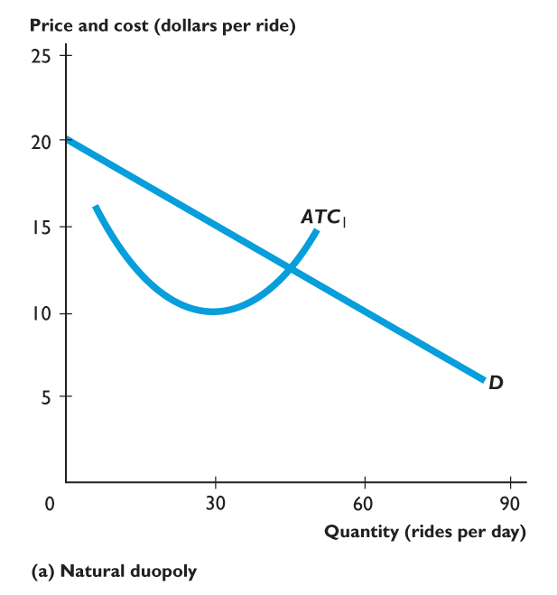
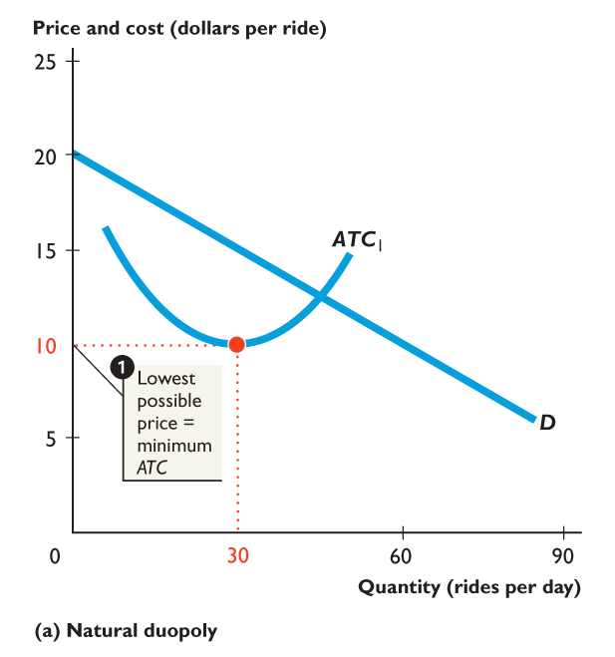
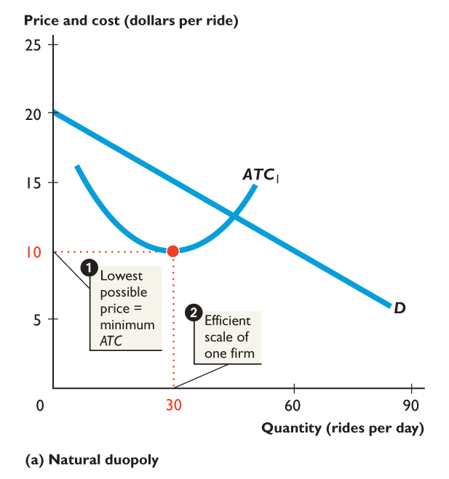
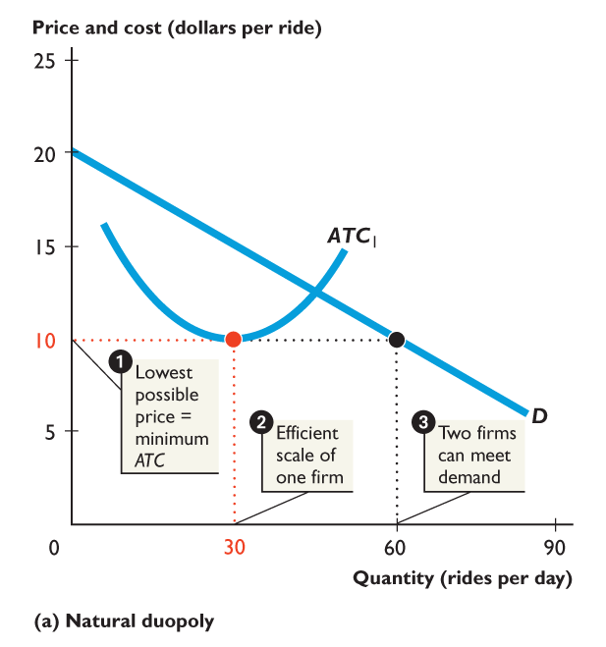
18.1 WHAT IS OLIGOPOLY?
Figure 18.1(a) shows the case of a natural duopoly.
A duopoly is a market with two firms.
The lowest possible price equals minimum ATC.
The efficient scale is 30 rides a day.
The quantity demanded (60 rides a day) can be met by two firms—natural duopoly.

Slide 8
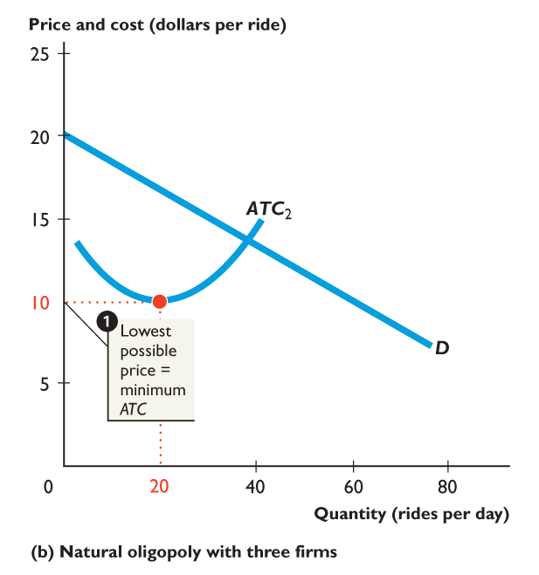
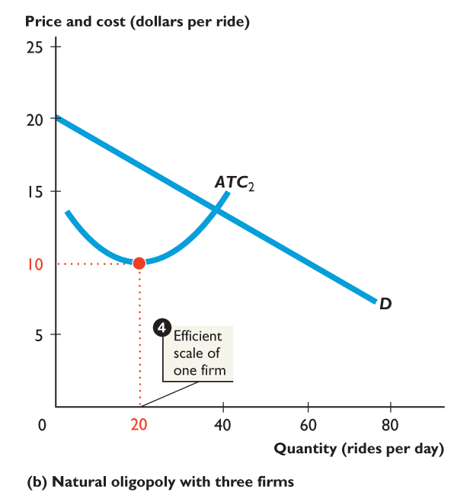
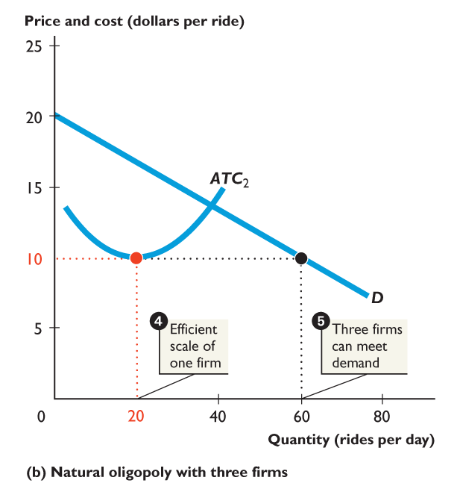

Slide 9
18.1 WHAT IS OLIGOPOLY?
Figure 18.1(b) shows the case of a natural oligopoly with three firms.
When the efficient scale is 20 rides a day, …
Three firms can satisfy the market demand at the lowest possible price.

Slide 10
18.1 WHAT IS OLIGOPOLY?
Identifying Oligopoly
Identifying oligopoly is the flip side of identifying monopolistic competition.
The borderline between oligopoly and monopolistic competition is hard to pin down.
As a practical matter, we try to identify oligopoly by looking at concentration measures.
A market in which HHI exceeds 1,800 is generally regarded as an oligopoly.

Slide 11
18.2 THE OLIGOPOLISTS' DILEMMA
Oligopoly might operate like monopoly, like perfect competition, or somewhere between these two extremes.
Monopoly Outcome
The firm would operate as a single-price monopoly.
Figure 18.2 on the next slide shows the monopoly outcome.

Slide 12
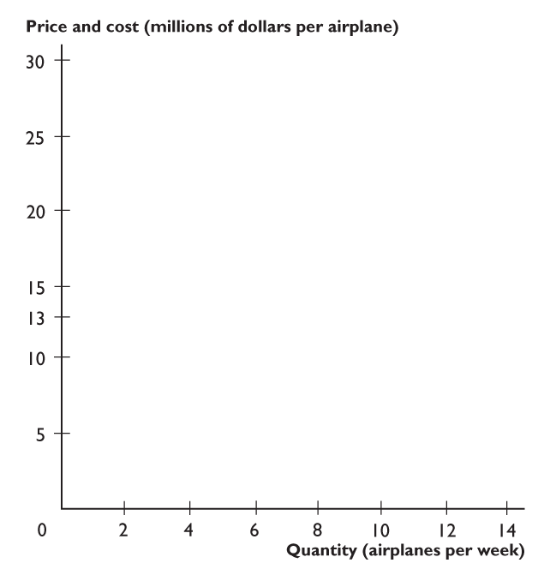
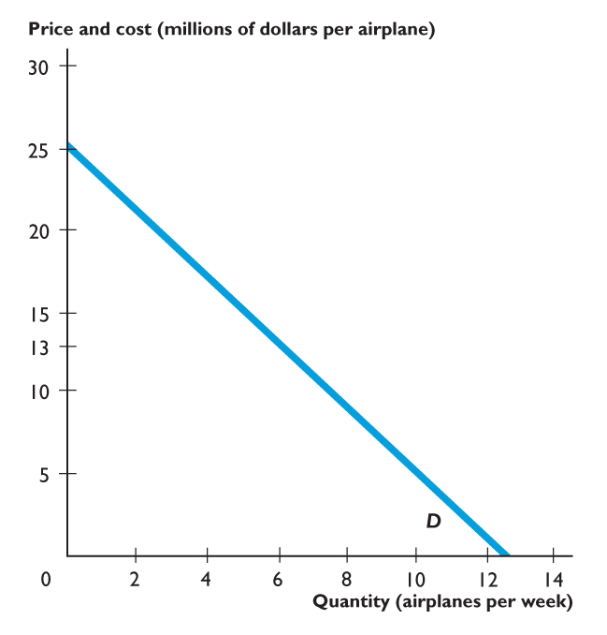
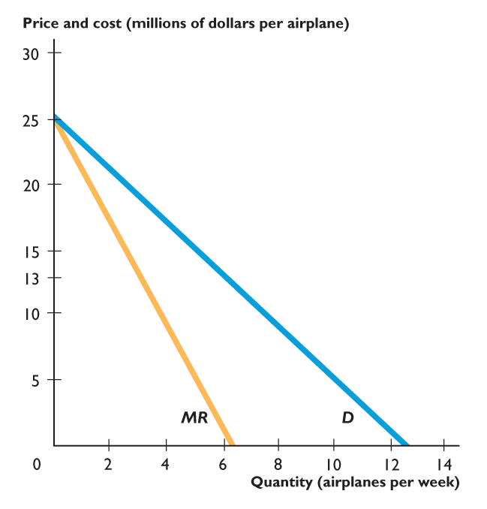
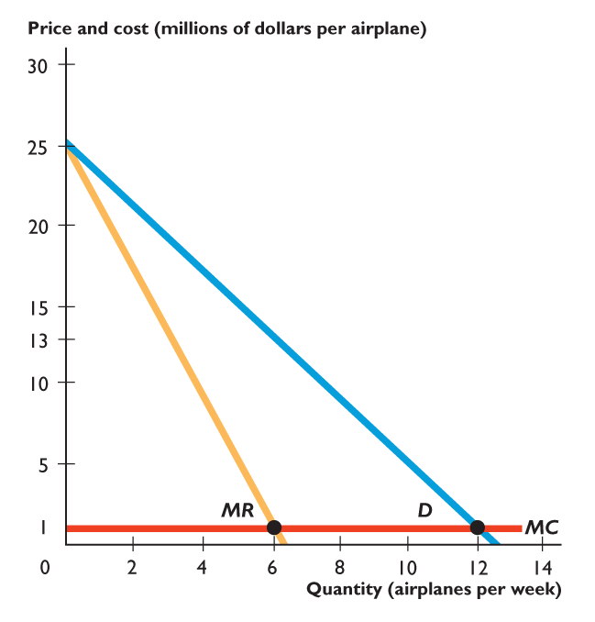
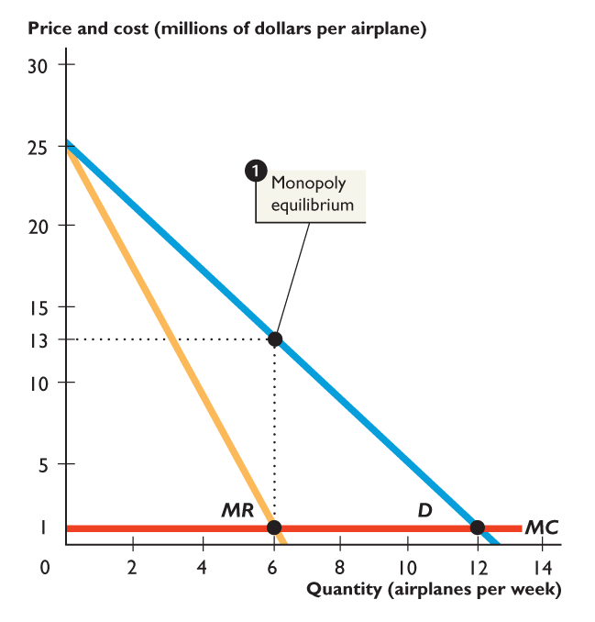
18.2 THE OLIGOPOLISTS' DILEMMA
With the market demand, D, marginal revenue curve, MR, and marginal cost, MC,
a monopoly airplane maker maximizes profit by producing 6 airplanes a week and selling them for $13 million an airplane.

Slide 13
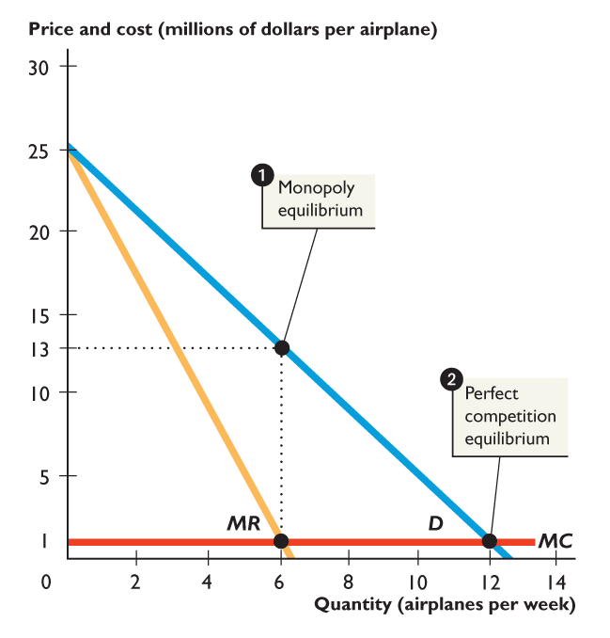
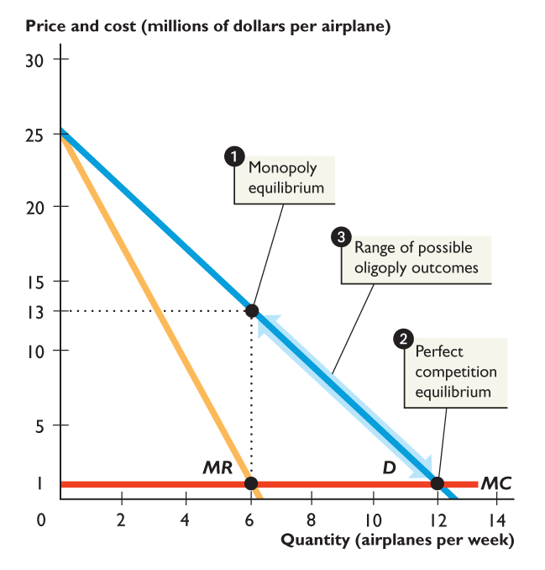

Slide 14
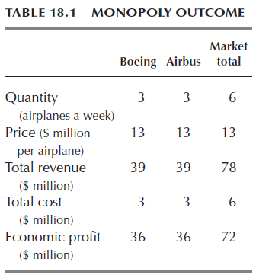
18.2 THE OLIGOPOLISTS' DILEMMA
Cartel to Achieve Monopoly Outcome
To achieve the monopoly profit Airbus and Boeing might attempt to form a cartel.
If the firms can agree to produce the monopoly output of 6 airplanes a week, joint profits will be $72 million.

Slide 16
18.2 THE OLIGOPOLISTS' DILEMMA
Would it be in the self-interest of Airbus and Boeing to stick to the agreement and limit production to 3 planes a week each?
With price exceeding marginal cost, one firm can increase its profit by increasing its output.
If both firms increased output when price exceeds marginal cost, the end of the process would be the same as perfect competition.

Slide 17
18.2 THE OLIGOPOLISTS' DILEMMA
Perfect Competition Outcome
Equilibrium occurs where the marginal revenue curve intersects the demand curve.
The quantity produced is 12 planes a week and the price would be $1 million a plane.

Slide 18
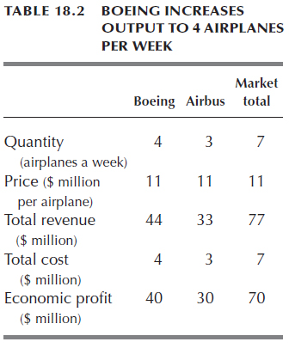
18.2 THE OLIGOPOLISTS' DILEMMA
Other Possible Cartel Breakdowns
Boeing Increases Output to 4 Airplanes a Week
Boeing can increase its economic profit by $4 million and cause the economic profit of Airbus to fall by $6 million to $30 million.

Slide 20
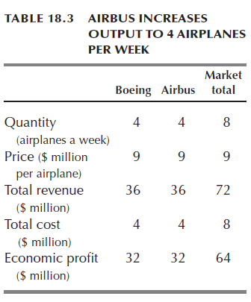
18.2 THE OLIGOPOLISTS' DILEMMA
Airbus Increases Output to 4 Airplanes a Week
For Airbus, this outcome is an improvement on the previous one by $2 million a week (up from $30 million).
For Boeing, the outcome is worse than the previous one by $8 million a week (down from $40 million).

Slide 22
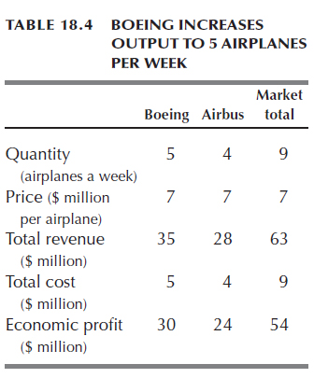
18.2 THE OLIGOPOLISTS' DILEMMA
Boeing Increases Output to 5 Airplanes a Week
If Boeing increases output to 5 airplanes a week, its economic profit falls.
Similarly, if Airbus increases output to 5 airplanes a week, its economic profit falls.

Slide 24
18.2 THE OLIGOPOLISTS' DILEMMA
A cartel might achieve the monopoly equilibrium, break down and result in the perfect competition equilibrium,
or operate somewhere between these two extreme outcomes.

Slide 25
18.2 THE OLIGOPOLISTS' DILEMMA
The Oligopoly Cartel Dilemma
If both firms stick to the monopoly output, they each produce 3 airplanes and make $36 million.
If they both increase production to 4 airplanes a week, they make $32 million each.
If only one firm increases production to 4 airplanes a week, that firm makes $40 million.
What do they do?
Game theory provides an answer.

Slide 26
18.3 GAME THEORY
Game theory is the tool used to analyze strategic behavior—behavior that recognizes mutual interdependence and takes account of the expected behavior of others.

Slide 27
18.3 GAME THEORY
What Is a Game?
All games involve three features:
Rules
Strategies
Payoffs
Prisoners’ dilemma is a game between two prisoners that shows why it is hard to cooperate, even when it would be beneficial to both players to do so.
Notes:
The prisoners’ dilemma is a great way to start your lecture on game theory. Tell students they get to play a game and get two students to volunteer to be the “criminals.” Give the entire class the story and rules. Don’t use a payoff matrix at this point, just write the options on the board. Then send one of your volunteers out of the room. Ask the remaining student what strategy he or she will take. Get your class to help. It usually takes a few minutes for everyone to agree that confessing is the best strategy. Send the first student from the room and then call in the second student. Ask this student what he or she will do. Because the class already knows what the first student has done, encourage them not to tell. Aid the students as they move toward choosing the equilibrium. Encourage students to remember this gaming strategy because it is the same material that you’ll use to describe a firm’s behavior.
You can actually play the prisoner’s dilemma game online. A good Web version of the game can be found on a site operated by a group called Serendip at Bryn Mawr College in Pennsylvania. The URL for the web site is http://serendip.brynmawr.edu/playground/pd.html. If you can use the Web in your classroom, open two browsers and go to this site twice. Get two teams trying to beat Serendip.

Slide 28
18.3 GAME THEORY
The Prisoners’ Dilemma
Art and Bob have been caught stealing a car: sentence is 2 years in jail.
DA wants to convict them of a big bank robbery: sentence is 10 years in jail.
DA has no evidence and to get the conviction, he makes the prisoners play a game.

Slide 29
18.3 GAME THEORY
Rules
Players cannot communicate with one another.
If both confess to the larger crime, each will receive a sentence of 3 years for both crimes.
If one confesses and the accomplice does not, the one who confesses will receive a 1-year sentence, while the accomplice receives a 10-year sentence.
If neither confesses, both receive a 2-year sentence.

Slide 30
18.3 GAME THEORY
Strategies
The strategies of a game are all the possible actions of each player.
The strategies in the prisoners’ dilemma are
Confess to the bank robbery.
Deny the bank robbery.

Slide 31
18.3 GAME THEORY
Payoffs
Four outcomes:
Both confess.
Both deny.
Art confesses and Bob denies.
Bob confesses and Art denies.
A payoff matrix is a table that shows the payoffs for every possible action by each player given every possible action by the other player.

Slide 32
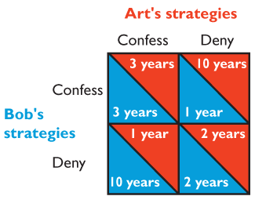
18.3 GAME THEORY
Table 18.5 shows the prisoners’ dilemma payoff matrix for Art and Bob.

Slide 34
18.3 GAME THEORY
Equilibrium
Occurs when each player takes the best possible action given the action of the other player.
Nash equilibrium is an equilibrium in which each player takes the best possible action given the action of the other player.
The Nash equilibrium for Art and Bob is to confess.
The equilibrium of the prisoners’ dilemma is not the best outcome for the players.
Notes:
John Nash’s life makes for an interesting anecdote you can tell in class. Some of your students might have seen the movie A Beautiful Mind, which was the somewhat embellished story of Nash’s life. To recapitulate the story, Nash was an incredibly bright graduate student and assistant professor in the early 1950s. During this time he developed the concept of the Nash equilibrium. Tragically, he was taken severely ill with schizophrenia. Princeton, where he was employed, made a supremely human decision and kept him on the faculty even though he was totally disabled. He spent the next three decades riding buses around Princeton and wandering the buildings at night. Nash’s condition has improved in recent years. The Nobel Prize committee heard of his improving condition and called several of his friends to inquire if he would be able to accept the prize. He was and so the Nobel Prize was awarded to him in 1994.

Slide 35
18.3 GAME THEORY
The Duopolists’ Dilemma
The dilemma of Boeing and Airbus is similar to that of Art and Bob.
Each firm has two strategies. It can produce airplanes at the rate of:
3 a week
4 a week
Notes:
The duopolist’s dilemma game has been carefully designed to get the maximum payoff from the knowledge your students have of the perfect competition and monopoly results of the two preceding chapters and to introduce them to game theory in a setting that is as close to the previously studied settings as possible. Instead of asserting a payoff matrix, the numbers in the matrix come directly from monopoly profit-maximizing and competitive outcomes calculated on the earlier pages. You need to do a bit of work to generate the payoff numbers, but the whole story hangs together so much better when the student can see where the numbers come from and can see the connection between the oligopoly set up and those of competition and monopoly. Start with Figure 18.2 and after you’ve explained the cost and demand conditions shown in the figure, ask the students what they think the price and quantity will be in this industry. There will be differences of opinion. This diversity of opinion motivates the need for a model of the choices the firms make.

Slide 36
18.3 GAME THEORY
Because each firm has two strategies, there are four possible combinations of actions:
Both firms produce 3 a week (monopoly outcome).
Both firms produce 4 a week.
Airbus produces 3 a week and Boeing produces 4 a week.
Boeing produces 3 a week and Airbus produces 4 a week.

Slide 37
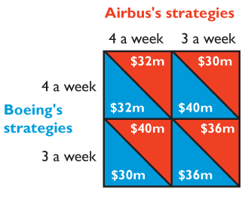
18.3 GAME THEORY
The Payoff Matrix
Table 18.6 shows the payoff matrix as the economic profits for each firm in each possible outcome.

Slide 38


Slide 39
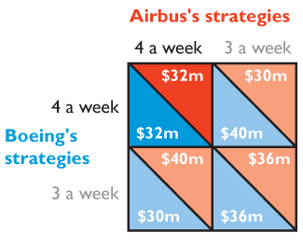
18.3 GAME THEORY
Equilibrium of the Duopolists’ Dilemma
Both firms produce 4 a week.
Like the prisoners, the duopolists fail to cooperate and get a worse outcome than the one that cooperation would deliver.
Notes:
Determining the Nash equilibrium of a game is often difficult for students. Try to make the game more “practical” by pointing out to the students that in the real world, real firms are almost always doing ”what if” analyses and that game theory is well designed for answering these sorts of “what if” questions. In the Airbus/Boeing game in the text, the two companies are trying to determine how many airplanes they should produce if their competitor produces 3 airplanes or if their competitor produces 4 airplanes. You can illustrate the equilibrium by starting with Airbus and stating that Airbus wants to determine what it should do if Boeing produces 4 airplanes. Then, after determining that Airbus will produce 4 airplanes, do the next “what if” by looking what Airbus should do if Boeing produces 3 airplanes. In this case, Airbus again wants to produce 4 airplanes. Therefore Airbus’s “what if” analysis has led to the conclusion that regardless of Boeing’s decision, Airbus wants to produce 4 airplanes. You can conduct the same “what if” for Boeing’s choices and determine that Boeing, too, will produce 4 airplanes regardless of Airbus’s choice.

Slide 41
18.3 GAME THEORY
Collusion Is Profitable but Difficult to Achieve
The duopolists’ dilemma explains why it is difficult for firms to collude and achieve the maximum monopoly profit.
Even if collusion were legal, it would be individually rational for each firm to cheat on a collusive agreement and increase output.
In an international oil cartel, OPEC, countries frequently break the cartel agreement and overproduce.

Slide 42
18.3 GAME THEORY
Advertising and Research Games in Oligopoly
Advertising campaigns by Coke and Pepsi, and research and development (R&D) competition between Procter & Gamble and Kimberly-Clark are like the prisoners’ dilemma game.

Slide 43
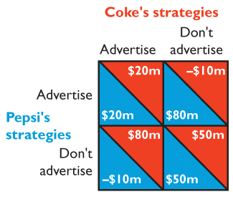
18.3 GAME THEORY
Advertising Game
Coke and Pepsi have two strategies: advertise or not advertise.
Table 18.8 shows the payoff matrix as the economic profits for each firm in each possible outcome.

Slide 45
18.3 GAME THEORY
The Nash equilibrium for this game is for both firms to advertise.
But they could earn a larger joint profit if they could collude and not advertise.

Slide 46
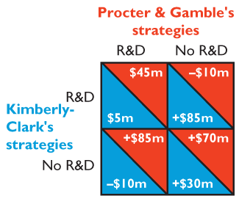
18.3 GAME THEORY
Research and Development Game
P&G and Kimberly-Clark have two strategies: spend on R&D or do no R&D.
Table 18.9 shows the payoff matrix as the economic profits for each firm in each possible outcome.

Slide 47
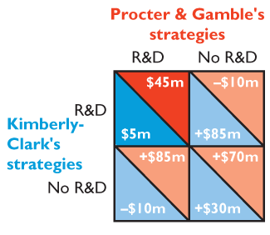

Slide 48
18.3 GAME THEORY
Research and Development Game
The Nash equilibrium for this game is for both firms to undertake R&D.
But they could earn a larger joint profit if they could collude and not do R&D.

Slide 49
18.3 GAME THEORY
Repeated Games
Most real-world games get played repeatedly.
Repeated games have a larger number of strategies because a player can be punished for not cooperating.
This suggests that real-world duopolists might find a way of learning to cooperate so they can enjoy monopoly profit.
The next slide shows the payoffs with a “tit-for-tat” response.
Notes:
The OPEC oil cartel is an excellent example of how useful game theory can be to explain real world events. Use the prisoner’s dilemma game to illustrate the incentive each nation faces: whether to cheat on their agreement or comply with it. A tit-for-tat strategy makes all the nations (as a group) better off but the demand for oil fluctuates and it is difficult for each nation to determine whether the other nations are cheating on the agreement. This combination makes a cartel agreement difficult to monitor, which is why we see the price of oil fluctuate so much, even during peaceful times. Saudi Arabia is widely believed to be the market leader for the cartel. Its oil output decisions have waxed and waned significantly over time, so oil prices fall when its government needs the extra oil revenues (cheating) or rises when the political environment requires greater economic unity among the member nations (cooperating).

Slide 50
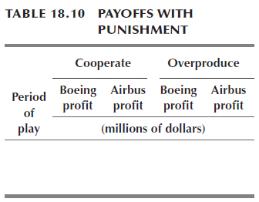
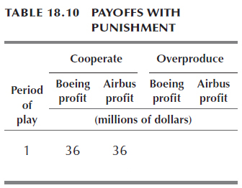
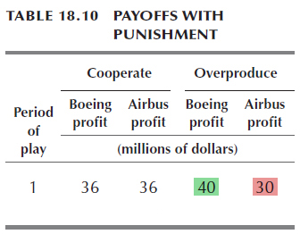
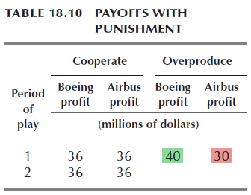
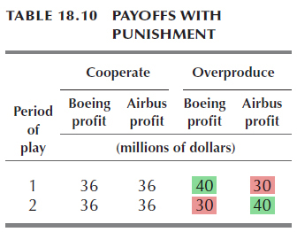
18.3 GAME THEORY
Week 1: Suppose Boeing contemplates producing 4 planes instead of the agreed 3 planes.
Boeing’s profit will increase from $36 million to $40 million, and Airbus’s profit will decrease from $36 million to $30 million.

Slide 52
18.3 GAME THEORY
Week 2: Airbus punishes Boeing and produces 4 planes.
But Boeing must go back to producing 3 planes to induce Airbus to cooperate in week 3.
In week 2, Boeing’s profit falls to $30 million and Airbus’s profit increases to $40 million.

Slide 53
18.3 GAME THEORY
Over the two-week period,
Boeing’s profit would have been $72 million if it had cooperated, but it was only $70 million with Airbus’s tit-for-tat response.

Slide 54
18.3 GAME THEORY
In reality, whether a duopoly works like a one-play game or a repeated game depends on the number of players and the ease of detecting and punishing overproduction.
The larger the number of players, the harder it is to maintain the monopoly outcome.

Slide 55
18.3 GAME THEORY
Is Oligopoly Efficient?
In oligopoly, price usually exceeds marginal cost.
So the quantity produced is less than the efficient quantity.
Oligopoly suffers from the same source and type of inefficiency as monopoly.
Because oligopoly is inefficient, antitrust laws and regulations are used to try to reduce market power and move the outcome closer to that of competition and efficiency.

Slide 56
18.4 ANTITRUST LAWS
Antitrust law is the body of law that regulates and prohibits certain kinds of market behavior, such as monopoly and monopolistic practices.
The Antitrust Laws
The first antitrust law, the Sherman Act, passed in 1890.
The Clayton Act of 1914 supplemented the Sherman Act.
Notes:
A large percentage of students read the Clayton Act as always prohibiting the activities listed, such as price discrimination or exclusive deals. Ask your students why airlines and movie theaters can price discriminate even though it is outlawed by the Clayton Act. Ask them why Coke and McDonald’s are allowed to have an exclusive deal so that only Coke products can be purchased at McDonald’s while Pepsi and KFC have similar exclusive deal. The objective is to force the students to understand that the business practices mentioned in the Clayton Act are illegal only if they substantially lessen competition or create monopoly. You can state this qualifying phrase as often as you like but real-life, specific examples are necessary to hammer the point home!

Slide 57
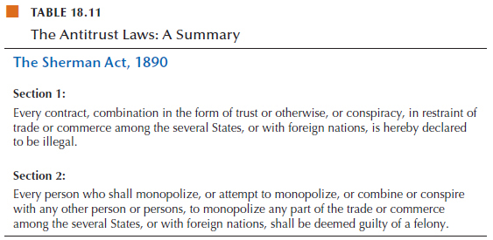
18.4 ANTITRUST LAWS

Slide 58
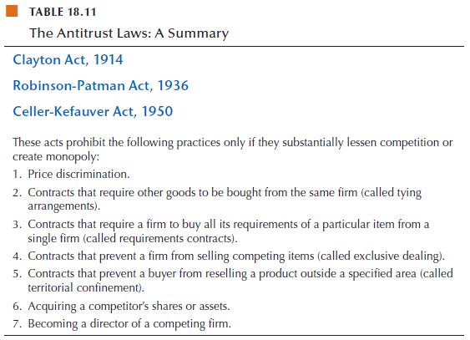
18.4 ANTITRUST LAWS

Slide 59
18.4 ANTITRUST LAWS
Three Antitrust Policy Debates
Price fixing is always a violation of the antitrust law.
Some other practices are more controversial and generate debate.
Three of these practices are
Resale price maintenance
Predatory pricing
Tying arrangements

Slide 60
18.4 ANTITRUST LAWS
Resale Price Maintenance
Resale price maintenance is an agreement between a manufacturer and a distributor on the price at which a product will be resold.
Resale price maintenance agreements (called vertical price fixing) are illegal under the Sherman Act.
But it is not illegal for a firm to refuse to supply a retailer who won’t accept the manufacturer’s guidance on what the price should be.

Slide 61
18.4 ANTITRUST LAWS
Resale price maintenance is inefficient if it enables a manufacturer and dealers to operate a cartel and charge the monopoly price.
Resale price maintenance can be efficient if it permits retailers to provide an efficient level of service in selling a product.

Slide 62
18.4 ANTITRUST LAWS
Predatory Pricing
Predatory pricing is setting a low price to drive competitors out of business with the intention of setting a monopoly price when the competition has gone.
If a firm engaged in this practice, it would incur a loss while its price were low.
The firm would gain only if the high monopoly price didn’t induce entry.
Most economists say that predatory pricing is unprofitable and doesn’t occur.

Slide 63
18.4 ANTITRUST LAWS
Tying Arrangements
A tying arrangement is an agreement to sell one product only if the buyer agrees to also buy another different product.
Example: textbook plus Web site bundle
It is sometimes possible to use tying as a way of price discriminating.

Slide 64
18.4 ANTITRUST LAWS
Recent Antitrust Showcase: The United States Versus Microsoft
The Case Against Microsoft
The Department of Justice claimed that Microsoft:
Possesses monopoly power in the market for PC operating systems.
Uses predatory pricing and tying agreements to achieve monopoly in the market for Web browsers.
Uses other anticompetitive practices to strengthen its monopoly in these two markets.
Notes:
Some students are familiar with the government’s case against Microsoft or, if not with the details, with the fact that the government had filed suit. When you discuss this case, be sure to point out that many expert witnesses were called at Microsoft’s trial. And, of course, each side brought its own economists…some of whom were paid over $1,000 an hour! More seriously, you can emphasize the tension between combining formerly separate goods into a product as a monopolizing action (tying agreements) and combining goods as a form of technological advancement to enhance consumer surplus (product innovation). The Microsoft defense to antitrust charges alluded to the inevitable combining of web browsers into computer operating system software. Microsoft could be truly enhancing its product but it also could be using its market power in one market to capture market power in another, more competitive market. If students are not sympathetic to Microsoft’s argument, ask them if when they buy a car, they also expect to get tires installed by the manufacturer.
Challenge them about this point—aren’t there independent tire companies? Why is the tire tied to purchase of the automobile? If students object that “you need a tire for the car to run,” quickly ask them if a radio should be tied to the purchase of the car? Why shouldn’t the purchase of a radio be an independent decision? You don’t need to take sides with this discussion. Just point out to your students that arguments aren’t always as clear cut as they might seem initially.

Slide 65
18.4 ANTITRUST LAWS
Microsoft’s Response
Microsoft challenged all claims.
It said that Windows competes with Macintosh.
Windows dominates because it is the best product.
Internet Explorer with Windows 98 provides a product of greater consumer value.
The browser and operating system is one product.

Slide 66
18.4 ANTITRUST LAWS
The Outcome
The court ruled that Microsoft was in violation of the Sherman Act and ordered that the company be broken into two firms:
One that produces operating systems
One that produces applications
Microsoft successfully appealed this order.
In its final judgment, the court ordered Microsoft to reveal details of its code to other software developers.

Slide 67
18.4 ANTITRUST LAWS
Merger Rules
The Department of Justice uses HHI to determine which mergers it will examine and possibly block:
A HHI between 1,000 and 1,800 indicates a moderately concentrated market.
The Department of Justice challenges a merger that would increase the index by 100 points.
A HHI above 1,800 indicates a concentrated market.
The Department of Justice challenges a merger that would increase the index by 50 points.

Slide 68

Your smartphone plan is almost certainly with one of four firms: AT&T, Verizon, Sprint, or T-Mobile.
AT&T and Verizon are the dominant players, but sharing almost equally the other third, Sprint and T-Mobile are also significant participants in what is a wireless service oligopoly.
Does this market have enough firms? Is four too few?
Would consumers be better served if more firms entered the market?
Notes:
<number>

Slide 69
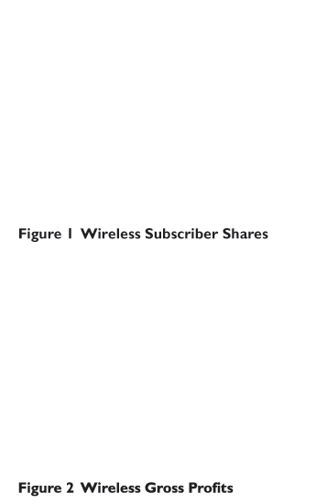
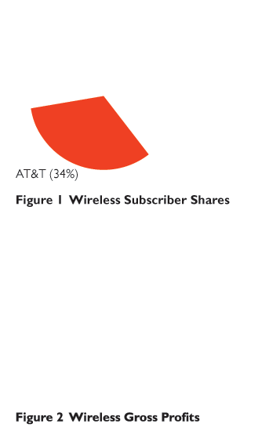
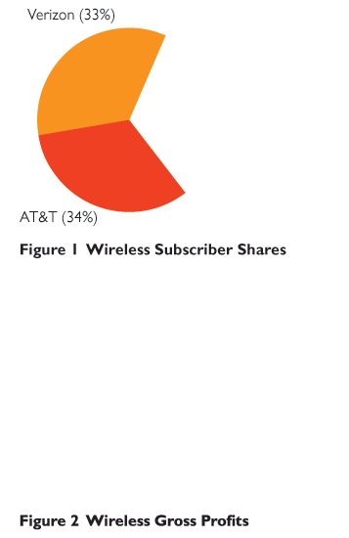
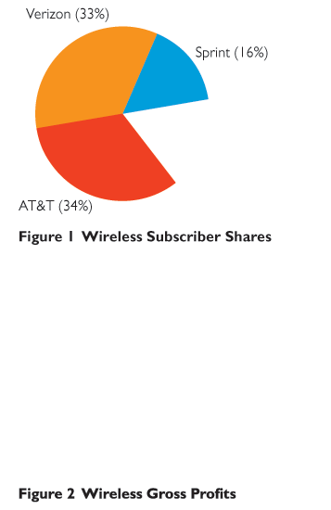
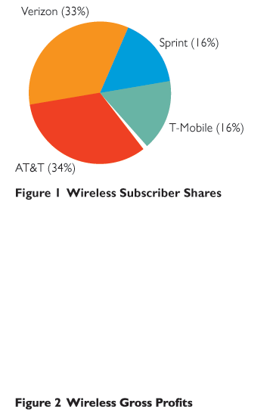
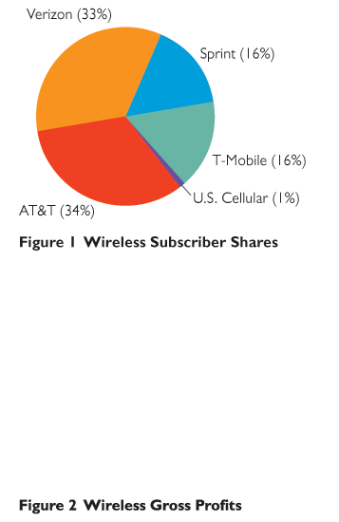
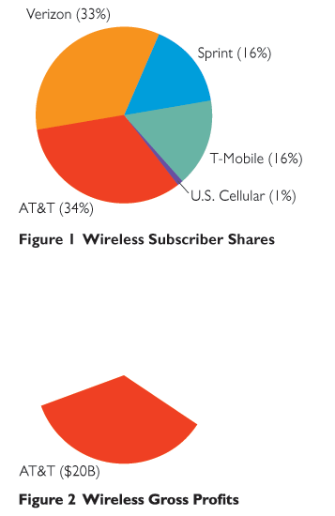
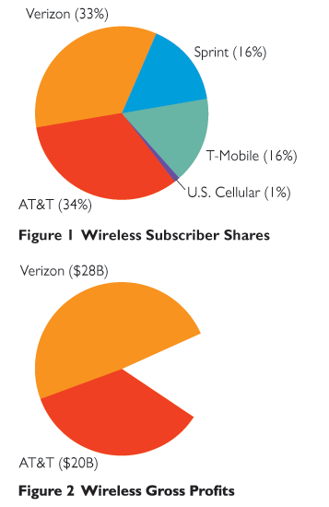
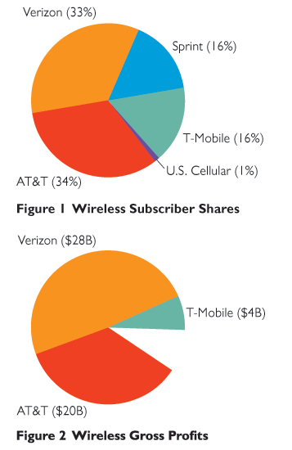
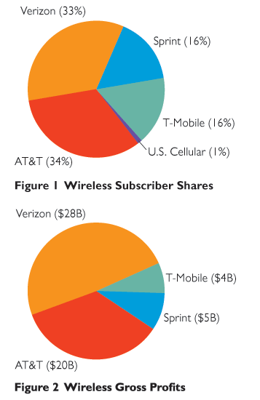
Figure 1 shows the four firms’ market shares along with that of a token fifth firm, U.S. Cellular.
Figure 2 shows the gross earnings of the four wireless firms. (Gross means before deducting depreciation.)
Notes:
<number>

Slide 70
The number of firms that a market can support depends on the extent of its economies of scale and the market demand.
We don’t have data on the firm’s long-run average cost curves that would tell us about the economies of scale, but we do have information about the firms’ profits.
We can use that profit information to get an indirect look at economies of scale.
Notes:
<number>

Slide 71
Because of economies of scale, the two larger firms have much bigger gross profits than the two smaller firms.
But the two smaller firms are large enough to earn a profit.
With the two smaller firms being profitable, and with each having about a one-sixth market share, …
it seems likely that demand in the U.S. wireless market is large enough for more than four firms to profitably survive.
Notes:
<number>

Slide 72
If more firms could operate profitably in this market, we should expect to see entry.
And that is exactly what is happening. Google in collaboration with Dish Network is entering with a virtual wireless service.
There might be room for even more firms.
Notes:
<number>

