Slide 1
Economics
Eleventh European Edition
Part 6
Monitoring macroeconomic performance
Chapter 20
Measuring GDP and economic growth

Slide 2


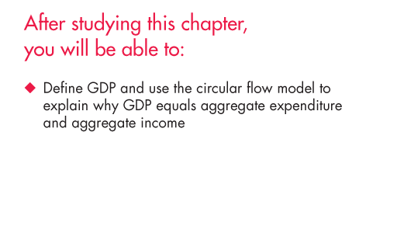
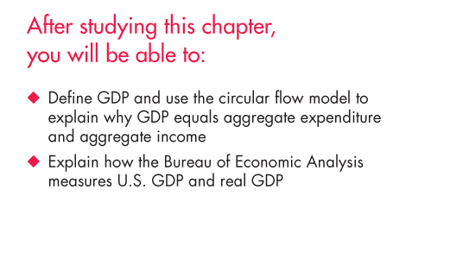
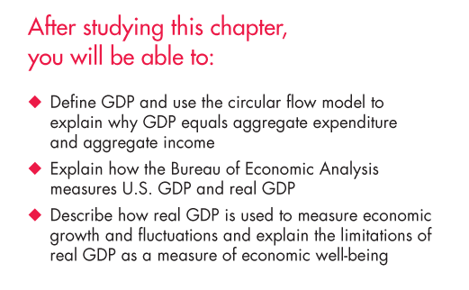
Notes:
Notes and teaching tips: 5, 16, 27, 39, 45, 48, 52, 55, and 56.
To view a full-screen figure during a class, click the red “expand” button.
To return to the previous slide, click the red “shrink” button.
To advance to the next slide, click anywhere on the full screen figure.

Slide 3
Gross Domestic Product
GDP Defined
GDP or gross domestic product is the market value of all final goods and services produced in a country in a given time period.
This definition has four parts:
Market value
Final goods and services
Produced within a country
In a given time period
Notes:
The main challenge in teaching this topic is generating interest in it. Many teachers are bored by it and not surprisingly, they bore their students. If you are one of the many who lean toward boredom, start by recalling just how vital it is that we measure the value of production with reasonable accuracy. It is vital because we use GDP as the basis of measurement of the standard of living, economic welfare, and making international comparisons.
Final goods versus intermediate goods. The distinction between final and intermediate goods is one of the key points in this first section. Use some standard examples to make the key point—tires and autos, chips and computers, and so on. Also, if you want to spend a bit of time on this topic, tell your students about the Bureau of Economic Analysis (BEA) revision in the treatment of business spending on software.
The BEA began a major revision in 1998 and published the first revisions to reclassify software from intermediate to final good status in 1999. And, when the 1996 GDP was recalculated to include software, it increased by $115 billion, or 1.5 percent of GDP.

Slide 4
Gross Domestic Product
Market Value
GDP is a market value—goods and services are valued at their market prices.
To add apples and oranges, computers and popcorn, we add the market values so we have a total value of output in dollars.

Slide 5
Gross Domestic Product
Final Goods and Services
GDP is the value of the final goods and services produced.
A final good (or service) is an item bought by its final user during a specified time period.
A final good contrasts with an intermediate good, which is an item that is produced by one firm, bought by another firm, and used as a component of a final good or service.
Excluding the value of intermediate goods and services avoids counting the same value more than once.

Slide 6
Gross Domestic Product
Produced Within a Country
GDP measures production within a country—domestic production.
In a Given Time Period
GDP measures production during a specific time period, normally a year or a quarter of a year.

Slide 7
Gross Domestic Product
GDP and the Circular Flow of Expenditure and Income
GDP measures the value of production, which also equals total expenditure on final goods and total income.
The equality of income and value of production shows the link between productivity and living standards.
The circular flow diagram in Figure 21.1 illustrates the equality of income and expenditure.

Slide 8

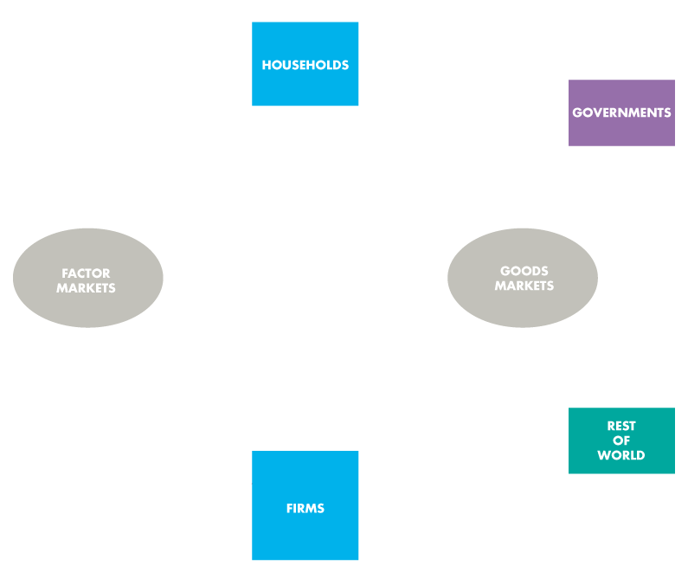
Gross Domestic Product
The circular flow diagram shows the transactions among households, firms, governments, and the rest of the world.

Slide 9
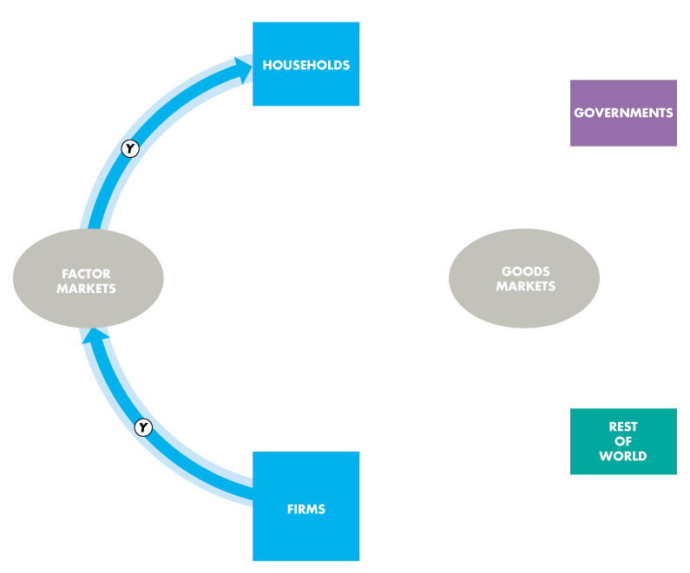
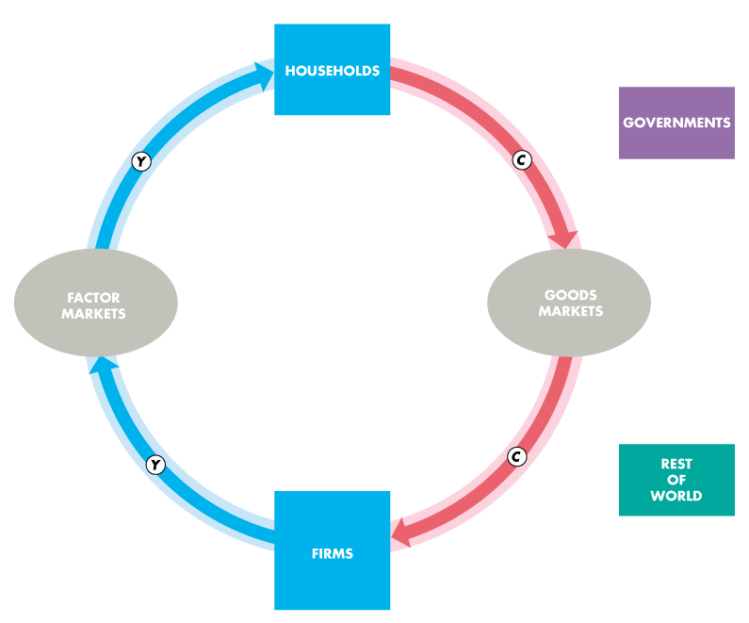
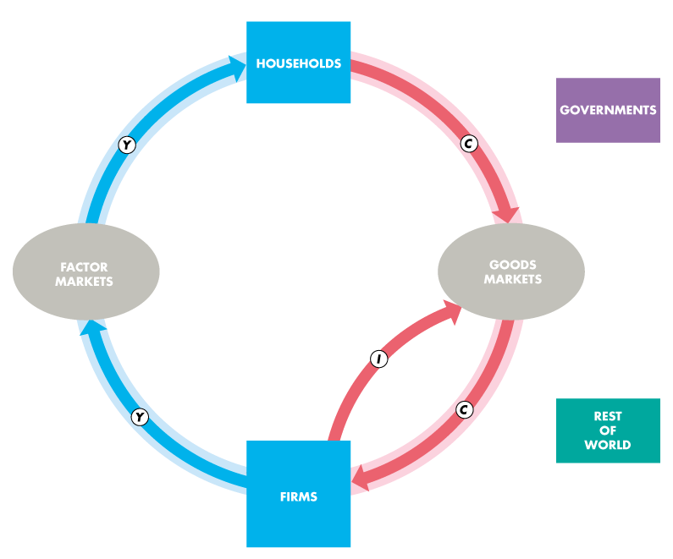
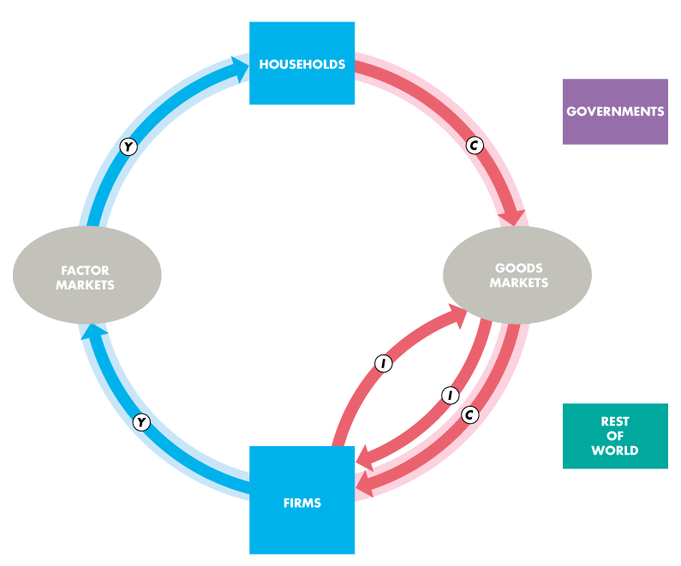
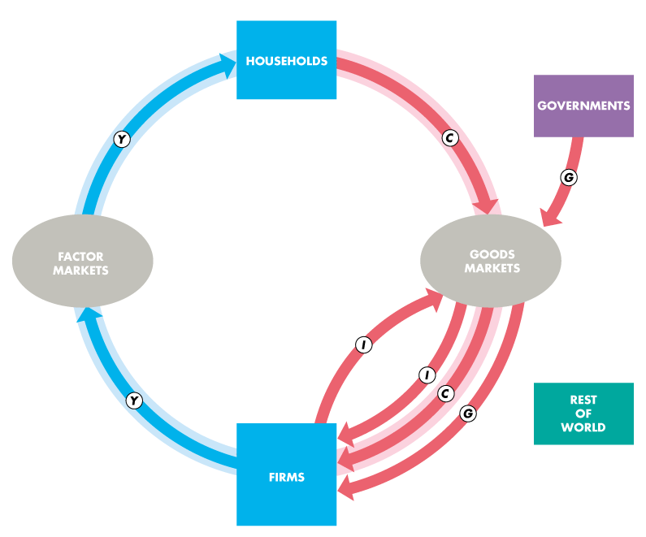

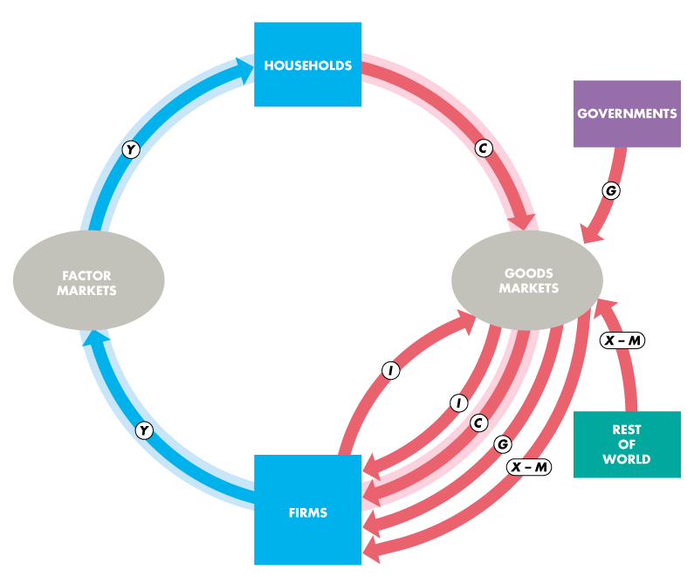

Slide 10
Gross Domestic Product
Households and Firms
Households sell and firms buy the services of labor, capital, and land in factor markets.
For these factor services, firms pay income to households: wages for labor services, interest for the use of capital, and rent for the use of land. A fourth factor of production, entrepreneurship, receives profit.
In the figure, the blue flow, Y, shows total income paid by firms to households.

Slide 11
Gross Domestic Product

Slide 12
Gross Domestic Product
Firms sell and households buy consumer goods and services in the goods market.
Consumption expenditure is the total payment for consumer goods and services, shown by the red flow labeled C .
Firms buy and sell new capital equipment in the goods market and put unsold output into inventory.
The purchase of new plant, equipment, and buildings and the additions to inventories are investment, shown by the red flow labeled I.

Slide 13
Gross Domestic Product

Slide 14
Gross Domestic Product
Governments
Governments buy goods and services from firms and their expenditure on goods and services is called government expenditure.
Government expenditure is shown as the red flow G.
Governments finance their expenditure with taxes and pay financial transfers to households, such as unemployment benefits, and pay subsidies to firms.
These financial transfers are not part of the circular flow of expenditure and income.
Notes:
Government transfer payments, such as Social Security payments, are not part of government expenditure because government expenditure includes only funds used by the government to buy goods and services. Transfer payments are not buying a good or service for the government and so are not included in government expenditures.

Slide 15
Gross Domestic Product

Slide 16
Gross Domestic Product
Rest of the World
Firms in the United States sell goods and services to the rest of the world—exports—and buy goods and services from the rest of the world—imports.
The value of exports (X ) minus the value of imports (M) is called net exports, the red flow X – M.
If net exports are positive, the net flow of goods and services is from U.S. firms to the rest of the world.
If net exports are negative, the net flow of goods and services is from the rest of the world to U.S. firms.

Slide 17
Gross Domestic Product

Slide 18
Gross Domestic Product
The blue and red flows are the circular flow of expenditure and income.

Slide 19
Gross Domestic Product
The sum of the red flows equals the blue flow.

Slide 20
Gross Domestic Product
That is: Y = C + I + G + X – M

Slide 21
Gross Domestic Product
The circular flow shows two ways of measuring GDP.
GDP Equals Expenditure Equals Income
Total expenditure on final goods and services equals GDP.
GDP = C + I + G + X – M.
Aggregate income equals the total amount paid for the use of factors of production: wages, interest, rent, and profit.
Firms pay out all their receipts from the sale of final goods, so income equals expenditure,
Y = C + I + G + (X – M).

Slide 22
Gross Domestic Product
Why Is Domestic Product “Gross”?
“Gross” means before deducting the depreciation of capital.
The opposite of gross is net.
“Net” means after deducting the depreciation of capital.

Slide 23
Gross Domestic Product
Depreciation is the decrease in the value of a firm’s capital that results from wear and tear and obsolescence.
Gross investment is the total amount spent on purchases of new capital and on replacing depreciated capital.
Net investment is the increase in the value of the firm’s capital.
Net investment = Gross investment − Depreciation.

Slide 24
Gross Domestic Product
Gross investment is one of the expenditures included in the expenditure approach to measuring GDP.
So total product is a gross measure.
Gross profit, which is a firm’s profit before subtracting depreciation, is one of the incomes included in the income approach to measuring GDP.
So total product is a gross measure.

Slide 25
Measuring U.S. GDP
Two approaches to measure GDP:
The expenditure approach
The income approach
Notes:
Little is spent on measuring U.S. GDP. You might like to tell your students that the U.S. government spends very little on the measurement of real GDP. The BEA (in the Department of Commerce) employs fewer than 500 economists, accountants, statisticians, and IT specialists at an annual cost of less that $70 million. It costs each American less than 0.25¢ (a quarter of a cent) to measure the value of the nation’s production. For some further perspective, the National Oceanic and Atmospheric Administration (also in the Department of Commerce), whose mission is to “describe and predict changes in the Earth’s environment, and conserve and manage wisely the nation’s coastal and marine resources so as to ensure sustainable economic opportunities,” employs more than 11,000 scientists and support personnel at an annual cost of $3.2 billion!
Most of the income data used by BEA comes from IRS. Expenditure data comes from a variety of sources.
You might like to explain how the omission of illegal goods and services also leads to some misleading comparisons. For instance, the day before prohibition ended, the production of (illegal) beer was not counted as part of GDP. But the day after prohibition ended, the production of (now legal) beer counted. Ask your students to suggest two good reasons why illegal goods and services are omitted.
First, the data are hard (but not impossible) to obtain. Second, there may be the moral position that illegal activities should not be included in GDP. This latter observation can lead to an interesting discussion. Ask the students if they think that the production of, say, marijuana should be included in GDP. Some, maybe even many, of them will see no problem with this. Then ask about the production of murder-for-hire. The response, we hope, will be significantly different. Does such a good have any value?

Slide 26
Measuring U.S. GDP
The Expenditure Approach
The expenditure approach measures GDP as the sum of consumption expenditure, investment, government expenditure on goods and services, and net exports.
GDP = C + I + G + (X − M)
Table 21.1 on next slide shows the expenditure approach with data (in billions) for 2010.
GDP = $10,285 + $1,842 + $2,991 − $539
= $14,579 billion

Slide 27
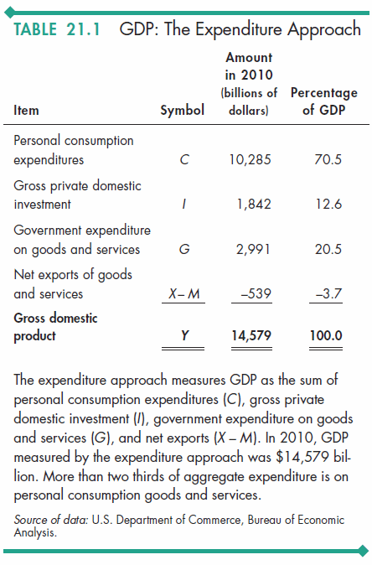

Slide 28
Measuring U.S. GDP
The Income Approach
The income approach measures GDP by summing the incomes that firms pay households for the factors of production they hire.

Slide 29
Measuring U.S. GDP
The National Income and Expenditure Accounts divide incomes into two broad categories:
1. Compensation of employees
2. Net operating surplus
Compensation of employees is the payments for labor services.
Net operating surplus is the sum of other factor incomes. It includes net interest, rental income, corporate profits, and proprietor’s income.

Slide 30
Measuring U.S. GDP
The sum of all factor incomes is net domestic income at factor cost.
Two adjustments must be made to get GDP:
1. Indirect taxes less subsidies are added to get from factor cost to market prices.
2. Depreciation is added to get from net domestic income to gross domestic income.
Table 21.2 on the next slide shows the income approach with data for 2010.

Slide 31
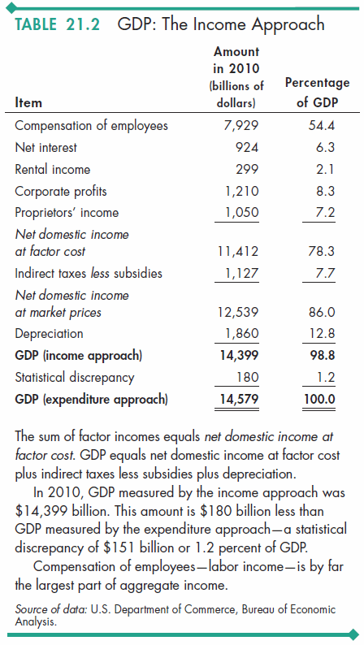

Slide 32
Measuring U.S. GDP
Nominal GDP and Real GDP
Real GDP is the value of final goods and services produced in a given year when valued at valued at the prices of a reference base year.
Currently, the reference base year is 2005 and we describe real GDP as measured in 2005 dollars.
Nominal GDP is the value of goods and services produced during a given year valued at the prices that prevailed in that same year.
Nominal GDP is just a more precise name for GDP.

Slide 33
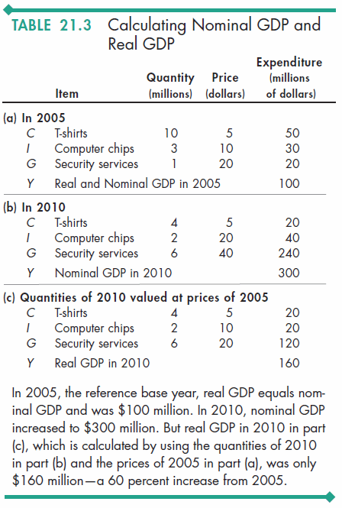
Measuring U.S. GDP
Calculating Real GDP
Table 21.3(a) shows the quantities produced and the prices in 2005 (the base year).
Nominal GDP in 2005 is $100 million.
Because 2005 is the base year, real GDP and nominal GDP both are $100 million.

Slide 34
Measuring U.S. GDP
Table 21.3(b) shows the quantities produced and the prices in 2010.
Nominal GDP in 2010 is $300 million.
Nominal GDP in 2010 is three times its value in 2005.

Slide 35
Measuring U.S. GDP
In Table 21.3(c), we calculate real GDP in 2010.
The quantities are those of 2010, as in part (b).
The prices are those in the base year (2005) as in part (a).
The sum of these expenditures is real GDP in 2010, which is $160 million.

Slide 36
The Uses and Limitations of Real GDP
Economists use estimates of real GDP for two main purposes:
To compare the standard of living over time
To compare the standard of living across countries

Slide 37
The Uses and Limitations of Real GDP
The Standard of Living Over Time
Real GDP per person is real GDP divided by the population.
Real GDP per person tells us the value of goods and services that the average person can enjoy.
By using real GDP, we remove any influence that rising prices and a rising cost of living might have had on our comparison.
Notes:
Omissions from GDP. A discussion of omissions from GDP can arouse students’ interest. For example, you might point out that if one of your students mows her/his own lawn, the value of the student’s production doesn’t show up in GDP. But if you hire the student to mow your lawn (and if your student reports the income earned correctly to CCRA), the value of the student’s production does show up in GDP.
Why don’t we measure all lawn mowing as part of GDP? Some reasons are cost of collecting data and the degree of intrusiveness we’d be willing to tolerate. But note how little we spend on collecting the GDP data and how relatively inexpensive it would be to add some questions about domestic production to either the Current Population Survey or the Family Expenditure Survey.
The inclusion of the imputed rental of owner-occupied houses, but not owner-used cars and other durables, is a good example.
You might like to explain how the omission of illegal goods and services also leads to some misleading comparisons. For instance, the day before prohibition ended, the production of (illegal) beer was not counted as part of GDP. But the day after prohibition ended, the production of (now legal) beer counted. Ask your students to suggest two good reasons why illegal goods and services are omitted. First, the data are hard (but not impossible) to obtain. Second, there may be the moral position that illegal activities should not be included in GDP. This latter observation can lead to an interesting discussion. Ask the students if they think that the production of, say, marijuana should be included in GDP. Some, maybe even many, of them will see no problem with this. Then ask about the production of murder-for-hire. The response, we hope, will be significantly different. Does such a good have any value?

Slide 38
The Uses and Limitations of Real GDP
Long-Term Trend
A handy way of comparing real GDP per person over time is to express it as a ratio of some reference year.
For example, in 1960, real GDP per person was $15,850 and in 2010, it was $42,800.
So real GDP per person in 2010 was 2.7 times its 1960 level—that is, $42,800 ÷ $15,850 = 2.7.

Slide 39
The Uses and Limitations of Real GDP
Two features of our expanding living standard are
The growth of potential GDP per person
Fluctuations of real GDP around potential GDP
The value of real GDP when all the economy’s labor, capital, land, and entrepreneurial ability are fully employed is called potential GDP.

Slide 40
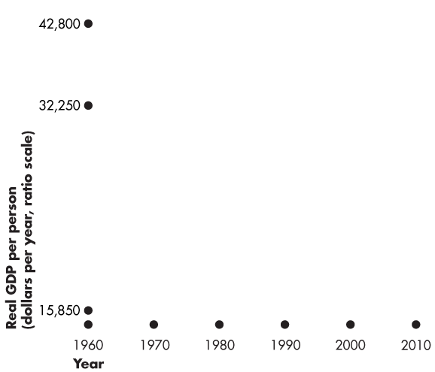
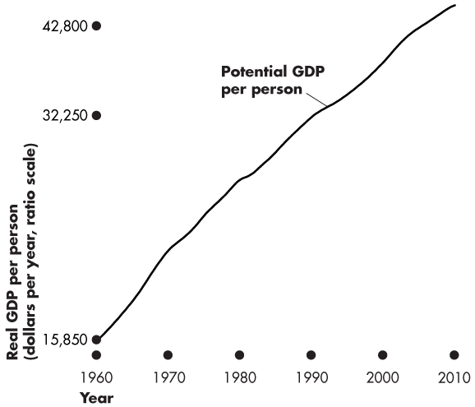
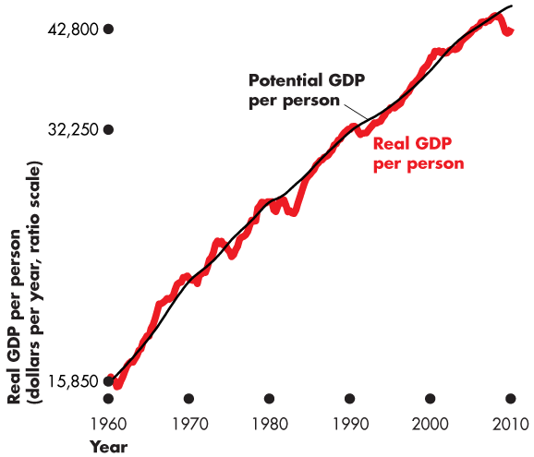
The Uses and Limitations of Real GDP
Figure 21.2 shows U.S. real GDP per person.
Potential GDP grows at a steady pace because the quantities of the factors of production and their productivity grow at a steady pace.
Real GDP fluctuates around potential GDP.

Slide 41
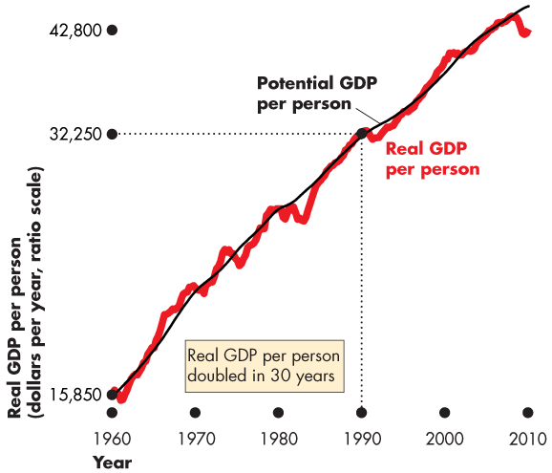
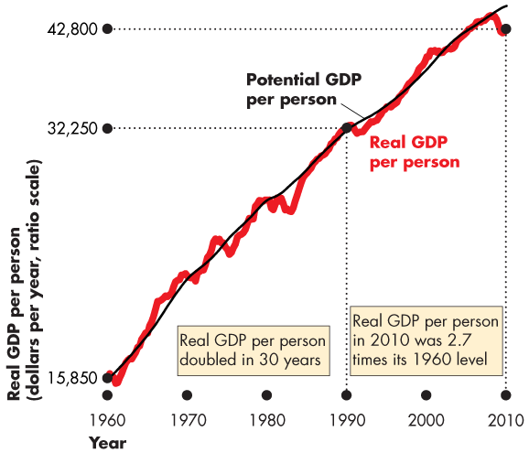

Slide 42
The Uses and Limitations of Real GDP
Real GDP per person in the United States:
Doubled between 1960 and 1990.
Was 2.7 times its 1960 level in 2010.

Slide 43
The Uses and Limitations of Real GDP
Real GDP Fluctuations— The Business Cycle
A business cycle is a periodic but irregular up-and-down movement of total production and other measures of economic activity.
Every cycle has two phases: 1. Expansion 2. Recession
and two turning points: 1. Peak 2. Trough
Notes:
The Business Cycle Students generally are interested in the topic of business cycles, particularly if the economy happens to be in a recession when this chapter is covered. Often it is very difficult to tell the future path of the economy. Stress to the students that it is not stupidity on the part of economists that prevents us from knowing where the economy is heading. Rather it is the fact that forecasting is difficult for at least two reasons.
First, different sectors of the economy frequently send different signals. For instance, retail sales may be down, signaling a start to a recession, but housing starts may be up, indicating that an expansion will continue for a while.
Second, the data that must be used always are at least a bit out-of-date. For example, the preliminary estimate of GDP is not made until approximately six weeks after the end of the quarter, and the final revision of GDP doesn’t appear until years later.
Although economists’ forecasts are much better than those of others, forecasting GDP with complete accuracy is unlikely. Conclude by mentioning that this fact is important in later chapters when we discuss implementation of countercyclical policies.

Slide 44
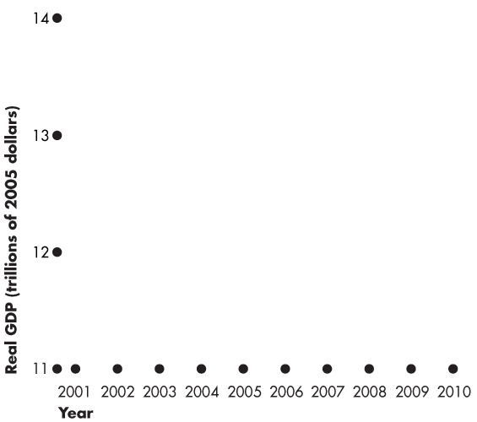
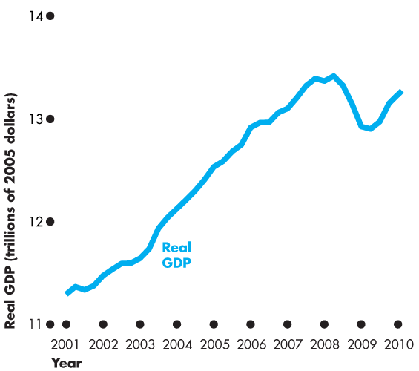
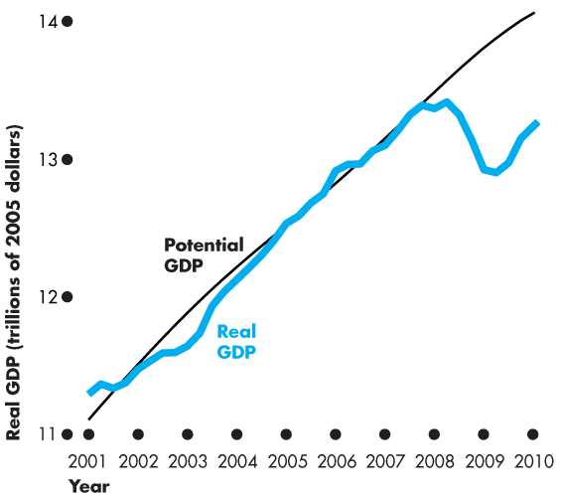
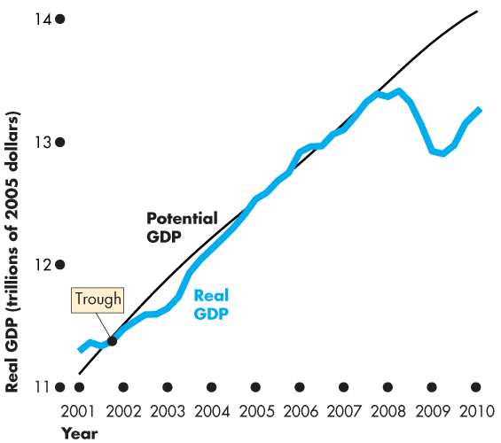
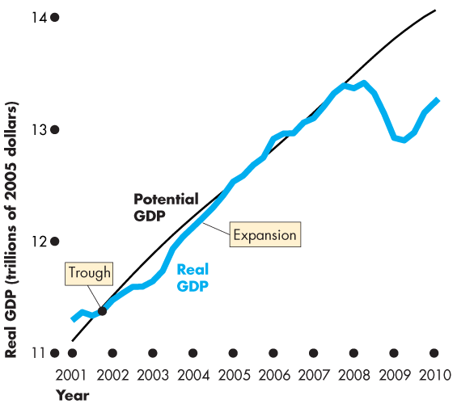
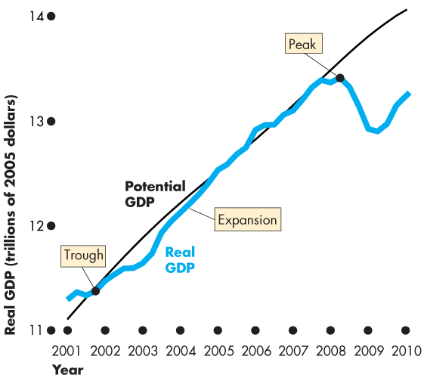
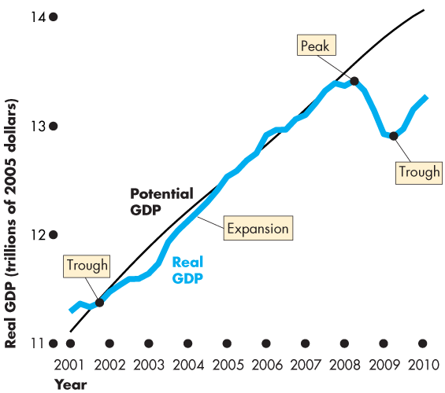
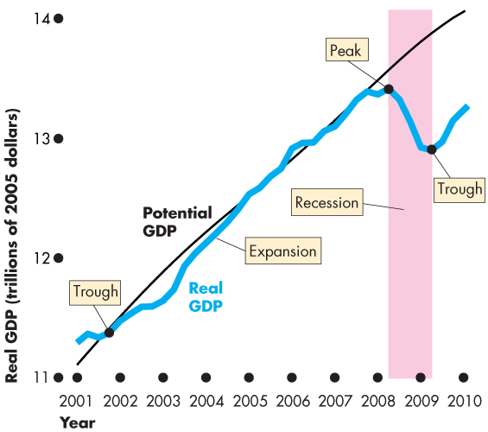
The Uses and Limitations of Real GDP
Figure 21.4 illustrates the business cycle.
An expansion is a period during which real GDP increases—from a trough to a peak.
Recession is a period during which real GDP decreases—its growth rate is negative for at least two successive quarters.

Slide 46
The Uses and Limitations of Real GDP
The Standard of Living Across Countries
Two problems arise in using real GDP to compare living standards across countries:
1. The real GDP of one country must be converted into the same currency units as the real GDP of the other country.
2. The goods and services in both countries must be valued at the same prices.

Slide 47
The Uses and Limitations of Real GDP
Limitations of Real GDP
Real GDP measures the value of goods and services that are bought in markets.
Some of the factors that influence the standard of living and that are not part of GDP are
Household production
Underground economic activity
Health and life expectancy
Leisure time
Environmental quality
Political freedom and social justice
Notes:
Omissions from GDP. A discussion of omissions from GDP can arouse students’ interest. For example, you might point out that if one of your students mows her/his own lawn, the value of the student’s production doesn’t show up in GDP. But if you hire the student to mow your lawn (and if your student reports the income earned correctly to the IRS), the value of the student’s production does show up in GDP.
Why don’t we measure all lawn mowing as part of GDP? Some reasons are cost of collecting data and the degree of intrusiveness we’d be willing to tolerate. But note how little we spend on collecting the GDP data and how relatively inexpensive it would be to add some questions about domestic production to either the Current Population Survey or the Consumer Expenditure Survey.
The inclusion of the imputed rental of owner-occupied houses, but not owner-used cars and other durables, is a good example.
You might like to explain how the omission of illegal goods and services also leads to some misleading comparisons. For instance, the day before prohibition ended, the production of (illegal) beer was not counted as part of GDP. But the day after prohibition ended, the production of (now legal) beer counted. Ask your students to suggest two good reasons why illegal goods and services are omitted. First, the data are hard (but not impossible) to obtain. Second, there may be the moral position that illegal activities should not be included in GDP. This latter observation can lead to an interesting discussion. Ask the students if they think that the production of, say, marijuana should be included in GDP. Some, maybe even many, of them will see no problem with this. Then ask about the production of murder-for-hire. The response, we hope, will be significantly different. Does such a good have any value?

Slide 48
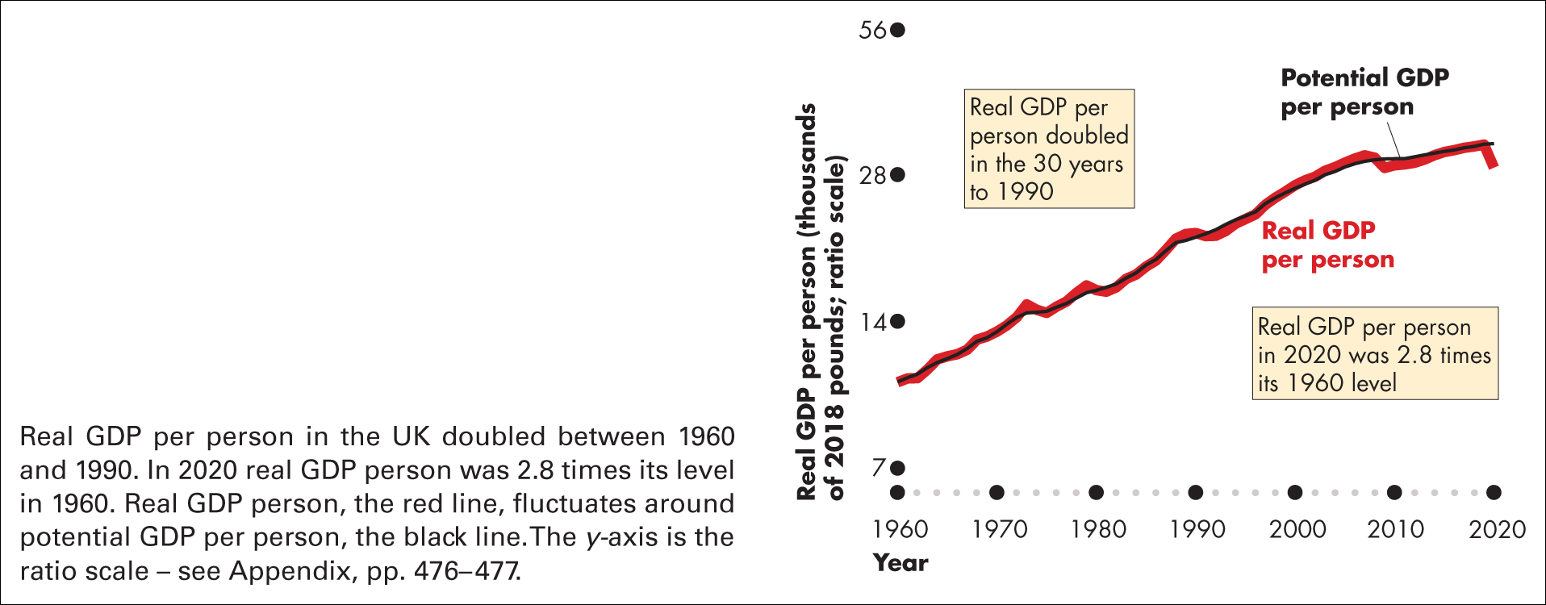
Figure 20.4 Rising UK standard of living
Sources of data: Authors’assumptions and calculations based on data from the Office for Budget Responsibility forecasts

Slide 49
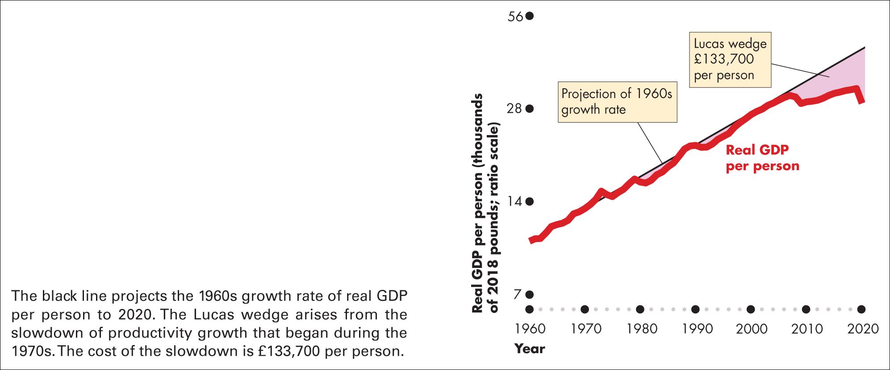
Figure 20.5 The cost of slower growth
Source of data: Office for National Statistics. Lucas wedge based on authors’ assumptions about the 1960s growth trend

Slide 50
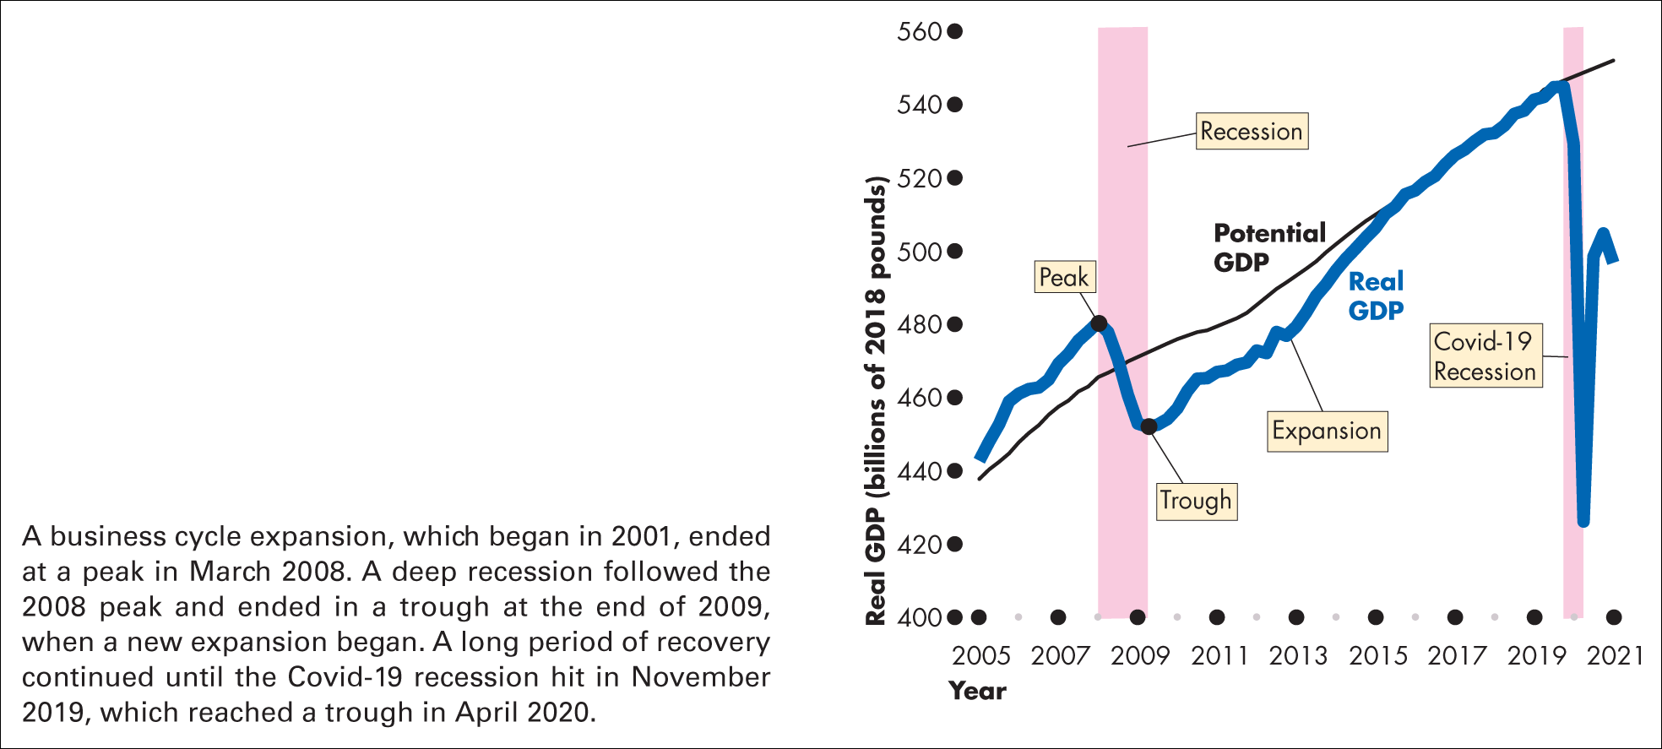
Figure 20.6 Most recent UK business cycle
Sources of data: Office for National Statistics and authors’ calculations

Slide 51
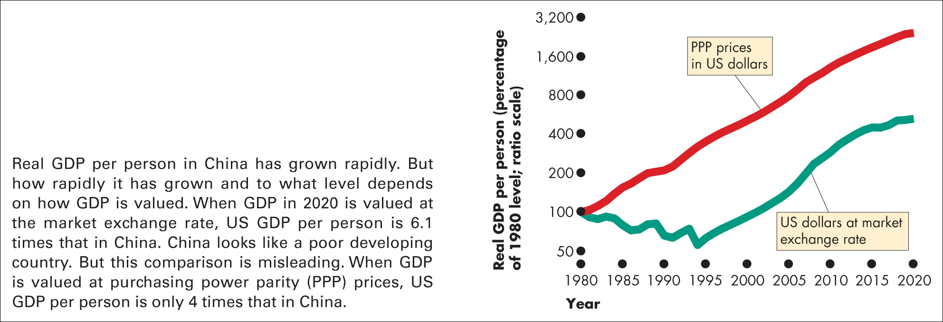
Figure 20.7 Two views of real GDP in china
Source of data: International Monetary Fund, World Economic Outlook database, April 2021

Slide 52
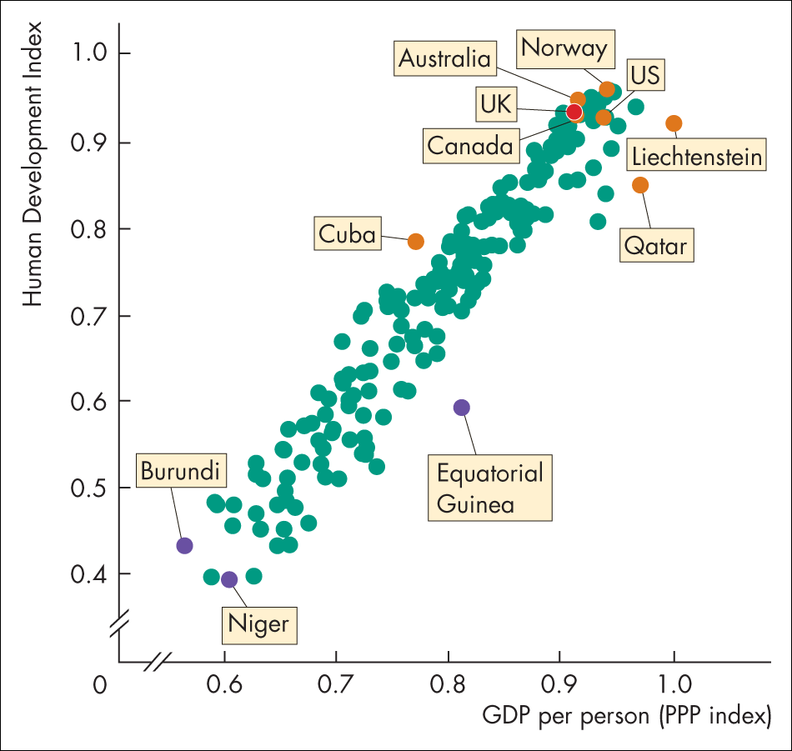
Figure 1 The human development index
Source of data: United Nations Human Development Report 2020

Slide 53
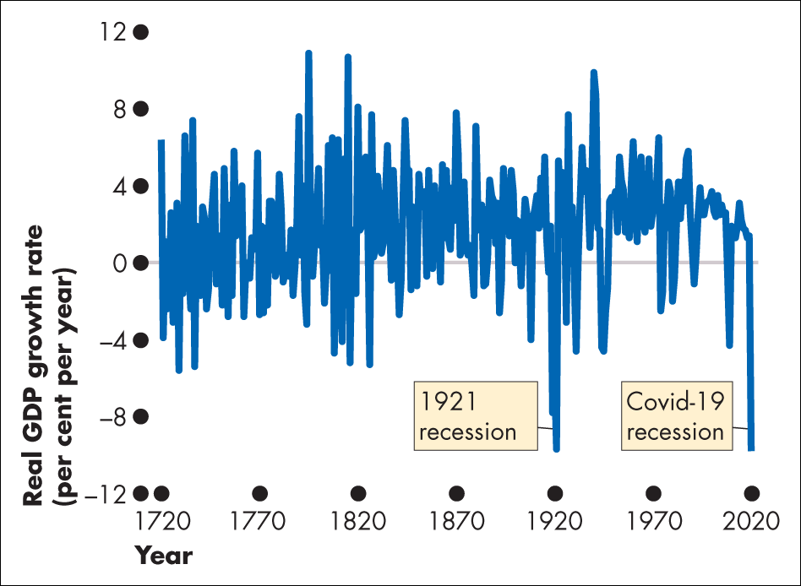
Figure 1 GDP growth 1720-2020

Slide 54
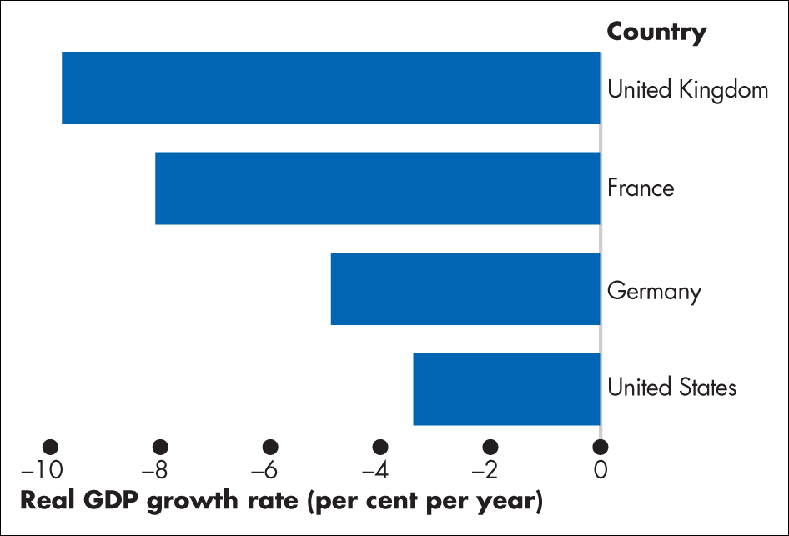
Figure 2 GDP growth in 2020

Slide 55
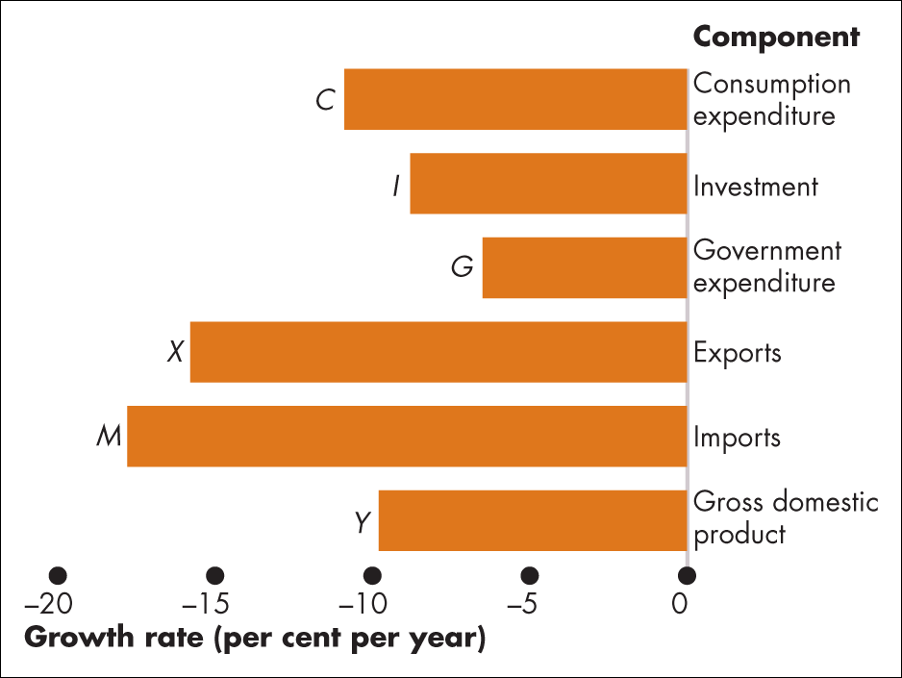
Figure 3 Percentage growth of GDP components in 2020

Slide 56
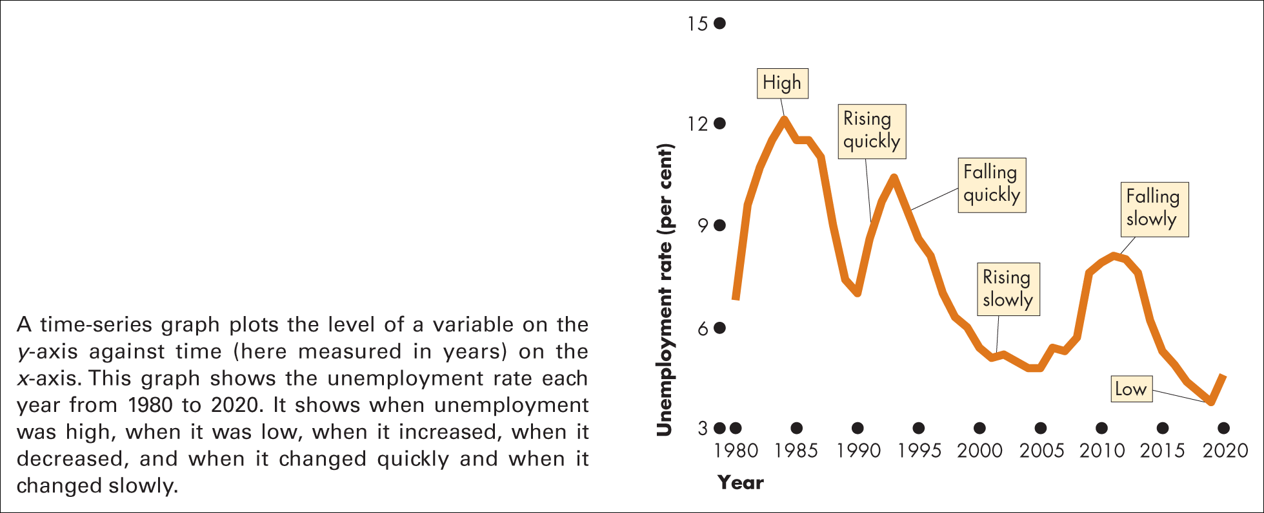
Figure A20.1 A time-series graph

Slide 57
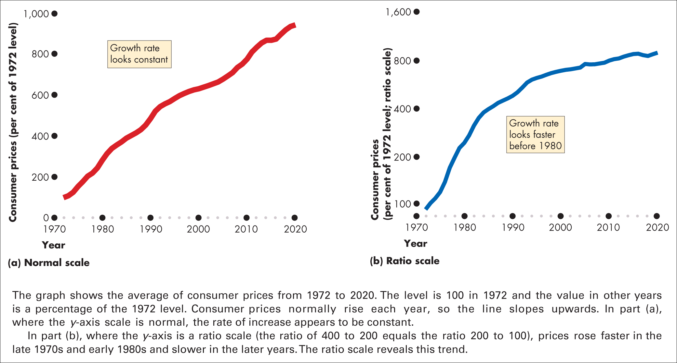
Figure A20.2 Ratio scale reveals trend

Slide 58
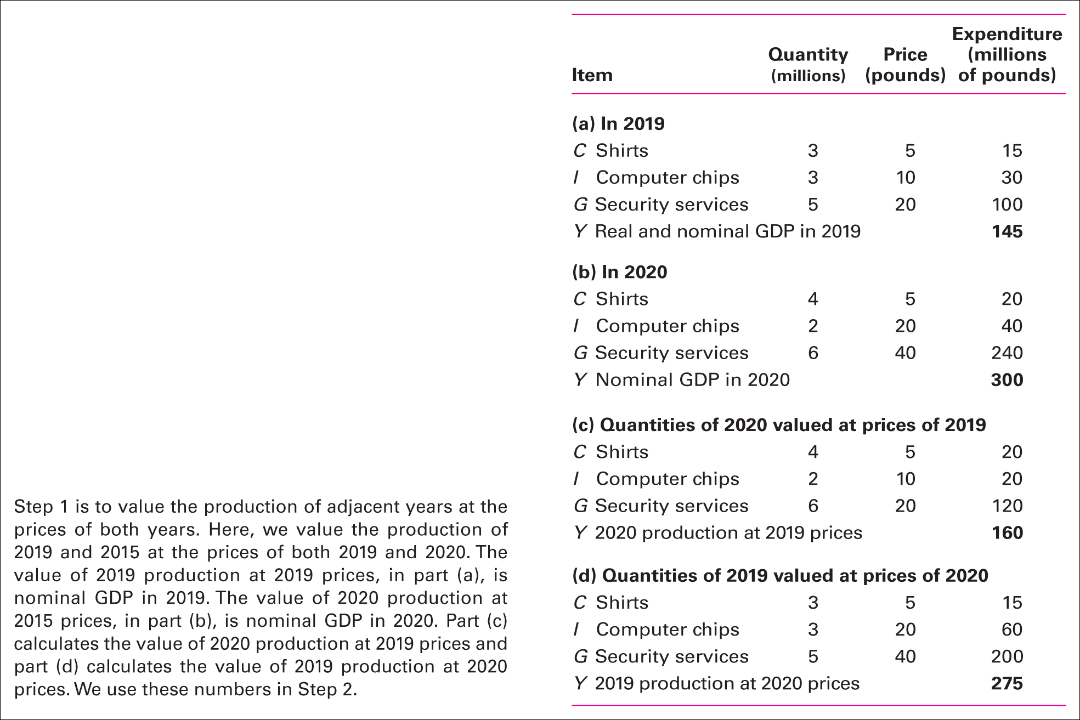
Table 1 Real GDP calculation step 1: value production in adjacent years at prices in both years

Slide 59
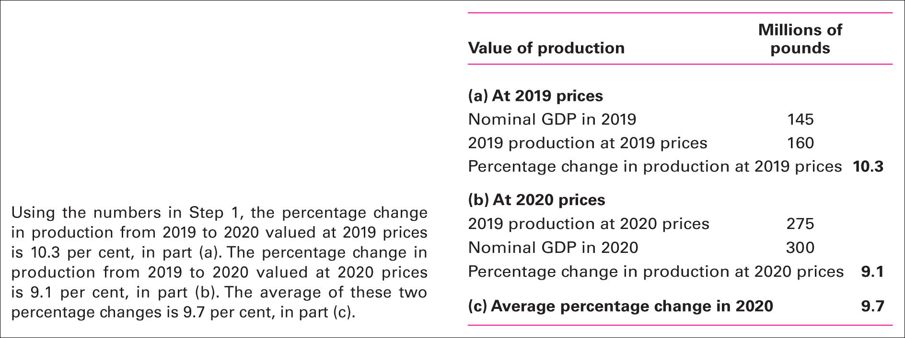
Table 2 Real GDP calculation step 2: find average of two percentage changes

Slide 60
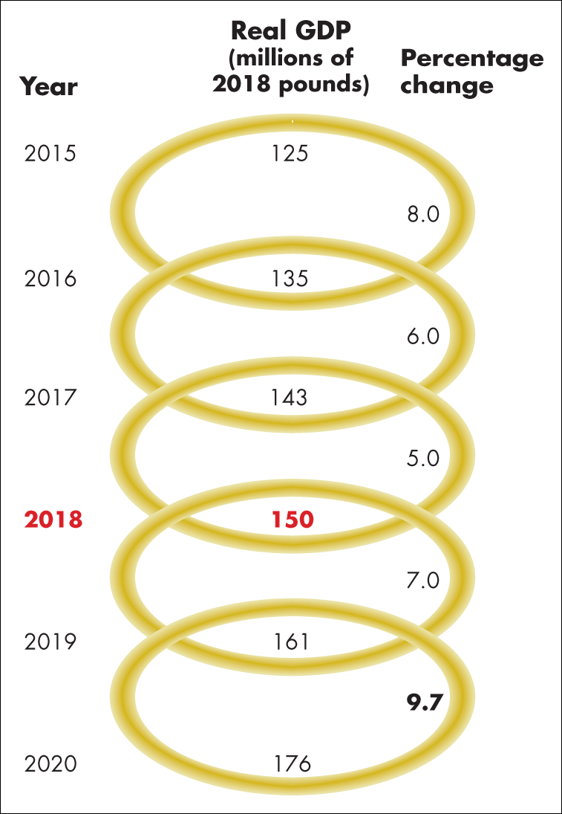
Figure 1 Real GDP calculation step 3: link (chain) to base year

