Slide 1
Economics
Eleventh European Edition
Part 6
Monitoring macroeconomic performance
Chapter 21
Monitoring jobs and inflation

Slide 2
After studying this chapter, you will be able to:
Explain why unemployment is a problem and how we measure the unemployment rate and other labor market indicators
Explain why unemployment occurs and why it is present even at full employment
Explain why inflation is a problem and how we measure
the inflation rate

Slide 3
Employment and Unemployment
What kind of job market will you enter when you graduate?
The class of 2017 had a better time in the job market when 7 million Americans (down from 10 million in 2015) who wanted a job but couldn’t find one.
Also in 2015, 8 million people had given up looking for a full-time job and taken a part-time job.
The U.S. economy creates lots of jobs: during the recession of 2009, 139 million people had jobs—22 million more than in 1989.
In recent years, the population has grown faster than the number of jobs, so unemployment is a serious problem.

Slide 4
Employment and Unemployment
Why Unemployment Is a Problem
Unemployment results in
Lost incomes and production
Lost human capital
The loss of income is devastating for those who bear it. Employment benefits create a safety net but don’t fully replace lost wages, and not everyone receives benefits.
Prolonged unemployment permanently damages a person’s job prospects by destroying human capital.

Slide 5
Employment and Unemployment
Current Population Survey
The U.S. Census Bureau conducts a monthly population survey to determine the status of the U.S. labor force.
The population is divided into two groups:
The working-age population—the number of people aged 16 years and older who are not in jail, hospital, or some other institution
People too young to work (under 16 years of age) or in institutional care

Slide 6
Employment and Unemployment
The working-age population is divided into two groups:
People in the labor force
People not in the labor force
The labor force is the sum of employed and unemployed workers.

Slide 7
Employment and Unemployment
To be counted as unemployed, a person must be in one of
the following three categories:
Without work but has made specific efforts to find a job within the previous four weeks
Waiting to be called back to a job from which he or she has been laid off
Waiting to start a new job within 30 days

Slide 8
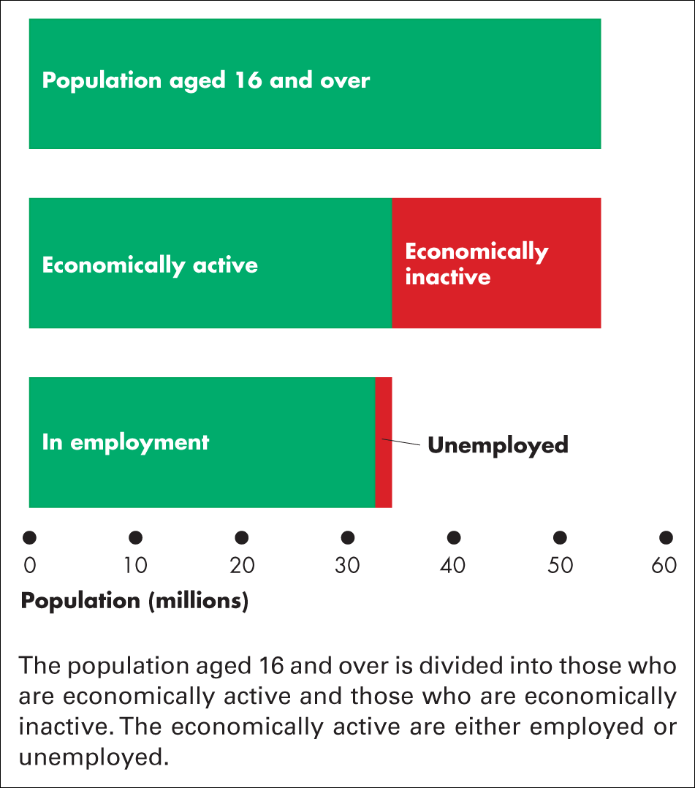
Figure 21.1 Population labour force categories
Source of data: Office for National Statistics

Slide 9
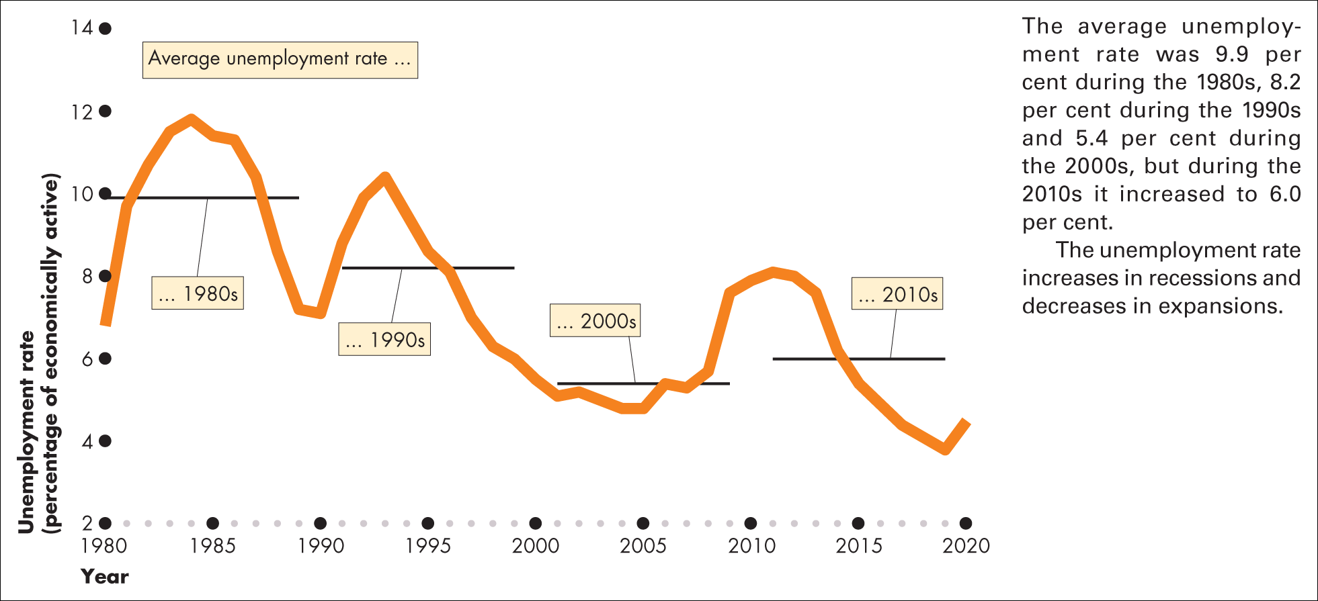
Figure 21.2 UK unemployment rate: 1980–2020
Source of data: Office for National Statistics

Slide 10
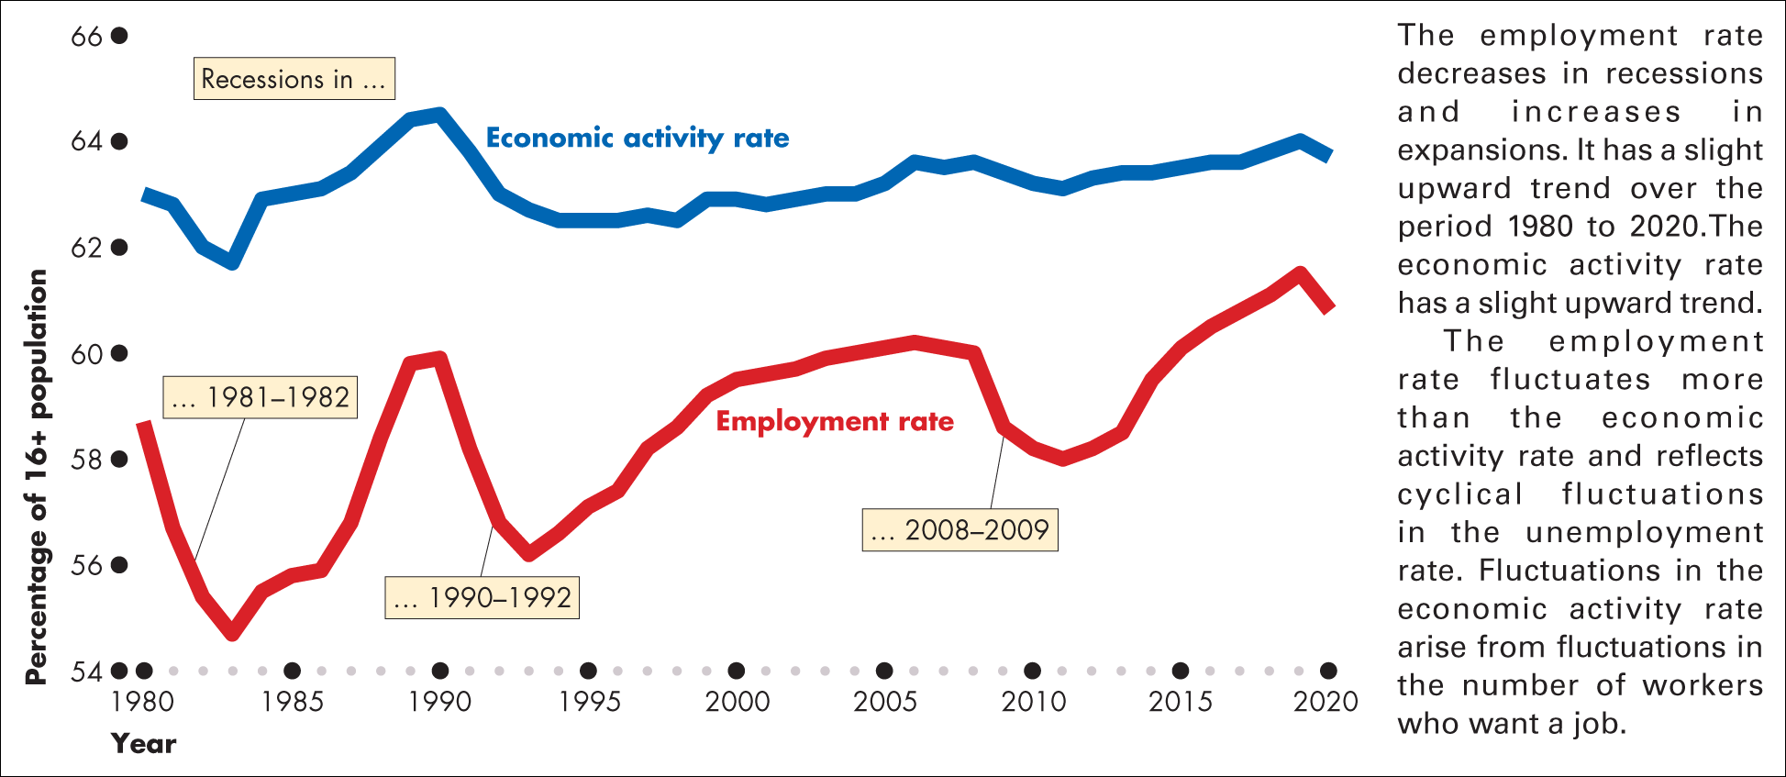
Figure 21.3 UK economic activity rate and employment rate: 1980–2020
Source of data: Office for National Statistics

Slide 11
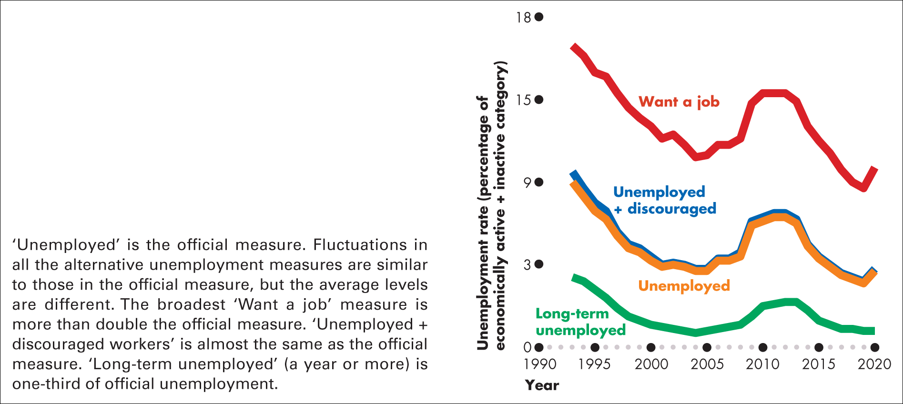
Figure 21.4 Alternative measures of unemployment: 1993–2020
Source of data: Office for National Statistics. Alternative unemployment rates calculated by the authors

Slide 12
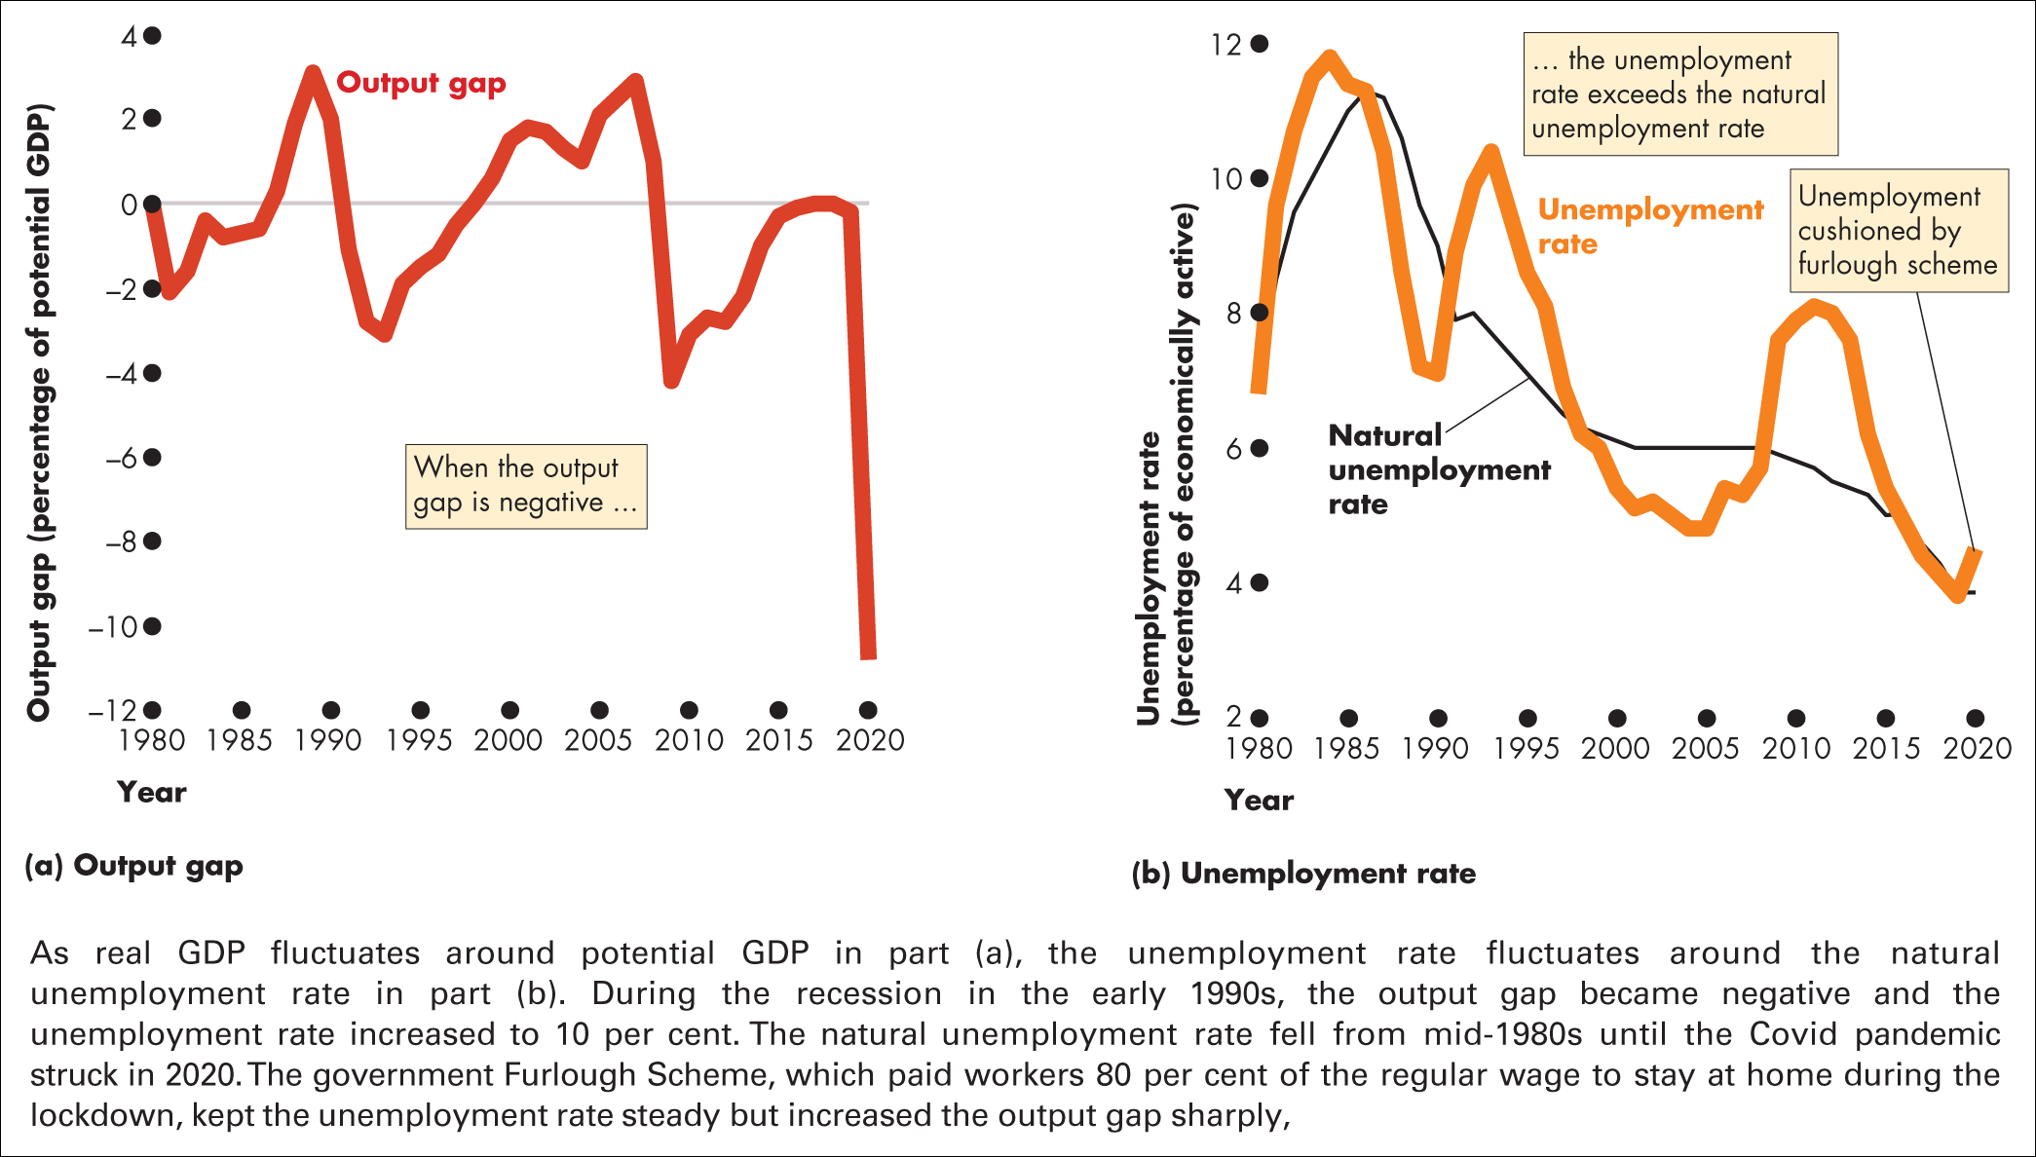
Figure 21.5 Output gap and the unemployment rate
Sources of data: Office for National Statistics; and authors’ assumptions and calculations

Slide 13
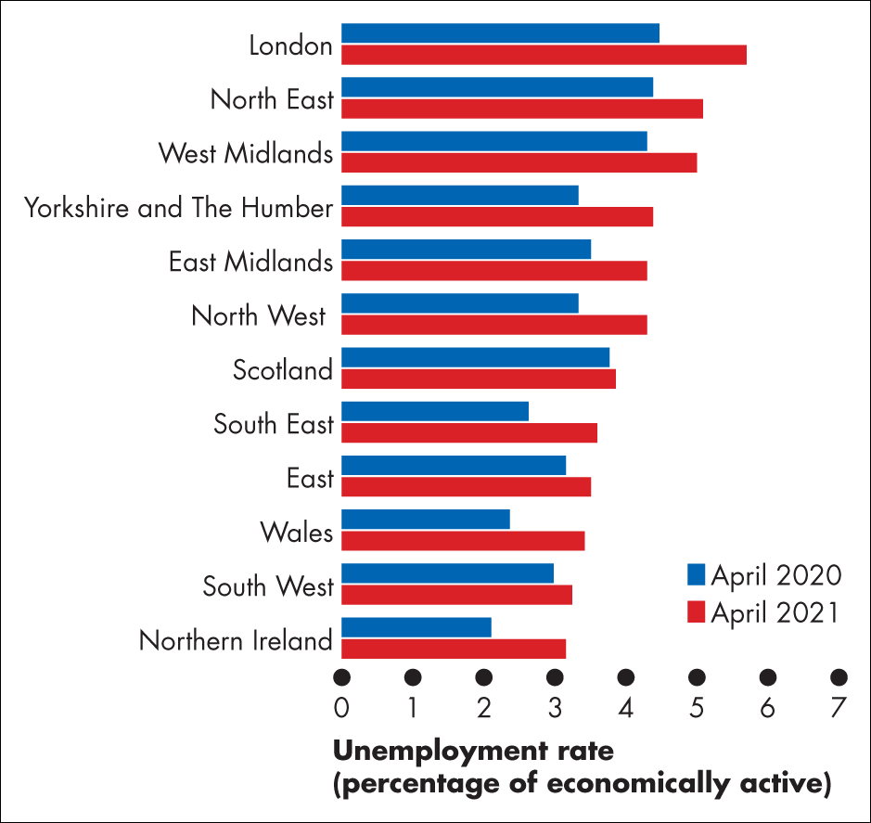
Figure 1 Unemployment rates across the United Kingdom
Source of data: Office for National Statistics

Slide 14
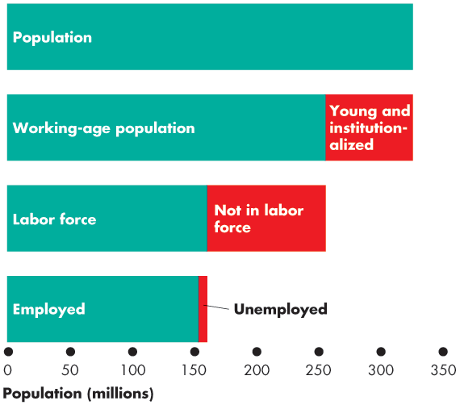

Employment and Unemployment
Figure 22.1 shows the
labor force categories.
In June 2017:
Population: 325 million
Working-age population: 255 million
Labor force: 160 million Employed: 153 million
Unemployed: 7 million

Slide 15
Employment and Unemployment
Three Labor Market Indicators
The unemployment rate
The employment-to-population ratio
The labor force participation rate

Slide 16
Employment and Unemployment
The Unemployment Rate
The unemployment rate is the percentage of the labor force that is unemployed.
The unemployment rate is
(Number of people unemployed ÷ labor force) × 100.
In June 2017, the labor force was 160 million and
7 million were unemployed, so the unemployment rate was
4.4 percent.
The unemployment rate increases in a recession and
reaches its peak value after the recession ends.

Slide 17
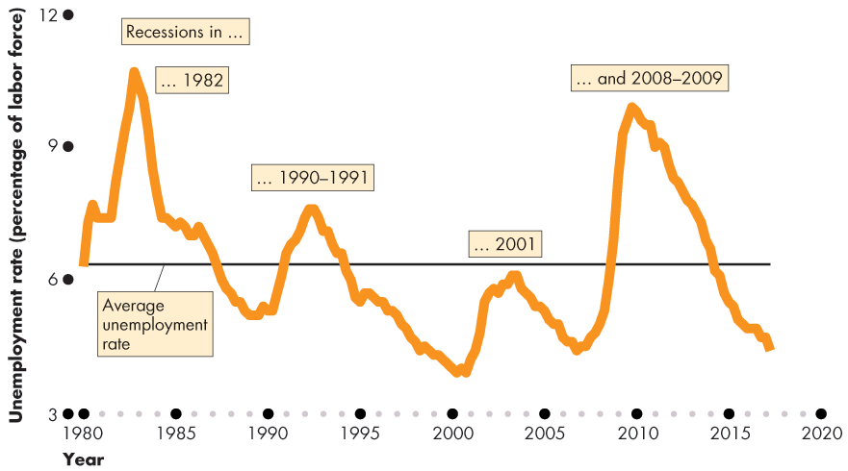
Employment and Unemployment
Figure 22.2 shows the unemployment rate: 1980–2017.
The unemployment rate increases in a recession.

Slide 18


Employment and Unemployment
The Employment-to-Population Ratio
The employment-to-population ratio is the percentage of the working-age population who have jobs.
The employment-to-population ratio is (Employment ÷ Working-age population) × 100.
In June 2017, the employment was 153 million and the
working-age population was 255 million.
The employment-to-population ratio was 60 percent.

Slide 19
Employment and Unemployment
The Labor Force Participation Rate
The labor force participation rate is the percentage of the working-age population who are members of the labor force.
The labor force participation rate is
(Labor force ÷ Working-age population) × 100.
In June 2017, the labor force was 160 million and the working-age population was 255 million.
The labor force participation rate was 62.7 percent.

Slide 20
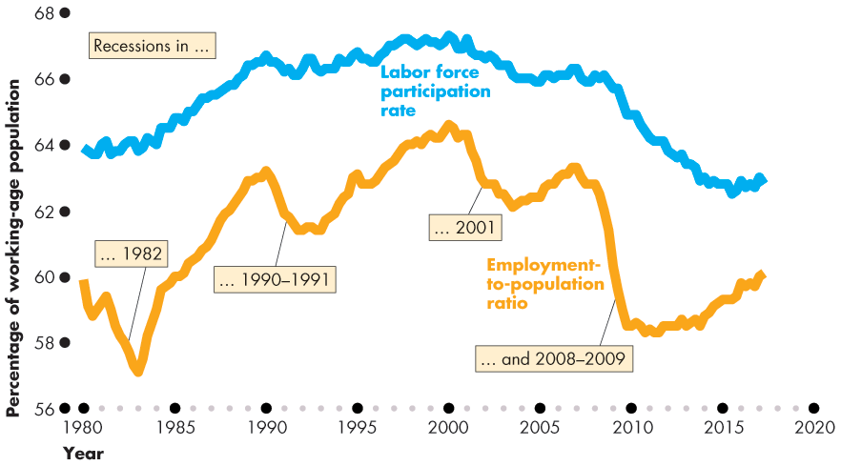
Employment and Unemployment
Figure 22.3 shows that the labor force participation rate and the employment-to-population ratio both trended upward before 2000 and downward after 2000.

Slide 21
Employment and Unemployment
Other Definitions of Unemployment
The purpose of the unemployment rate is to measure the underutilization of labor resources.
The BLS believes that the unemployment rate gives a correct measure.
But the official measure is an imperfect measure because
it excludes
Marginally attached workers
Part-time workers who want full-time jobs

Slide 22
Employment and Unemployment
Marginally Attached Workers
A marginally attached worker is a person who currently is neither working nor looking for work but has indicated that he or she wants and is available for a job and has looked for work sometime in the recent past.
A discouraged worker is a marginally attached worker who has stopped looking for a job because of repeated failure to find one.

Slide 23
Employment and Unemployment
Part-Time Workers Who Want Full-Time Jobs
Many part-time workers want to work part time, but some part-time workers would like full-time jobs and can’t find them.
In the official statistics, these workers are called economic part-time workers and they are partly unemployed.
Most Costly Unemployment
All unemployment is costly, but the most costly is long- term unemployment that results from job loss.

Slide 24
Employment and Unemployment
Alternative Measures of Unemployment
The BLS reports six alternative measures of the unemployment rate: two narrower than the official measure and three broader ones.
The narrower measures, U-1 and U-2, focus on the personal cost of unemployment.
The broader measures, U-4, U-5, and U-6, focus on assessing the full amount of unused labor resources.

Slide 25
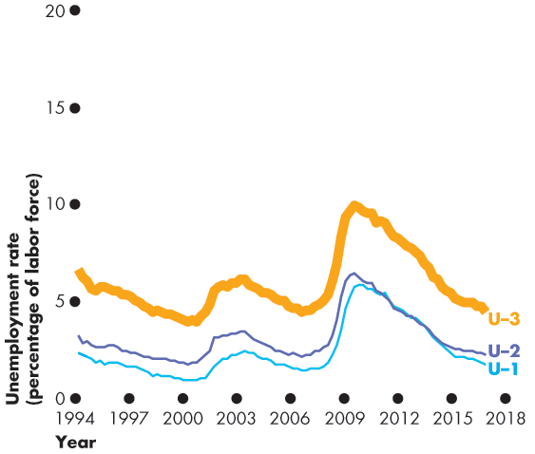
Employment and Unemployment
Figure 22.4 shows six
alternative measures.
U-1: Those
unemployed for 15 weeks or longer
U-2: Unemployed job losers
U-3: The official
unemployment rate

Slide 26
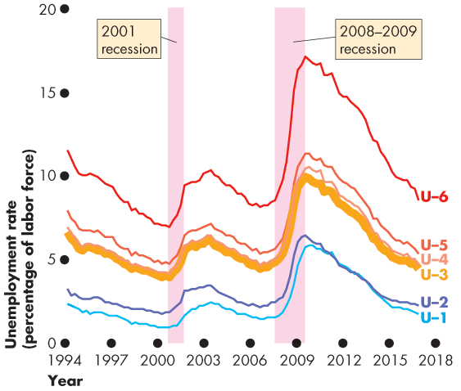
Employment and Unemployment
Broader measures are
U-4: U-3 + Discouraged workers
U-5: U-4 + Other
marginally attached workers
U-6: U-4 + Part-time workers who want full-time jobs
All measures increase together in recession.

Slide 27
Unemployment and Full Employment
Unemployment can be classified into three types:
Frictional unemployment
Structural unemployment
Cyclical unemployment

Slide 28
Unemployment and Full Employment
Frictional Unemployment
Frictional unemployment is unemployment that arises from normal labor market turnover.
The creation and destruction of jobs requires that unemployed workers search for new jobs.
Increases in the number of people entering and reentering the labor force and increases in unemployment benefits raise frictional unemployment.
Frictional unemployment is a permanent and healthy
phenomenon of a growing economy.

Slide 29
Price Level, Inflation, and Deflation
The price level is the average level of prices and the
value of money.
A persistently rising price level is called inflation. A persistently falling price level is called deflation.
We are interested in the price level because we want to
Measure the inflation rate or the deflation rate
Distinguish between money values and real values of economic variables.

Slide 30
Price Level, Inflation, and Deflation
Why Inflation and Deflation Are Problems
Low, steady, and anticipated inflation or deflation is not a problem.
Unpredictable inflation or deflation is a problem because it
Redistributes income
Redistributes wealth
Lowers real GDP and employment
Diverts resources from production

Slide 31
Price Level, Inflation, and Deflation
Unpredictable changes in the inflation rate redistribute income in arbitrary ways between employers and workers and between borrowers and lenders.
A high inflation rate is a problem because it diverts resources from productive activities to inflation forecasting.
From a social perspective, this waste of resources is a cost of inflation.
At its worst, inflation becomes hyperinflation—an inflation rate that is so rapid that workers are paid twice a day because money loses its value so quickly.

Slide 32
Price Level, Inflation, and Deflation
The Consumer Price Index
The Consumer Price Index, or CPI, measures the average of the prices paid by urban consumers for a “fixed” basket of consumer goods and services.

Slide 33
Price Level, Inflation, and Deflation
Reading the CPI Numbers
The CPI is defined to equal 100 for the reference base period.
Currently, the reference base period is 1982−1984.
That is, for the average of the 36 months from January 1982 through December 1984, the CPI equals 100.
In June 2017, the CPI was 245.
This number tells us that the average of the prices paid by urban consumers for a fixed basket of goods was 145 percent higher in June 2017 than it was during 1982−1984.

Slide 34
Price Level, Inflation, and Deflation
Constructing the CPI
Constructing the CPI involves three stages:
Selecting the CPI basket
Conducting a monthly price survey
Calculating the CPI

Slide 35
Price Level, Inflation, and Deflation
The CPI Basket
The CPI basket is based on a Consumer Expenditure Survey, which is undertaken infrequently.
The CPI basket today is based on data collected in the Consumer Expenditure Survey of 2016.

Slide 36
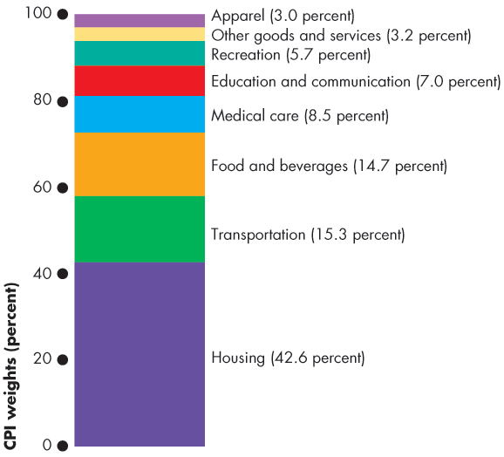
Price Level, Inflation, and Deflation
Figure 22.6 illustrates the
CPI basket.
Housing is the largest component.
Transportation and food and beverages are the next largest components.
All other components account for 27.4 percent of the basket.

Slide 37
Price Level, Inflation, and Deflation
The Monthly Price Survey
Every month, BLS employees check the prices of the 80,000 goods in the CPI basket in 30 metropolitan areas.
Calculating the CPI
Find the cost of the CPI basket at base-period prices.
Find the cost of the CPI basket at current-period prices.
Calculate the CPI for the current period.

Slide 38
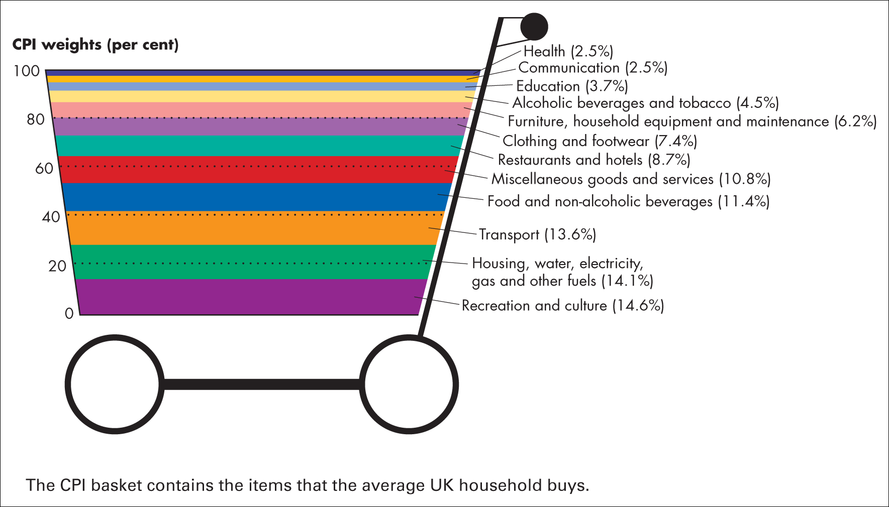
Figure 21.6 The CPI basket
Source of data: Office for National Statistics

Slide 39
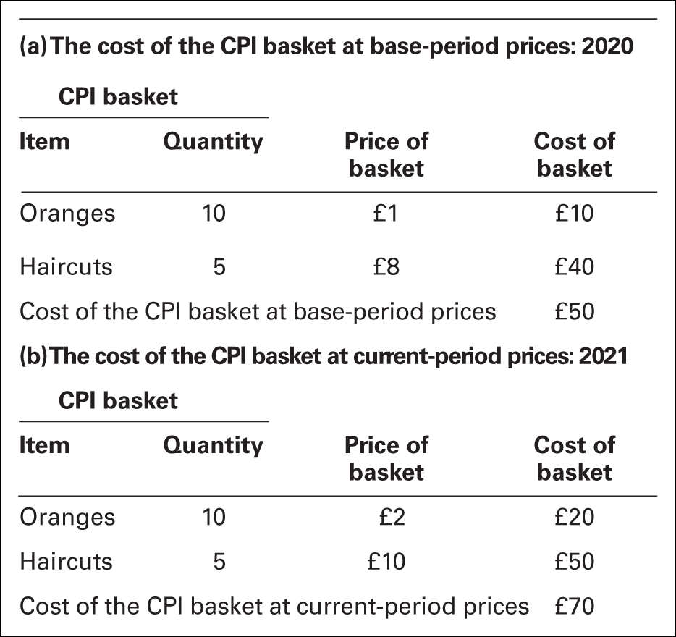
Table 21.1 The CPI: a simplified calculation

Slide 40
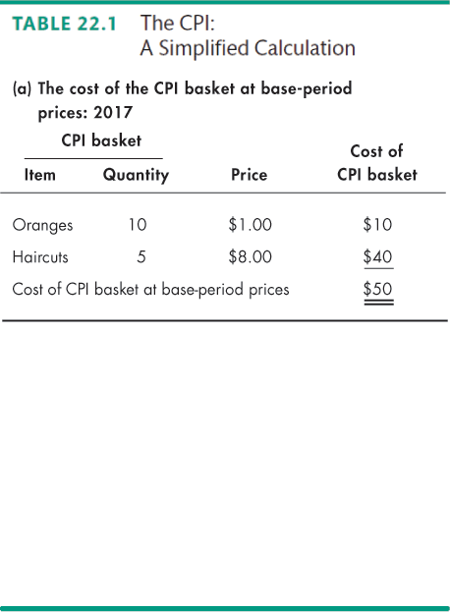
Price Level, Inflation, and Deflation
Let’s work an example of
the CPI calculation.
In a simple economy, people consume only oranges and haircuts.
The CPI basket is
10 oranges and 5 haircuts.
The table also shows the prices in the base period.
The cost of the CPI basket in the base period was $50.

Slide 41
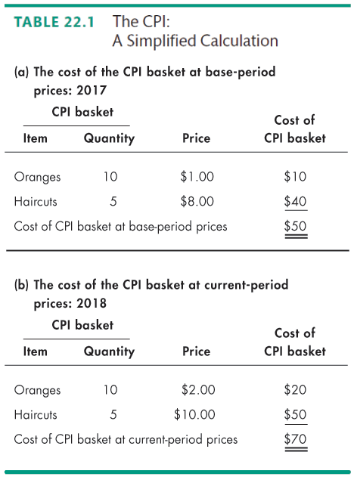
Price Level, Inflation, and Deflation
Table 22.1(b) shows the
fixed CPI basket of goods.
It also shows the prices in the current period.
The cost of the CPI basket at current-period prices is
$70.

Slide 42
Price Level, Inflation, and Deflation
The CPI is calculated using the formula:
CPI = (Cost of basket at current-period prices ÷ Cost of basket at base-period prices) x 100.
Using the numbers for the simple example,
CPI = ($70 ÷ $50) x 100 = 140.
The CPI is 40 percent higher in the current period than it
was in the base period.

Slide 43
Price Level, Inflation, and Deflation
Measuring the Inflation Rate
The major purpose of the CPI is to measure inflation. The inflation rate is the percentage change in the price
level from one year to the next.
The inflation formula is:
Inflation rate = [(CPI this year – CPI last year) ÷ CPI last
year] × 100.

Slide 44
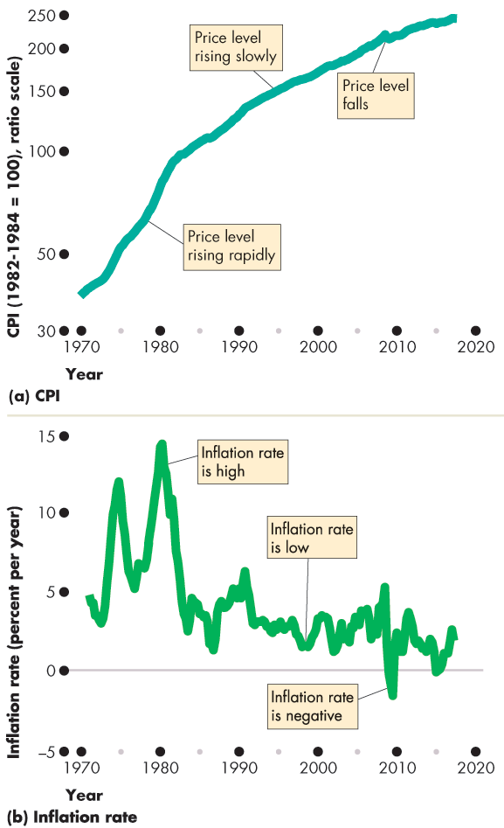
Price Level, Inflation, and Deflation
Figure 22.7 shows the relationship between the price level and the inflation rate.
The inflation rate is
High when the price level is rising rapidly.
Low when the price level is rising slowly.
Negative when the price
level is falling.

Slide 45
Price Level, Inflation, and Deflation
The Biased CPI
The CPI might overstate the true inflation rate for four reasons:
New goods bias
Quality change bias
Commodity substitution bias

Slide 46
Price Level, Inflation, and Deflation
New Goods Bias
New goods that were not available in the base year appear and, if they are more expensive than the goods they replace, they put an upward bias into the CPI.
Quality Change Bias
Quality improvements occur every year. Part of the rise in the price is payment for improved quality and is not inflation.
The CPI counts all the price rise as inflation.

Slide 47
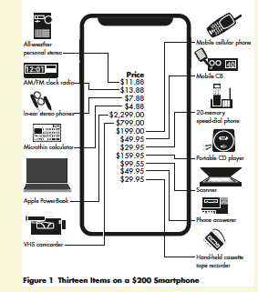

Slide 48
Price Level, Inflation, and Deflation
Commodity Substitution Bias
The market basket of goods used in calculating the CPI is fixed and does not take into account consumers’ substitutions away from goods whose relative prices increase.

Slide 49
Example of Substitution Bias
CPI basket
Good | Quantity | Price (Year 0) | Price (Year 1)
Beef | 10 kg | $10 | $20
Chicken | 10 kg | $5 | $5
Actual consumer behavior (substitution)
Good | Quantity (Year 1) | Price
Beef | 5 kg | $20
Chicken | 15 kg | $5
Actual consumer behavior (substitution)
Consumers substitute chicken for beef:
Beef: 5 kg at $20
Chicken: 15 kg at $5
Actual spending in Year 1: 5 × 20 + 15 × 5 = $175
True cost increase: (175 − 150) ÷ 150 = 16.7%
Cost of the CPI basket
Cost in Year 0: 10 × 10 + 10 × 5 = $150
Cost in Year 1 (fixed basket): 10 × 20 + 10 × 5 = $250
Measured inflation (CPI): (250 − 150) ÷ 150 = 66.7%

Slide 50
Price Level, Inflation, and Deflation
The Magnitude of the Bias
An estimate made in 1996 says that the CPI overstates inflation by 1.1 percentage points a year.
Some Consequences of the Bias
Distorts private contracts.
Increases government outlays (close to a third of
federal government outlays are linked to the CPI).
The BLS has now corrected much of the bias, but some still remains.

Slide 51
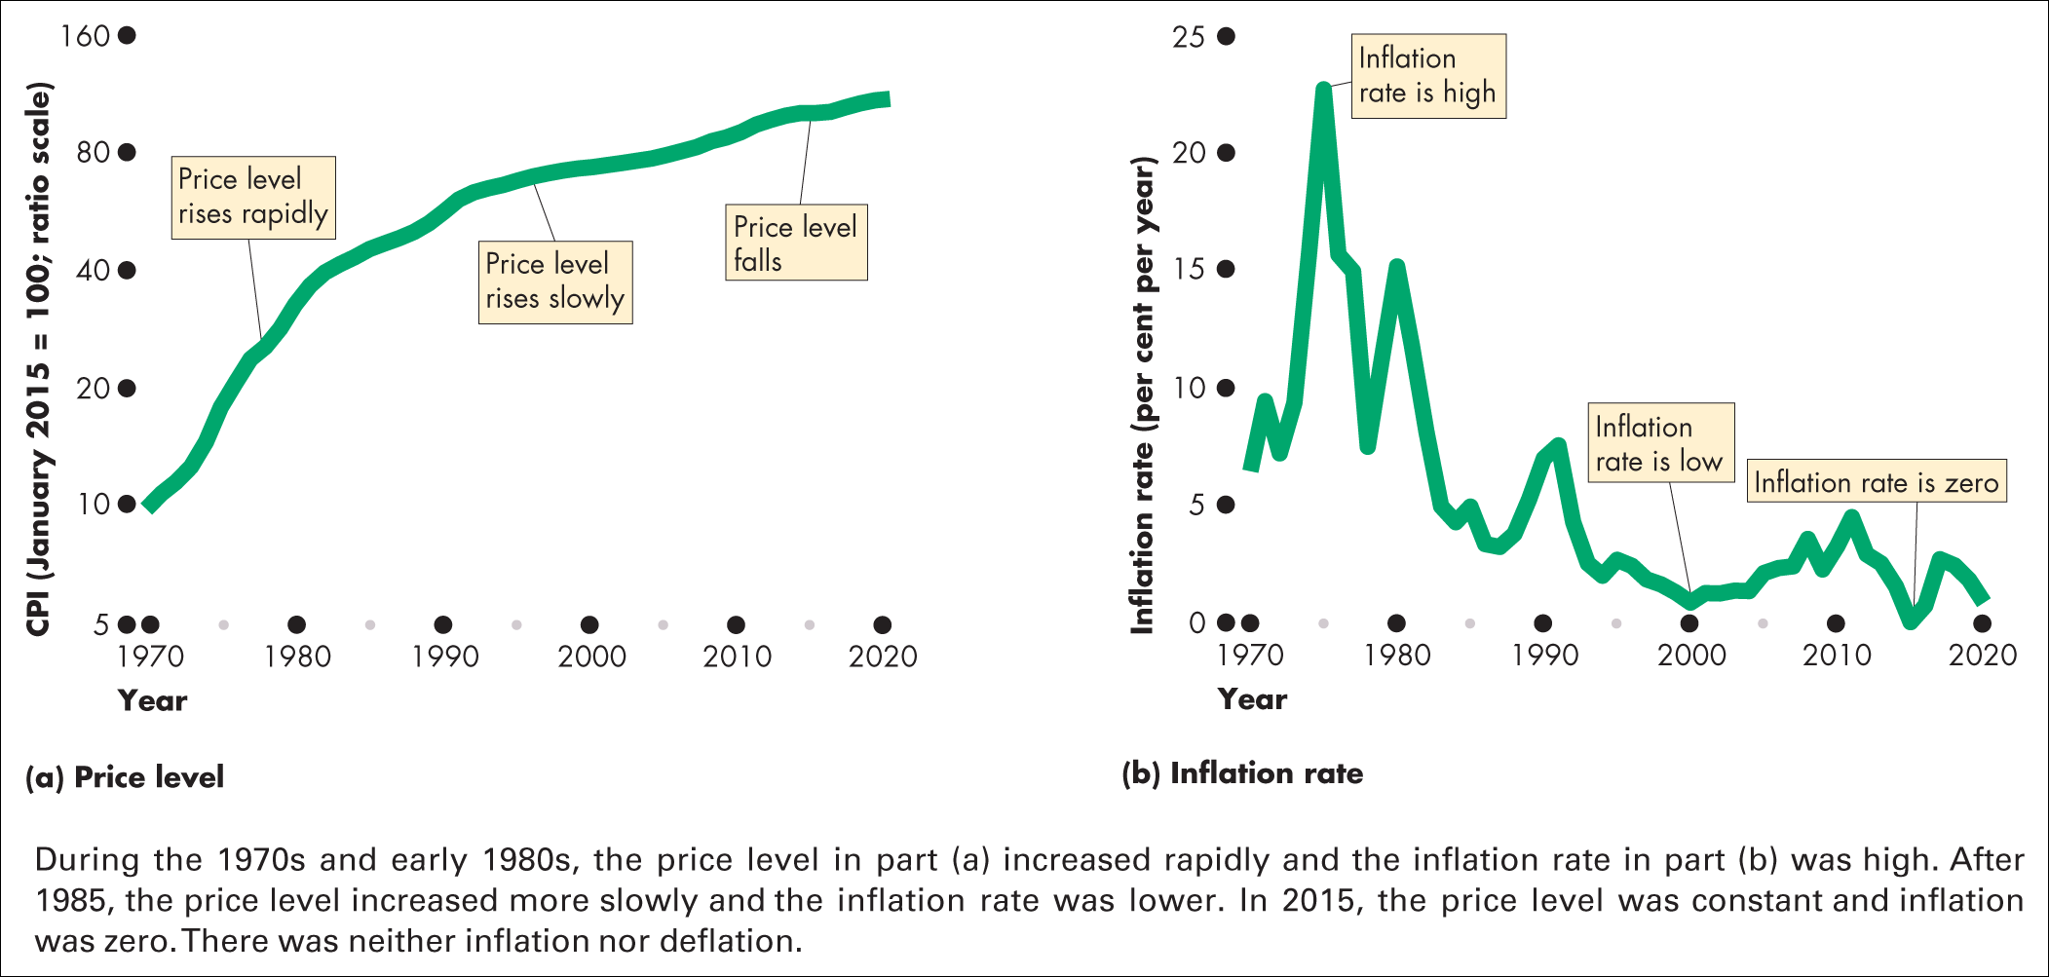
Figure 21.7 The price level and inflation
Source of data: Office for National Statistics

Slide 52
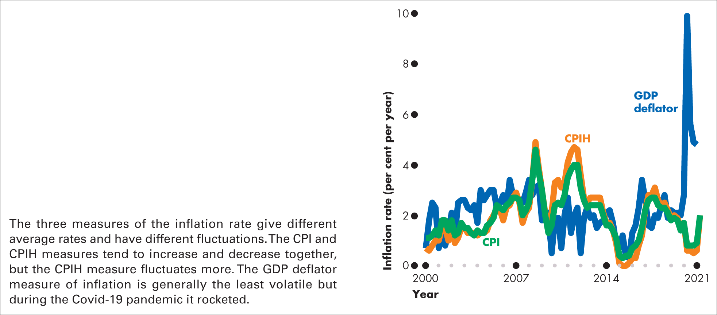
Figure 21.8 Comparing three measures of inflation
Source of data: Office for National Statistics

Slide 53
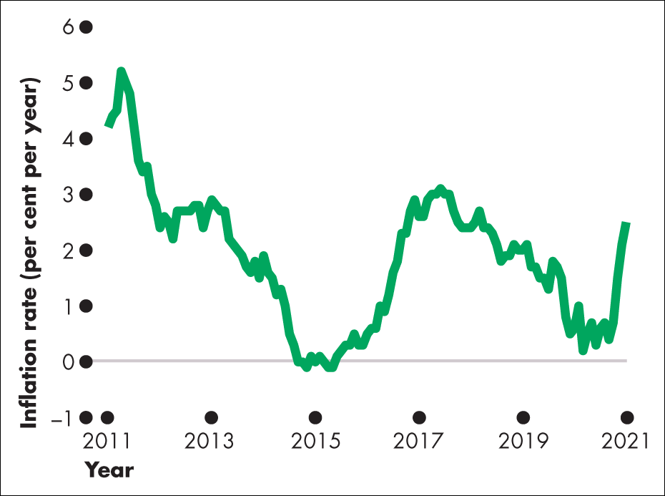
Figure 1 Official CPI inflation

Slide 54
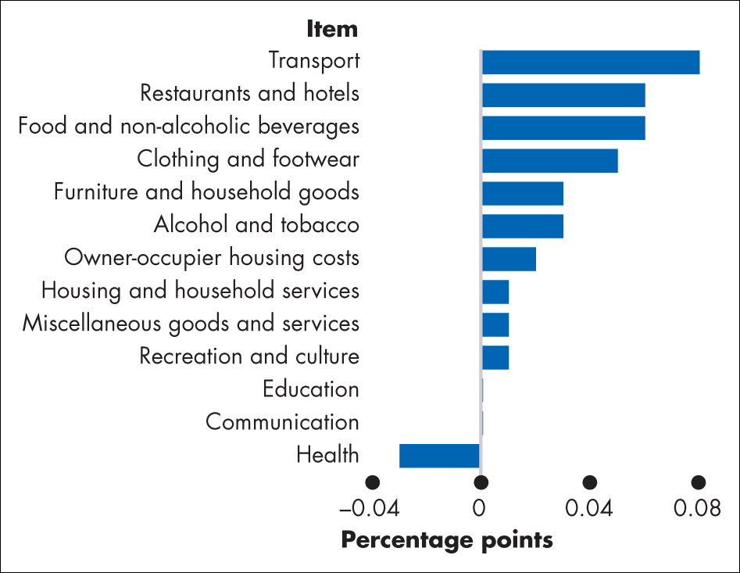
Figure 2 Contributions to inflation June 2021

