Slide 1
Economics
Eleventh European Edition
Part 7
Macroeconomic trends
Chapter 22
Economic growth

Slide 2
After studying this chapter, you will be able to:
Define and calculate the economic growth rate and explain the implications of sustained growth
Describe the economic growth trends in the United
States and other countries and regions
Explain what makes potential GDP grow
Explain the sources of labor productivity growth
Explain the theories of economic growth and policies to increase its rate

Slide 3
The Basics of Economic Growth
Economic growth is the sustained expansion of production possibilities measured as the increase in real GDP over a given period.
Calculating Growth Rates
The economic growth rate is the annual percentage change of real GDP.
The economic growth rate tells us how rapidly the total economy is expanding.

Slide 4
The Basics of Economic Growth
The standard of living depends on real GDP per person.
Real GDP per person is real GDP divided by the population.
Real GDP per person grows only if real GDP grows faster than the population grows.

Slide 5
The Basics of Economic Growth
Economic Growth Versus Business Cycle Expansion
Real GDP can increase for two distinct reasons:
The economy might be returning to full employment in
an expansion phase of the business cycle.
Potential GDP might be increasing.
The return to full employment in an expansion phase of
the business cycle isn’t economic growth.
The expansion of potential GDP is economic growth.

Slide 6
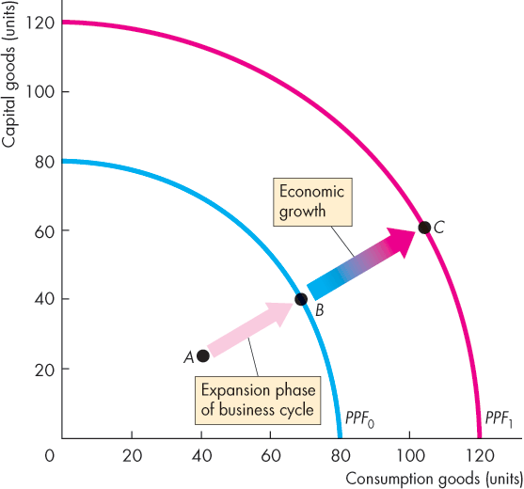

The Basics of Economic Growth
Figure 23.1 illustrates the
distinction.
A return to full employment in an expansion is a movement from inside the PPF to a point on the PPF: from point A to point B.
Economic growth is the outward shift of the PPF from PPF₀ to PPF₁ : from point B to point C.

Slide 7
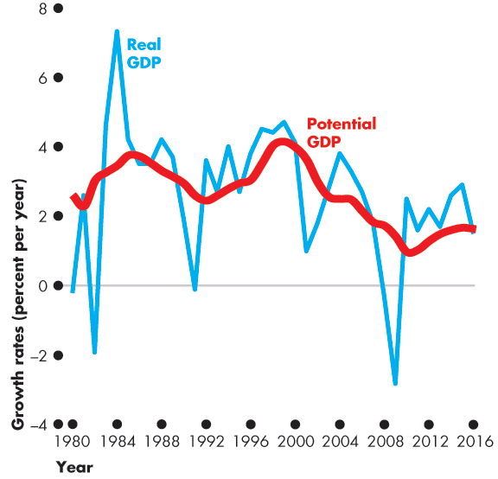
The Basics of Economic Growth
The figure shows the
growth rate of real GDP.
The growth rate of potential GDP measures the pace of expansion of production possibilities and …
smooths out the business cycle fluctuations in the growth rate of real GDP.

Slide 8
The Basics of Economic Growth
The Magic of Sustained Growth
The Rule of 70 states that the number of years it takes for the level of a variable to double is approximately
70 divided by the annual percentage growth rate of the variable.

Slide 9
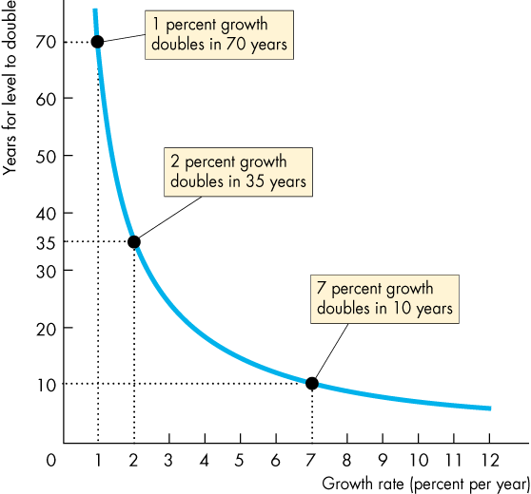
The Basics of Economic Growth
Applying the Rule of 70
Figure 23.3 shows the doubling time for growth rates.
A variable that grows:
At 7 percent a year doubles in 10 years.
At 2 percent a year doubles in 35 years.
At 1 percent a year doubles
in 70 years.

Slide 10
Long-Term Growth Trends
Long-Term Growth in the U.S. Economy
From 1916 to 2016, growth in real GDP per person in the United States averaged 2 percent a year.
Real GDP per person fell precipitously during the Great Depression and rose rapidly during World War II.
Growth was rapid during the 1960s.
Growth slowed during the 1970s and sped up again in the 1980s and1990s, but never returned to the 1960s’ rate.
Figure 23.4 on the next slide illustrates.

Slide 11
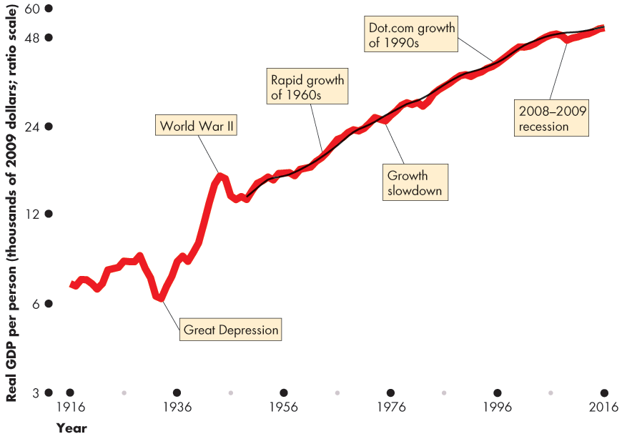
Long-Term Growth Trends

Slide 12
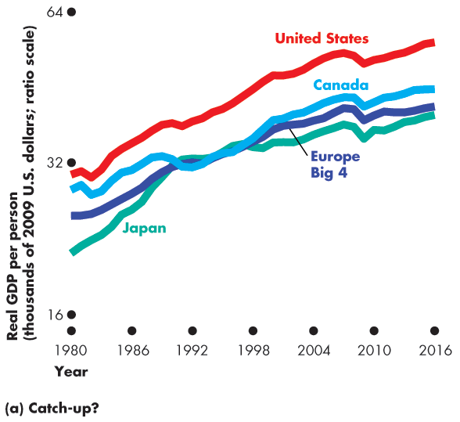
Long-Term Growth Trends
Real GDP Growth in the
World Economy
Figure 23.5(a) shows the growth in rich countries.
Japan grew rapidly in the 1960s, slower in the 1980s, and stagnated during the 1990s.
Growth in Europe Big 4, Canada, and the United States has been similar.

Slide 13
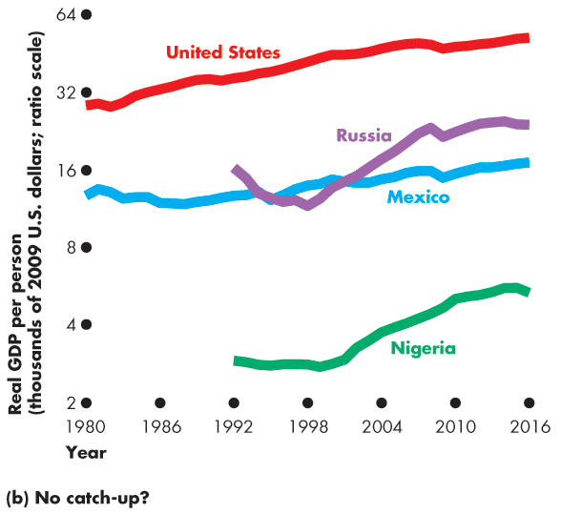
Economic Growth Trends
Figure 23.5(b) shows the growth of real GDP per person in a group of poor countries.
The gaps between real GDP per person in the United States and in these countries have widened.

Slide 14
How Potential GDP Grows
Economic growth occurs when real GDP increases.
But a one-shot increase in real GDP or a recovery from recession is not economic growth.
Economic growth is the sustained, year-on-year increase in potential GDP.

Slide 15
How Potential GDP Grows
What Determines Potential GDP?
Potential GDP is the quantity of real GDP produced when the quantity of labor employed is the full-employment quantity.
To determine potential GDP we use a model with two components:
An aggregate production function
An aggregate labor market

Slide 16
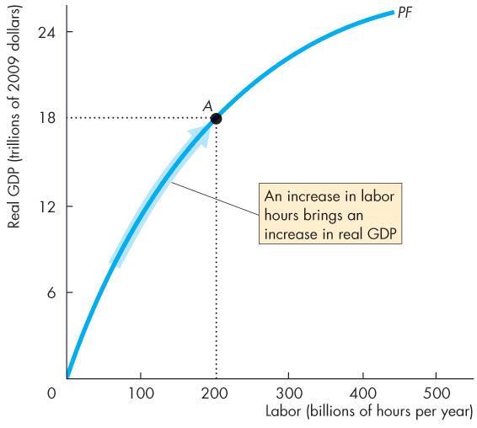

How Potential GDP Grows
Aggregate Production
Function
The aggregate production function tells us how real GDP changes as the quantity of labor changes when all other influences on production remain the same.
An increase in labor
increases real GDP.

Slide 17
How Potential GDP Grows
Aggregate Labor Market
The demand for labor shows the quantity of labor demanded and the real wage rate.
The real wage rate is the money wage rate divided by the price level.
The supply of labor shows the quantity of labor supplied
and the real wage rate.
The labor market is in equilibrium at the real wage rate at which the quantity of labor demanded equals the quantity of labor supplied.

Slide 18
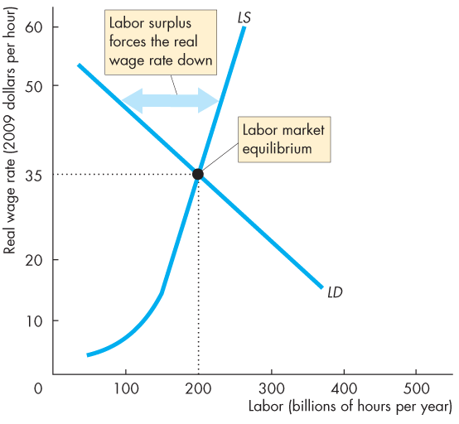
How Potential GDP Grows
Figure 23.7 illustrates labor
market equilibrium.
Labor market equilibrium occurs at a real wage rate of $35 an hour and 200 billion hours employed.
At a real wage rate above
$35 an hour, there is a surplus of labor and the real wage rate falls.

Slide 19
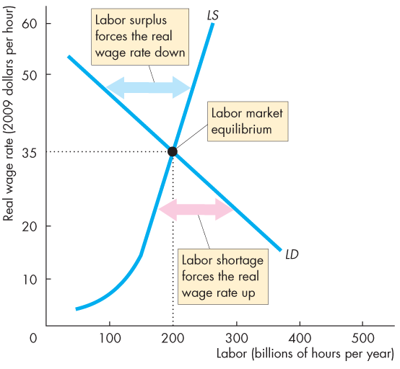
How Potential GDP Grows
At a real wage rate below
$35 an hour, there is a shortage of labor and the real wage rate rises.
At the labor market equilibrium, the economy is at full employment.

Slide 20
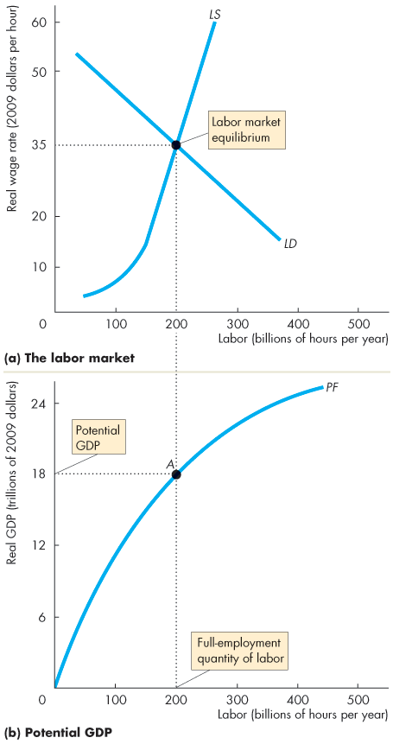
How Potential GDP Grows
Potential GDP
The quantity of real GDP produced when the economy is at full employment is potential GDP.
The economy is at
full-employment when 200 billion hours of labor are employed.
Potential GDP is $18 trillion.

Slide 21
How Potential GDP Grows
What Makes Potential GDP Grow?
We begin by dividing real GDP growth into the forces that increase:
Growth in the supply of labor
Growth in labor productivity

Slide 22
How Potential GDP Grows
Growth in the Supply of Labor
Aggregate hours, the total number of hours worked by all the people employed, change as a result of changes in:
Average hours per worker
Employment-to-population ratio
The working-age population growth
Population growth increases aggregate hours and real GDP, but to increase real GDP per person, labor must become more productive.

Slide 23
How Potential GDP Grows
The Effects of Population Growth
An increase in population increases the supply of labor. With no change in the demand for labor, the equilibrium
real wage rate falls and the aggregate hours increase.
As aggregate hours increase, potential GDP increases.

Slide 24
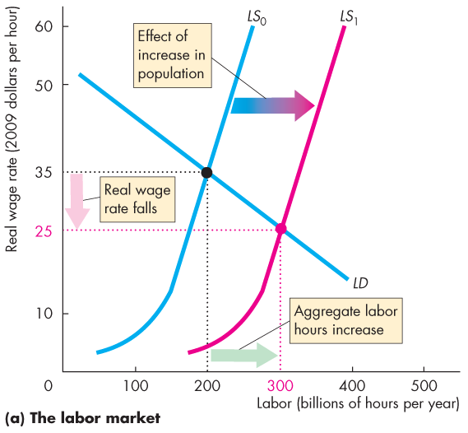
How Potential GDP Grows
Figure 23.9(a) illustrates the effects of population growth in the labor market.
The labor supply curve shifts rightward.
The real wage rate falls …
and aggregate hours increase.

Slide 25
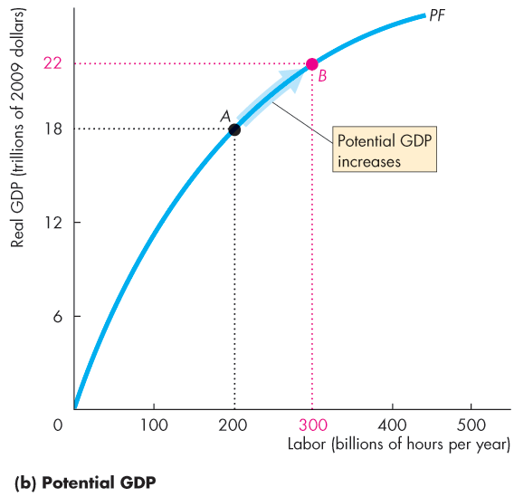
How Potential GDP Grows
As aggregate hours increase, potential GDP increases.
Because of the diminishing returns, the increased population …
increases real GDP, …
but decreases real GDP per hour of labor.

Slide 26
How Potential GDP Grows
Growth of Labor Productivity
Labor productivity is the quantity of real GDP produced by an hour of labor.
Labor productivity equals real GDP divided by aggregate labor hours.
If labor becomes more productive, firms are willing to pay more for a given number of hours so the demand for labor increases.

Slide 27
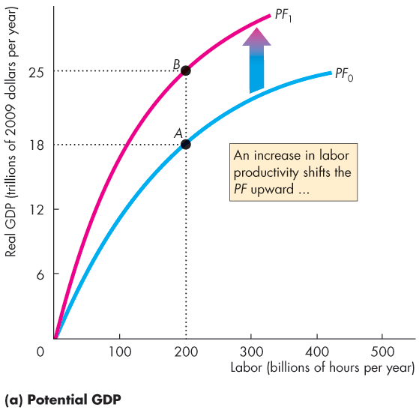
How Potential GDP Grows
Figure 23.10 shows the effect of an increase in labor productivity.
The increase in labor productivity shifts the production function upward.

Slide 28
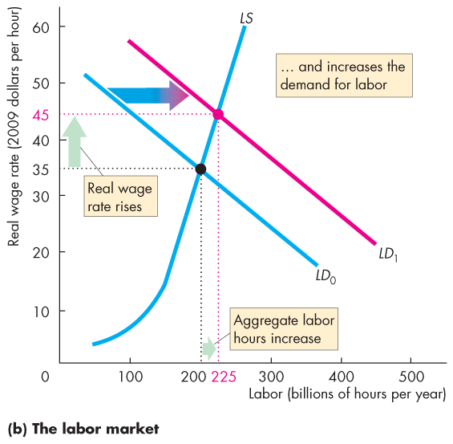
How Potential GDP Grows
In the labor market:
An increase in labor productivity increases the demand for labor.
With no change in the supply of labor, the real wage rate rises …
and aggregate hours increase.

Slide 29
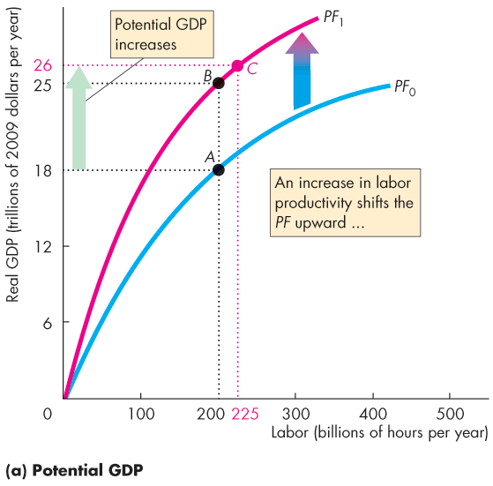
How Potential GDP Grows
And with the increase in aggregate hours, potential GDP increases from B to C.

Slide 30
Why Labor Productivity Grows
Preconditions for Labor Productivity Growth
The fundamental precondition for labor productivity growth is the incentive system created by firms, markets, property rights, and money.
With preconditions for labor productivity growth in place, three things influence its pace:
Physical capital growth
Human capital growth
Technological advances

Slide 31
Why Labor Productivity Grows
Physical Capital Growth
The accumulation of new capital increases capital per worker and increases labor productivity.
Human Capital Growth
Human capital acquired through education, on-the-job training, and learning-by-doing is the most fundamental source of labor productivity growth.

Slide 32
Why Labor Productivity Grows
Technological Advances
Technological change—the discovery and the application of new technologies and new goods—has contributed immensely to increasing labor productivity.
Figure 23.11 on the next slide summarizes the process of growth.
It also shows that the growth of real GDP per person depends on real GDP growth and the population growth rate.

Slide 33
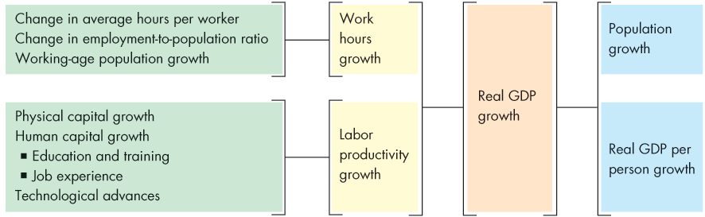
Why Labor Productivity Grows

Slide 34
Growth Theories, Evidence, and Policies
Two further facts play a key role in the new growth theory:
Discoveries are a public capital good.
Knowledge is not subject to diminishing returns.
Increasing the stock of knowledge makes capital and labor more productive.
The central proposition of new growth theory is that knowledge capital does not experience diminishing returns.

Slide 35
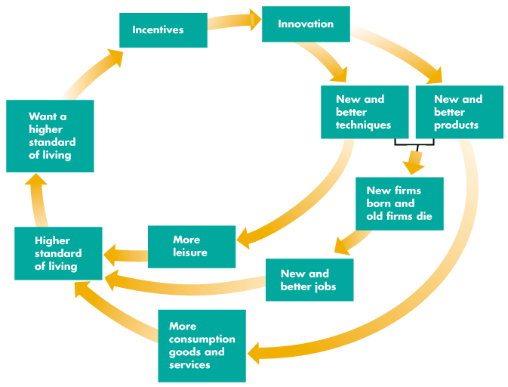
Growth Theories, Evidence, and Policies
Figure 23.12 summarizes the ideas of new growth theory as a perpetual motion machine.

Slide 36

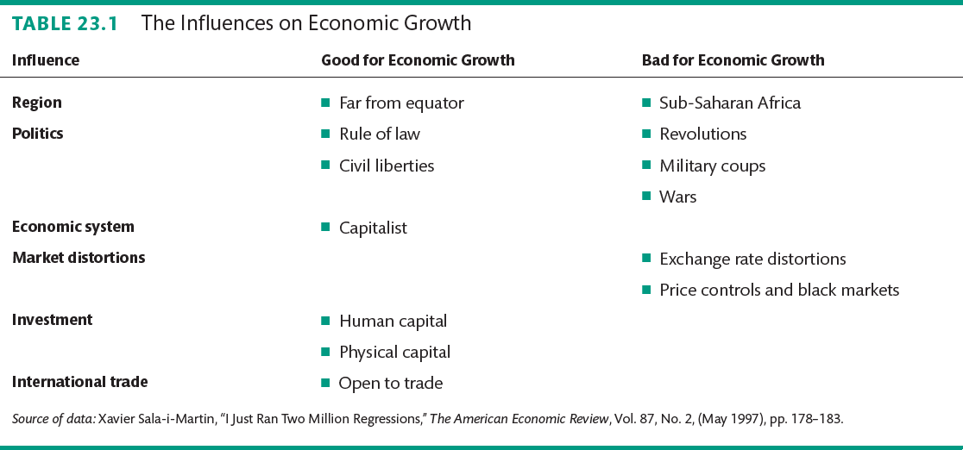
Growth Theories, Evidence, and Policies

Slide 37
Growth Theories, Evidence, and Policies
Policies for Achieving Faster Growth
Growth accounting tells us that to achieve faster economic growth we must either increase the growth rate of capital per hour of labor or increase the pace of technological change.
The main suggestions for achieving these objectives are
Stimulate Saving
Saving finances investment. So higher saving rates might increase physical capital growth.
Tax incentives might be provided to boost saving.

Slide 38
Growth Theories, Evidence, and Policies
Stimulate Research and Development
Because the fruits of basic research and development efforts can be used by everyone, not all the benefit of a discovery falls to the initial discoverer.
So the market might allocate too few resources to research and development.
Government subsidies and direct funding might stimulate basic research and development.

Slide 39
Growth Theories, Evidence, and Policies
Improve the Quality of Education
The benefits from education spread beyond the person being educated, so there is a tendency to under invest in education.
Provide International Aid to Developing Nations
If rich countries give financial aid to developing countries,
investment and growth will increase.
But data on the effect of aid shows that it has had zero or a negative effect.

Slide 40
Growth Theories, Evidence, and Policies
Encourage International Trade
Free international trade stimulates growth by extracting all the available gains from specialization and trade.
The fastest growing nations are the ones with the fastest growing exports and imports.

Slide 41
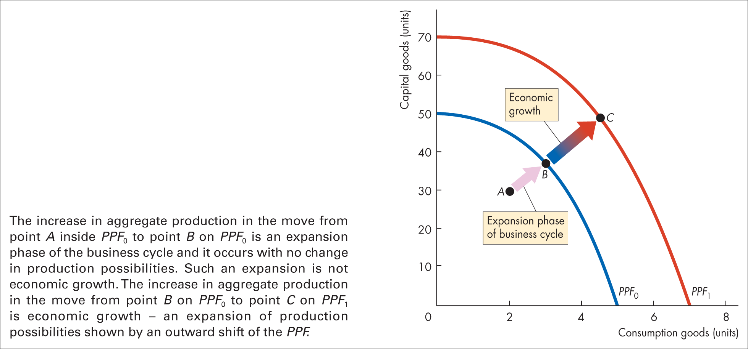
Figure 22.1 Economic growth and the business cycle

Slide 42
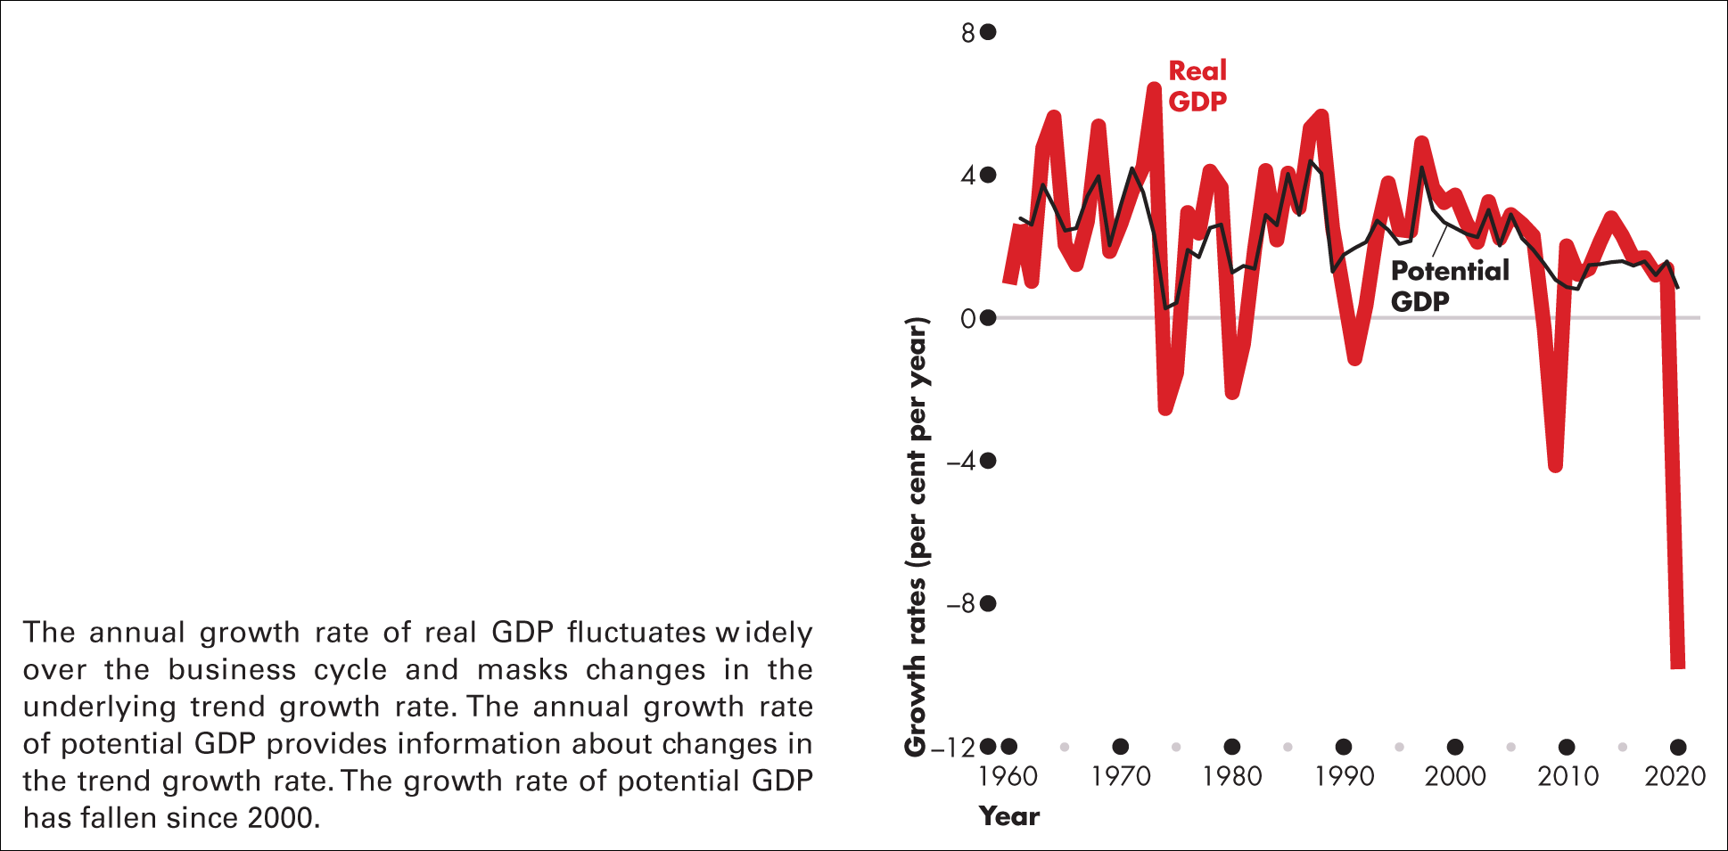
Figure 22.2 Growth rates of real GDP and potential GDP
Sources of data: Office for National Statistics and IMF

Slide 43
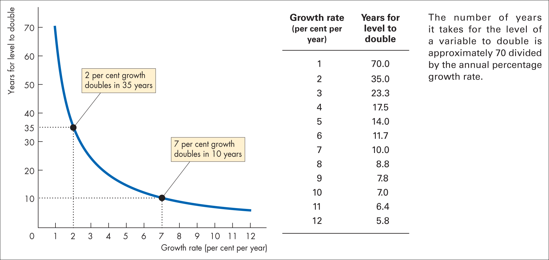
Figure 22.3 Rule of 70

Slide 44
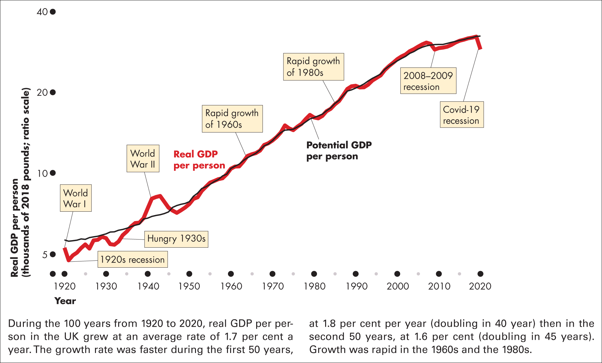
Figure 22.4 One hundred years of economic growth in the UK
Sources of data: ONS and Bank of England IMF

Slide 45
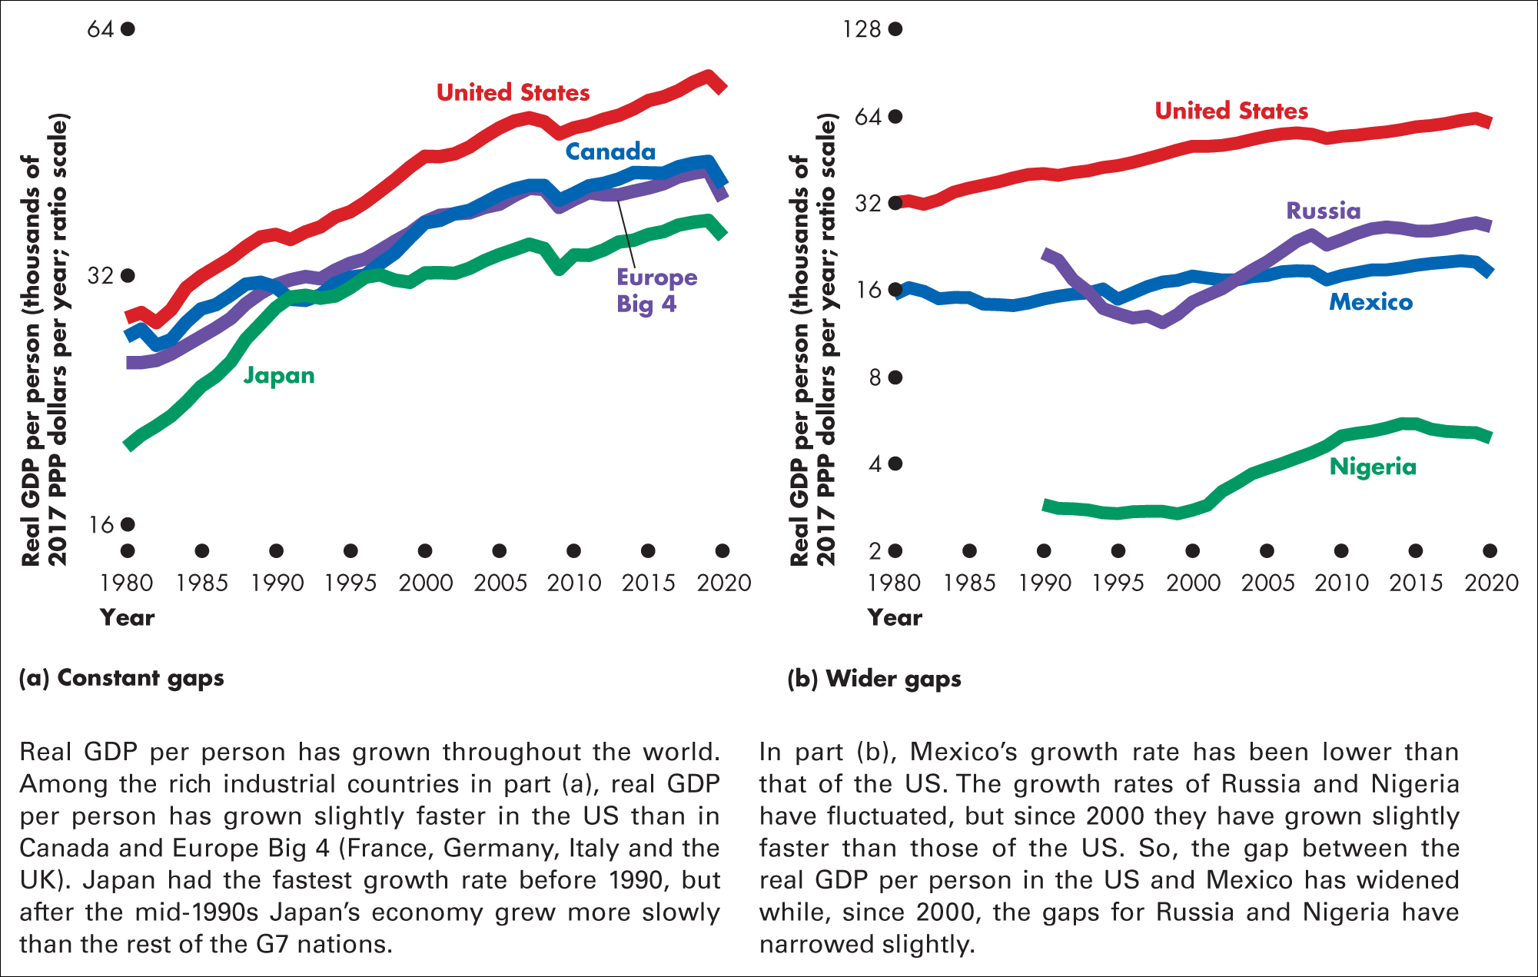
Figure 22.5 Economic growth around the world: catch-up or not?
Sources of data: World Economic Outlook Database, International Monetary Fund, April 2021

Slide 46
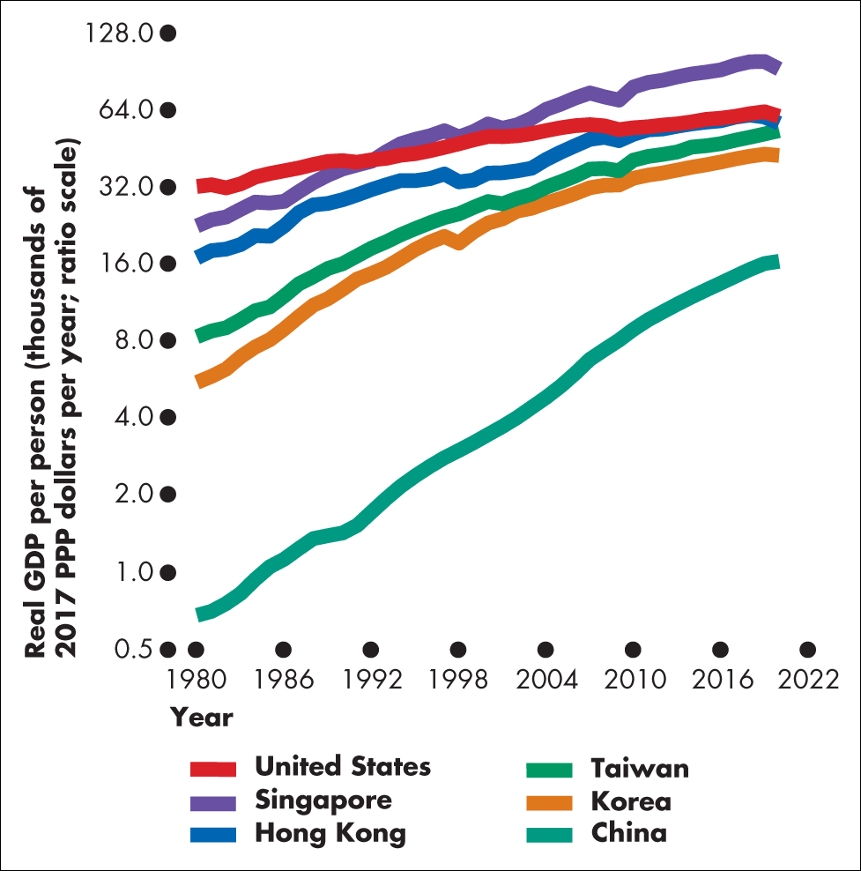
Figure 1 Closing gaps
Sources of data: Economic Outlook Database, International Monetary Fund, April 2021

Slide 47
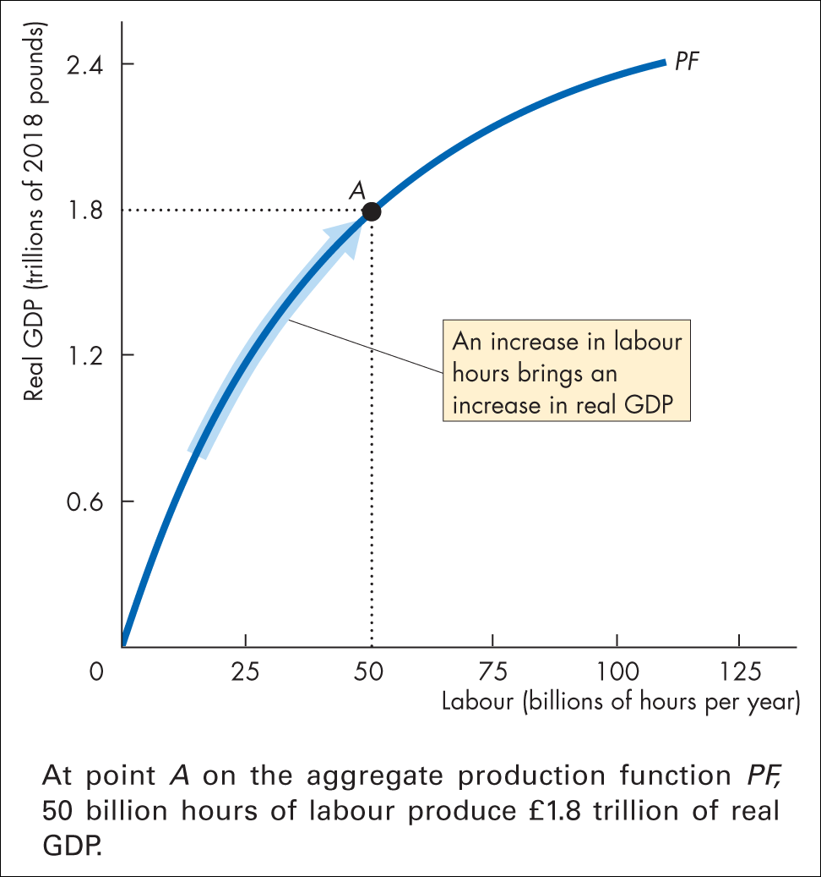
Figure 22.6 The aggregate production function

Slide 48
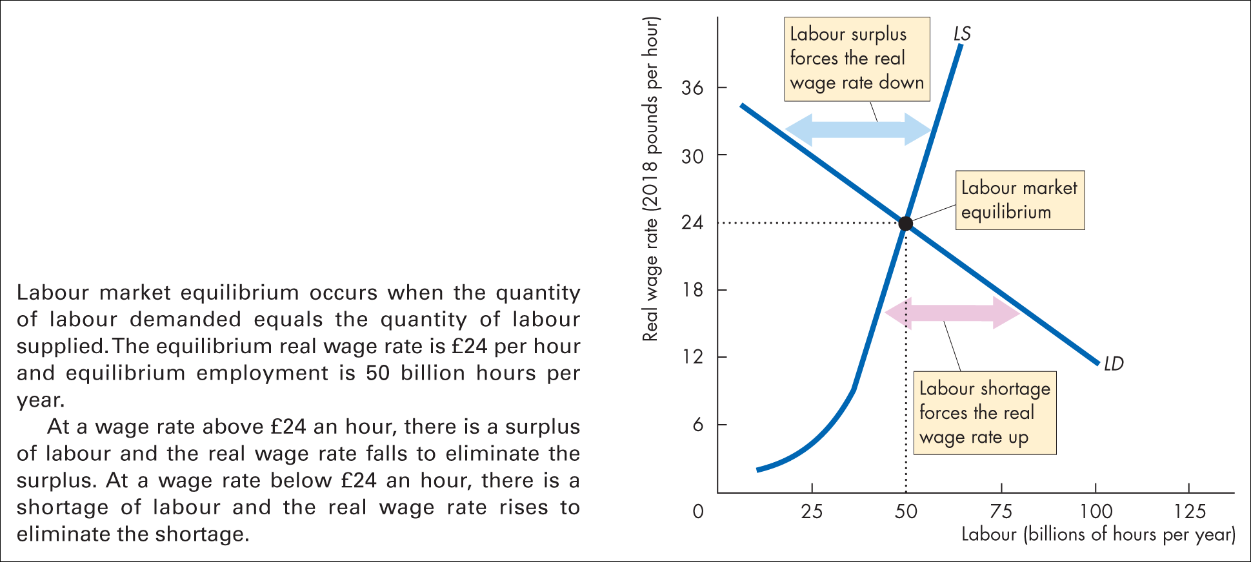
Figure 22.7 Labour market equilibrium

Slide 49
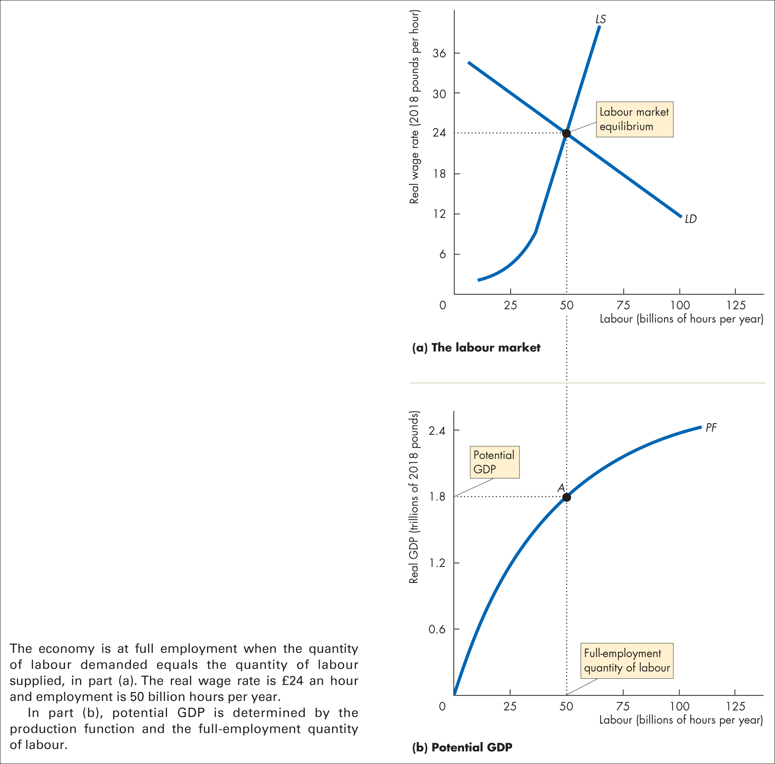
Notes:
Figure 22.8 The labour market and potential GDP

Slide 50
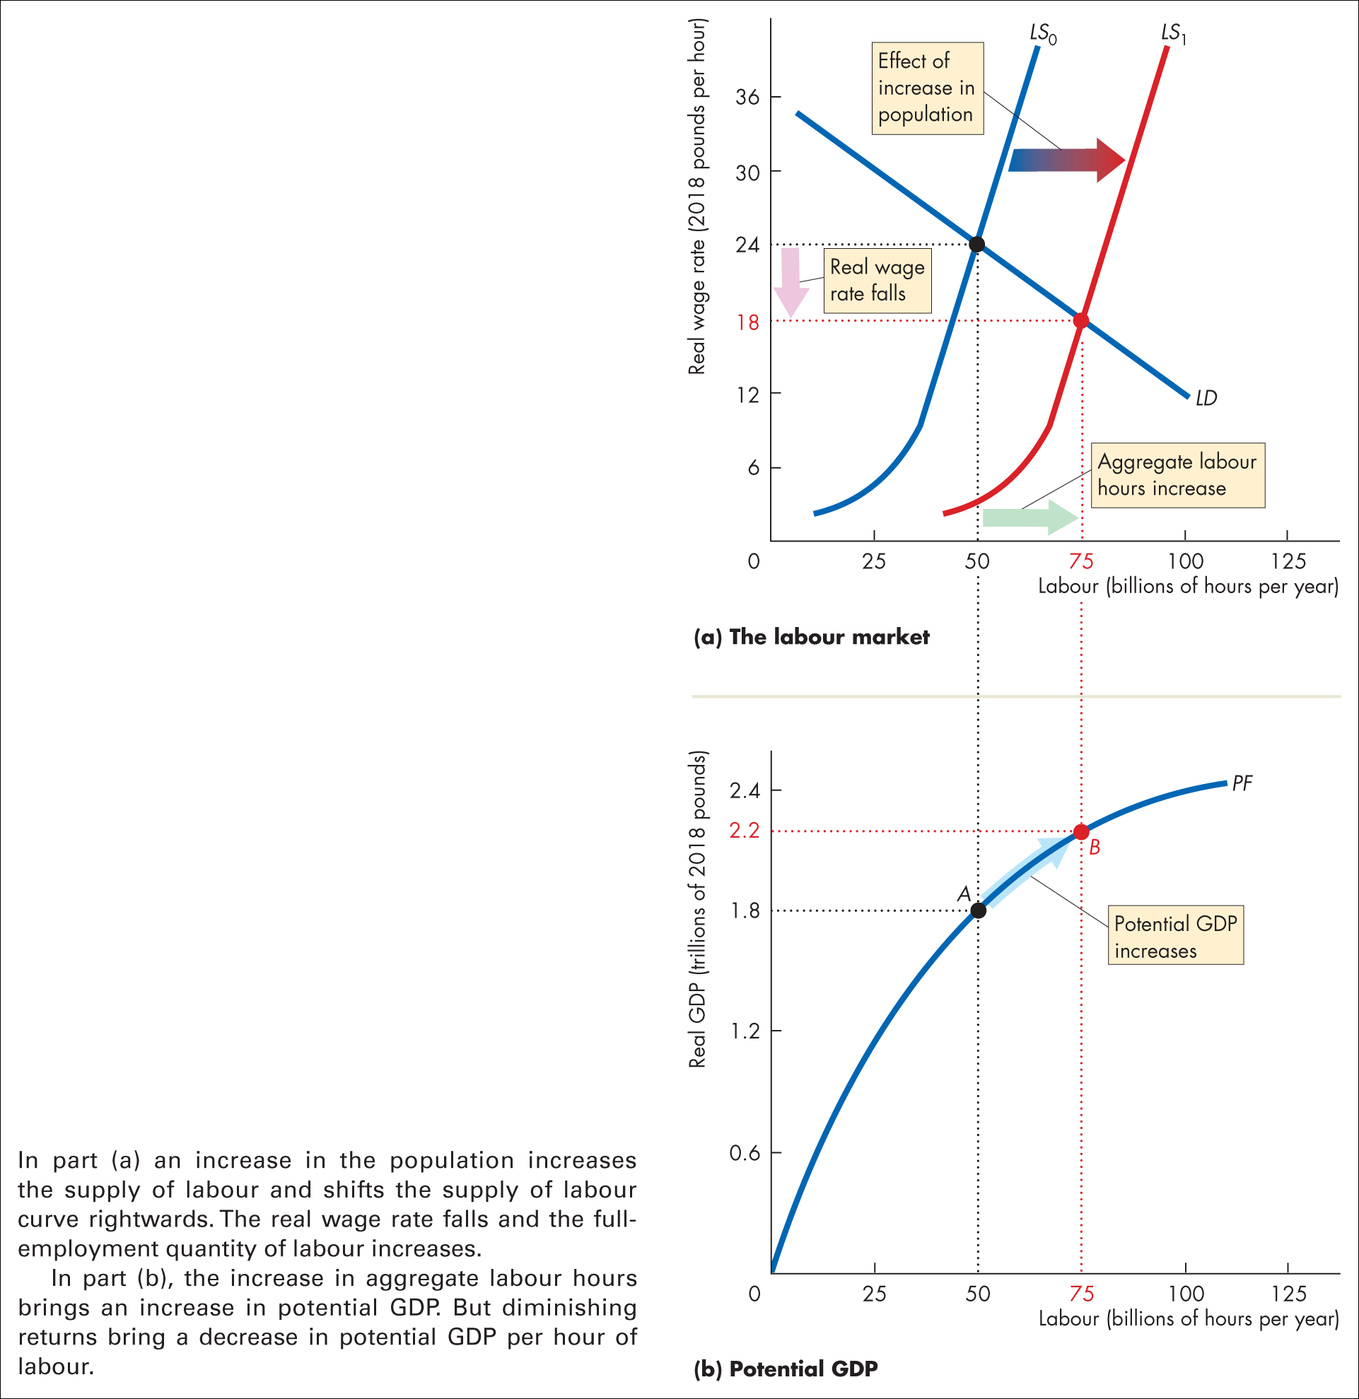
Notes:
Figure 22.9 Effects of an increase in population

Slide 51
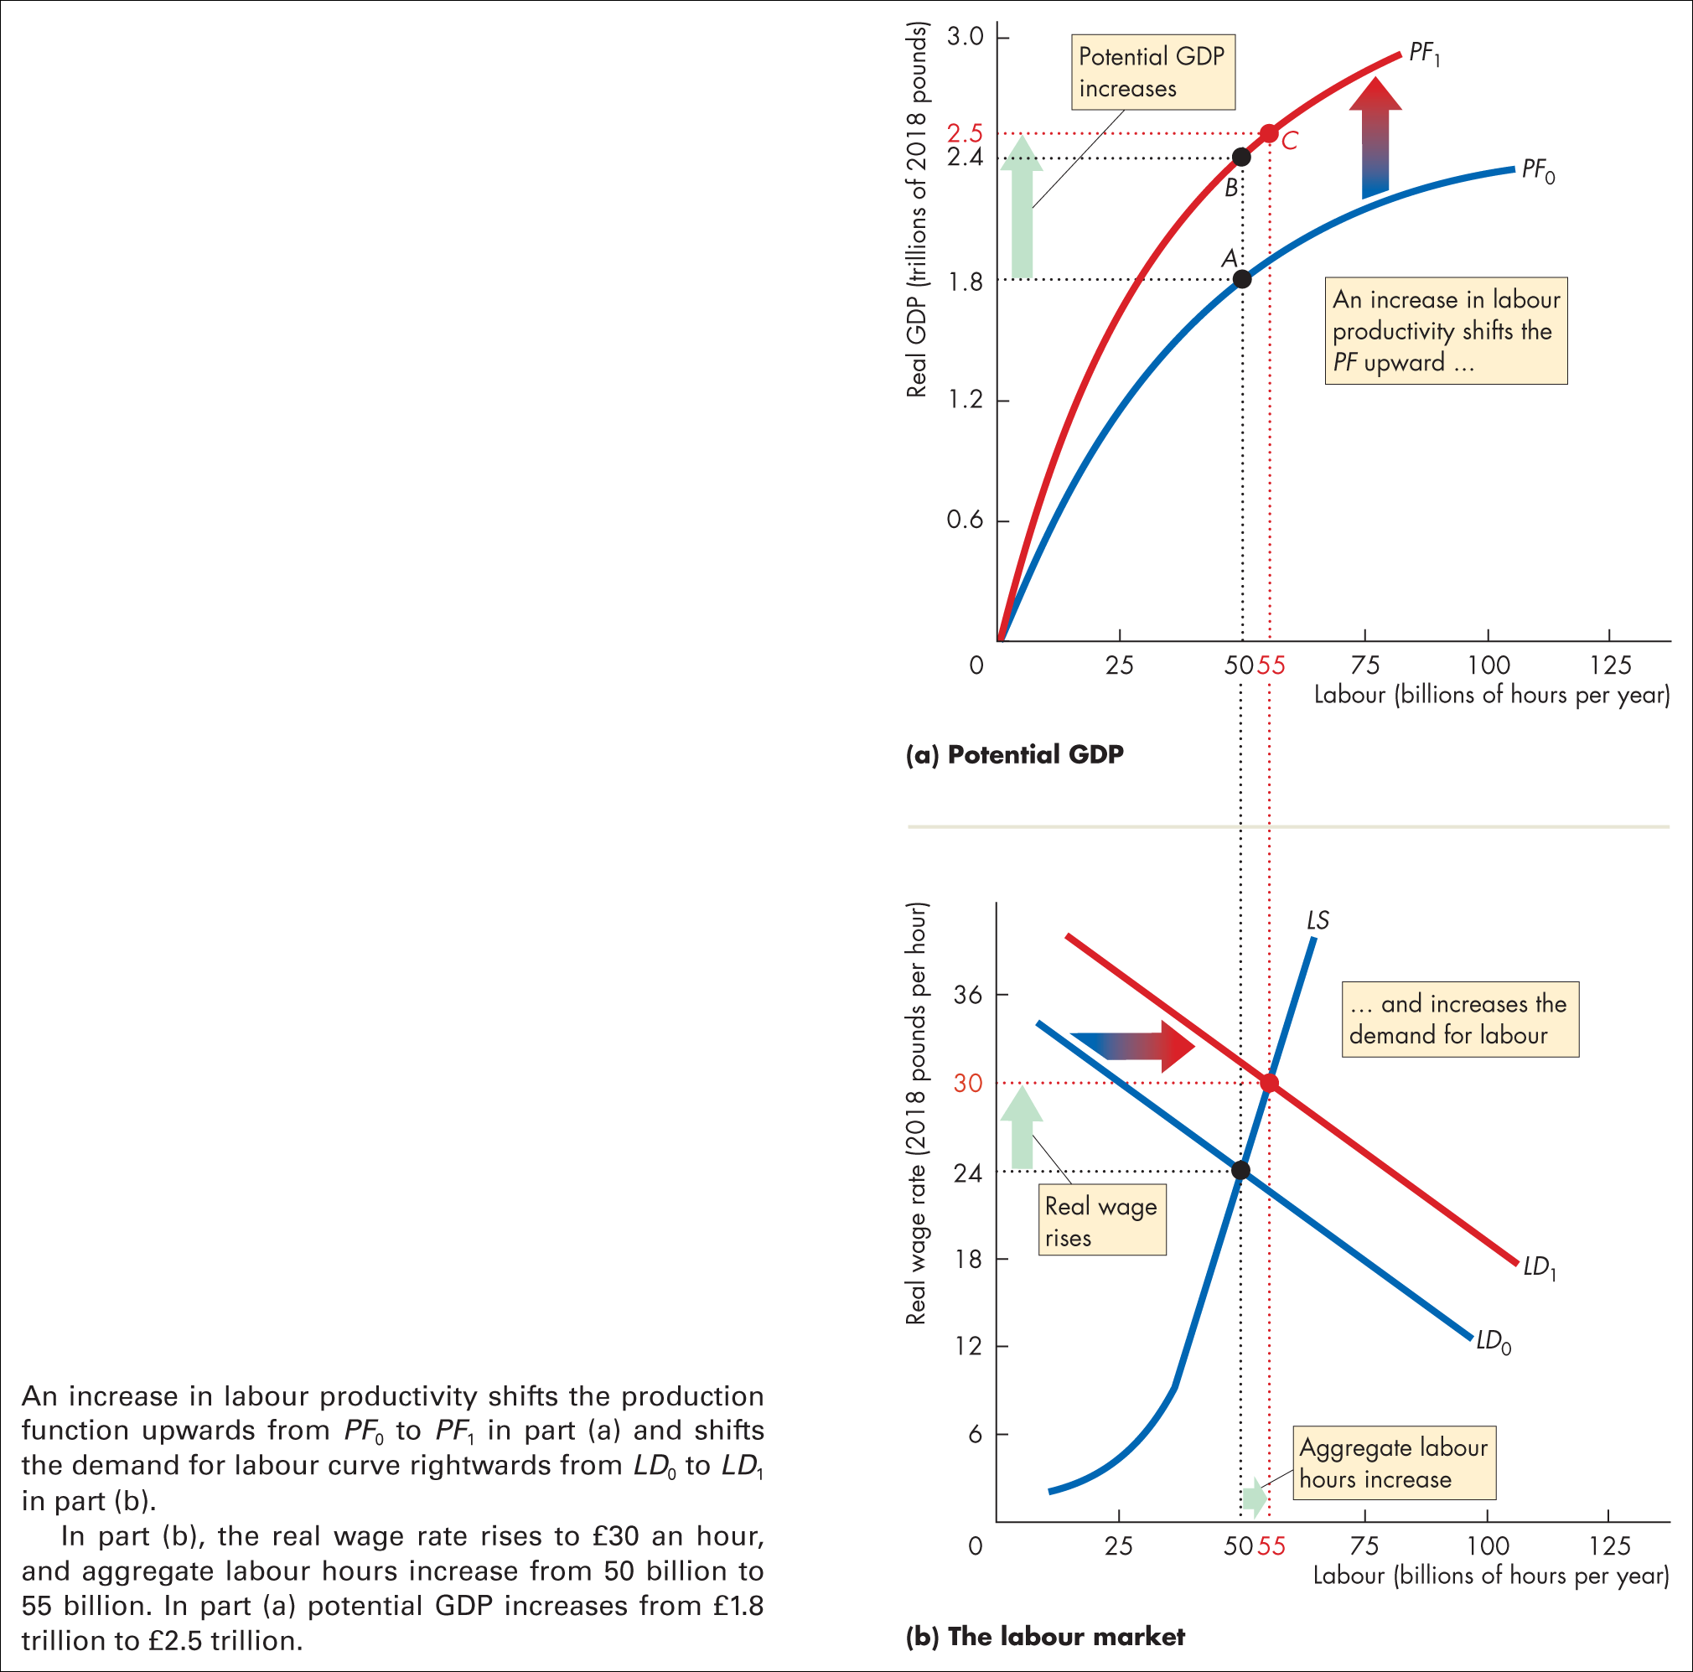
Notes:
Figure 22.10 Effects of an increase in labour productivity

Slide 52
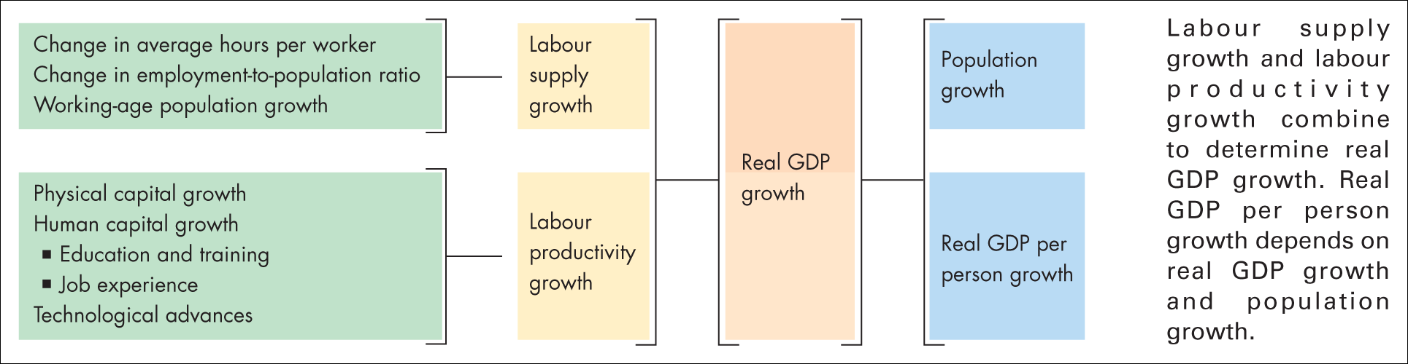
Figure 22.11 Sources of economic growth

Slide 53
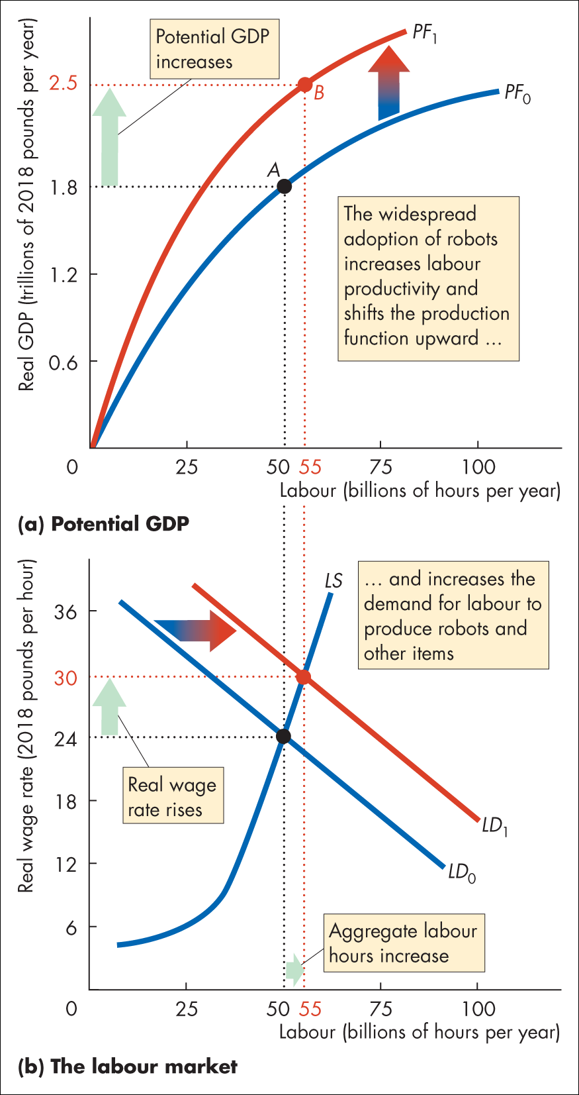
Figure 1 The effects of robots on employment and GDP

Slide 54
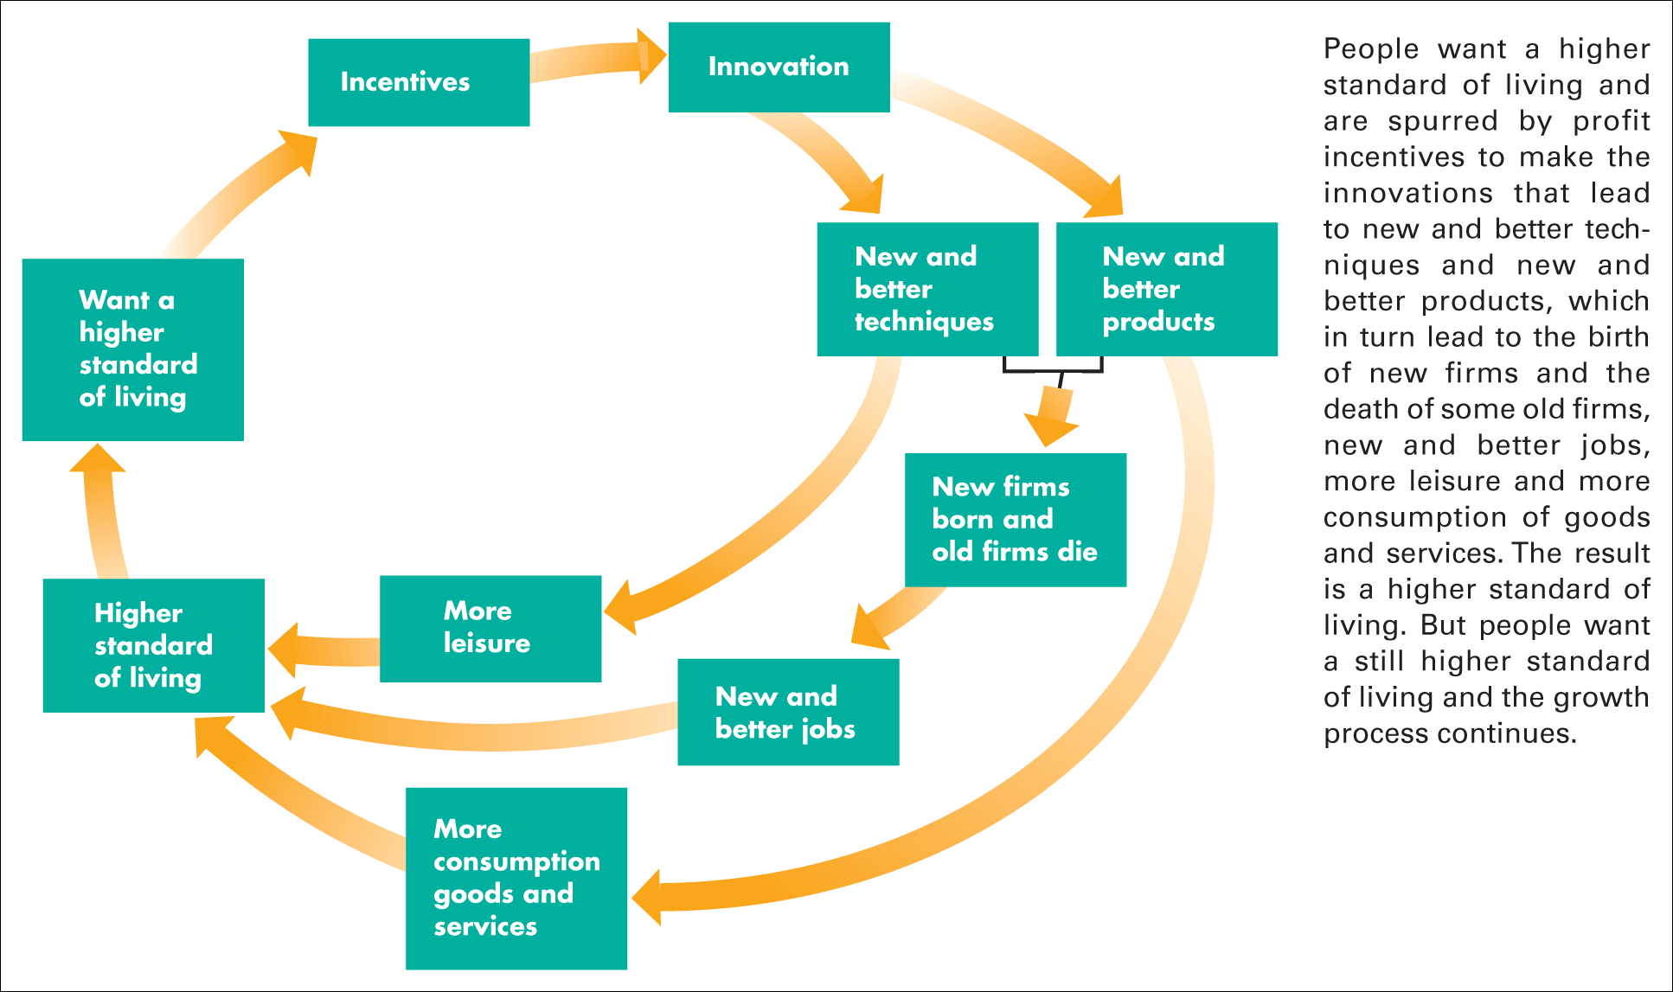
Figure 22.12 A perpetual motion machine
Source: Based on a similar figure in These Are the Good Old Days: A Report on United States Living Standards, Federal Reserve Bank of Dallas 1993 Annual Report

Slide 55
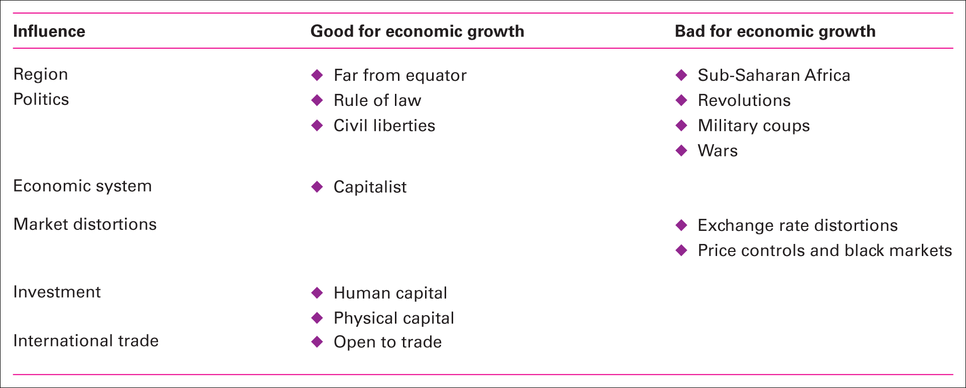
Table 22.1 The influences on economic growth
Source of information: Xavier Sala-i-Martin, ‘I Just Ran Two Million Regressions’, The American Economic Review, Vol. 87, No. 2 (May 1997), pp. 178–183.

Slide 56
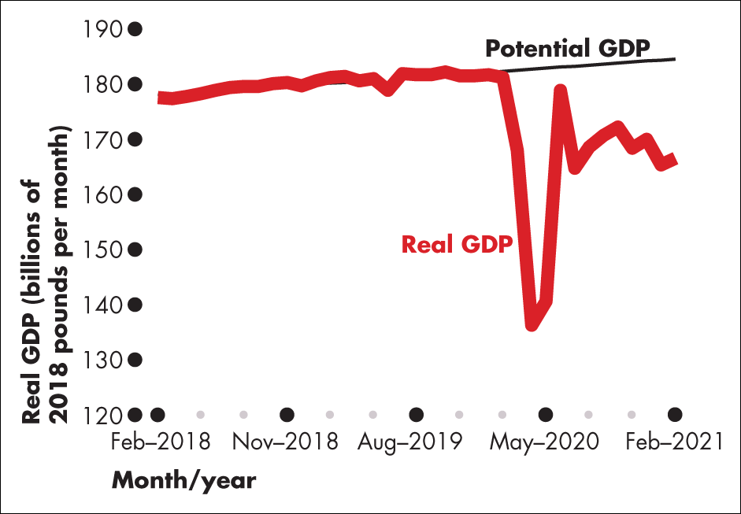
Figure 1 Real GDP and potential GDP

Slide 57
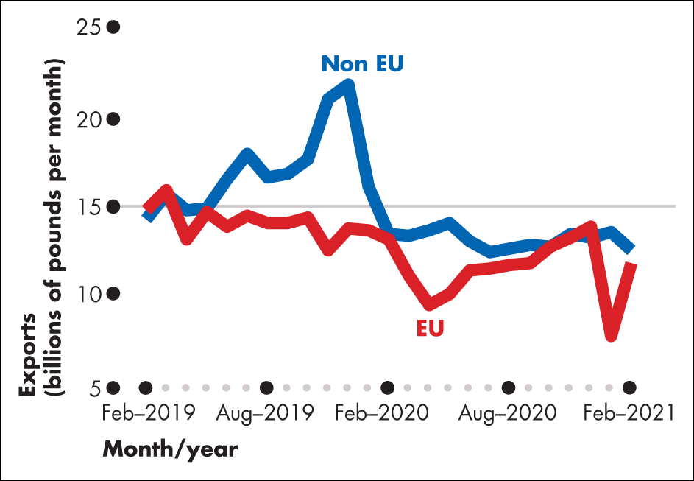
Figure 2 UK exports of goods

Slide 58
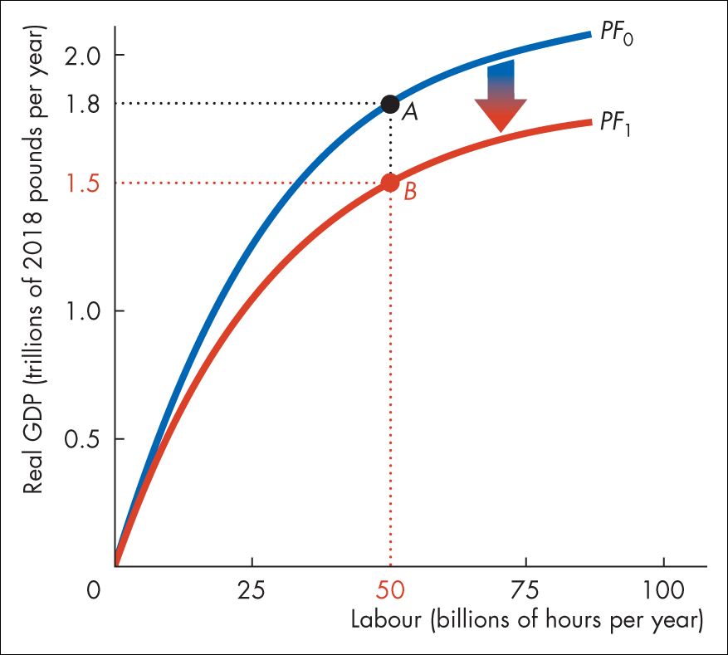
Figure 3 Brexit shifts the production function

