Slide 1
Economics
Eleventh European Edition
Part 8
Macroeconomic fluctuations
Chapter 28
The business cycle, inflation and deflation

Slide 2

28
The business cycle, inflation and deflation
When you have completed your study of this chapter, you will be able to
CHAPTER CHECKLIST
1 Explain how aggregate demand shocks and aggregate
supply shocks create the business cycle
2 Explain how demand-pull and cost-push forces
bring cycles in inflation and output
3 Explain the causes and consequences of deflation
4 Explain the short-run and long-run tradeoff
Notes:
Notes and teaching tips: 32−33 and 55.
To view a full-screen figure during a class, click the red “expand” button.
To return to the previous slide, click the red “shrink” button.
To advance to the next slide, click anywhere on the full screen figure.
To enhance your lecture, check out the Lecture Launchers, Land Mines, and Class Activities in the Instructor’s Manual.

Slide 3
28.1 AGGREGATE SUPPLY
The quantity of real GDP supplied is the total amount of final goods and services that firms in the United States plan to produce.
The quantity of real GDP supplied depends on the quantities of
Labor employed
Capital, human capital, and the state of technology
Land and natural resources
Entrepreneurial talent

Slide 4
28.1 AGGREGATE SUPPLY
At full employment:
The real wage rate makes the quantity of labor demanded equal to the quantity of labor supplied.
Real GDP equals potential GDP.
Over the business cycle:
The quantity of labor employed fluctuates around its full employment level.
Real GDP fluctuates around potential GDP.

Slide 5
28.1 AGGREGATE SUPPLY
Aggregate Supply Basics
Aggregate supply is the relationship between the quantity of real GDP supplied and the price level when all other influences on production plans remain the same.
Other things remaining the same,
When the price level rises, the quantity of real GDP supplied increases.
When the price level falls, the quantity of real GDP supplied decreases.

Slide 6
28.1 AGGREGATE SUPPLY
Along the aggregate supply curve, the only influence on production plans that changes is the price level.
All the other influences on production plans remain constant. Among these other influences are
The money wage rate
The money prices of other resources
In contrast, along the potential GDP line, when the price level changes the money wage rate changes to keep the real wage rate at the full-employment level.

Slide 7
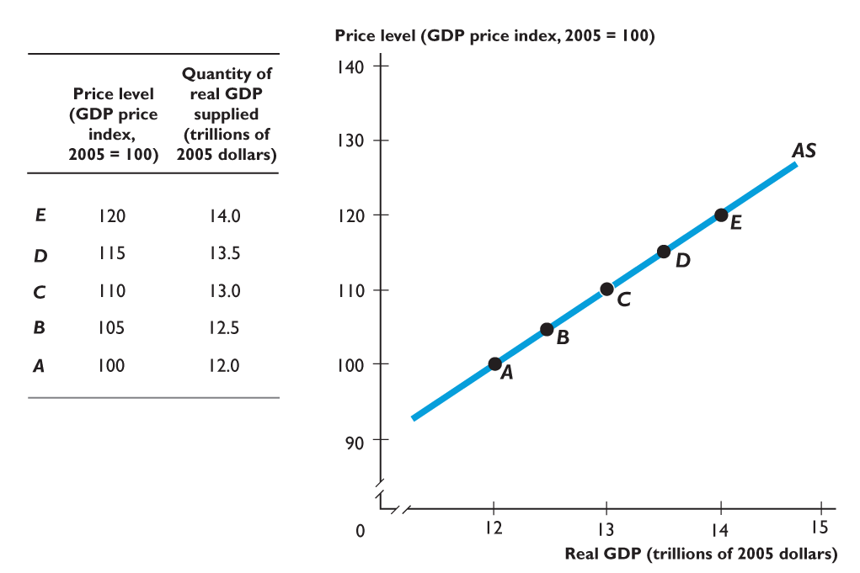
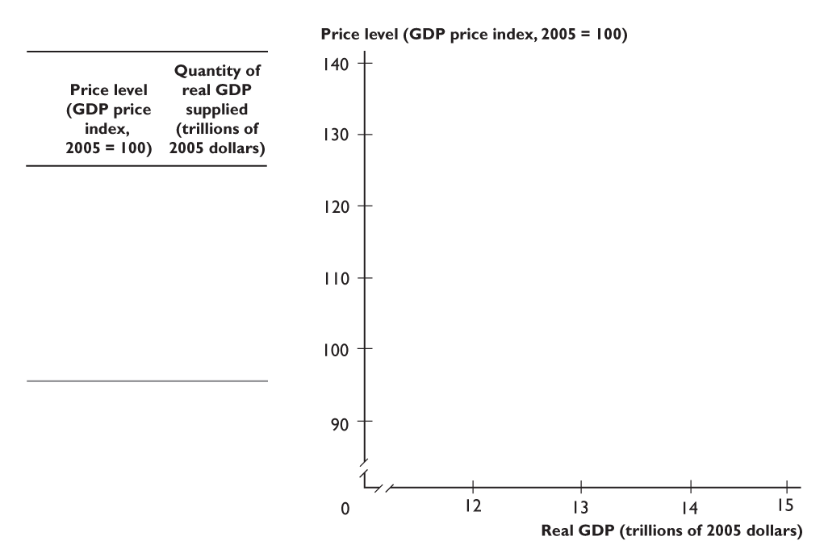
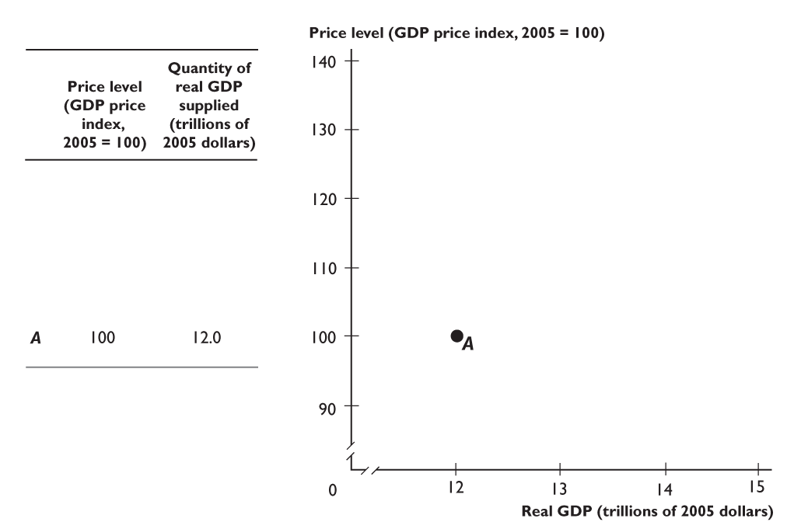
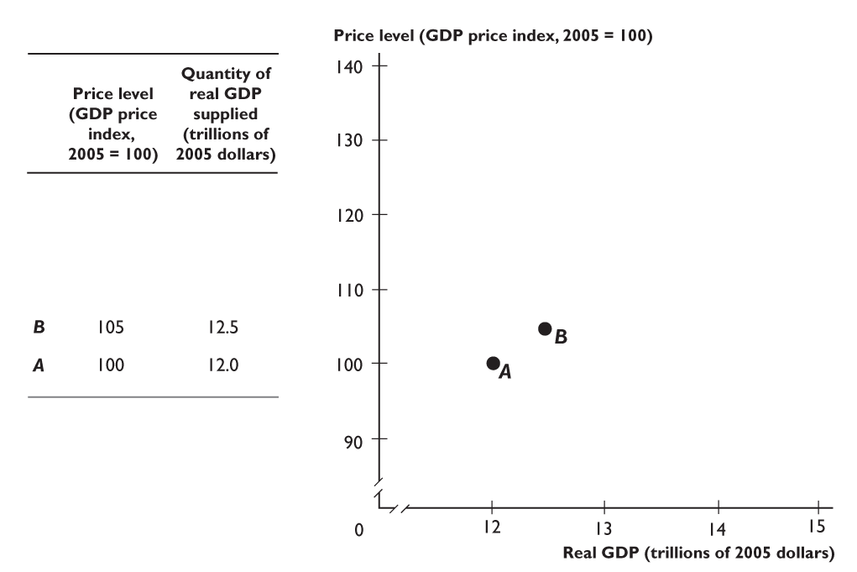
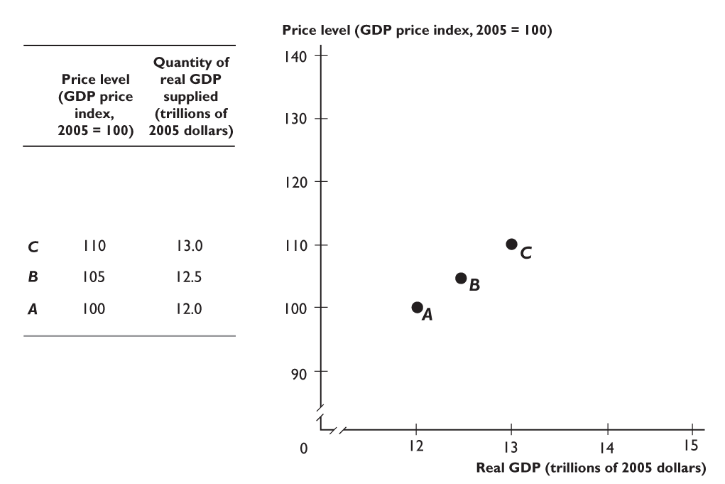
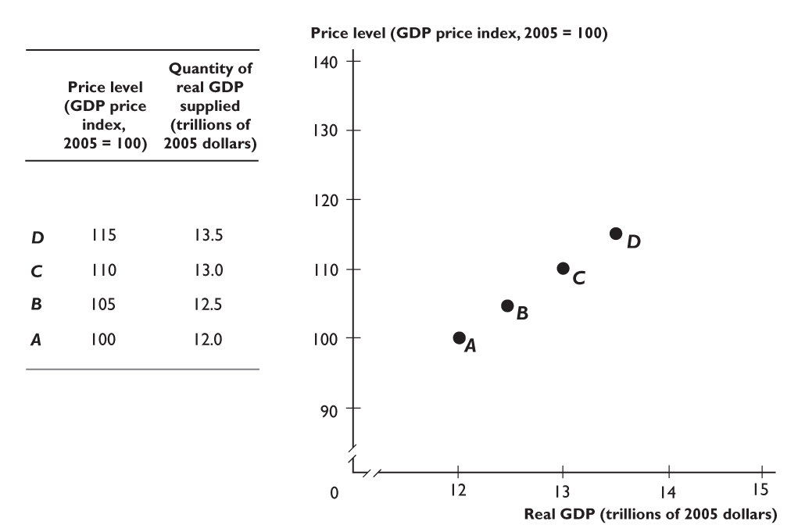
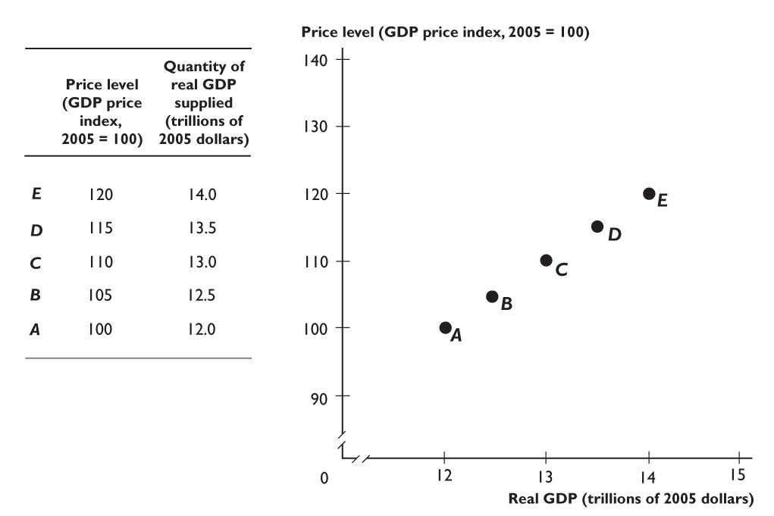
28.1 AGGREGATE SUPPLY
Figure 28.1 shows the aggregate supply schedule and aggregate supply curve.
Each point A to E on the AS curve corresponds to a row of the schedule.
Notes:
It’s difficult to start using the AS-AD model until you are convinced that students have bought into the notion that the aggregate supply curve is upward sloping and the reasons behind it. The AS curve that is used in this chapter is a short-run aggregate supply curve because it assumes that product prices and resources prices do not move in lock step with one another. That is to say that wages, materials prices, energy prices and the like move with a lag behind product prices. To launch your lecture, walk through this thought experiment with your students. Ask your class if firms are likely to be motivated to step up production in the face of rising product prices. They will have no trouble responding in the affirmative. Now tell your students that the higher price is actually the result of an increase in the general price level. Ask them how quickly workers are likely to respond by asking for wage increases. The answer is that it will take time for workers to see that the general price level has risen and that their real wages are now lower. Eventually they will demand higher wages. Firms will grant the wage increase in the face of higher profits. But until workers realize that their real wage has fallen, firms are in the position of receiving higher prices with no change in money wages so they increase their production. And with this result, you have demonstrated the upward-sloping aggregate supply curve!

Slide 8
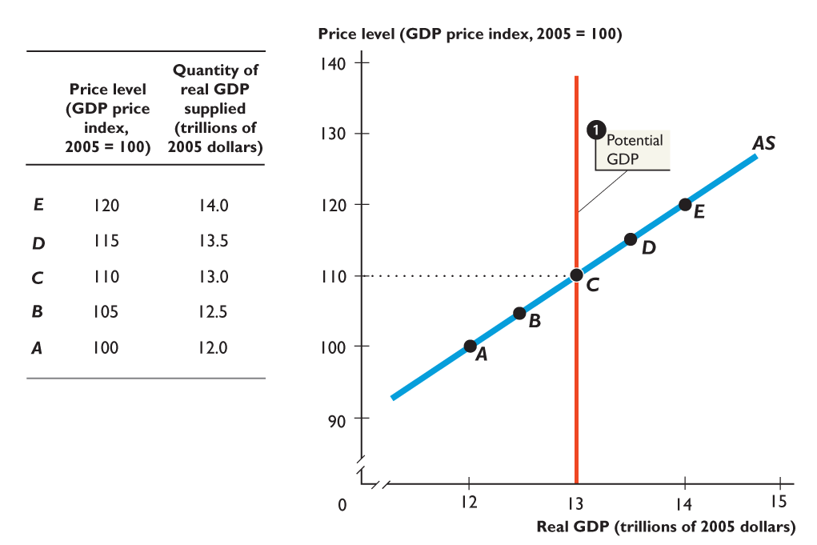
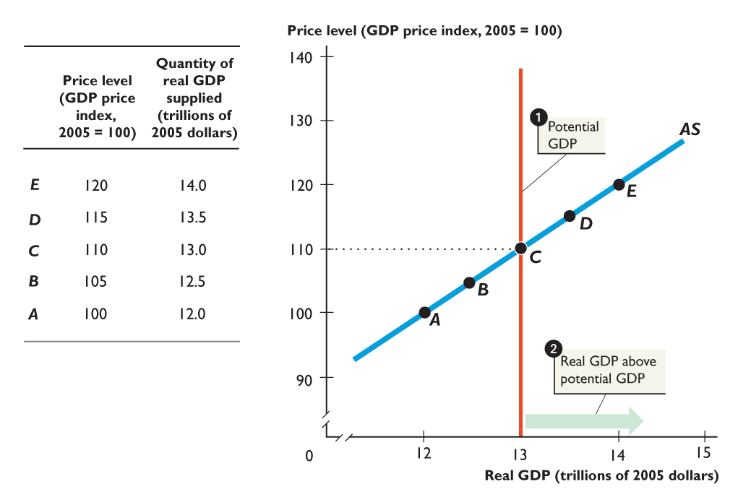
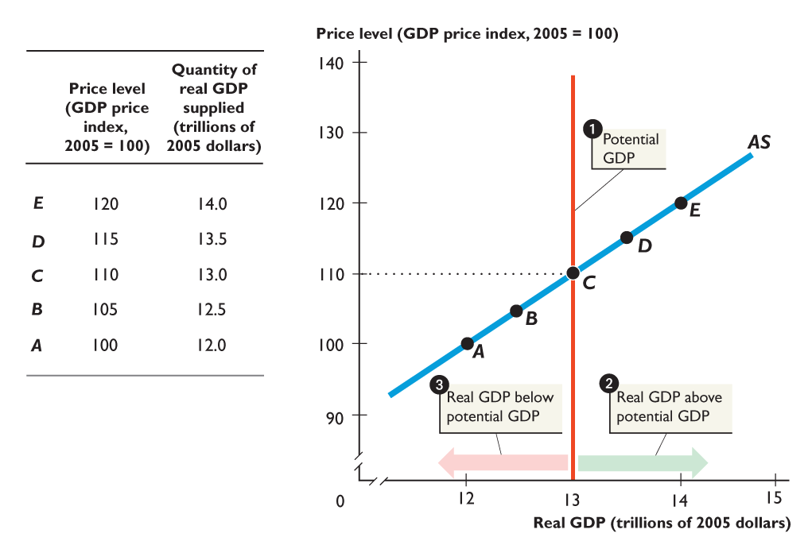
28.1 AGGREGATE SUPPLY
1. Potential GDP is $13 trillion and when the price level is 110, real GDP equals potential GDP.
2. If the price level is above 110, real GDP exceeds potential GDP.
3. If the price level is below 110, real GDP is less than potential GDP.

Slide 9
28.1 AGGREGATE SUPPLY
Why the AS Curve Slopes Upward
When the price level rises and the money wage rate is constant, the real wage rate falls and employment increases. The quantity of real GDP supplied increases.
When the price level falls and the money wage rate is constant, the real wage rate rises and employment decreases. The quantity of real GDP supplied decreases.

Slide 10
28.1 AGGREGATE SUPPLY
Changes in Aggregate Supply
Aggregate supply changes when any influence on production plans other than the price level changes.
In particular, aggregate supply changes when
Potential GDP changes.
The money wage rate changes.
The money prices of other resources change.

Slide 11
28.1 AGGREGATE SUPPLY
Changes in Potential GDP
Anything that changes potential GDP changes aggregate supply and shifts the aggregate supply curve.
Figure 28.1 on the next slide illustrates.

Slide 12
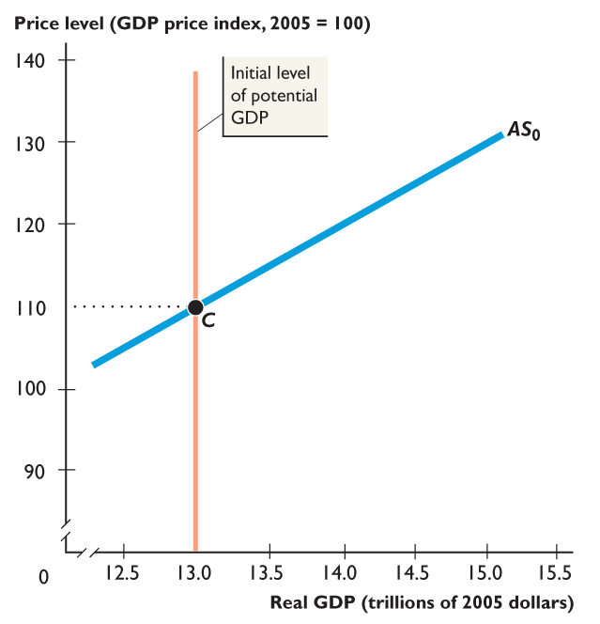
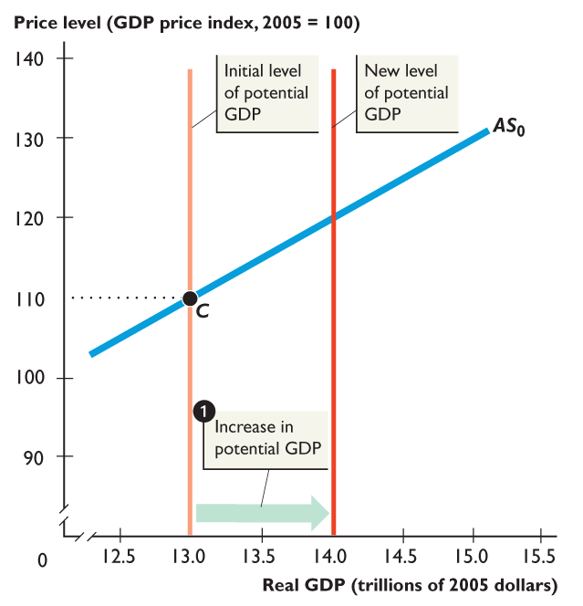
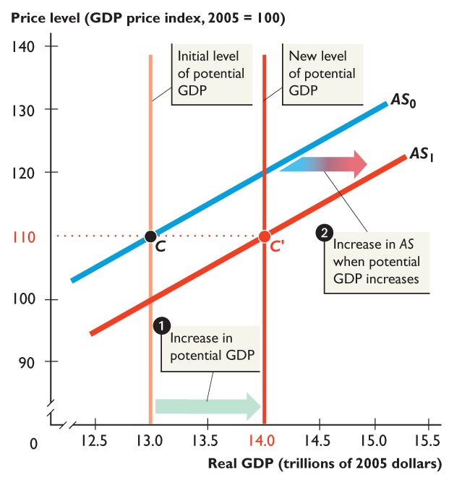
28.1 AGGREGATE SUPPLY
Point C at the intersection of the potential GDP line and AS curve is an anchor point.
1. An increase in potential GDP shifts the potential GDP line rightward and ...
2. The aggregate supply curve shifts rightward from AS₀ to AS₁.

Slide 13
28.1 AGGREGATE SUPPLY
Change in Money Wage Rate
A change in the money wage rate changes aggregate supply because it changes firms’ costs.
The higher the money wage rate, the higher are firms’ costs and the smaller is the quantity that firms are willing to supply at each price level.
So an increase in the money wage rate decreases aggregate supply.

Slide 14
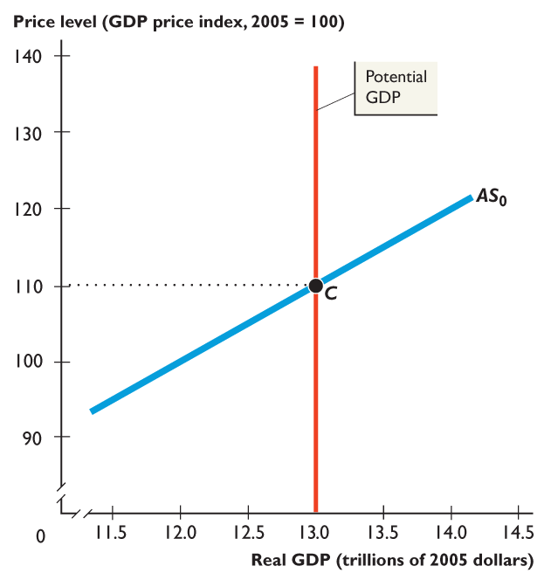
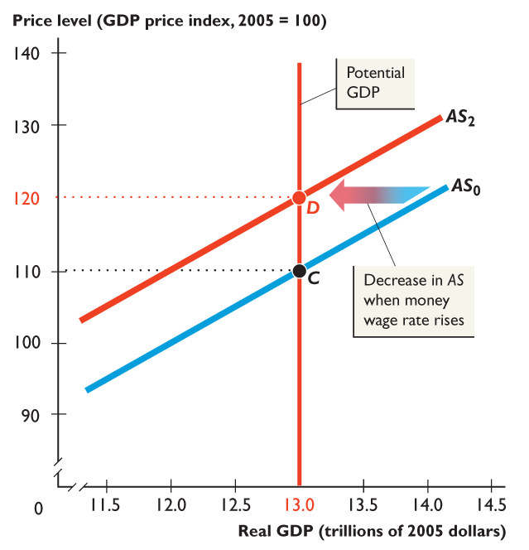
28.1 AGGREGATE SUPPLY
Figure 28.3 shows the effect of a change in the money wage rate.
A rise in the money wage rate decreases aggregate supply and the aggregate supply curve shifts leftward from AS₀ to AS₂.
A rise in the money wage rate does not change potential GDP.

Slide 15
28.1 AGGREGATE SUPPLY
Change in Money Prices of Other Resources
A change in the money prices of other resources changes aggregate supply because it changes firms’ costs.
The higher the money prices of other resources, the higher are firms’ costs and the smaller is the quantity that firms are willing to supply at each price level.
So an increase in the money prices of other resources decreases aggregate supply.

Slide 16
28.2 AGGREGATE DEMAND
The quantity of real GDP demanded is the total amount of final goods and services produced in the United States that people, businesses, governments, and foreigners plan to buy.
This quantity is the sum of the real consumption expenditure (C), investment (I), government expenditure on goods and services (G), and exports (X) minus imports (M).
That is,
Y = C + I + G + X – M

Slide 17
28.2 AGGREGATE DEMAND
Aggregate Demand Basics
Aggregate demand is the relationship between the quantity of real GDP demanded and the price level when all other influences on expenditure plans remain the same.
Other things remaining the same,
When the price level rises, the quantity of real GDP demanded decreases.
When the price level falls, the quantity of real GDP demanded increases.

Slide 18
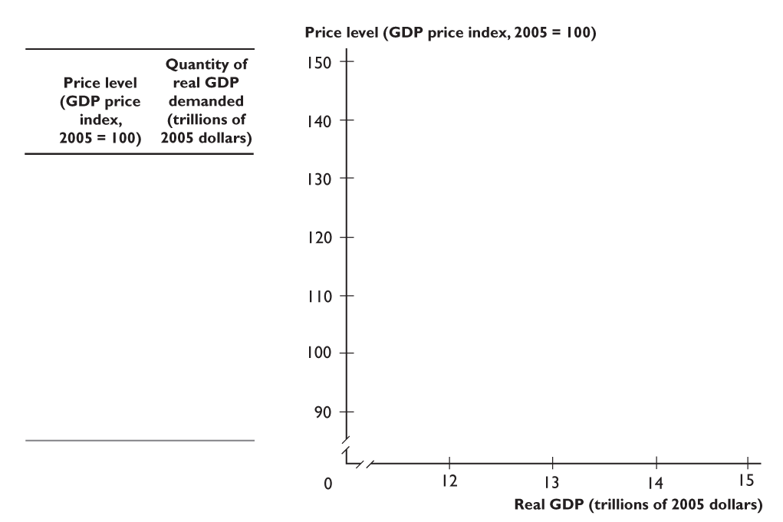
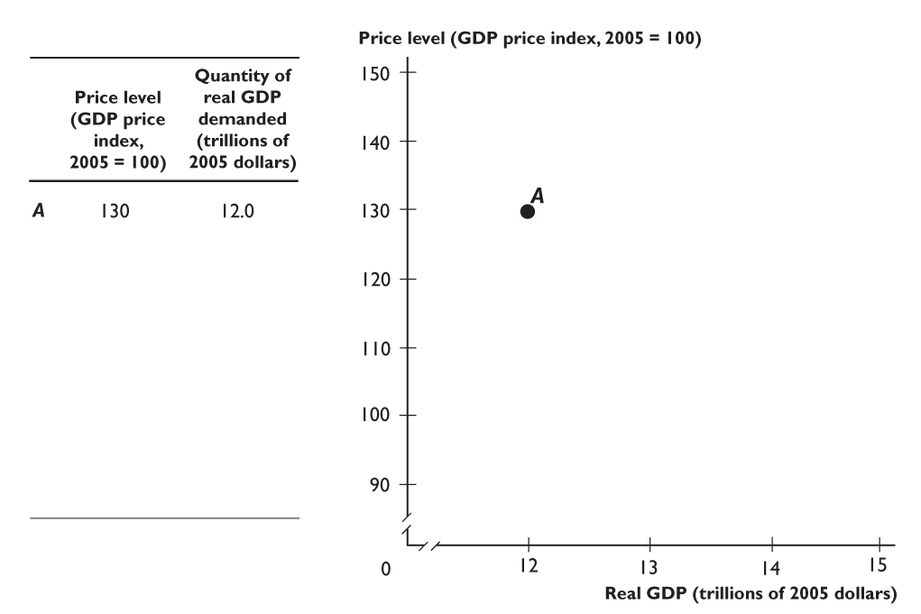
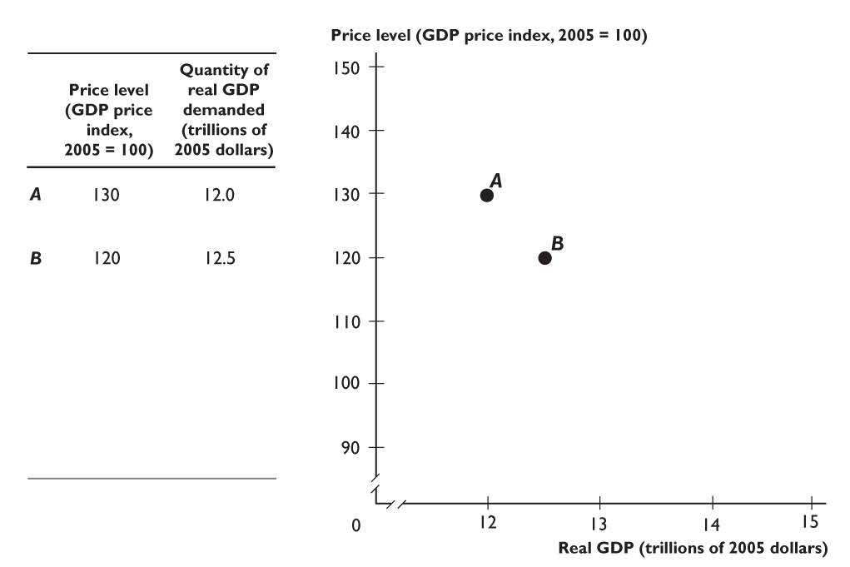
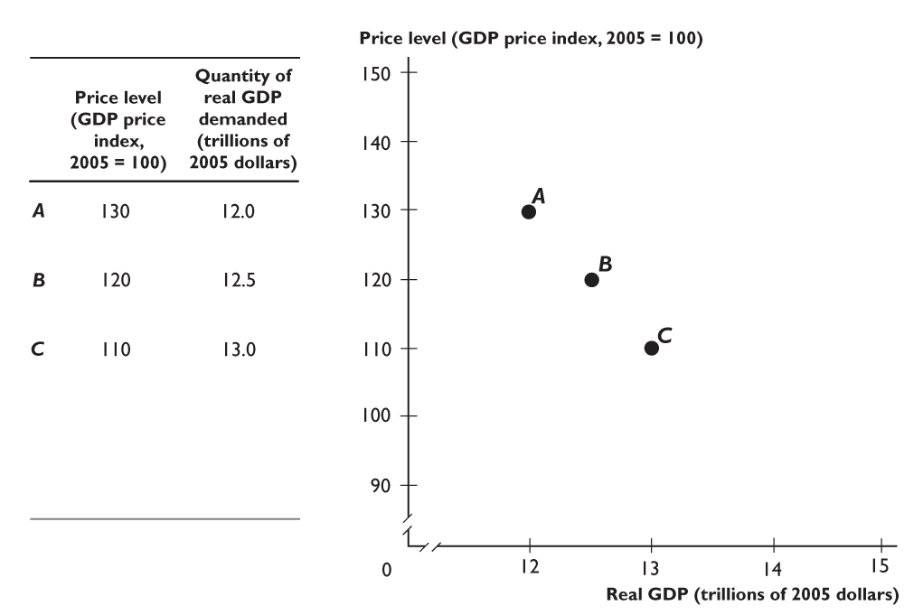
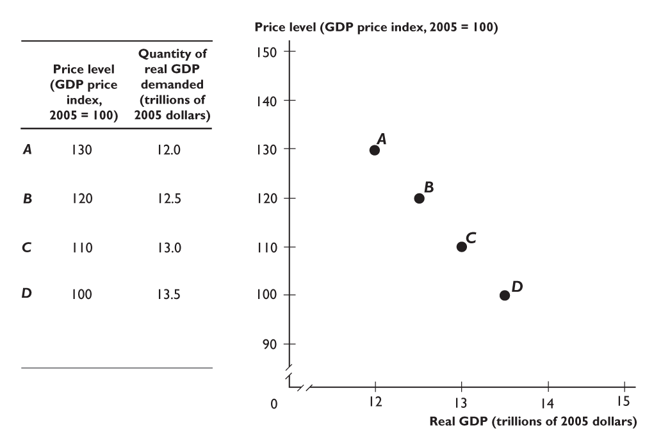
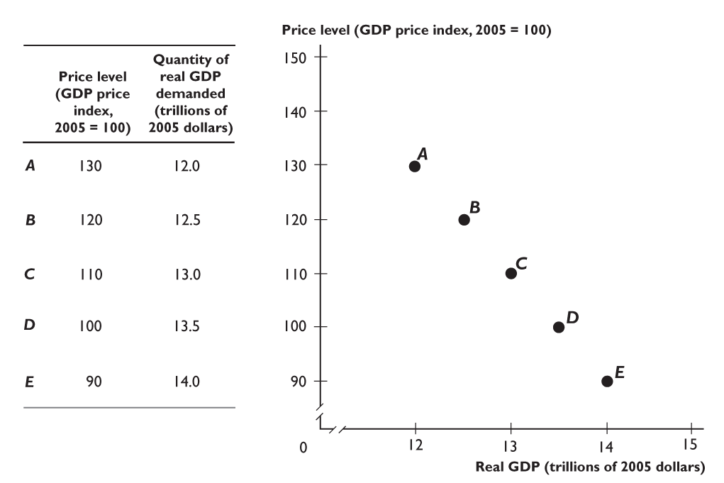
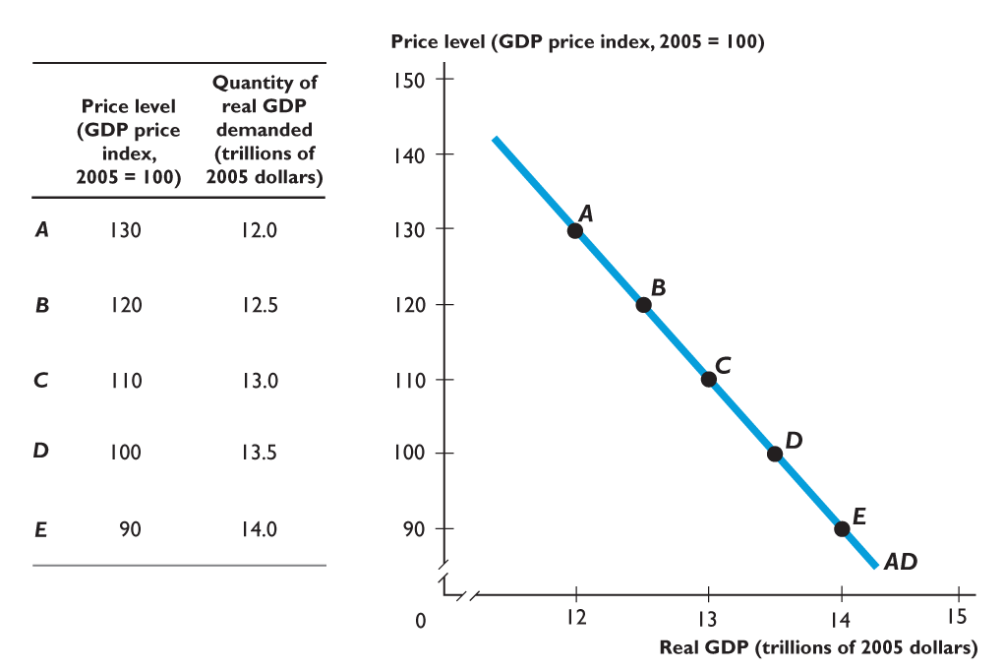
28.2 AGGREGATE DEMAND
Figure 28.4 shows the aggregate demand schedule and aggregate demand curve.
Each point A to E on the AD curve corresponds to a row of the schedule.

Slide 19
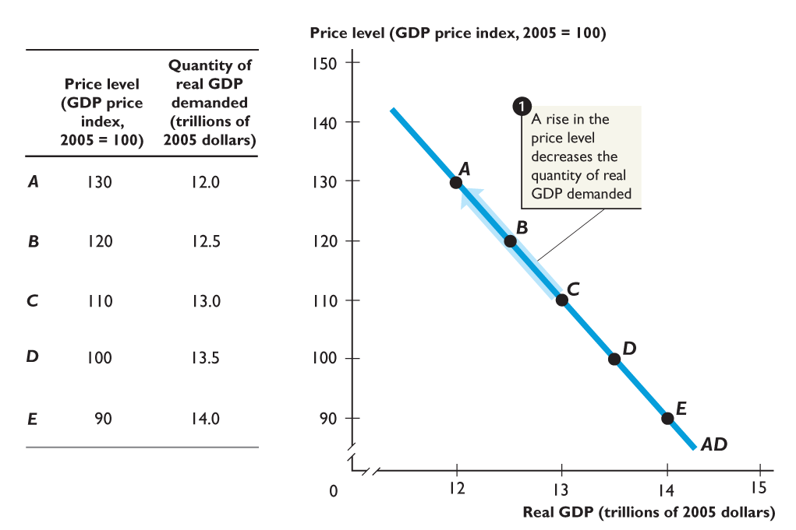
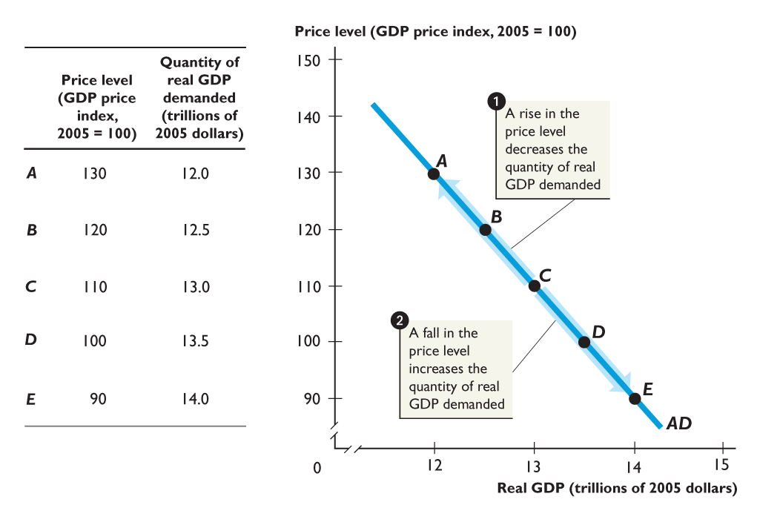
28.2 AGGREGATE DEMAND
The quantity of real GDP demanded
1. Decreases when the price level rises.
2. Increases when the price level falls.

Slide 20
28.2 AGGREGATE DEMAND
The price level influences the quantity of real GDP demanded because a change in the price level brings changes in
The buying power of money
The real interest rate
The real prices of exports and imports

Slide 21
28.2 AGGREGATE DEMAND
The Buying Power of Money
A rise in the price level lowers the buying power of money and decreases the quantity of real GDP demanded.
For example, if the price level rises and other things remain the same, a given quantity of money will buy less goods and services, so people cut their spending.
So the quantity of real GDP demanded decreases.

Slide 22
28.2 AGGREGATE DEMAND
The Real Interest Rate
When the price level rises, the real interest rate rises.
An increase in the price level increases the amount of money that people want to hold—increases the demand for money.
When the demand for money increases, the nominal interest rate rises.
In the short run, the inflation rate doesn’t change, so a rise in the nominal interest rate brings a rise in the real interest rate.

Slide 23
28.2 AGGREGATE DEMAND
Faced with a higher real interest rate, businesses and people delay plans to buy new capital goods and consumer durable goods and cut back on spending.
So the quantity of real GDP demanded decreases.

Slide 24
28.2 AGGREGATE DEMAND
The Real Prices of Exports and Imports
When the U.S. price level rises and other things remain the same, the prices in other countries do not change.
So a rise in the U.S. price level makes U.S.-made goods and services more expensive relative to foreign-made goods and services.
This change in real prices encourages people to spend less on U.S.-made items and more on foreign-made items.

Slide 25
28.2 AGGREGATE DEMAND
In the long run, when the price level changes by more in one country than in other countries, the exchange rate changes.
The exchange rate neutralizes the price level change, so this international price effect on buying plans is a short-run effect only.
But the short-run effect is powerful.

Slide 26
28.2 AGGREGATE DEMAND
Changes in Aggregate Demand
A change in any factor that influences expenditure plans other than the price level brings a change in aggregate demand.
When aggregate demand increases, the aggregate demand curve shifts rightward.
When aggregate demand decreases, the aggregate demand curve shifts leftward.
Notes:
Some of the same issues regarding change in demand and change in quantity demanded not only apply in the microeconomic model but also apply to the aggregate supply and aggregate demand curves as well. Remind your students that a change in the price level does not shift the aggregate supply curve or aggregate demand curve. A change in the price level results in movements along the curves. You can also involve your students in the material by asking them a few hypothetical questions. Ask your class what will happen to the aggregate demand curve in each of the following cases:
a. A cut in taxes.
b. An increase in expected future profit.
c. A cut in government spending.
d. An increase in foreign income.
e. A rise in the price level abroad.
Each of these examples gives students practice shifting the aggregate demand curve rightward and leftward as well as understanding why it shifts in the direction that it does.

Slide 27
28.2 AGGREGATE DEMAND
The factors that change aggregate demand are
Expectations about the future
Fiscal policy and monetary policy
The state of the world economy

Slide 28
29.2 AGGREGATE DEMAND
Expectations
An increase in expected future income increases the amount of consumption goods that people plan to buy today and increases aggregate demand.
An increase in expected future inflation increases aggregate demand today because people decide to buy more goods and services now before their prices rise.
An increase in expected future profit increases the investment that firms plan to undertake today and increases aggregate demand.

Slide 29
28.2 AGGREGATE DEMAND
Fiscal Policy and Monetary Policy
Governments can use fiscal policy to influence aggregate demand.
Fiscal policy is changing taxes, transfer payments, and government expenditure on goods and services.
The Federal Reserve can use monetary policy to influence aggregate demand.
Monetary policy is changing the quantity of money and the interest rate.

Slide 30
28.2 AGGREGATE DEMAND
A tax cut or an increase in either transfer payments or government expenditure on goods and services increases aggregate demand.
A cut in the interest rate or an increase in the quantity of money increases aggregate demand.

Slide 31
28.2 AGGREGATE DEMAND
The World Economy
The foreign exchange rate and foreign income influence aggregate demand.
The foreign exchange rate is the amount of foreign currency you can buy with a U.S. dollar.
Other things remaining the same, a rise in the foreign exchange rate decreases aggregate demand.
An increase in foreign income increases U.S. exports and increases U.S. aggregate demand.

Slide 32
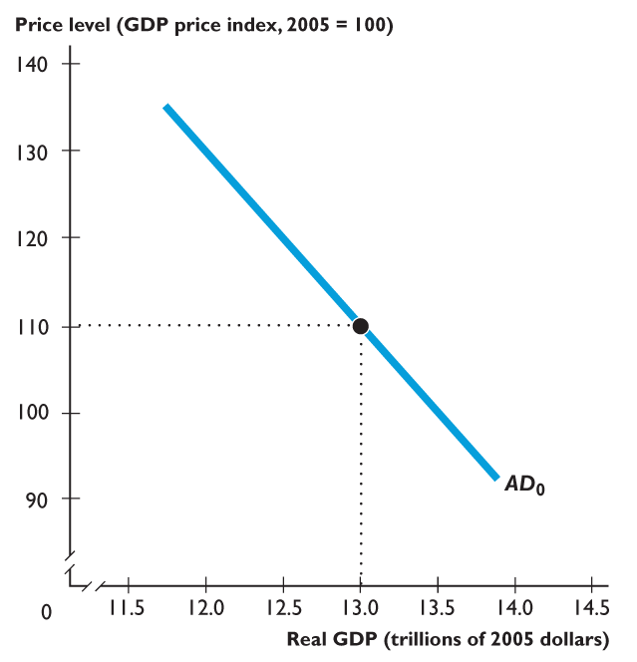
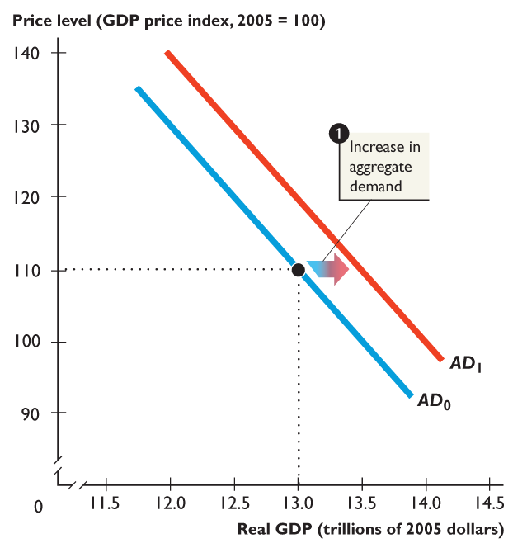
28.2 AGGREGATE DEMAND
Figure 28.5 shows changes in aggregate demand.
1. Aggregate demand increases if
Expected future income, inflation, or profits increase.
Fiscal policy or monetary policy actions increase planned expenditure.
The exchange rate falls or foreign income increases.

Slide 33
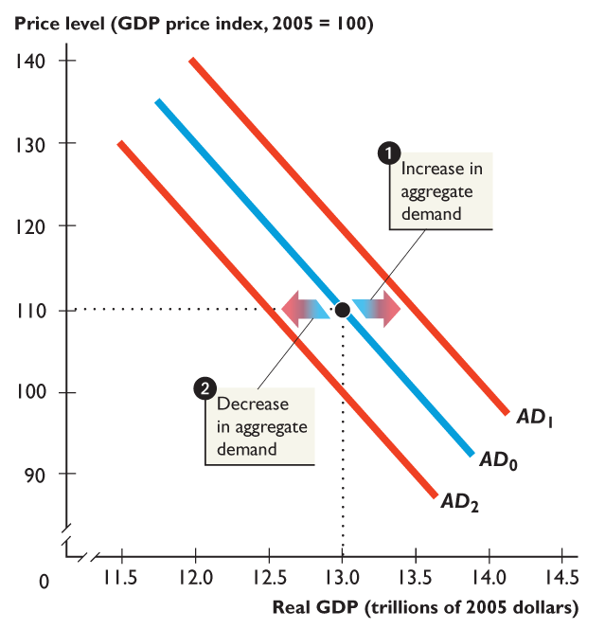
28.2 AGGREGATE DEMAND
2. Aggregate demand decreases if
Expected future income, inflation, or profits decrease.
Fiscal policy or monetary policy actions decrease planned expenditure.
The exchange rate rises or foreign income decreases.

Slide 34
28.3 EXPLAINING ECONOMIC TRENDS AND FLUCTUATIONS
Aggregate supply and aggregate demand determine real GDP and the price level.
Macroeconomic equilibrium occurs when the quantity of real GDP demanded equals the quantity of real GDP supplied.
Macroeconomic equilibrium occurs at the point of intersection of the AD curve and the AS curve.
Figure 28.7 on the next slide illustrates macroeconomic equilibrium.

Slide 35
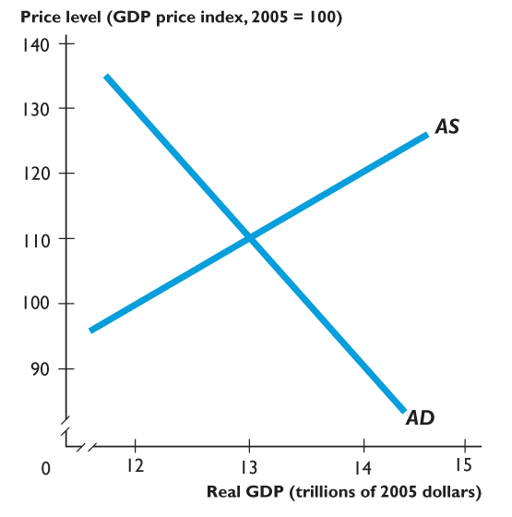
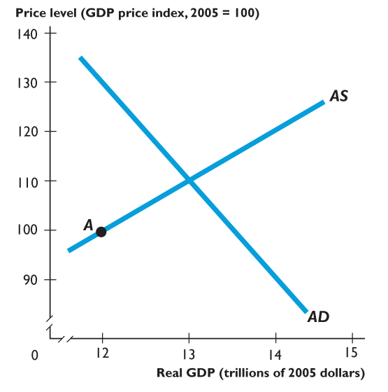
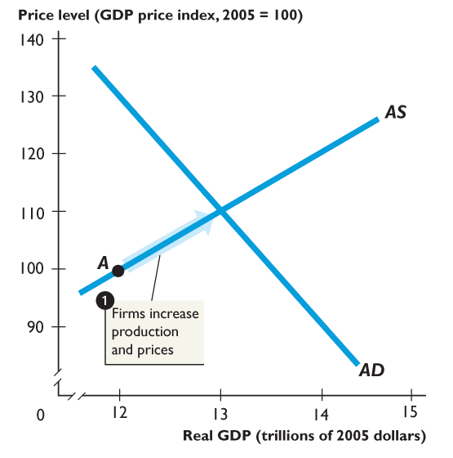
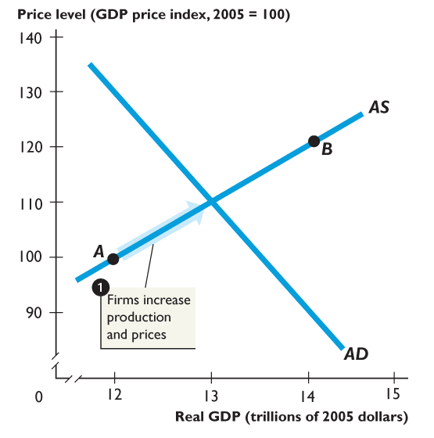
28.3 EXPLAINING ECONOMIC TRENDS AND FLUCTUATIONS
Suppose that the price level is 100 and that real GDP is $12 trillion, at point A.
The quantity of real GDP demanded exceeds $12 trillion and
1. Firms cannot meet the demand for their output, so they increase production and raise prices.

Slide 36
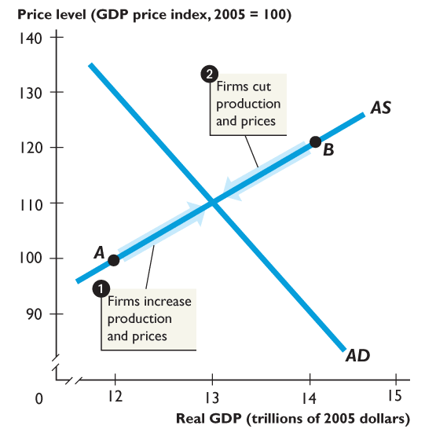
28.3 EXPLAINING ECONOMIC TRENDS AND FLUCTUATIONS
Suppose that the price level is 120 and that real GDP is $14 trillion, at point B.
The quantity of real GDP demanded is less than $14 trillion.
2. Firms cannot sell all they produce, so they cut production and lower prices.

Slide 37
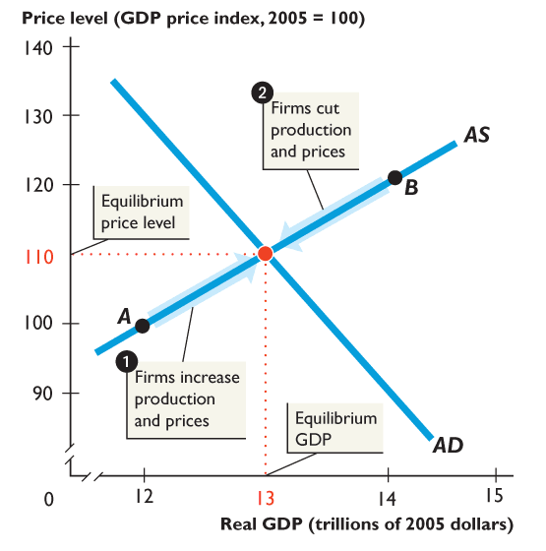
28.3 EXPLAINING ECONOMIC TRENDS AND FLUCTUATIONS
Macroeconomic equilibrium occurs when the price level is 110 and real GDP is $13 trillion.

Slide 38
28.3 EXPLAINING ECONOMIC TRENDS AND FLUCTUATIONS
In macroeconomic equilibrium, the economy might be at full employment or above or below full employment.
Full-employment equilibrium—when equilibrium real GDP equals potential GDP—occurs where the AD curve intersects the AS curve.
Recessionary gap is a gap that exists when potential GDP exceeds real GDP and that brings a falling price level.
Inflationary gap is a gap that exists when real GDP exceeds potential GDP and that brings a rising price level.

Slide 39
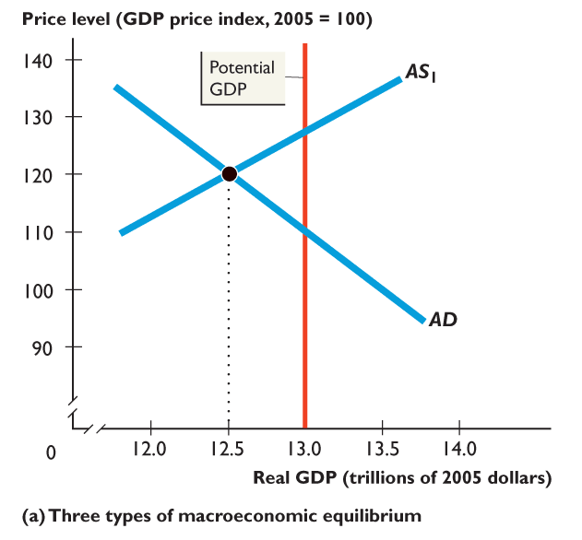
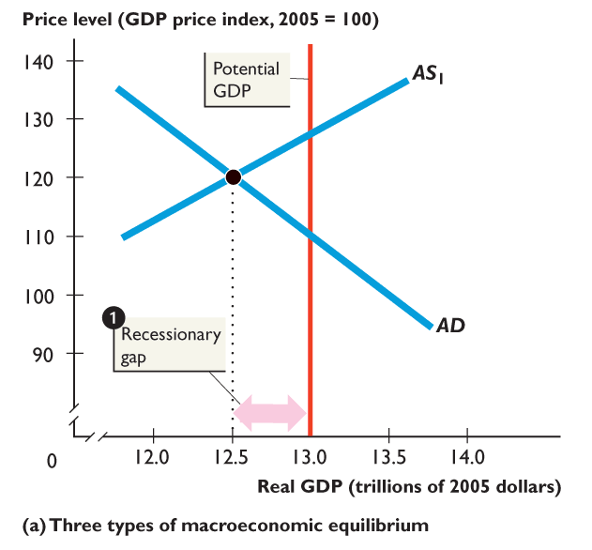
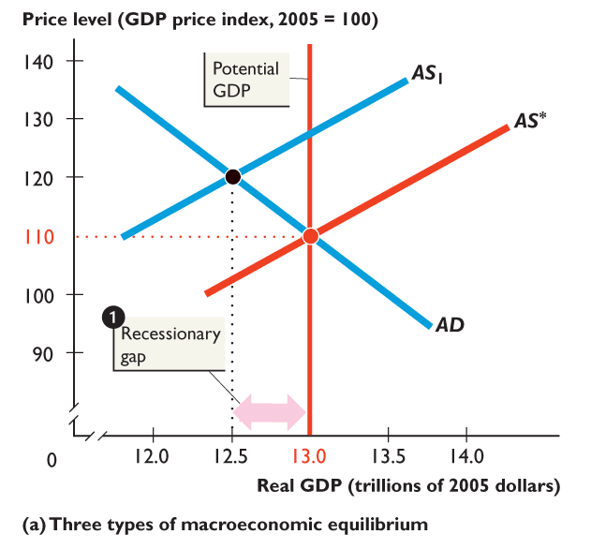
28.3 EXPLAINING ECONOMIC TRENDS AND FLUCTUATIONS
Figure 28.8(a) shows the three types of macro-economic equilibrium.
With real GDP less than potential GDP, the economy is below full employment.
A recessionary gap emerges.
With real GDP equal to potential GDP, the economy is at full employment.

Slide 40
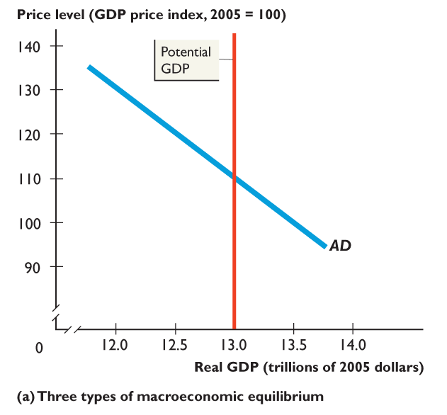
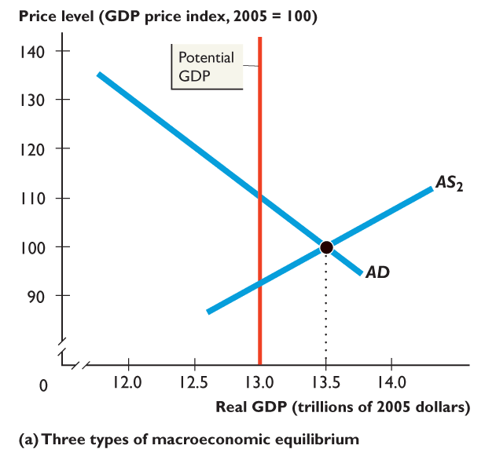
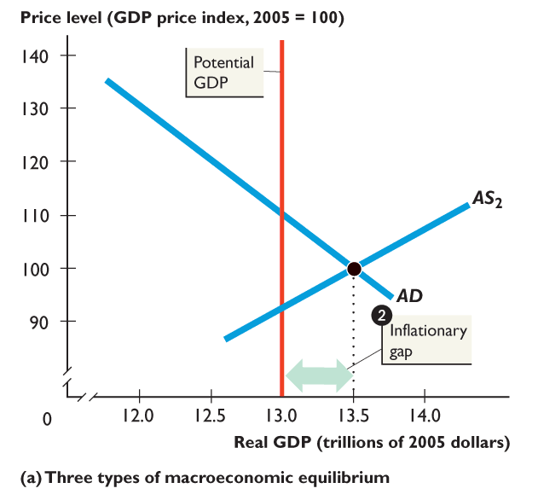
28.3 EXPLAINING ECONOMIC TRENDS AND FLUCTUATIONS
2. When real GDP exceeds potential GDP, the economy is above full employment.
An inflationary gap emerges.

Slide 41
28.3 EXPLAINING ECONOMIC TRENDS AND FLUCTUATIONS
Adjustment toward Full Employment
When real GDP is below or above potential GDP, the money wage rate gradually changes to bring full employment.
Figure 28.8(b) illustrates this adjustment.
Notes:
Don’t neglect the predictions of the model. This is the payoff for the student. With this simple model, we can now say quite a lot about growth, inflation, and the business cycle. However, when you do so, be aware that the AS-AD model predicts a fall in the price level when either aggregate demand decreases or aggregate supply increases. And the model predicts that real GDP decreases when either aggregate supply or aggregate demand decreases. But, some students object by pointing out that GDP rarely decreases and the price level rarely falls. These students are bothered by this apparent mismatch between the predictions of the model and the observed economy. The best way to handle this issue is to emphasize that in our actual economy, aggregate supply and aggregate demand almost always are increasing. When we use the model to simulate the effects of a decrease in either aggregate supply and aggregate demand, we’re studying what happens relative to the trends in real GDP and the price level. A fall in the price level in the model translates into a lower price level than would otherwise have occurred and a slowing of inflation. The story is similar for real GDP.

Slide 42
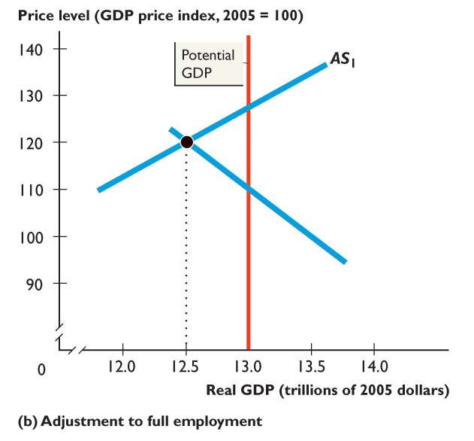
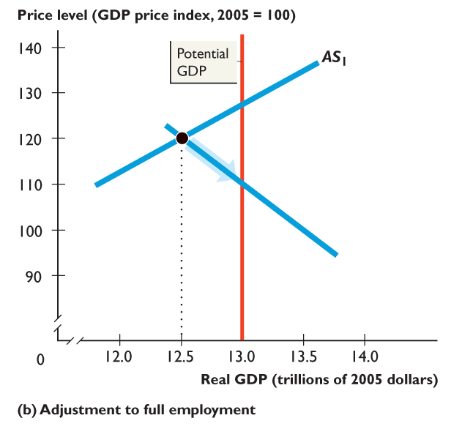
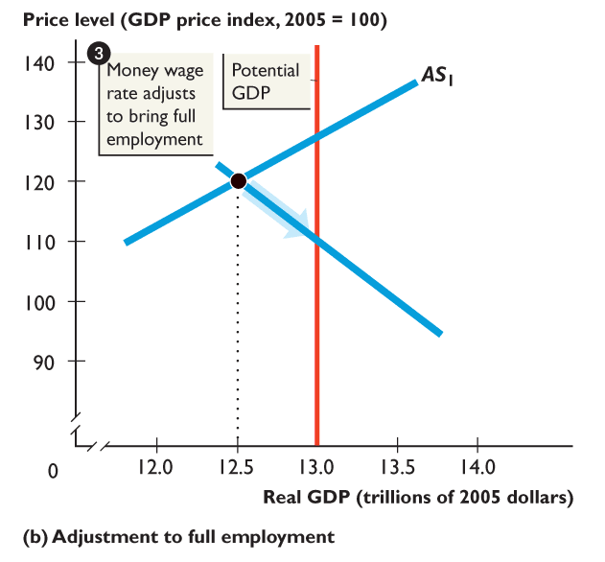
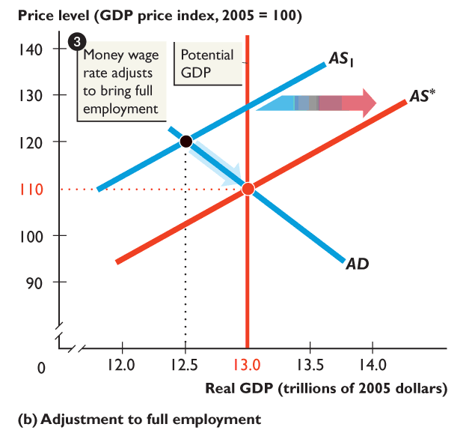
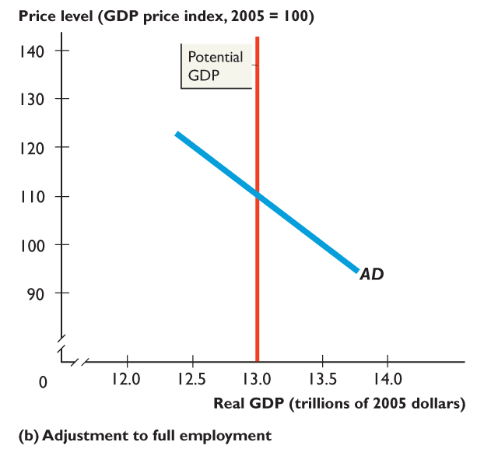
28.3 EXPLAINING ECONOMIC TRENDS AND FLUCTUATIONS
In a recessionary gap , there is a surplus of labor and firms can hire new workers at a lower wage rate.
As the money wage rate falls, the AS curve shifts from AS₁ toward AS *.
The price level falls and real GDP increases.

Slide 43
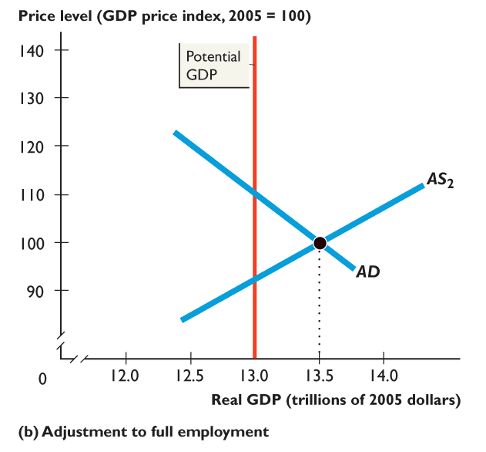
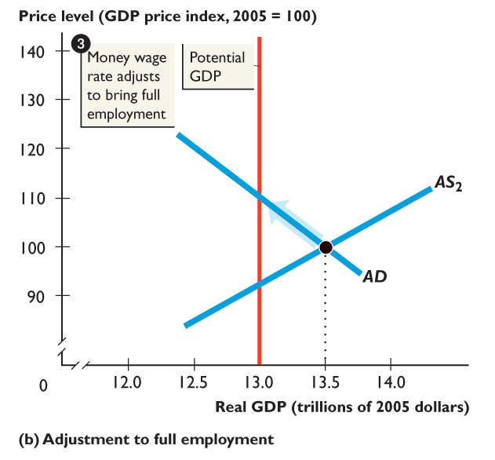
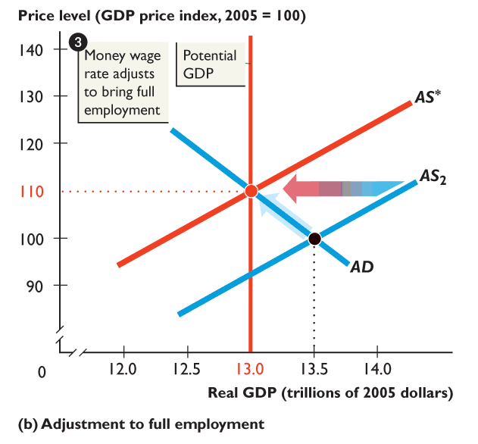
28.3 EXPLAINING ECONOMIC TRENDS AND FLUCTUATIONS
In an inflationary gap , there is a shortage of labor and to hire new workers firms raise the wage rate.
As the money wage rate rises, the AS curve shifts from AS₂ toward AS *.
The price level rises and real GDP decreases.

Slide 44
28.3 EXPLAINING ECONOMIC TRENDS AND FLUCTUATIONS
Economic Growth and Inflation Trends
Economic growth results from a growing labor force and increasing labor productivity, which together make potential GDP grow.
Inflation results from a growing quantity of money that outpaces the growth of potential GDP.
The AS-AD model can be used to understand economic growth and inflation trends.

Slide 45
28.3 EXPLAINING ECONOMIC TRENDS AND FLUCTUATIONS
In the AS-AD model,
Economic growth arises from increasing potential GDP—a persistent rightward shift in the potential GDP line.
Inflation arises from a persistent increase in aggregate demand at a faster pace than that of the increase in potential GDP—a persistent rightward shift of the AD curve at a faster pace than the growth of potential GDP.

Slide 46
28.3 EXPLAINING ECONOMIC TRENDS AND FLUCTUATIONS
The Business Cycle
The business cycle results from fluctuations in aggregate supply and aggregate demand.
Aggregate supply fluctuates because labor productivity grows at a variable pace, which brings fluctuations in the growth rate of potential GDP.
The resulting cycle is called a real business cycle.

Slide 47
28.3 EXPLAINING ECONOMIC TRENDS AND FLUCTUATIONS
But the main source of the business cycle is aggregate demand fluctuations.
The key reason is that the swings in aggregate demand occur more quickly than changes in the money wage rate that change aggregate supply.
The result is that the economy swings from inflationary gap to full employment to recessionary gap and back again.

Slide 48
28.3 EXPLAINING ECONOMIC TRENDS AND FLUCTUATIONS
Inflation Cycles
Just as there are cycles in real GDP, there are cycles in inflation, and these cycles interact.
To study the interaction of real GDP cycles and inflation cycles we distinguish between two sources of inflation:
Demand-pull inflation
Cost-push inflation

Slide 49
28.3 EXPLAINING ECONOMIC TRENDS AND FLUCTUATIONS
Demand-Pull Inflation
An inflation that starts because aggregate demand increases is called demand-pull inflation.
Any factor that increases aggregate demand can start an inflation, but the only factor that can sustain it is growth in the quantity of money.

Slide 50
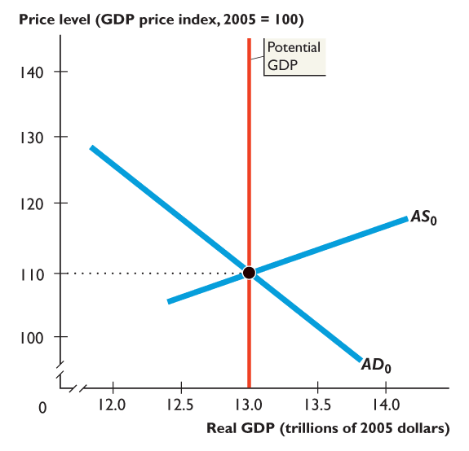
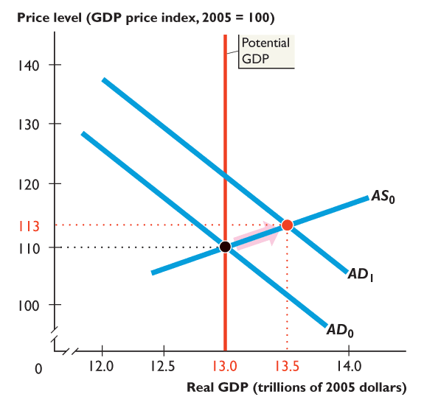
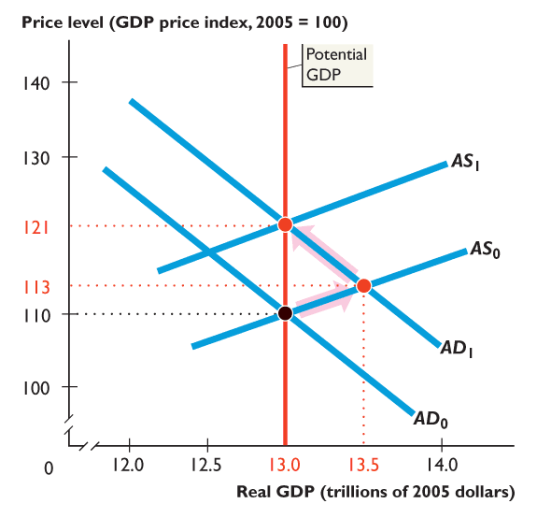



28.3 EXPLAINING ECONOMIC TRENDS AND FLUCTUATIONS
Figure 28.9 illustrates the process.
Each time the quantity of money increases, the AD curve shifts rightward.
Each time real GDP exceeds potential GDP, the money wage rate rises and the AS curve shifts leftward.
A demand-pull inflation results.

Slide 51

Figure 28.1 Mainstream business cycle theory

Slide 52

Figure 1 Real business cycle impulse
Real business cycle theory explains business cycles as fluctuations in productivity that shift the short-run aggregate supply curve.
technology shocks
productivity shocks
Sources of data: Office for National Statistics and the authors’ calculations
Notes:
invention of new machines
new software
automation
AI
Productivity = output per unit of labor
Nguyên nhân có thể là:
Technology changes
Human capital changes
Natural conditions (weather, disasters)
Energy prices
Regulations
→ tất cả đều làm productivity thay đổi

Slide 53

Figure 28.2 Loanable funds and labour markets in a real business cycle

Slide 54

Figure 28.3 Demand-pull rise in the price level

Slide 55

Figure 28.4 Demand-pull inflation spiral

Slide 56

Figure 28.5 Cost-push rise in the price level

Slide 57

Figure 28.6 Cost-push inflation spiral

Slide 58

Figure 28.7 Expected inflation

Slide 59

Figure 1 Japan’s long deflation
Sources of data: Financial Statistics and World Economic Outlook, International Monetary Fund, Washington, DC
AD grows slower than potential GDP
Notes:
nền kinh tế có thể sản xuất nhiều hơn nhưng demand không tăng đủ để mua hết

Slide 60

Figure 2 Money growth rate too low
Sources of data: Financial Statistics and World Economic Outlook, International Monetary Fund, Washington, DC

Slide 61

Figure 3 Japan’s decade average real GDP growth rates
Sources of data: Financial Statistics and World Economic Outlook, International Monetary Fund, Washington, DC

Slide 62
THE SHORT-RUN PHILLIPS CURVE
Short-run Phillips curve is a curve that shows the relationship between the inflation rate and the unemployment rate when the natural unemployment rate and the expected inflation rate remain constant.
Figure 31.1 on the next slide shows a short-run Phillips curve.
Notes:
The story of the Phillips curve is a wonderful illustration of how the science of economics advances. The story I tell starts in 1958 when A. W. Phillips published his empirical work. At that time the mainstream economic model was quite different from the AS-AD model derived in the text. Essentially, it was similar to the simple aggregate expenditure model presented in Chapter 29. The model was based on the assumption that the price level was constant, making the inflation rate zero. This assumption was not too unrealistic immediately after World War II. By 1955, though, the inflation rate began to creep higher and averaged 2.7 percent a year between 1956 and 1959. Inflation was beginning to be perceived as a problem, one that a model with a “fixed price level assumption” was poorly suited to solve.
[Continued on next slide]

Slide 63




THE SHORT-RUN PHILLIPS CURVE
1. The natural unemployment rate is 6 percent.
2. The expected inflation rate is 3 percent a year.
3. This combination, at point B, provides the anchor point for the short-run Phillips curve.
Notes:
In this environment, economists gladly welcomed the simple, short-run Phillips curve, for it gave them a handle on inflation. They believed that they could predict the unemployment rate from their standard model and then combine this unemployment rate with the Phillips curve to determine the resulting inflation rate. The vital assumption in this procedure is that the Phillips curve captures a fixed trade-off between the actual inflation rate and the unemployment rate that is part of the economy’s structure. This type of analysis reached its peak of popularity during the early and middle 1960s. By 1967, however, it was under attack. On a theoretical level, economist Milton Friedman and others pointed out the flimsy justification behind the simple fixed Phillips curve assumption. On an empirical level, the simple fixed Phillips curve failed as the inflation rate rose toward the end of the 1960s and into the 1970s: the unemployment rate did not fall as predicted by the fixed Phillips curve.

Slide 64



THE SHORT-RUN PHILLIPS CURVE
A lower unemployment rate brings a higher inflation rate, such as at point A.
A higher unemployment rate brings a lower inflation rate, such as at point C.
4. The short-run Phillips curve passes through points A, B, and C and is the curve SRPC.
Notes:
At this point the idea of a long-run Phillips curve (as distinct from the short-run one) was developed. The concept that aggregate supply is an important component of macroeconomics was taking hold, as was the idea that short-run Phillips curves shift because of changes in people’s expectations. The profession has advanced significantly between the initial discussion of the Phillips curve and what students learn today. This advance was the result of the interaction between theory, suggesting that the idea of a fixed short-run Phillips curve was inadequate, and empirical work that reinforced the point that the simple, early approach was deficient.

Slide 65
THE SHORT-RUN PHILLIPS CURVE
Aggregate Supply and the Short-Run Phillips Curve
The AS-AD model explains the negative relationship between unemployment and inflation along the short-run Phillips curve.
The short-run Phillips curve is another way of looking at the upward-sloping aggregate supply curve.
Both curves arise because the money wage rate is fixed in the short run.

Slide 66
THE SHORT-RUN PHILLIPS CURVE
Along the aggregate supply curve, the money wage rate is fixed. So when the price level rises, the real wage rate falls.
And the quantity of labor employed increases.
Along the short-run Phillips curve, the rise in the price level means an increase in inflation.
The increase in quantity of labor employed means a decrease in the number unemployed and a decrease in the unemployment rate.

Slide 67
THE SHORT-RUN PHILLIPS CURVE
So a movement along the AS curve is equivalent to a movement along the short-run Phillips curve.
Unemployment and Real GDP
At full employment, the quantity of real GDP is potential GDP and the unemployment rate is the natural unemployment rate.
If real GDP exceeds potential GDP, employment exceeds its full-employment level and the unemployment rate falls below the natural unemployment rate.

Slide 68

THE SHORT-RUN PHILLIPS CURVE
Similarly, if real GDP is less than potential GDP, employment is less than its full employment level and the unemployment rate rises above the natural unemployment rate.
Okun’s Law
For each percentage point that the unemployment rate is above the natural unemployment rate, there is a 2 percent gap between real GDP and potential GDP.

Slide 69
THE SHORT-RUN PHILLIPS CURVE
Inflation and the Price Level
The inflation rate is defined as the percentage change in the price level.
So starting from any given price level, the higher the inflation rate, the higher is the current period’s price level.
Figure 31.2 on the next slide shows the connection between the short-run Phillips Curve and the aggregate supply curve.

Slide 70


THE SHORT-RUN PHILLIPS CURVE
At point A on the Phillips curve: The unemployment rate is 5 percent and the inflation rate is 4 percent a year.
Point A on the Phillips curve corresponds to point A on the aggregate supply curve: Real GDP is $10.2 trillion and the price level is 104.

Slide 71


THE SHORT-RUN PHILLIPS CURVE
At point B on the Phillips curve: The unemployment rate is 6 percent and the inflation rate is 3 percent a year.
Point B on the Phillips curve corresponds to point B on the aggregate supply curve: Real GDP is $10 trillion and the price level is 103.

Slide 72


THE SHORT-RUN PHILLIPS CURVE
At point C on the Phillips curve: The unemployment rate is 7 percent and the inflation rate is 2 percent a year.
Point C on the Phillips curve corresponds to point C on the aggregate supply curve: Real GDP is $9.8 trillion and the price level is 102.

Slide 73
THE SHORT-RUN PHILLIPS CURVE
Aggregate Demand Fluctuations
Aggregate demand fluctuations bring movements along the aggregate supply curve and equivalent movements along the short-run Phillips curve.

Slide 74
THE SHORT-RUN PHILLIPS CURVE
Why Bother with the Phillips Curve?
First, the Phillips curve focuses directly on two policy targets: the inflation rate and the unemployment rate.
Second, the aggregate supply curve shifts whenever the money wage rate or potential GDP changes, but the short-run Phillips curve does not shift unless either the natural unemployment rate or the expected inflation rate change.

Slide 75

Figure 28.8 Short-run Phillips curve

Slide 76
31.2 SHORT-RUN AND LONG-RUN PHILLIPS CURVES
The Long-Run Phillips Curve
The long-run Phillips curve is a vertical line that shows the relationship between inflation and unemployment when the economy is at full employment.
Figure 31.3 shows the long-run Phillips Curve.

Slide 77



31.2 SHORT-RUN AND LONG-RUN ...
The long-run Phillips curve is a vertical line at the natural unemployment rate.
In the long run, there is no unemployment-inflation tradeoff.

Slide 78
SHORT-RUN AND LONG-RUN PHILLIPS CURVES
No Long-Run Tradeoff
Because the long-run Phillips curve is vertical, there is no long-run tradeoff between unemployment and inflation.
In the long run, the only unemployment rate available is the natural unemployment rate, but any inflation rate can occur.

Slide 79
SHORT-RUN AND LONG-RUN PHILLIPS CURVES
Expected Inflation
The expected inflation rate is the inflation rate that people forecast and use to set the money wage rate and other money prices.
Because the actual inflation rate equals the expected inflation rate at full employment, we can interpret the long-run Phillips curve as the relationship between inflation and unemployment when the inflation rate equals the expected inflation rate.

Slide 80



31.2 SHORT-RUN AND LONG-RUN ...
If the natural unemployment rate is 6 percent, the long-run Phillips curve is LRPC.
1. If the expected inflation rate is 3 percent a year, the short-run Phillips curve is SRPC₀.
2. If the expected inflation rate is 7 percent a year, the short-run Phillips curve is SRPC₁.

Slide 81
SHORT-RUN AND LONG-RUN PHILLIPS CURVES
The Natural Rate Hypothesis
The natural rate hypothesis is the proposition that when the inflation rate changes, the unemployment rate changes temporarily and eventually returns to the natural unemployment rate.
Figure 31.5 illustrates the natural rate hypothesis.

Slide 82



SHORT-RUN AND LONG-RUN ...
The inflation rate is 3 percent a year and the economy is at full employment, at point A.
Then the inflation rate increases.
In the short run, the increase in inflation brings a decrease in the unemployment rate — a movement along SRPC₀ to point B.

Slide 83


SHORT-RUN AND LONG-RUN PHILLIPS CURVES
Eventually, the higher inflation rate is expected and the short-run Phillips curve shifts upward to SRPC₁.
At the higher expected inflation rate, unemployment returns to the natural unemployment rate—the natural rate hypothesis.

Slide 84
SHORT-RUN AND LONG-RUN PHILLIPS CURVES
Changes in the Natural Unemployment Rate
If the natural unemployment rate changes, both the long-run Phillips curve and the short-run Phillips curve shift.
When the natural unemployment rate increases, both the long-run Phillips curve and the short-run Phillips curve shift rightward.
When the natural unemployment rate decreases, both the long-run Phillips curve and the short-run Phillips curve shift leftward.

Slide 85



SHORT-RUN AND LONG-RUN ...
Figure 31.6 shows the effect of changes in the natural unemployment rate.
The expected inflation rate is 3 percent a year.
The natural unemployment rate is 6 percent.

Slide 86

SHORT-RUN AND LONG-RUN PHILLIPS CURVES
The short-run Phillips curve is SRPC₀ and the long-run Phillips curve is LRPC₀.
A decrease in the natural unemployment rate shifts the two Phillips curves leftward to LRPC₁ and SRPC₁.

Slide 87
SHORT-RUN AND LONG-RUN PHILLIPS CURVES
Have Changes in the Natural Unemployment Rate Changed the Tradeoff?
Changes in the natural unemployment rate have changed the tradeoff.
According to the Congressional Budget Office, the natural unemployment rate increased from about 5 percent in 1950 to more than 6 percent in the mid-1970s.
It decreased to 4.8 percent by 2000 and has been constant at this level through 2009.

Slide 88
INFLUENCING INFLATION AND UNEMPLOYMENT
Influencing the Expected Inflation Rate
The expected inflation rate is the inflation rate that people forecast and use to set the money wage rate and other money prices.
Rational expectation is the forecast that results from the use of all the relevant data and economic science.

Slide 89





31.3 INFLUENCING INFLATION AND UNEMPLOYMENT
Figure 31.7 illustrates the effects of the Fed’s policy.
The economy starts at point A, with the unemployment rate higher than the natural unemployment rate on SRPC₀.
The Fed increases the growth rate of real GDP and the economy slides up along SRPC₀.

Slide 90
31.3 INFLUENCING INFLATION AND UNEMPLOYMENT
What Can the Fed Do to Lower Expected Inflation?
If the Fed wants to lower the inflation rate, it can pursue two alternative lines of attack:
A surprise inflation reduction
A credible announced inflation reduction
The figure on the next slide shows the effects of policy actions to lower the inflation rate.

Slide 91









INFLUENCING INFLATION AND UNEMPLOYMENT
Gradually, the expected inflation rate falls and the short run Phillips curve gradually shifts downward.
The unemployment rate remains above at 6 percent through the adjustment to point B on SRPC1.

Slide 92








31.3 INFLUENCING INFLATION AND UNEMPLOYMENT
A Credible Announced Inflation Reduction
A credible announced plan to reduce the inflation rate lowers the expected inflation rate and shifts the short-run Phillips curve downward.
Inflation rate falls and unemployment remains at 6 percent as the economy moves along LRPC.

Slide 93

Figure 28.9 Short-run and long-run phillips curves

Slide 94

Figure 1 The UK phillips curves 2008–2020

Slide 95

Figure 1 Real GDP growth rates in Eurozone countries

Slide 96

Figure 2 Eurozone inflation

Slide 97

Figure 3 Eurozone aggregate demand and aggregate supply

