Slide 1
Economics
Eleventh European Edition
Part 7
Macroeconomic trends
Chapter 23
Finance, saving and investment

Slide 2

24
FINANCE, SAVING AND INVESTMENT

Slide 3
After studying this chapter, you will be able to:
Describe the flow of funds in financial markets
Explain how financial decisions are made and the risks that arise from these decisions
Explain how lending and borrowing decisions interact in financial markets
Explain how governments influence financial markets

Slide 4
Financial Markets and Financial Institutions
To study the economics of financial institutions and
markets we distinguish between
Finance and money
Physical capital and financial capital
Finance and Money
The study of finance looks at how households and firms obtain and use financial resources and how they cope with the risks that arise in this activity.
The study of money looks at how households and firms use it, how much of it they hold, how banks create and manage it, and how its quantity influences the economy.

Slide 5
Financial Markets and Financial Institutions
Capital and Financial Capital
Capital (or physical capital) is the tools, instruments, machines, buildings, and other items that have been produced in the past and that are used today to produce goods and services.
The funds that firms use to buy physical capital are called financial capital.

Slide 6
Financial Markets and Financial Institutions
Capital and Investment
Gross investment is the total amount spent on purchases of new capital and on replacing depreciated capital.
Depreciation is the decrease in the quantity of capital that results from wear and tear and obsolescence.
Net investment is the change in the quantity of capital.
Net investment = Gross investment − Depreciation.

Slide 7
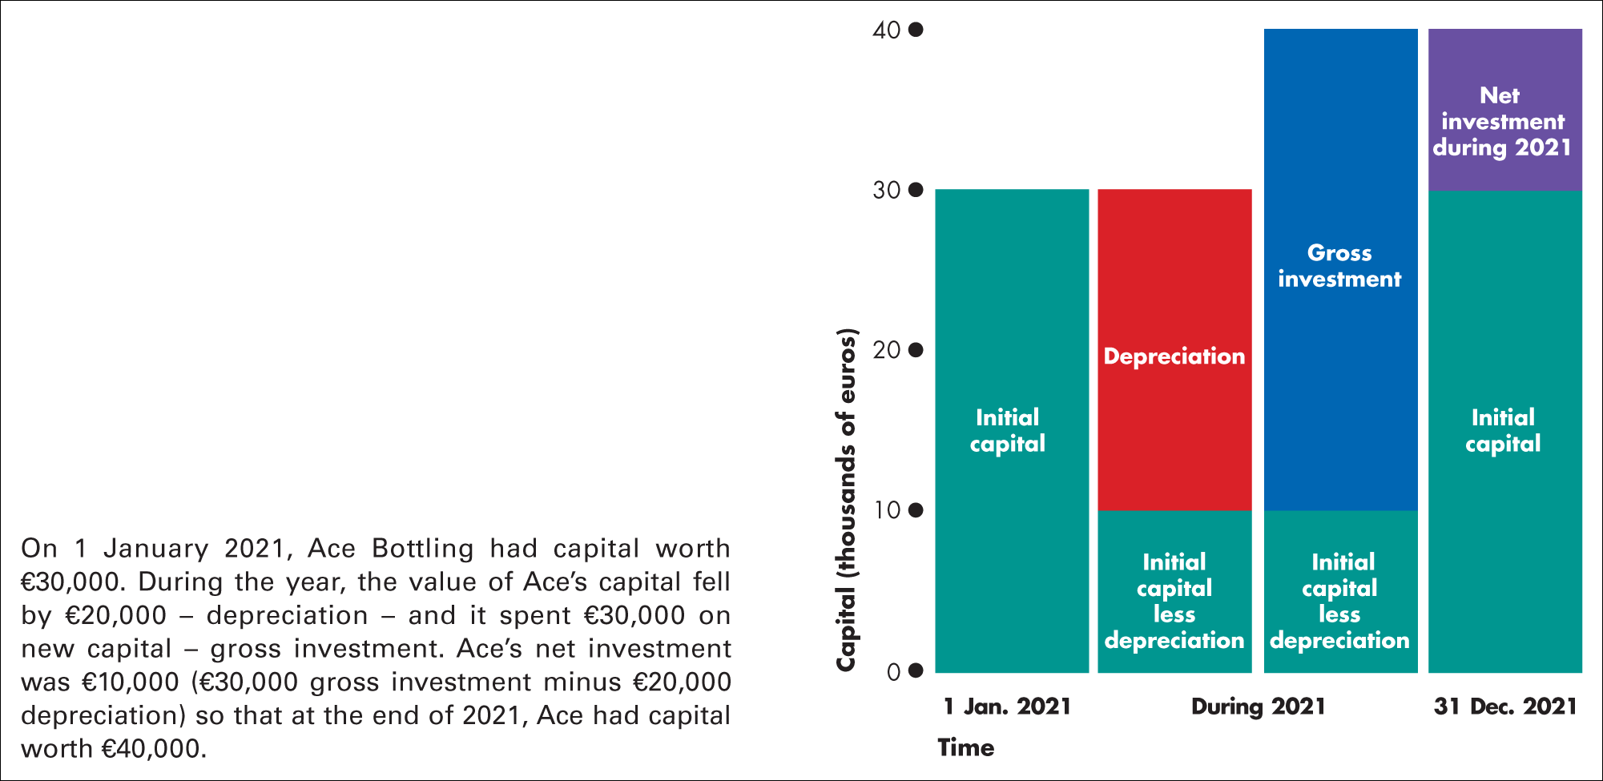
Figure 23.1 Capital and investment
Figure 23.1 illustrates the relationships among the capital, gross investment, depreciation, and net investment.

Slide 8
Financial Markets and Financial Institutions
Wealth and Saving
Wealth is the value of all the things that people own.
Saving is the amount of income that is not paid in taxes or spent on consumption goods and services.
Saving increases wealth.
Wealth also increases when the market value of assets rises—called capital gains—and decreases when the market value of assets falls—called capital losses.

Slide 9
Financial Markets and Financial Institutions
Financial Capital Markets
Saving is the source of funds used to finance investment. These funds are supplied and demanded in three types of
financial markets:
Loan markets
Bond markets
Stock markets

Slide 10
Financial Markets and Financial Institutions
Financial Institutions
A financial institution is a firm that operates on both sides of the markets for financial capital.
It is a borrower in one market and a lender in another. Key financial institutions are
Commercial banks
Government-sponsored mortgage lenders
Mutual funds and Pension funds
Insurance companies
The Federal Reserve

Slide 11
Financial Markets and Financial Institutions
Funds that Finance Investment
Funds come from three sources:
Household saving S
Government budget surplus (T – G)
Borrowing from the rest of the world (M – X)
Figure 24.2 on the next slide illustrates the flows of funds that finance investment.

Slide 12
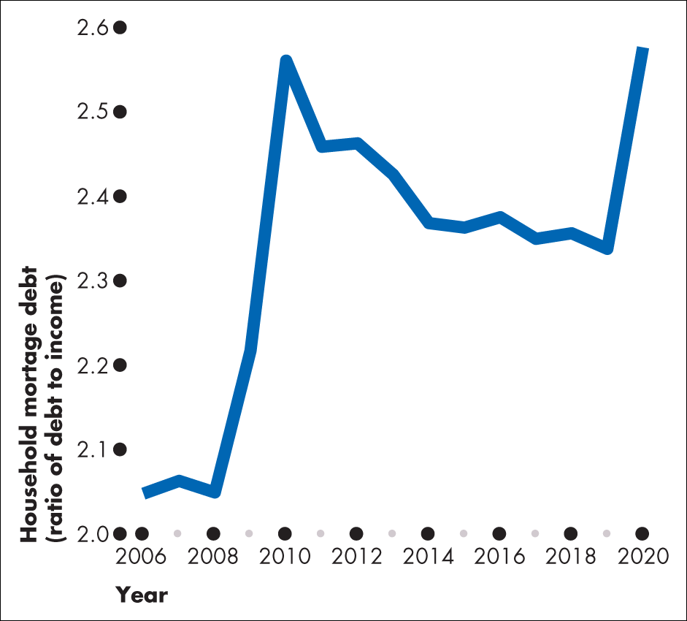
Figure 1 Mortgage debt to income ratio

Slide 13
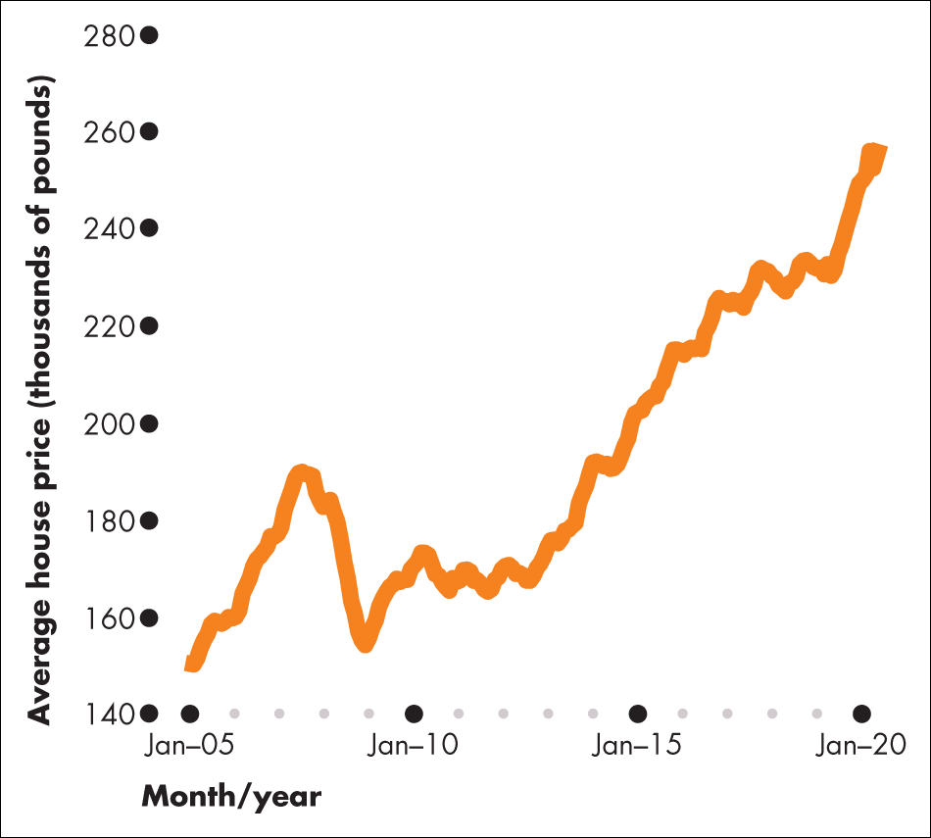
Figure 2 UK average house price

Slide 14
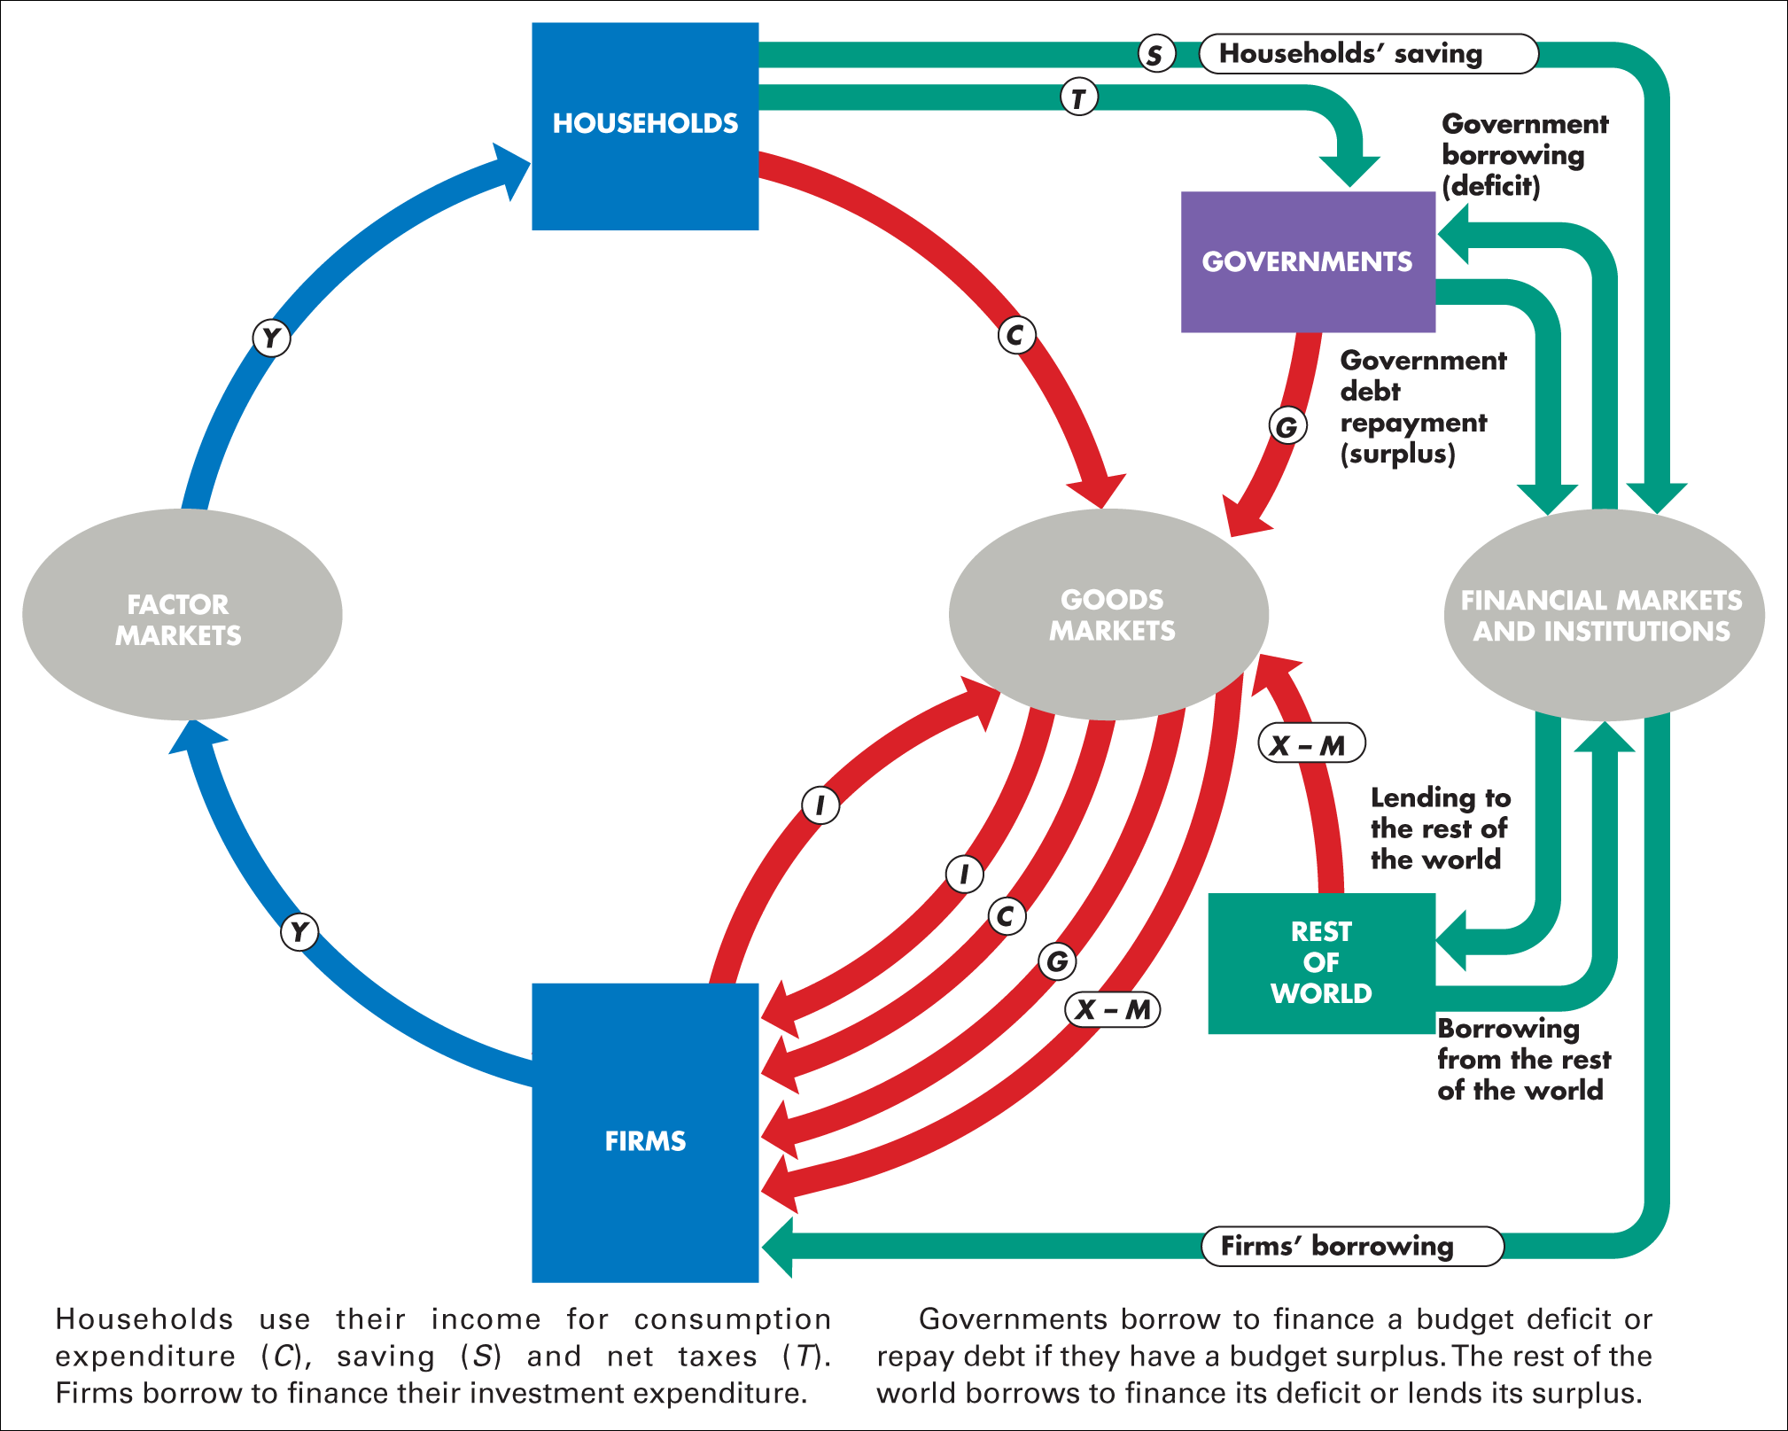
Figure 23.2 Financial flows and the circular flow of expenditure and income

Slide 15
Financial Decisions and Risk
Financial markets and institutions enable us to make decisions about the timing of our use of scarce resources, and to manage the risks that arise from these decisions.
The Time Value of Money
To compare current and future dollars, we convert future dollars, called “future value,” to current dollars, called “present value.”
Present value of Future amount, n years in the future when the interest rate is r percent equals
Future amount divided by (1 + r)^{n}

Slide 16
Financial Decisions and Risk
Net Present Value
Net present value is the present value of all the future flows of money that arise from a financial decision minus the initial cost of the decision.
An example:
Jack can make a game bot for $500 and sell it after two
years for $2,420. The interest rate is 10 percent a year.
The present value of $2,420 two years in the future is
$2,420 divided by (1 + 0.1)², which is $2,000.
The net present value of Jack’s bot equals $2,000 – $500, or $1,500.

Slide 17
Financial Decisions and Risk
Decision Rule
The financial decision rule is:
If the net present value is positive, do it!
If the net present value is negative, don’t do it!
Following this decision rule maximizes wealth when the future money flows are not risky.
Where the future is uncertain, the rule is modified to: Do it if the net present value is large enough to make a loss sufficiently unlikely.

Slide 18
Financial Decisions and Risk
Financial Risk: Insolvency and Illiquidity
A financial institution’s net worth is the total market value of what it has lent minus the market value of what it has borrowed.
If net worth is positive, the institution is solvent and can remain in business.
But if net worth is negative, the institution is insolvent and will go out of business.

Slide 19
Financial Decisions and Risk
Market Risk: Interest Rates and Asset Prices
The interest rate on a financial asset equals the interest received expressed as a percentage of the price of the asset.
For example, if the price of the asset is $50 and the interest is $5, then the interest rate is 10 percent
If the asset price rises (say to $200), other things remaining the same, the interest rate falls (2.5 percent).
If the asset price falls (say to $20), other things remaining the same, the interest rate rises (to 25 percent).

Slide 20
Financial Decisions and Risk
Getting Real
An economy with inflation has two interest rates: The nominal interest rate and the real interest rate.
The nominal interest rate is the number of dollars that a borrower pays and a lender receives in interest in a year expressed as a percentage of the number of dollars borrowed and lent.
For example:
If the annual interest paid on a $500 loan is $25, the
nominal interest rate is 5 percent per year.

Slide 21
Financial Decisions and Risk
The real interest rate is the nominal interest rate adjusted to remove the effects of inflation on the buying power of money.
The real interest rate is approximately equal to the nominal interest rate minus the inflation rate.
For example:
If the nominal interest rate is 5 percent a year and the inflation rate is 2 percent a year, the real interest rate is 3 percent a year.
The real interest rate is the opportunity coast of borrowing.

Slide 22
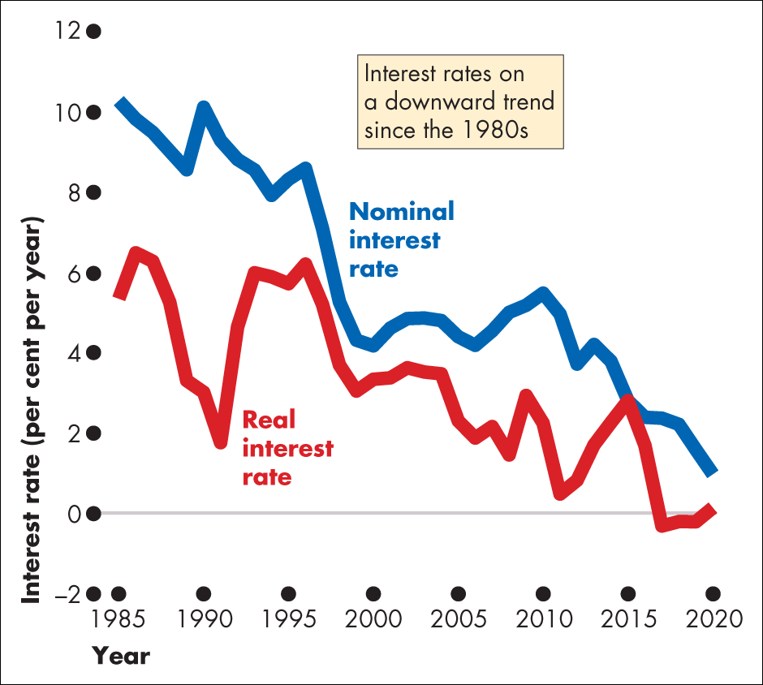
Figure 1 Nominal and real interest rate history
Source of data: Bank of England

Slide 23
The Loanable Funds Market
The market for loanable funds is the aggregate of all the
individual financial markets.
The market for loanable funds determines the real interest rate, the quantity of funds loaned, saving, and investment.
We’ll start by ignoring the government and the rest of the world.
The Demand for Loanable Funds
The quantity of loanable funds demanded depends on
The real interest rate
Expected profit

Slide 24
The Loanable Funds Market
Demand for Loanable Funds Curve
The demand for loanable funds is the relationship between the quantity of loanable funds demanded and the real interest rate when all other influences on borrowing plans remain the same.
Business investment is the main item that makes up the demand for loanable funds.

Slide 25
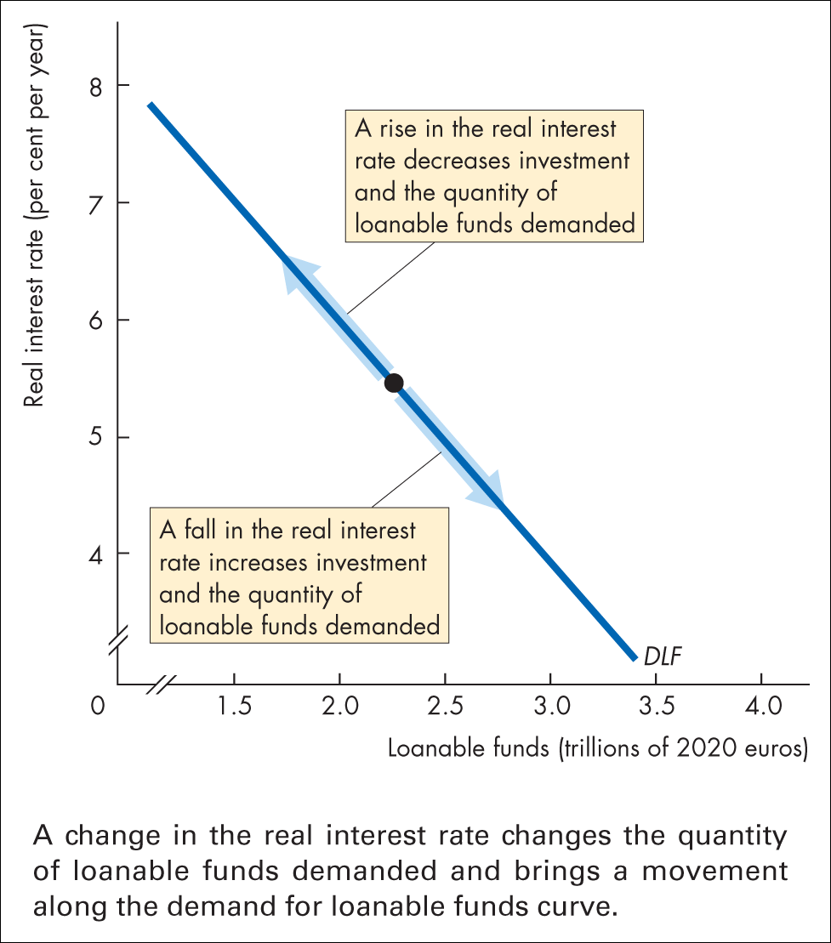
Figure 23.3 Demand for loanable funds
Figure 23.3 shows the demand for loanable funds curve.
A rise in the real interest rate decreases the quantity of loanable funds demanded.
A fall in the real interest rate increases the quantity of loanable funds demanded.

Slide 26
The Loanable Funds Market
Changes in the Demand for Loanable Funds
When the expected profit changes, the demand for loanable funds changes.
Other things remaining the same, the greater the expected profit from new capital, the greater is the amount of investment and the greater the demand for loanable funds.

Slide 27
The Loanable Funds Market
The Supply of Loanable Funds
The quantity of loanable funds supplied depends on
The real interest rate
Disposable income
Expected future income
Wealth
Default risk

Slide 28
The Loanable Funds Market
The Supply of Loanable Funds Curve
The supply of loanable funds is the relationship between the quantity of loanable funds supplied and the real interest rate when all other influences on lending plans remain the same.
Saving is the main item that makes up the supply of loanable funds.

Slide 29
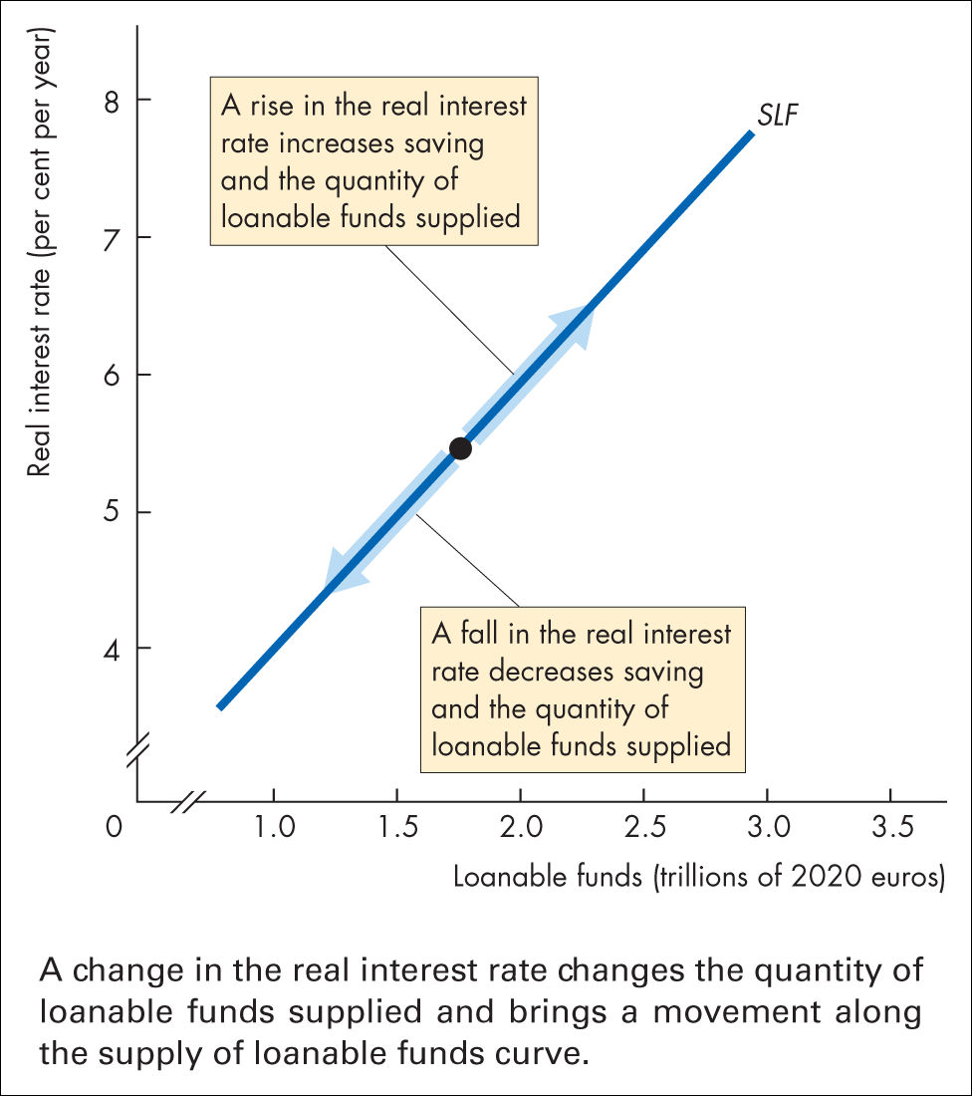
Figure 23.4 Supply of loanable funds
Figure 23.4 shows the supply of loanable funds curve.
A rise in the real interest rate increases the quantity of loanable funds supplied.
A fall in the real interest rate decreases the quantity of loanable funds supplied.

Slide 30
The Loanable Funds Market
Changes in the Supply of Loanable Funds
A change in disposable income, expected future income, wealth, or default risk changes the supply of loanable funds.
An increase in disposable income, a decrease in expected future income, a decrease in wealth, or a fall in default risk increases saving and increases the supply of loanable funds.

Slide 31
The Loanable Funds Market
Equilibrium in the Loanable Funds Market
The loanable funds market is in equilibrium at the real interest rate at which the quantity of loanable funds demanded equals the quantity of loanable funds supplied.

Slide 32
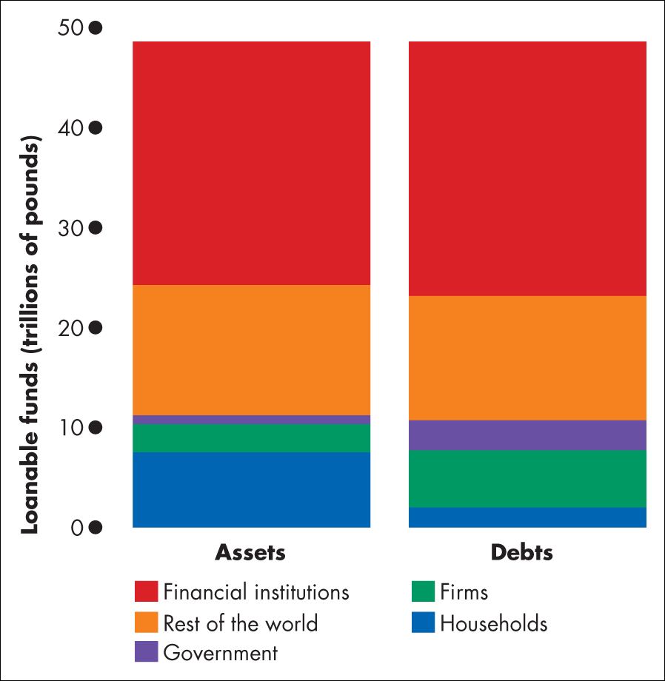
Figure 1 UK financial assets and debts
Source of data: Office for National Statistics

Slide 33
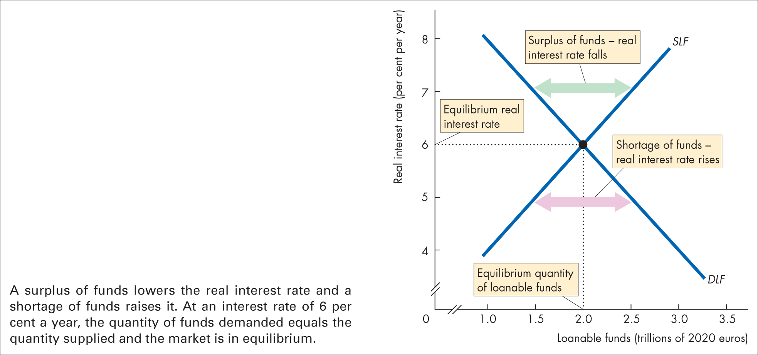
Figure 23.5 Loanable funds market equilibrium
Figure 23.5 illustrates the loanable funds market.
At 7 percent a year, there is a surplus of funds and the real interest rate falls.
At 5 percent a year, there is a shortage
of funds and the real interest rate rises.
Equilibrium occurs at a real interest rate of 6 percent a year.

Slide 34
The Loanable Funds Market
Changes in Demand and Supply
Financial markets are highly volatile in the short run but remarkably stable in the long run.
Volatility comes from fluctuations in either the demand for loanable funds or the supply of loanable funds.
These fluctuations bring fluctuations in the real interest rate and in the equilibrium quantity of funds lent and borrowed.
They also bring fluctuations in asset prices.

Slide 35
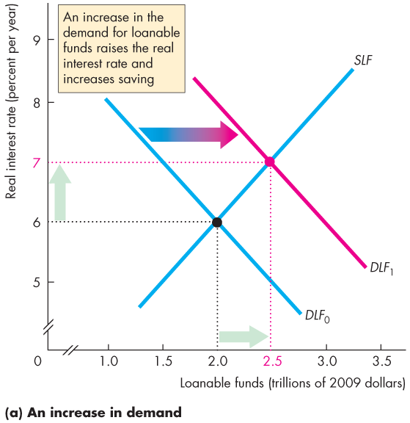

The Loanable Funds Market
Figure 24.6(a) illustrates an increase in the demand for loanable funds.
An increase in expected profits increases the demand for funds today.
The real interest rate rises.
Saving and quantity of funds supplied increases.

Slide 36
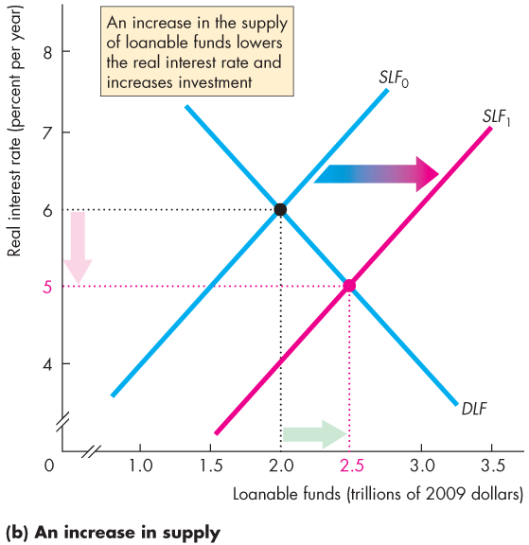
The Loanable Funds Market
Figure 24.6(b) illustrates an increase in the supply of loanable funds.
If one of the influences on saving plans changes and saving increases, the supply of funds increases.
The real interest rate falls. Investment increases.

Slide 37
Government in the Loanable Funds Market
Government enters the loanable funds market when it has
a budget surplus or deficit.
A government budget surplus increases the supply of funds.
A government budget deficit increases the demand for funds.

Slide 38
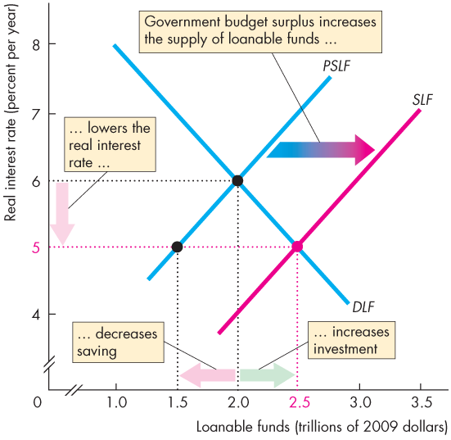
Government in the Loanable Funds Market
Figure 24.7 illustrates the effect of a government budget surplus.
A government budget surplus increases the supply of funds.
The real interest rate falls. Private saving decreases. Investment increases.

Slide 39
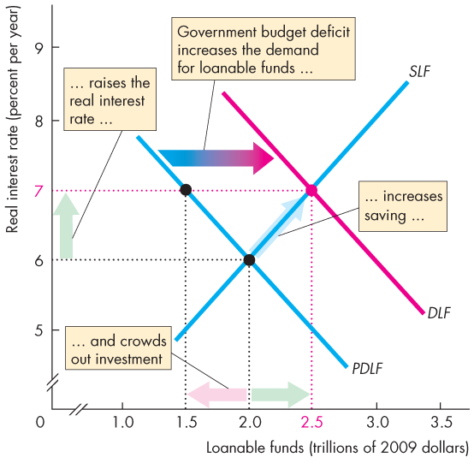
Government in the Loanable Funds Market
Figure 24.8 illustrates the effect of a government budget deficit.
A government budget deficit increases the demand for funds.
The real interest rate rises. Private saving increases.
Investment decreases—is
crowded out.

Slide 40
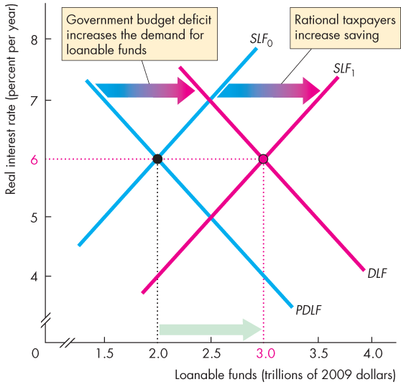
Government in the Loanable Funds Market
Figure 24.9 illustrates the
Ricardo-Barro effect.
A budget deficit increases the demand for funds.
Rational taxpayers increase saving, which increases the supply of funds.
Increased private saving finances the deficit.
Crowding-out is avoided.

Slide 41
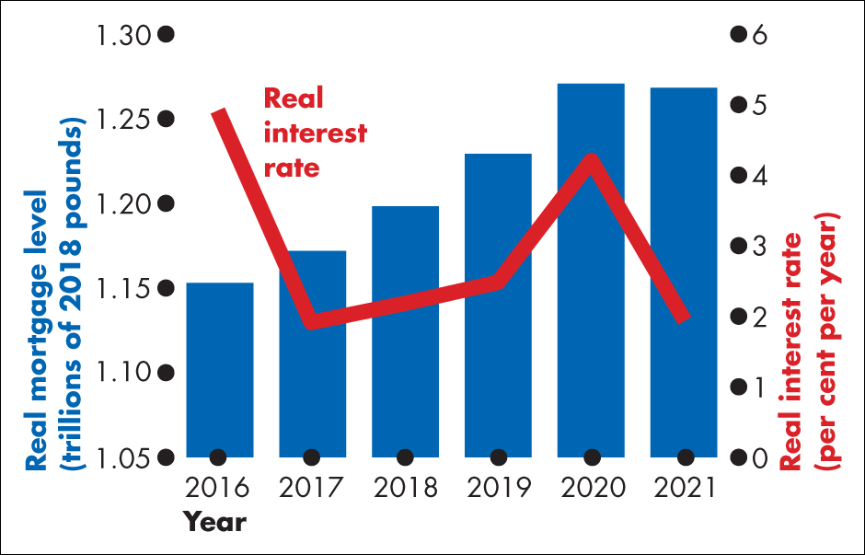
Figure 1 Real interest rate and real mortgage level

Slide 42
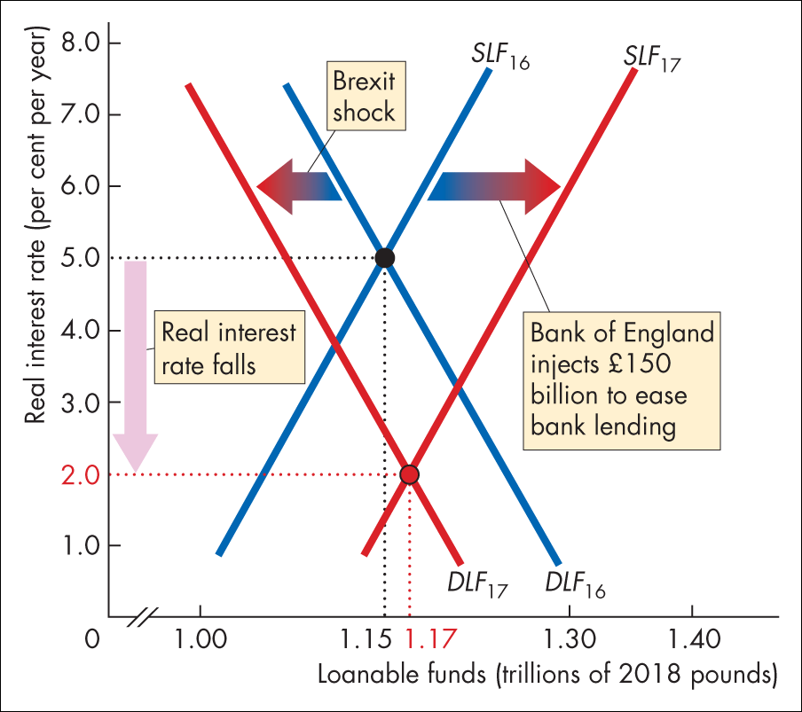
Figure 2 Responding to Brexit

Slide 43
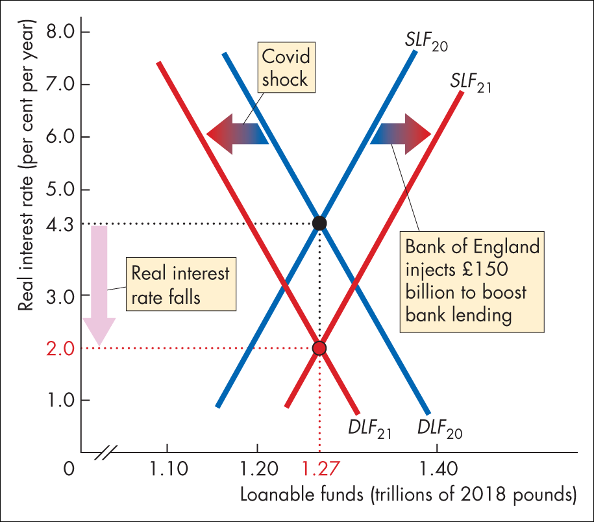
Figure 3 Responding to covid-19

Slide 44
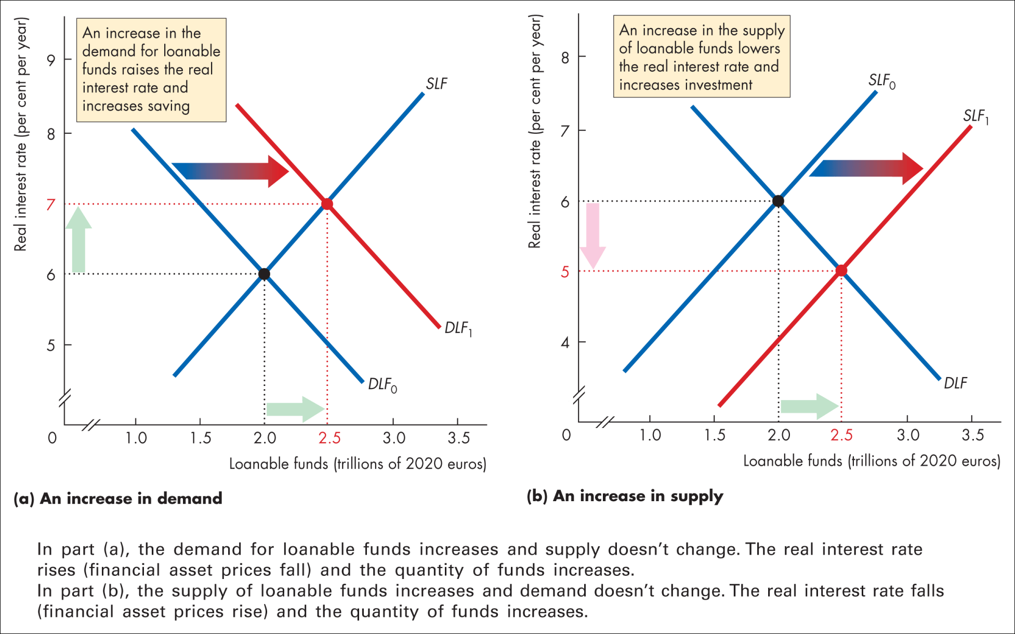
Figure 23.6 Changes in demand and supply

Slide 45
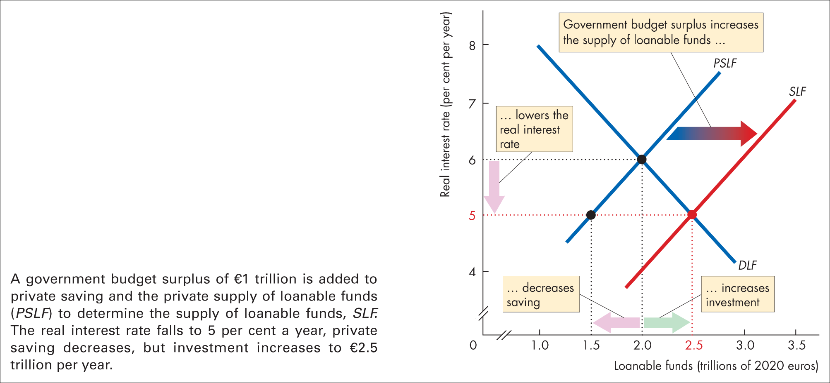
Figure 23.7 Government budget surplus

Slide 46
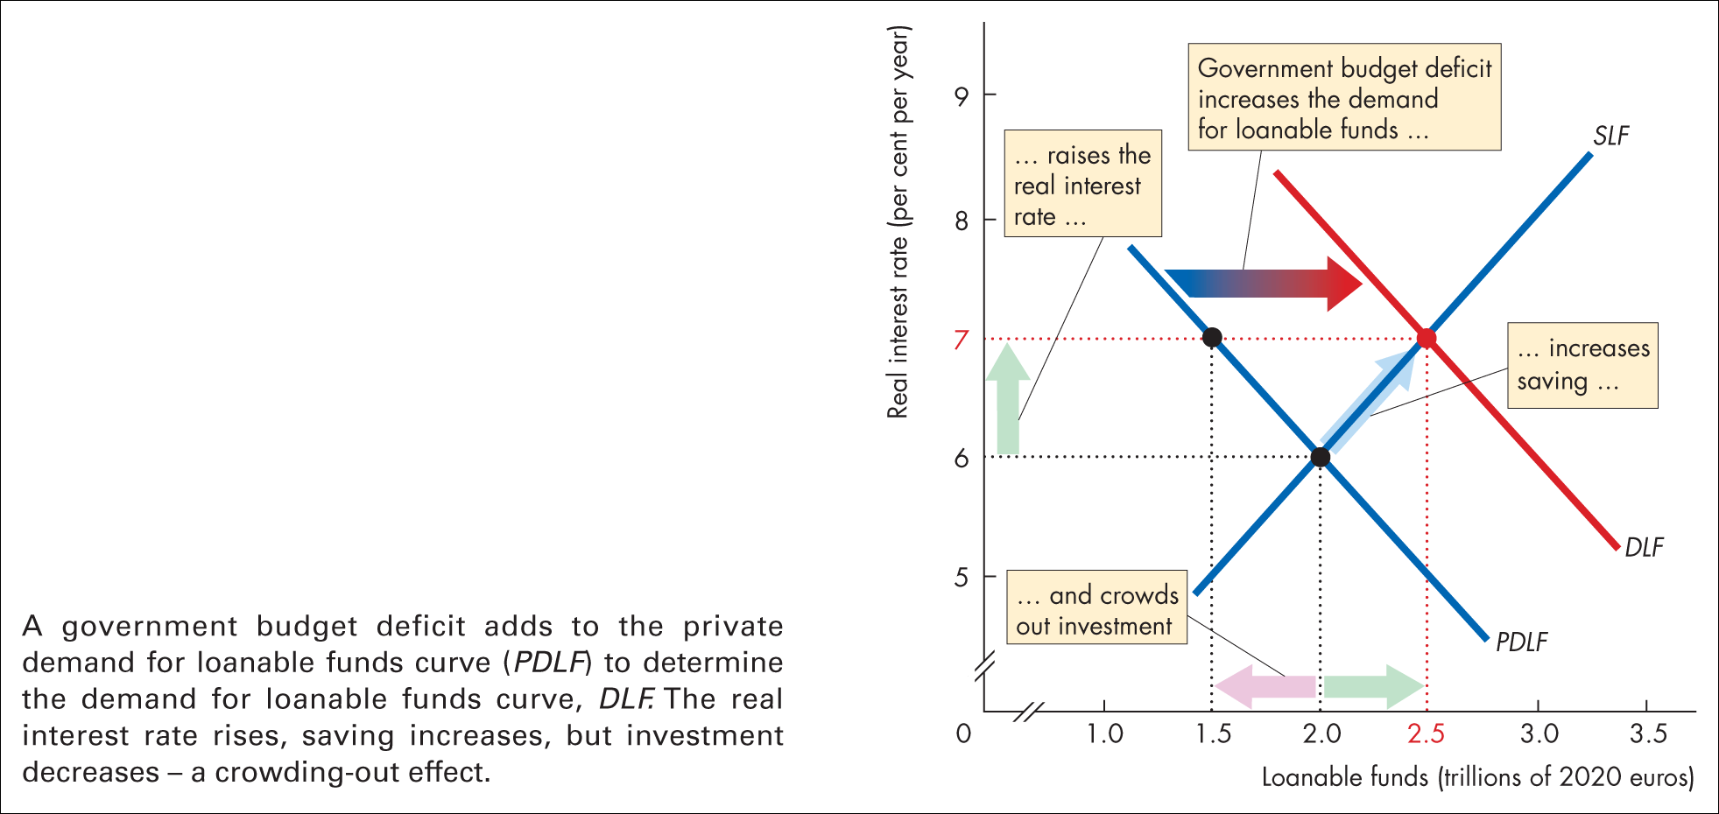
Figure 23.8 Government budget deficit

Slide 47
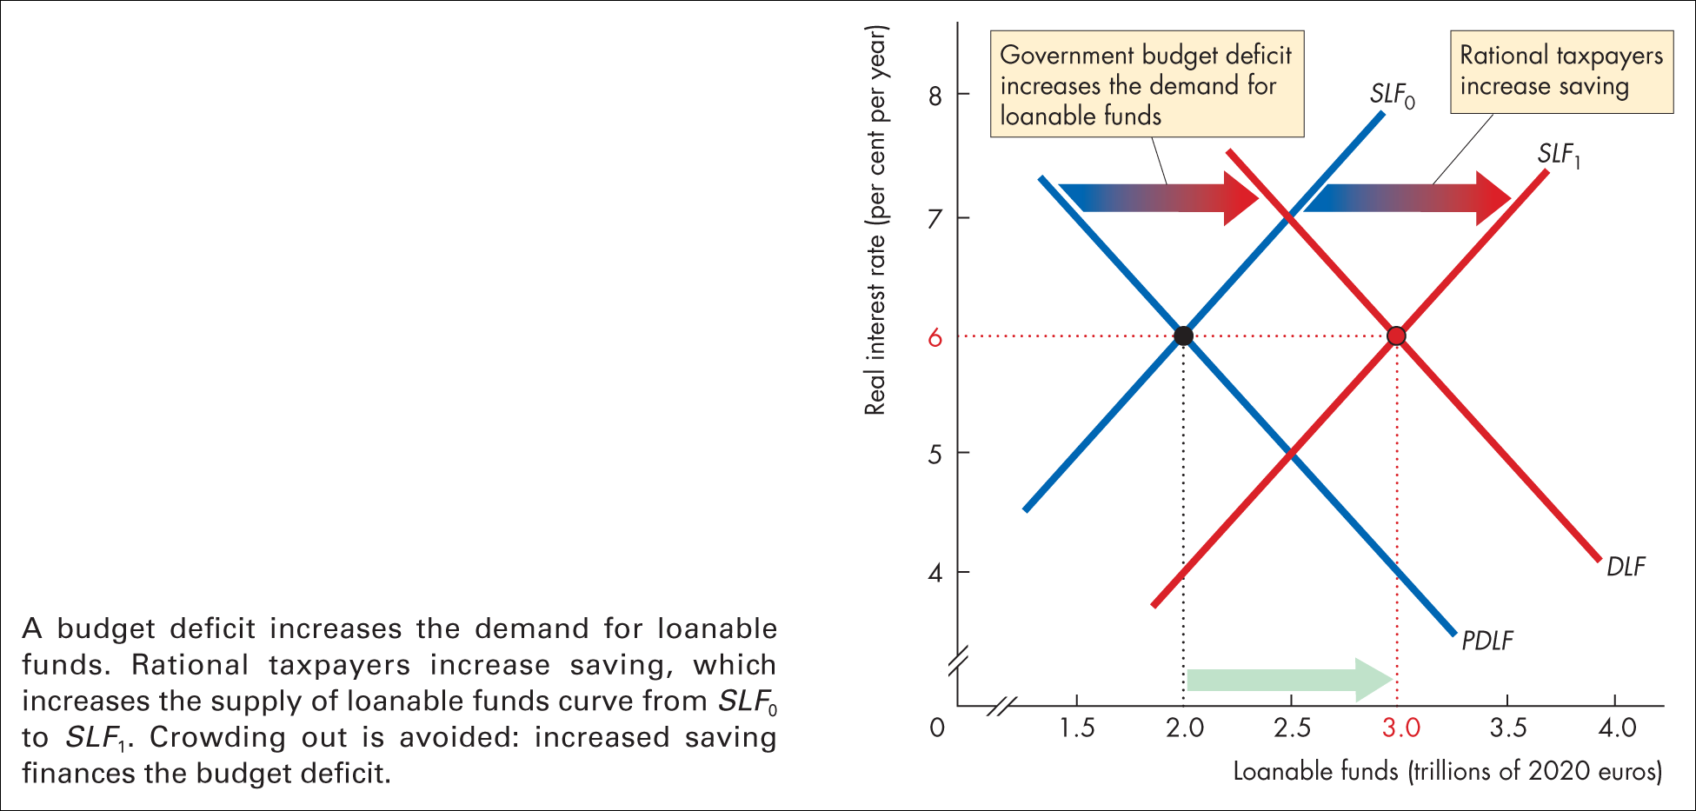
Figure 23.9 The Ricardo–Barro effect

Slide 48
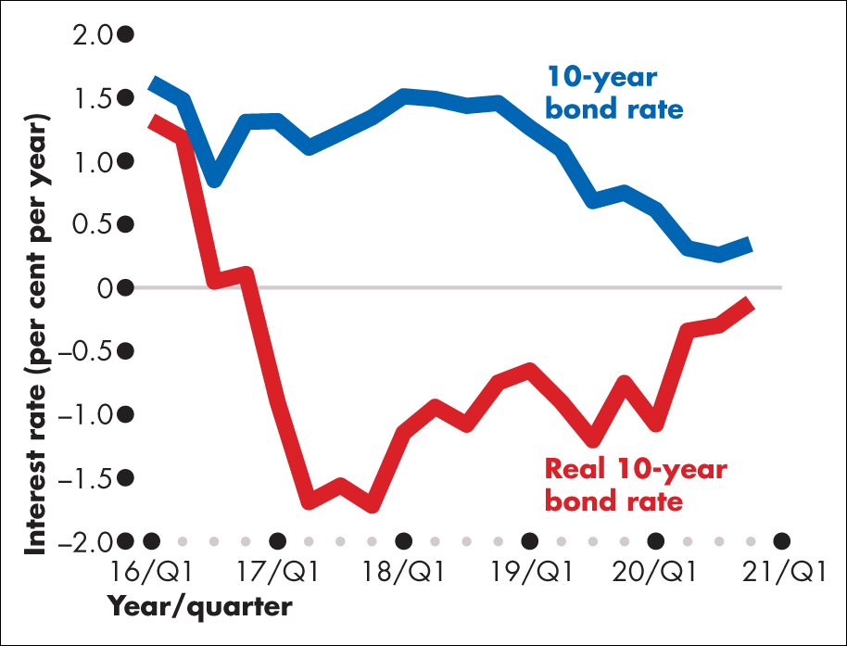
Figure 1 Government 10-year bond rate

Slide 49
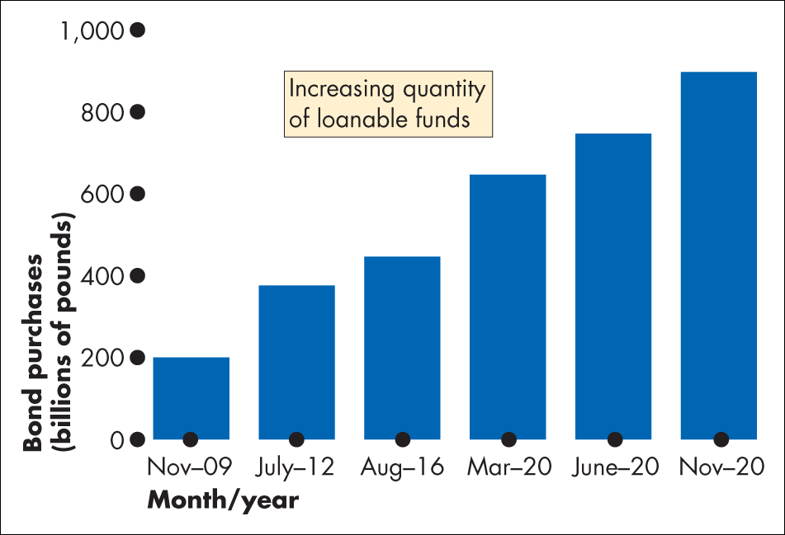
Figure 2 Bank of England bond purchases

Slide 50
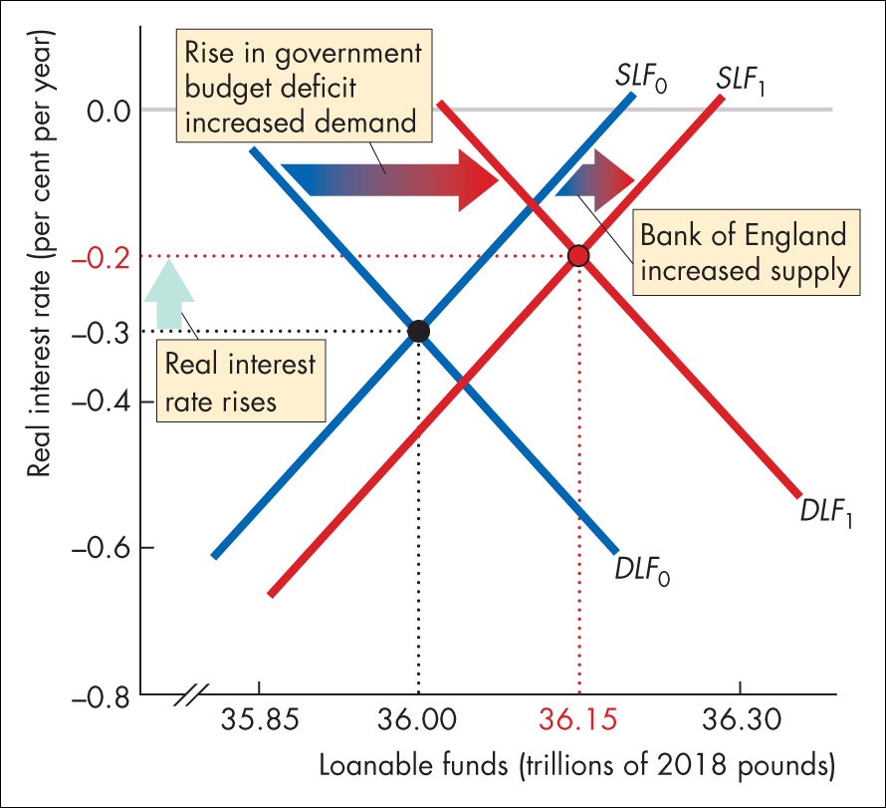
Figure 3 The UK loanable funds market in 2020

