Slide 1
Economics
Eleventh European Edition
Part 7
Macroeconomic trends
Chapter 24
Money, the price level and inflation

Slide 2

24
MONEY, THE PRICE LEVEL, AND INFLATION

Slide 3
After studying this chapter, you will be able to:
Define money and describe its functions
Explain the economic functions of banks
Describe the structure and functions of the central bank
Explain how the banking system creates money
Explain what determines the quantity of money and the nominal interest rate
Explain how the quantity of money influences the price level and the inflation rate

Slide 4
What is Money?
Money is any commodity or token that is generally
acceptable as a means of payment.
A Commodity or Token
Money is something that can be recognized.
Money can be divided up into small parts.
A means of payment is a method of settling a debt. Money has three other functions:
Medium of exchange
Unit of account
Store of value

Slide 5
What is Money?
Medium of Exchange
A medium of exchange is an object that is generally accepted in exchange for goods and services.
In the absence of money, people would need to exchange goods and services directly, which is called barter.
Barter requires a double coincidence of wants, which is rare, so barter is costly.

Slide 6
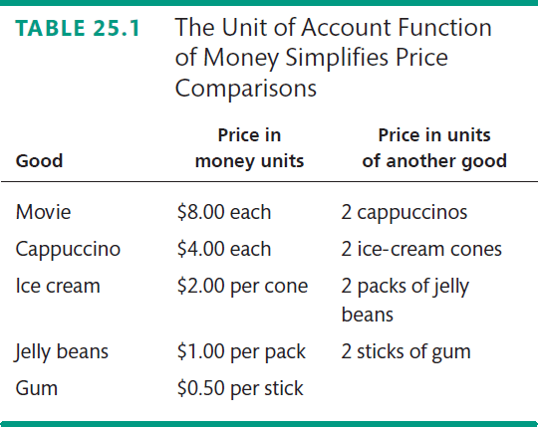

What is Money?
Unit of Account
A unit of account is an agreed measure for stating the prices of goods and services.
Table 25.1 illustrates how money simplifies comparisons.
Store of Value
As a store of value, money can be held for a time and later exchanged for goods and services.

Slide 7


Slide 8
WHAT IS MONEY?
Money Today
Money in the world today is called fiat money.
Fiat money is objects that are money because the law decrees or orders them to be money.
The objects that we use as money today are
Currency
Deposits at banks and other financial institutions
Currency is the notes and coins we use in transactions.
Currency in circulation is the notes and coins held by individuals and businesses.
Deposits are money because the owners can use the deposit to make payments.
Notes:
Our money today is fiat money. To reinforce this point, as a simple experiment, take a dollar bill out of your pocket in class and pretend to buy a pencil from the first student in class. Tell that student that she can now use that dollar to buy anything from the next student in her row. Ask each student to “go along” with the experiment by pretending that what is being bought each time is only worth a dollar. The dollar will continue to circulate around the room until everyone has had a chance to “buy something” with it. Now, pass around a piece of paper with George W. Bush’s name (or, perhaps your name!) on it and the phrase “One Dollar” printed somewhere on it. Ask your students how far this note is likely to get around the class. Most students will say that it won’t get as far as even the first transaction because this new note is not a socially accepted medium of exchange. However, now ask what might happen if I (the instructor) agreed to convert these George W. Bush notes into genuine U.S. one‐dollar notes upon demand. Students will now be indifferent between accepting these new notes versus receiving the “real thing,” Federal Reserve notes. What happens is that the George W. Bush notes, which previously were only pieces of paper, have now effectively become money. That is, they are now considered money (in our fictional but otherwise possibly real example). In fact, as long as people believe they will be converted into actual dollar bills there might never be any reason for people to demand original greenbacks. You can tell your students that this is no different than the story of the goldsmiths in olden days who originally acted as simply caretakers or depositories of people’s gold. As soon as the script or gold certificates that circulated began to be accepted as means of payment there was no further need of demanding payment in gold because most people regarded the gold certificates as being “as good as gold.”

Slide 9
WHAT IS MONEY?
Deposits
Deposits at banks, credit unions, savings banks, and savings and loan associations are also money.
Deposits are money because they can be converted into currency on demand and are used directly to make payments.

Slide 10
WHAT IS MONEY?
Currency inside Banks Is Not Money
Bank deposits are one form of money, and currency outside the banks is another form.
Currency inside the banks is not money.
When you get some cash from the ATM, you convert your bank deposit into currency.
Notes:
The old joke, “I must have money, I still have checks left, “ is one that you can be sure your students have heard. Unfortunately for many Americans and perhaps for many of your students it is their reality. You can use this bit of humor to drive home a point about the difference between the instrument in the money process and money itself, a point that can really bedevil more than a few students. Checks aren’t money, unlike the deposits that they are drawn against. Ask your class if, when they write a check, have they created more money? The answer will be no. All that takes place is that the distribution of money changes but the absolute level of money (M1) remains the same. This same argument can be made for credit cards as well. Tell your students that if the unused credit lines of credit cards were actually counted as part of the money supply then M1 would be many trillions of dollars greater than it is already! The reason that credit cards are not counted as money is that they are nothing more than unsecured short‐term loans. Because loans do not fit the definition of money, credit cards quite appropriately are not classified as money.

Slide 11
What is Money?
Official Measures of Money
The two main official measures of money in the United States are M1 and M2.
M1 consists of currency and traveler’s checks and checking deposits owned by individuals and businesses.
M2 consists of M1 plus savings deposits and small time deposits, money market funds, and other deposits

Slide 12
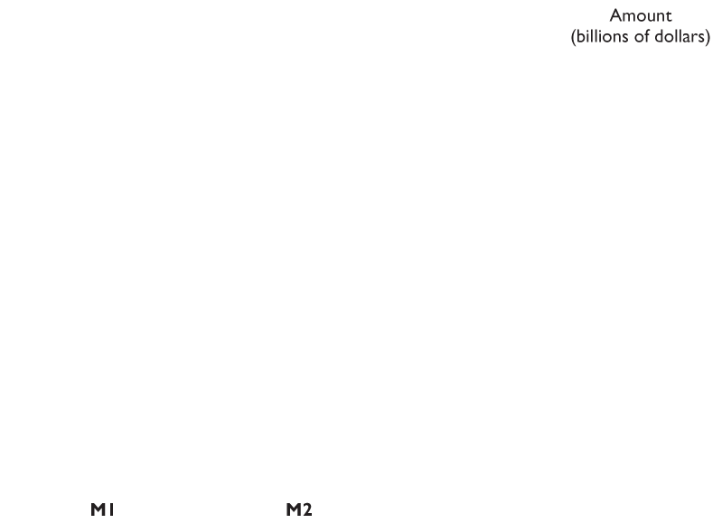
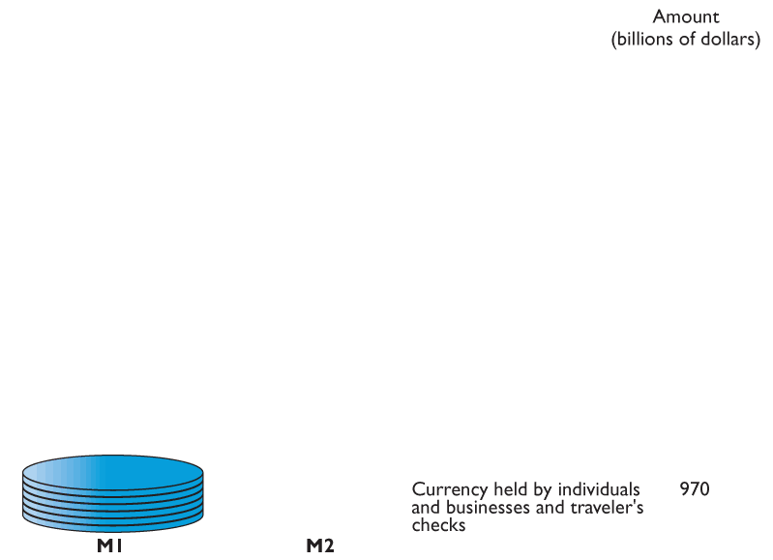
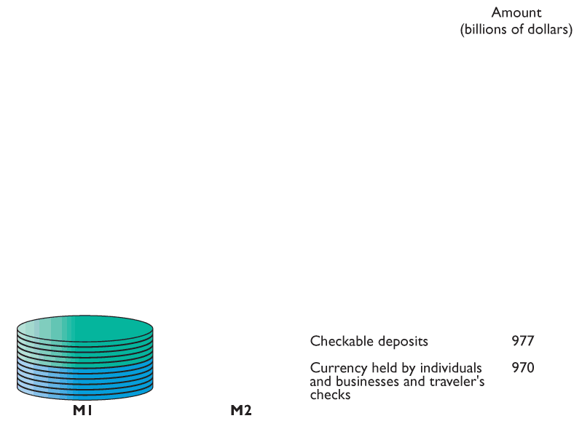
WHAT IS MONEY?
Figure 27.1 shows two measures of money.
M1
Currency and traveler’s checks
Checkable deposits

Slide 13
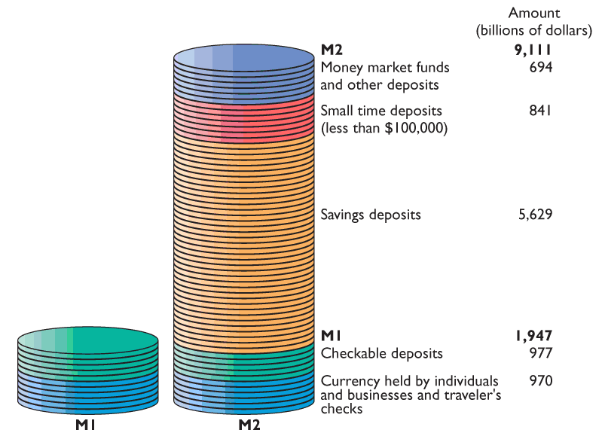
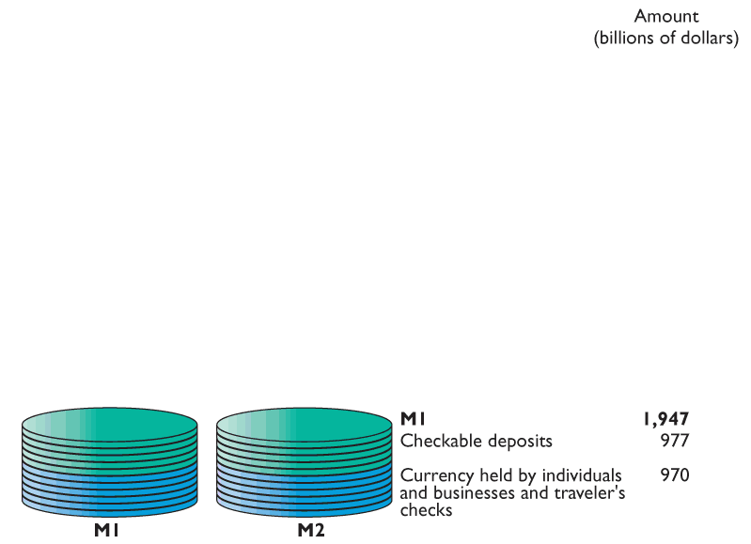
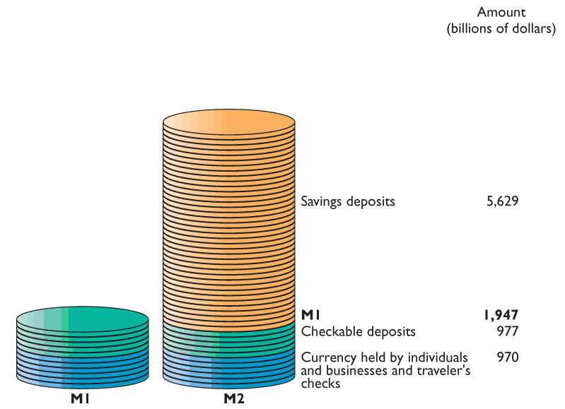
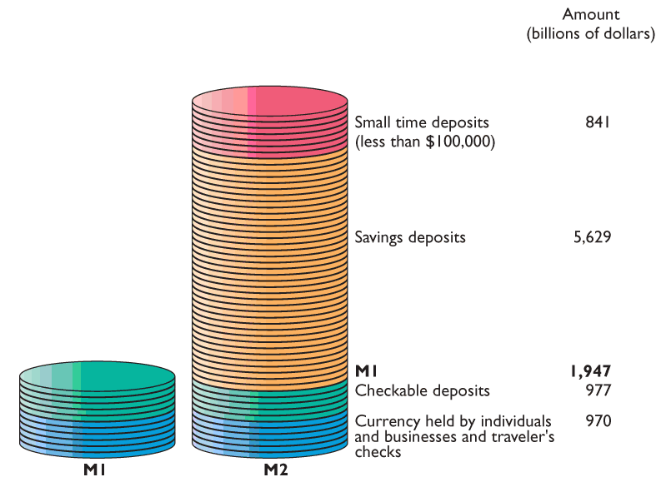
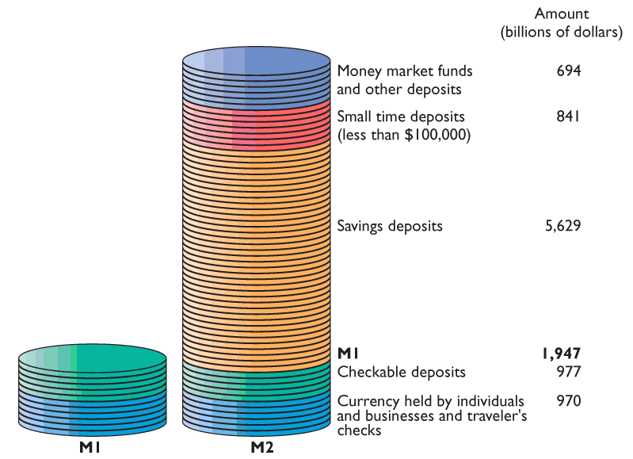
WHAT IS MONEY?
M2
M1
Savings deposits
Small time deposits
Money market funds and other deposits

Slide 14
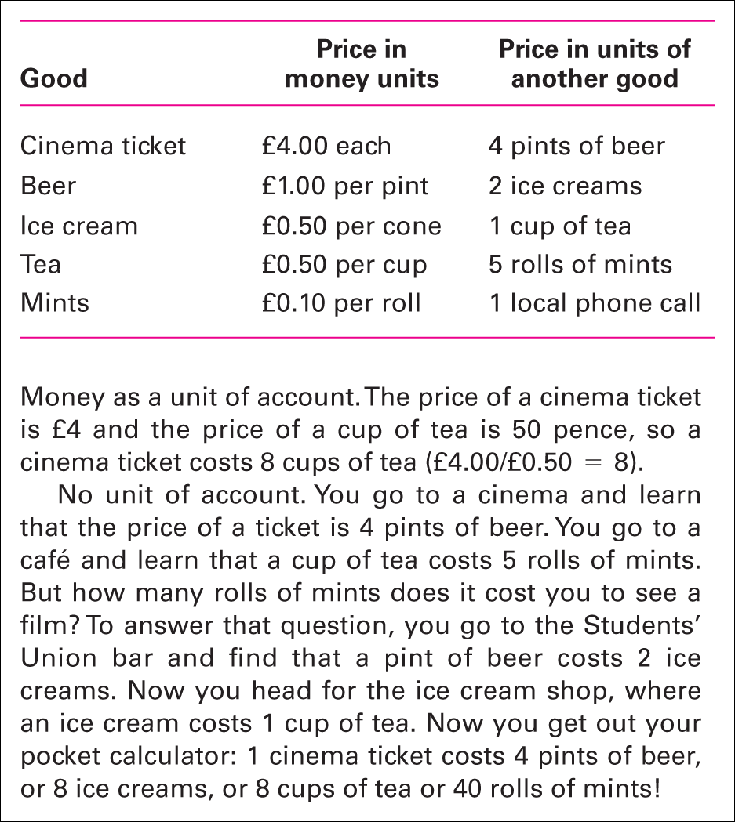
Table 24.1 The unit of account function of money simplifies price comparisons

Slide 15
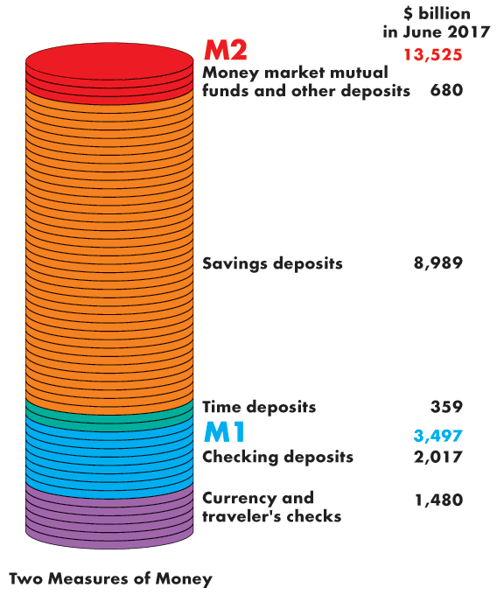
What is Money?
The figure illustrates the
composition of M1…
and M2.
It also shows the relative magnitudes of the components.

Slide 16
What is Money?
Are M1 and M2 Really Money?
All the items in M1 are means of payment, so they are money.
Some saving deposits in M2 are not means of payments— they are called liquid assets.
Liquidity is the property of being instantly convertible into a means of payment with little loss of value.
Deposits are money, but checks are not—a check is an instruction to a bank to transfer money.
Other savings deposits, time deposits, and money market funds are not instantly convertible and are not a means of payment.

Slide 17
WHAT IS MONEY?
Checks, Credit Cards, Debit Cards and E-Checks
Checks
A check is not money. It is an instruction to a bank to make a payment.

Slide 18
WHAT IS MONEY?
Credit Cards
A credit card is not money because it does not make a payment.
When you use your credit card, you create a debt (the outstanding balance on your card account), which you eventually pay off with money.
Debit Cards
A debit card is not money. It is like an electronic check.
It is an electronic equivalent of a paper check.

Slide 19
WHAT IS MONEY?
E-Checks
An e-check is not money.
It is an electronic equivalent of a paper check.
An Embryonic New Money: E-Cash
Works like money and when it becomes widely acceptable, it will be money.

Slide 20
What is Money?
Deposits Are Money but Checks and Debit Cards Are Not
In defining money, we include, along with currency, deposits at banks and other depository institutions.
A check or card swipe is an instruction to a bank to transfer money.
A check or card swipe is not money, but the deposit on which
it is linked is money.
Credit Cards Are Not Money?
A credit card enables the holder to obtain a loan, but it must
be repaid with money. Credit cards are not money.

Slide 21
Depository Institutions
A depository institution is a firm that takes deposits from households and firms and makes loans to other households and firms.
Types of Depository Institutions
Deposits at three institutions make up the nation’s money. They are
Commercial banks
Thrift institutions
Money market mutual funds

Slide 22
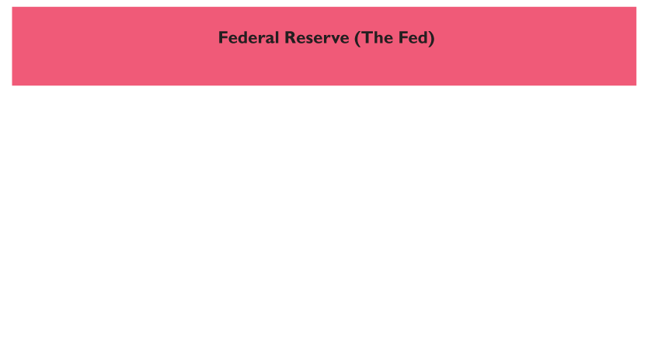
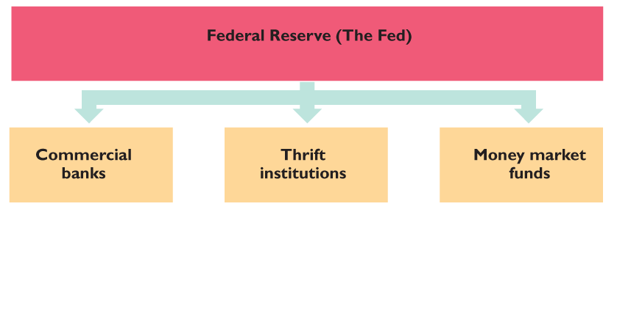
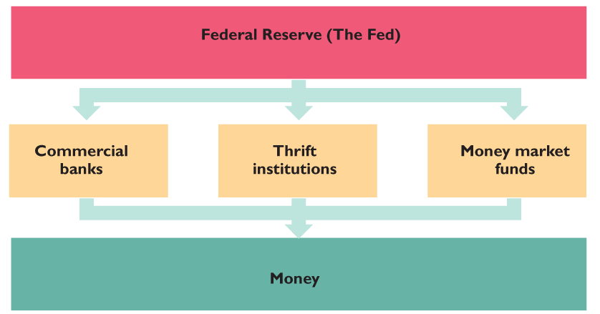
27.2 THE BANKING SYSTEM
Figure 27.2 shows the institutions of the banking system.
The Federal Reserve regulates and influences the activities of the commercial banks, thrift institutions, and money market funds, whose deposits make up the nation’s money.

Slide 23
Depository Institutions
Commercial Banks
A commercial bank is a private firm that is licensed by the Controller of the Currency or by a state agency to receive deposits and make loans.
Thrift Institutions
Savings and loan associations, savings banks, and credit union are called thrift institutions.
Money Market Mutual Funds
A money market mutual fund is a fund operated by a financial institution that sells shares in the fund and holds assets such as U.S. Treasury bills.

Slide 24
Depository Institutions
Commercial Banks
A commercial bank is a private firm that is licensed by the Comptroller of the Currency or by a state agency to receive deposits and make loans.
Thrift Institutions
Savings and loan associations, savings banks, and credit
unions are called thrift institutions.
Money Market Mutual Funds
A money market mutual fund is a fund operated by a financial institution that sells shares in the fund and holds assets such as U.S. Treasury bills.

Slide 25
Depository Institutions
What Depository Institutions Do
The goal of any bank is to maximize the wealth of its owners.
To achieve this objective, the interest rate at which it lends exceeds the interest rate it pays on deposits.
But the banks must balance profit and prudence:
Loans generate profit.
Depositors must be able to obtain their funds when they want them.

Slide 26
THE BANKING SYSTEM
Bank Deposits
A commercial bank accepts three types of deposits:
Checkable deposits
Savings deposits
Time deposits

Slide 27
THE BANKING SYSTEM
Profit and Risk: A Balancing Act
The goal of a commercial bank is to maximize the long-term wealth of its stockholders.
To achieve this goal, banks borrow from depositors and others and lend for long-terms at high interest rates.
Lending is risky, so a bank must be prudent in the way it uses its depositors’ funds and balance security for depositors and stockholders against high but risky returns.

Slide 28
THE BANKING SYSTEM
To trade off between risk and profit, a bank divided its assets into four parts:
Reserves
Liquid assets
Securities
Loans

Slide 29
Depository Institutions
A commercial bank puts the depositors’ funds into three
types of assets:
Cash assets (Reserves)—notes and coins in its vault or its deposit at the Federal Reserve
Liquid assets—U.S. government Treasury bills and commercial bills
Securities—U.S. government Treasury bills and commercial bills and longer-term U.S. government bonds and other bonds such as mortgage-backed securities
Loans—commitments of fixed amounts of money for agreed-upon periods of time

Slide 30
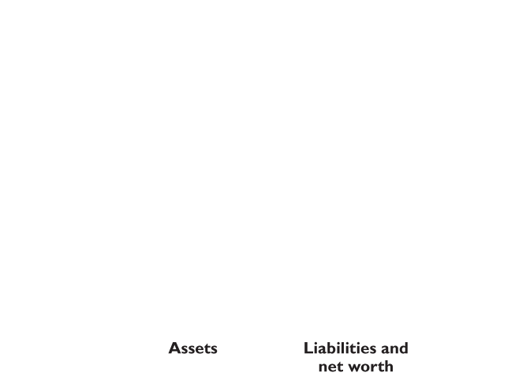
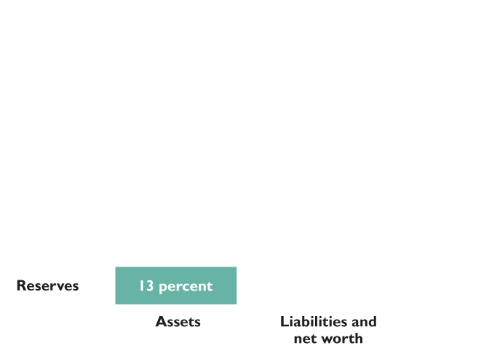
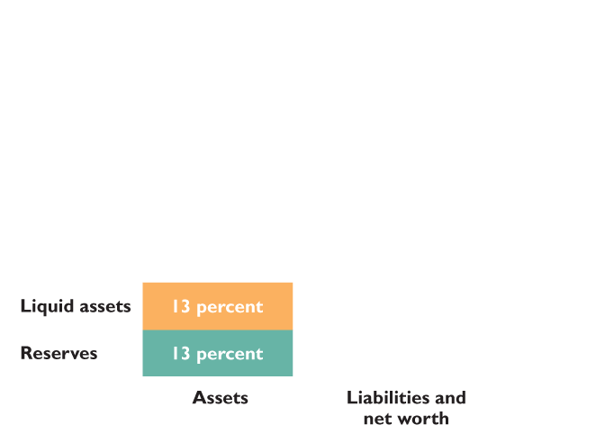
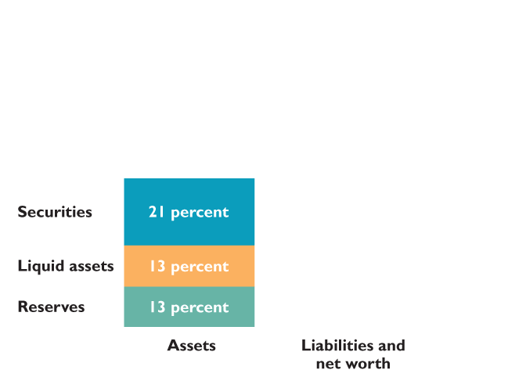
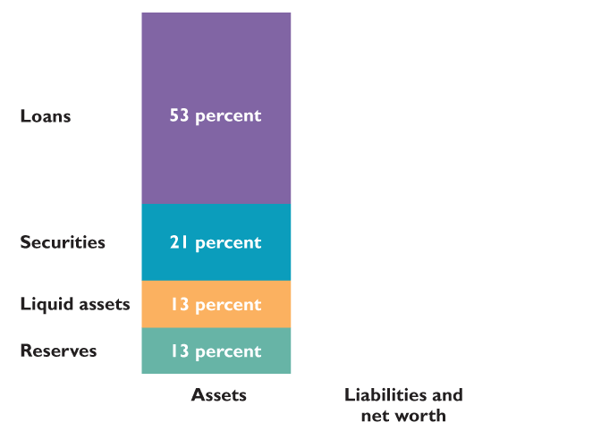
THE BANKING SYSTEM
Figure 27.3 shows that in 2011, commercial banks held :
13 percent of total assets as reserves
13 percent as liquid assets
21 percent as securities
53 percent as loans

Slide 31
THE BANKING SYSTEM
Reserves
A bank’s reserves consist of currency in the bank’s vaults plus the balance on its reserve account at a Federal Reserve Bank.
The Fed requires the banks and other financial institutions to hold a minimum percentage of deposits as reserves, called the required reserve ratio.
Banks’ desired reserves might exceed the required reserves, especially when the cost of borrowing reserves is high.

Slide 32
THE BANKING SYSTEM
Liquid Assets
Banks’ liquid assets are short-term Treasury bills and overnight loans to other banks.
When banks have excess reserves, they can lend them to other banks that are short of reserves in an interbank loans market.
The interbank loans market is called federal funds market and the interest rate on interbank loans is the federal funds rate.
The Fed’s policy actions target the federal funds rate.

Slide 33
THE BANKING SYSTEM
Securities and Loans
Securities held by banks are bonds issued by the U.S. government and by other organizations.
A bank earns a moderate interest rate on securities, but it can sell them quickly if it needs cash.
Loans are the funds that banks provide to businesses and individuals and include outstanding credit card balances.
Loans earn the bank a high interest rate, but they are risky and cannot be called in before the agreed date.

Slide 34
THE BANKING SYSTEM
Bank Assets and Liabilities: The Relative Magnitudes
In 2011, checkable deposits at commercial banks in the United States, included in M1, were about 8 percent of total commercial bank deposits.
Another 51 percent of deposits were savings deposits and small time deposits, which are part of M2.

Slide 35
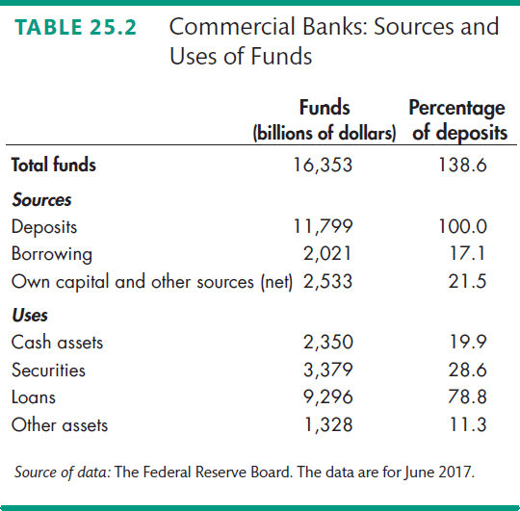
Depository Institutions
Table 25.2 shows the sources and uses of funds in all U.S. commercial banks in June 2017.

Slide 36
Depository Institutions
Economic Benefits Provided by Depository Institutions
Depository institutions make a profit from the spread between the interest rate they pay on their deposits and the interest rate they charge on their loans.
Depository institutions provide four benefits:
Create liquidity
Pool risk
Lower the cost of borrowing
Lower the cost of monitoring borrowers

Slide 37
Depository Institutions
How Depository Institutions Are Regulated
Depository institutions engage in risky business.
To make the risk of failure small, depository institutions are required to hold levels of reserves and owners’ capital equal to or that surpass the ratios laid down by regulation.
If a depository institution fails, deposits are guaranteed up to $250,000 per depositor per bank by the FDIC—Federal Deposit Insurance Corporation.

Slide 38
Depository Institutions
Financial Innovation
The aim of financial innovation—the development of new financial products—is to lower the cost of deposits or to increase the return from lending.
Two influences on financial innovation are
Economic environment
Technology

Slide 39
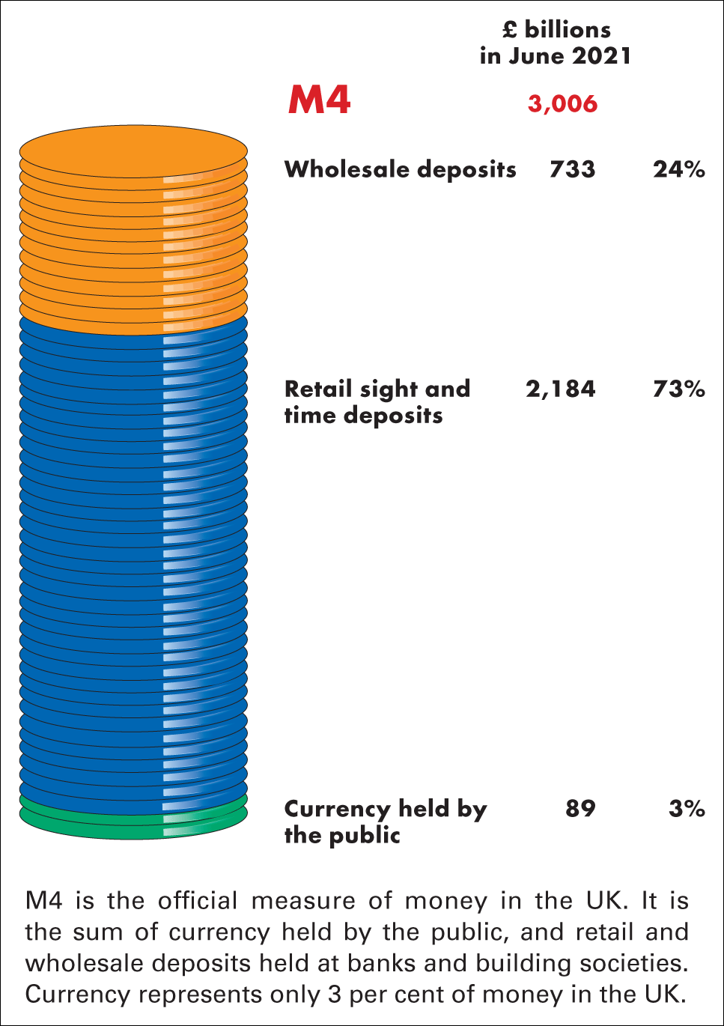
Figure 24.1 The official measure of money in the UK
Source of data: Bank of England

Slide 40
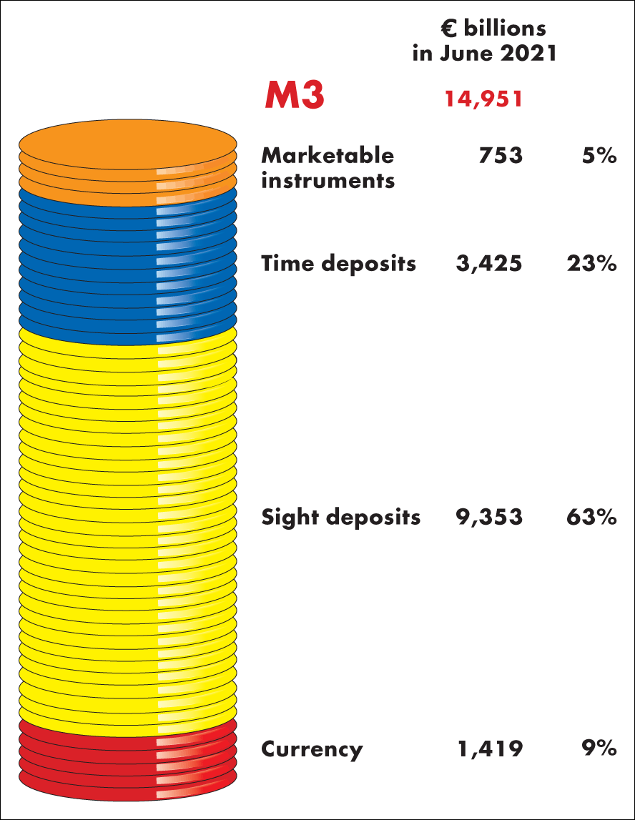
Figure 1 Official Eurozone measure of money
Source of data: European Central Bank

Slide 41
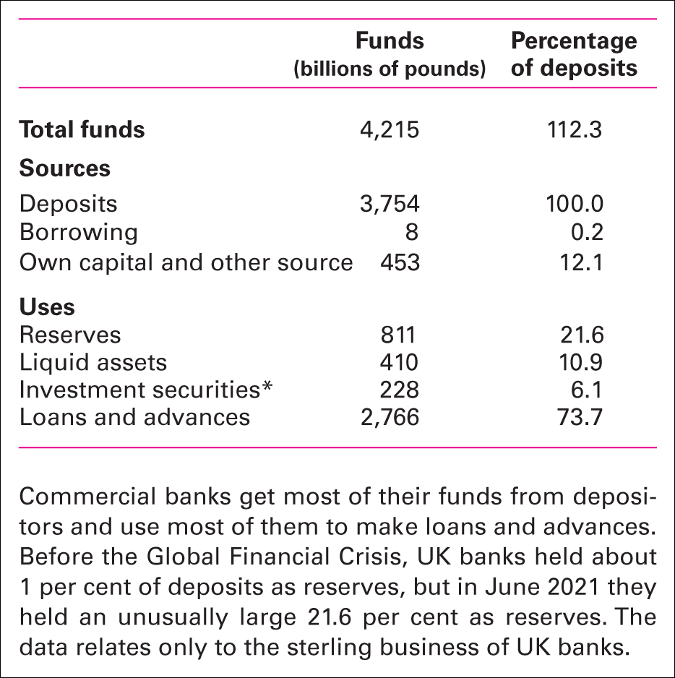
Table 24.2 Monetary financial institutions: sources and uses of funds
Source of data: Bank of England, Bankstat Table B1.4, June 2021
*Investment securities includes other assets.

Slide 42
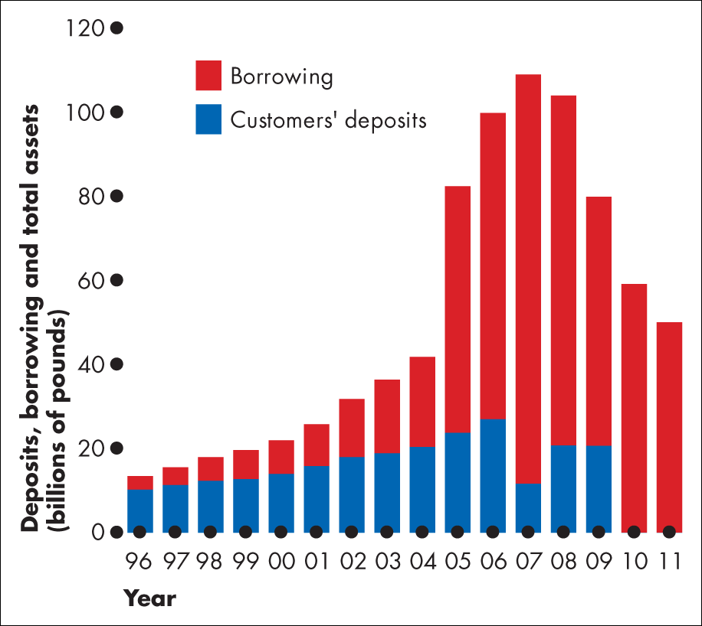
Figure 1 Northern rock’s spectacular rise and fall
Source of data: Bureau van dijk Bankscope

Slide 43
REGULATING THE QUANTITY OF MONEY
The Monetary Base
The monetary base is the sum of Federal Reserve notes, coins, and banks’ deposits at the Fed.
The size of the monetary base limits the total quantity of money that the banking system can create because
1. Banks have desired reserves.
2. Households and firms have desired currency holdings.
And both of these desired holdings of monetary base depend on the quantity of money.

Slide 44
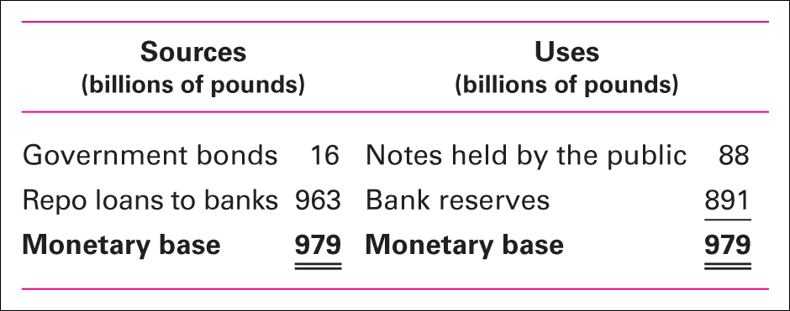
Table 24.3 Sources and uses of the monetary base
The monetary base is the sum of coins, Federal Reserve notes, and banks’ reserves at the Central bank (Bank of England).
The monetary base is so called because it acts like a base that supports the nation’s money.
The larger the monetary base, the greater is the quantity of money that it can support.

Slide 45
The Federal Reserve System
The Fed’s Policy Tools
To achieve its objectives, the Fed uses three main policy tools:
Open market operations
Last resort loans
Required reserve ratios

Slide 46
The Conduct of Monetary Policy
Open Market Operations
An open market operation is the purchase or sale of government securities by the Fed from or to a commercial bank or the public.
When the Fed buys securities, it pays for them with newly created reserves held by the banks.
When the Fed sells securities, they are paid for with reserves held by banks.
So open market operations influence banks’ reserves.

Slide 47
REGULATING THE QUANTITY OF MONEY
The Fed Buys Securities
Suppose the Fed buys $100 million of U.S. government securities in the open market.
The seller might be
A commercial bank
The nonbank public

Slide 48
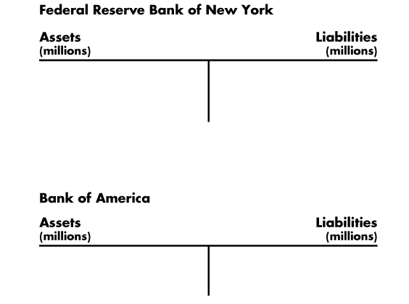
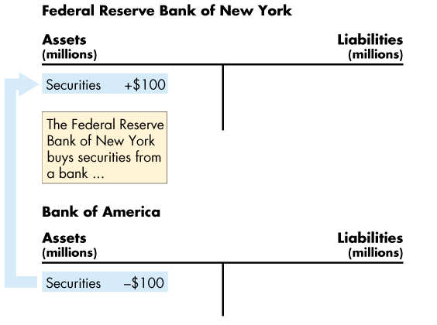
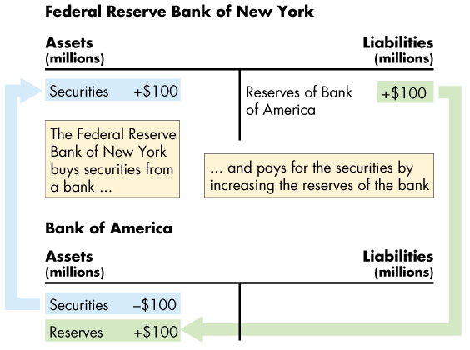
The Conduct of Monetary Policy
An Open Market Purchase
Figure 8.2 shows the effects of an open market purchase on the balance sheets of the Fed and the Bank of America.
The open market purchase increases bank reserves.

Slide 49
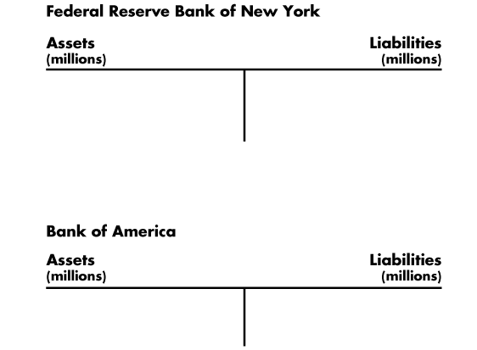
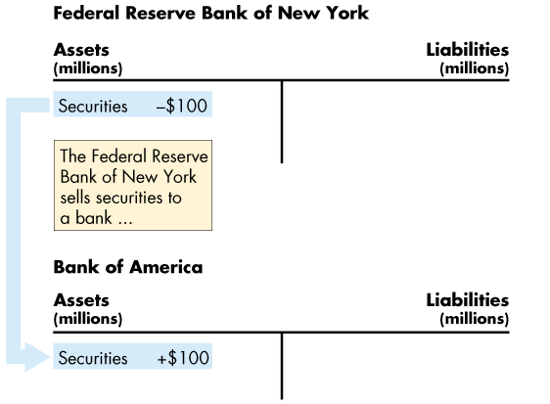
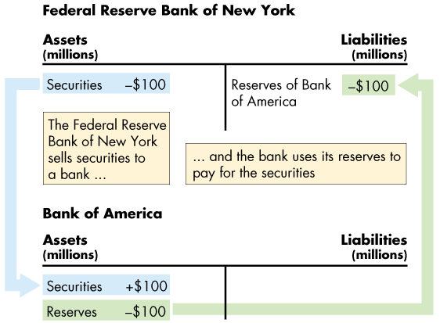
The Conduct of Monetary Policy
An Open Market Sale
This figure shows the effects of an open market sale on the balance sheets of the Fed and Bank of America.
The open market sale decreases bank reserves.

Slide 50
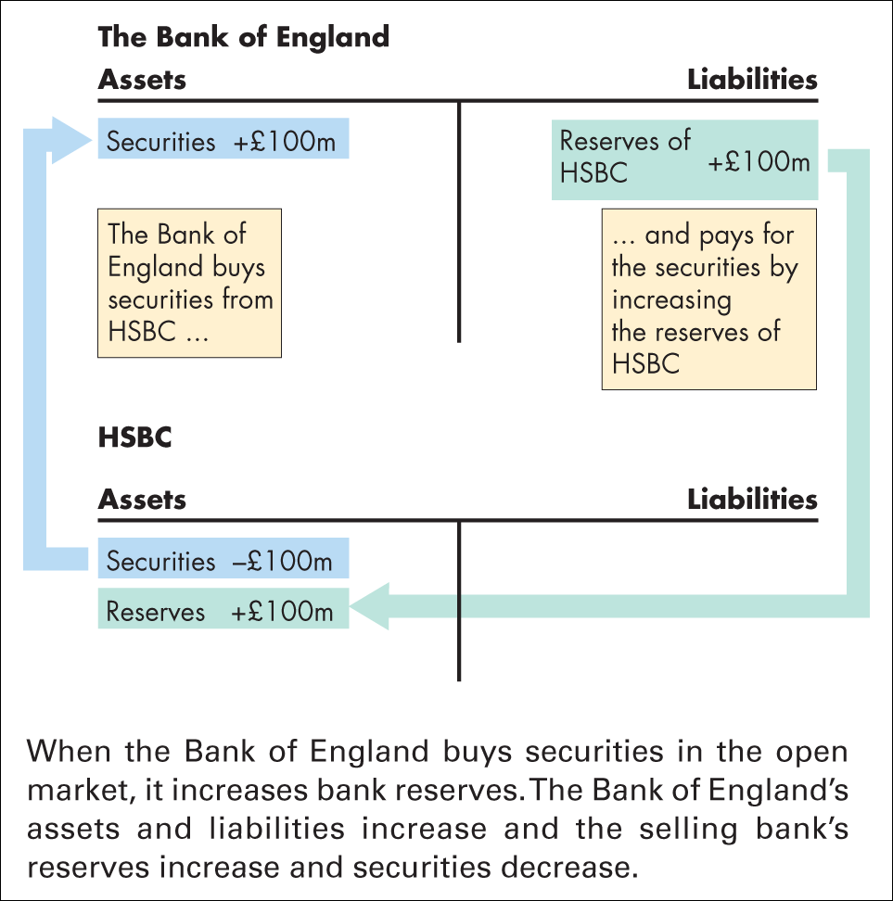
Figure 24.2 Bank of England buys securities in the open market
By selling securities in the open market, the Fed can decrease the monetary base.

Slide 51
THE BANKING SYSTEM
By increasing the required reserve ratio, the BOE can force banks to hold a larger quantity of monetary base.
By raising the discount rate, the BOE can make it more costly for the banks to borrow reserves—borrow monetary base.
By selling securities in the open market, the BOE can decrease the monetary base.
All these actions lead to an increase in the interest rate.

Slide 52
THE BANKING SYSTEM
By decreasing the required reserve ratio, the BOE can permit the banks to hold a smaller quantity of monetary base.
By lowering the discount rate, the BOE can make it less costly for the banks to borrow monetary base.
By buying securities in the open market, the BOE can increase the monetary base.
All these actions lead to a decrease in the interest rate.

Slide 53
REGULATING THE QUANTITY OF MONEY
How Open Market Operations Change the Monetary Base
When the Fed buys securities in an open market operation, it pays for them with newly created bank reserves and money.
With more reserves in the banking system, the supply of interbank loans increases, the demand for interbank loans decreases, and the federal funds rate falls.
The federal funds rate is the interest rate on loans in the interbank market.

Slide 54
REGULATING THE QUANTITY OF MONEY
Similarly, when the Fed sells securities in an open market operation, buyers pay for them with bank reserves and money.
With fewer reserves in the banking system, the supply of interbank loans decreases, the demand for interbank loans increases, and the federal funds rate rises.
The Fed sets a target for the federal funds rate and conducts open market operations on the scale needed to hit its target.

Slide 55
REGULATING THE QUANTITY OF MONEY
A change in the federal funds rate is only the first stage in an adjustment process that follows an open market operation.
If banks’ reserves increase, they increase their lending, which increases the quantity of money.
If banks’ reserves decrease, they decrease their lending, which decreases the quantity of money.

Slide 56
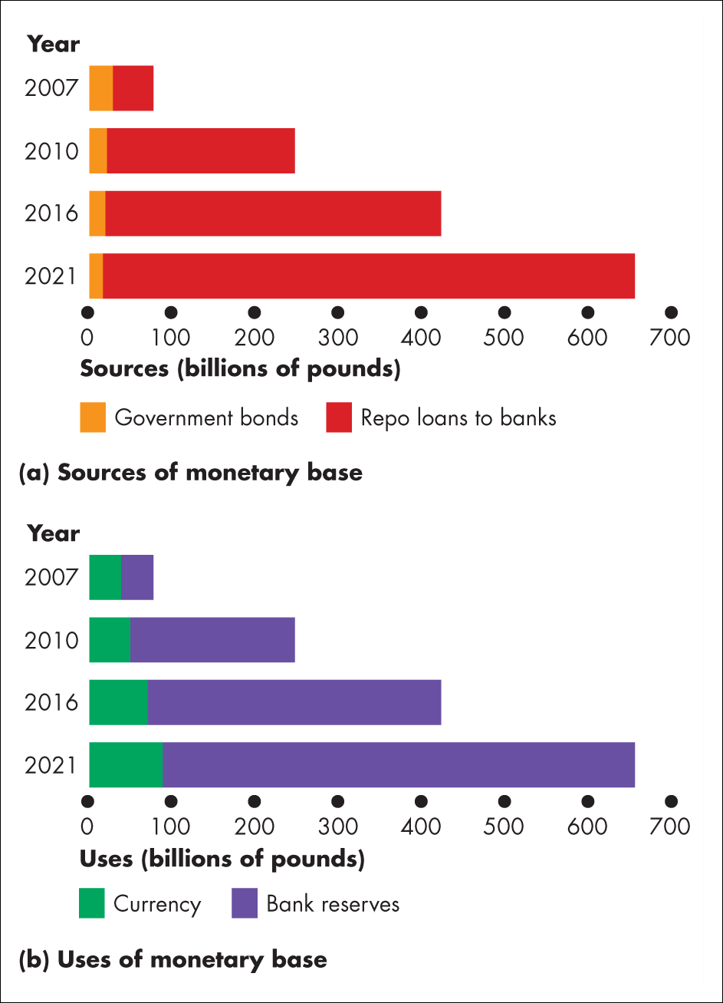
Figure 1 Changes in the sources and uses of monetary base
Source of data: Bank of England

Slide 57
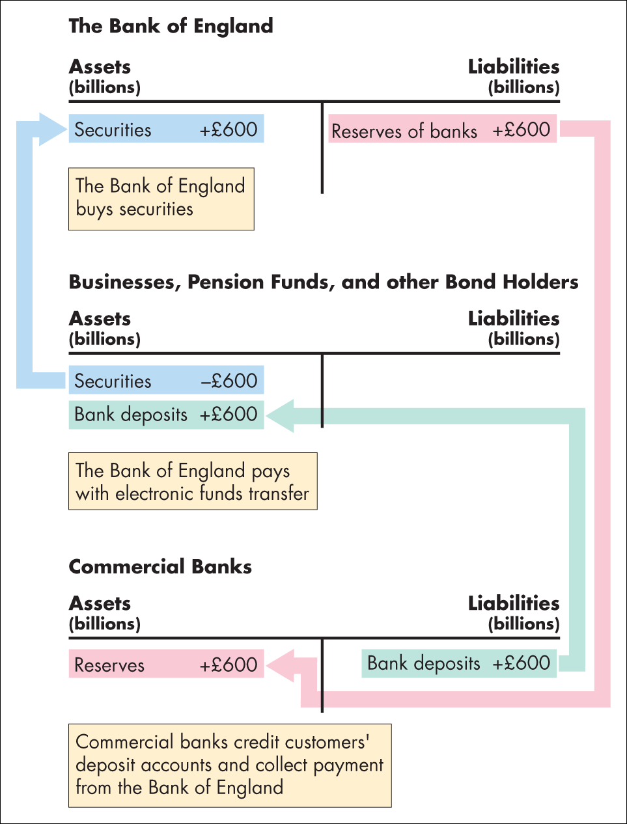
Figure 1 The QE transactions

Slide 58
REGULATING THE QUANTITY OF MONEY
Creating Deposits by Making Loans
Banks create deposits when they make loans and the new deposits created are new money.
The quantity of deposits that banks can create is limited by three factors:
The monetary base
Desired reserves
Desired currency holding

Slide 59
REGULATING THE QUANTITY OF MONEY
The Monetary Base
The monetary base is the sum of Federal Reserve notes, coins, and banks’ deposits at the Fed.
The size of the monetary base limits the total quantity of money that the banking system can create because
1. Banks have desired reserves.
2. Households and firms have desired currency holdings.
And both of these desired holdings of monetary base depend on the quantity of money.

Slide 60
REGULATING THE QUANTITY OF MONEY
Desired Reserves
A bank’s actual reserves consists of notes and coins in its vault and its deposit at the Fed.
The fraction of a bank’s total deposits held as reserves is the reserve ratio.
The desired reserve ratio is the ratio of reserves to deposits that a bank wants to hold. This ratio exceeds the required reserve ratio by the amount that the bank determines to be prudent for its daily business.
Excess reserves equal the bank’s actual reserves minus desired reserves.

Slide 61
REGULATING THE QUANTITY OF MONEY
Desired Currency Holding
We hold money in the form of currency and bank deposits and some fraction of their money as currency.
So when the total quantity of money increases, so does the quantity of currency that people want to hold.
Because desired currency holding increases when deposits increase, currency leaves the banks when they make loans and increase deposits.
This leakage of currency is called the currency drain.
The ratio of currency to deposits is called the currency drain ratio.

Slide 62
REGULATING THE QUANTITY OF MONEY
The Central bank constantly takes actions that influence the quantity of money, and open market operations are the Central bank’s major policy tool.
An open market operation is the purchase or sale of government securities by the Central bank in the open market.

Slide 63
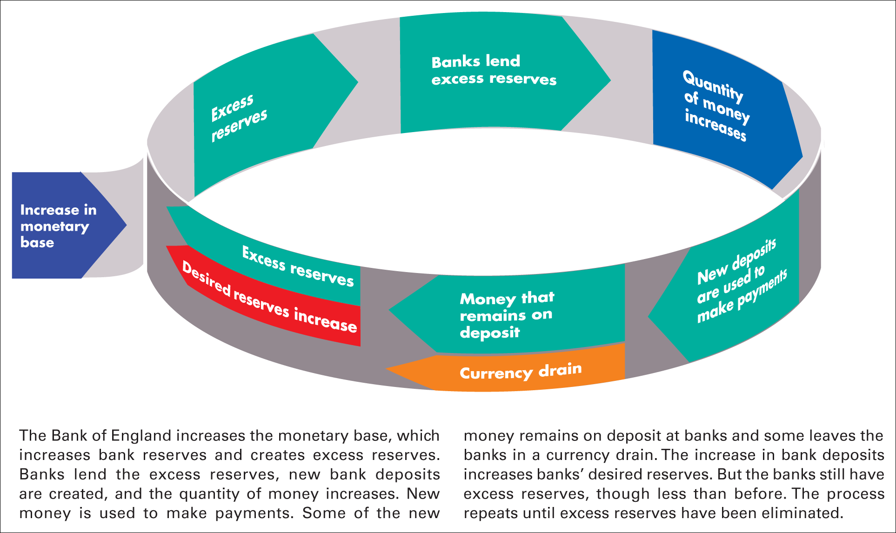
Figure 24.3 How the banking system creates money by making loans

Slide 64
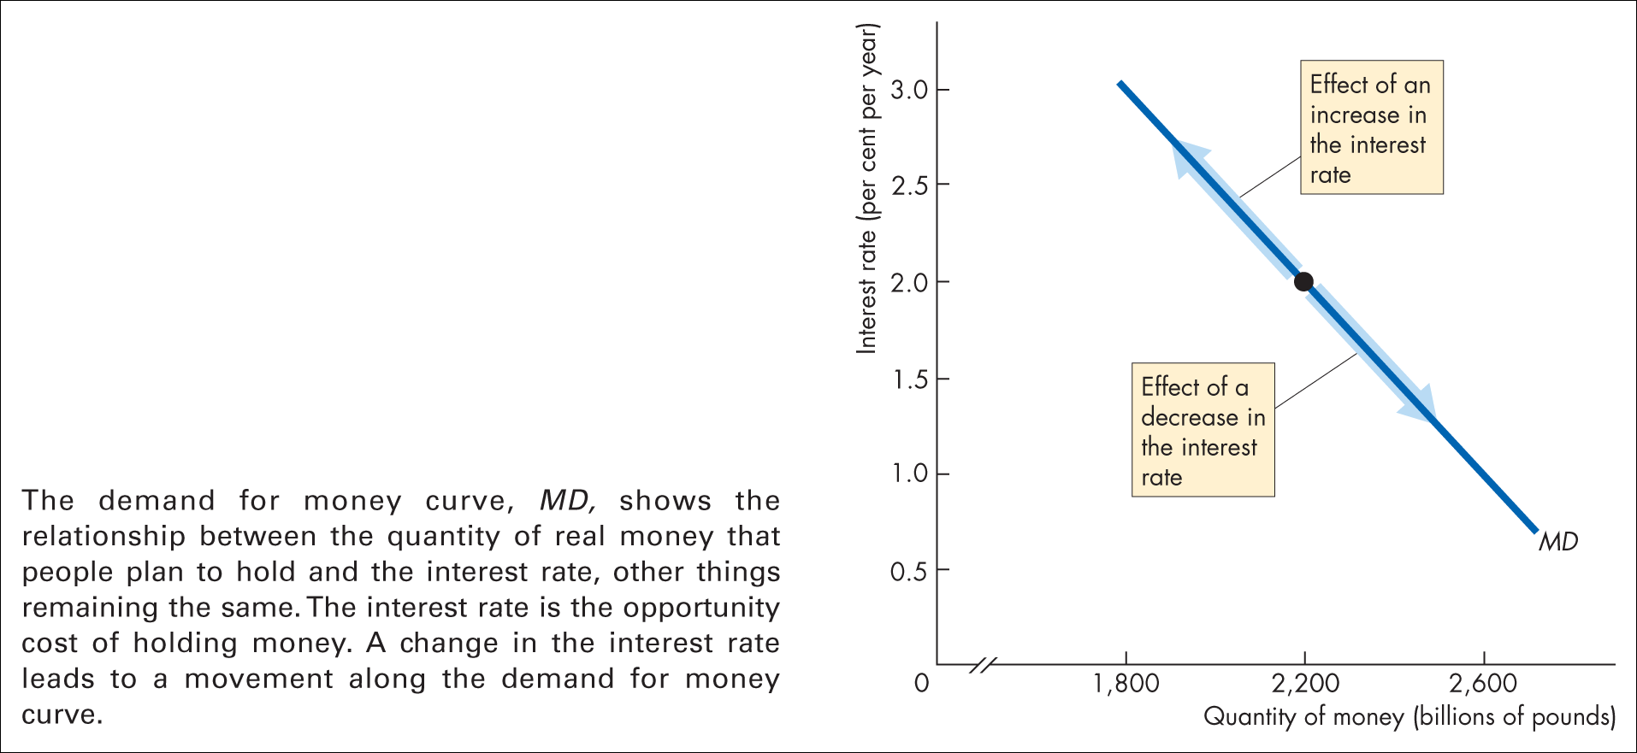
Figure 24.4 The demand for money

Slide 65
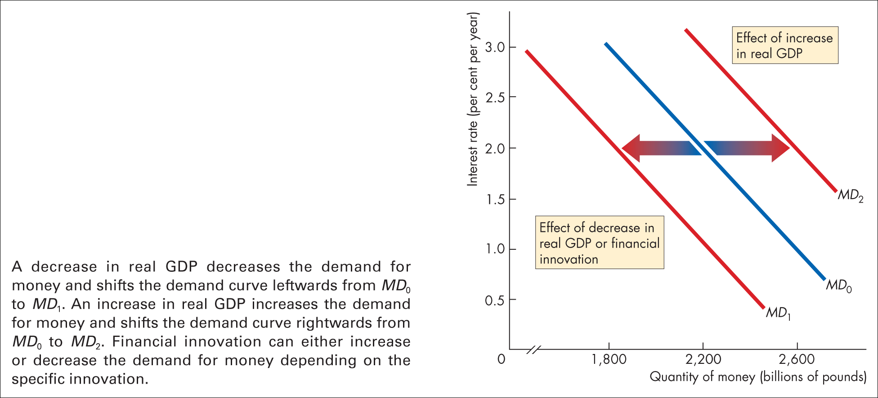
Figure 24.5 Changes in the demand for money

Slide 66
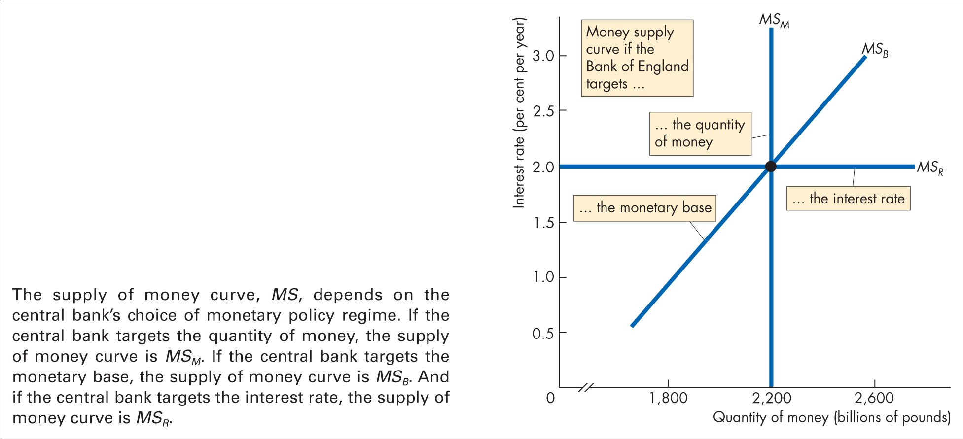
Figure 24.6 The supply of money

Slide 67
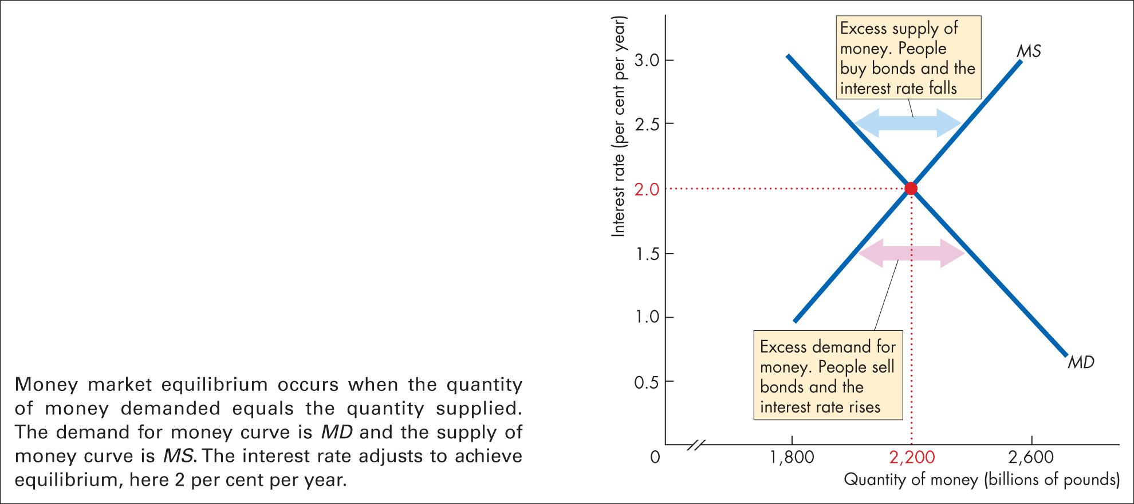
Figure 24.7 Money market equilibrium

Slide 68
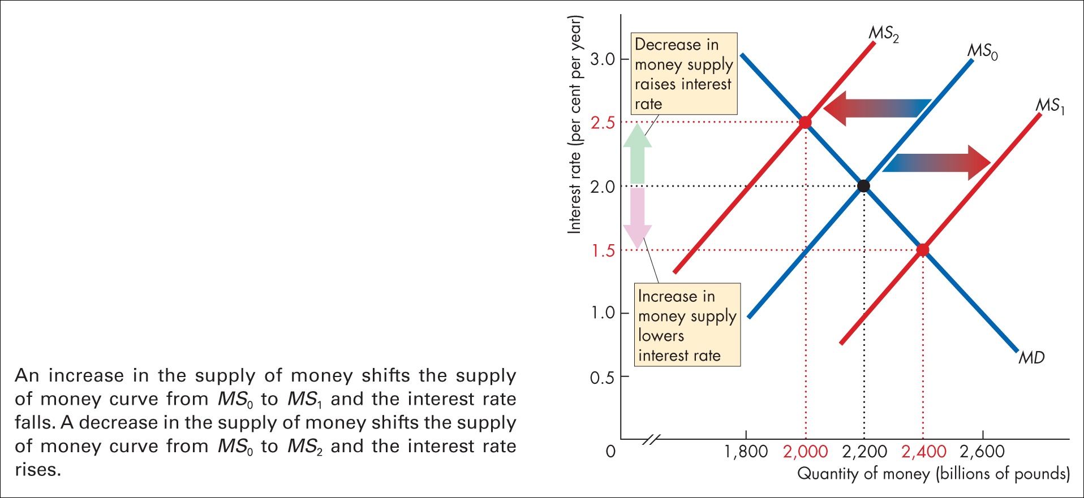
Figure 24.8 A change in the supply of money

Slide 69
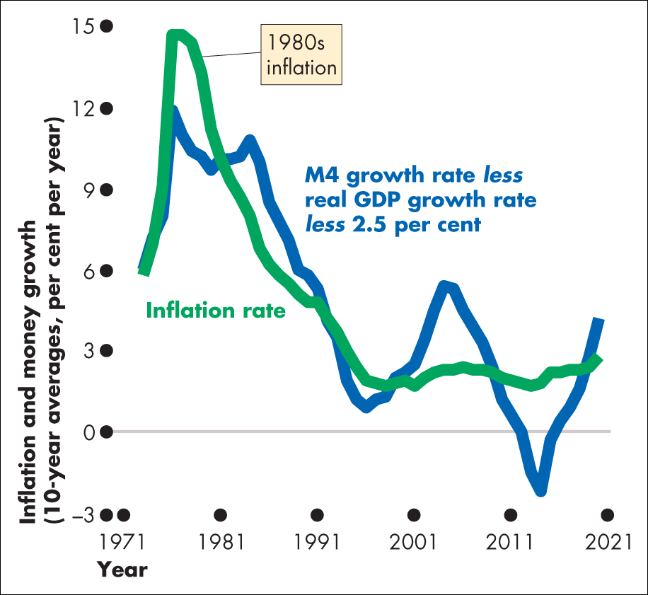
Figure 1 UK money growth and inflation
Source of data: Bank of England

Slide 70
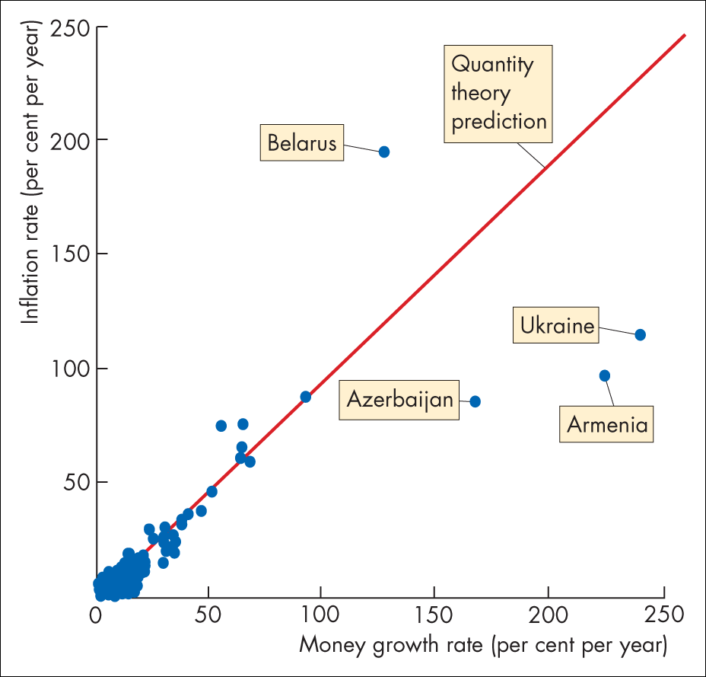
Figure 2 134 Countries: 1990–2005
Sources of data: International Financial Statistics Yearbook, 2017, and International Monetary Fund, World Economic Outlook, October 2017

Slide 71
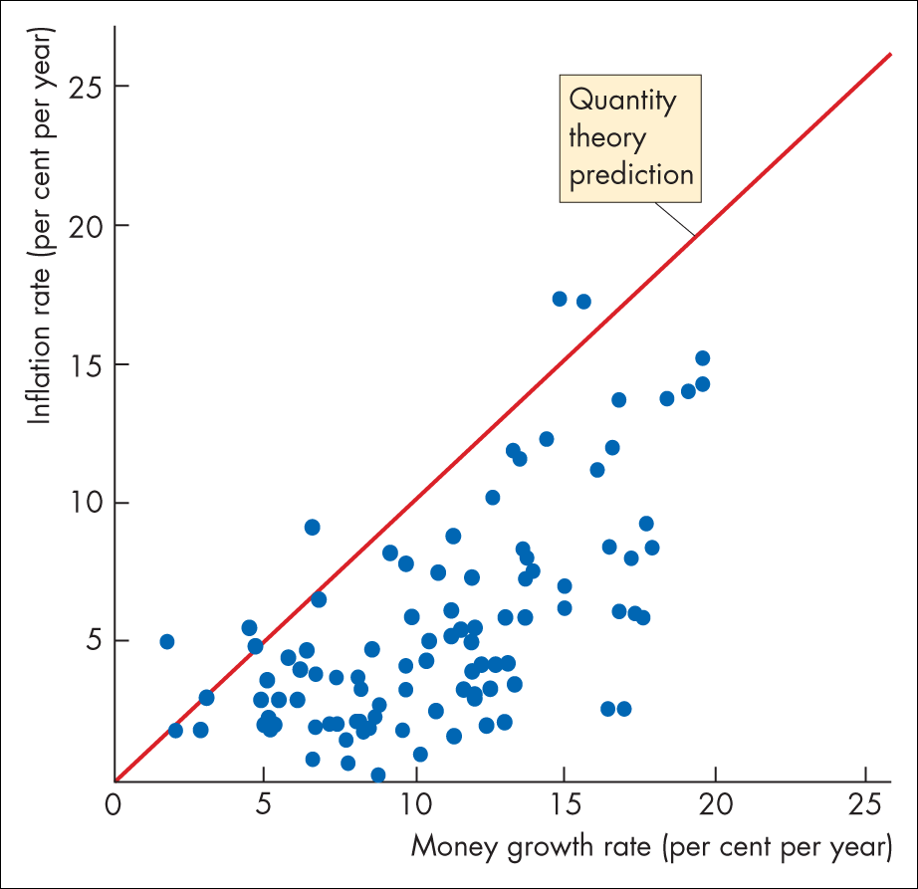
Figure 3 Lower-inflation countries: 1990–2005
Sources of data: International Financial Statistics Yearbook, 2017, and International Monetary Fund, World Economic Outlook, October 2017

Slide 72
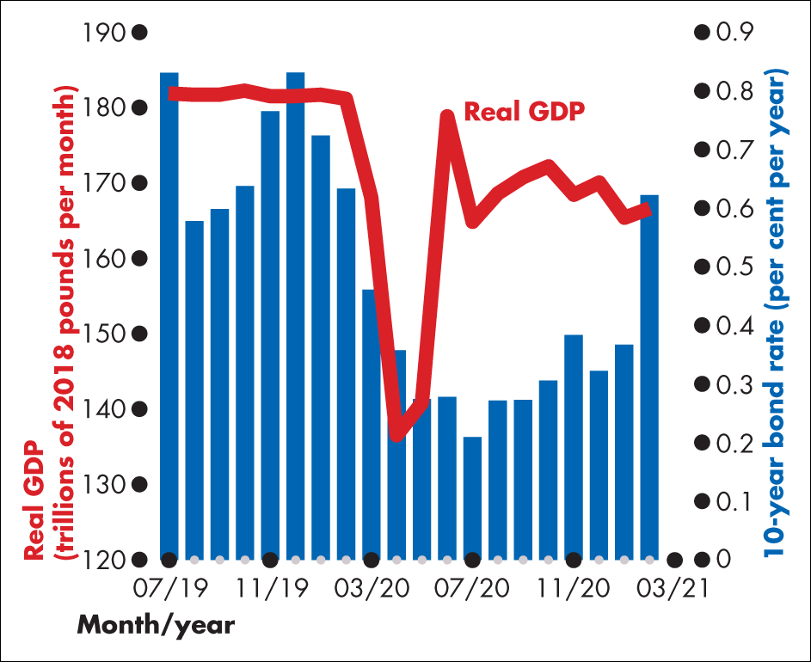
Figure 1 10-year bond interest rate and real GDP

Slide 73
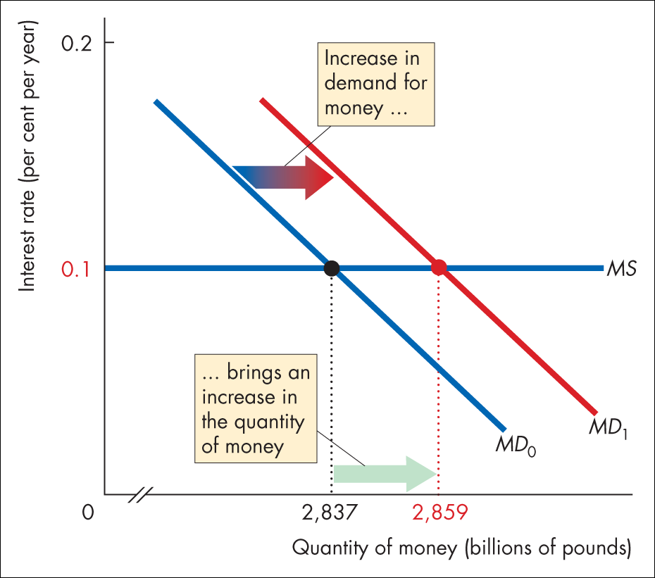
Figure 2 Money market equilibrium

Slide 74
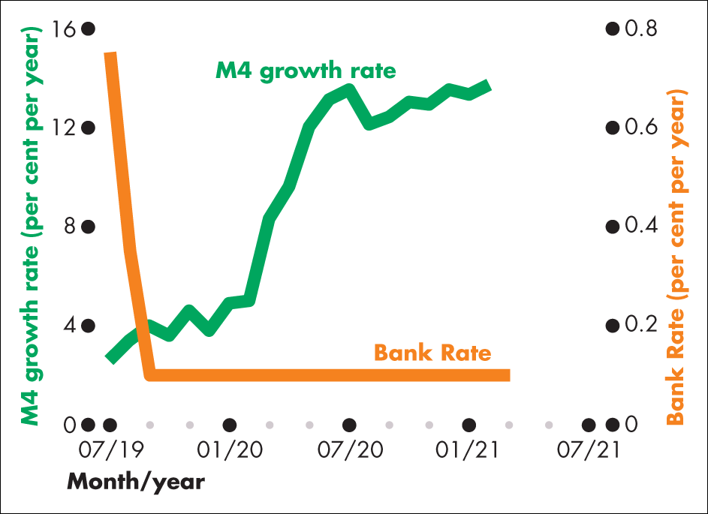
Figure 3 M4 growth rate and bank rate

Slide 75
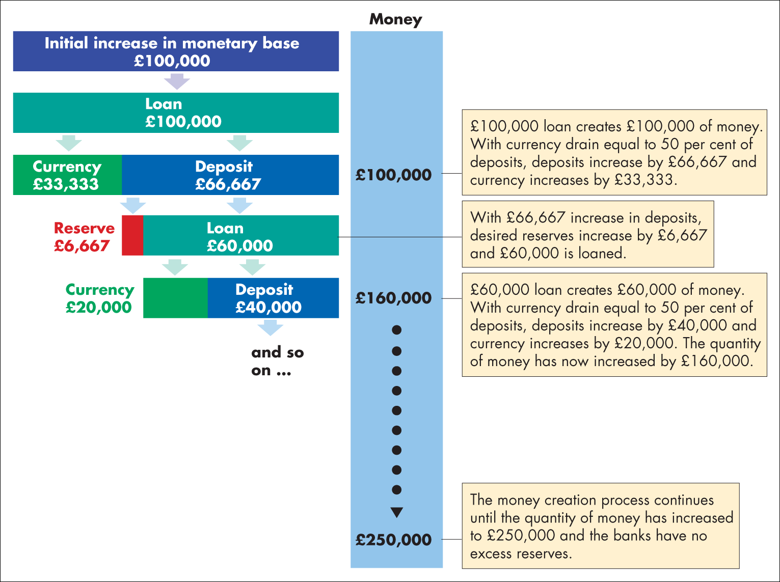
Figure 1 The money creation process

