Slide 1
Economics
Eleventh European Edition
Part 2
How markets work
Chapter 6
Government actions in markets

Slide 2

Can the President repeal the laws
of supply and demand?

Slide 3

7
Government Actions in Markets
CHAPTER CHECKLIST
When you have completed your study of this chapter, you will be able to
1 Explain how a price ceiling works and show how a rent ceiling creates a housing shortage, inefficiency, and unfairness.
2 Explain how a price floor works and show how the minimum wage creates unemployment, inefficiency, and unfairness.
3 Explain how a price support in the market for an agricultural product creates a surplus, inefficiency, and unfairness.
Notes:
Notes and teaching tips: 5, 8, 9, 25, and 26.
To view a full-screen figure during a class, click the red “expand” button.
To return to the previous slide, click the red “shrink” button.
To advance to the next slide, click anywhere on the full screen figure.
To enhance your lecture, check out the Lecture Launchers, Land Mines, and Class Activities in the Instructor’s Manual.

Slide 4
7.1 PRICE CEILINGS
A price ceiling or price cap is a government regulation that places an upper limit on the price at which a particular good, service, or factor of production may be traded.
An example is a price ceiling on housing rents.
Trading above the price ceiling is illegal.

Slide 5
7.1 PRICE CEILINGS
A Rent Ceiling
A rent ceiling is a regulation that makes it illegal to charge more than a specified rent for housing.
The effect of a rent ceiling depends on whether it is imposed at a level above or below the market equilibrium rent.
Notes:
Ask the students if they saw the article in the day’s local paper that the local government plans to place a $200 limit on rents that landlords could charge for apartments near campus. (Of course this story wasn’t in the paper, but students are more likely to pay attention if they think you’re serious! Don’t tell them this yet though.) Ask them to participate in an informal vote by raising a hand in response to “Who thinks this is a good idea?”, “Who thinks this is a bad idea?”, and “Who doesn’t care?” (This last one always catches a few honest students who like to chuckle as they raise their hands!)
Then explain to the students that this limit is called a “rent ceiling” and cities across the country have them…so they must be good, right? However, further explain that in this lecture, they’ll find out several ways that the government intervenes in markets and that while the ideas might sound good, economically they create problems. At the end of the lecture, remark how astute the students were that voted against the price ceilings and definitely be sure to tell the students that the local government isn’t really going to impose the rent ceiling.

Slide 6
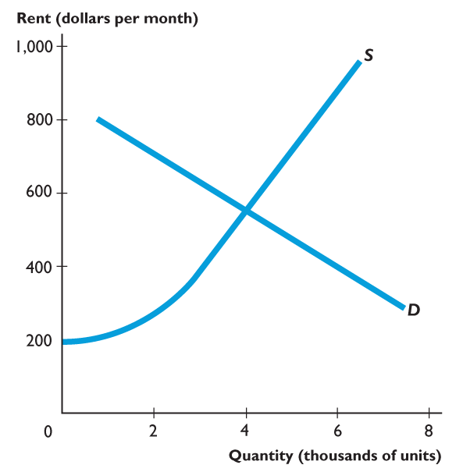
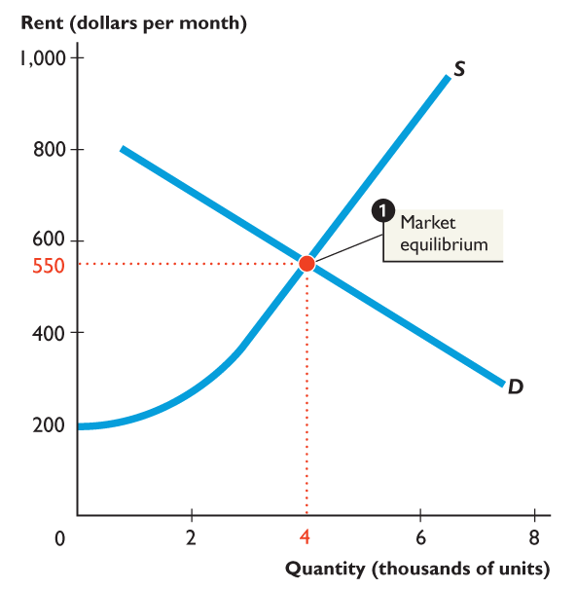
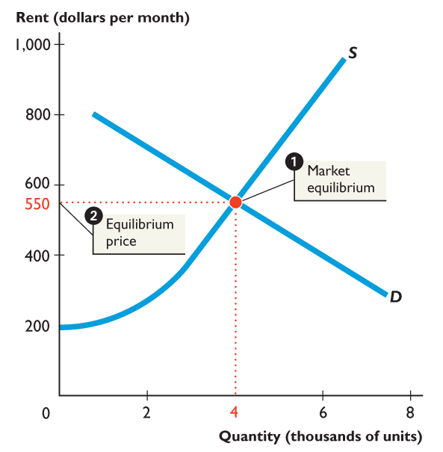
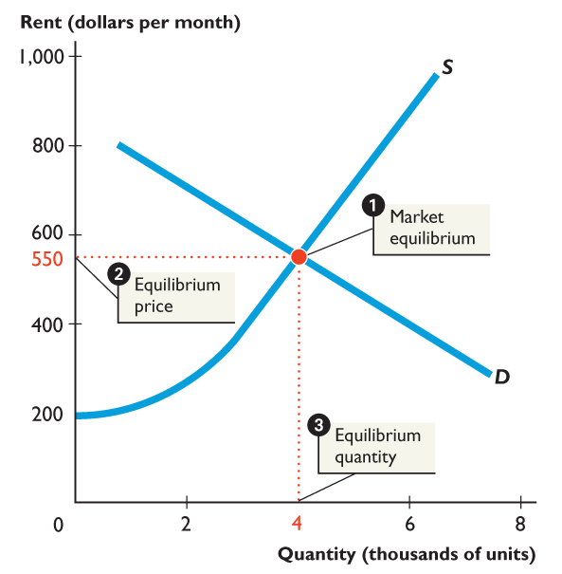
7.1 PRICE CEILINGS
Figure 7.1 shows a housing market.
1. At the market equilibrium
2. The equilibrium rent is $550 a month and
3. The equilibrium quantity is 4,000 units of housing.
If a rent ceiling is set above $550 a month, nothing will change.

Slide 8

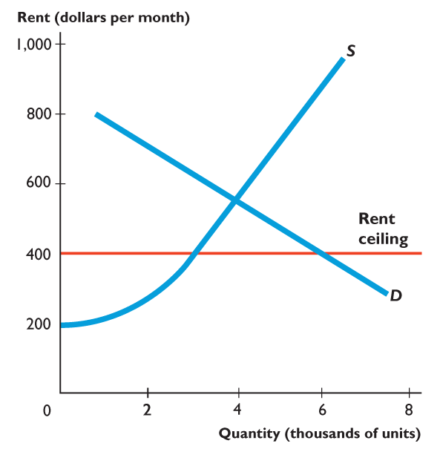
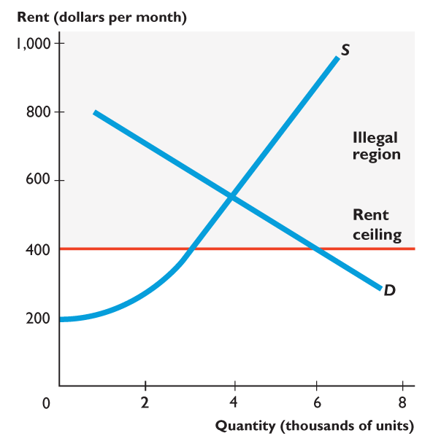
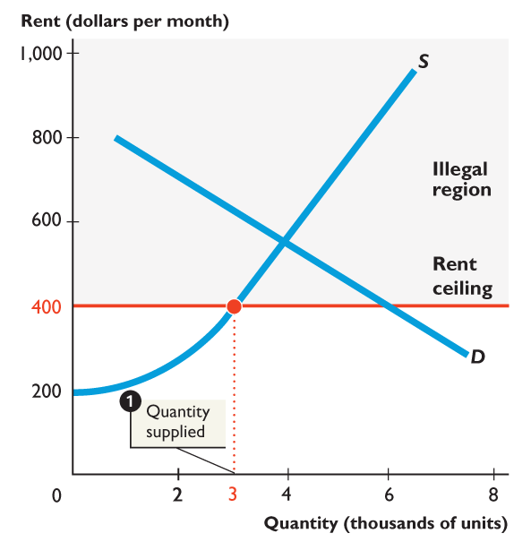
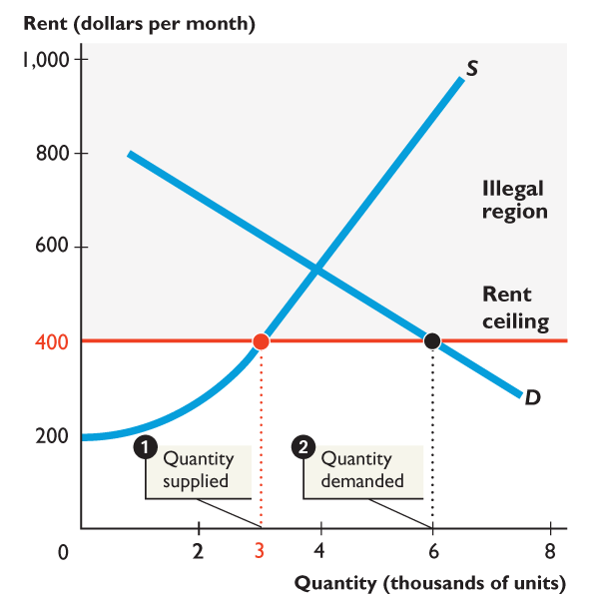
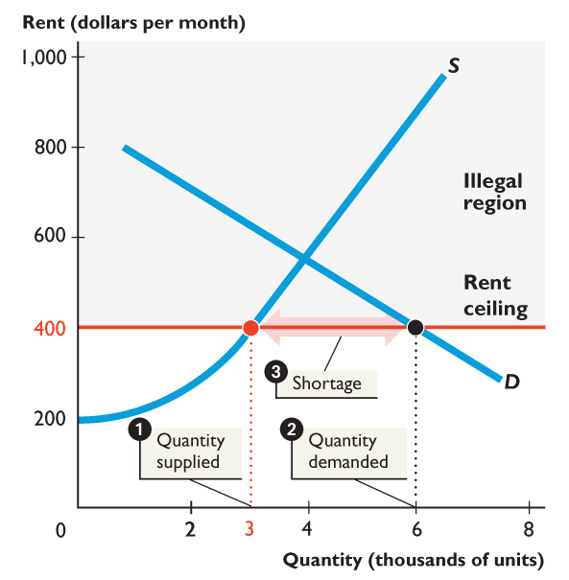
7.1 PRICE CEILINGS
Figure 7.2 shows how a rent ceiling creates a shortage.
A rent ceiling is imposed at $400 a month, which is below the market equilibrium rent.
1. The quantity of housing supplied decreases to 3,000 units.
2. The quantity of housing demanded increases to 6,000 units.
3. A shortage of 3,000 units arises.
Notes:
When you use a demand-supply graph to show the effects of a price ceiling or price floor, be sure to label all the prices, quantities, and the ceiling or floor. In the case of the price ceiling, clearly label and emphasize the shortage created. In the case of the price floor, clearly label and emphasize the surplus created. As you add more lines to the demand-supply graph, there is always the chance for confusion. Many times the students leave the labels off, and when they go back to study, they can’t remember what that extra line is. So, be sure that you label the lines and stress to your class that they should be doing the same. Use price ceilings and floors to remind students that any surplus or shortage is a horizontal distance. Some students want to look at vertical distances or areas of triangles as the measure of the surplus or shortage.

Slide 9
Notes:
Emphasize that the shaded illegal region is out of bounds.

Slide 10
7.1 PRICE CEILINGS
When a rent ceiling creates a housing shortage, two developments occur:
A black market
Increased search activity
A black market is an illegal market that operates alongside a government-regulated market.
Search activity is the time spent looking for someone with whom to do business.

Slide 11


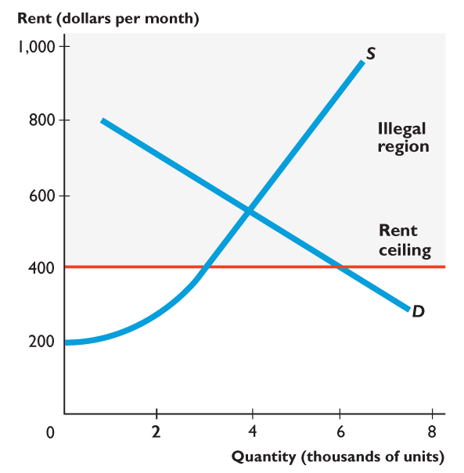
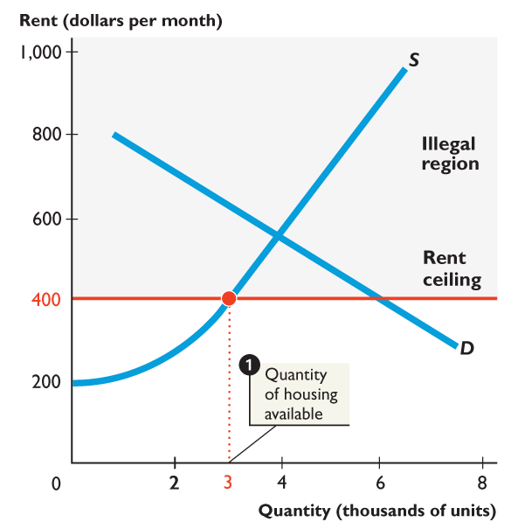
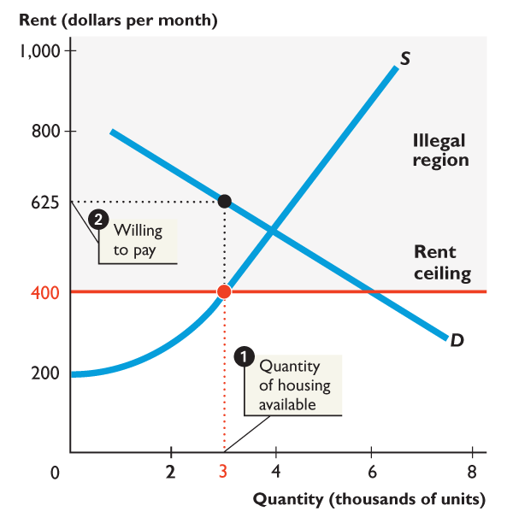
7.1 PRICE CEILINGS
Figure 7.3 shows how a rent ceiling creates a black market and housing search.
With a rent ceiling of $400 a month:
1. 3,000 units of housing are available.
2. Someone is willing to pay $625 a month for the 3,000th unit of housing.

Slide 12
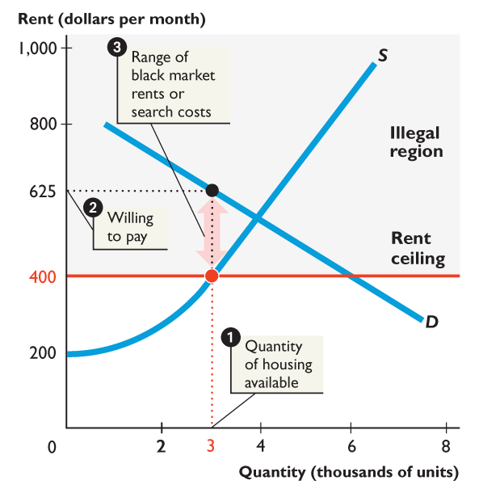

Slide 13
7.1 PRICE CEILINGS
3. Black market rents might be as high as $625 a month and resources get used up in costly search activity.

Slide 14
7.1 PRICE CEILINGS
Are Rent Ceilings Efficient?
With a rent ceiling, the outcome is inefficient.
Marginal benefit exceeds marginal cost.
Total surplus—the sum of producer surplus and consumer surplus—shrinks and a deadweight loss arises.
People who can’t find housing and landlords who can’t offer housing at a lower rent lose.

Slide 15
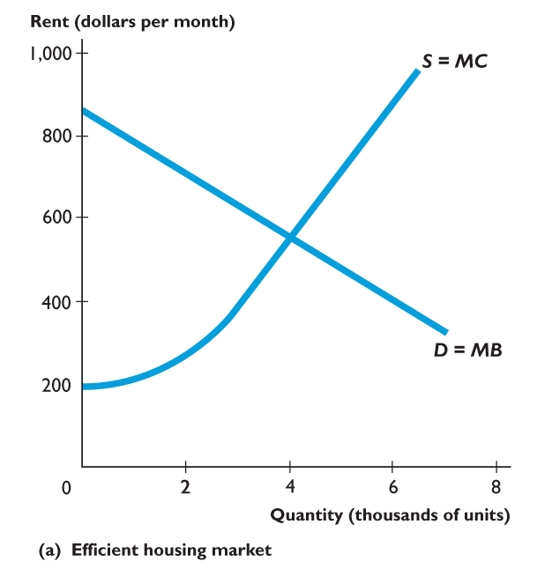
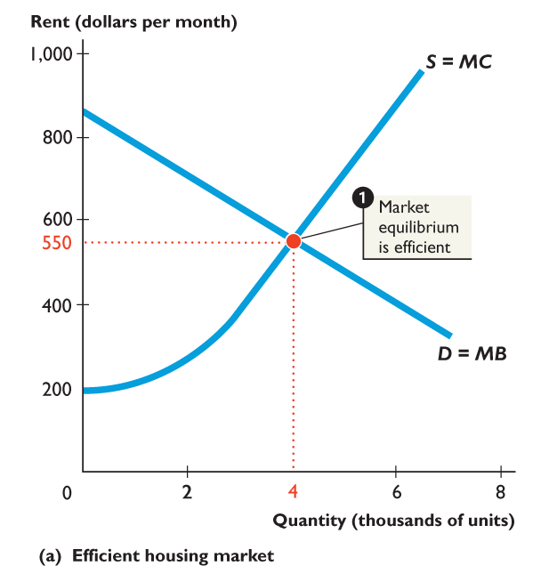
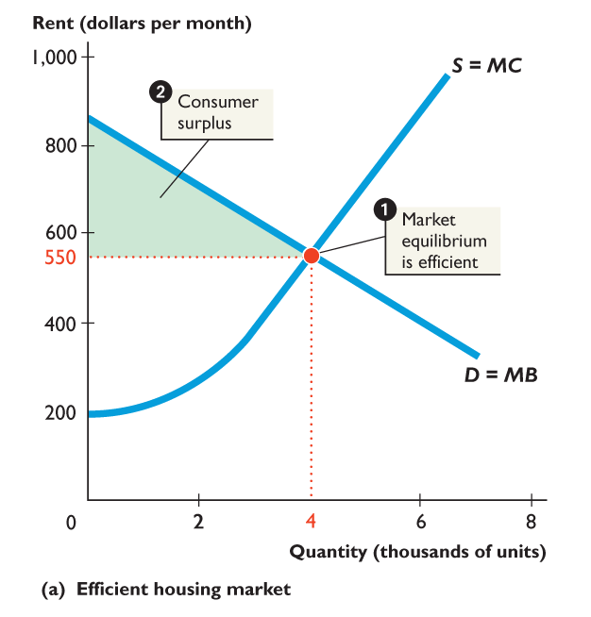
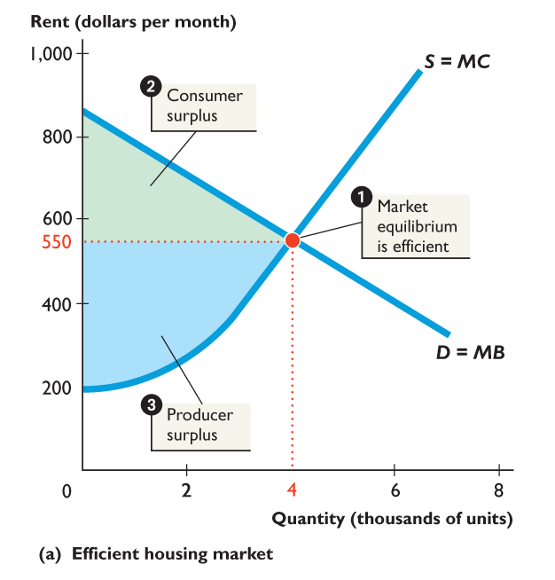
7.1 PRICE CEILINGS
Figure 7.4(a) shows an efficient housing market.
1. The market is efficient with marginal benefit equal to marginal cost.
2. Consumer surplus plus ...
3. Producer surplus is as large as possible.

Slide 16
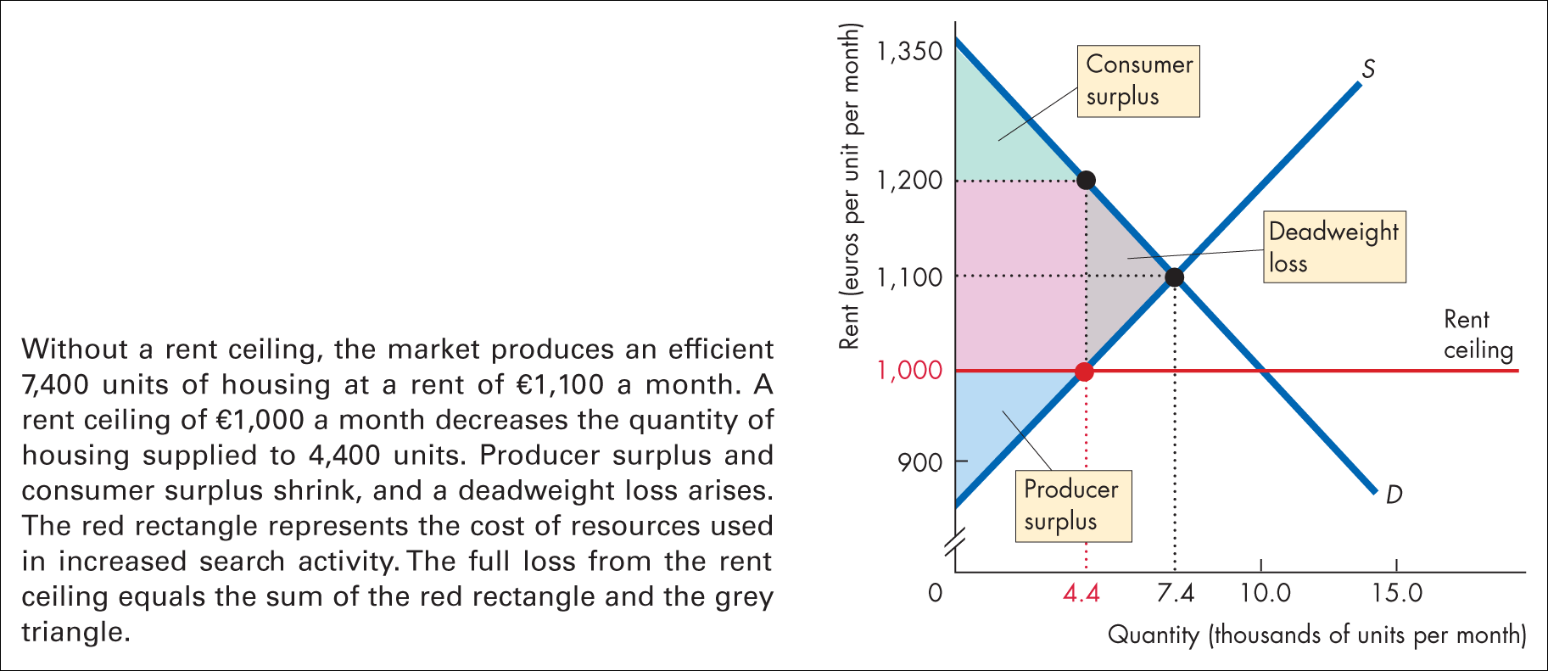
Figure 7.2 The inefficiency of a rent ceiling

Slide 18

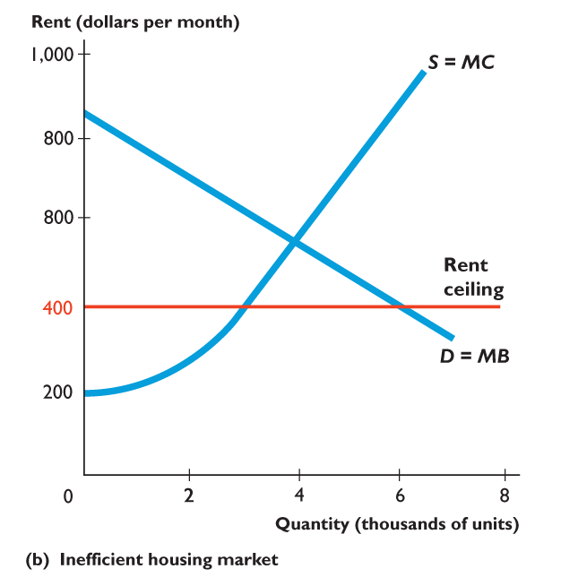
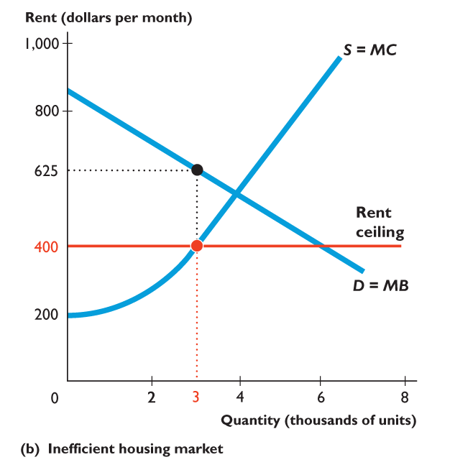
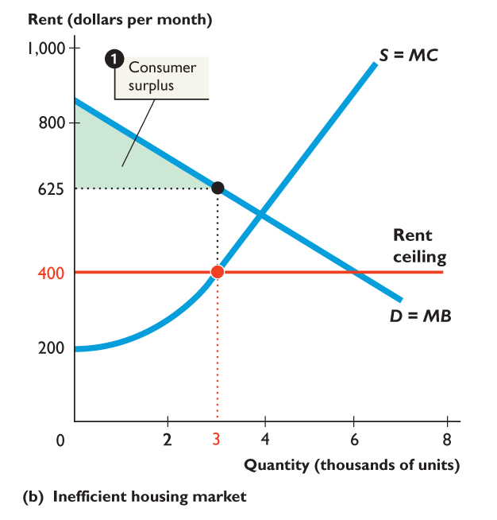
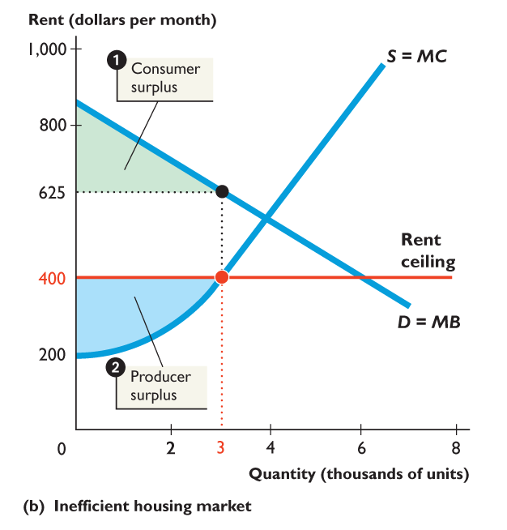
7.1 PRICE CEILINGS
Figure 7.4(b) shows the inefficiency of a rent ceiling.
A rent ceiling restricts the quantity supplied and marginal benefit exceeds marginal cost.
1. Consumer surplus shrinks.
2. Producer surplus shrinks.

Slide 19
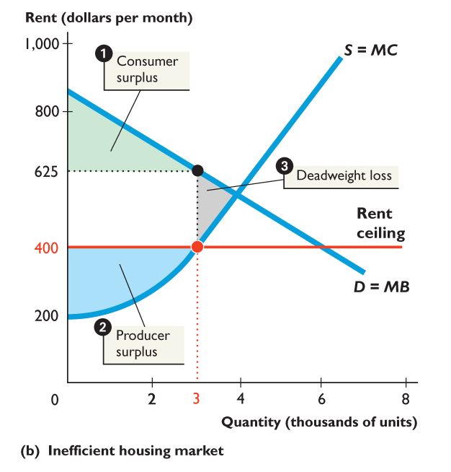
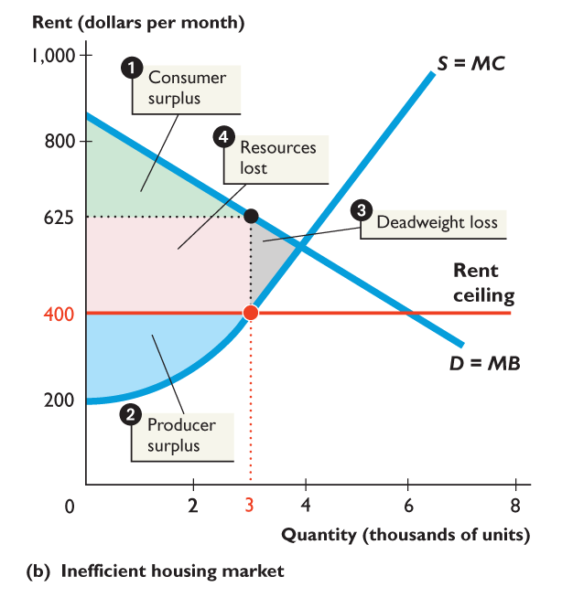

Slide 20
7.1 PRICE CEILINGS
3. A deadweight loss arises.
4. Other resources are lost in search activity and evading and enforcing the rent ceiling law.
Resource use is inefficient.

Slide 21
7.1 PRICE CEILINGS
Are Rent Ceilings Fair?
Are the rules fair?
Are the results fair?
Does blocking rent adjustments avoid scarcity?
What mechanisms allocate resources when prices don’t do the job?
Are those non-price mechanisms fair?

Slide 22
7.1 PRICE CEILINGS
If Rent Ceilings Are So Bad, Why Do We Have Them?
Current renters gain and lobby politicians.
More renters than landlords, so rent ceilings can tip an election.

Slide 23
7.2 PRICE FLOORS
A price floor is a government regulation that places a lower limit on the price at which a particular good, service, or factor of production may be traded.
An example is the minimum wage in labor markets.
Trading below the price floor is illegal.

Slide 24
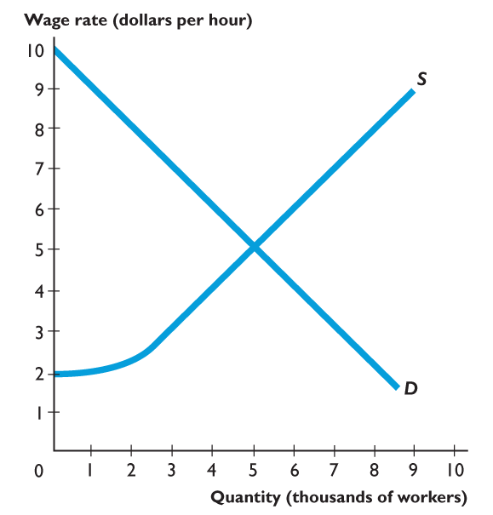
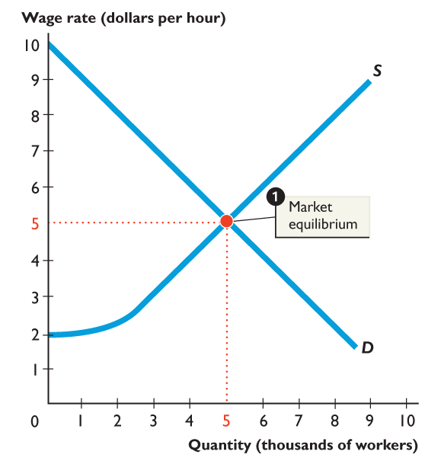
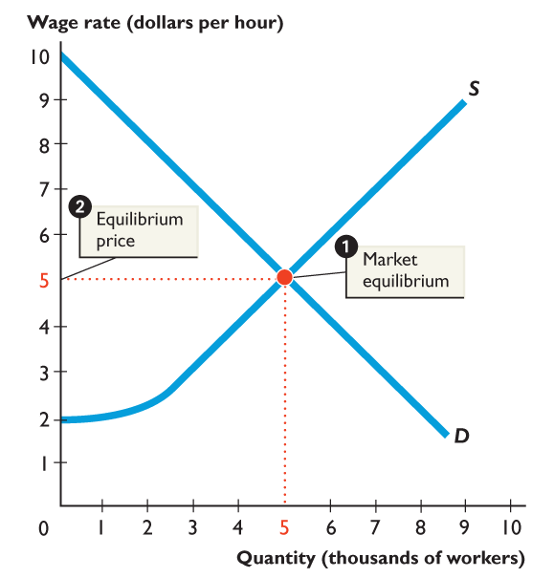
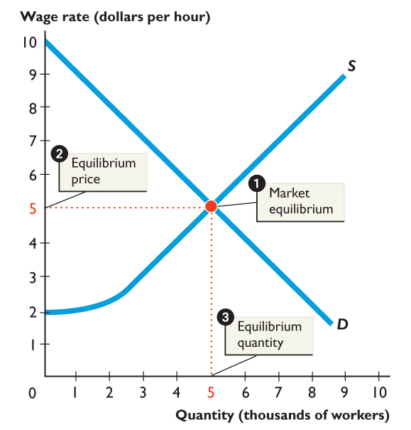
7.2 PRICE FLOORS
Figure 7.5 shows a market for fast-food servers.
1. The demand for and supply of fast-food servers determine the market equilibrium.
2. The equilibrium wage rate is $5 an hour.
3. The equilibrium quantity is 5,000 servers.

Slide 26
7.2 PRICE FLOORS
The Minimum Wage
A minimum wage law is a government regulation that makes hiring labor for less than a specified wage illegal.
Firms can pay a wage rate above the minimum wage but they may not pay a wage rate below the minimum wage.
The effect of a minimum wage depends on whether it is set above or below the market equilibrium wage rate.
Notes:
To launch your lecture on the minimum wage, ask the students about jobs around town. Sound them out to see if there are a lot of jobs that pay the minimum wage. (Do not ask a particular student his or her wage, because he or she may be embarrassed if the wage is the minimum wage!) Then, ask the students if they think jobs would be easier or harder to find without the minimum wage. You can easily segue from the students’ answers to your lecture on the minimum wage and you also can easily interweave their answers into your lecture.

Slide 27
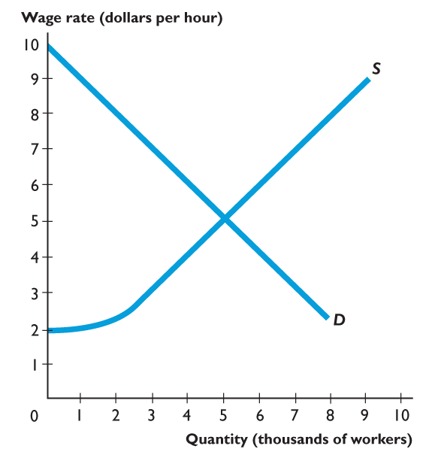
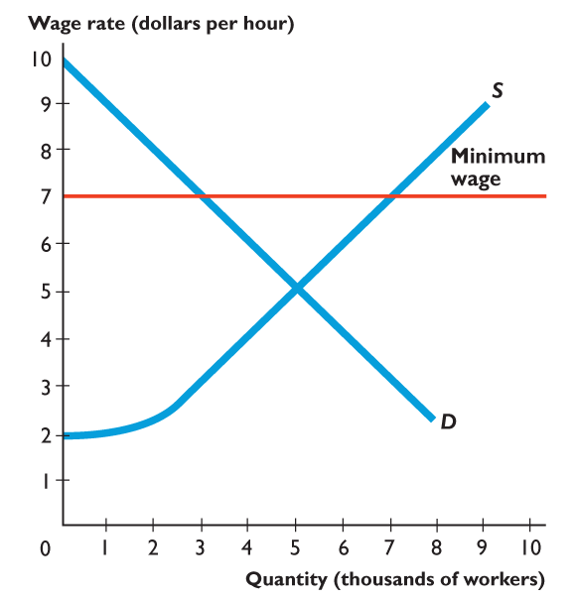
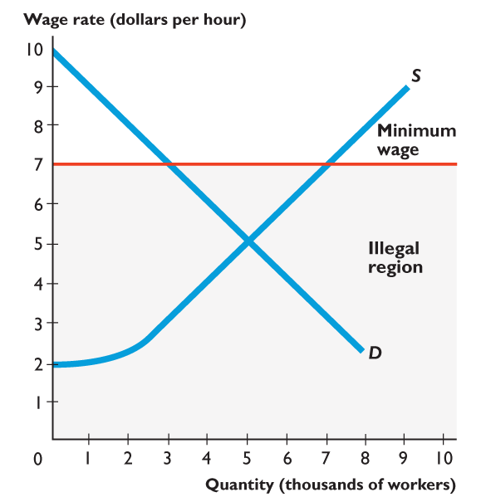
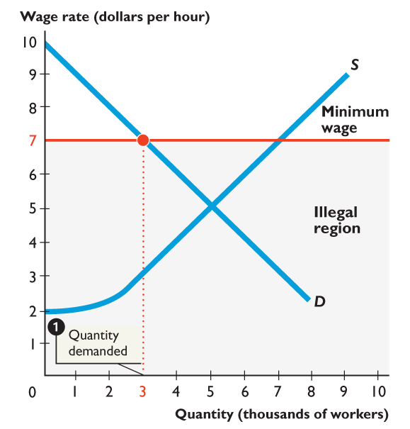
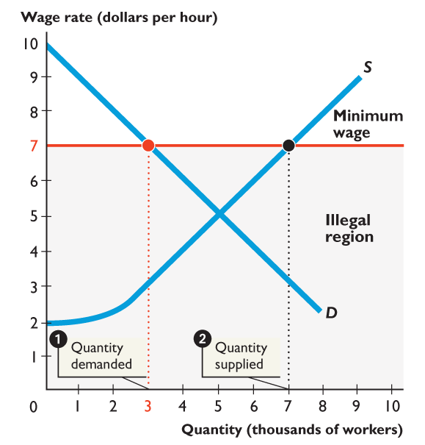
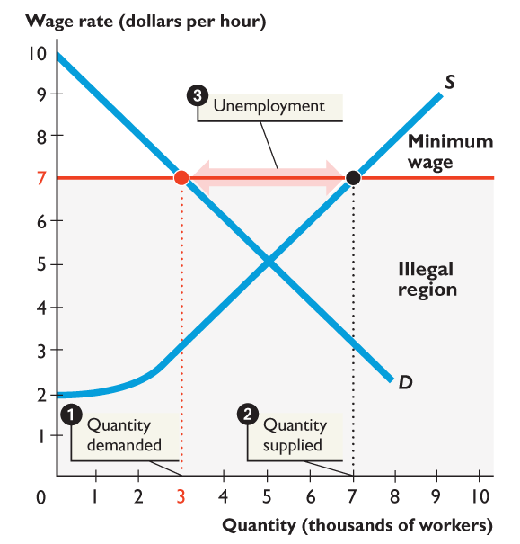
7.2 PRICE FLOORS
Figure 7.6 shows how a minimum wage creates unemployment.
A minimum wage is set above the equilibrium wage.
1. The quantity demanded decreases to 3,000 workers.
2. The quantity supplied increases to 7,000 people.
3. 4,000 people are unemployed.
Notes:
Again, emphasize that the shaded illegal region is out of bounds.

Slide 29
7.2 PRICE FLOORS
Of the 4,000 people unemployed, 2,000 have been fired and another 2,000 would like to work at $7 an hour.
The 3,000 jobs must somehow be allocated to the 7,000 people who would like to work.
This allocation is achieved by
Increased search activity
Illegal hiring

Slide 30
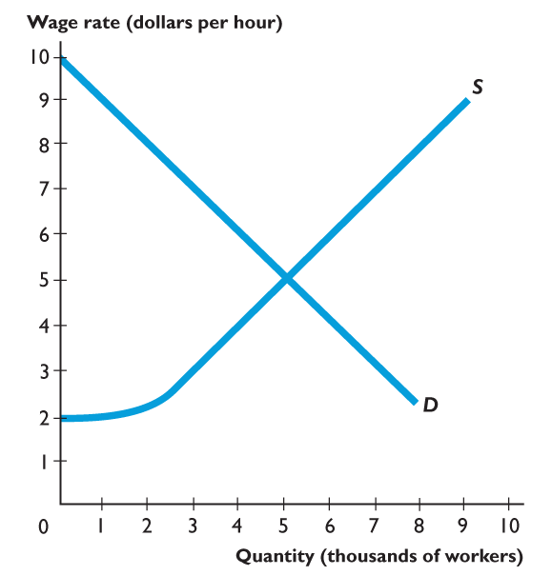

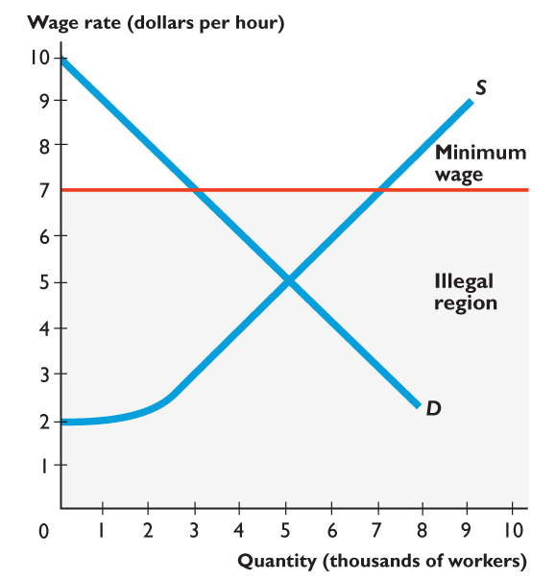
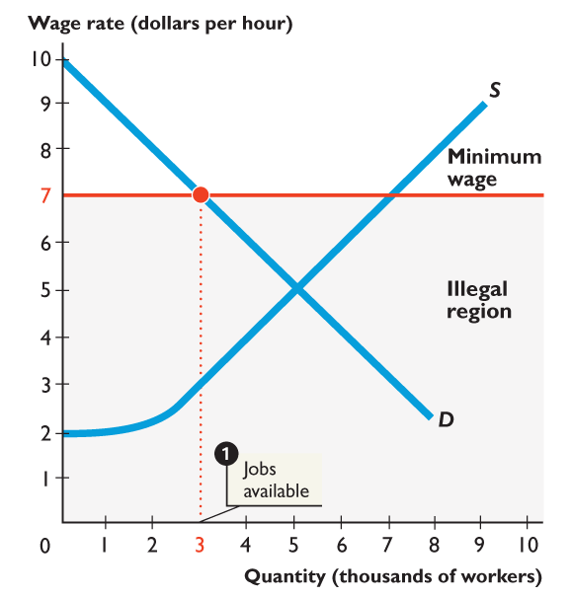
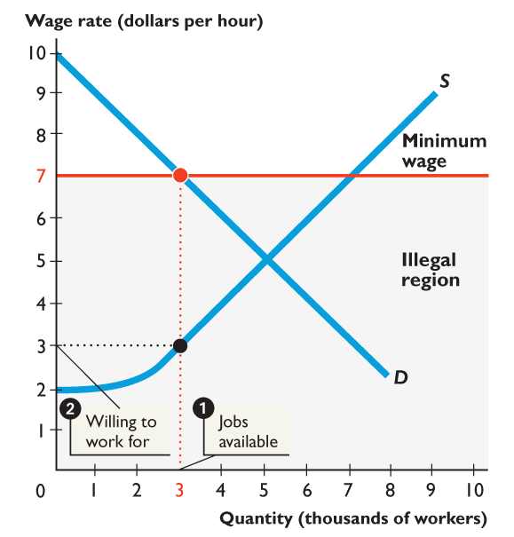
7.2 PRICE FLOORS
Figure 7.7 shows how a minimum wage increases job search.
1. At the minimum wage rate of $7 an hour, 3,000 jobs are available.
2. Someone is willing to take the 3,000th job for $3 an hour.

Slide 31
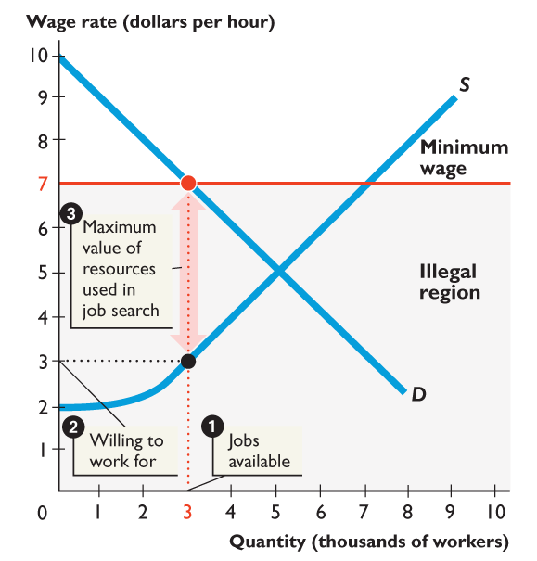

Slide 32
7.2 PRICE FLOORS
3. Illegal wage rates might range from just below $7 an hour to $3 an hour.
People are willing to spend time on job search that is worth the equivalent of lowering their wage rate by $4 an hour.

Slide 33
7.2 PRICE FLOORS
Is the Minimum Wage Efficient?
The firms’ surplus and workers’ surplus shrink, and a deadweight loss arises.
Firms that cut back employment and people who can’t find jobs at the higher wage rate lose.
The total loss exceeds the deadweight loss because resources get used in costly job-search activity.

Slide 34
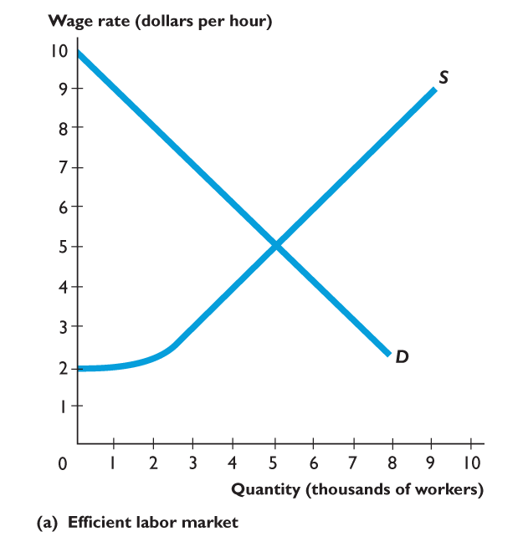
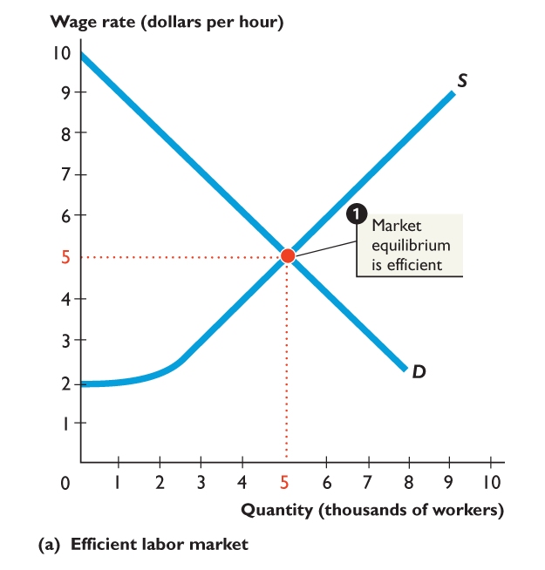
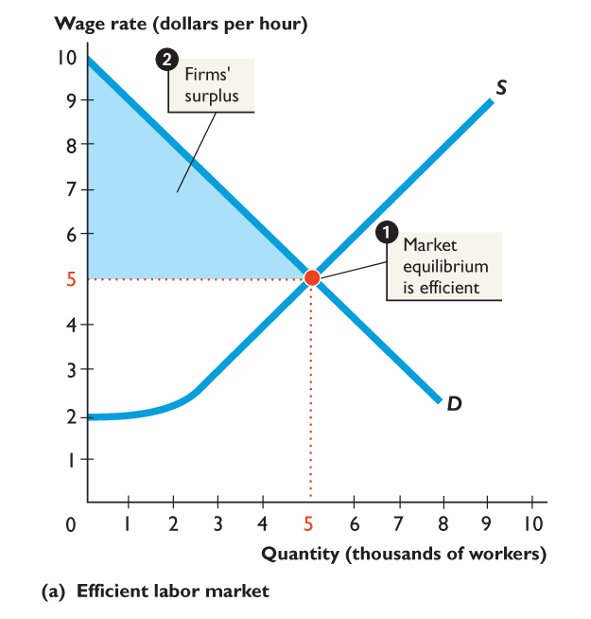
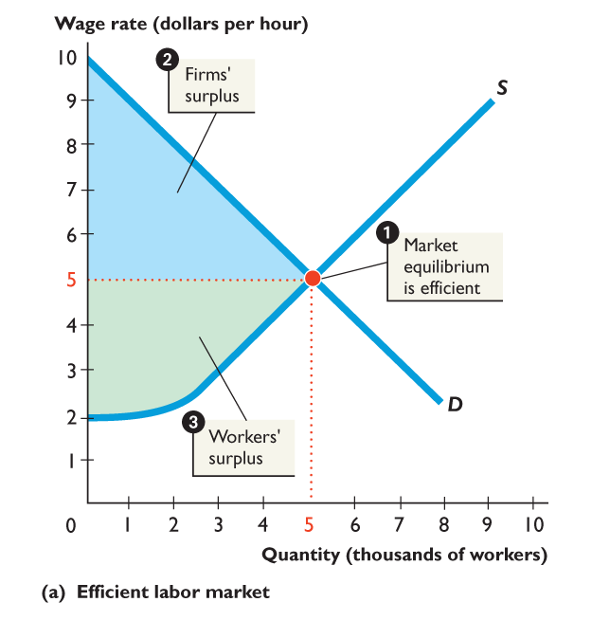
7.2 PRICE FLOORS
Figure 7.8(a) shows an efficient labor market.
1. At the market equilibrium, the marginal benefit of labor to firms equals the marginal cost of working.
2. The sum of the firms’ and workers’ surpluses is as large as possible.

Slide 36
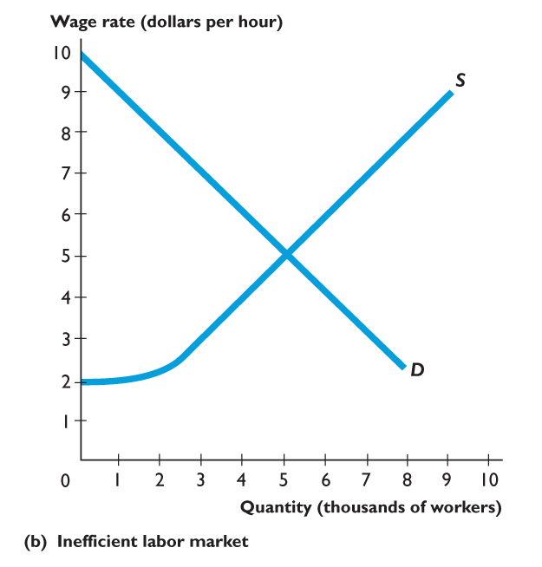
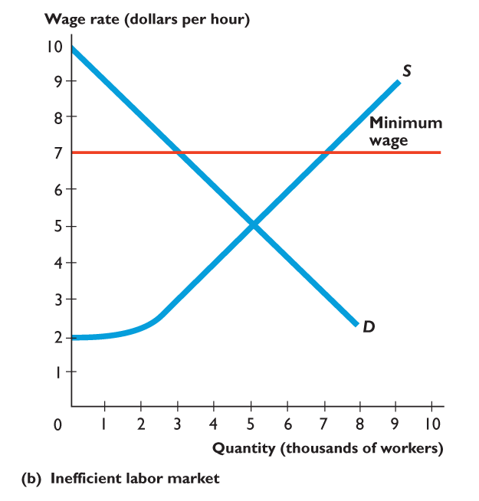
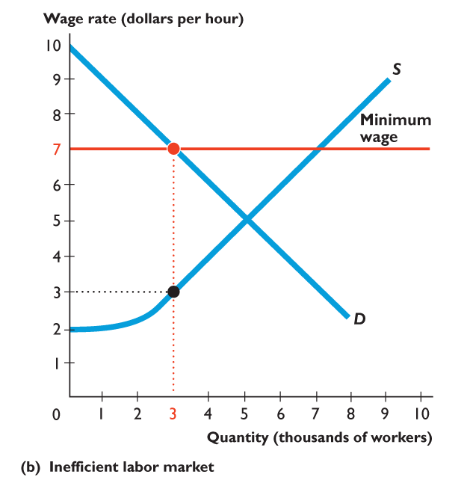
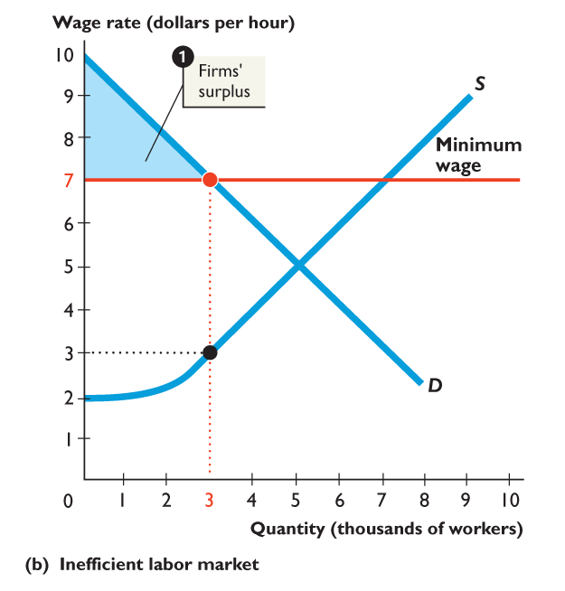
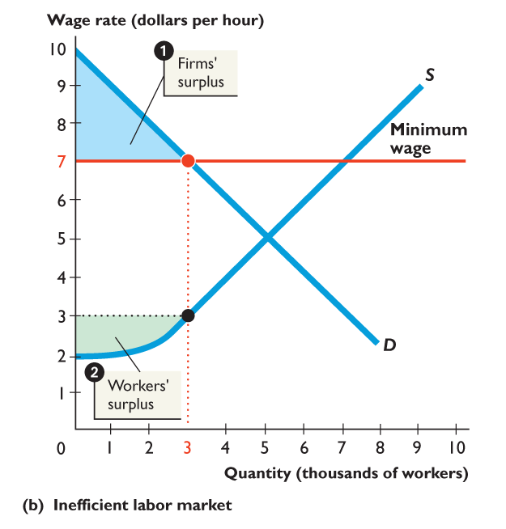
7.2 PRICE FLOORS
Figure 7.8(b) shows an inefficient labor market with a minimum wage.
The minimum wage restricts the quantity demanded.
1. The firms’ surplus shrinks.
2. The workers’ surplus shrinks.

Slide 37
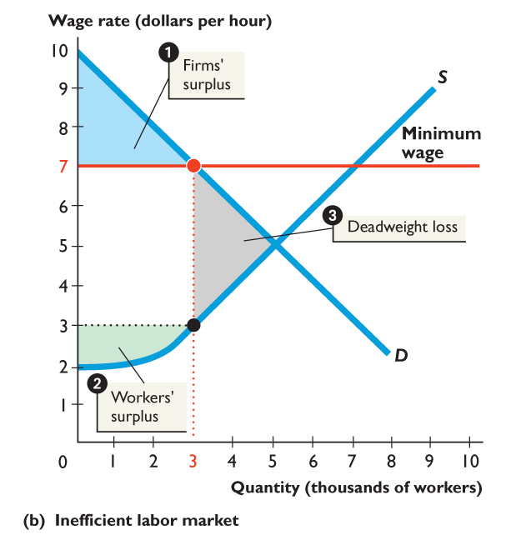
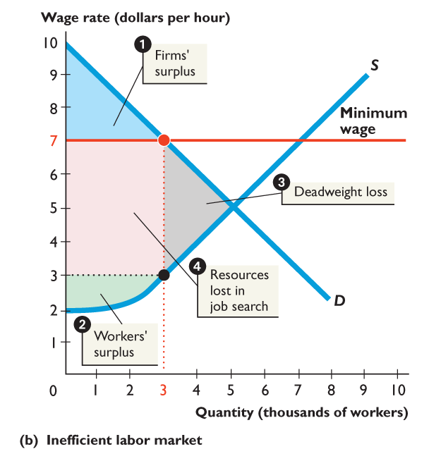

Slide 38
7.2 PRICE FLOORS
3. A deadweight loss arises.
4. Other resources are used up in job-search activity.
The outcome is inefficient.

Slide 39
7.2 PRICE FLOORS
Is the Minimum Wage Fair?
Is the rule fair?
Is the result fair?
If the wage rate doesn’t allocate labor, what does?
Are non-wage allocation mechanisms fair?

Slide 40
7.2 PRICE FLOORS
If the Minimum Wage Is So Bad, Why Do We Have It?
The effects of minimum wage on employment might be small.
What would make the effects on employment small?
Labor unions might lobby for a minimum wage: why?
Notes:
Minimum wage is close to equilibrium wage
Labor demand is inelastic
If firms cannot easily substitute labor (e.g., service jobs, caregiving): → they keep hiring even when wage increases
Productivity / efficiency wage effects
Higher wage → workers:
work harder
quit less
are more productive
→ Firms may accept higher wages without cutting jobs
Firms adjust elsewhere
Instead of firing workers, firms:
raise prices
reduce profits
cut non-wage costs
Why would labor unions lobby for a minimum wage?
This is a strategic reason, not altruism.
(1) Reduce competition from non-union workers
Union workers already earn high wages
Non-union workers accept lower wages
👉 Minimum wage forces:
all workers → higher wage floor
→ reduces advantage of non-union labor
(2) Protect union wage premium
If low-wage workers are pushed up: → gap between union and non-union shrinks → employers less likely to replace union workers

Slide 41

Figure 6.5 A tax on sellers

Slide 42

Figure 6.6 A tax on buyers

Slide 43

Figure 6.7 Tax with perfectly inelastic demand

Slide 44

Figure 6.8 Tax with perfectly elastic demand

Slide 45

Figure 6.9 Tax and the elasticity of supply

Slide 46

Figure 6.10 Taxes and efficiency

Slide 47

Figure 1 UK taxes
Source of data: Miller, H. and Roantree, B., Tax revenues: where does the money come from and what are the next government’s challenges? Institute for Fiscal Studies Briefing note, 2017. Available at: www.ifs.org.uk.

Slide 48

Figure 6.11 The effects of a production quota

Slide 49

Figure 6.12 The effects of a production subsidy

Slide 50

Figure 6.13 The effects of a price support

Slide 51

Figure 6.14 A market for an illegal good

Slide 52
7.3 PRICE SUPPORTS IN AGRICULTURE
How Governments Intervene in Markets for Farm Products
To support farms, governments most always:
Isolate the domestic market from global competition.
Introduce a price floor.
Pay the farmers a subsidy.

Slide 53
7.3 PRICE SUPPORTS IN AGRICULTURE
Isolate the Domestic Market
A government cannot regulate the market price of a farm product without isolating the domestic market from the global market.
To isolate the domestic market, the government restricts imports from the rest of the world.

Slide 54
7.3 PRICE SUPPORTS IN AGRICULTURE
Introduce a Price Floor
A price support is a price floor in an agricultural market maintained by a government guarantee to buy any surplus output at that price.
A price floor set above the market equilibrium price creates a surplus.
To maintain the price, the government buys the surplus.

Slide 55
7.3 PRICE SUPPORTS IN AGRICULTURE
Pay Farmers a Subsidy
A subsidy is a payment by the government to a producer to cover part of the cost of production.
When the government buys the surplus produced by farmers, it provides them with a subsidy.
Given the surplus produced, farms would not cover their costs without a subsidy.

Slide 56


7.3 PRICE SUPPORTS IN AGRICULTURE
Figure 7.9 shows how a price support works in the market for sugar beets.
1. With no price support, the competitive equilibrium price is $25 a ton and 25 million tons a year are grown.

Slide 57






Slide 58
7.3 PRICE SUPPORTS IN AGRICULTURE
2. A price support is set at $35 a ton.
3. The quantity produced is 30 million tons a year.
4. The quantity bought by domestic users is 20 million tons a year.
5. The government buys the surplus of 10 million tons at $35 a ton—a subsidy of $350 million a year.
6. A deadweight loss arises.

Slide 59
7.3 PRICE SUPPORTS IN AGRICULTURE
The price support increases farmers’ revenue.
With no price support, farmers receive $625 billion (25 million tons multiplied by $25 a ton).
With the price support, farmers receive $1,050 billion (30 million tons multiplied by $35 a ton).
The price support is inefficient because it creates deadweight loss—farmers gain and buyers lose but buyers lose more than farmers gain.

Slide 60
7.3 PRICE SUPPORTS IN AGRICULTURE
Effects on the Rest of the World
The rest of the world receives a double-whammy from price supports:
1. Import restrictions in advance economies deny developing economies access to markets in the advanced economies.
The result is lower prices and smaller farm production in developing countries.
2. Advanced economies sell their surpluses on the world market, which lowers the prices of farm products in the rest of the world even further.

Slide 61

Can the President Repeal the Laws of Demand and Supply
The President’s pen is powerful, but it holds no magical powers.
When the President signs a Bill or an Executive Order to bring in a new law or regulation, the outcome is not always exactly what was intended.
A mismatch between intention and outcome is almost inevitable when a law or regulation seeks to block the laws of supply and demand.
You’ve seen that the federal minimum wage law leaves some teenagers without jobs.
Problems would also arise if a law tried to cap executive pay.
© 2013 Pearson

Slide 62
Can the President Repeal the Laws of Demand and Supply
Placing a cap on executive pay would work like putting a ceiling on home rents.
The quantity of executive services supplied would decrease and the most talented executives would seek jobs with the unregulated employers.
The firms in the most difficulty would face the added challenge of recruiting and keeping competent executives and directors.
The deadweight loss from this action would be large.
© 2013 Pearson

