Slide 1
Economics
Eleventh European Edition
Part 1
The scope of economics
Chapter 2
The economic problem

Slide 2

2
The Economic Problem
CHAPTER CHECKLIST
When you have completed your study of this chapter, you will be able to
1 Explain and illustrate the concepts of scarcity, production efficiency, and tradeoff using the production possibilities frontier.
2 Calculate opportunity cost.
3 Explain what makes production possibilities expand.
4 Explain how people gain from specialization and trade.

Slide 3
3.1 PRODUCTION POSSIBILITIES
Production Possibilities Frontier
Production possibilities frontier is the boundary between the combinations of goods and services that can be produced and the combinations that cannot be produced, given the available factors of production and the state of technology.
The PPF is a valuable tool for illustrating the effects of scarcity and its consequences.

Slide 4
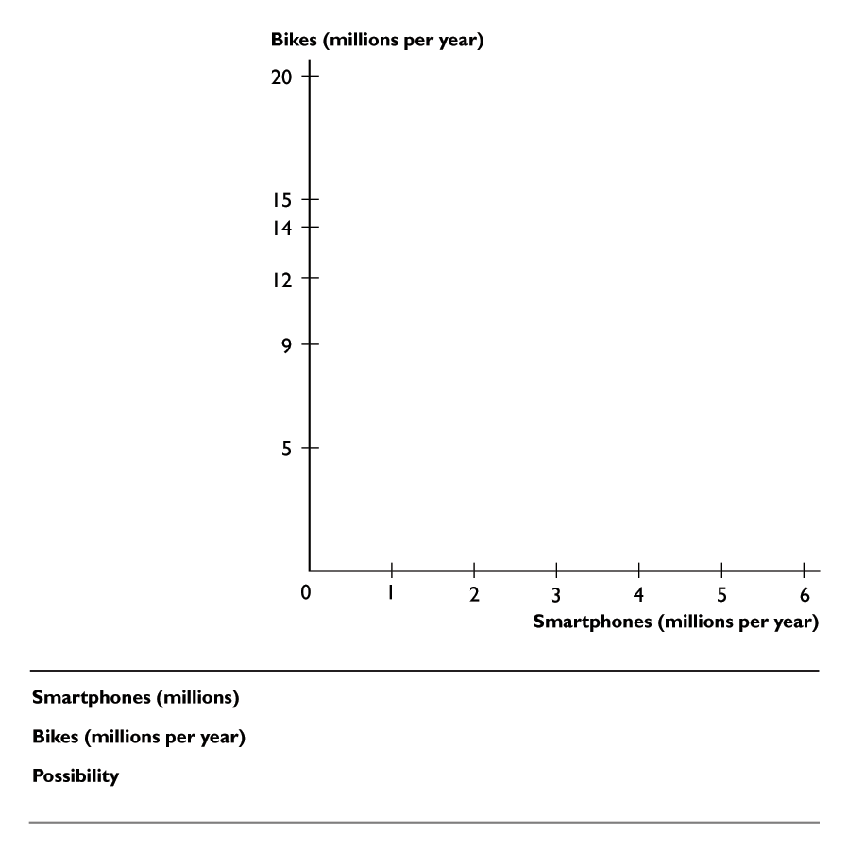
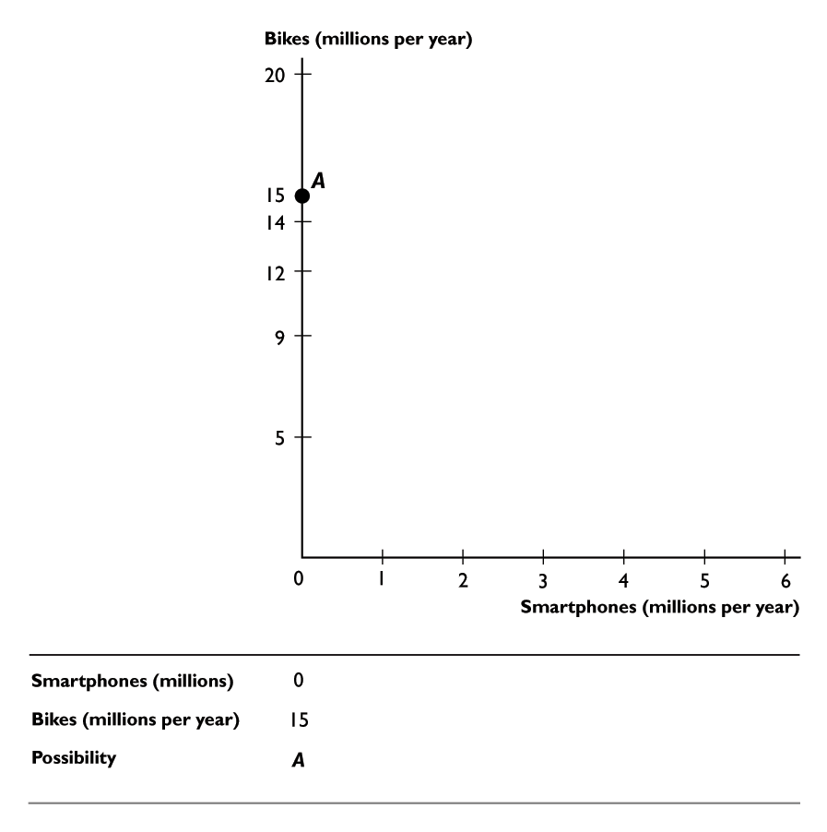
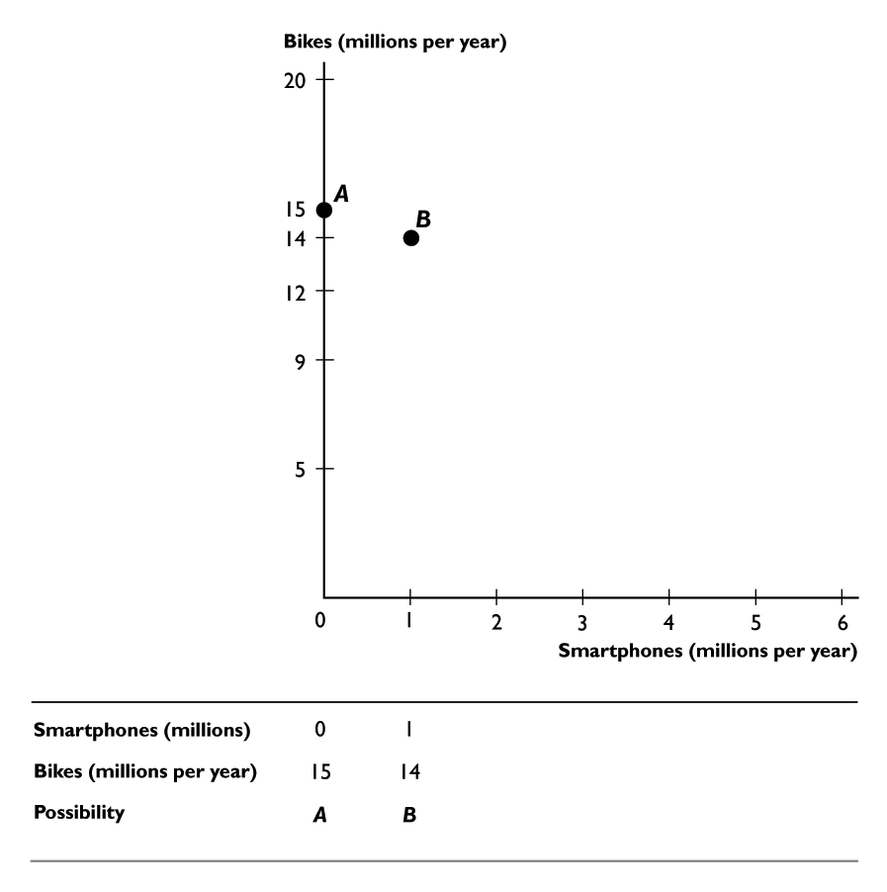
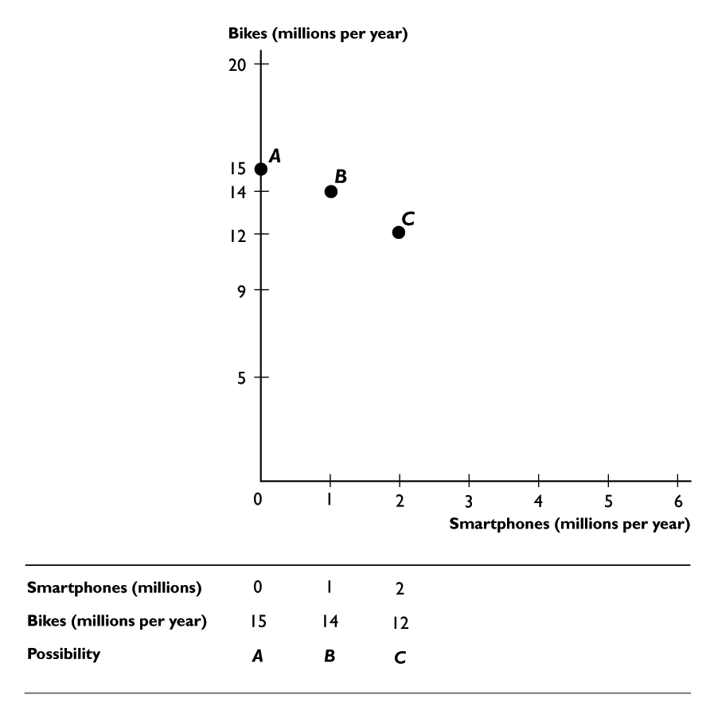
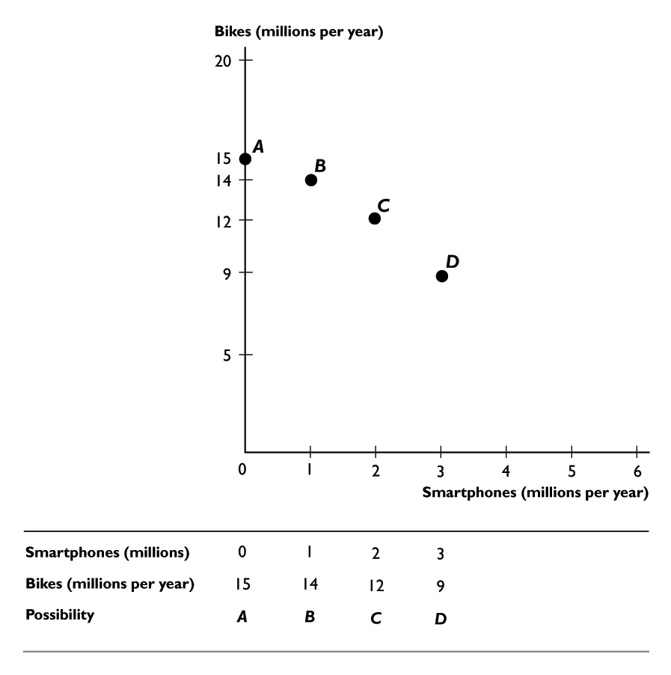
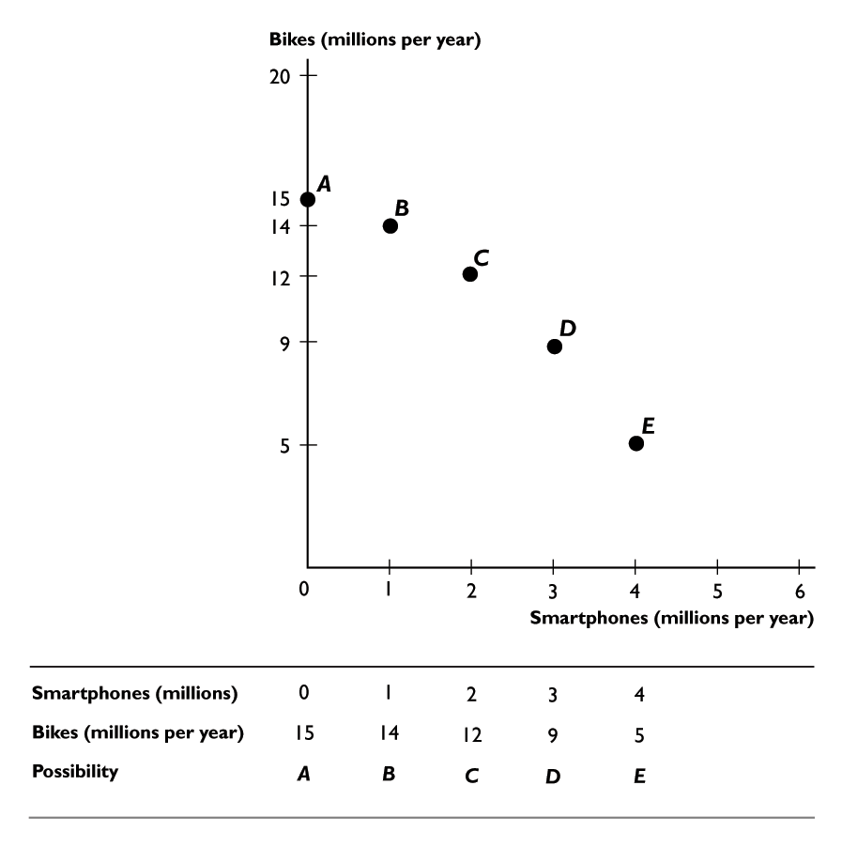
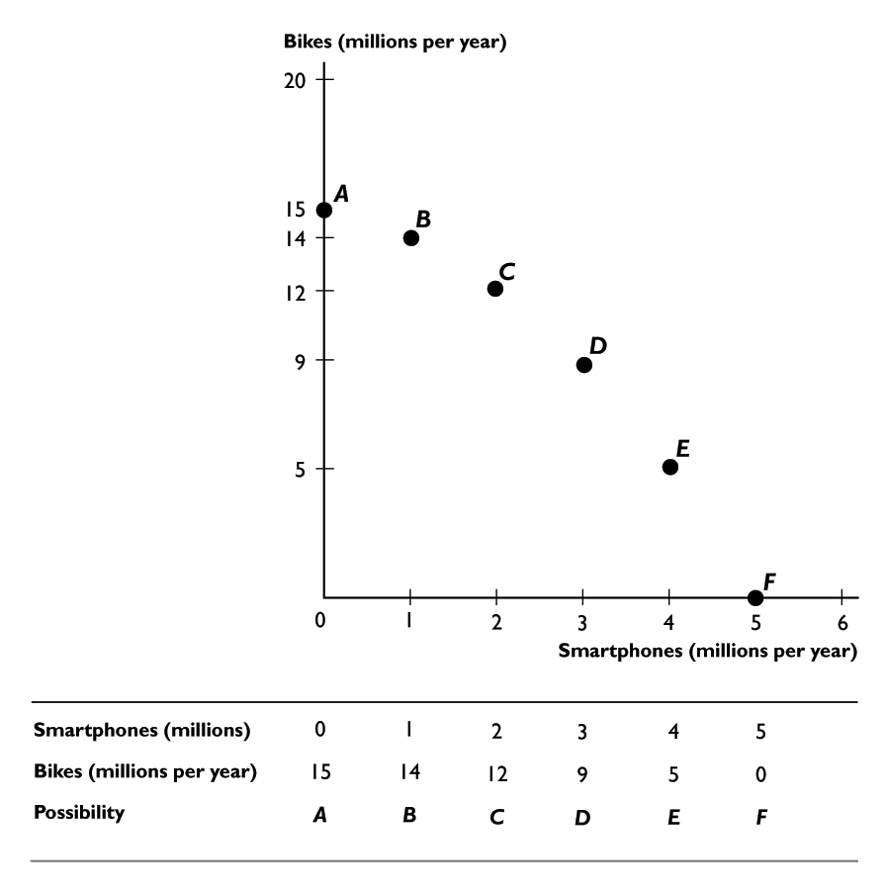
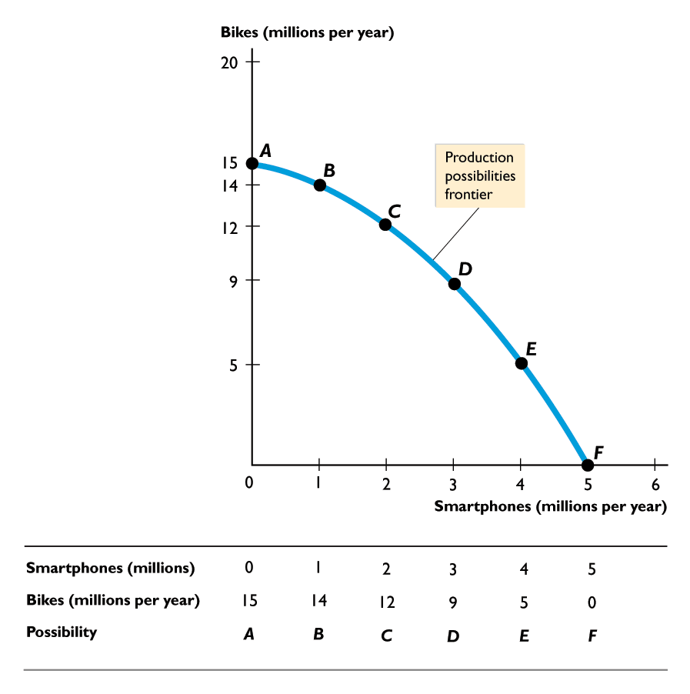
3.1 PRODUCTION POSSIBILITIES
Figure 3.1 shows the PPF for smartphones and bikes.
Each point on the graph represents a column of the table.
The line through the points is the PPF.

Slide 6
3.1 PRODUCTION POSSIBILITIES
How the PPF Illustrates Scarcity and Its Consequences
The PPF puts three distinctions in sharp focus:
Attainable and unattainable combinations
Efficient and inefficient production
Tradeoffs and free lunches

Slide 7
3.1 PRODUCTION POSSIBILITIES
Attainable and Unattainable Combinations
Because the PPF shows the limits to production, it separates attainable combinations from unattainable ones.
Figure 3.2 on the next slide illustrates the attainable and unattainable combinations.

Slide 8
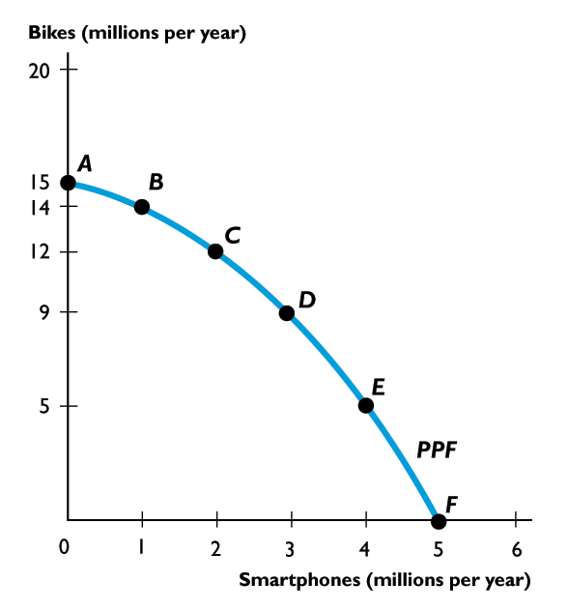
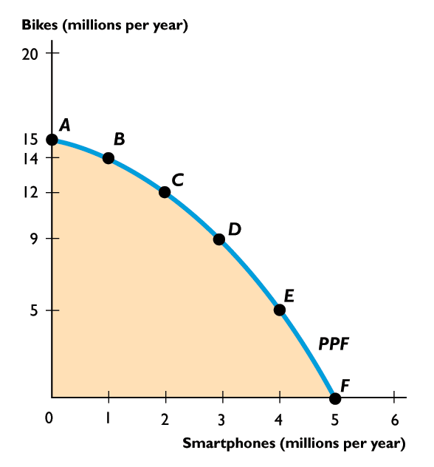
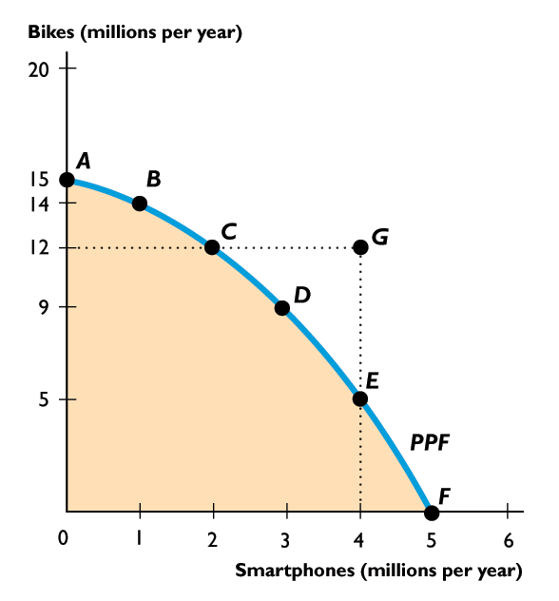
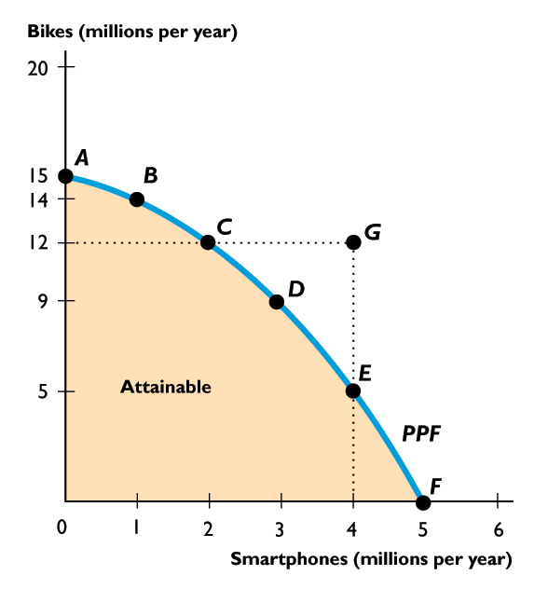
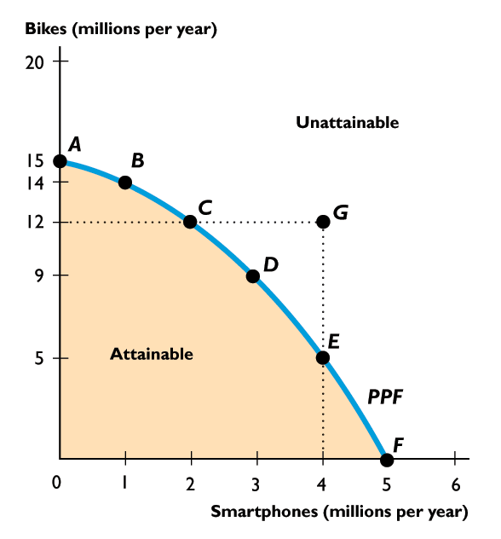
3.1 PRODUCTION POSSIBILITIES
We can produce at any point inside the PPF or on the frontier.
We cannot produce at any point outside the PPF such as point G.
The PPF separates attainable combinations from unattainable combinations.

Slide 10
3.1 PRODUCTION POSSIBILITIES
Efficient and Inefficient Production
Production efficiency is a situation in which we cannot produce more of one good or service without producing less of something else.
Figure 3.3 on the next slide illustrates the distinction between efficient and inefficient production.

Slide 11
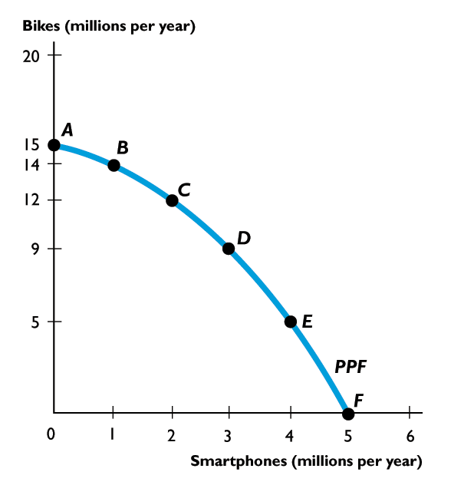
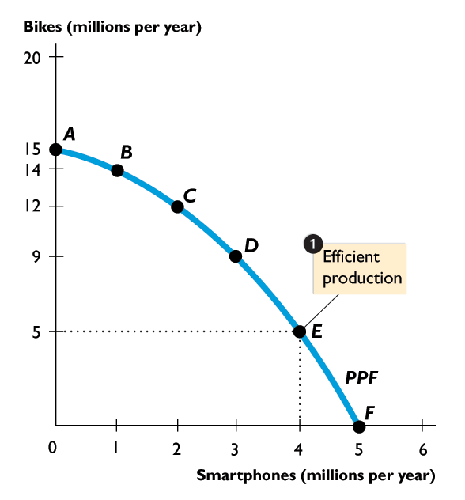
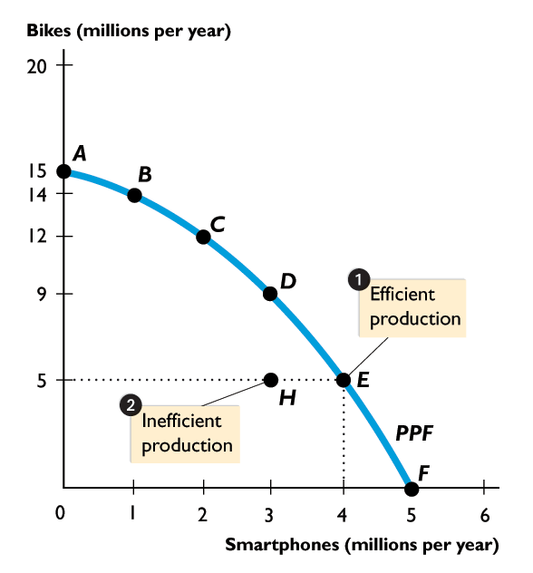
3.1 PRODUCTION POSSIBILITIES
When production is on the PPF, such as at point E or D, production is efficient.
If production were inside the PPF, such as at point H, more goods could be produced without forgoing either good.
Production inside PPF is inefficient.

Slide 12
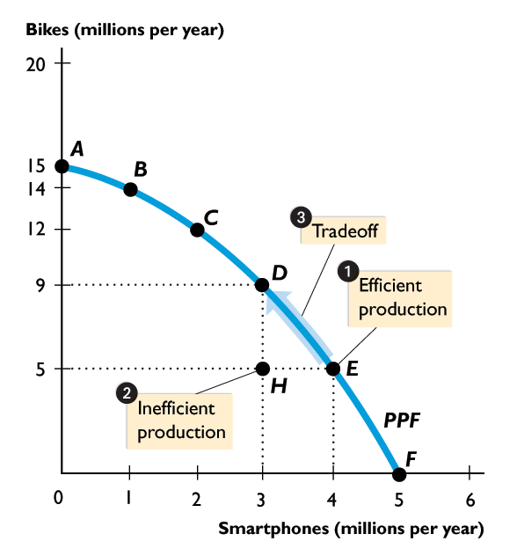
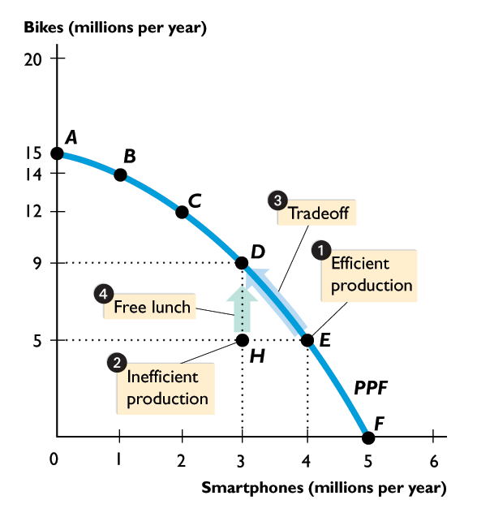

Slide 13
3.1 PRODUCTION POSSIBILITIES
Tradeoffs and Free Lunches
A tradeoff is an exchange—giving up one thing to get something else.
A free lunch is a gift—getting something without giving up something else.
Figure 3.3 on the next slide illustrates the distinction between a tradeoff and a free lunch.

Slide 14
3.1 PRODUCTION POSSIBILITIES
When production is on the PPF, we face a tradeoff.
If production were inside the PPF, there would be a free lunch.
Moving from point H to point D does not involve a tradeoff.

Slide 15
3.2 OPPORTUNITY COST
The Opportunity Cost of a Smartphone
The opportunity cost of producing a smartphone is the decrease in the quantity of bikes divided by the increase in the number of smartphones as we move along the PPF.
Figure 3.4 illustrates the calculation of the opportunity cost of producing a smartphone.

Slide 16
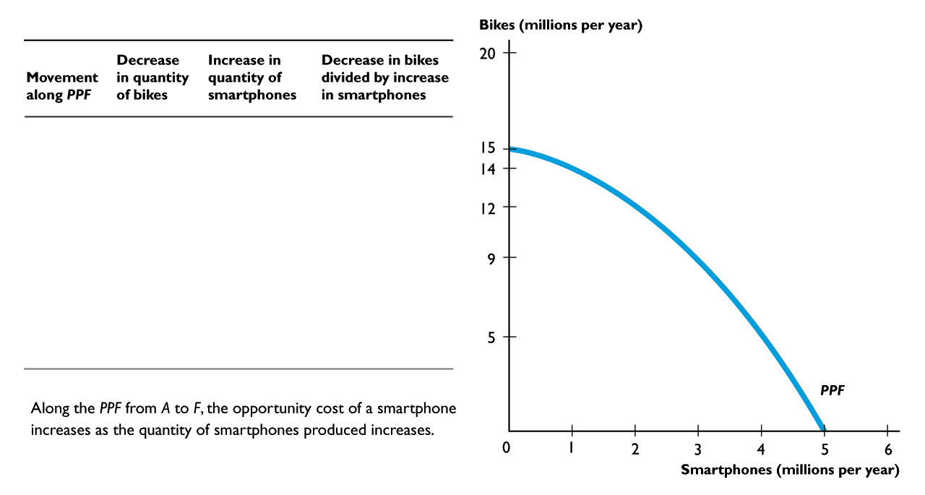
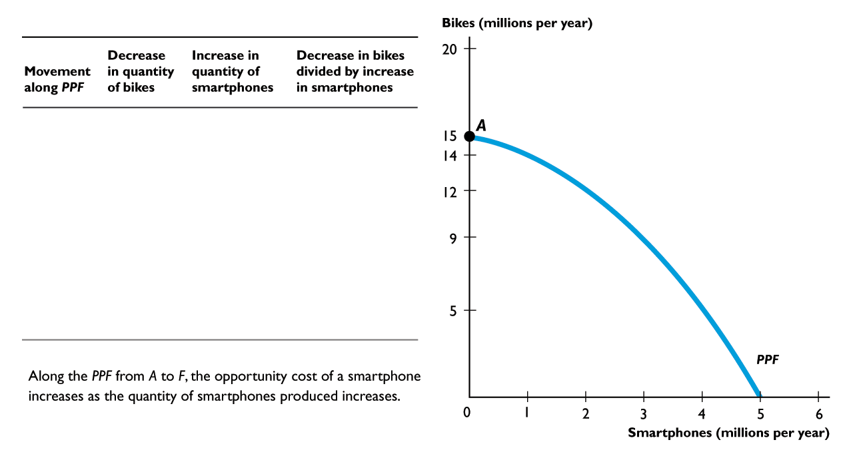
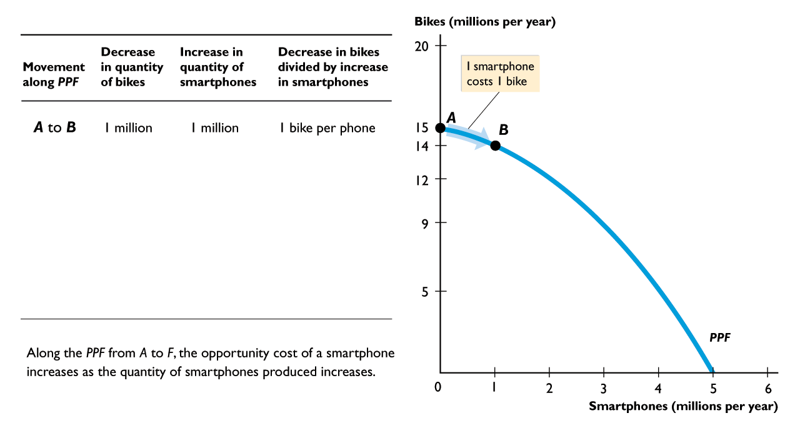
3.2 OPPORTUNITY COST
Moving from A to B, 1 smartphone costs 1 bike

Slide 17
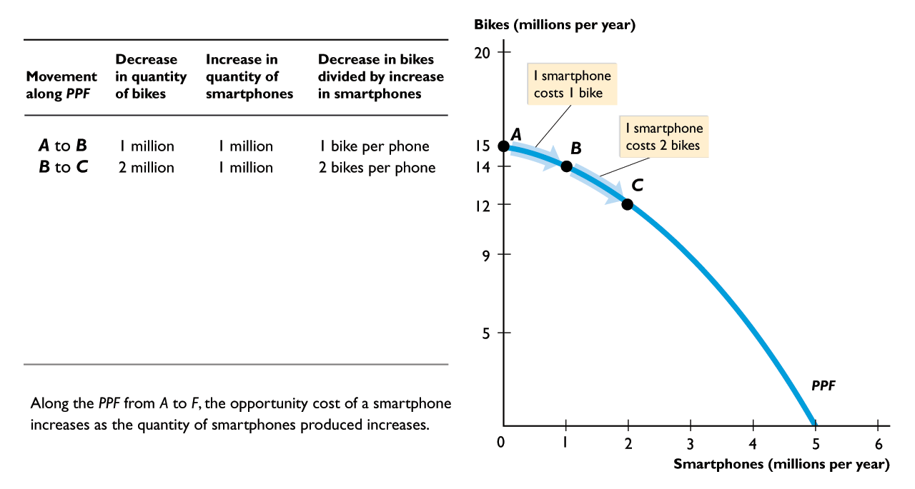
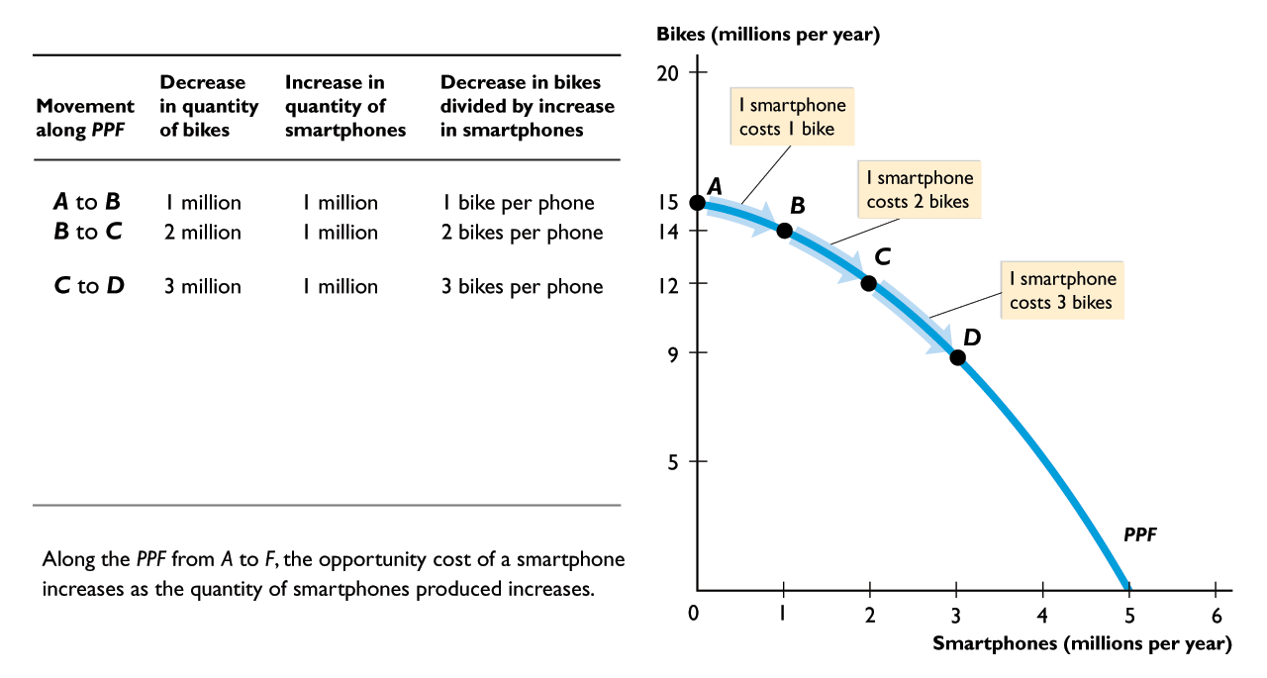
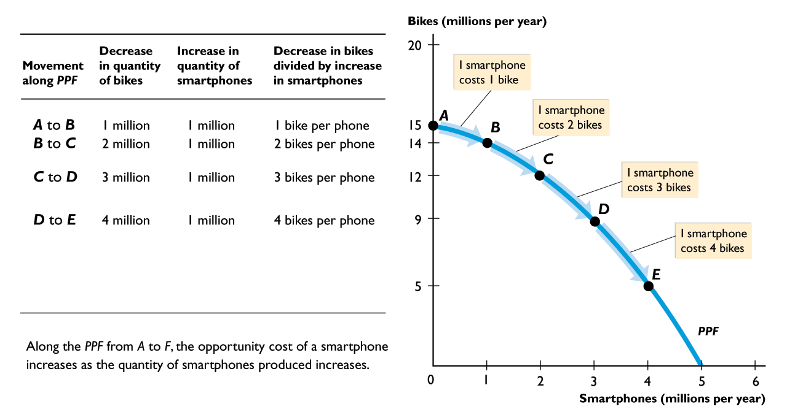
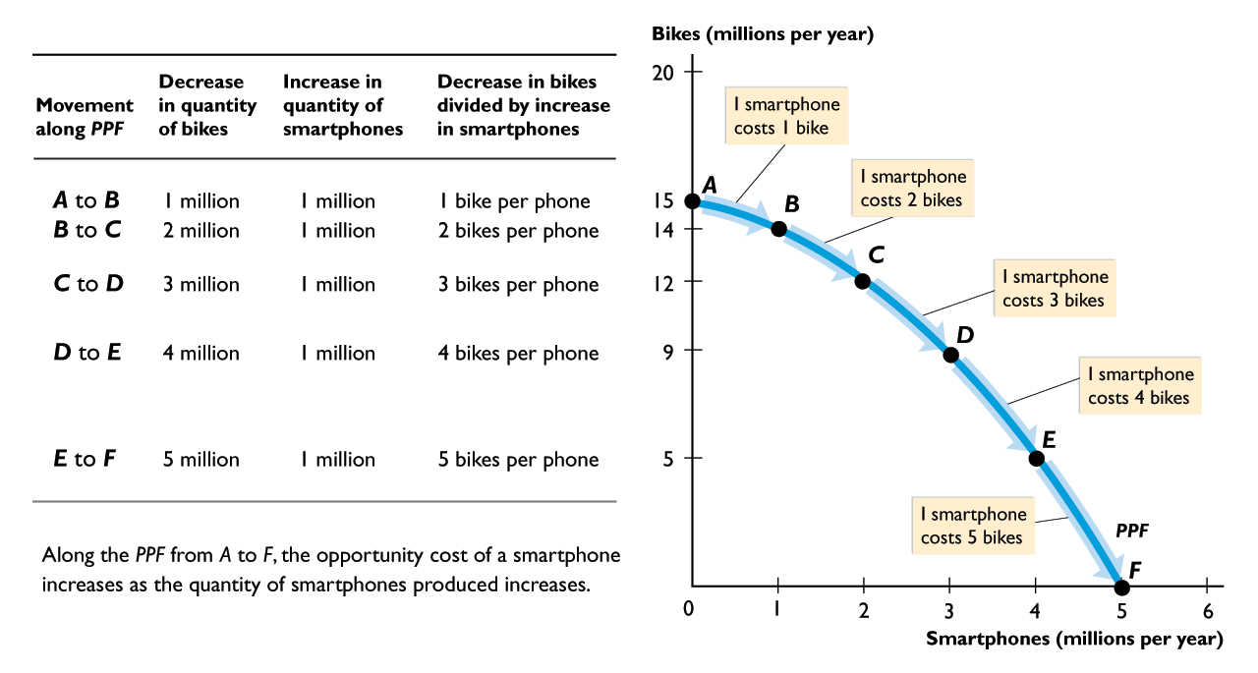

Slide 18
3.2 OPPORTUNITY COST
Moving from B to C, 1 smartphone costs 2 bikes.

Slide 19
3.2 OPPORTUNITY COST
Moving from C to D, 1 smartphone costs 3 bikes.

Slide 20
3.2 OPPORTUNITY COST
Moving from D to E, 1 smartphone costs 4 bikes.

Slide 21
3.2 OPPORTUNITY COST
Moving from E to F, 1 smartphone costs 5 bikes.

Slide 22
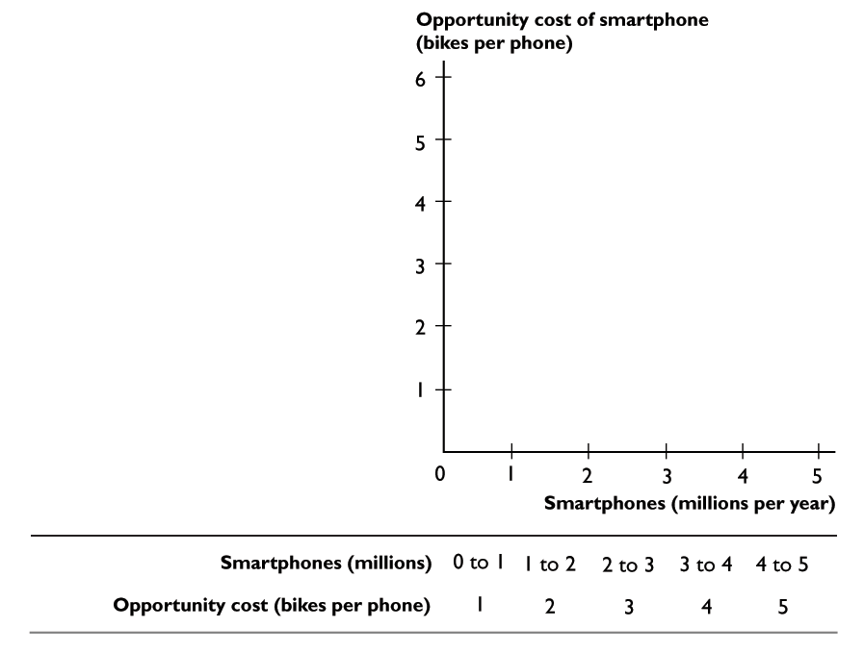
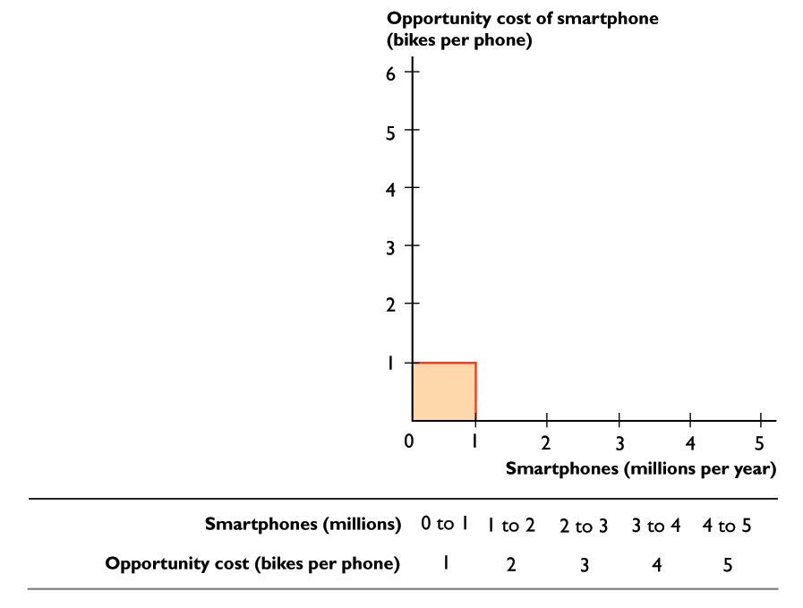
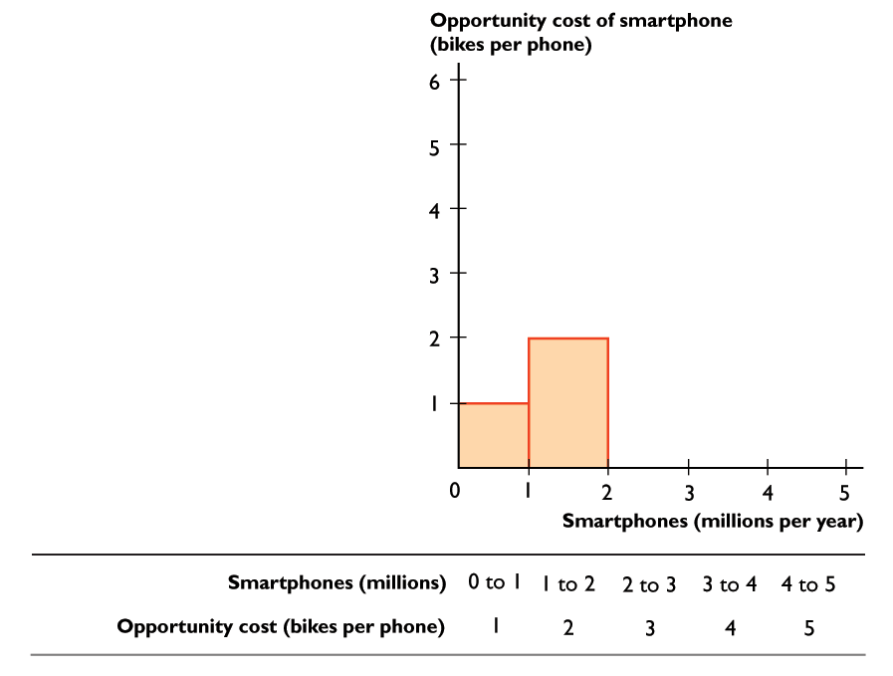
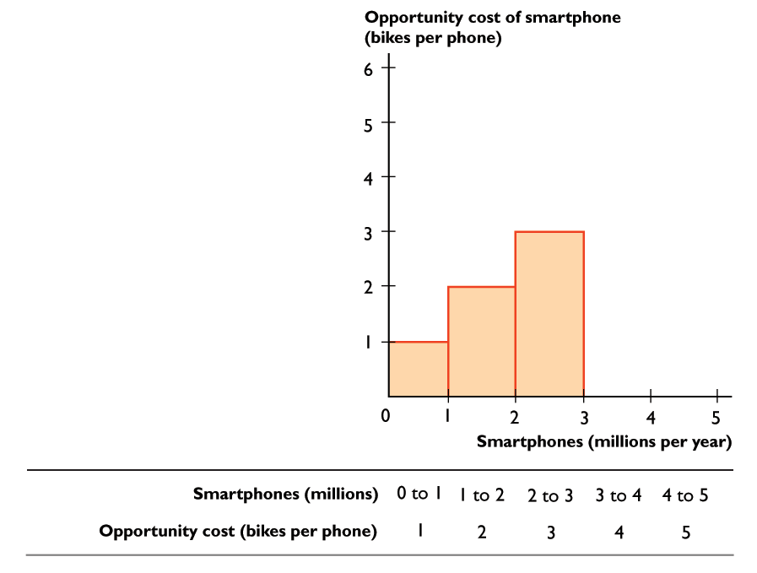
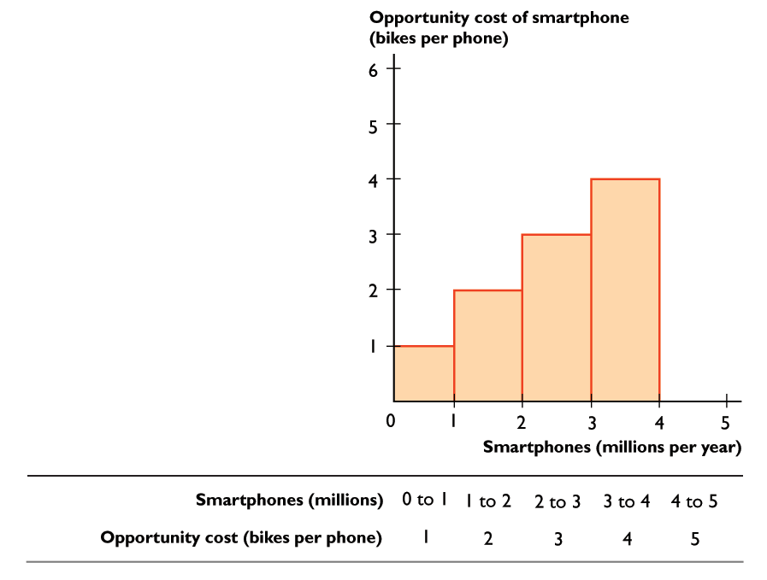
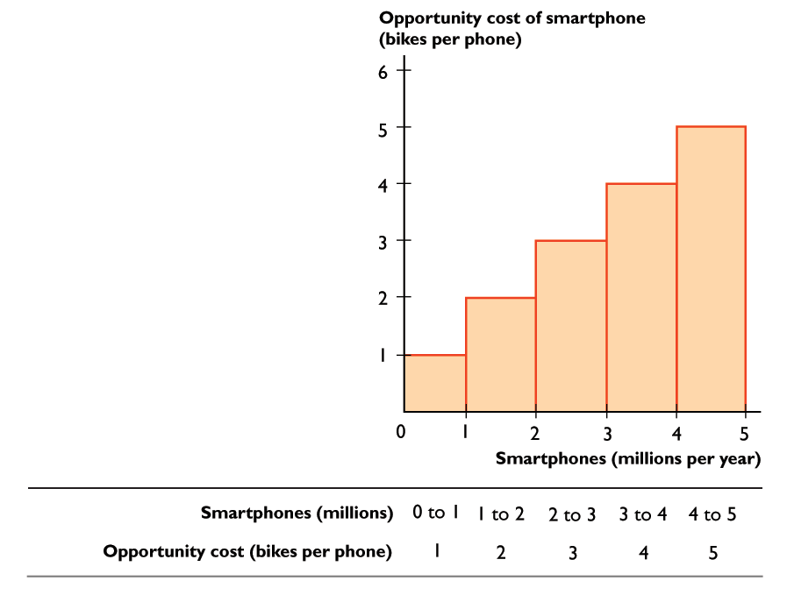
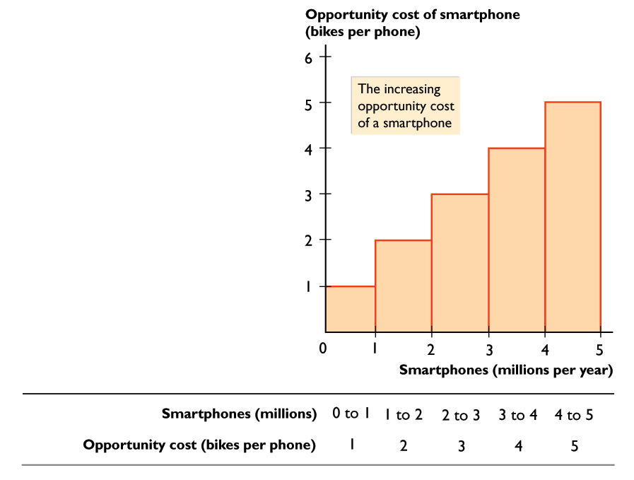
3.2 OPPORTUNITY COST
Increasing Opportunity Cost
The opportunity cost of a smartphone increases as more smartphones are produced.

Slide 24
3.2 OPPORTUNITY COST
Opportunity Cost and the Slope of the PPF
The magnitude of the slope of the PPF measures opportunity cost.
The slope of the PPF in Figure 3.4 measures the opportunity cost of a smartphone.
The PPF is bowed outward. As more smartphones are produced, the PPF becomes steeper and the opportunity cost of a smartphone increases.

Slide 25
3.2 OPPORTUNITY COST
Opportunity Cost Is a Ratio
The opportunity cost of a smartphone is the quantity of bikes forgone divided by the increase in the quantity of smartphones gained.
The opportunity cost of a bike is the quantity of smartphones forgone divided by the increase in the quantity of bikes gained.
When the opportunity cost of a smartphone is x bikes, the opportunity cost of a bike is 1/x smartphones.

Slide 26
3.2 OPPORTUNITY COST
Increasing Opportunity Costs Are Everywhere
Almost every activity has an increasing opportunity cost.

Slide 27
3.3 ECONOMIC GROWTH
Economic growth is the sustained expansion of production possibilities.
An economy grows when it develops better technology, improves the quality of labor, or increases the quantity of capital.
When an economy’s resources increase, its production possibilities expand and its PPF shifts outward.
To study economic growth, we begin at the PPF with consumption goods on one axis and a capital good on the other.

Slide 28
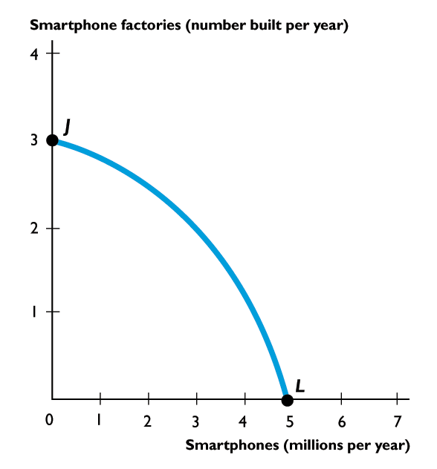
3.3 ECONOMIC GROWTH
If we produce at point J, we produce only smart-phone factories and no smartphones.
If we produce at point L, we produce smartphones and no smartphone factories.
At L, consumption remains at 5 million smartphones every year.

Slide 29
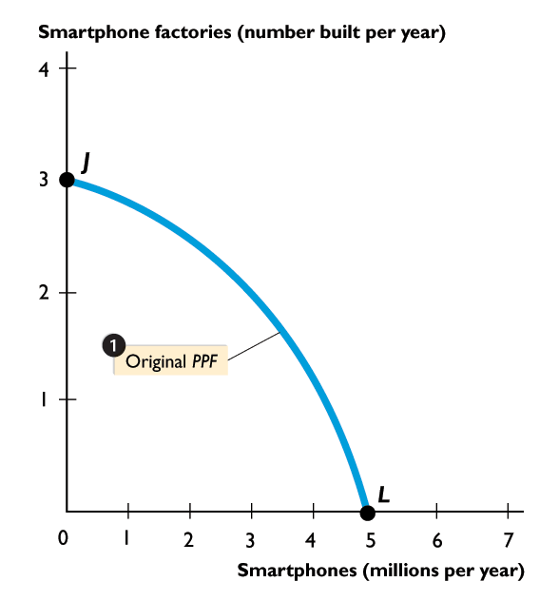
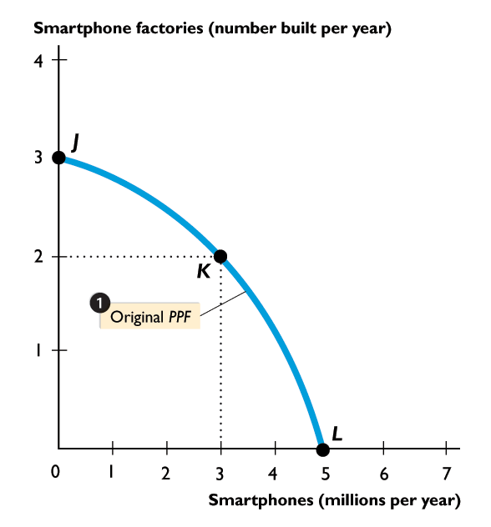
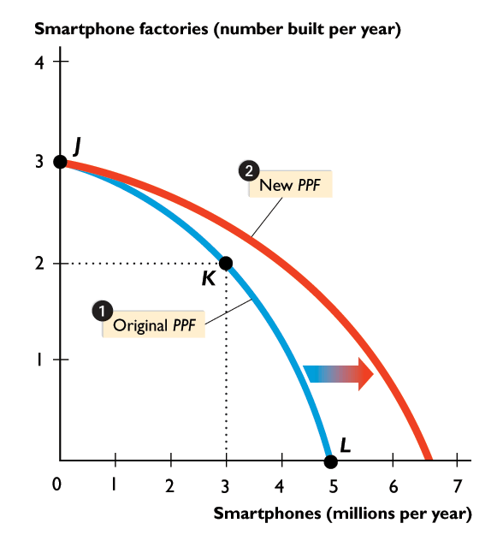
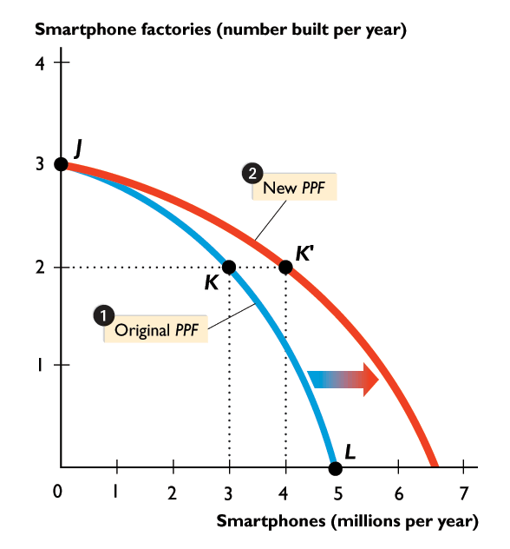

Slide 30
3.3 ECONOMIC GROWTH
But if we cut production of smart- phones to 3 million this year, we can produce 2 smartphone factories at point K.
Then next year, our PPF rotates outward because we have more capital.
We can produce at a point outside our original PPF, such as K'.

Slide 31
3.4 SPECIALIZATION AND TRADE
When one person (or nation) is more productive than another—needs fewer inputs or takes less time to produce a good or perform a production task—we say that this person (or nation) has an absolute advantage.
People and nations can gain from specializing in production of the goods in which they have a comparative advantage and then trading.

Slide 32
3.4 SPECIALIZATION AND TRADE
Comparative Advantage
Comparative advantage is the ability of a person to perform an activity or produce a good or service at a lower opportunity cost than someone else.
Liz and Joe operate smoothie bars and produce smoothies and salads.

Slide 33
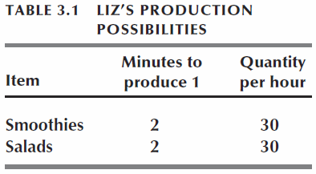
3.4 SPECIALIZATION AND TRADE
Liz's Smoothie Bar
In an hour, Liz can produce either 30 smoothies or 30 salads.
Liz's opportunity cost of producing 1 smoothie is 1 salad.
Liz's opportunity cost of producing 1 salad is 1 smoothie.
Each hour, Liz splits her time equally between smoothies and salads and produces 15 smoothies and 15 salads.

Slide 34
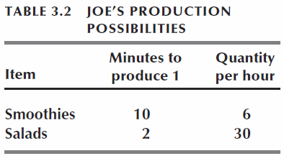
3.4 SPECIALIZATION AND TRADE
Joe's Smoothie Bar
In an hour, Joe can produce either 6 smoothies or 30 salads.
Joe's opportunity cost of producing 1 smoothie is 5 salads.
Joe's opportunity cost of producing 1 salad is 1/5 smoothie.
Each hour, Joe spends 50 minutes producing smoothies and makes 5 smoothies. In the other 10 minutes, he produces 5 salads.

Slide 35
3.4 SPECIALIZATION AND TRADE
Liz’s Comparative Advantage
Liz’s opportunity cost of a smoothie is 1 salad.
Joe’s opportunity cost of a smoothie is 5 salads.
Liz’s opportunity cost of a smoothie is less than Joe’s, so Liz has a comparative advantage in producing smoothies.

Slide 36
3.4 SPECIALIZATION AND TRADE
Joe’s Comparative Advantage
Joe’s opportunity cost of a salad is 1/5 smoothie.
Liz’s opportunity cost of a salad is 1 smoothie.
Joe’s opportunity cost of a salad is less than Liz’s, …
so Joe has a comparative advantage in producing salads.
To keep things simple, we assume that Liz’s and Joe’s opportunity costs are constant.

Slide 37
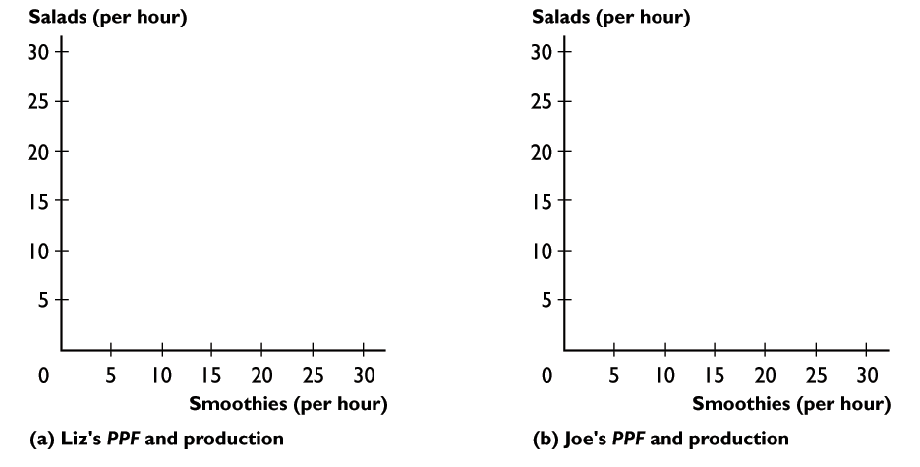
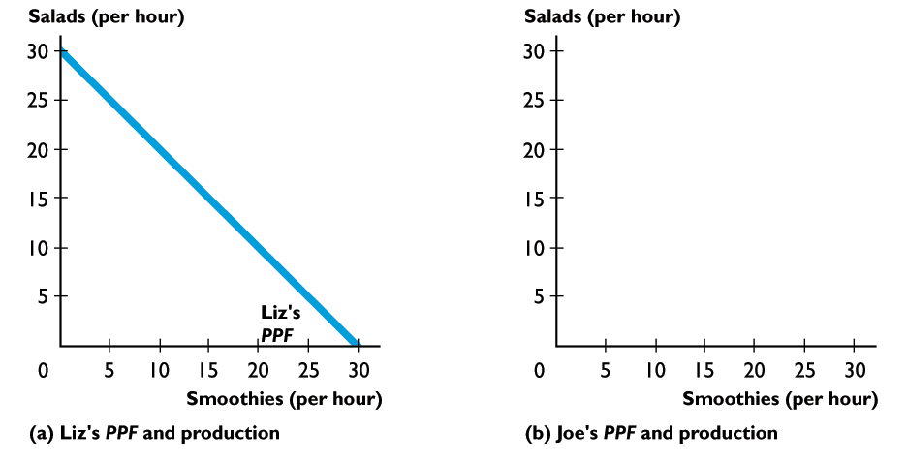
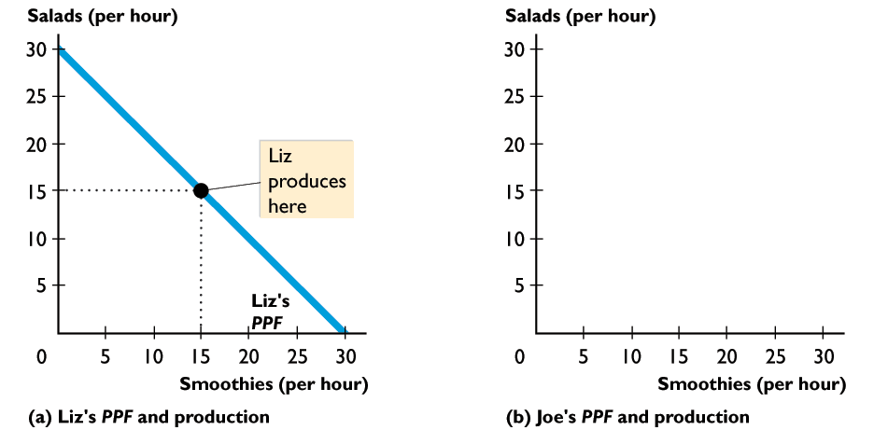
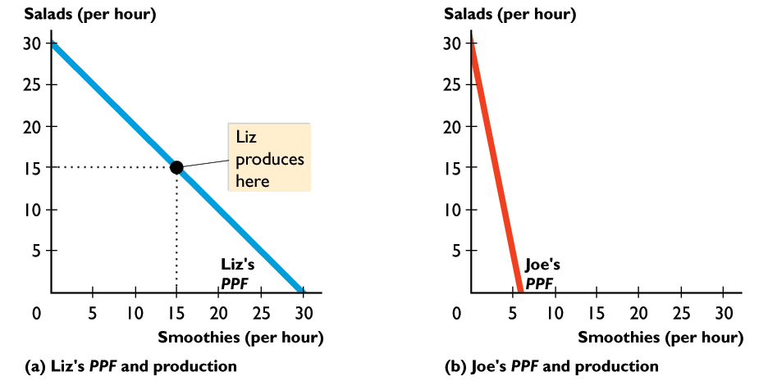
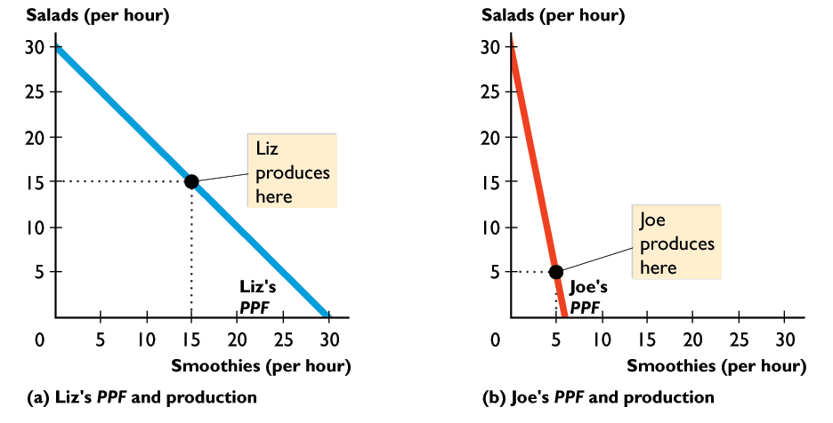
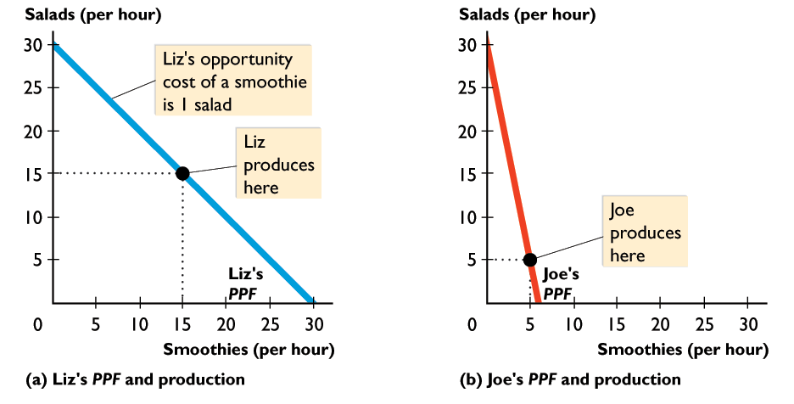
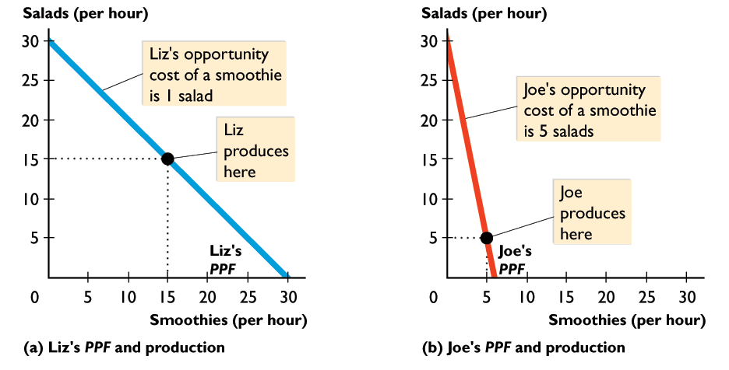
3.4 SPECIALIZATION AND TRADE
Liz and Joe produce at a point on their PPFs.
Liz has a comparative advantage in producing smoothies.
Joe has a comparative advantage in producing salads.

Slide 39

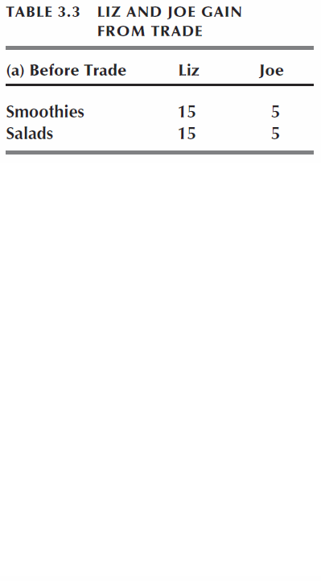
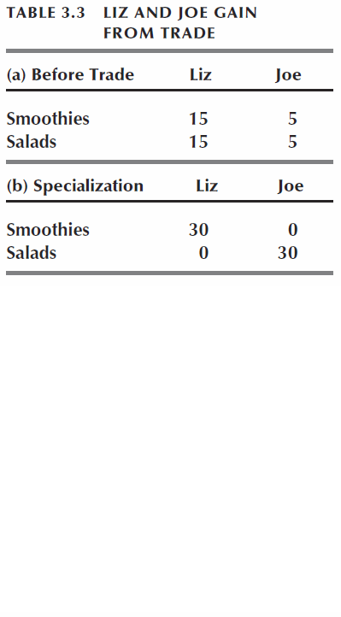
3.4 SPECIALIZATION AND TRADE
Achieving Gains from Trade
Liz and Joe specialize in producing the good in which they have a comparative advantage:
Liz produces 30 smoothies.
Joe produces 30 salads.

Slide 40
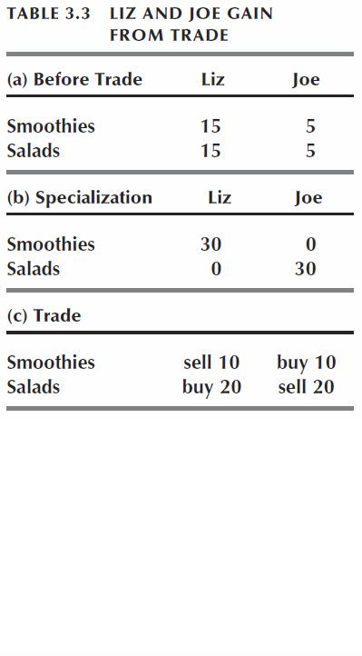
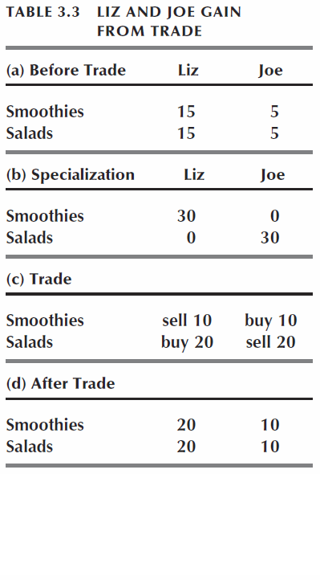


Slide 41
3.4 SPECIALIZATION AND TRADE
Liz and Joe trade:
Liz sells Joe 10 smoothies and buys 20 salads.
Joe sells Liz 10 salads and buys 20 smoothies.
After trade:
Liz has 20 smoothies and 20 salads.
Joe has 10 smoothies and 10 salads.

Slide 42
3.4 SPECIALIZATION AND TRADE
Gains from trade:
Liz gains 5 smoothies and 5 salads an hour.
Joe gains 5 smoothies and 5 salads an hour.
Figure 3.8 on the next slide illustrates the gains from trade.

Slide 43



3.4 SPECIALIZATION AND TRADE
Liz and Joe each produce at point A on their PPFs.

Slide 44





Slide 45
3.4 SPECIALIZATION AND TRADE
Liz has a comparative advantage in producing smoothies.
Joe has a comparative advantage in producing salads.

Slide 46
3.4 SPECIALIZATION AND TRADE
Liz and Joe specialize in producing the good in which they have a comparative advantage.

Slide 47
3.4 SPECIALIZATION AND TRADE
Liz and Joe trade salads and smoothies at a price of 2 salads per smoothie.

Slide 48
3.4 SPECIALIZATION AND TRADE
Liz and Joe consume at point C, which is outside their PPFs. Both gain from specialization and trade.

Slide 49


3.4 SPECIALIZATION AND TRADE
Figure 3.9 shows that although Liz and Joe have constant opportunity costs, the society has increasing opportunity cost.

Slide 50





Slide 51
3.4 SPECIALIZATION AND TRADE
The first 30 smoothies can be produced (by Liz) for 1 salad per smoothie, but the 31st smoothie produced (by Joe) costs 5 salads.

Slide 52
3.4 SPECIALIZATION AND TRADE
Similarly, first 30 salads can be produced (by Joe) for 1/5 smoothie per salad, but the 31st salad produced (by Liz) costs 1 smoothie.

Slide 53
3.4 SPECIALIZATION AND TRADE
When Liz and Joe specialize, they produce efficiently on the economy’s PPF.
But without specialization and trade, they produce at an inefficient point inside the economy’s PPF.

Slide 54

Wind power is not free.
Its opportunity cost includes the huge amounts of other goods and services we give up to build wind turbines and transmission lines.
Wind turbines can produce electricity only when the wind is strong enough, but advances in technology are enabling turbines to operate in lower wind conditions.
Also some of the best wind farm locations are a long way from major population centers, so transmission lines would be long and power transmission losses large.

Slide 55





Point A is a point of efficient electricity production.
If the United States produces most of its electricity using wind power, …
it would be operating inside the PPF at a point such as Z.
Inefficient production.

Slide 56

Figure 2.8 Circular flows in the market economy

Slide 57

Figure 1 The UK economy in 2022

Slide 58

Figure 2 The UK economy in 2030

