Slide 1
Economics
Eleventh European Edition
Part 2
How markets work
Chapter 3
Demand and supply

Slide 2

4
Elasticities of
Demand and Supply
CHAPTER CHECKLIST
When you have completed your study of this chapter, you will be able to
1 Define and calculate the price elasticity of demand, and explain the factors that influence it.
2 Define and calculate the price elasticity of supply, explain the factors that influence it.
3 Define the cross elasticity of demand and the income elasticity of demand, and explain the factors that influence them.

Slide 3
5.1 THE PRICE ELASTICITY OF DEMAND
Price elasticity of demand is a measure of the extent to which the quantity demanded of a good changes when the price of the good changes.
To determine the price elasticity of demand, we compare the percentage change in the quantity demanded with the percentage change in price.

Slide 4
5.1 THE PRICE ELASTICITY OF DEMAND
Percentage Change in Price
Suppose Starbucks raises the price of a latte from $3 to $5. What is the percentage change in price?
Percentage change in price
New price – Initial price
=
x 100
Initial Price
Percentage change in price
$5 – $3
=
x 100
= 66.67 percent
$3

Slide 5
5.1 THE PRICE ELASTICITY OF DEMAND
A
Suppose Starbucks cuts the price of a latte from $5 to $3. What is the percentage change in price?
Percentage change in price
New price – Initial price
=
x 100
Initial Price
Percentage change in price
$3 – $5
=
x 100
= – 40 percent
$5

Slide 6
5.1 THE PRICE ELASTICITY OF DEMAND
The same price change, $2, over the same interval, $3 to $5, is a different percentage change depending on whether the price rises or falls.
We need a measure of percentage change that does not depend on the direction of the price change.
We use the average of the initial price and the new price to measure the percentage change.

Slide 7
5.1 THE PRICE ELASTICITY OF DEMAND
The Midpoint Method
To calculate the percentage change in the price divide the change in the price by the average price and then multiply by 100.
The average price is at the midpoint between the initial price and the new price, hence the name midpoint method.
New price – Initial price
Percentage change in price
=
x 100
(New Price + Initial Price) ÷ 2

Slide 8
5.1 THE PRICE ELASTICITY OF DEMAND
The percentage change in price calculated by the midpoint method is the same for a price rise and a price fall.
Percentage change in price
$5 – $3
=
x 100
($5 + $3) ÷ 2
Percentage change in price
= 50 percent.

Slide 9
5.1 THE PRICE ELASTICITY OF DEMAND
Percentage Change in Quantity Demanded
If Starbucks raises the price of a latte, the quantity of lattes demanded decreases.
Percentage change in
quantity
New quantity – Initial quantity
=
x 100
(New quantity + Initial quantity) ÷ 2
Percentage change in
quantity
5 – 15
=
x 100 = – 100 percent
(5 + 15) ÷ 2

Slide 10
5.1 THE PRICE ELASTICITY OF DEMAND
When the price rises, the quantity demanded decreases along the demand curve.
Similarly, when the price falls, the quantity demanded increases along the demand curve.
Price and quantity always change in opposite directions.
So to compare the percentage change in the price and the percentage change in the quantity demanded, we ignore the minus sign and use the absolute values.

Slide 11
5.1 THE PRICE ELASTICITY OF DEMAND
Elastic and Inelastic Demand
Demand is elastic if the percentage change in the quantity demanded exceeds the percentage change in price.
Demand is unit elastic if the percentage change in the quantity demanded equals the percentage change in price.

Slide 12
5.1 THE PRICE ELASTICITY OF DEMAND
Demand is inelastic if the percentage change in the quantity demanded is less than the percentage change in price.
Demand is perfectly elastic if the quantity demanded changes by a very large percentage in response to an almost zero percentage change in price.
Demand is perfectly inelastic if the quantity demanded remains constant as the price changes.

Slide 13
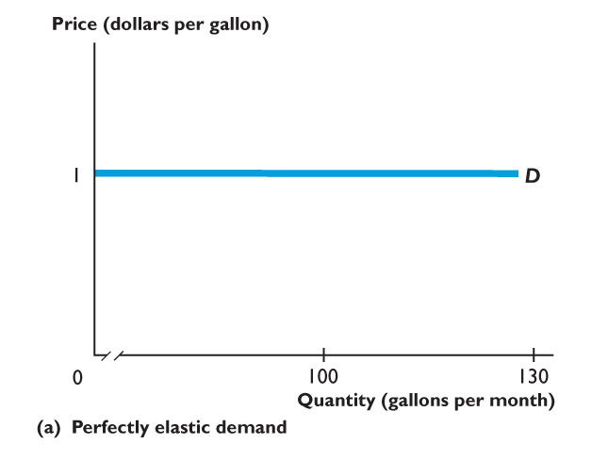
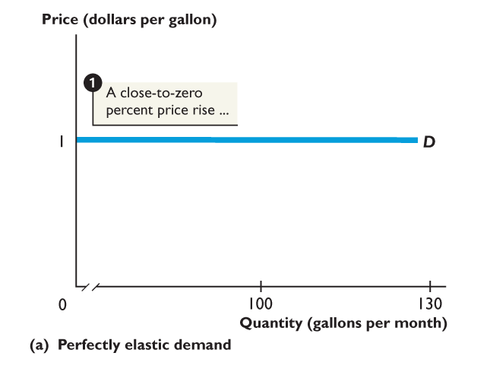
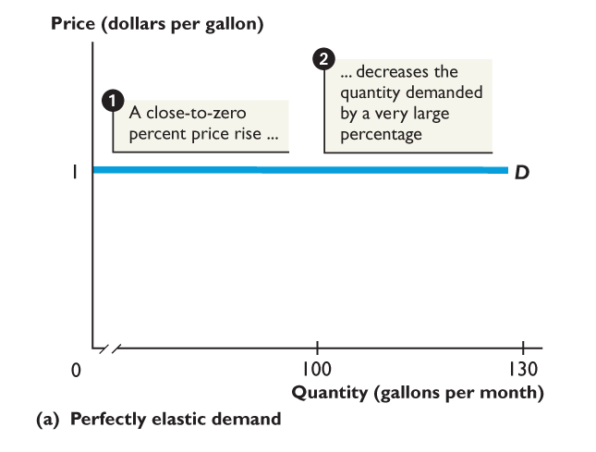
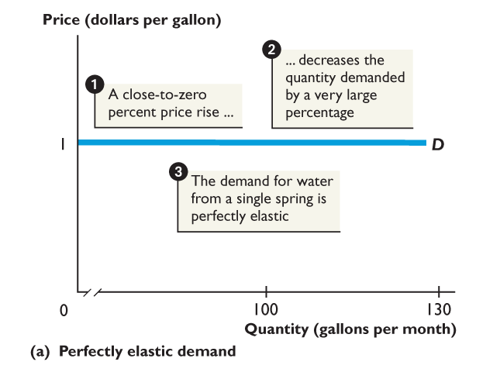
5.1 THE PRICE ELASTICITY OF DEMAND
Figure 5.1(a) shows a perfectly elastic demand.
For a small change in the price of spring water,
The quantity of spring water demanded changes by a large amount.
The demand for spring water is perfectly elastic.

Slide 14
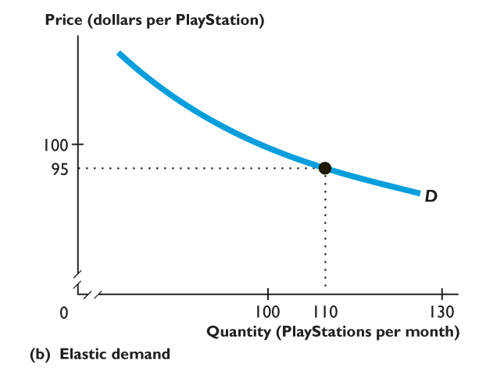
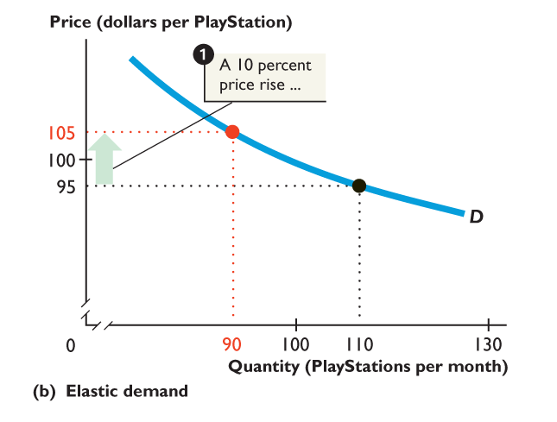
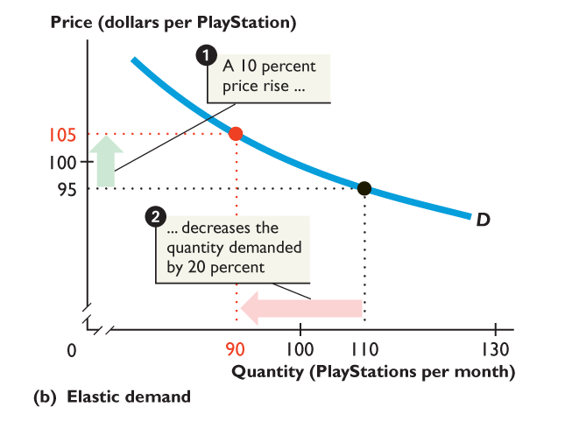
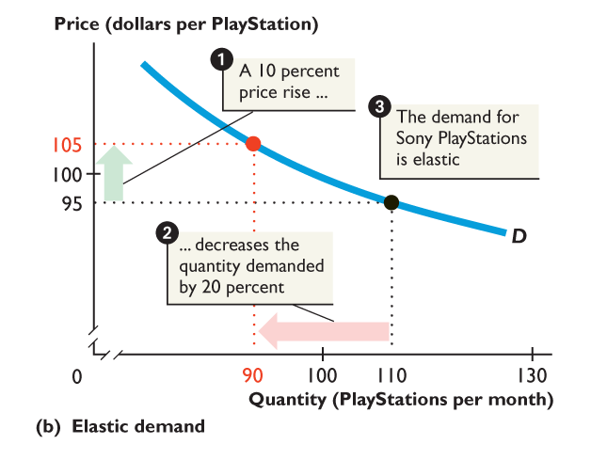
5.1 THE PRICE ELASTICITY OF DEMAND
Figure 5.1(b) shows an elastic demand.
When the price of a Sony PlayStation rises by 10%,
The quantity of PlayStations demanded decreases by 20%.
Demand for Sony Playstations is elastic.

Slide 15
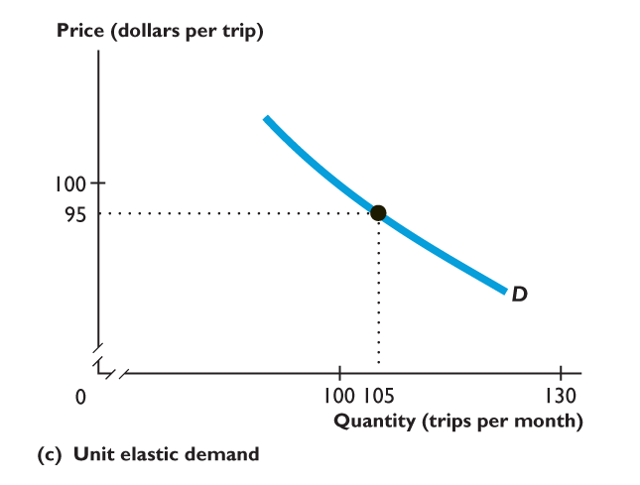
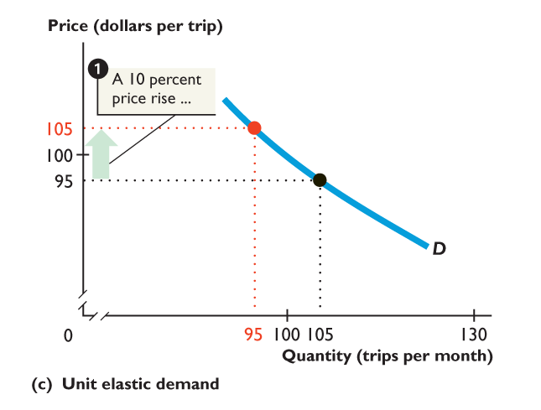
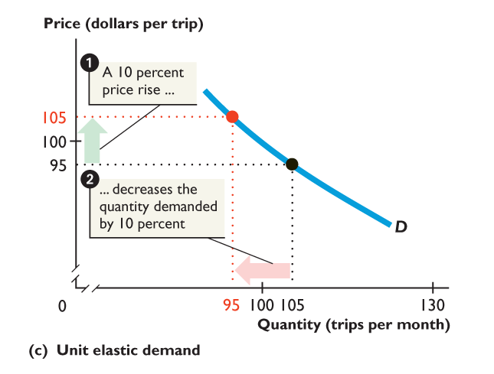
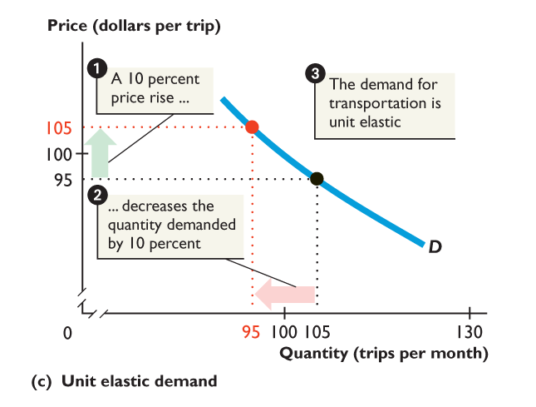
5.1 THE PRICE ELASTICITY OF DEMAND
Figure 5.1(c) shows a unit elastic demand.
When the price of a trip rises by 10%,
The quantity of trips demanded decreases by 10%.
The demand for trips is unit elastic.

Slide 16
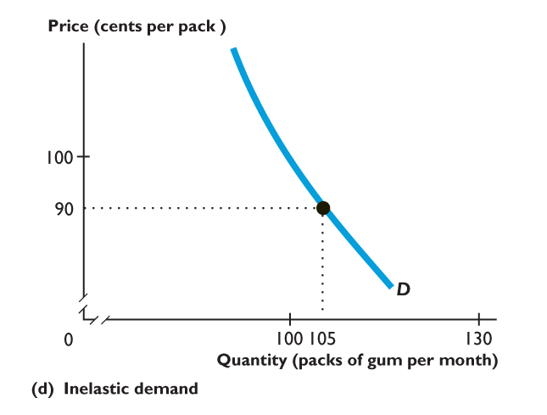
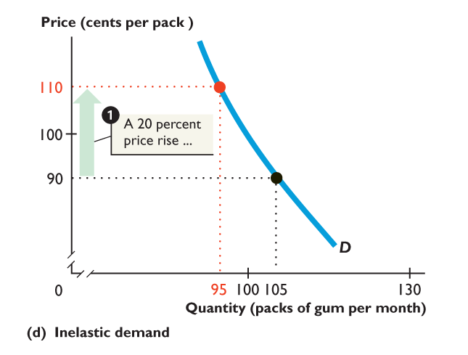
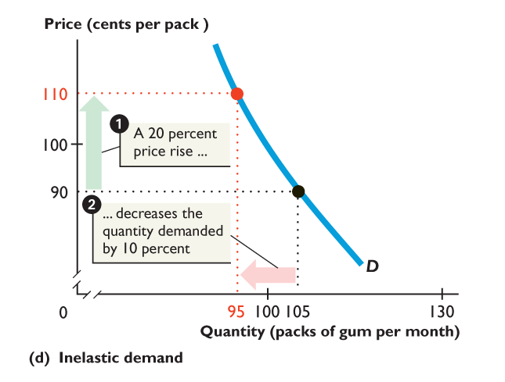
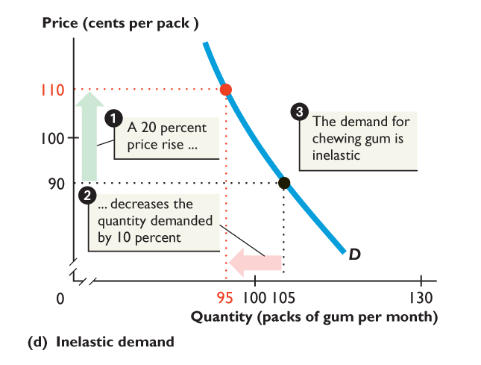
5.1 THE PRICE ELASTICITY OF DEMAND
Figure 5.1(d) shows an inelastic demand.
When the price of gum rises by 20%,
The quantity of gum demanded decreases by 10%.
The demand for gum is inelastic.

Slide 17
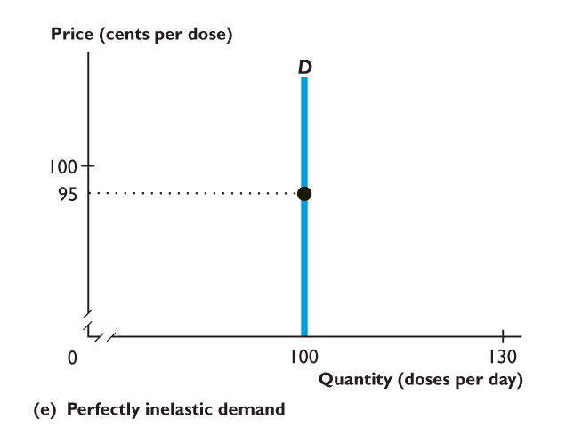
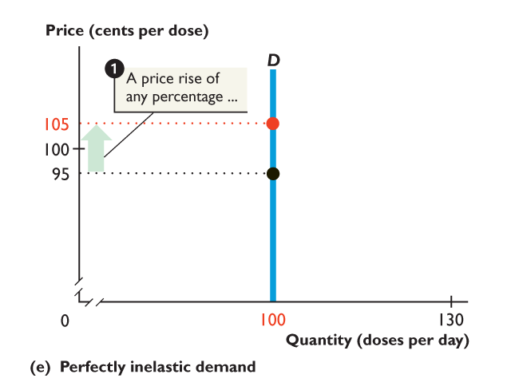
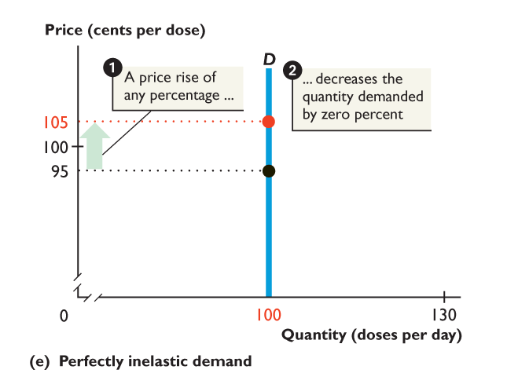
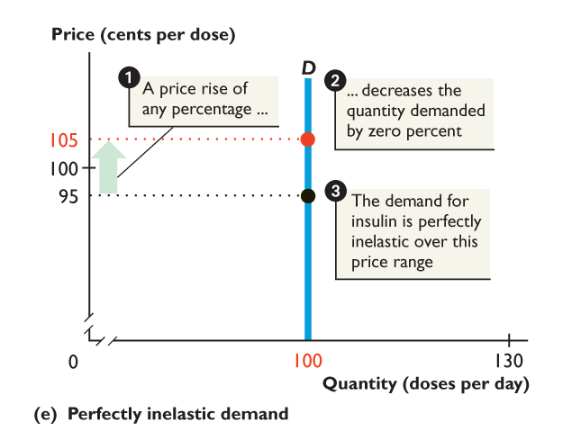
5.1 THE PRICE ELASTICITY OF DEMAND
Figure 5.1(e) shows a perfectly inelastic demand.
When the price of a dose rises,
The quantity of doses demanded does not change.
Demand for doses is perfectly inelastic.

Slide 18
5.1 THE PRICE ELASTICITY OF DEMAND
Influences on the Price Elasticity of Demand
Influences on the price elasticity of demand fall into two categories:
Availability of substitutes
Proportion of income spent
Availability of Substitutes
The demand for a good is elastic if a substitute for it is easy to find.
The demand for a good is inelastic if a substitute for it is hard to find.

Slide 19
5.1 THE PRICE ELASTICITY OF DEMAND
Three main factors influence the ability to find a substitute for a good:
Luxury Versus Necessity
A necessity has poor substitutes, so the demand for a necessity is inelastic. Food is a necessity.
A luxury has many substitutes, so the demand for a luxury is elastic. Exotic vacations are luxuries.
Narrowness of Definition
The demand for a narrowly defined good is elastic.
The demand for a broadly defined good is inelastic.

Slide 20
5.1 THE PRICE ELASTICITY OF DEMAND
Time Elapsed Since Price Change
The longer the time elapsed since the price change, the more elastic is the demand for the good.
Proportion of Income Spent
A price rise, like a decrease in income, means that people cannot afford to buy the same quantities.
The greater the proportion of income spent on a good, the more elastic is the demand for the good.

Slide 21
5.1 THE PRICE ELASTICITY OF DEMAND
Computing the Price Elasticity of Demand
If the price elasticity of demand is greater than 1, demand is elastic.
If the price elasticity of demand equals 1, demand is unit elastic.
If the price elasticity of demand is less than 1, demand is inelastic.
Percentage change in quantity demanded
Price elasticity of demand
=
Percentage change in the price
Notes:
.

Slide 22
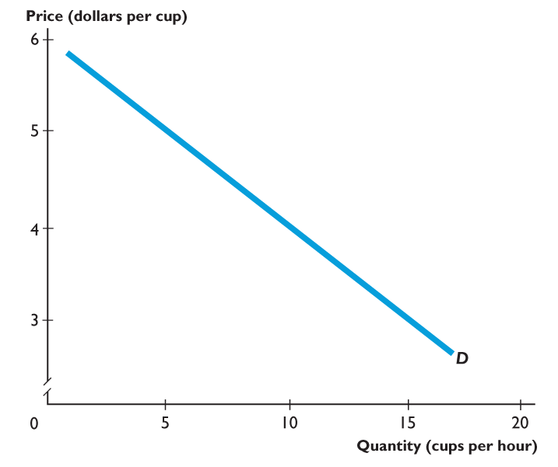
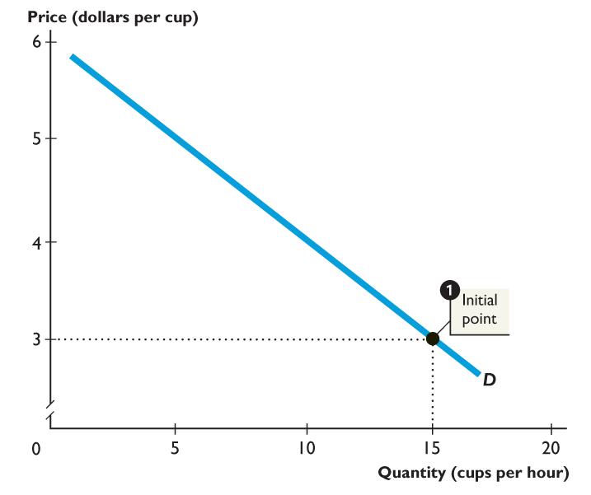
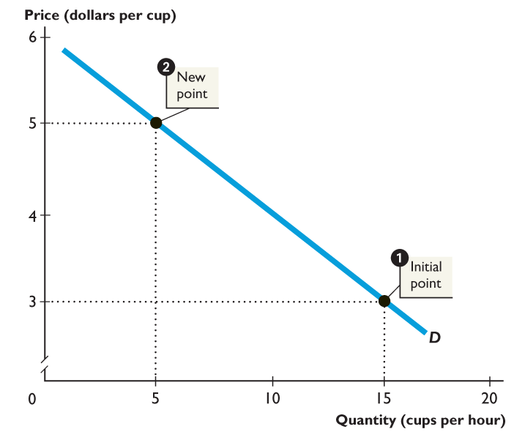
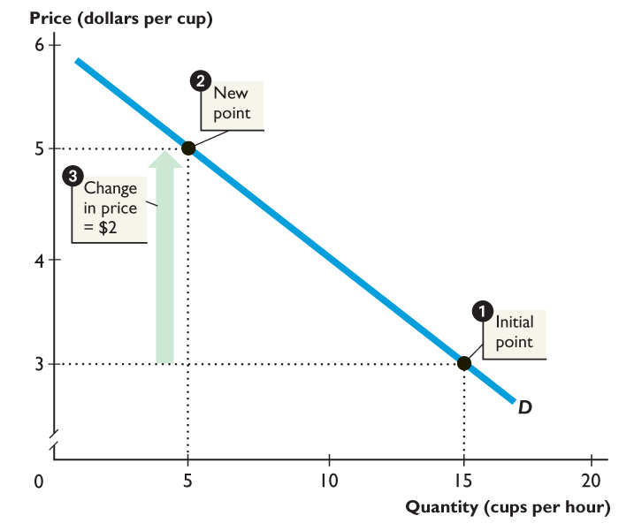
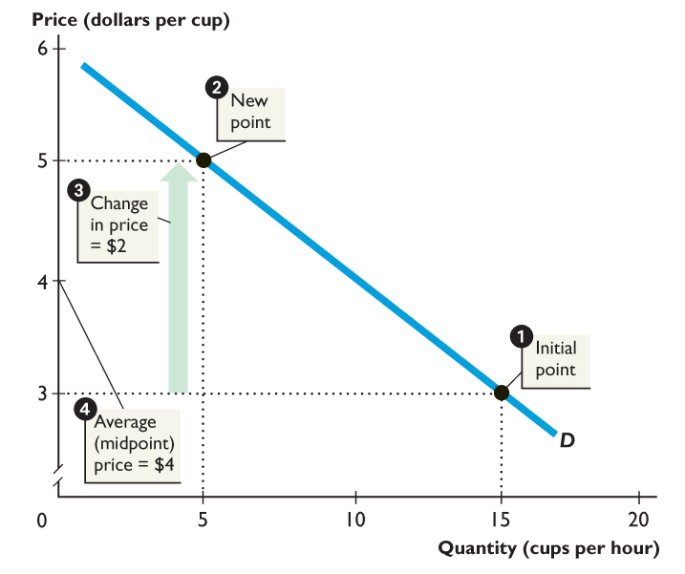
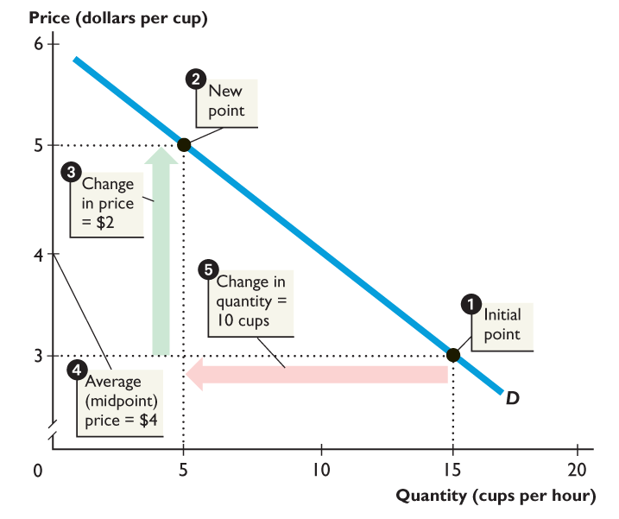
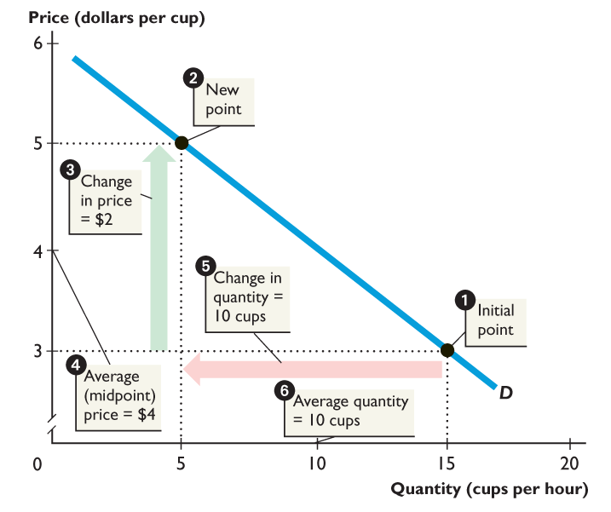
5.1 THE PRICE ELASTICITY OF DEMAND
Figure 5.2 shows the price elasticity of demand calculation.
The percentage change in the price equals ($2/$4) × 100, or 50%.
The percentage change in the quantity equals (10 cups/10 cups) × 100, or 100%.

Slide 23
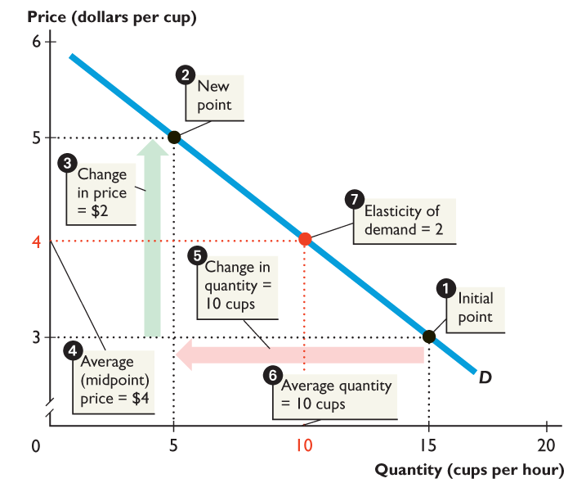
5.1 THE PRICE ELASTICITY OF DEMAND
The price elasticity of demand equals …
Percentage change in quantity ÷ Percentage change in price.
The price elasticity of demand equals 100% divided by 50%.
The price elasticity of demand is 2.

Slide 24
5.1 THE PRICE ELASTICITY OF DEMAND
That is:
We can use this formula to calculate the price elasticity of demand for a Starbucks latte:
Percentage change in quantity demanded
Price elasticity of demand
=
Percentage change in the price
100%
Price elasticity of demand
=
=
2
50%

Slide 25
5.1 THE PRICE ELASTICITY OF DEMAND
Interpreting the Price Elasticity of Demand Number
The elasticity of demand for a Starbucks latte of 2 tells us three things:
The demand for Starbucks lattes is elastic—it has substitutes and the proportion of a buyer’s income spent is small.
If Starbucks raised its price, revenue per cup will rise but it will lose potential business.
Even a slightly lower price could bring in more revenue.

Slide 26
5.1 THE PRICE ELASTICITY OF DEMAND
Elasticity Along a Linear Demand Curve
Slope measures responsiveness. But slope and elasticity are not the same thing!
Along a linear (straight-line) demand curve, the slope is constant but the elasticity varies.
Along a linear demand curve, demand is:
Unit elastic at the midpoint of the curve.
Elastic above the midpoint of the curve.
Inelastic below the midpoint of the curve.

Slide 27
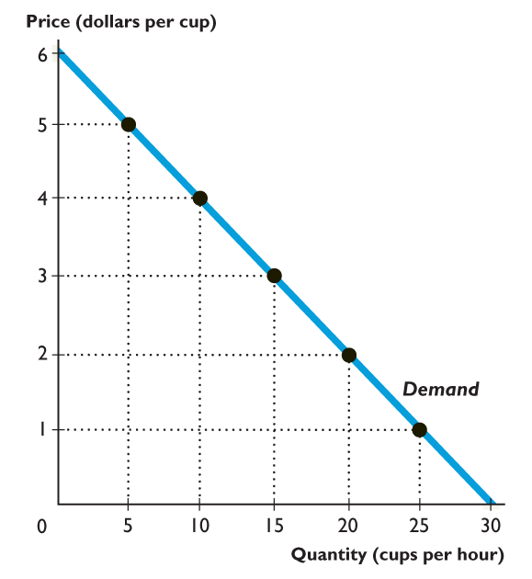
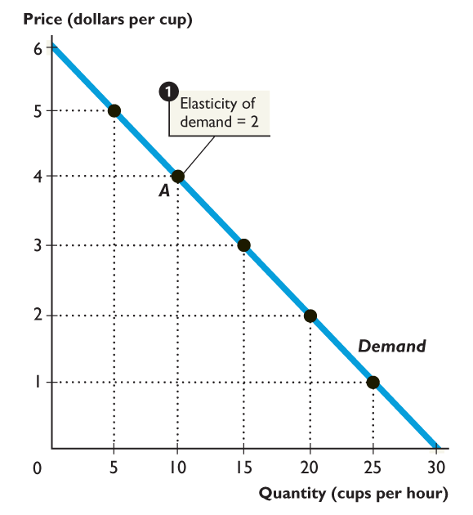
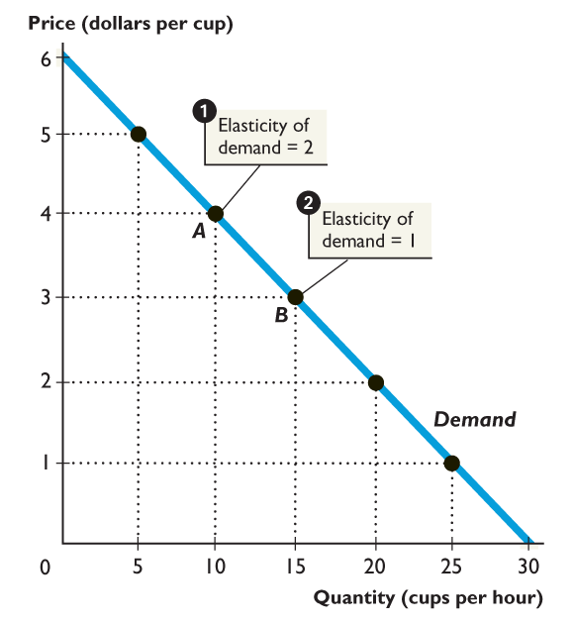
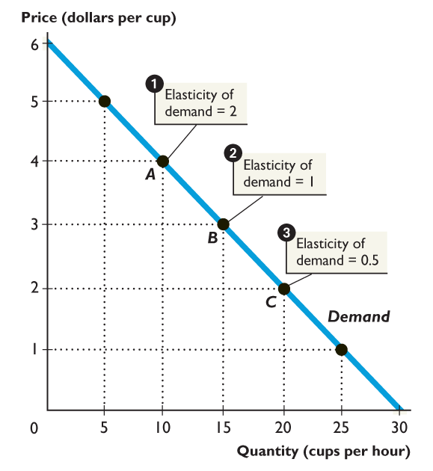
5.1 THE PRICE ELASTICITY OF DEMAND
Figure 5.3 shows that the elasticity decreases along a linear demand curve as the price falls.
At any price above the midpoint, demand is elastic.
At the midpoint, demand is unit elastic.
At any price below the midpoint, demand is inelastic.

Slide 28
5.1 THE PRICE ELASTICITY OF DEMAND
Total Revenue and the Price Elasticity of Demand
Total revenue is the amount spent on a good and received by its sellers and equals the price of the good multiplied by the quantity of the good sold.
Total revenue test is a method of estimating the price elasticity of demand by observing the change in total revenue that results from a price change.

Slide 29
5.1 THE PRICE ELASTICITY OF DEMAND
If demand is elastic:
A given percentage rise in price brings a larger percentage decrease in the quantity demanded.
Total revenue decreases.
If demand is inelastic:
A given percentage rise in price brings a smaller percentage decrease in the quantity demanded.
Total revenue increases.

Slide 30
5.1 THE PRICE ELASTICITY OF DEMAND
Total revenue test:
If price and total revenue change in the opposite directions, demand is elastic.
If a price change leaves total revenue unchanged, demand is unit elastic.
If price and total revenue change in the same direction, demand is inelastic.

Slide 31
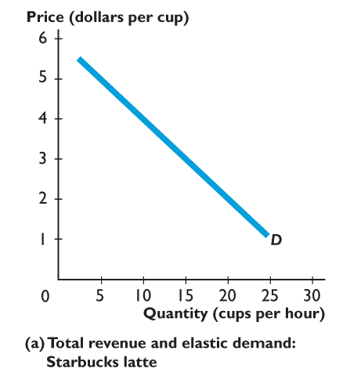
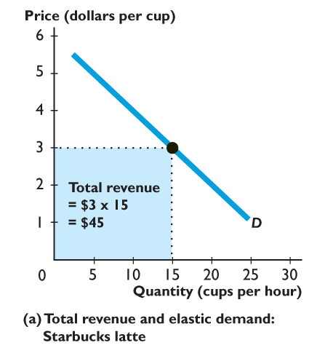
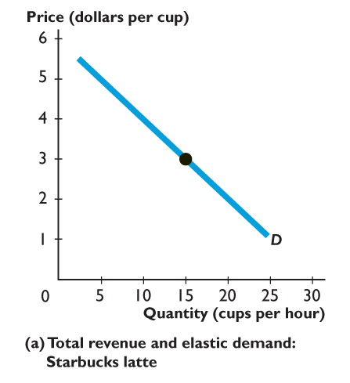
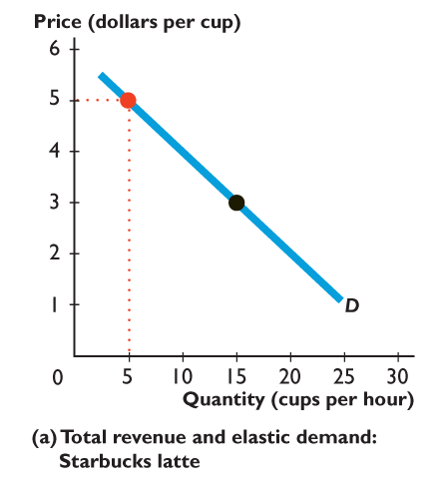
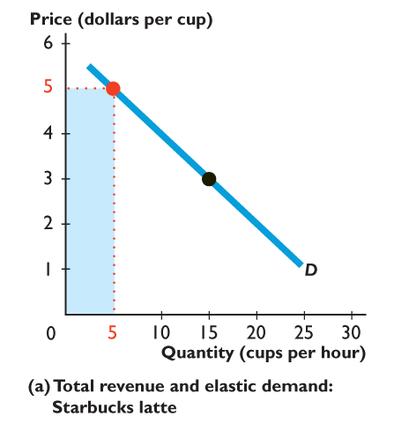
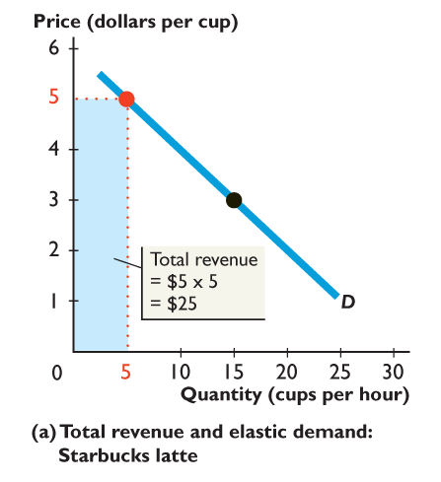
5.1 THE PRICE ELASTICITY OF DEMAND
Figure 5.4(a) shows total revenue and elastic demand.
At $3 a cup, the quantity demanded is 15 cups an hour.
Total revenue is $45 an hour.
When the price rises to $5 a cup, the quantity demanded decreases to 5 cups an hour.
Total revenue decreases to $25 an hour.
Demand is elastic.

Slide 32
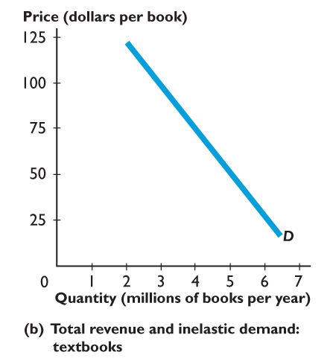
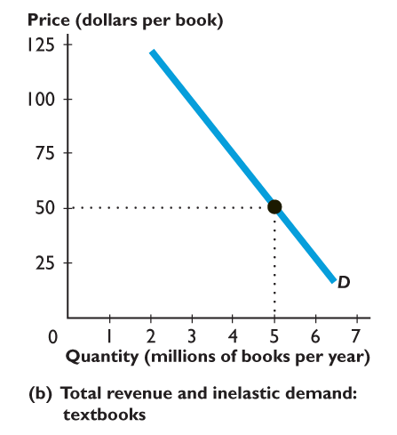
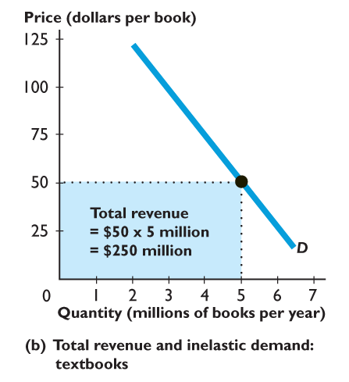

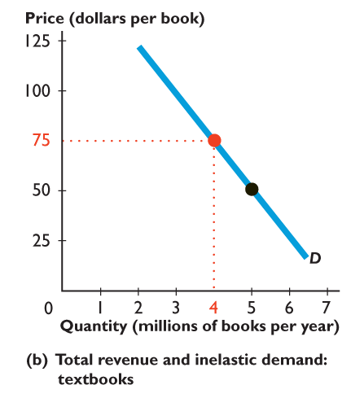
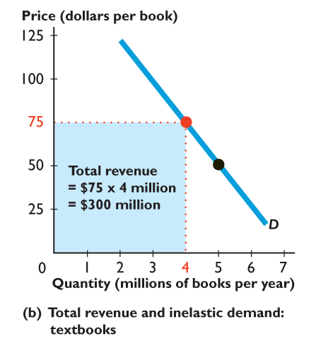
5.1 THE PRICE ELASTICITY OF DEMAND
Figure 5.4(b) shows total revenue and inelastic demand.
At $50 a book, the quantity demanded is 5 million books.
Total revenue is $250 million.
When the price rises to $75 a book, the quantity demanded decreases to 4 million books.
Total revenue increases to $300 million.
Demand is inelastic.

Slide 33
5.1 THE PRICE ELASTICITY OF DEMAND
Applications of the Price Elasticity of Demand
Orange Prices and Total Revenue
Price elasticity of demand for agricultural products (oranges) is 0.4.
So if a frost cuts the supply of oranges (and demand doesn’t change), a 1 percent decrease in the quantity harvested will lead to a 2.5 percent rise in the price.
Demand is inelastic and farmers’ total revenue will increase.

Slide 34
5.1 THE PRICE ELASTICITY OF DEMAND
Addiction and Elasticity
Nonusers’ demand for addictive substances is elastic.
A moderately higher price will lead to a substantially smaller number of people trying a drug.
Existing users’ demand for addictive substances is inelastic.
So even a substantial price rise brings only a modest decrease in the quantity demanded.

Slide 35
5.1 THE PRICE ELASTICITY OF DEMAND
High taxes on cigarettes and alcohol limit the number of young people who become habitual users of these products.
High taxes have only a modest effect on the quantities consumed by established users.

Slide 36
5.2 THE PRICE ELASTICITY OF SUPPLY
Price elasticity of supply is a measure of the extent to which the quantity supplied of a good changes when the price of the good changes.
To determine the price elasticity of supply, we compare the percentage change in the quantity supplied with the percentage change in price.

Slide 37
5.2 THE PRICE ELASTICITY OF SUPPLY
Elastic and Inelastic Supply
Supply is perfectly elastic if an almost zero percentage change in price brings a very large percentage change in the quantity supplied.
Supply is elastic if the percentage change in the quantity supplied exceeds the percentage change in price.

Slide 38
5.2 THE PRICE ELASTICITY OF SUPPLY
Supply is unit elastic if the percentage change in the quantity supplied equals the percentage change in price.
Supply is inelastic if the percentage change in the quantity supplied is less than the percentage change in price.
Supply is perfectly inelastic if the percentage change in the quantity supplied is zero when the price changes.

Slide 39
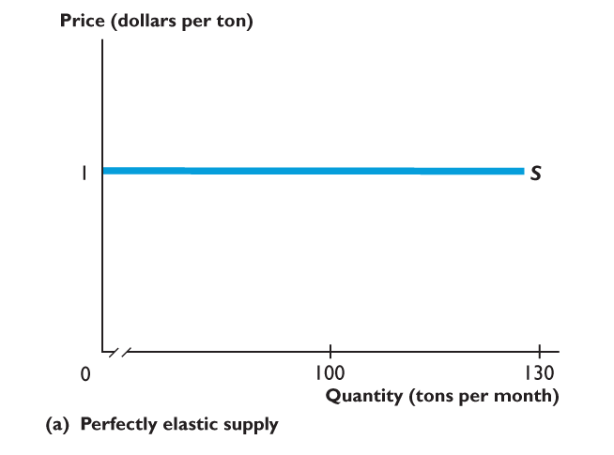
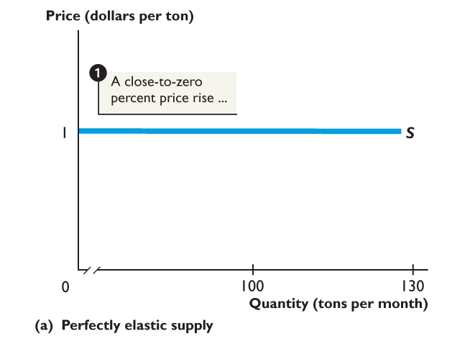
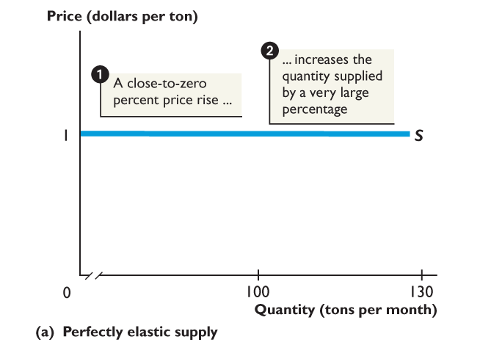
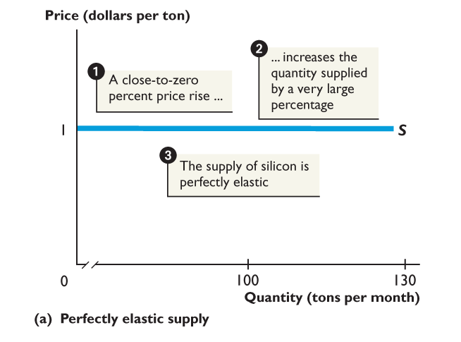
5.2 THE PRICE ELASTICITY OF SUPPLY
Figure 5.5(a) shows perfectly elastic supply.
A small rise in the price,
Increases the quantity supplied by a very large amount,
Supply is perfectly elastic.

Slide 40
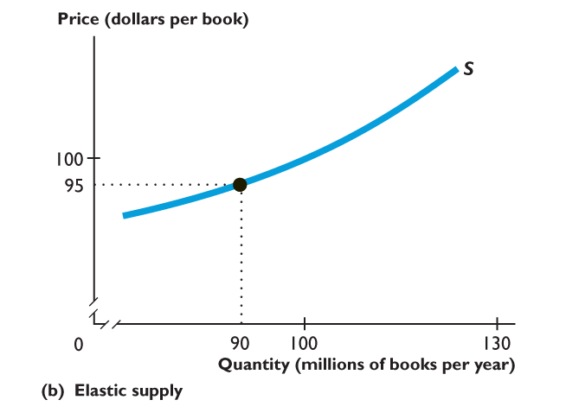
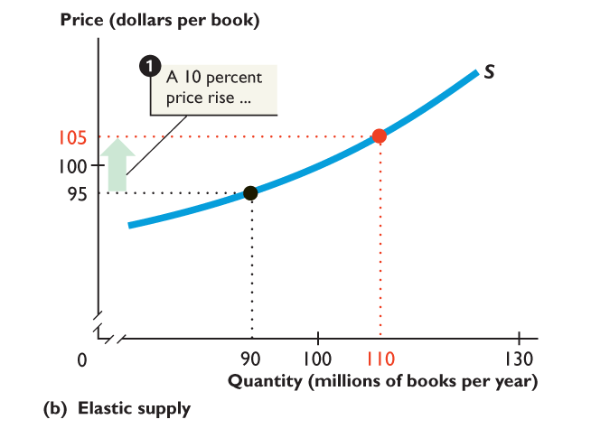
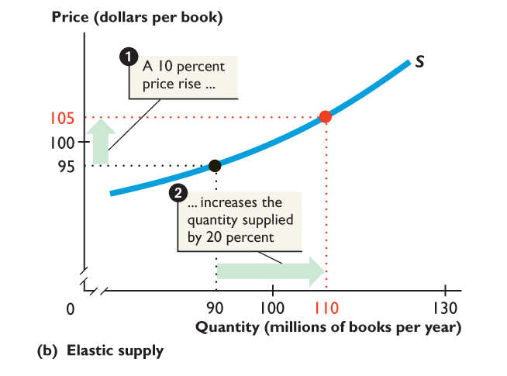

5.2 THE PRICE ELASTICITY OF SUPPLY
Figure 5.5(b) shows an elastic supply.
A 10% rise in the price of a book,
Increases the quantity of books supplied by 20%.
The supply of books is elastic.

Slide 41




5.2 THE PRICE ELASTICITY OF SUPPLY
Figure 5.5(c) shows a unit elastic supply.
A 10% rise in the price of fish,
Increases the quantity of fish supplied by 10%.
The supply of fish is unit elastic.

Slide 42




5.2 THE PRICE ELASTICITY OF SUPPLY
Figure 5.5(d) shows an inelastic supply.
A 20% rise in the price of a hotel room,
Increases the quantity of hotel rooms supplied by 10%.
The supply of hotel rooms is inelastic.

Slide 43




5.2 THE PRICE ELASTICITY OF SUPPLY
Figure 5.5(e) shows a perfectly inelastic supply.
The price of a beachfront lot rises by a small percentage.
The quantity of beachfront lots supplied increases by 0%.
The supply of beachfront lots is perfectly inelastic.

Slide 44
5.2 THE PRICE ELASTICITY OF SUPPLY
Influences on the Price Elasticity of Supply
The two main influences are:
Production possibilities
Storage possibilities
Production Possibilities
Goods that can be produced at a constant (or very gently rising) opportunity cost have an elastic supply.
Goods that can be produced in only a fixed quantity have a perfectly inelastic supply.

Slide 45
5.2 THE PRICE ELASTICITY OF SUPPLY
Time Elapsed Since Price Change
As time passes after a price change, producers find it easier to change their production plans, so supply becomes more elastic.
Storage Possibilities
The supply of a storable good is highly elastic.
The cost of storage is the main influence on the elasticity of supply of a storable good.

Slide 46
5.2 THE PRICE ELASTICITY OF SUPPLY
Computing the Price Elasticity of Supply
If the price elasticity of supply is greater than 1, supply is elastic.
If the price elasticity of supply equals 1, supply is unit elastic.
If the price elasticity of supply is less than 1, supply is inelastic.
Percentage change in quantity supplied
Price elasticity of supply
=
Percentage change in the price

Slide 47







5.2 THE PRICE ELASTICITY OF SUPPLY
Figure 5.6 shows how to calculate the price elasticity of supply.
Percentage change in the price equals $40/$60 × 100, or 66.67%.
Percentage change in the quantity equals 18 bouquets/15 bouquets × 100, or 120%.

Slide 48

5.2 THE PRICE ELASTICITY OF SUPPLY
The price elasticity of supply equals the Percentage change in the quantity ÷ Percentage change in the price.
The price elasticity of supply equals 120% ÷ 66.67%.
The price elasticity of supply is 1.8.

Slide 49
5.3 CROSS ELASTICITY AND INCOME ELASTICITY
Cross Elasticity of Demand
Cross elasticity of demand is a measure of the extent to which the demand for a good changes when the price of a substitute or complement changes, other things remaining the same.
Percentage change in quantity demanded of a good
Cross elasticity of demand
=
Percentage change in the price of one of its substitutes or complements

Slide 50
5.3 CROSS ELASTICITY AND INCOME ELASTICITY
Suppose that when the price of a burger falls by 10 percent, the quantity of pizza demanded decreases by 5 percent.
Cross elasticity of demand
– 5 percent
=
=
0.5
– 10 percent

Slide 51
5.3 CROSS ELASTICITY AND INCOME ELASTICITY
The cross elasticity of demand for a substitute is positive.
A fall in the price of a substitute of the good brings a decrease in the quantity demanded of the good.
The quantity demanded of the good and the price of its substitute change in the same direction.
The cross elasticity of demand for a complement is negative.
A fall in the price of a complement of the good brings an increase in the quantity demanded of the good.
The quantity demanded of the good and the price of one of its complements change in opposite directions.

Slide 52


5.3 CROSS ELASTICITY AND INCOME ELASTICITY
Figure 5.7 shows cross elasticity of demand.
Pizzas and burgers are substitutes. When the price of a burger falls, the demand for pizza decreases. Cross elasticity of demand is positive.

Slide 53

5.3 CROSS ELASTICITY AND INCOME ELASTICITY
Figure 5.7 shows cross elasticity of demand.
Pizzas and soda are complements. When the price of soda falls, the demand for pizza increases. Cross elasticity of demand is negative.

Slide 54
5.3 CROSS ELASTICITY AND INCOME ELASTICITY
Income Elasticity of Demand
Income elasticity of demand is a measure of the extent to which the demand for a good changes when income changes, other things remaining the same.
Income elasticity of demand
Percentage change in quantity demanded
=
Percentage change in income

Slide 55

If you are like most people, you complain when the price of a latte rises, but the first thing to do is look at the prices of a latte in other nearby coffee shops.
Suppose that their prices have not increased and you can get an acceptable latte for a lower price at Dunkin’ Doughnuts.
You decide to switch to Dunkin’ Doughnuts and keep drinking the same quantity of latte.
But soon though, all the coffee shops in your neighborhood have raised their price. Your daily latte is more expensive, so you go back to Starbucks for your latte.

Slide 56
Price Elasticity of Demand
We can translate your possible response to a hike in Starbucks’ price into estimates of your price elasticity of demand for Starbucks latte and for latte in general.
Close Substitutes
A Starbucks latte and a Dunkin’ Doughnuts latte are different, but for some people they are reasonably close substitutes.
So when Starbucks alone raises its price, the quantity sold by Starbucks changes a lot—the demand for a Starbucks latte is elastic.

Slide 57
Poor Substitutes
Later, when all the coffee shops have raised the price of a latte, you return to Starbucks but cut back a bit on your consumption of latte. Your price elasticity of demand for latte of all types is low—it is inelastic.
Latte, tea, and other drinks are poor substitutes.
So when the price of a latte rises, the quantity of latte bought decreases but not by very much—the demand for latte of all types is inelastic

