Slide 1

5
Efficiency and Equity
CHAPTER CHECKLIST
When you have completed your study of this chapter, you will be able to
1 Describe the alternative methods of allocating scarce resources, and define and explain the features of an efficient allocation.
2 Distinguish between value and price, and define consumer surplus.
3 Distinguish between cost and price, and define producer surplus.
Notes:
Notes and teaching tips: 5, 32, 39, 40, 41, 56, 57, 75, and 78.
To view a full-screen figure during a class, click the red “expand” button.
To return to the previous slide, click the red “shrink” button.
To advance to the next slide, click anywhere on the full screen figure.
To enhance your lecture, check out the Lecture Launchers, Land Mines, and Class Activities in the Instructor’s Manual.

Slide 2
When you have completed your study of this chapter, you will be able to
4 Evaluate the efficiency of the alternative methods of allocating resources.
5 Explain the main ideas about fairness, and evaluate the fairness of alternative methods of allocating scarce resources.

Slide 3
6.1 ALLOCATION METHODS AND EFFICIENCY
Resource Allocation Methods
Scarce resources might be allocated by
How does each method work?
Market price
Command
Majority rule
Contest
First-come, first-served
Sharing equally
Lottery
Personal characteristics
Force
Notes:
Make the discussion of this topic concrete and real. Come to class with something of low but positive value that you’ve going to end up giving to a student. How will the decision about who gets the object be made?
Make the class debate the pros and cons of each of the methods.
If you did the demand curve experiment, remind the class that market price allocated the bottles of water.
The question now is does market price do a good job?

Slide 4
6.1 ALLOCATION METHODS AND EFFICIENCY
Market Price
When a market allocates a scarce resource, the people who get the resource are those who are willing to pay the market price.
Most of the scarce resources that you supply get allocated by market price.
You sell your labor services in a market, and you buy most of what you consume in markets.
For most goods and services, the market turns out to do a good job.

Slide 5
6.1 ALLOCATION METHODS AND EFFICIENCY
Command
Command system allocates resources by the order (command) of someone in authority.
For example, if you have a job, most likely someone tells you what to do. Your labor time is allocated to specific tasks by command.
A command system works well in organizations with clear lines of authority but badly in an entire economy.

Slide 6
6.1 ALLOCATION METHODS AND EFFICIENCY
Majority Rule
Majority rule allocates resources in the way that a majority of voters choose.
Societies use majority rule for decisions about tax rates that allocate resources between private and public use and tax dollars between competing uses such as defense and health care.
Majority rule works well when the decision affects lots of people and self-interest must be suppressed to use resources efficiently.

Slide 7
6.1 ALLOCATION METHODS AND EFFICIENCY
Contest
A contest allocates resources to a winner (or group of winners).
The most obvious contests are sporting events but they occur in other arenas:
For example, the Oscars are a type of contest.
Contest works well when the efforts of the “players” are hard to monitor and reward directly.

Slide 8
6.1 ALLOCATION METHODS AND EFFICIENCY
First-Come, First-Served
A first-come, first-served allocates resources to those who are first in line.
Casual restaurants use first-come, first served to allocate tables. Supermarkets use first-come, first-served at checkout. Airlines use first-come, first-served to allocate standby seats.
First-come, first-served works best when scarce resources can serve just one person at a time in a sequence.

Slide 9
6.1 ALLOCATION METHODS AND EFFICIENCY
Sharing Equally
When a resource is shared equally, everyone gets the same amount of it.
You might use this method to share a dessert in a restaurant.
To make sharing equally work, people must be in agreement about its use and implementation.
It works best for small groups who share common goals and ideals.

Slide 10
6.1 ALLOCATION METHODS AND EFFICIENCY
Lottery
Lotteries allocate resources to those with the winning number, draw the lucky cards, or come up lucky.
State lotteries and casinos reallocate millions of dollars worth of goods and services each year, but lotteries are more widespread.
For example, tickets to Michael Jackson’s memorial service were allocated by lottery.
Lotteries work well when there is no effective way to distinguish among potential users of a scarce resource.

Slide 11
6.1 ALLOCATION METHODS AND EFFICIENCY
Personal Characteristics
Personal characteristics allocate resources to those with the “right” characteristics.
For example, people choose marriage partners on the basis of personal characteristics.
But this method gets used in unacceptable ways: allocating the best jobs to white males and discriminating against minorities and women.

Slide 12
6.1 ALLOCATION METHODS AND EFFICIENCY
Force
Force plays a role in allocating resources.
For example, war has played an enormous role historically in allocating resources.
Theft, the taking property of others without their consent, also plays a large role.
But force provides an effective way of allocating resources—for the state to transfer wealth from the rich to the poor and establish the legal framework in which voluntary exchange can take place in markets.

Slide 13
6.1 ALLOCATION METHODS AND EFFICIENCY
Using Resources Efficiently
Allocative efficiency is a situation in which the quantities of goods and services produced are those that people value most highly.
It is not possible to produce more of one good or service without producing less of something else.
Efficiency and the PPF
Production efficiency—producing on PPF
Producing at the highest-valued point on PPF
The PPF tells us what can be produced, but the PPF does not tell us about the value of what we produce.

Slide 14
6.1 ALLOCATION METHODS AND EFFICIENCY
Marginal Benefit
Marginal benefit is the benefit that a person receives from consuming one more unit of a good or service.
People’s preferences determine marginal benefit.
The marginal benefit from a good is what people are willing to forgo to get one more unit of the good.
Marginal benefit decreases as the quantity of the good increases—the principle of decreasing marginal benefit.

Slide 15
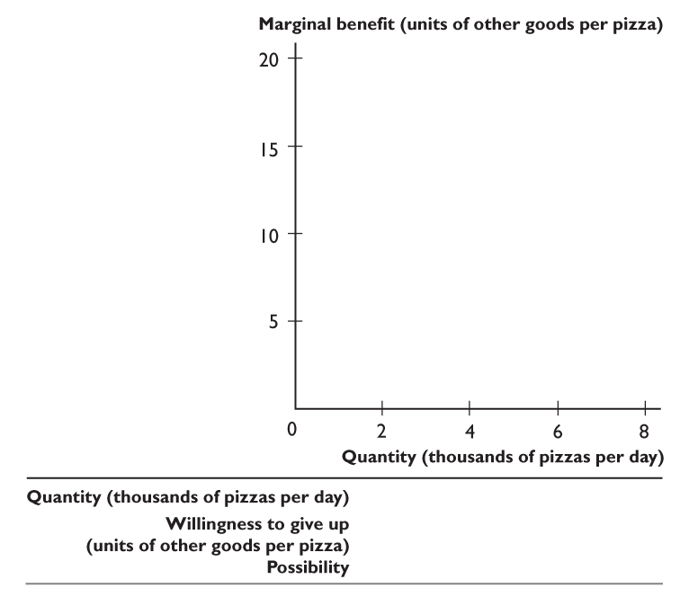
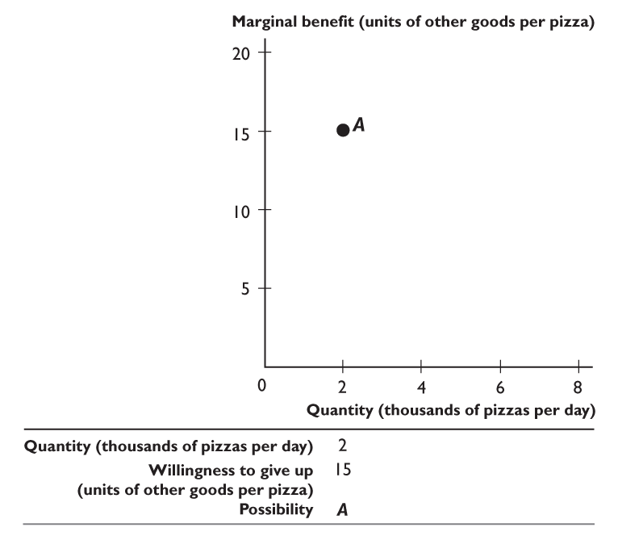
6.1 ALLOCATION METHODS AND EFFICIENCY
Possibility A and point A tell us that if we produce 2,000 pizzas a day, …
people are willing to give up 15 units of other goods and services to get one more pizza.

Slide 16
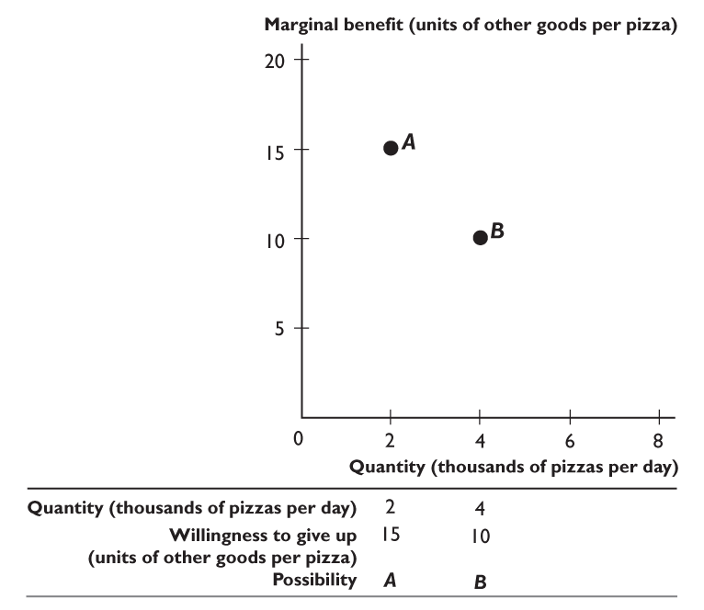
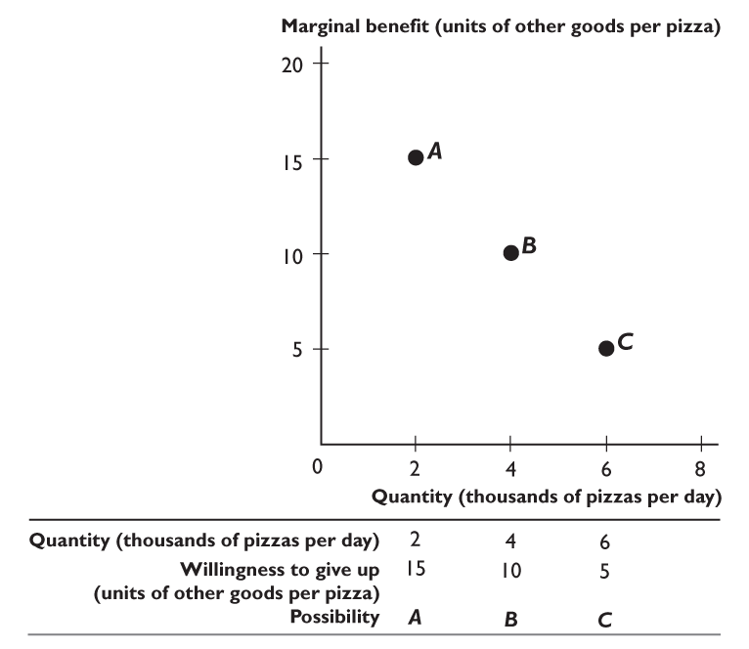
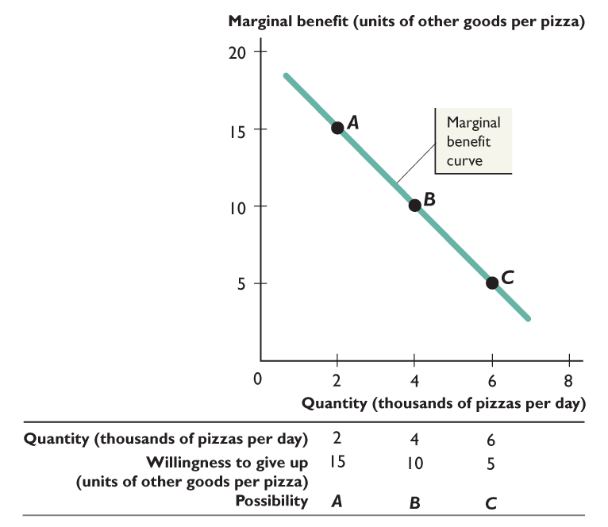

Slide 17
6.1 ALLOCATION METHODS AND EFFICIENCY
Point B tells us that if we produce 4,000 pizzas a day,
people are willing to give up 10 units of other goods and services to get one more pizza.

Slide 18
6.1 ALLOCATION METHODS AND EFFICIENCY
Point C tells us that if we produce 6,000 pizzas a day,
people are willing to give up 5 units of other goods and services to get one more pizza.
The line through points A, B, and C is the marginal benefit curve.

Slide 19
6.1 ALLOCATION METHODS AND EFFICIENCY
Marginal Cost
Marginal cost is the opportunity cost of producing one more unit of a good or service and is measured by the slope of the PPF.
The marginal cost of producing a good increases as more of the good is produced.
The marginal cost curve shows the amount of other goods and services that we must give up to produce one more pizza.

Slide 20
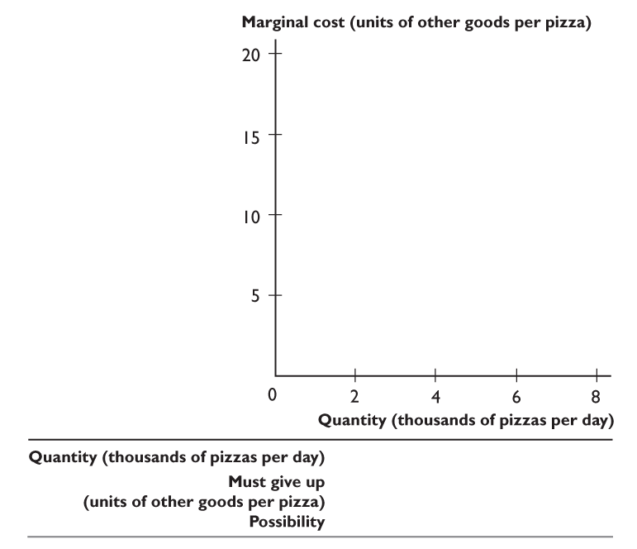
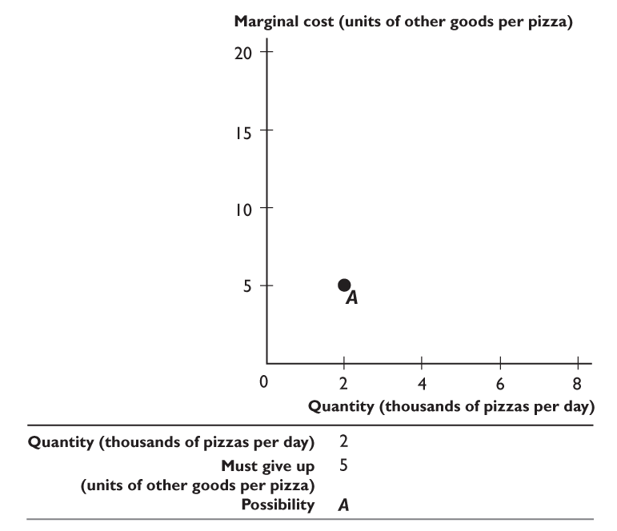
6.1 ALLOCATION METHODS AND EFFICIENCY
Possibility A and point A tell us that if we produce 2,000 pizzas a day,
we must give up 5 units of other goods and services to produce one more pizza.

Slide 21
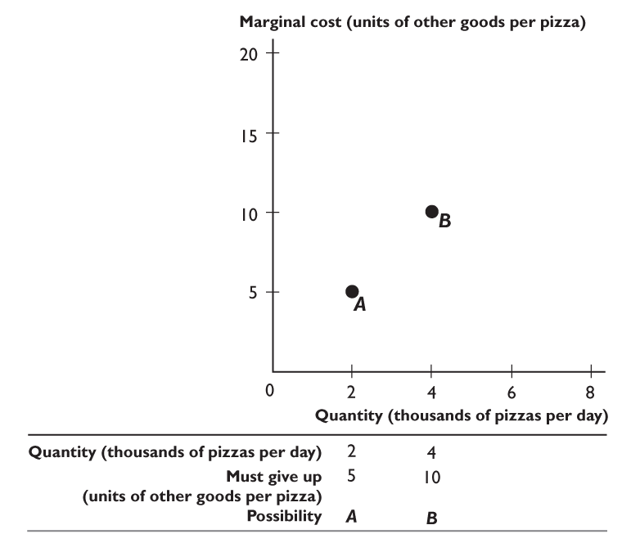
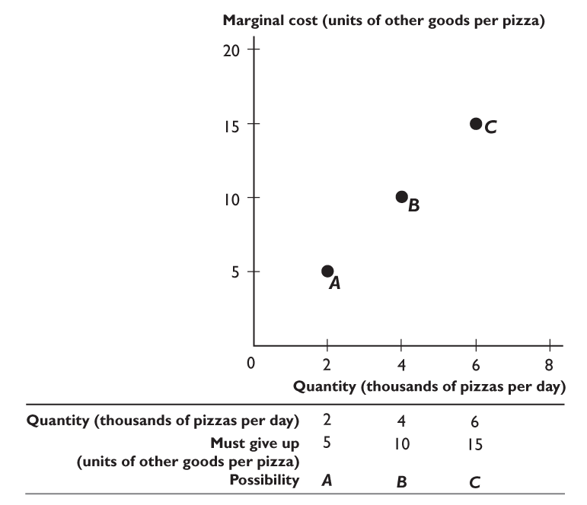
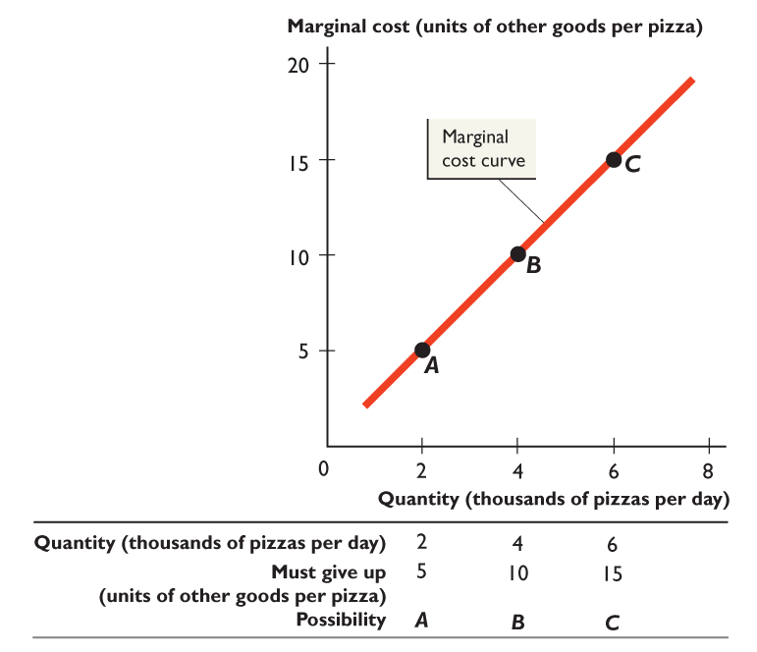

Slide 22
6.1 ALLOCATION METHODS AND EFFICIENCY
Point B tells us that if we produce 4,000 pizzas a day,
we must give up 10 units of other goods and services to produce one more pizza.

Slide 23
6.1 ALLOCATION METHODS AND EFFICIENCY
Point C tells us that if we produce 6,000 pizzas a day,
we must give up 15 units of other goods and services to produce one more pizza.
The line through points A, B, and C is the marginal cost curve.

Slide 24
6.1 ALLOCATION METHODS AND EFFICIENCY
Efficient Allocation
The efficient allocation is the highest-valued allocation.
That is, the allocation is efficient if it is not possible to produce more of any good without producing less of something else that is valued more highly.
To find the efficient allocation, we compare marginal benefit and marginal cost.
Figure 6.3 on the next slide shows the efficient quantity of pizzas.

Slide 25
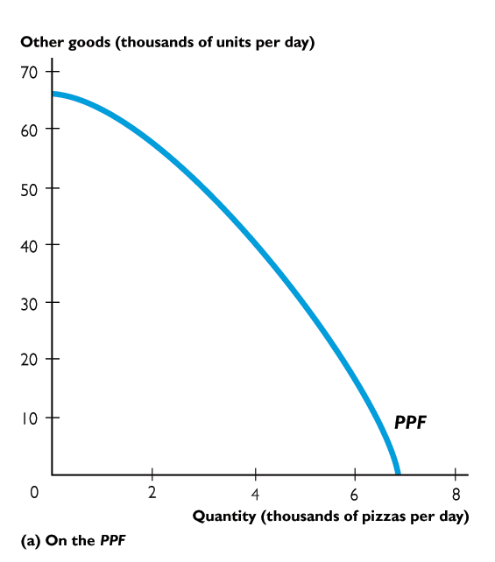
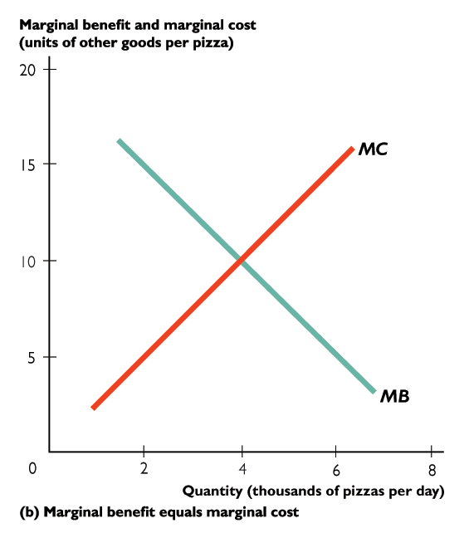
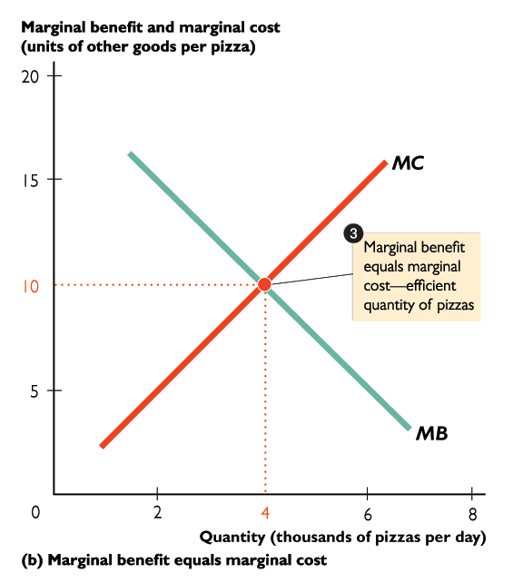
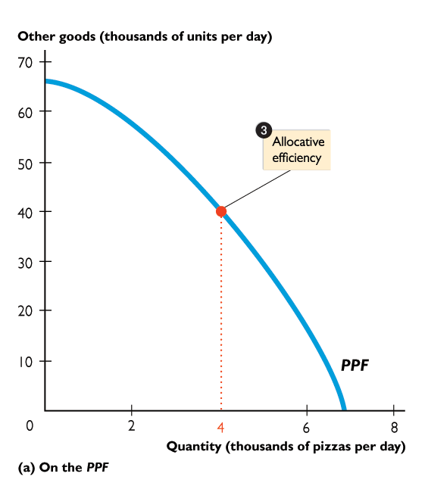
6.1 ALLOCATION METHODS AND EFFICIENCY
Production efficiency occurs at all points on the PPF.
Allocative efficiency occurs at the intersection of the marginal benefit curve (MB) and the marginal cost curve (MC).
Allocative efficiency occurs at only one point on the PPF.

Slide 26

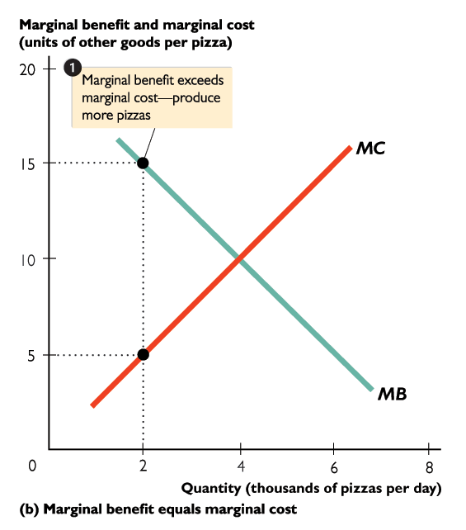
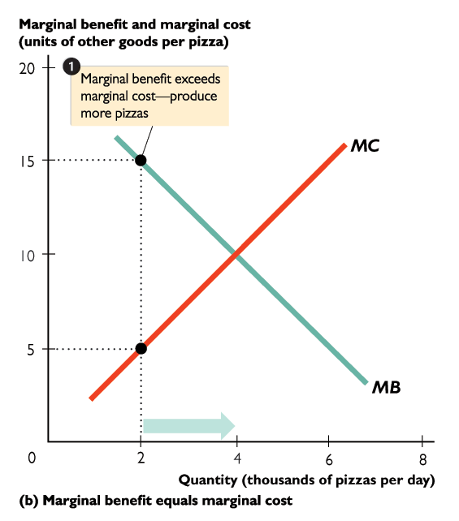
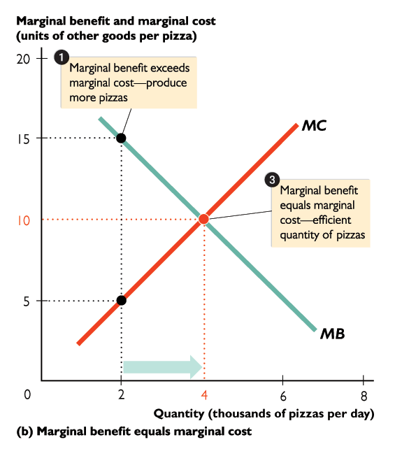
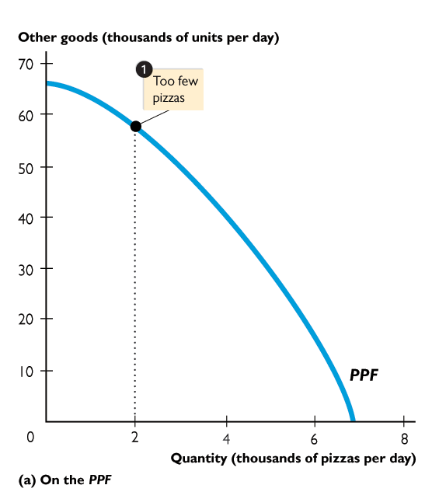
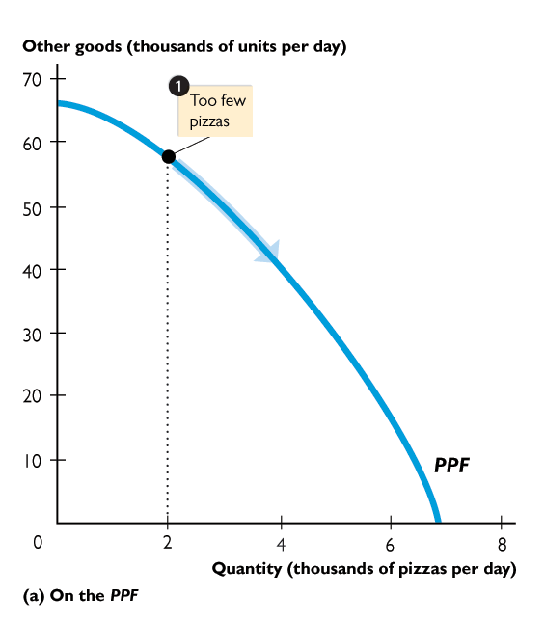
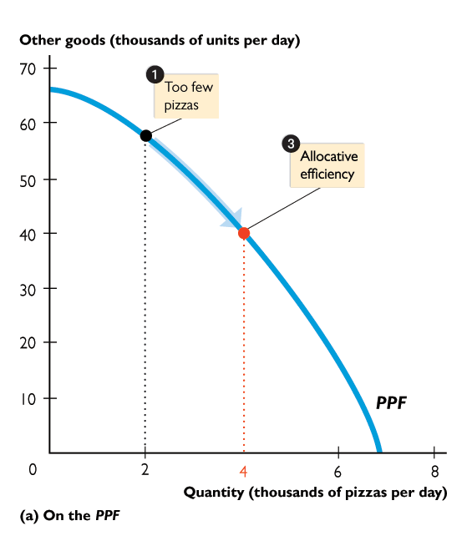
6.1 ALLOCATION METHODS AND EFFICIENCY
When 2,000 pizzas are produced, marginal benefit exceeds marginal cost,
so the efficient quantity is larger.
Too few pizzas are being produced.
Increase the quantity of pizzas by moving along the PPF.

Slide 28
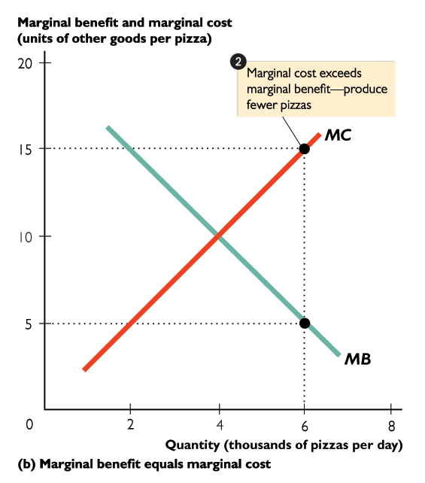
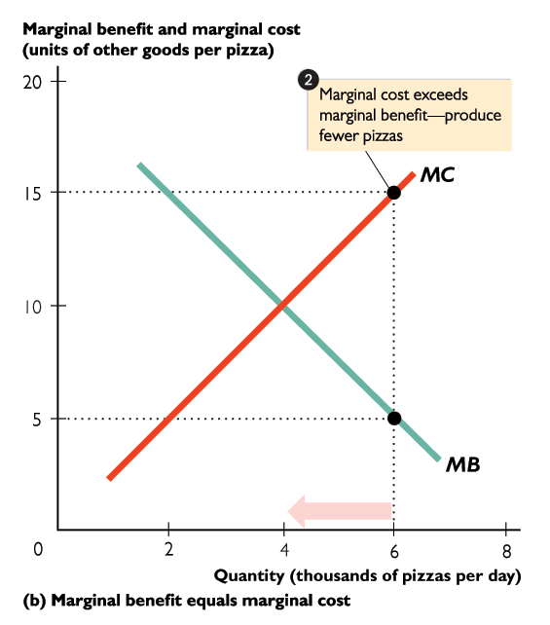
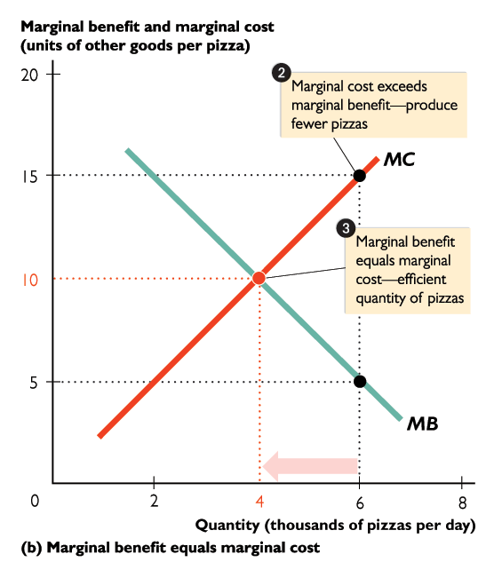
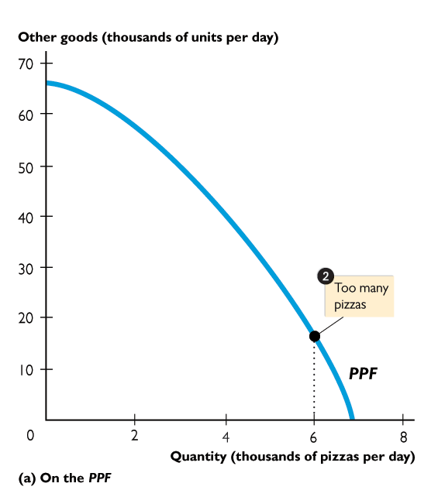
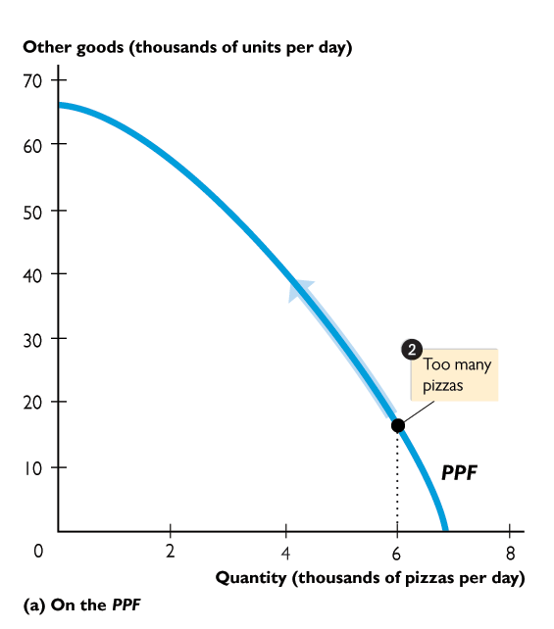
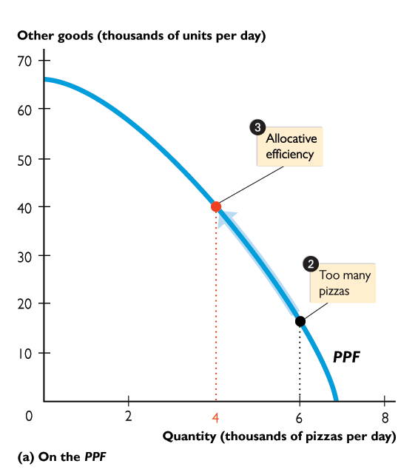
6.1 ALLOCATION METHODS AND EFFICIENCY
When 6,000 pizzas are produced, marginal cost exceeds marginal benefit,
so the efficient quantity is smaller.
Too many pizzas are being produced.
Decrease the quantity of pizzas by moving along the PPF.

Slide 30
6.2 VALUE, PRICE, AND CONSUMER SURPLUS
Demand and Marginal Benefit
Buyers distinguish between value and price.
Value is what the buyer gets.
Price is what the buyer pays.
The value of one more unit of a good or service is its marginal benefit.
Marginal benefit can be measured as the maximum price that people are willing to pay for another unit of the good or service.
Notes:
Draw a demand curve and emphasize its two interpretations.
Use numbers for the price and quantity to make the otherwise abstract discussion more concrete.

Slide 31
6.2 VALUE, PRICE, AND CONSUMER SURPLUS
The consumer will buy one more unit of a good or service if its price is less than or equal to the value the consumer places on it.
A demand curve is a marginal benefit curve.
For example, the demand curve for pizzas tells us the dollars worth of other goods and services that people are willing to forgo to consume one more pizza.
That is, the demand curve for pizzas shows the value the consumer places on each pizza.

Slide 32
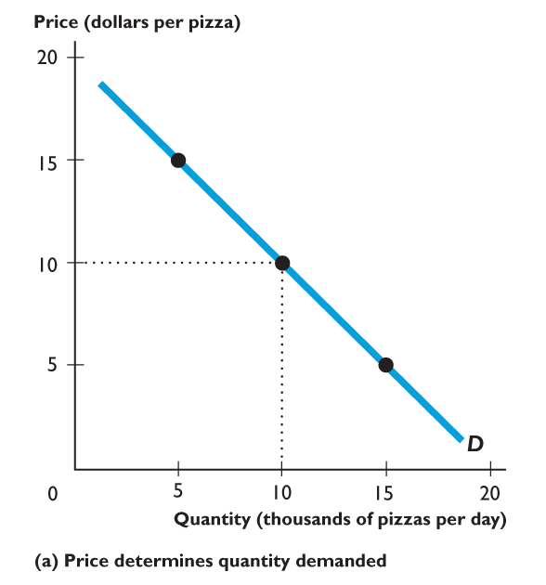
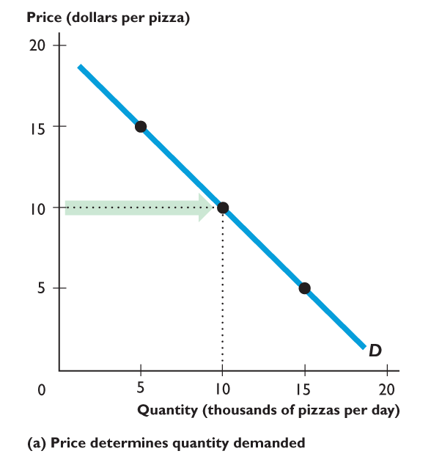
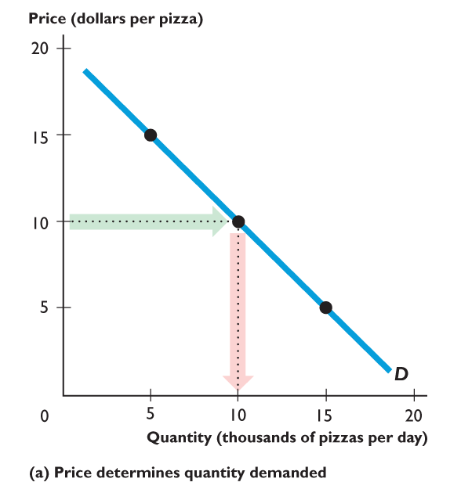
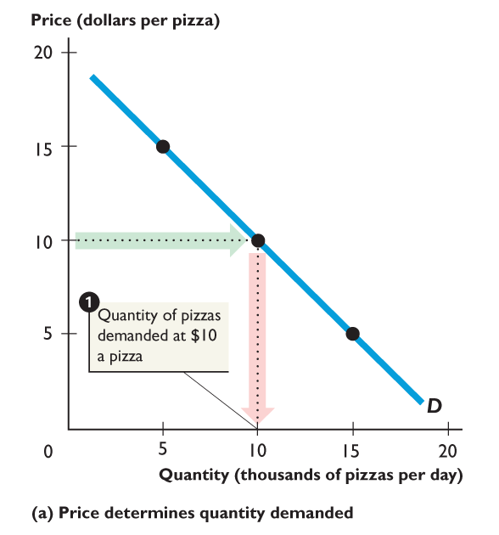
6.2 VALUE, PRICE, AND CONSUMER SURPLUS
Figure 6.4 shows demand, willingness to pay, and marginal benefit.
The demand curve shows:
The quantity demanded at each price, other things remaining the same.

Slide 34
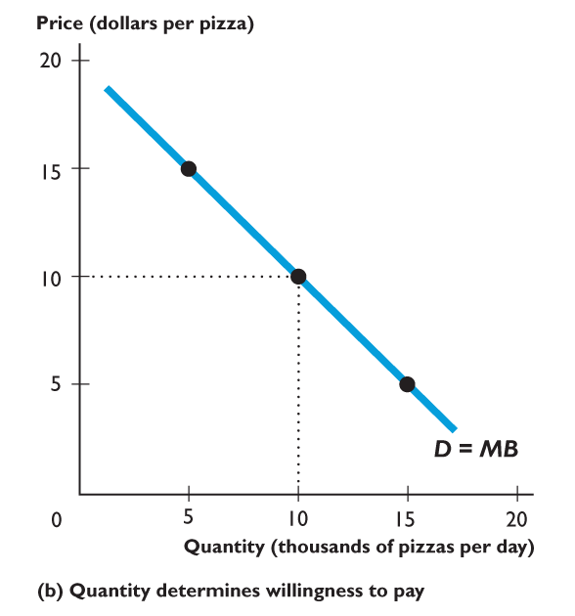
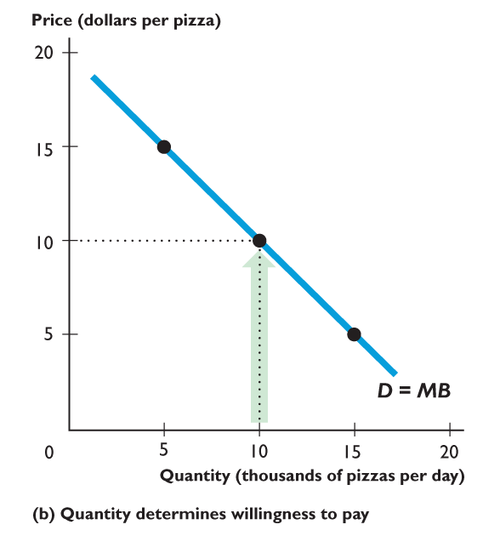
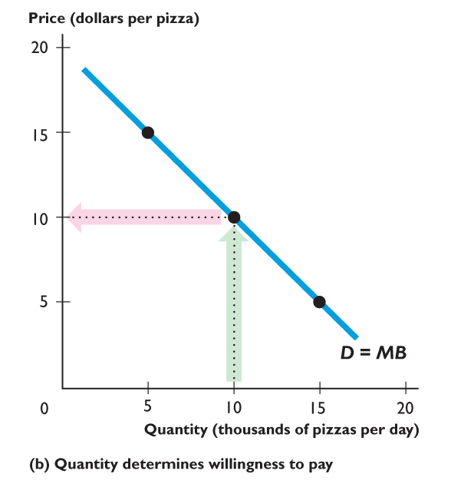
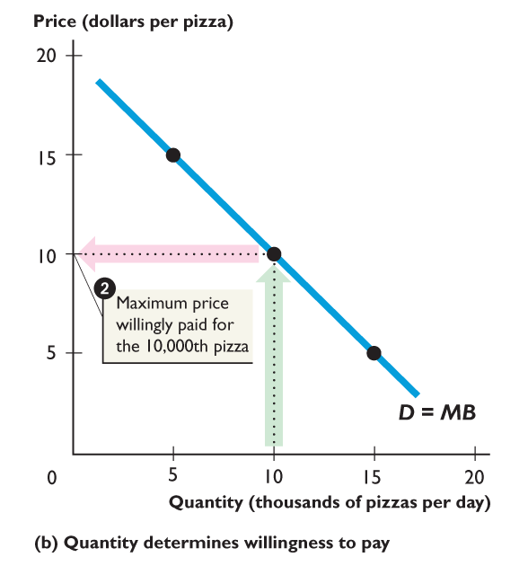
6.2 VALUE, PRICE, AND CONSUMER SURPLUS
Figure 6.4 shows demand, willingness to pay, and marginal benefit.
The demand curve shows:
The maximum price willingly paid for the last pizza available.

Slide 36
6.2 VALUE, PRICE, AND CONSUMER SURPLUS
Consumer Surplus
Consumer surplus is the marginal benefit from a good or service minus the price paid for it, summed over the quantity consumed.
Figure 6.5 on the next slide shows the consumer surplus from pizzas.

Slide 37
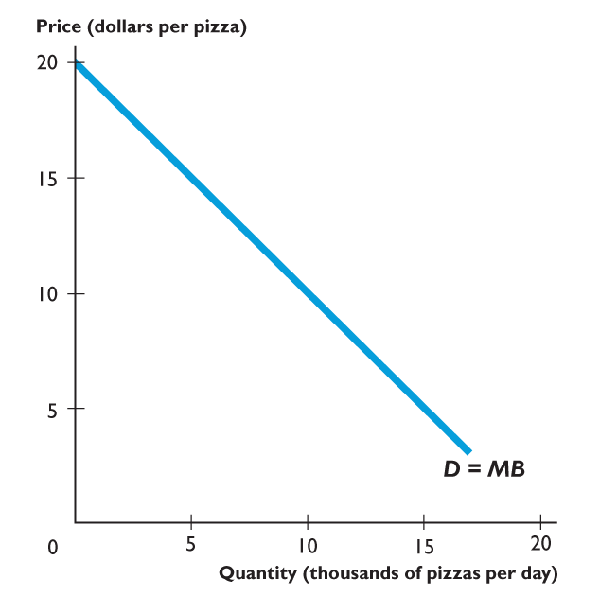
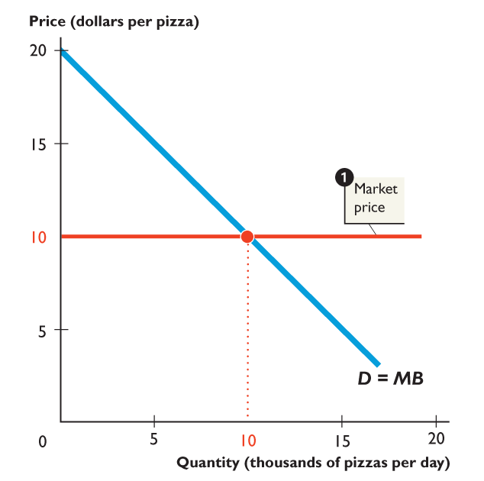
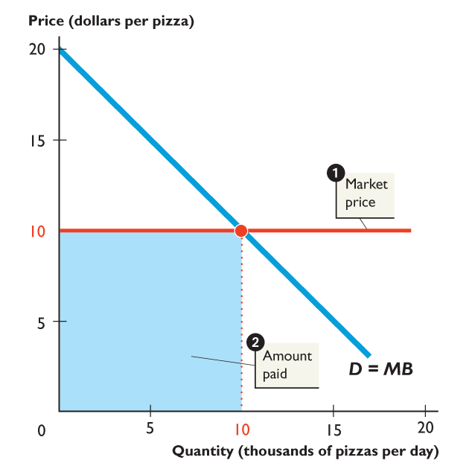
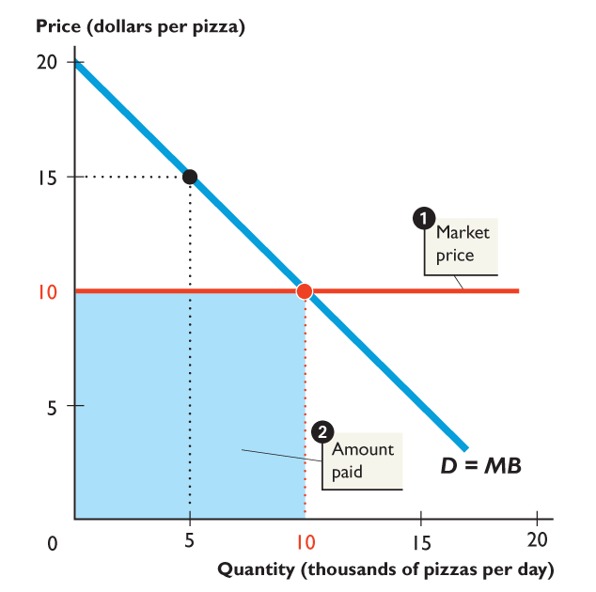
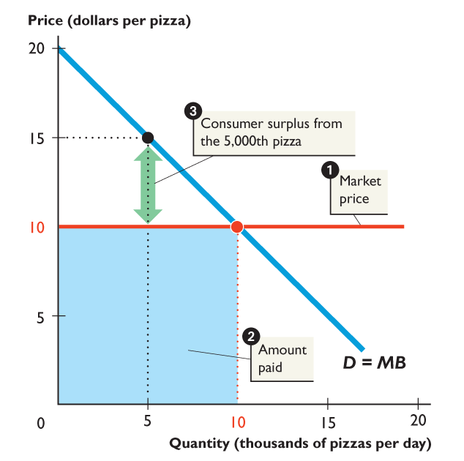
6.2 VALUE, PRICE, AND CONSUMER SURPLUS
The market price of a pizza is $10.
People buy 10,000 pizzas and spend $100,000 a day on pizzas.
But people are willing to pay $15 for the 5,000th pizza, so consumer surplus from that pizza is $5.
Notes:
The consumer surplus, producer surplus, and deadweight loss are all generally triangular in shape. Indeed, if you draw only linear demand and supply curves and do not make either curve vertical or horizontal, these surpluses and any deadweight loss are triangles. So, it is a good idea to remind your students of the formula for calculating the area of a triangle. Make sure to do several examples of the calculation for both consumer and producer surplus. Remind them that this area represents a dollar value. This reminder is especially useful when you quantify the deadweight losses created by monopolies, quotas, subsidies, etc. Many students just see the loss to society as a loss of jobs or less output, but you can create more intuition by putting the loss in dollar terms.

Slide 38
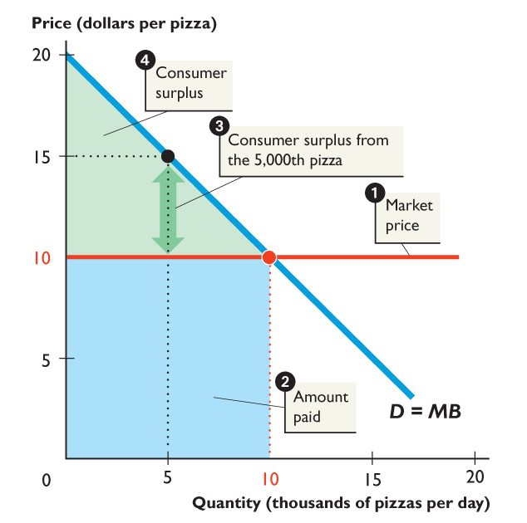
Notes:
It always helps to use colored chalk, overheads, or PowerPoint slides when dividing up the demand-supply graph into producer surplus, consumer surplus, and deadweight loss. By using colored chalk or the other techniques, you can refer to area by color.
In the text and PPT slides, we use color consistently:
Consumer surplus is green
Producer surplus is blue
Total expenditure is blue
Total cost is red
Deadweight loss is gray.

Slide 39
6.2 VALUE, PRICE, AND CONSUMER SURPLUS
Consumer surplus from the 10,000 pizzas that people buy is the area of the green triangle.
Consumer surplus from pizzas is $50,000.
The total benefit from pizzas is $150,000—the $100,000 that people spend on pizzas plus the $50,000 of consumer surplus.
Notes:
The consumer surplus, producer surplus, and deadweight loss are all generally triangular in shape. Indeed, if you draw only linear demand and supply curves and do not make either curve vertical or horizontal, these surpluses and any deadweight loss are triangles. So, it is a good idea to remind your students of the formula for calculating the area of a triangle. Make sure to do several examples of the calculation for both consumer and producer surplus. Remind them that this area represents a dollar value. This reminder is especially useful when you quantify the deadweight losses created by monopolies, quotas, subsidies, etc. Many students just see the loss to society as a loss of jobs or less output, but you can create more intuition by putting the loss in dollar terms.

Slide 40
6.3 COST, PRICE, AND PRODUCER SURPLUS
Supply and Marginal Cost
Sellers distinguish between cost and price.
Cost is what a seller must give up to produce the good.
Price is what a seller receives when the good is sold.
The cost of producing one more unit of a good or service is its marginal cost.

Slide 41
6.3 COST, PRICE, AND PRODUCER SURPLUS
The seller will produce one more unit of a good or service if the price for which it can be sold exceeds or equals its marginal cost.
A supply curve is a marginal cost curve.
For example, the supply curve of pizzas tells us the dollars worth of other goods and services that firms must forgo to produce one more pizza.
That is, the supply curve of pizzas shows the seller’s cost of producing each unit of pizza.

Slide 42
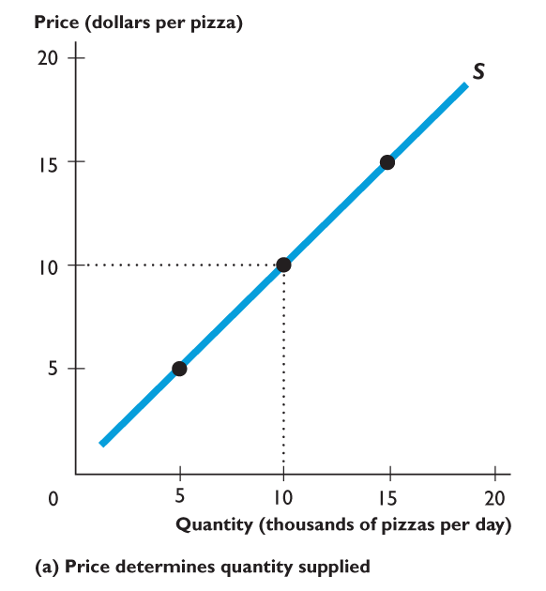
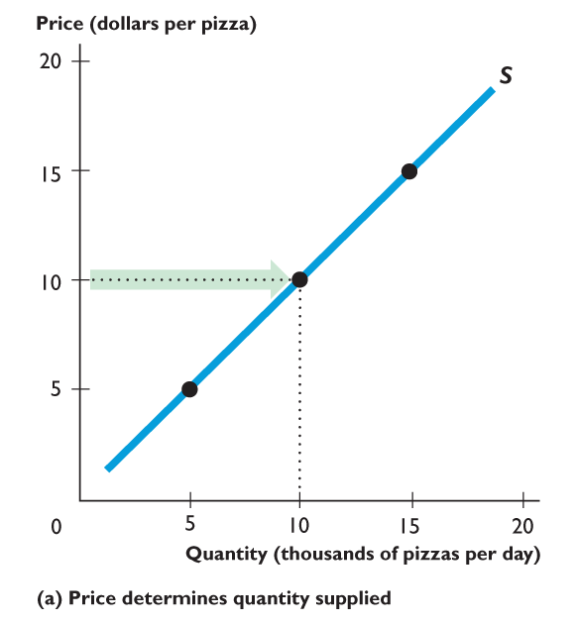
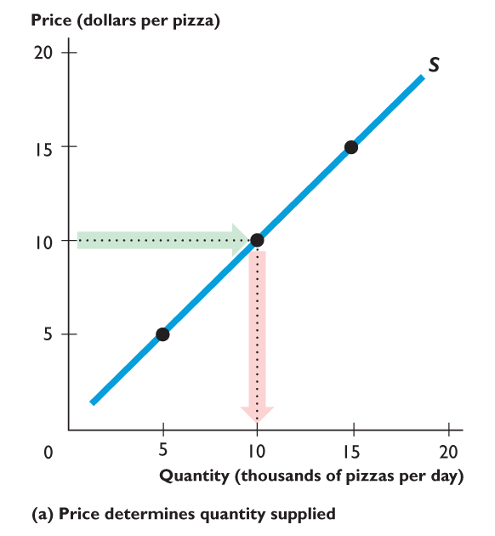
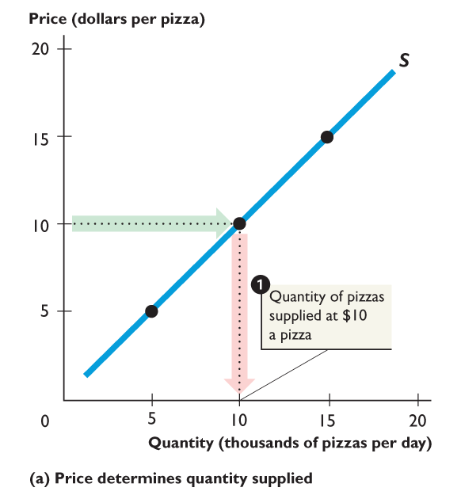
6.3 COST, PRICE, AND PRODUCER SURPLUS
Figure 6.6 shows supply, minimum supply price, and marginal cost.
The supply curve shows:
The quantity supplied at each price, other things remaining the same.

Slide 44
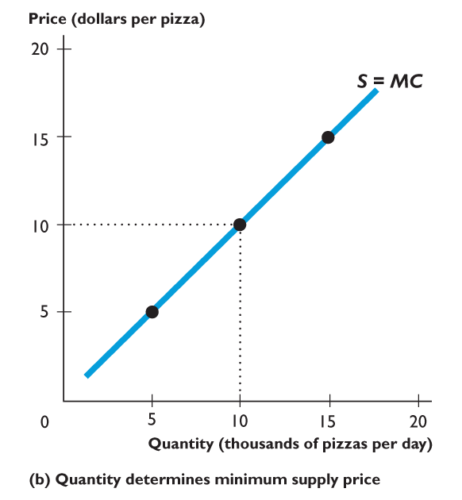
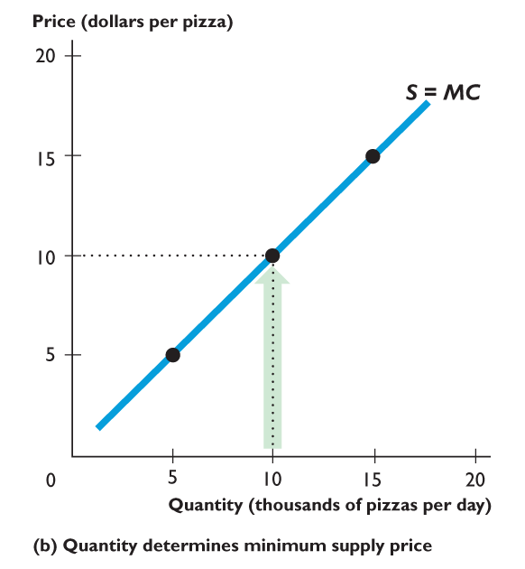
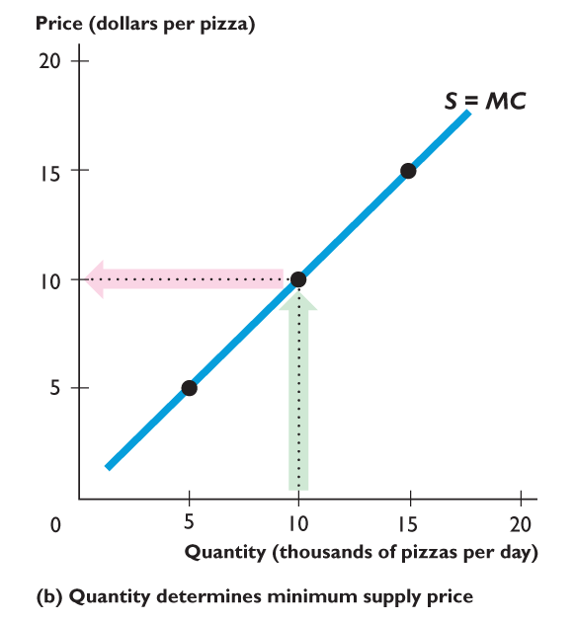
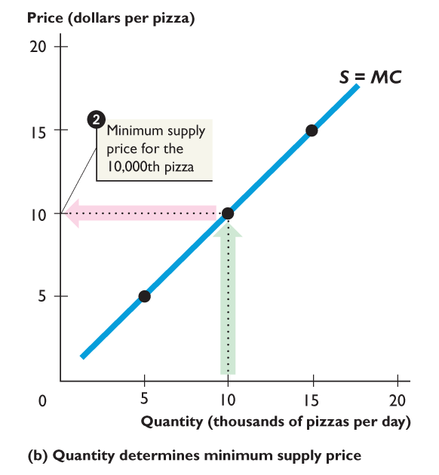
6.3 COST, PRICE, AND PRODUCER SURPLUS
Figure 6.6 shows supply, minimum supply price, and marginal cost.
The supply curve shows:
The quantity supplied at each price, other things remaining the same.
The minimum price that firms must be offered to supply a given quantity of pizzas.

Slide 46
6.3 COST, PRICE, AND PRODUCER SURPLUS
Producer Surplus
Producer surplus is the price of a good minus the opportunity cost of producing it, summed over the quantity produced.
Figure 6.7 shows the producer surplus for pizza producers.

Slide 47
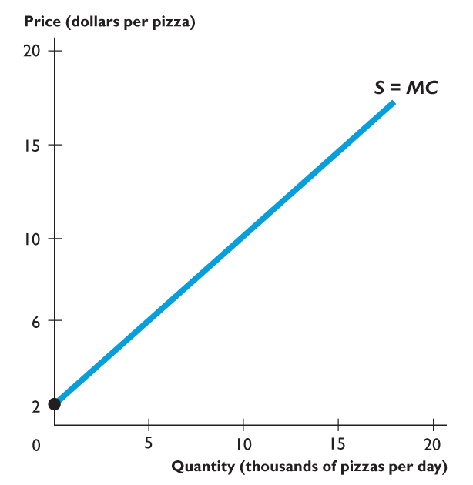
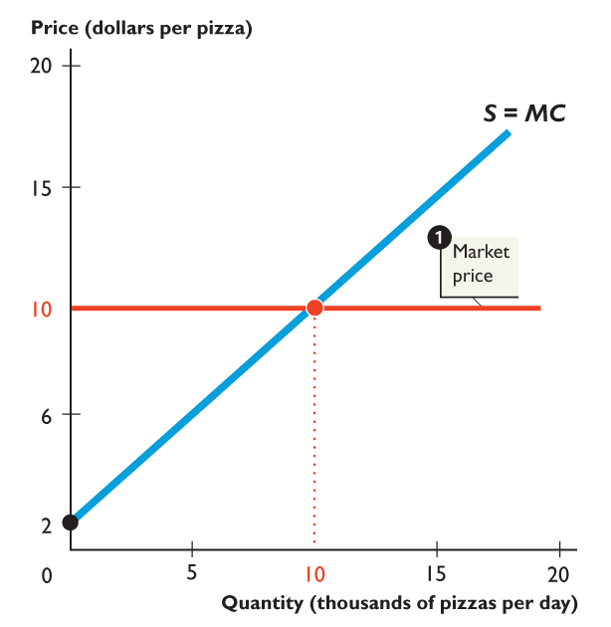


6.3 COST, PRICE, AND PRODUCER SURPLUS
The market price of a pizza is $10.
At that price producers plan to sell 10,000 pizzas.
The marginal cost of producing the 5,000th pizza is $6,
so the producer surplus on the 5,000th pizza is $4.

Slide 48



Slide 49
6.3 COST, PRICE, AND PRODUCER SURPLUS
Producer surplus from the 10,000 pizzas sold is $40,000 a day—the area of the blue triangle.
The cost of 10,000 pizzas is $60,000 a day—the red area under the marginal cost curve.
The cost equals total revenue of $100,000 minus the producer surplus of $40,000.

Slide 50







6.4 ARE MARKETS EFFICIENT?
Figure 6.8 shows an efficient pizza market
Market equilibrium
Marginal cost curve
Marginal benefit curve
When marginal cost equals marginal benefit, quantity is efficient.
Consumer surplus plus …
Producer surplus is maximized.

Slide 52
6.4 ARE MARKETS EFFICIENT?
In a competitive market:
The demand curve shows buyers’ marginal benefit.
The supply curve shows the sellers’ marginal cost.
So at the equilibrium in a competitive market, marginal benefit equals marginal cost.
Resource allocation is efficient.
So the competitive market delivers the efficient quantity.

Slide 53
6.4 ARE MARKETS EFFICIENT?
Total Surplus Is Maximized
Total surplus is the sum of consumer surplus and producer surplus.
The competitive equilibrium maximizes total surplus.
Buyers seek the lowest possible price and sellers seek the highest possible price.
But as buyers and sellers pursue their self-interest, the social interest is served.

Slide 54
6.4 ARE MARKETS EFFICIENT?
The Invisible Hand
Adam Smith, in the Wealth of Nations (1776), suggested that competitive markets send resources to the uses in which they have the highest value.
Smith believed that each participant in a competitive market is “led by an invisible hand to promote an end which was no part of his intention.”
Notes:
Although done just with words and a diagram, this chapter explains the astonishing so-called “first fundamental theorem of welfare economics” that under appropriate conditions, a competitive equilibrium is Pareto efficient. Though the textbook does not discuss Pareto efficiency, if you choose you can provide your students with more background to this astonishing result. It begins with Adam Smith’s invisible hand conjecture. Some progress was made by Vilfredo Pareto (1848–1923), an Italian economist (see http://cepa.newschool.edu/het/profiles/pareto.htm), who defined an efficient allocation as one in which it is not possible to rearrange the use of resources an make someone better off without making someone else worse off. But Adam Smith’s conjecture did not receive formal proof until the 1950s. Sir John Hicks, Kenneth Arrow, and Gerard Debreu, are credited with the major contributions to welfare economics and all received the Nobel Prize in Economic Sciences for their work (see http://www.nobel.se/economics/laureates/1972/index.html for Sir John Hicks, and http://www.nobel.se/economics/laureates/1983/index.html) for Kenneth Arrow and Gerard Debreu. Lionel McKenzie (University of Rochester) is also credited with a major independent statement of the theorem and some economists refer to it as the Arrow-Debreu-McKenzie theorem. The A-D-M proof is deeper and more restricted that the arm waving words and diagrams of a principles text. But we do not mislead our students by being enthusiastic and amazed at the astonishing proposition. Selfish people all pursuing their own ends and making themselves as well off as possible end up allocating resources in such a way that no one can be made better off (qualified by the exceptions that we quickly note in the chapter.)

Slide 55
6.4 ARE MARKETS EFFICIENT?
Market Failure
Market failure is a situation in which the market delivers an inefficient outcome.
Inefficiency can occur because:
Too little is produced—underproduction.
Too much is produced—overproduction.
Notes:
Don’t get hung up on the mechanics of how the obstacles to efficiency work. Just note at this stage that they bring either underproduction or overproduction and emphasize the deadweight loss that they generate. You will go into the details in later chapters. The list is a guide to what is coming.

Slide 56
6.4 ARE MARKETS EFFICIENT?
Underproduction
When a firm cuts production to less than the efficient quantity, a deadweight loss is created.
Deadweight loss is the decrease in total surplus that results from an inefficient underproduction or overproduction.
The deadweight loss is borne by the entire society. It is a social loss.

Slide 57





6.4 ARE MARKETS EFFICIENT?
Figure 6.9(a) shows the effects of underproduction.
Efficient quantity is 10,000 pizzas.
If production is 5,000 pizzas a day:
Deadweight loss arises.
Total surplus is reduced by the amount of the deadweight loss.
Underproduction is inefficient.

Slide 59
6.4 ARE MARKETS EFFICIENT?
Overproduction
When the government pays producers a subsidy, the quantity produced exceeds the efficient quantity.
A deadweight loss arises that reduces total surplus to less than its maximum.

Slide 60





6.4 ARE MARKETS EFFICIENT?
Figure 6.9(b) shows the effects of overproduction.
Efficient quantity is 10,000 pizzas.
If production is 15,000 pizzas:
A deadweight loss arises.
Total surplus is reduced by the amount of the deadweight loss.
Overproduction is inefficient.

Slide 62
6.4 ARE MARKETS EFFICIENT?
Sources of Market Failure
Markets generally do a good job of sending resources to where they are most highly valued.
But obstacles to efficient that bring market failure are:
Price and quantity regulations
Taxes and subsidies
Externalities
Public goods and common resources
Monopoly
High transactions costs

Slide 63
6.4 ARE MARKETS EFFICIENT?
Price and Quantity Regulations
Price regulations sometimes put a block on the price adjustments and lead to underproduction.
Quantity regulations that limit the amount that a farm is permitted to produce also leads to underproduction.

Slide 64
6.4 ARE MARKETS EFFICIENT?
Taxes and Subsidies
Taxes increase the prices paid by buyers and lower the prices received by sellers.
So taxes decrease the quantity produced and lead to underproduction.
Subsidies lower the prices paid by buyers and increase the prices received by sellers.
So subsidies increase the quantity produced and lead to overproduction.

Slide 65
6.4 ARE MARKETS EFFICIENT?
Externalities
An externality is a cost or benefit that affects someone other than the seller or the buyer of a good.
An electric utility creates an external cost by burning coal that creates acid rain.
The utility doesn’t consider this cost when it chooses the quantity of power to produce. Overproduction results.

Slide 66
6.4 ARE MARKETS EFFICIENT?
An apartment owner would provide an external benefit if she installed a smoke detector. But she doesn’t consider her neighbor’s marginal benefit and decides not to install the smoke detector.
The result is underproduction.

Slide 67
6.4 ARE MARKETS EFFICIENT?
Public Goods and Common Resources
A public good benefits everyone and no one can be excluded from its benefits.
It is in everyone’s self-interest to avoid paying for a public good (called the free-rider problem), which leads to underproduction.

Slide 68
6.4 ARE MARKETS EFFICIENT?
A common resource is owned by no one but used by everyone.
It is in everyone’s self interest to ignore the costs of their own use of a common resource that fall on others (called tragedy of the commons), which leads to overproduction.

Slide 69
6.4 ARE MARKETS EFFICIENT?
Monopoly
A monopoly is a firm that is sole provider of a good or service.
The self-interest of a monopoly is to maximize its profit. To do so, a monopoly sets a price to achieve its self-interested goal.
As a result, a monopoly produces too little and underproduction results.

Slide 70
6.4 ARE MARKETS EFFICIENT?
High Transactions Costs
Transactions costs are the opportunity costs of making trades in a market.
To use market prices as the allocators of scarce resources, it must be worth bearing the opportunity cost of establishing a market.
Some markets are just too costly to operate.
When transactions costs are high, the market might underproduce.

Slide 71
6.4 ARE MARKETS EFFICIENT?
Alternatives to the Market
No one method allocates resources efficiently. But supplemented by other methods, markets do an amazingly good job.
Table 6.1 on the next slide shows some possible remedies for market inefficiencies.

Slide 72

6.4 ARE MARKETS EFFICIENT?

Slide 73
6.5 ARE MARKETS FAIR?
Two broad and generally conflicting views of fairness are:
It’s not fair if the rules aren’t fair.
It’s not fair if the result isn’t fair.
Notes:
You could spend the rest of the course talking about and discussing equity, fairness, or distributive justice as it is sometimes called. The textbook contains a nice section laying out the basics needed to discuss fairness. This material is not standard and you’ll be hard pressed to find it in any other principles text. It is included here because students are very curious about what is fair. And the news media writes and talks of little else when it discusses economic issues.
But make sure the students know that economists are professionals on efficiency but just like everyone else on fairness. There is a right and wrong about efficiency but not about fairness.

Slide 74
6.5 ARE MARKETS FAIR?
It’s Not Fair if the Rules Aren’t Fair
This idea translates into “equality of opportunity.”
Harvard philosopher, Robert Nozick, in Anarchy, State, and Utopia (1974), argues that the rules must be fair and must respect two principles:
The state must enforce laws that establish and protect private property.
Private property may be transferred from one person to another only by voluntary exchange.

Slide 75
6.5 ARE MARKETS FAIR?
It’s Not Fair if the Result Isn’t Fair
The fair rules approach is consistent with allocative efficiency, but the distribution might be “too unequal.”
Most people recognize that there is no easy answer or principle to guide the amount of equality.
The fair results approach conflicts with efficiency and leads to what is called the “big tradeoff.”

Slide 76
6.5 ARE MARKETS FAIR?
The big tradeoff is a tradeoff between efficiency and fairness that recognizes the cost of making income transfers.
The tradeoff is between the size of the economic pie and the degree of equality with which it is shared.
The greater the amount of income redistribution through income taxes, the greater is the inefficiency—the smaller is the economic pie.
Notes:
Some years ago, Jim Tobin told Michael Parkin a nice test of whether a person is a liberal or a conservative. It also generates a good classroom discussion. Here’s how it goes. Give the students the following scenario and question: You are at an oasis in a large desert and you have some ice cream in an unmovable refrigerator. (Ice cream is the only food available). The people in the next oasis some miles away have no ice cream (and no other food) and are too old and infirm to travel. You have plenty of ice cream and you can transport it to the next oasis, but on the journey, some of it will melt. Now the question: How much of the ice cream would have to survive the journey for it to be worth transporting to the next oasis? The most liberal would transport if only the smallest percentage survived the journey. The most conservative would want a large proportion to survive before undertaking the redistribution.

Slide 77
6.5 ARE MARKETS FAIR?
Taking all the costs of income transfers into account, the fair distribution of the economic pie is the one that makes the poorest person as well off as possible.
The “fair results” ideas require a change in the results after the game is over. Some say that this in itself is unfair.

